Slide 1
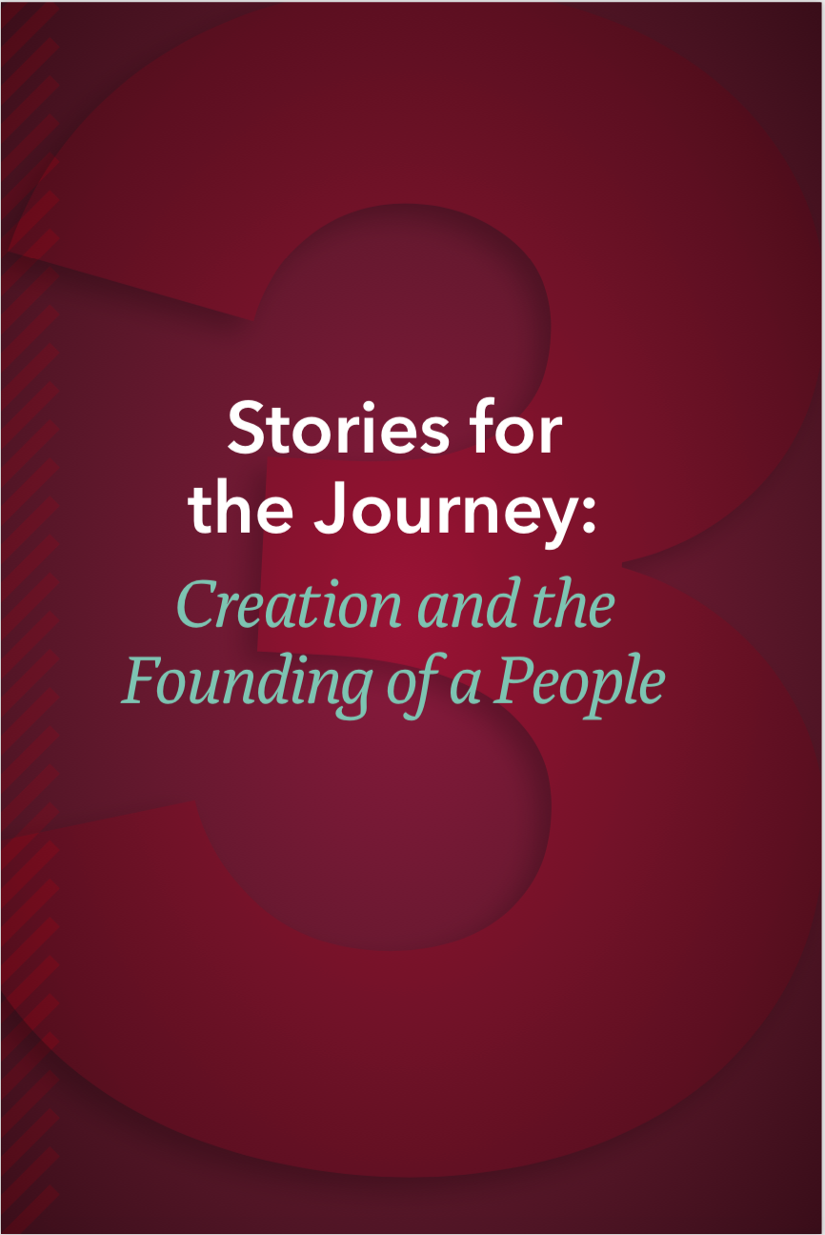
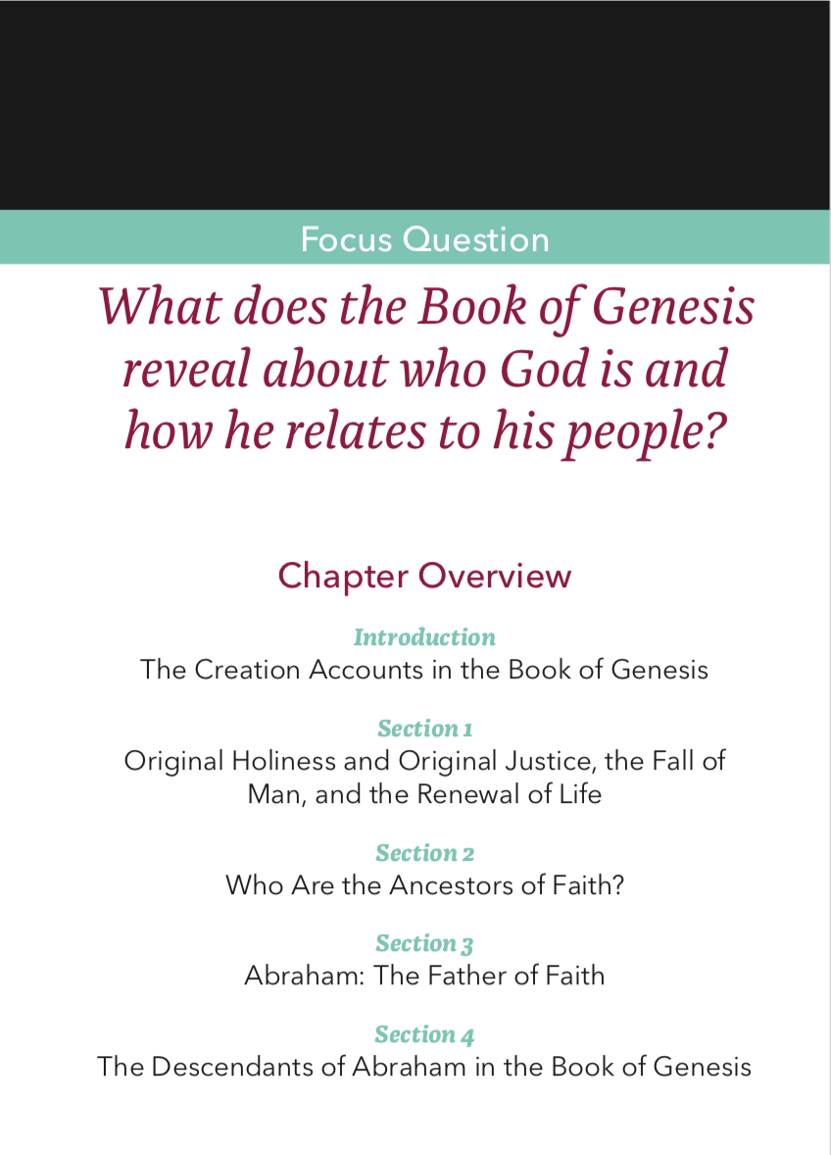
The Old Testament

Slide 2

What does primeval history teach about God?
God’s will is to create people in his image—male and female.
God’s will is peace, not violence.
God’s will is trust and truthfulness, not lies and deception.
God’s will is to care for creation, not destruction and exploitation.
God’s will is diversity, not forced unification.
God is impressed with how we care for one another and all of creation, not our material accomplishments.
The Creation Accounts in the Book of Genesis
Notes:
“Explaining Primeval History and Myth in the Bible” (8:04) is a short video providing an overview of the primeval history and Genesis 1—11. https://www.youtube.com/watch?v=cqKwTtYTSFo

Slide 3
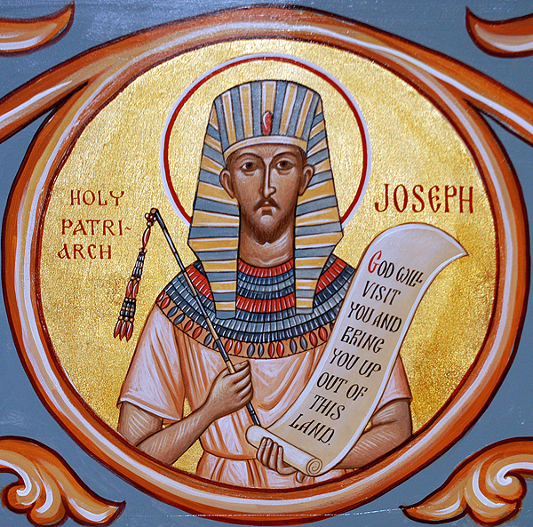
Ancestors of the Faith
The Creation Accounts in the Book of Genesis
Notes:
Use this slide as a backdrop to accompany Chapter 3, Section 2, Teaching Approaches 1, 2, or 3.

Slide 4
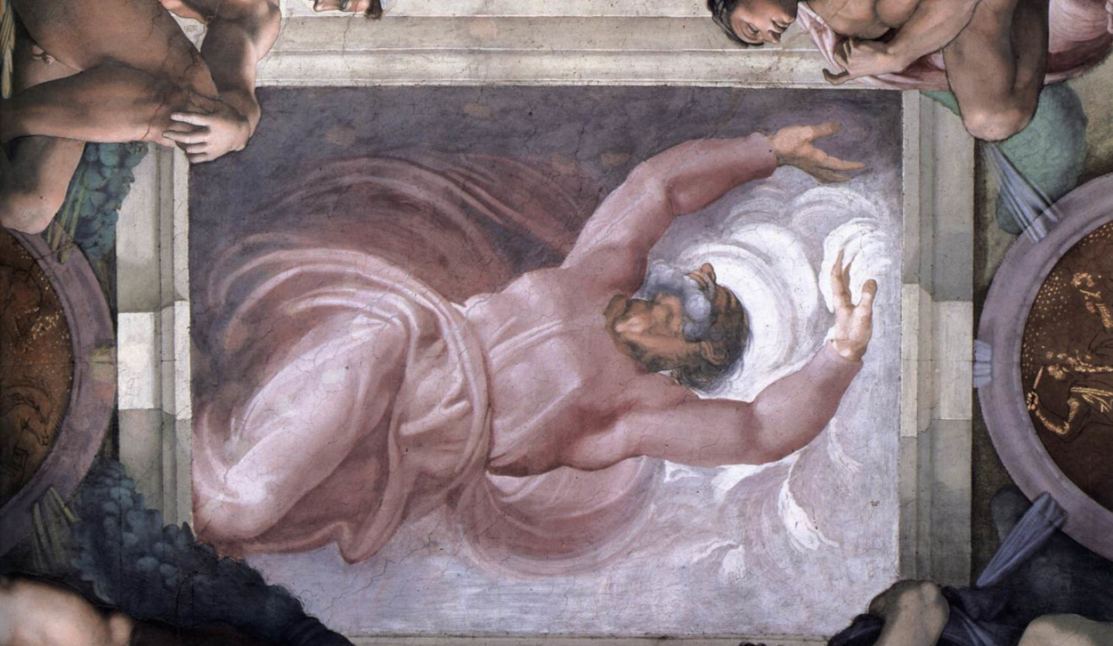
Oral Tradition
Inspired by the Holy Spirit, ancient Hebrews told of God’s goodness and creation myths through oral storytelling
Creation Accounts in the Book of Genesis
Notes:
See Chapter 4, Introduction, Teaching Approach 3 in the Teacher’s Wraparound Edition.

Slide 5
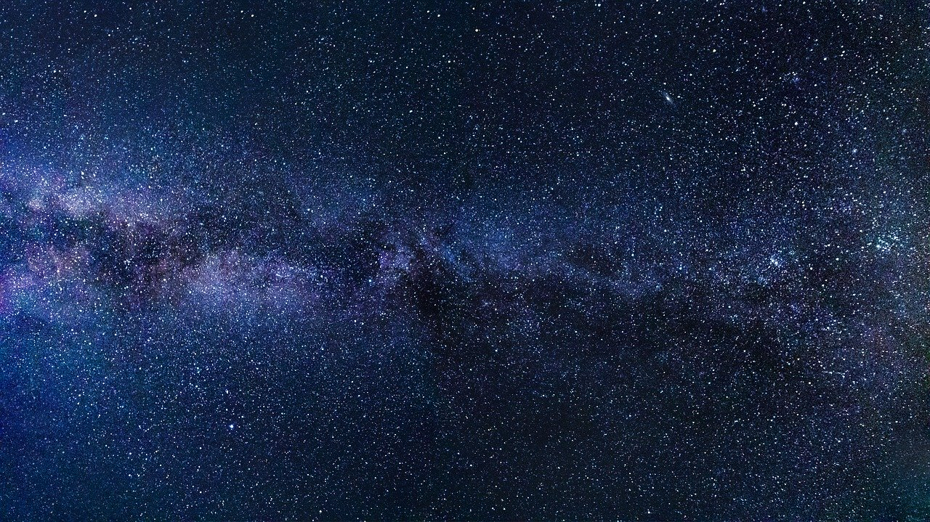
The Two Creation Accounts in Genesis
Genesis 1:1–2:3
God created mankind in his image; in the image of God he created them; male and female he created them.
Genesis 2:4–3:24
“Then the LORD God formed the man out of the dust of the ground and blew into his nostrils the breath of life, and the man became a living being. 2:7
The LORD God then built the rib that he had taken from the man into a woman. 2:22
The Creation Accounts in the Book of Genesis
Notes:
See Chapter 4, Introduction, Teaching Approaches 1, 2, and 3 in the Teacher’s Wraparound Edition.

Slide 6
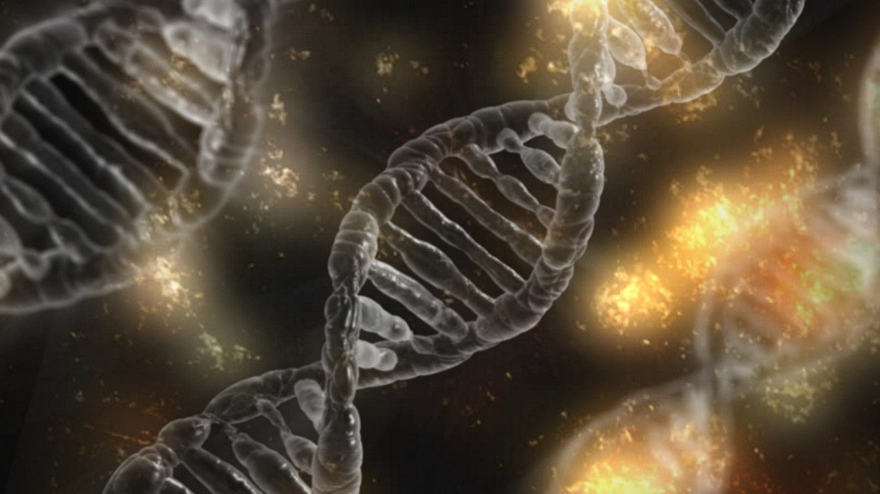
Evolution
The scientific theory that proposes that current forms of life developed gradually out of earlier ones.
The Creation Accounts in the Book of Genesis
Notes:
Read Pope Francis’ words to the students about the Catholic understanding of evolution: “The evolution in nature is not opposed to the notion of Creation, because evolution presupposes the creation of beings that evolve…. God is not a demiurge or a magician, but the Creator who gives being to all entities.” See: https://www.ncronline.org/news/vatican/pope-francis-evolution-not-inconsistent-notion-creation

Slide 7
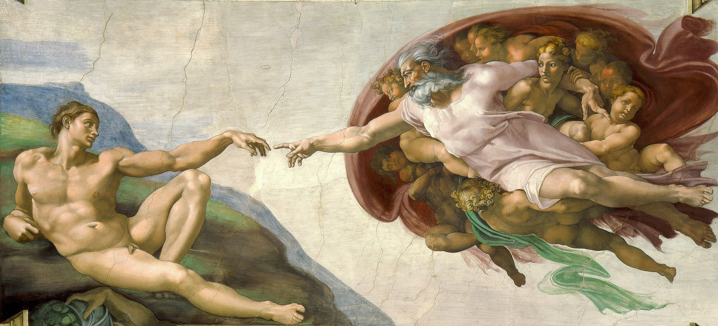
God Created Humans with a Body and Soul
“Then the LORD God formed the man* out of the dust of the ground and blew into his nostrils the breath of life, and the man became a living being.” Genesis 2:7
The Creation Accounts in the Book of Genesis
Notes:
The quotes below make reference to Genesis 2:7. Discuss in class how the breath of God relates to God creating the human, body and soul as one and at once. See page 101 of the Student Text.
Thus says the Lord GOD to these bones: Listen! I will make breath enter you so you may come to life. Ez 37:5
I prophesied as he commanded me, and the breath entered them; they came to life and stood on their feet, a vast army. Ez 37:10
[Jesus] said to them again,^{l} “Peace be with you. As the Father has sent me, so I send you.” And when he had said this, he breathed on them and said to them, ”Receive the holy Spirit.” Jn 20: 21-22

Slide 8
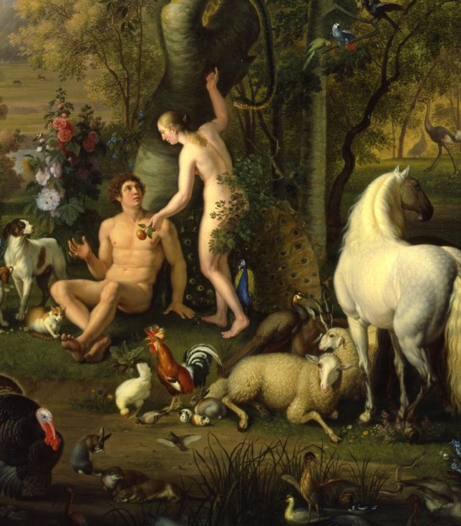
The gifts of original holiness and original justice
There was no suffering or death.
Man was at peace with himself.
There was harmony between man and woman.
There was peace between Adam and Eve, the first couple, and all of creation.
Original Holiness and Original Justice, the Fall, and Renewal
Notes:
The painting entitled Adam and Eve in the Garden of Eden was completed in 1745 by Wenzel Peter. See Chapter 3, Section 1, Teaching Approach 3 in the TWE for a discussion on original holiness and original justice.

Slide 9
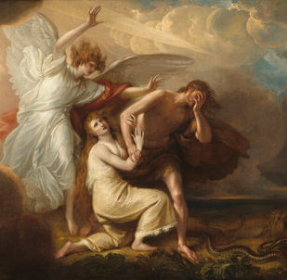
Original Sin
Original Sin is the disobedience of God by Adam and Eve.
With the Original Sin, death enters human history.
Original Holiness and Original Justice,
the Fall and Renewal
Notes:
The painting on this slide is The Expulsion of Adam and Eve from Paradise by Benjamin West painted in 1791. This painting imagines an angel delivering the message from God that the covenant bond and gift of original justice has been lost forever by disobeying God’s will. Original holiness is restored in baptism, a gift that God foreshadows in Genesis (see page 106 of the Student Text). As the text mentions, without the doctrine of Original Sin, the mystery of Christ is undermined. As the Exsultet at the Easter Vigil proclaims:
O truly necessary sin of Adam,
destroyed completely by the Death of Christ!
O happy fault
that earned so great, so glorious a Redeemer!
Ask the students to write or discuss how this is true.

Slide 10

Journal Question
Why does human sin or concupiscence exist if we are not Adam and our choices are our own free will? Why did God need to send Jesus Christ, his beloved Son to save humanity?
Notes:
Ask the students to consider these points in their responses:
The need for Baptism.
How the sacrifices of the Old Testament were not able to redeem the world from sin?
Words or actions of Jesus from the Gospels that help to explain their response.

Slide 11
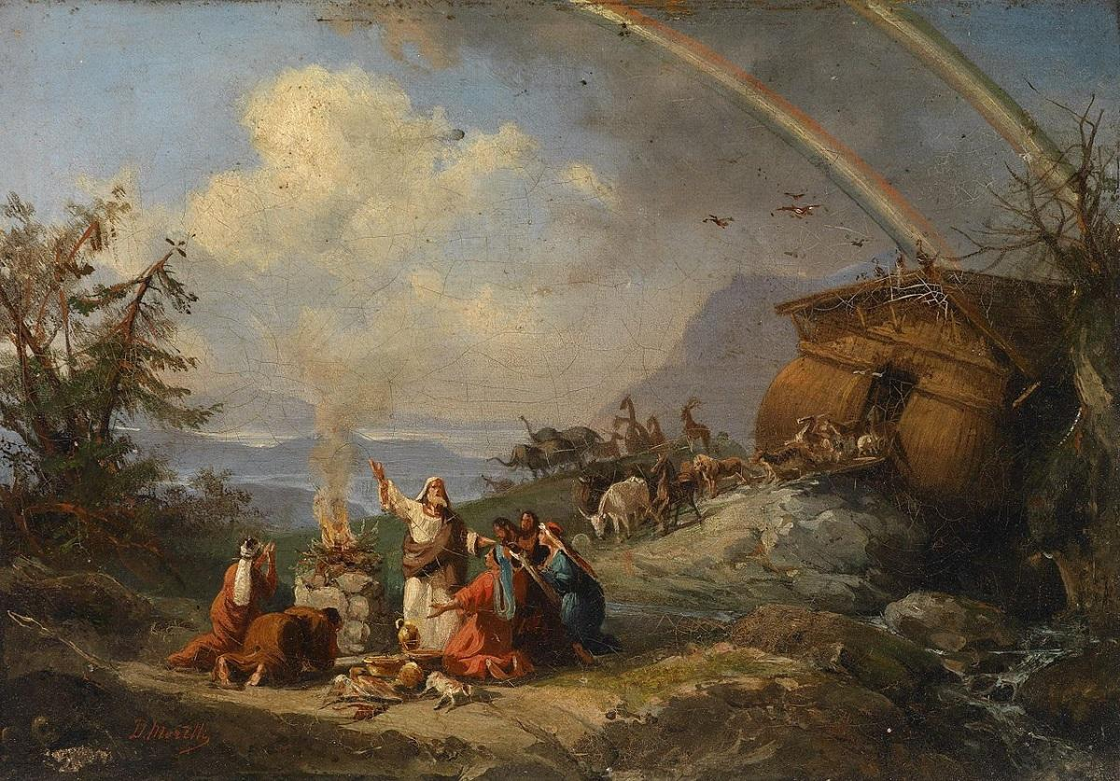
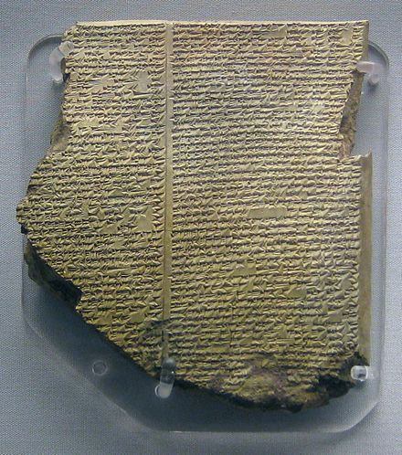
Comparing Two Flood Stories
The Epic of Gilgamesh and Great Flood in the Bible
Original Holiness and Original Justice, the Fall and Renewal
Notes:
If desired, discuss some of the comparison between the two flood stories as well as criticism for a world-wide flood and how Catholics come to accept the stories in Genesis. See:
https://www.catholic.com/magazine/online-edition/a-catholic-perspective-on-a-new-attraction
https://www.youtube.com/watch?v=XMedFbenWaQ
https://www.youtube.com/watch?v=CmJEAw6LUxk

Slide 12
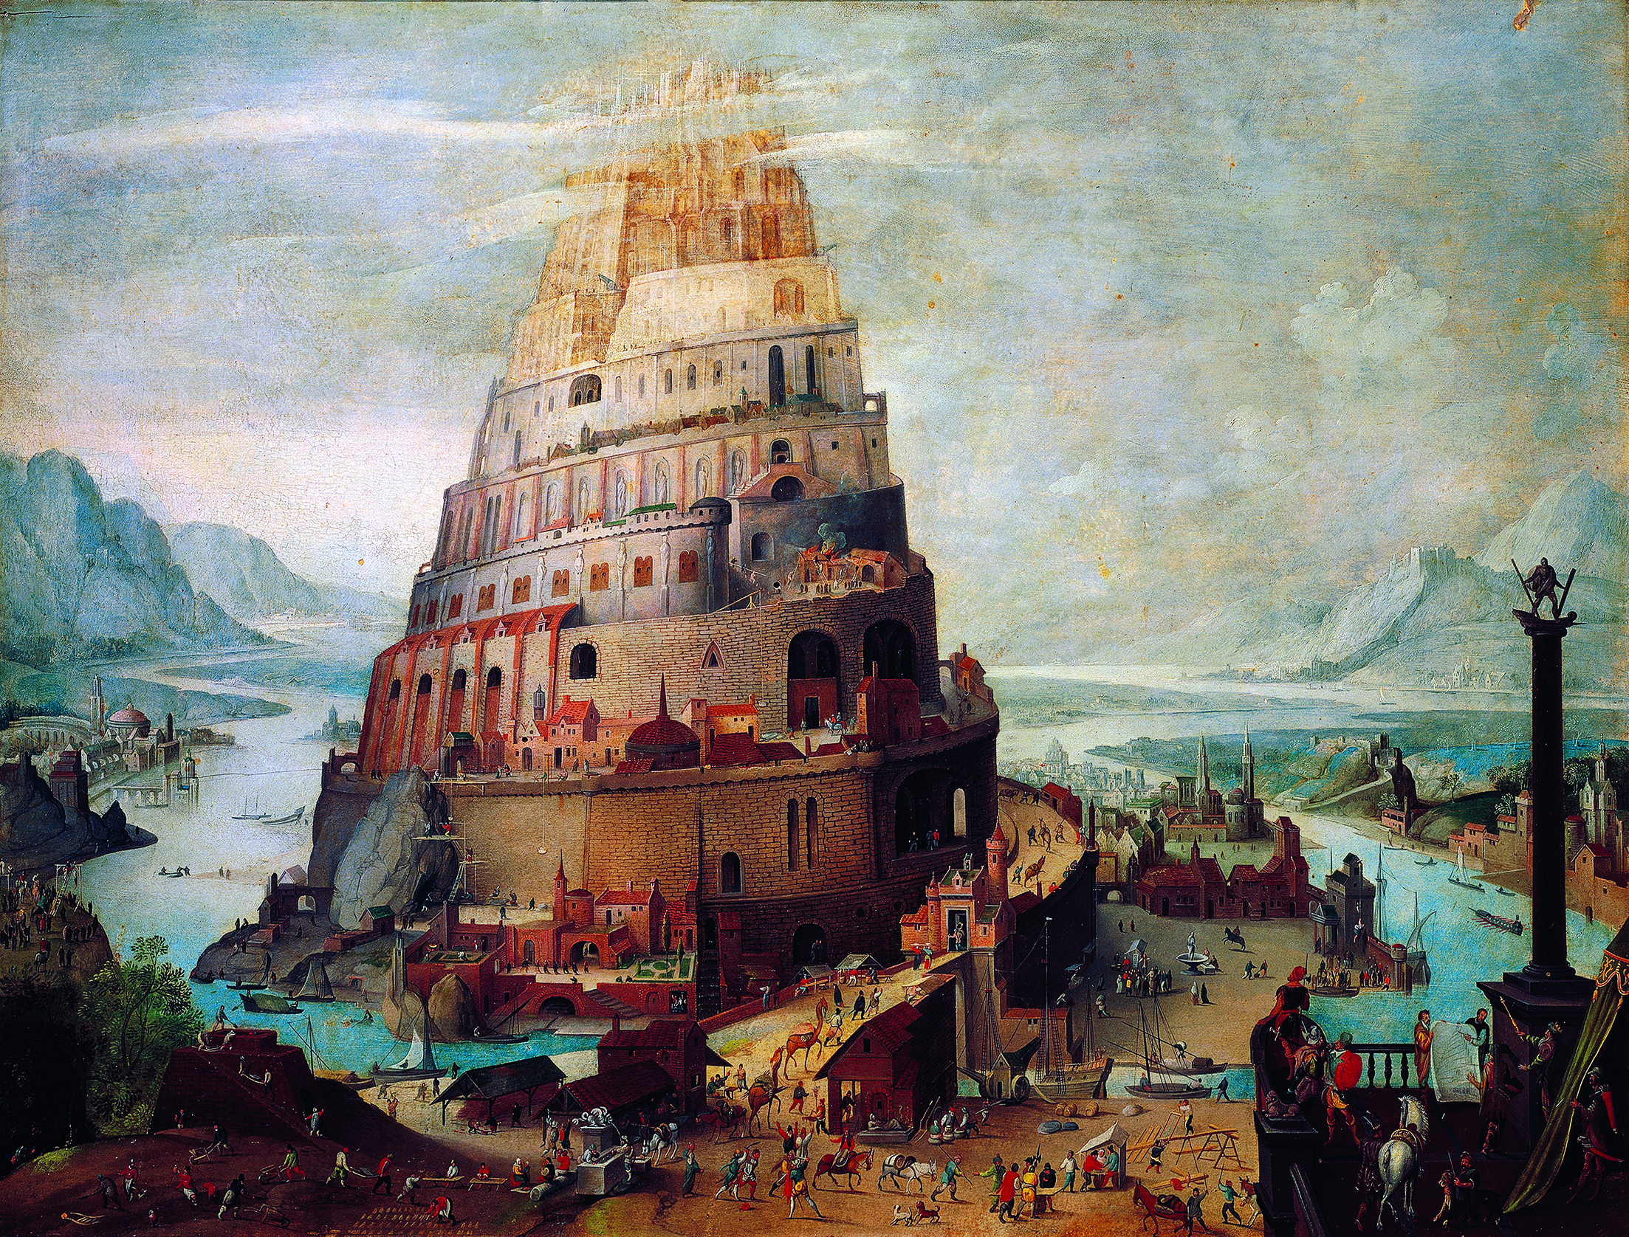
Tower of Babel
Babylon: a term used throughout the Old and New testament to refer to any oppressive regime, including the Roman Empire
Original Holiness and Original Justice, the Fall and Renewal
Notes:
Another story of how human pride broke the covenant with God and his original people, the Tower of Babel is a creation myth which describes the many languages across the earth. See page 110 of the Student Text. Have the students read about the Tower of Babel directly from Genesis 11:1-9.

Slide 13
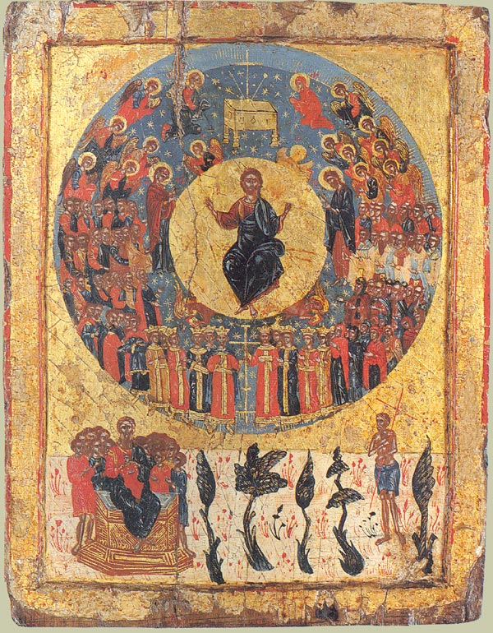
Patriarchs See Genesis 12—50
Abraham—Father of the Faith
Isaac
Jacob
Joseph
Who are the Ancestors of Faith?
Notes:
See Chapter 3, Section 2, Teaching Approaches 1 and 3 in the Teacher’s Wraparound Edition.
Abraham, Issac, Jacob, and Joseph… the people in the stories have been corroborated by non-biblical sources. Judaism, Christianity and Islam are all Abrahamic religions meaning the source of their line is Abraham as father of the faith.

Slide 14
Abraham’s Travels
“to a land that I will show you” (Gn 12:1).
Four stages of Abraham’s journey:
Ur to Haran
Haran to Beer Sheba
Beer Sheba to Egypt
Out of Egypt to settle in Canaan
e
Abraham: The Father of Faith
Notes:
See page 120 of the Student Text for explanation of the four stages.

Slide 15
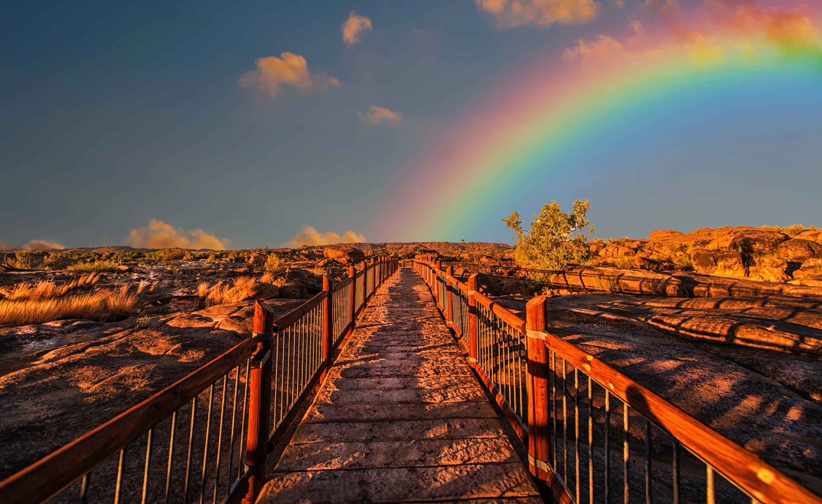
God’s Promise to Abraham
“I will make of you a great nation, and I will bless you; I will make your name great, so that you will be a blessing. I will bless those who bless you and curse those who curse you. All the families of the earth will find blessing in you. (Gn 12:2–3)
Abraham: The Father of Faith
Notes:
See pages 122-124 of the Student Text for Abraham’s part in fulfilling the covenant. Also: Chapter 3, Section 3, Teaching Approach 3 of the Teacher’s Wraparound Edition.

Slide 16
Trickery of Jacob’s Stories
Who Deceived | Who was Deceived | What happened | consequence
Rebekah and Jacob | Isaac | Tricked Isaac into giving Jacob the Blessing | Isaac must flee
Laban | Jacob | Laban gave his first daughter in marriage when Jacob thought it would be Rachel | Must work for another 7 years to marry Rachel
Jacob | Laban | Said he would work for 6 more years and only take the spotted sheep//made it so their were many | Becomes a wealthy many and invokes jealousy of Laban’s sons
Rachel, Jacob | Laban | Steals from her father | Jacob believes there is justice in the theft
Who are the Ancestors of Faith?
The Descendants of Abraham in the Book of Genesis
Notes:
Discuss the deceit of the stories of Jacob. How does the Old Testament make this deceit “ok” for Jacob? Was he justified? See Chapter 3, Section 4, Teaching Approaches 1 and 2 in the Teacher’s Wraparound Edition.

Slide 17
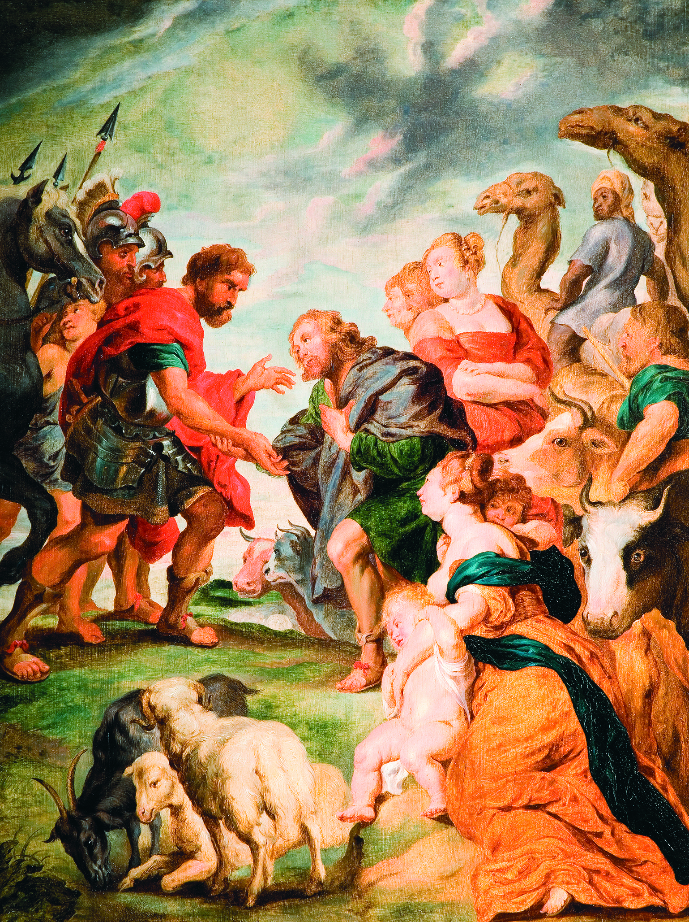
Journal Question
Have you ever had a time in your life where you or someone else you know had to offer apologies and seek reconciliation as Jacob did towards his brother Esau? What happened? Did the outcome benefit both parties?
The Descendants of Abraham in the Book of Genesis
Notes:
Some examples might include from times from the students’ past or present friend groups or perhaps some example of apologies and reconciliation within their own families. Perhaps they were entirely to blame or led into the deception with good “intentions” paralleling the story of Jacob.

Slide 18
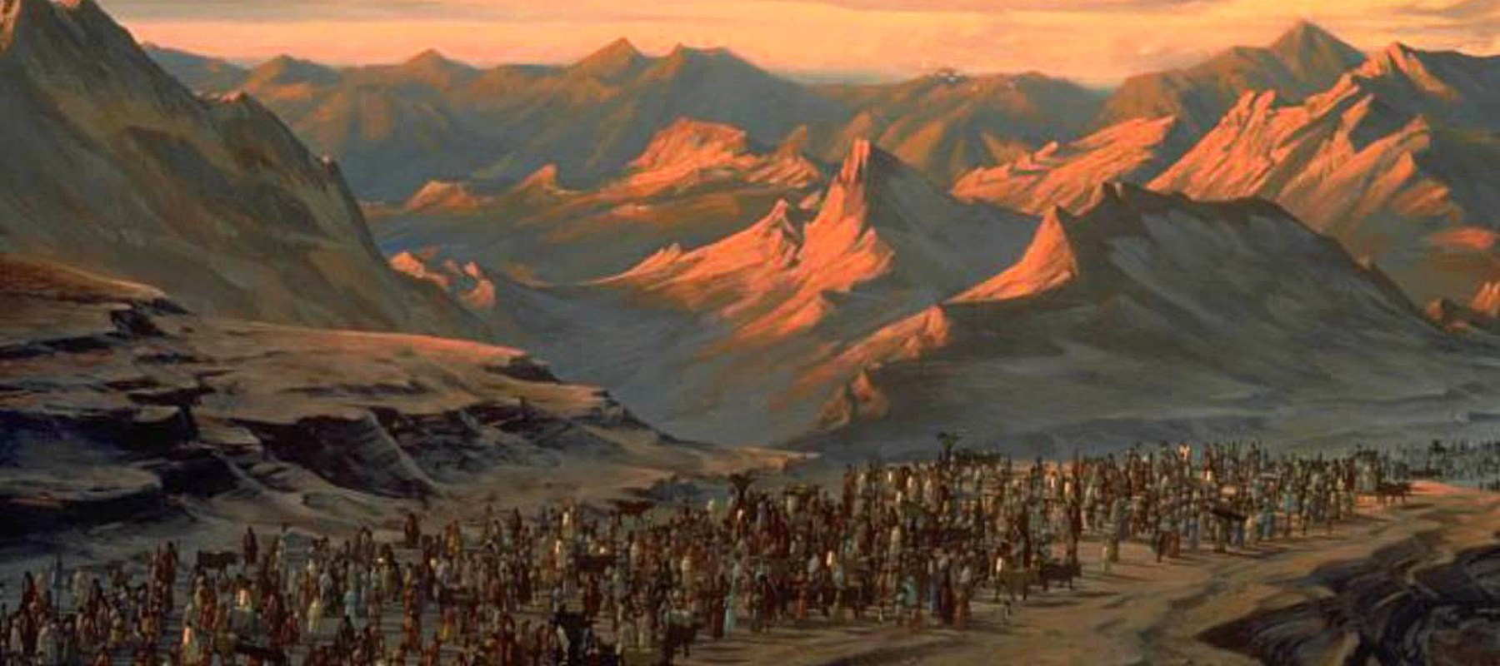
Foreshadowing Exodus
“When God thus takes care of you, you must bring my bones up from this place.” (Gn 50:24–25)
When you are led out of Egypt to the land of our people, carry my bones from here to bury me in Canaan.
The Descendants of Abraham in the Book of Genesis
Notes:
Preview Chapter 4 with the students. Have them browse through the section headings of Chapter 4 in the Student Text. Also refer to the Chapter 4, Chapter Notes in the Teacher’s Wraparound Edition.

Slide 19
References
Slide 6: Pope Francis: https://www.usnews.com/news/articles/2014/10/28/pope-francis-comments-on-evolution-and-the-catholic-church

Slide 20
Images
Slide 2: https://www.pexels.com/photo/close-up-environment-flora-ground-1151418/
Slide 3: https://www.oca.org/saints/lives/2014/03/31/205337-righteous-joseph-the-patriarch
Slide 4: https://www.artbible.info/art/large/70.html
Slide 5: https://pixabay.com/photos/milky-way-starry-sky-night-sky-star-2695569/
Slide 6: https://pixabay.com/illustrations/dna-microscopic-cell-gene-helix-1903318/
Slide 7: https://en.wikipedia.org/wiki/The_Creation_of_Adam#/media/File:Michelangelo_-_Creation_of_Adam_(cropped).jpg
Slide 8: https://upload.wikimedia.org/wikipedia/commons/a/a0/Johann_Wenzel_Peter_-_Adam_and_Eve_in_the_earthly_paradise.jpg
Slide 9: https://commons.wikimedia.org/wiki/File:Benjamin_West_The_Expulsion_of_Adam_and_Eve_from_Paradise.jpg
Slide 10: https://www.pexels.com/photo/close-up-photo-of-person-holding-red-apple-1451649/
Slide 11: https://commons.wikimedia.org/wiki/File:Domenico_Morelli_Noahs_Dankgebet.jpg https://it.m.wikipedia.org/wiki/File:British_Museum_Flood_Tablet.jpg
Slide 13: https://upload.wikimedia.org/wikipedia/commons/f/fd/Icon_second_coming.jpg
Slide 15: https://www.pexels.com/photo/rainbow-830829/
Slide 18: https://lacasadecristo.com/wp-content/uploads/2018/09/exodus.jpg

