Slide 1
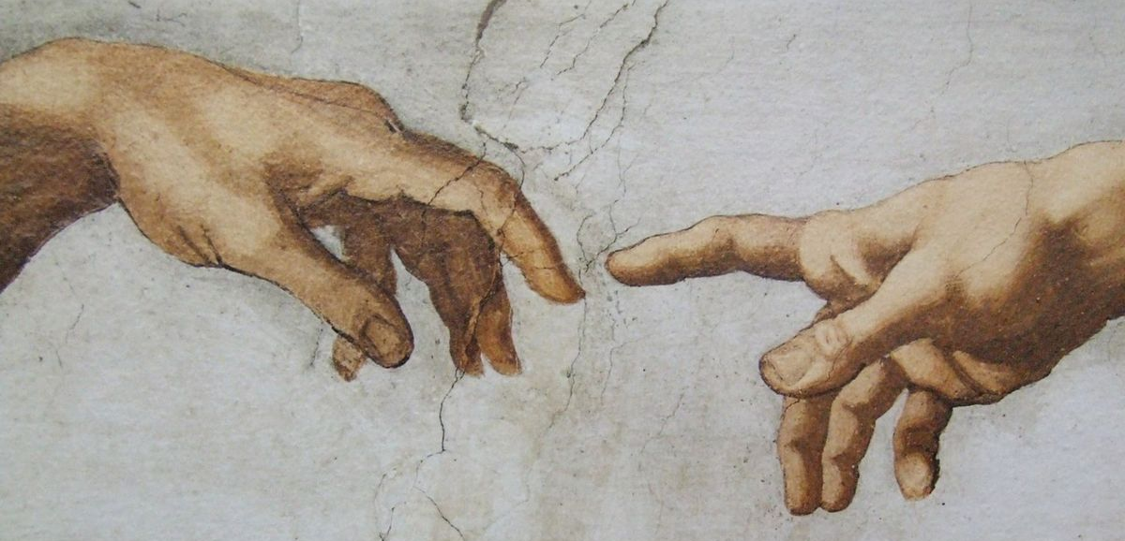
1
God Wants to Be Known
God Reveals: An Introduction to the Bible
Notes:
*Photo Credit: https://commons.wikimedia.org/wiki/File:The_Creation_Michelangelo_Italy_Vatican_-_Creative_Commons_by_gnuckx_(3492637506).jpg
Suggestions for students’ note taking:
●Require students to use a three-ring binder (1/2-1 inches) full of loose-leaf paper (college or wide ruled).
●Notes must be taken in pen only and handwritten.
●Notebooks should contain information and notes for religion class only.
●Notebooks must have a table of contents with topic of notes, dates, and page numbers.
●All notes must have a topic and page number.
●Students will be required to copy each slide unless the teacher directs students to skip certain slides or parts of slides. Notebooks will be graded based on neatness, completeness, and organization. Notebooks should have a significant point value representing 20-25% of the overall grade.

Slide 2
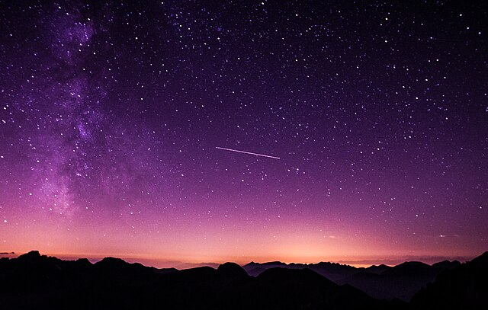
The heavens declare the glory of
God; the firmament proclaims the works of His hands.
Psalm 19:2
Notes:
*Photo Credit: Vincentiu Solomon. Creative Commons Zero, Public Domain Dedication, https://commons.wikimedia.org/wiki/File:Sublime_purple_night_sky_(Unsplash).jpg
Directions: Follow steps 1-4 below.
1. Ask Question: What are your eyes drawn to in the background photo?
2. Share Reflection: We speak of “the heavens” as we gaze at the stars. We have a sense that we are being drawn closer to God when we ponder the stars at night.
3. Share Quote: “When the feet mount the steps, the whole man, including his spiritual substance, goes up with them. All ascension, all going up, if we will but give it thought, is motion in the direction of that high place where everything is great, everything made perfect. For this sense we have that heaven is ‘up’ rather than ‘down’ we depend on something in us deeper than our reasoning powers. How can God be up or down? The only approach to God is by becoming better morally, and what has spiritual improvement to do with a material action like going up a pair of stairs? What has pure being to do with a rise in the position of our bodies? There is no explanation. Yet the natural figure of speech for what is morally bad is baseness, and a good and noble action we call a high action. In our minds we make a connection, unintelligible but real, between rising up and the spiritual approach to God; and Him we call the All-Highest.” (Fr. Romano Guardini, Sacred Signs)
4. Share Key Scripture: “The heavens declare the glory of God; the firmament proclaims the works of his hands” (Psalm 19:2).

Slide 3
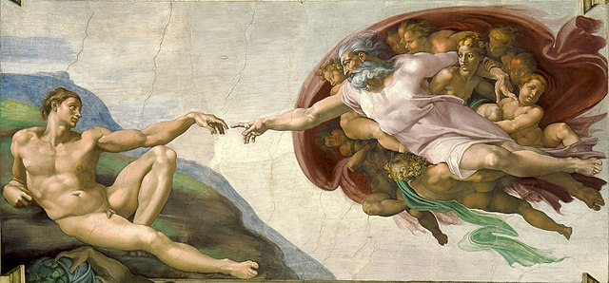
Humans Desire to Know God
God Wants to be Known
Notes:
*Photo Credit: Creation of Adam, Michelangelo (1475–1564), public domain, https://commons.wikimedia.org/w/index.php?search=creation+of+adam&title=Special:MediaSearch&go=Go&type=image
Directions: Follow steps 1-4 below.
1. Ask Question: This is a detail called The Creation of Adam from the ceiling of the Sistine Chapel in Rome. Why do you think Adam and God are portrayed as a type of mirror image by the artist Michelangelo? Why is God situated in a brain-shaped background?
2. Share Reflection: Part of what it means to be made in the image of God is that humans have a capacity to know things; we are knowers first and foremost. The greatest thing to know is God. In knowing God, we attain wisdom, which is the goal of philosophy. We are made to know, to love, and to serve God.
3. Share Quote: “Even in young children, we find a desire for perfect knowledge when they ask ‘Why is that?’ and when given an answer they then ask the next question, ‘Well, why is that?’ It seems this questioning would go on forever, at least until an adult brings it to an end! This process reveals that children (indeed, all of us) recognize the inadequacy of a partial answer, and that true satisfaction will occur only when a complete and perfect understanding has been achieved.
Humans do not seek just practical knowledge (e.g., ‘How do I get the food I need to survive?’). Rather, we want to know just for the sake of knowing, and we have an innate desire for a full and complete explanation. This is evident in the ongoing work of science in seeking a more complete understanding of our world. We know we have not yet reached a perfect understanding of our world, so we research and seek more knowledge, more truth.” –Steve Hemler, https://strangenotions.com/5-human-desires-that-point-to-god/
4. Share Key Scripture: “God created mankind in his image; in the image of God he created them; male and female he created them” (Gen 1:27).

Slide 4


Humans Desire to Know God
“He made from one the whole human race to dwell on the entire surface of the earth, and he fixed the ordered seasons and the boundaries of their regions, so that people might seek God, even perhaps grope for him and find him, though indeed he is not far from any one of us.”
Acts 17:26-27
Notes:
*Photo Credit: Aziz Acharki, Creative Commons Zero, Public Domain Dedication, https://commons.wikimedia.org/wiki/File:Sunset_romantic_(Unsplash).jpg
Directions: Follow steps 1-3 below.
1. Note Taking: Have students copy down the underlined parts of the verse.
2. Ask Question: According to Acts 17:26-27, Why were humans made by God?
3. Share Quote: “The desire for God is written in the human heart, because man is created by God and for God; and God never ceases to draw man to himself. Only in God will he find the truth and happiness he never stops searching for:
The dignity of man rests above all on the fact that he is called to communion with God. This invitation to converse with God is addressed to man as soon as he comes into being. For if man exists it is because God has created him through love, and through love continues to hold him in existence. He cannot live fully according to truth unless he freely acknowledges that love and entrusts himself to his creator.¹
In many ways, throughout history down to the present day, men have given expression to their quest for God in their religious beliefs and behavior: in their prayers, sacrifices, rituals, meditations, and so forth. These forms of religious expression, despite the ambiguities they often bring with them, are so universal that one may well call man a religious being:
From one ancestor [God] made all nations to inhabit the whole earth, and he allotted the times of their existence and the boundaries of the places where they would live, so that they would search for God and perhaps grope for him and find him - though indeed he is not far from each one of us. For "in him we live and move and have our being“² (CCC 27-28).
¹Vatican Council II, GS 19 # 1.
²Acts 17:26-28.

Slide 5
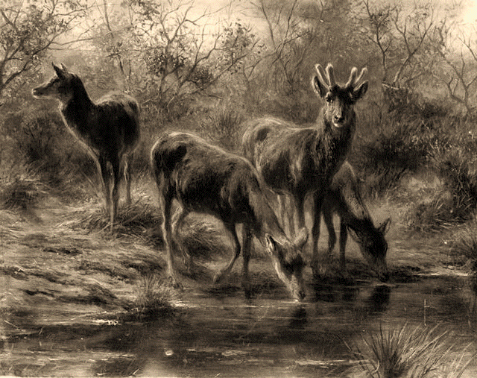
Our Built-In Desire for God: ‘Innate Desire’
“You have made us for yourself, O Lord, and our hearts are restless until they rest in You.” -St. Augustine
“As the deer longs for streams of water, so my soul longs for you, O God. My soul thirsts for God, the living God. When can I enter and see the face of God?”-Psalm 42:2-3
Notes:
*Photo Credit: Rosa Bonheur, public domain, https://commons.wikimedia.org/wiki/File:Deer_Drinking_-_Rosa_Bonheur_NYHS_S-237.jpg
Directions: Use the animation feature to animate the two quotes on the slide and follow steps 1-3 below.
1. Share Reflection: Saint Augustine lived a life that was radically worldly before his conversion. In what most consider a great masterpiece of Christian literature, he gives an account of his conversion. They key turning point was when he realized that he could never be satisfied without God in his life. He famously wrote: “For You are great, O Lord, and greatly to be praised: great is your power and your wisdom is without measure. And man, so small a part of your creation, wants to praise you: this man, though clothed with mortality and bearing the evidence of sin and the proof that you withstand the proud. Despite everything, man, though but a small a part of your creation, wants to praise you. You yourself encourage him to delight in your praise, for you have made us for yourself, and our heart is restless until it rests in you.” (St. Augustine, Confessions).
In the Bible, we see over and over again that our innate desire is described as a type of hunger or thirst for God. This comes out mostly in the book of Psalms.
2. Share Quote: ”Creatures are not born with desires unless satisfaction for those desires exists. A baby feels hunger: well, there is such a thing as food. A duckling wants to swim: well, there is such a thing as water. Men feel sexual desire: well, there is such a thing as sex. If I find in myself a desire which no experience in this world can satisfy, the most probable explanation is that I was made for another world.” (CS Lewis, Mere Christianity).
3. Online Resources: View videos in the order below (Tom Brady comes to the conclusion that “there has to be more” than what this world offers, and in the next video God says, “It is Me you seek!”).
-Tom Brady, “There has to be more” (2 minutes). https://youtu.be/-TA4_fVkv3c
-”It is Me you Seek!” (4 minutes). https://youtu.be/QyvjsKhpGag

Slide 6
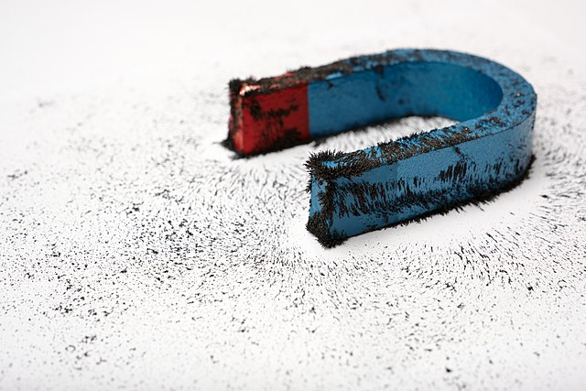
Our Built-In Desire for God
The desire for God is written in the human heart…
  ‘Innate Desire’
  Humans are created by God and for God
  God never ceases to draw humanity to himself.
  (CCC, 27)
    Like a magnet that attracts iron.
    Like gravity.
Notes:
*Photo Credit: Maciej J. Mrowinski, Creative Commons Attribution-Share Alike 4.0, https://commons.wikimedia.org/wiki/File:Metal_shavings_around_bar_magnet_(close-up).jpg
Directions: Follow steps 1-2 below.
1. Clarify: Define the word innate. Innate: inborn; natural. “Her innate capacity.”
2. Ask Question: Which is more helpful in understanding innate desire: the magnet analogy or the idea of the force of gravity? Why?

Slide 7
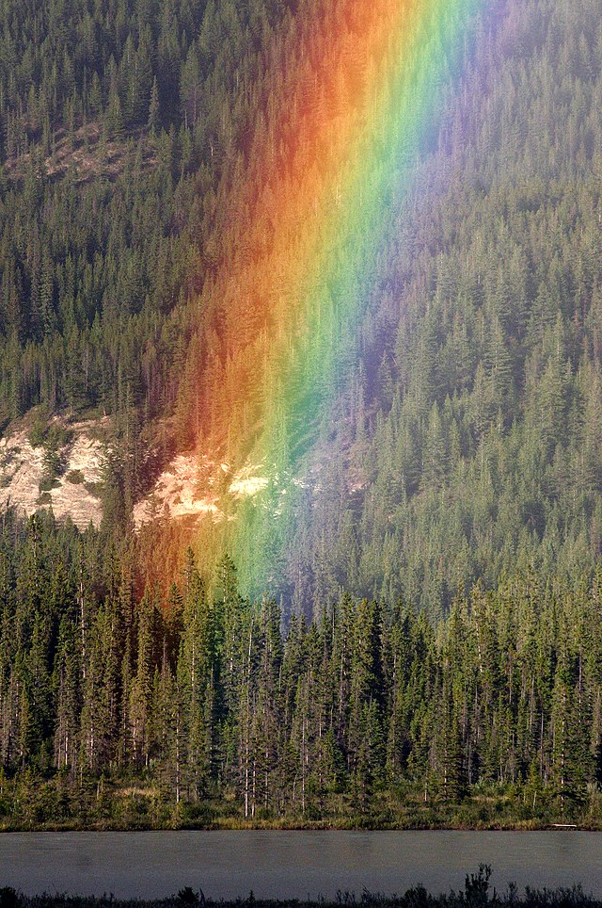
“Foolish by nature were all who were in ignorance of God, and who from the good things seen did not succeed in knowing the one who is, and from studying the works did not discern the artisan.”
Wisdom 13:1
Notes:
Directions: Ask students what they think the verse shown on the slide from Wisdom means. Read the quote below and then ask students to react to the “Double Rainbow Guy” video by answering the following questions: Why do you think nature has the power to provoke an emotional response? What does the beauty of the rainbow say about God the Creator? Is this an example of God using nature to reveal Himself?
Quote: “’Where do these beautiful things come from?’ St. Augustine suggested this path of inquiry:
Question the beauty of the earth, question the beauty of the sea,
question the beauty of the air distending and diffusing itself,
question the beauty of the sky, . . . question all these realities. All
respond: ‘See, we are beautiful.’ Their beauty is a profession. These
beauties are subject to change. Who made them if not the Beautiful
One who is not subject to change? (Sermo 241, 2, in PL, 38, 1134,
quoted in CCC, 32)”
(Quotation from page 22 of God Reveals Student Text)
Online Resources: View “Double Rainbow Guy” video. URL here: https://youtu.be/OQSNhk5ICTI

Slide 8

Turn and Talk
Out of these five common human desires that point to God, which one do you personally desire the most? Why?
Truth Beauty Love Home Justice
Notes:
Directions: Have students write the question down and allow them enough time to quietly write a thoughtful answer that they will share. After the time to write has ended, have students turn to the person next to them and ask them to share their answer taking turns. Ask for a few volunteers to share with the class.
Online Resources: Create an assignment out of the article “The 5 Transcendentals (And How They Provide Evidence for the Soul)”
URL here: https://www.magiscenter.com/blog/evidence-of-the-soul-from-our-transcendental-desires-i-the-basic-argument-from-plato-to-lonergan

Slide 9

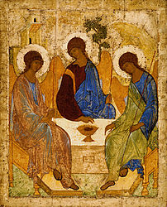
How God Responds to Our Desire for Him
God Responds by revealing Himself in FOUR WAYS . . .
1. Through Nature
2. Through Scripture
3. Through Tradition
4. Through the Ongoing Teachings of the Church
Notes:
*Photo Credit: Andrei Rublev, Trinity, public domain, https://commons.wikimedia.org/wiki/File:Angelsatmamre-trinity-rublev-1410.jpg
Directions: Animate the arrows. For each number, share the bullet point information below.
1. Through Nature
The majesty, beauty and design of nature. Sunsets, thunder, orca whales, the cell, the solar system etc.
Theophany: a visible manifestation of God such as a burning bush, audible voice, dreams, angels, cloud etc..
2. Through Scripture
God spoke to prophets and holy men and inspired them to write his Word.
3. Through Tradition
The sacred oral preaching and way of life of the Apostles and apostolic men.
4. Through the Ongoing Teachings of the Church
The Pope and bishops, together, form the Teaching office or magisterium

Slide 10

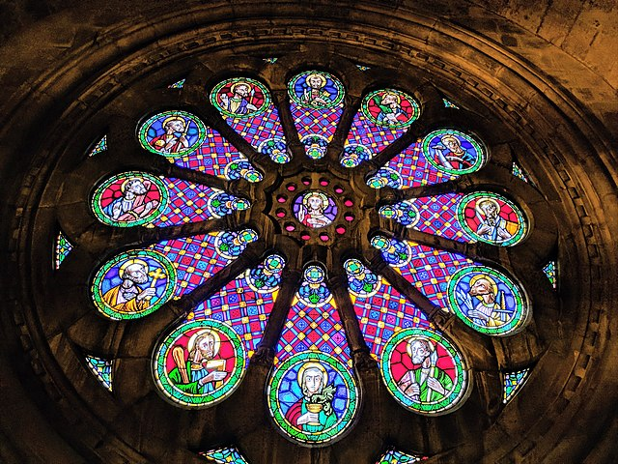
Divine Revelation
Key
Vocab
The way God communicates knowledge of himself to humankind, a self-communication realized by his actions and words over time and most fully realized by the sending of his divine Son, Jesus Christ.
Notes:
*Photo Credit: FuriousYogi, Rose Window at Lisbon Cathedral, Creative Commons Attribution-Share Alike 4.0, https://commons.wikimedia.org/wiki/File:Rose_window_in_Lisbon_Cathedral.jpg
Directions: Have students write down the term and definition as part of a Key Vocab section in their notes.

Slide 11
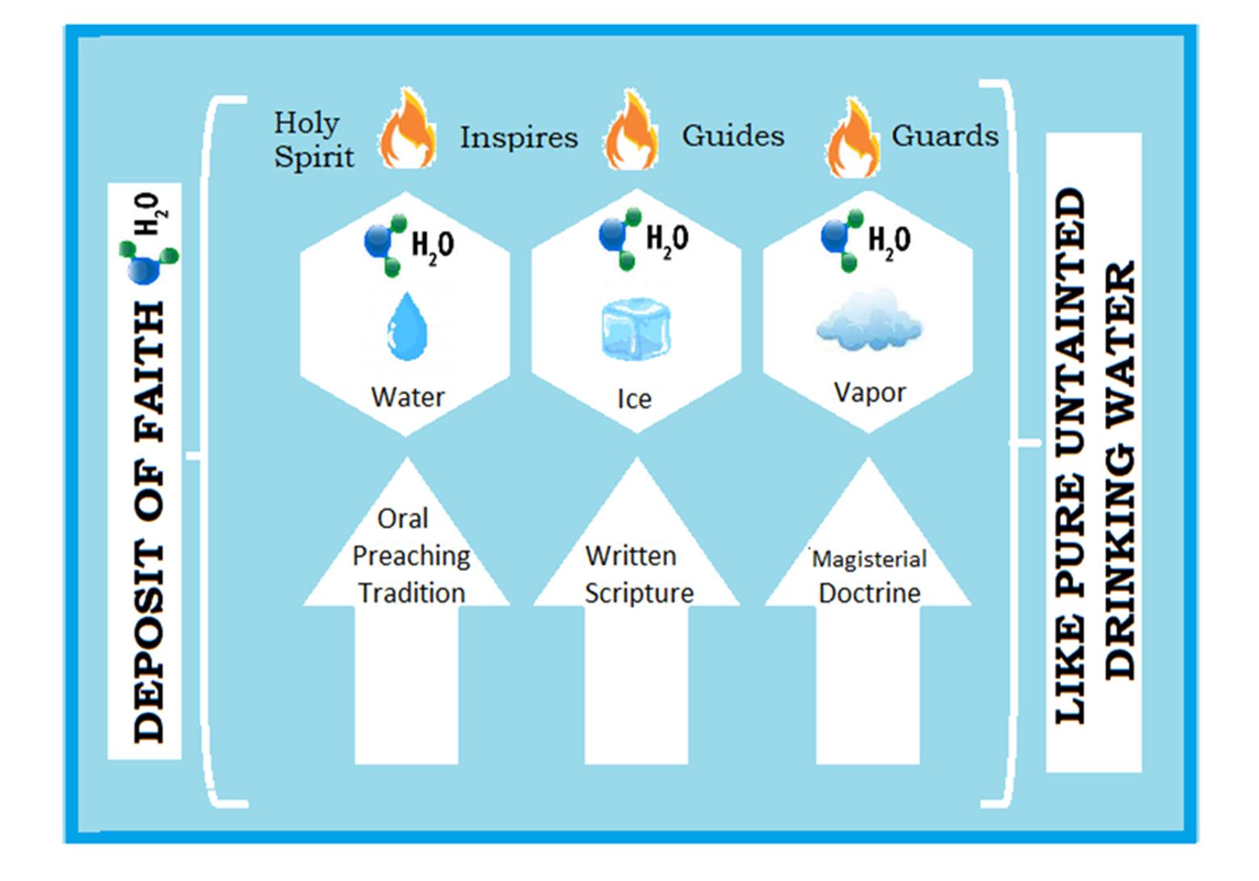
Revelation as Pure Untainted Water
“Sacred tradition and Sacred Scripture. For both of them, flowing from the same divine wellspring, in a certain way merge into a unity and tend toward the same end.”
A sacred deposit of faith to be handed on in its “full purity.”
(Dei Verbum, 9)
Wellspring: The source of water for a stream, spring or well; a fountainhead; a bountiful wellhead.
Notes:
Directions: Follow steps 1-2 below.
1. Share Reflection: Like water for our bodies, this spiritual water is also a universal human right. Saint John Paul II wrote, “the person who becomes a disciple of Christ has the right to receive ‘the word of faith’ not in mutilated, falsified or diminished form but whole and entire, in all its rigor and vigor. Unfaithfulness on some point to the integrity of the message means a dangerous weakening of catechesis and putting at risk the results that Christ and the ecclesial community have a right to expect from it” (Catechesi Tradendae, 30). The doctrinal water that Christ gave must be preserved and handed on, pure and potable, with nothing added or taken away.
The Refrigerator Analogy
We learn from Jesus that it is not only acceptable but wise to use metaphors, analogies, and allegory that incorporate everyday life. For Jesus, everyday life was agrarian, centering around crops, animals, grain, wheat, weeds, rocks, seeds and sowers. These were used to make a deeper moral point or allegorical connection teaching about the Kingdom of God.
For our times a refrigerator could be used as an analogy for the role of the Church in handing on the Deposit of Faith. Since water signifies the Deposit of Faith, the water line connected to the refrigerator would be Jesus as the Word of God and source of Divine Revelation. I’m thinking about a refrigerator that dispenses ice and water from the outside of the door. If the Church were the refrigerator, ice would be Scripture and water would be Tradition, ice being more solid and water more fluid, but both are H₂O.
The refrigerator powered by electricity would signify the power of the Holy Spirit animating the Church. Without the constant guidance and inspiration of the Holy Spirit, the Church would not have life and the Magisterium would not be deemed credible. There would not be ice since the motor would not be activated. To take the analogy to the next step, we could consider water vapor, sometimes visible when we open the freezer, as the ongoing infallible teaching of the Church. This also works as an analogy for the Catholic Church as the single, authoritative source of both Scripture and Tradition. Christianity got the Bible and the Creeds from the Church, not the other way around. This is why the Bible calls the Church ‘the pillar and foundation of truth’.
2.Share Quote: ”Sacred tradition and Sacred Scripture form one sacred deposit of the word of God, committed to the Church. Holding fast to this deposit the entire holy people united with their shepherds remain always steadfast in the teaching of the Apostles, in the common life, in the breaking of the bread and in prayers (see Acts 2, 42, Greek text), so that holding to, practicing and professing the heritage of the faith, it becomes on the part of the bishops and faithful a single common effort.
But the task of authentically interpreting the word of God, whether written or handed on, has been entrusted exclusively to the living teaching office of the Church, whose authority is exercised in the name of Jesus Christ. This teaching office is not above the word of God, but serves it, teaching only what has been handed on, listening to it devoutly, guarding it scrupulously and explaining it faithfully in accord with a divine commission and with the help of the Holy Spirit, it draws from this one deposit of faith everything which it presents for belief as divinely revealed.
It is clear, therefore, that sacred tradition, Sacred Scripture and the teaching authority of the Church, in accord with God's most wise design, are so linked and joined together that one cannot stand without the others, and that all together and each in its own way under the action of the one Holy Spirit contribute effectively to the salvation of souls” (Dei Verbum, 10).

Slide 12
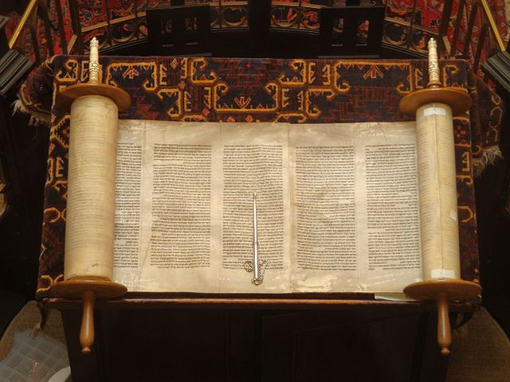
Sacred Scripture
Key
Vocab
The written transmission of the Church’s Gospel message found in the Church’s teaching, life, and worship. It is faithfully preserved, handed down, and interpreted by the Church’s Magisterium.
Notes:
*Photo Credit: Lawrie Cate, The Torah, the Jewish Holy Book., Creative Commons Attribution 2.0, https://commons.wikimedia.org/wiki/File:Open_Torah_and_pointer.jpg
Directions: Have students write down the term and definition as part of a Key Vocab section in their notes as you share the quote below.
Quote: “God gave us the Scriptures not just to inform or motivate us; more than anything he wants to save us.”— Scott Hahn

Slide 13
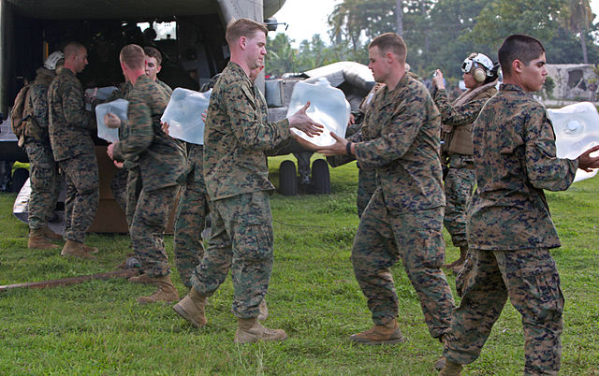
Sacred Tradition
Key
Vocab
The living transmission of the Church’s Gospel message found in the Church’s teaching, life, and worship. It is faithfully preserved, handed down, and interpreted by the Church’s Magisterium.
Notes:
*Photo Credit: Lance Cpl. Christopher M. Carroll, U.S. Marine Corps, Public domain, https://commons.wikimedia.org/wiki/File:Defense.gov_News_Photo_100120-M-6151C-017.jpg
Directions: Have students write down the term and definition as part of a Key Vocab section in their notes.

Slide 14

Deposit of Faith
Key
Vocab
“The heritage of faith contained in Sacred Scripture and Sacred
Tradition, handed down in the Church from the time of the Apostles, from which the Magisterium draws all that it proposes for belief as being divinely revealed” (CCC, glossary).
Notes:
*Photo Credit: badaman, treasure chest, Creative Commons Zero, Public Domain Dedication. https://commons.wikimedia.org/wiki/File:Treasure_chest.svg
Directions: Have students write down the term and definition as part of a Key Vocab section in their notes as you share the quote below.
“What is the Deposit of Faith?
The deposit of faith is not as we might speak of a deposit of dust on the furniture. It is not like a deposit of money in the bank. The deposit of faith is the Church’s possession of unchangeable truth: What God has revealed through His prophets in the Old Law, and through His Divine Son in the New Law. It is the ocean of divine wisdom that God has manifested to His people over the centuries, but especially revealed to us in the words and actions of Jesus Christ the Incarnate Second Person of the Blessed Trinity.
Where is this Deposit of Faith? If we pursue the question, and ask, where can this deposit of faith be found, the answer is easy to express, but not easy to live up to. This deposit of faith, which we call the possession of unchangeable truth, is found substantially and essentially in the Catechism of the Catholic Church. Pope John Paul II, in his apostolic constitution called Deposit of Faith, introduces the Catechism by calling it a “compendium of all Catholic doctrine.” To repeat our question, Where do we find the deposit of faith? - we answer, in the Catechism of the Catholic Church.“-Fr. Hardon.
Online Resources: See website that discusses the deposit of faith in more detail. URL here: https://www.therealpresence.org/archives/Catechism/Catechism_008.htm

Slide 15

Handing on Divine Revelation: From Jesus to the Church
Life of Jesus
Oral Preaching of Gospel
The Gospels Written
Ongoing Magisterial Teachings
Notes:
Directions: Fill in the information for each part using the guide below.
Life of Jesus: “This Gospel had been promised in former times through the prophets, and Christ Himself had fulfilled it and promulgated it with His lips” (Dei Verbum, 7).
“Therefore Christ the Lord in whom the full revelation of the supreme God is brought to completion…
Oral Preaching of Gospel: …commissioned the Apostles to preach to all men that Gospel which is the source of all saving truth and moral teaching . . . .This commission was faithfully fulfilled by the Apostles who, by their oral preaching, by example, and by observances handed on what they had received from the lips of Christ, from living with Him, and from what He did, or what they had learned through the prompting of the Holy Spirit” (Dei Verbum, 7).
The Gospels Written: “The commission was fulfilled, too, by those Apostles and apostolic men who under the inspiration of the same Holy Spirit committed the message of salvation to writing” (Dei Verbum, 7).
Ongoing Magisterial Teachings: “But in order to keep the Gospel forever whole and alive within the Church, the Apostles left bishops as their successors, ‘handing over’ to them ‘the authority to teach in their own place’” (Dei Verbum, 7).

Slide 16
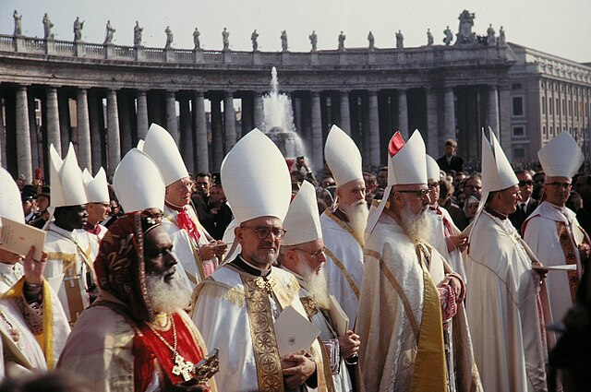
Magisterium
Key
Vocab
The official teaching authority of the Church. Christ bestowed the right and power to teach in his name on St. Peter and the Apostles and their successors. The Magisterium is the bishops in communion with the successor of Peter, the bishop of Rome (the pope).
Notes:
*Photo Credit: Peter Geymayer, Public domain, https://commons.wikimedia.org/wiki/File:Konzilseroeffnung_2.jpg
Directions: Have students write down the term and definition as part of a Key Vocab section in their notes. View video below.
Online Resource(s) for this Slide: Video related to Magisterium, “Who Gave Bishops Authority?” URL here: https://youtu.be/Rrq8BvHoS0E

Slide 17
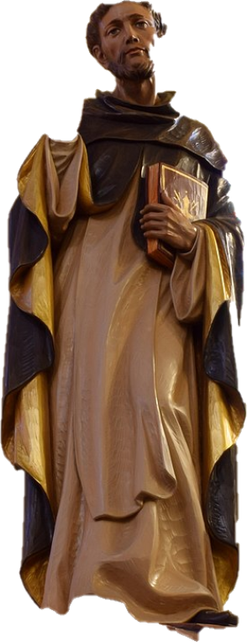
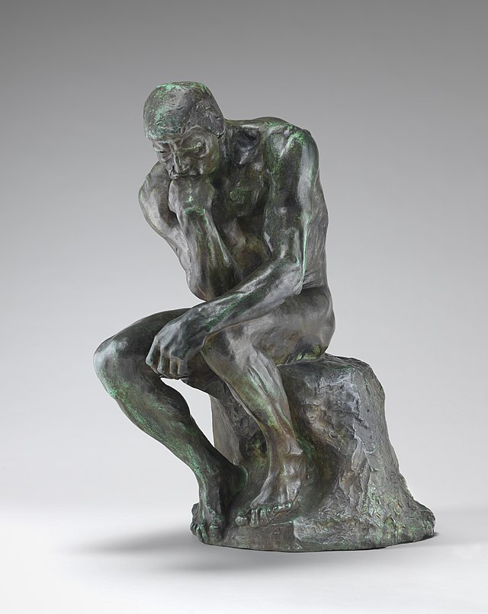
Two Men Who Found God through Human Reason
St. Thomas Aquinas 1225-1274 AD
Five Ways to Reason that God Exists…
  Prime Mover
  First Cause
  Necessary Being
  Absolute Being
  Grand Designer
Anthony Flew 1923-2010 AD
Famous atheist turns into a Believer
  “Since there is complexity in the cell which natural selection or evolution cannot account for then there must be a designer.”
  Which of the Five Ways of St. Thomas Aquinas fits with Anthony Flew’s reasoning?
Notes:
*Photo Credit: Nheyob, Creative Commons Attribution-Share Alike 4.0, https://commons.wikimedia.org/wiki/File:Saint_Thomas_Aquinas_Church_(Zanesville,_Ohio)_-_St._Dominic_statue.jpg
Auguste Rodin, The Thinker, Creative Commons Zero, Public Domain Dedication, https://commons.wikimedia.org/wiki/File:Auguste_Rodin,_The_Thinker_(Le_Penseur),_model_1880,_cast_1901,_NGA_1005.jpg, Anthony Flew, AMP textbook p.17.
Directions: Have students write down three important facts in their notes as they view each of the videos (addresses below). After viewing the videos, have students answer the question on the slide.
Online Resources:
View video, “Aquinas’ Five Proofs for the Existence of God” (6 minutes): https://youtu.be/-XhMy79k4gA
View video, “Never Too Late | Antony Flew: The Atheist Who Wrote ‘There Is a God’” (6 minutes): https://youtu.be/nYlDHGetNOQ
View video, “The Complexity of Life (Secrets of the Cell with Michael Behe, Ep. 2)” (5 minutes): https://youtu.be/VLlJXn0XOFg

Slide 18
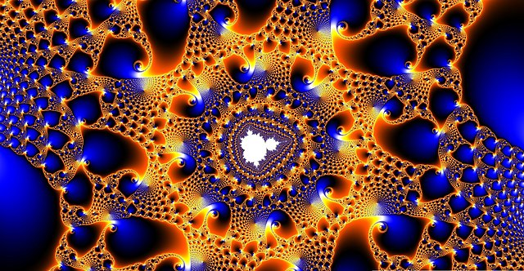
Math as a Proof for God
The Mandelbrot Set has been called “God's thumbprint.”
It contains an infinite number of fractals that never repeat themselves.
Notes:
*Photo Credit: Daniel Toschläger, Creative Commons Attribution-Share Alike 4.0, https://commons.wikimedia.org/wiki/File:Mandelbrot-Menge.jpg
Directions: Have students view and take notes on the following video, “Proving God Exists Using Math.” URL here: https://youtu.be/z0hxb5UVaNE
Online Resources: For a lengthier video on the Mandelbrot Set, see “Colors of infinity.” URL here: https://youtu.be/DyeR19m8gGk

Slide 19
Divine Inspiration
Divine Dictation
Divine Inspiration means that God inspired the “human authors” of the sacred books by acting in and through them, all the while they made full use of their own faculties and powers.
  The human authors are also referred to as the sacred authors or writers.
The Holy Spirit acts in and through a human writer to write what God wants us to know as it relates to our salvation.
  “The Bible is the Word of God in the words of men.”
The Human writer is free to use his own style and have his own intention and audience.
The outcome is called Inerrancy…
  The Bible is free of errors in matters of faith and salvation.
Divine dictation theory is rejected by the Catholic Church because it is different than Divine Inspiration.
Divine Dictation means that God or one of the angels dictated each word of the sacred text to a human author who simply wrote it down.
  In this view, the human author is not a true author of the Bible.
    The clouds did not open up and angels did not descend from the sky presenting the believers with a completed text of Sacred Scripture, handwritten by God himself.
When Catholics say “God is the author of Sacred Scripture” it does not mean that we believe He dictated the contents word for word.
vs
Notes:
Directions: Share quote from Dei Verbum on the meaning of Divine Inspiration. Ask students to copy down notes and then ask them in their own words to compare and contrast the two concepts.
Share Quote: “Those divinely revealed realities which are contained and presented in Sacred Scripture have been committed to writing under the inspiration of the Holy Spirit. For holy mother Church, relying on the belief of the Apostles…holds that the books of both the Old and New Testaments in their entirety, with all their parts, are sacred and canonical because written under the inspiration of the Holy Spirit, they have God as their author and have been handed on as such to the Church herself. In composing the sacred books, God chose men and while employed by Him they made use of their powers and abilities, so that with Him acting in them and through them, they, as true authors, consigned to writing everything and only those things which He wanted.
Therefore, since everything asserted by the inspired authors or sacred writers must be held to be asserted by the Holy Spirit, it follows that the books of Scripture must be acknowledged as teaching solidly, faithfully and without error that truth which God wanted put into sacred writings for the sake of salvation. Therefore ‘all Scripture is divinely inspired and has its use for teaching the truth and refuting error, for reformation of manners and discipline in right living, so that the man who belongs to God may be efficient and equipped for good work of every kind’ (2 Tim. 3:16-17, Greek text).
However, since God speaks in Sacred Scripture through men in human fashion, (6) the interpreter of Sacred Scripture, in order to see clearly what God wanted to communicate to us, should carefully investigate what meaning the sacred writers really intended, and what God wanted to manifest by means of their words” (Dei Verbum, 11-12).
Key Scriptures: John 20:31; 2 Tim. 3:16; 2 Peter 1:19-20, 3:15-16

Slide 20

“All scripture is inspired by God and is useful for teaching, for refutation, for correction, and for training in righteousness.”
2 Tim 3:16
Notes:
*Photo Credit: Romain Guy , Creative Commons Zero, Public Domain Dedication, https://commons.wikimedia.org/wiki/File:Marshall_Beach_Sunset_(6753666737).jpg
Directions: Ask students to identify the four things that Scripture says Scripture is used for.
Question: According to 2 Timothy 3:16, what four things is Scripture used for?

Slide 21
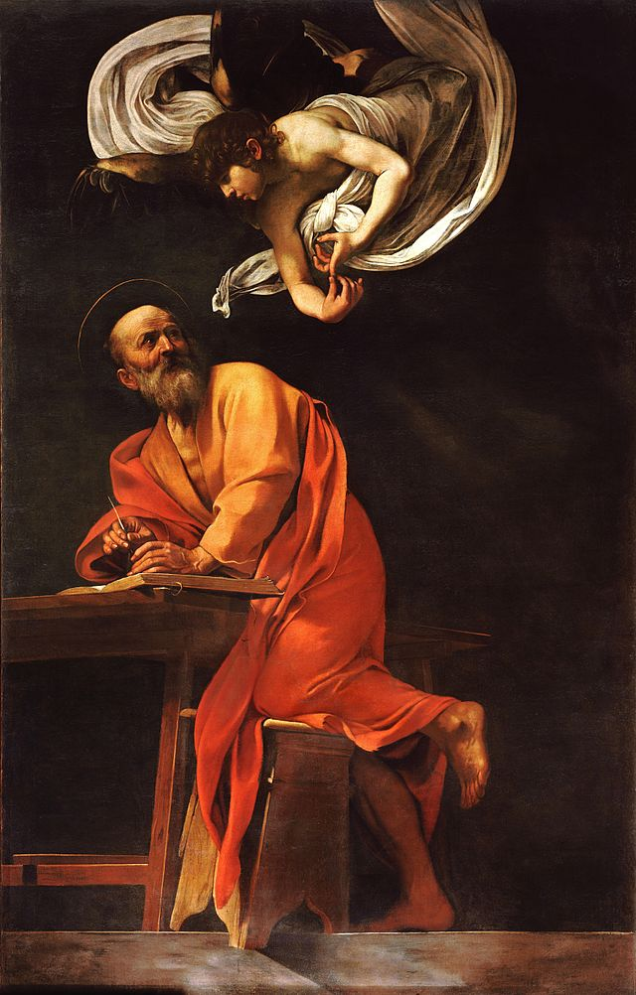
Inerrancy
Key
Vocab
“Refers to the belief that the Bible is infallible or without error.”
“The Books of Scripture must be acknowledged as teaching solidly, faithfully, and without error that truth which God wanted put into sacred writings for the sake of salvation.”
(Dei Verbum, 11)
Notes:
*Photo Credit: Caravaggio, Public domain, https://commons.wikimedia.org/wiki/File:The_Inspiration_of_Saint_Matthew-Caravaggio_(1602).jpg
Directions: Have students write down the term and definition as part of a Key Vocab section in their notes.

Slide 22
Criteria for books to make it into the New Testament
The four main criteria for inclusion in the New Testament were:
1. Inspiration of the Holy Spirit
2. Apostolic origin
3. Liturgical use
4. Universality
Notes:
Directions: Share the extra information for each part using the guide below.
The four main criteria for inclusion in the New Testament were:
1. Inspiration of the Holy Spirit. The Church determined which books were inspired. They contain nothing contrary to the truth.
2. Apostolic origin. The author of the book needed to be an Apostle or someone closely associated with the Apostles.
3. Liturgical use. St. Paul’s letters, for example, were often read as part of the liturgy. The liturgical context was an important factor for inclusion in the canon.
4. Universality. For a writing to be considered part of Sacred Scripture, its audience had to be outside a local community or region. St. Paul’s Letters to the Corinthians, for example, were read beyond Corinth and throughout the Roman Empire.

