Slide 1
Chapter 8 PowerPoint

Slide 2
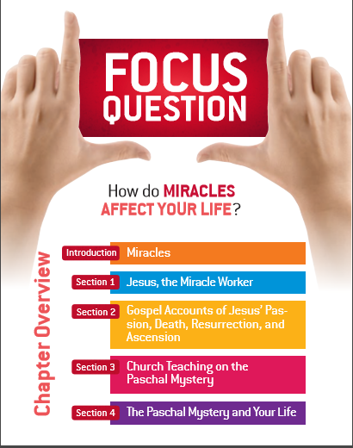

Slide 3
Miracles

Slide 4
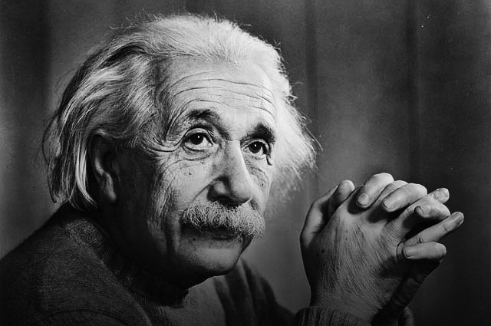
Miracle A powerful sign of God’s Kingdom worked by Jesus.
There are only two
ways to live your life.
One is as though
nothing is a miracle.
The other is as though everything is a miracle.
Albert Einstein
Miracles

Slide 5
A miracle is undeniable proof of the divine origin of the truth in testimony of which it has been worked. In examining a miracle and its relation to the proof of a truth presented by God, several points should be considered:
1. Did the occurrence actually take place?
2. Was it indeed beyond the power of nature?
3. Was this miracle worked in support of the truth of some teaching?
Catholicism & Reason: The Creed and Apologetics, p. 55
Miracles

Slide 6
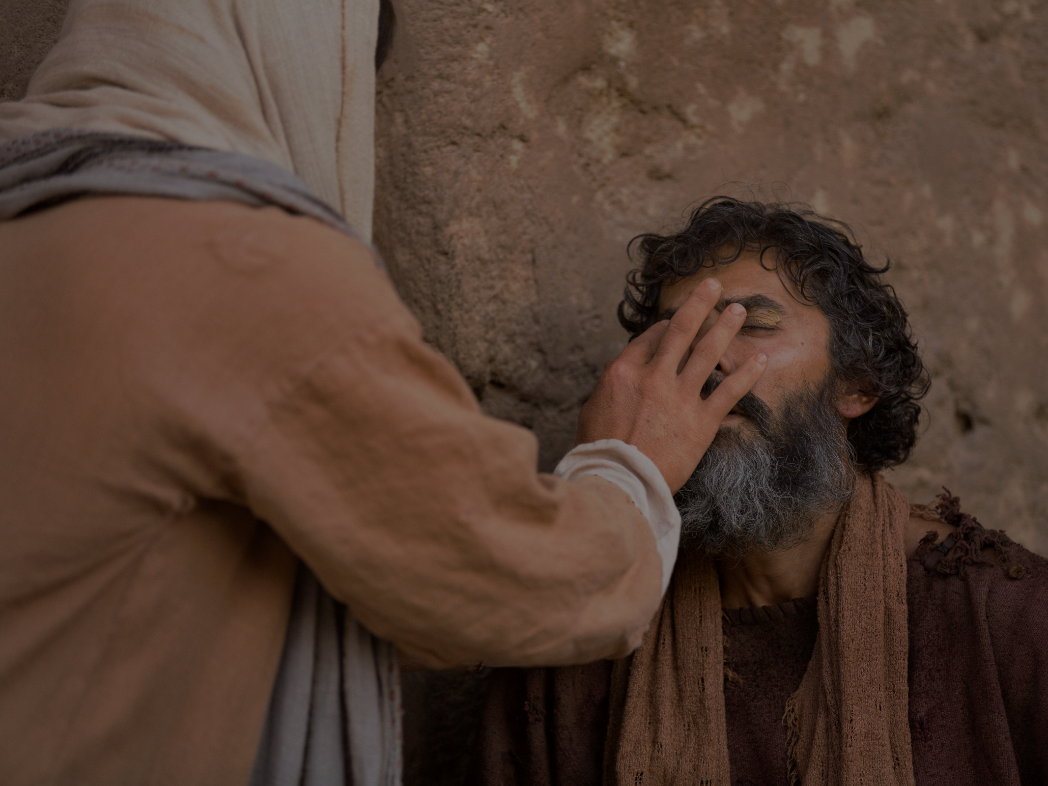
From the Catechism of the Catholic Church
By freeing some individuals from the earthly evils of hunger, injustice, illness and death, Jesus performed messianic signs. Nevertheless he did not come to abolish all evils here below, but to free men from the gravest slavery, sin, which thwarts them in their vocation as God's sons and causes all forms of human bondage (no. 549).
Miracles

Slide 7
Jesus, the Miracle Worker

Slide 8
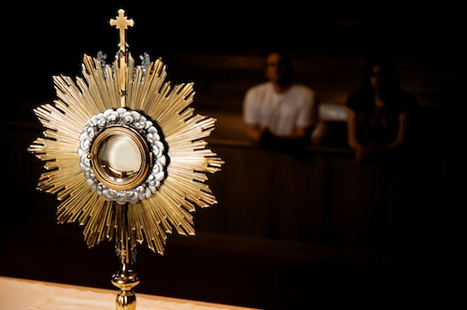
Sacrament of the Holy Eucharist
The sacrament commemorating the Last Supper, at which Jesus gave his Apostles his Body and Blood in the form of bread and wine. The source and summit of Christian life, the Eucharist is one of the Sacraments of Initiation. It re-presents, or makes present, the Lord’s sacrificial Death on the Cross. The word eucharist means “thanksgiving.”
Jesus, the Miracle Worker

Slide 9
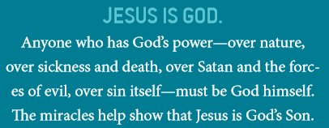
The miracles of Jesus demonstrate these truths:
Jesus, the Miracle Worker

Slide 10
Jesus, the Miracle Worker

Slide 11
Gospel Accounts of Jesus Death & Resurrection

Slide 12
Gospel Accounts of Jesus Death & Resurrection

Slide 13
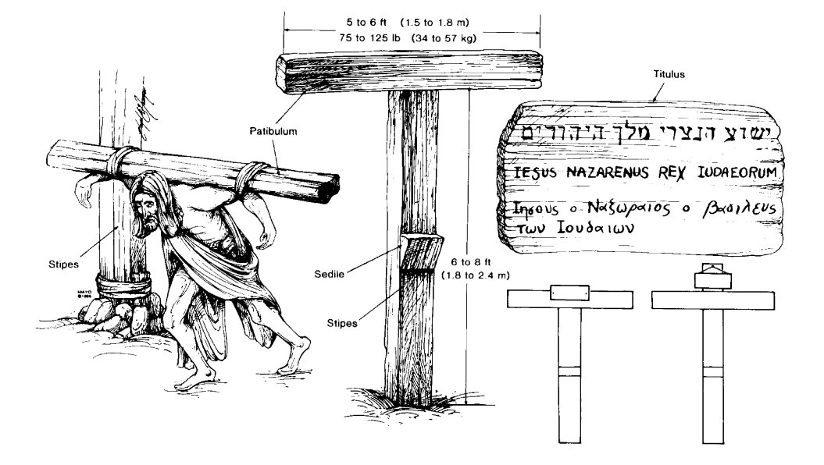
Left, victim carrying crossbar (patibulum) to site of upright post (stipes). Center, Low Tau cross (crux commissa), commonly used by Romans at time of Christ. Upper right, Rendition of Jesus' titulus with name and crime : “Jesus of Nazareth, King of the Jews” written in Hebrew, Latin, and Greek. Lower right, possible methods for attaching tittles to Tau cross (left) and Latin cross (right).

Slide 14
Gospel Accounts of Jesus Death & Resurrection

Slide 15
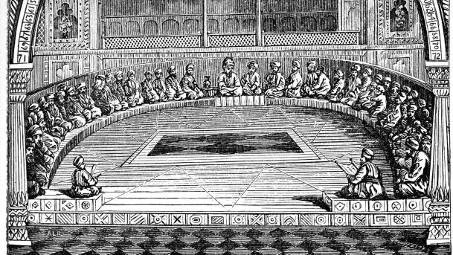
Sanhedrin The seventy-one-member supreme legislative and judicial body of the Jewish people during Jesus’ life on earth. Many of its members were Sadducees.
Gospel Accounts of Jesus Death & Resurrection

Slide 16
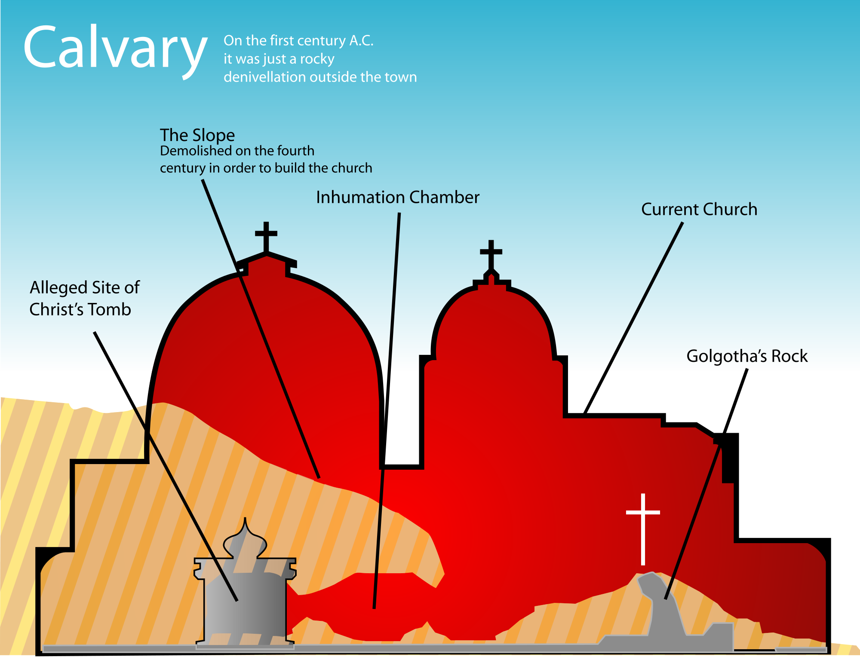
Gospel Accounts of Jesus Death & Resurrection

Slide 17
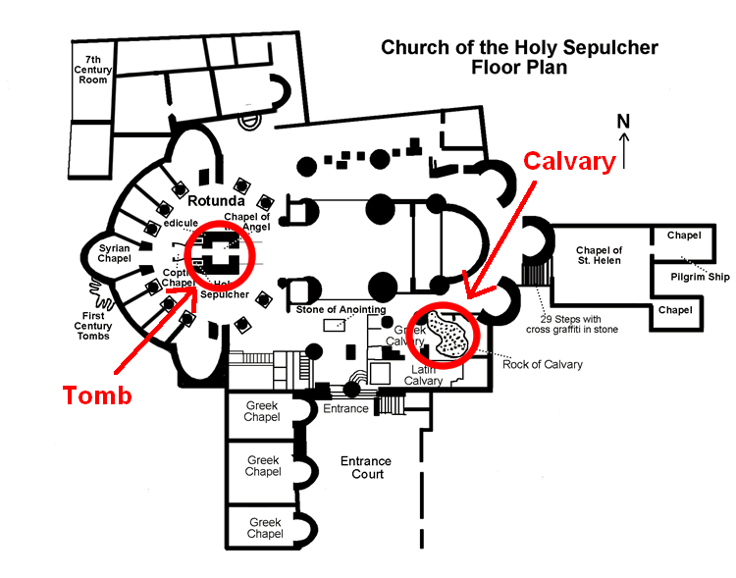
Gospel Accounts of Jesus Death & Resurrection

Slide 18
Event | Matthew 28:1-8 | Mark 16:1-8 | Luke 24:1-10 | John 20:1-8
When | At dawn | Just after sunrise | Very early in the morning | While it was still dark
Who comes first | Mary Magdalene and the other Mary | Mary Magdalene, Mary the mother of James, and Salome | Mary Magdalene, Joanna, Mary the mother of James, and others | Mary Magdalene
What they find | Earthquake with angel who rolls back the stone | Stone rolled away | Stone rolled away | Stone removed from the entrance
Who they see | Angel sitting on the stone | A young man in a white robe, sitting on the right | Two men in clothes that gleamed like lightening | No one
What happens next | Jesus meets them |  | Peter goes to the tomb to investigate | Peter and the other disciple investigate
What is the third scene? | Guards report to the chief priests and are bribed |  | The story of two disciples on the road to Emmaus | Mary sees two angels in white, seated where Jesus’ body had been
Gospel Accounts of Jesus Death & Resurrection

Slide 19
Church Teaching on the Paschal Mystery

Slide 20
Church Teaching on the Paschal Mystery

Slide 21
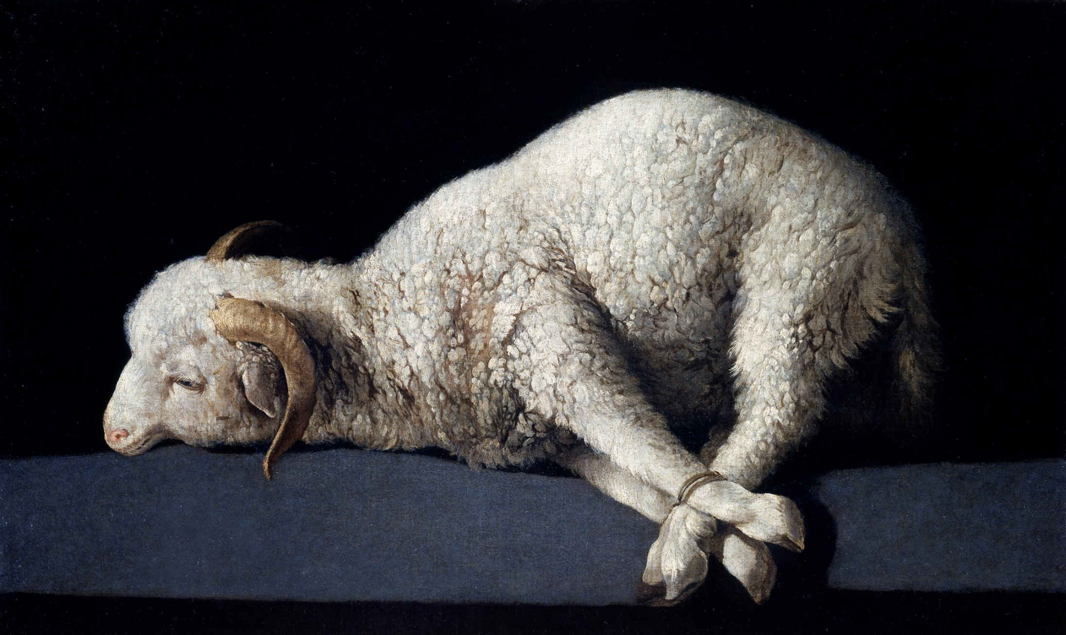
The divine plan, the Paschal Mystery, was accomplished for all time by the redemptive Passion, Death, Resurrection, and Ascension of Jesus Christ. The Paschal Mystery is at the center of the Good News that the Apostles, and the Church after them, needed to proclaim to the world. The Paschal Mystery of Christ’s sacrifice repaired the broken relationship between God and humans in the New Covenant. p. 240
Church Teaching on the Paschal Mystery

Slide 22
Church Teaching on the Paschal Mystery

Slide 23
The Paschal Mystery and Your Life

Slide 24
Catechism of the Catholic Church
The seven sacraments touch all the stages and all the important moments of Christian life: they give birth and increase, healing and mission to the Christian's life of faith. There is thus a certain resemblance between the stages of natural life and the stages of the spiritual life. (1210)
The Paschal Mystery and Your Life

Slide 25
The Paschal Mystery and Your Life

Slide 26
The Seven Sacraments
 | Matter | Form | Minister | Effects
Baptism | Water (immersion, infusion or sprinkling | “I baptize you in the name of the Father, Son, and Holy Spirit” | Bishop, Priest, or Deacon (anyone in an emergency) | Cleanses Original Sin, made and adopted son / daughter of God, entrance into the Church, receive the Holy Spirit, indelible mark on the soul
Confirmation | Chrism/ Blessed oil and the laying on of hands | “Be sealed with the gift of the Holy Spirit.” | Bishop (The bishop may also designate a priest to confirm) | Increase in the Holy Spirit and his gifts, full initiation into the Church
Eucharist | Bread and win | “This is my Body” & “This is my Blood.” | Bishop or Priest | Unity with Christ, unity with the Church in Heaven, on earth, and purgatory
The Paschal Mystery and Your Life

Slide 27
The Seven Sacraments
 | Matter | Form | Minister | Effects
Reconciliation | Contrition for the confession of sins | “I absolve you of your sin in the name of the Father, Son, and Holy Spirit | Bishop or Priest | Healing and forgiveness of sins, grace to avoid future sin, healing of one’s relationship with Christ, reconciliation with the Church
Anointing of the Sick | Blessed oil and the laying on of hands | “Through this holy anointing, may the Lord in his love and mercy help you with the grace of the Holy Spirit. May the Lord who frees you from sin save you and raise you up.” | Bishop or Priest | Forgiveness of sins, strength for the suffering
Holy Orders | Laying on of hands | The prayer of ordination according to the particular order: deacon, priest, or bishop | Bishop | An indelible mark on the soul, able to act as a representative of Christ in a unique way, specific effects different for the three levels
Matrimony | Mutual consent to enter into Marriage, the consummation of the marriage | Vows | The couple | Indissoluble bond between the couple, grace for the unity of the family, special grace to help the other attain holiness
The Paschal Mystery and Your Life

Slide 28
The Paschal Mystery and Your Life

Slide 29
Endnotes
Quotations from Sacred Scripture come from the New American Bible, Revised Edition (NABRE) http://wwwmigrate.usccb.org/bible/
Quotations from the Catechism of the Catholic Church http://www.vatican.va/archive/ENG0015/_INDEX.HTM
Quotations from Documents of the Second Vatican Council http://www.vatican.va/archive/hist_councils/ii_vatican_council/index.htm
Catholicism & Reason: The Creed and Apologetics, Hayes, C.R. Publications, 2009.

