Slide 1

CHAPTER 7

Slide 2

Chapter 7
The Sacrament
of the Anointing of the Sick

Slide 3
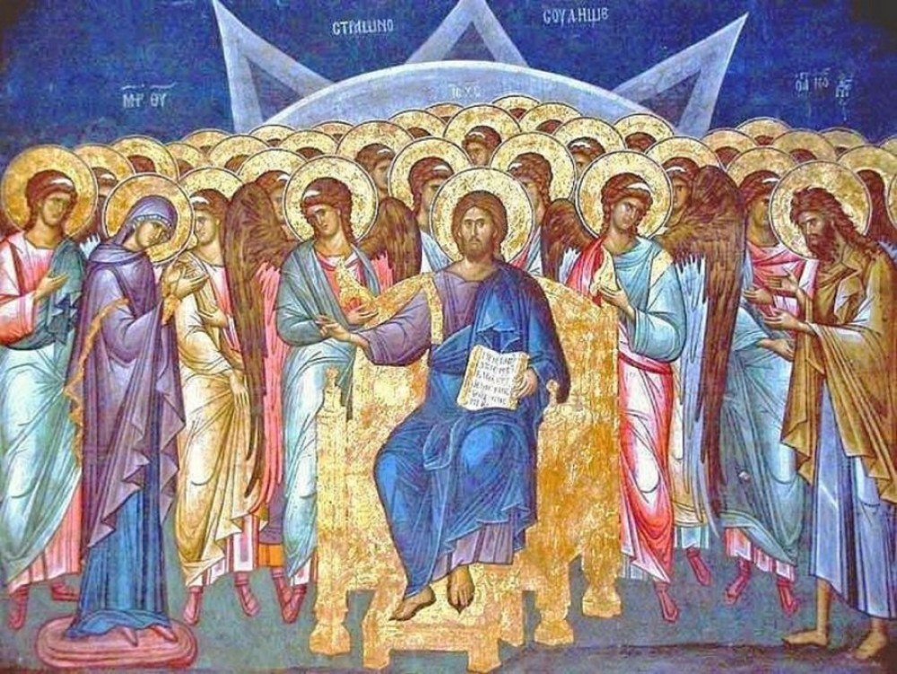
Apocalyptic: Relating to belief in the enactment of God’s justice after death or in an end time when good people will be rewarded and evil people will be punished. In the Bible, the Books of Daniel and Revelation contain examples of apocalyptic writing.
“Is Anyone Among You Suffering?”

Slide 4
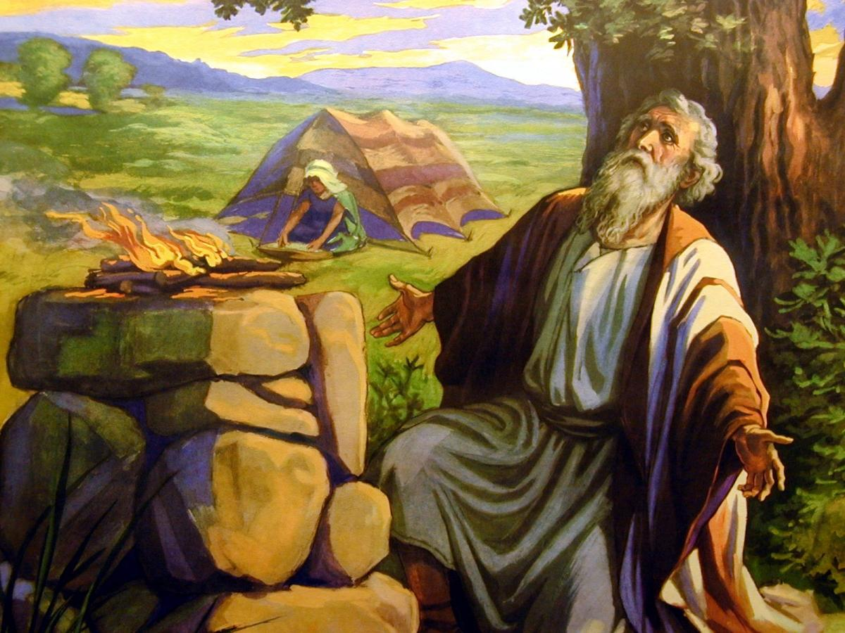
Beliefs about Suffering in the Old Testament
Suffering was a moral condition.
Each instance of suffering resulted from a specific sin: “the law of retribution.”
God blessed “good people” with health, many children, riches, and a long life. This mentality was challenged by the story of Job, a good man who lost everything
Israelites believed God’s justice remains intact and good people if not rewarded in this life will be rewarded in the next
“Is Anyone Among You Suffering?”

Slide 5
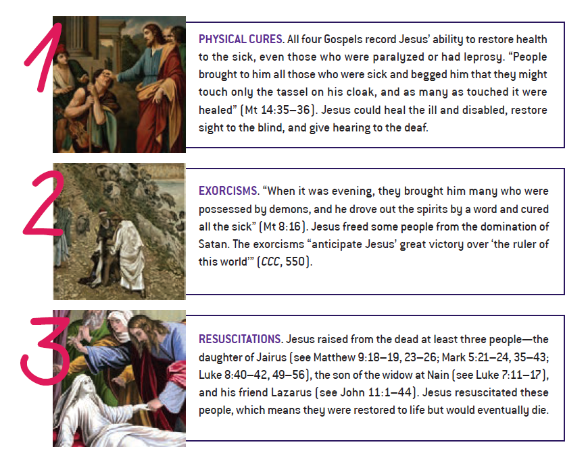

“Is Anyone Among You Suffering?”

Slide 6
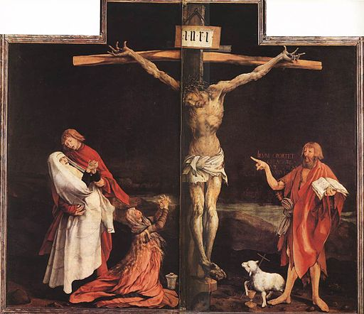
What did Jesus teach about suffering?
Sickness and death are not God’s ways of punishing people.
God loves the sick and disabled just as much as he loves healthy people.
God’s love is stronger than sickness, pain, suffering, and death.
God does not abandon you when you are sick or suffering. Rather, he shares your suffering, above all through the Cross.
The sick should not be treated as outcasts; instead, they have an important role to play in the community.
“Is Anyone Among You Suffering?”

Slide 7
Redemptive Suffering
“I understood that to become a saint one had to suffer much, seek out always the most perfect thing to do, and forget self... I do not want to be a saint by halves. I'm not afraid to suffer for You. I fear only one thing: to keep my own will; so take it, for I choose all that You will!” k
St. Thérèse of Lisieux
Redemptive suffering is the notion that our sufferings can be offered up as a sacrifice for the grace of others
“ [Isaiah] intuits that suffering can also have a redemptive meaning for the sins of others” (CCC 1502).
“Is Anyone Among You Suffering?”

Slide 8

Journal Question
What are some ways you can “offer up” your sufferings for the good of the Church and the grace of others?

Slide 9
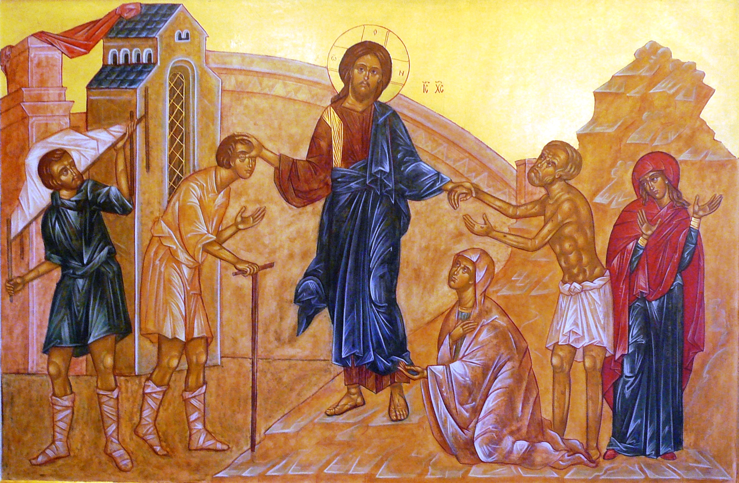
"Is any among you sick? Let him call for the elders of the church, and let them pray over him, anointing him with oil in the name of the Lord; and the prayer of faith will save the sick man, and the Lord will raise him up; and if he has committed sins, he will be forgiven" (Jas. 5:14–15)

Slide 10
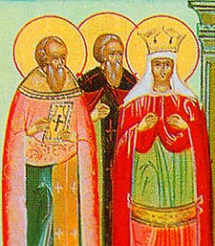
Presbyters
The name for priests or members of the order of priesthood who are coworkers with the bishops and are servants to God’s People, especially in celebrating the Eucharist.
Understanding the Sacrament of Anointing the Sick

Slide 11
Selected History of the Anointing of the Sick
Date | Practice | Outcome
Ca. 215 | Hippolytus described the bishop blessing of the oil of sick (olive or another plant oil). | Christians regarded their blessed oil as an especially effective remedy and a sign of God’s presence.
Ca. 416 | Pope Innocent I described how blessed oil was used. | “Is anyone among you sick? He should summon the presbyters of the church, and they should pray over him and anoint [him] with oil in the name of the Lord, and the prayer of faith will save the sick person, and the Lord will raise him up. If he has committed any sins, he will be forgiven.” (Jas 5:13-15)
428 | St. Cyril of Alexandria warned Christians not to turn to pagan magicians and sorcerers when sick. | The faithful were to turn to God’s healing through the bishop and presbyters of the Church
1551 | Only priests (bishops and presbyters) are ministers of Anointing of the Sick. | The faithful sought out ministers.
1965 | “Extreme Unction” is not a sacrament intended only for those on the verge of death. | Any faithful who is in danger of death due to sickness or old age may receive the sacrament.
Understanding the Sacrament of Anointing the Sick

Slide 12
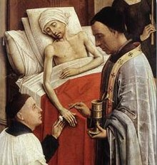
Extreme Unction
A term from the Latin for “last
anointing.” It once referred to the reception of the Sacrament
of the Anointing of the Sick just before death. It is accompanied by Viaticum.
Understanding the Sacrament of Anointing the Sick

Slide 13
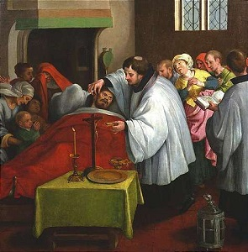
Conditions for the Sacrament of the Anointing of the Sick
Given during sickness or immediately before death.
Intended for a communal setting with family and friends in attendance.
May take place in the family home, a hospital, a convalescent home, a hospice, or a parish church.
Can be for a single sick person or a group.
The sick person and all those present are encouraged to receive the Sacrament of Penance prior to the Anointing of the Sick.

Slide 14
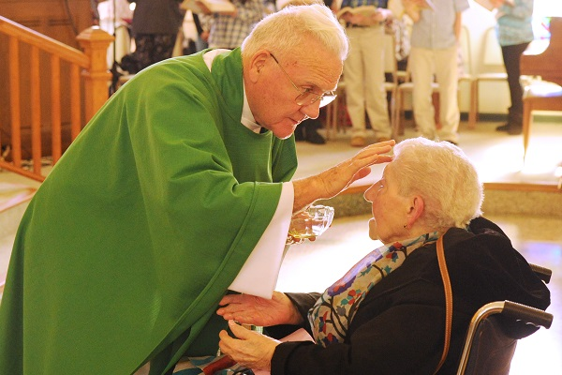
Rite of the Anointing of the Sick
Introductory Rites
Liturgy of the Word
Litany (Prayer of the Faithful)
Laying on of Hands
Blessing of Oil
Prayer of Thanksgiving
Anointing with Oil of the Sick (hands and forehead)
Prayer after Anointing
Celebrating the Sacrament of Anointing the Sick

Slide 15
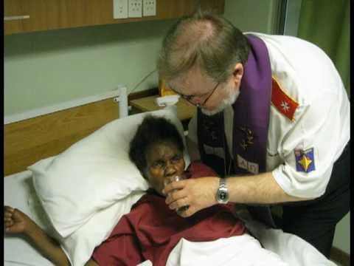
The Final Journey
Name of Rite | Details
Extreme Unction (Last Rites) | Encompasses all the ministering to the person on the bed of death, including Penance, Anointing of the Sick ,Viaticum, and the Final Blessing.
Anointing of the Sick | Sacrament given to those who face sickness or death. Must be administered by a priest or bishop .
Viaticum | The last reception of Holy Communion may be brought by a deacon or other member of the parish community if a priest is not available.
Celebrating the Sacrament of Anointing the Sick

Slide 16
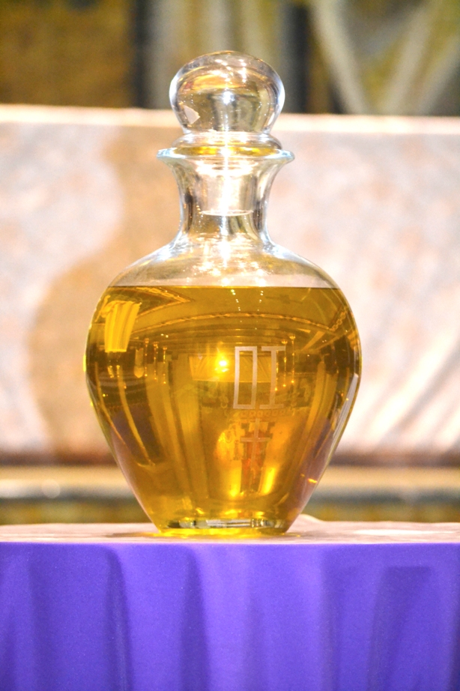
Oil of the Sick
Olive oil blessed by the bishop of a diocese on Holy Thursday.
Abbreviated O.I. (oleum infirmorum, oil of the sick)
Olive oil was prescribed as the only oil valid for the sacrament until 1874 when Pope Paul VI allowed any plant oil.
In an emergency, any priest may bless the oil.
Celebrating the Sacrament of Anointing the Sick

Slide 17
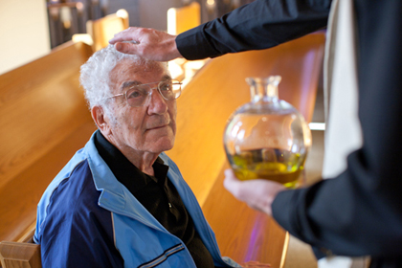
The Effects of the Anointing of the Sick
The sacrament is a particular gift of the Holy Spirit.
The sacrament unites the person with the Passion of Christ.
The sacrament is a grace for the Church.
The sacrament is preparation for the final journey.
The Graces of the Sacrament of Anointing the Sick

Slide 18

Being a Good Samaritan
Graces of the Sacrament
God-Centered
The sacrament facilitates the conversion from self-pity toward acceptance.
You become the “anointed one” united with Christ.
Other-Centered
You can heal others because you know what it is like to surrender and to be healed by God’s love.
You have been on the receiving end of God’s compassionate love and encouragement. You can profoundly encourage others to have faith too.
The Graces of the Sacrament of Anointing the Sick

Slide 19
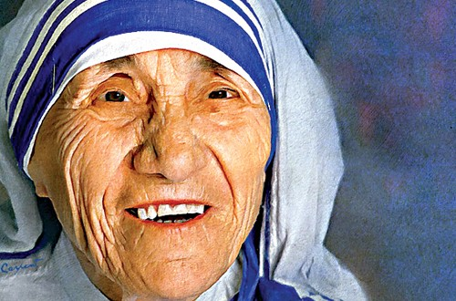
St. Teresa of Calcutta
St. Teresa ministered to the poor, the sick, and the dying.
She founded the Missionaries of Charity in 1950.
At the time of her death in 1997, the Missionaries of Charity (which had grown to 4,000 sisters, 300 brothers, and more than 100,000 laypeople) were operating more than 600 missions in 123 countries.
“The fruit of faith is love, and the fruit of love is service. . . . Unless a life is lived for others, it is not worthwhile.”

Slide 20
https://www.catholicculture.org/culture/library/dictionary/index.cfm?id=35245

