Slide 1
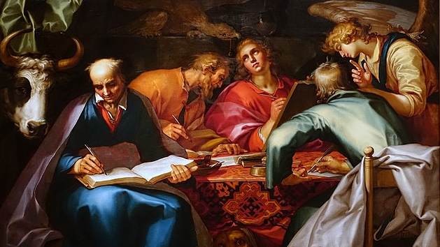
5
Jesus and God’s Kingdom Seen through the Synoptic Gospels
God Reveals: An Introduction to the Bible
Notes:
*Photo Credit: https://commons.wikimedia.org/wiki/File:The_Four_Evangelists,_by_Abraham_Bloemaert,_Dutch,_1612-1615,_oil_on_canvas_-_Princeton_University_Art_Museum_-_DSC06485.jpg
Suggestions for students’ note taking:
●Require students to use a three-ring binder (1/2-1 inches) full of loose-leaf paper (college or wide ruled).
●Notes must be taken in pen only and handwritten.
●Notebooks should contain information and notes for religion class only.
●Notebooks must have a table of contents with topic of notes, dates, and page numbers.
●All notes must have a topic and page number.
●Students will be required to copy each slide unless the teacher directs students to skip certain slides or parts of slides. Notebooks will be graded based on neatness, completeness, and organization. Notebooks should have a significant point value representing 20-25% of the overall grade.

Slide 2
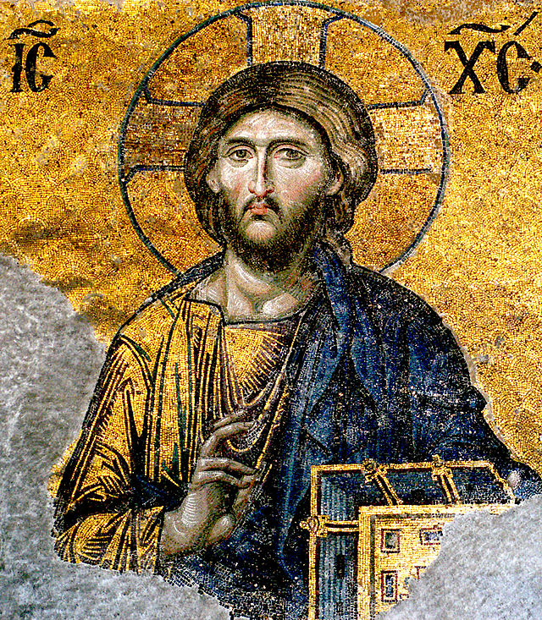
Synoptic Gospels
Key
Vocab
Three of the four Gospels that are seen together or have a shared view of the life of Jesus. Matthew, Mark and Luke all have many similarities compared to John.
Notes:
*Photo Credit: Edal Anton Lefterov, Creative Commons Attribution-Share Alike 3.0, https://commons.wikimedia.org/wiki/File:Jesus-Christ-from-Hagia-Sophia.jpg
Directions: Have students copy down key vocabulary in their notes.

Slide 3
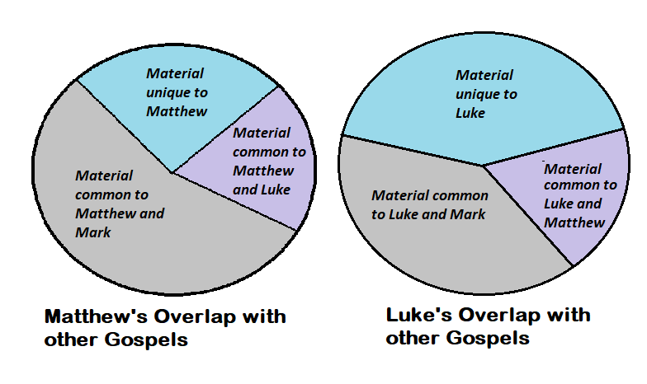
Synoptic Gospel Overlap
Of the 661 verses in Mark’s Gospel, eighty percent of these appear in Matthew’s Gospel, and sixty-five percent occur in Luke’s Gospel.
The Gospels of both Matthew and Luke are considerably longer but they follow the general outline of Mark’s Gospel in reporting the events of Jesus’ life.
Notes:
Directions: Have students copy the pie charts in their notes as you share the quote below.
“Despite the likeness among the synoptics, comparing them can feel like comparing apples and oranges. Though each gospel was written under the inspiration of the Holy Spirit, each is unique and written by a different author who had his own specific sources and who reflected theologically on the story of Jesus as he knew it and lived it. Each author wrote in a given year, for a unique audience, and with a specific message in mind. Each gospel complements the others with differences and similarities, giving us a better and more complete understanding of who Jesus the Christ was and is for us today.”
-Santiago Cortes-Sjoberg, https://uscatholic.org/articles/200909/what-are-the-synoptic-gospels/

Slide 4

The Synoptic Gospel Mystery
Which Gospel came first?
Was Mark the source used by Matthew and Luke or was Matthew the source used by Luke and Mark since he was an eyewitness and apostle?
Was there another source (Q) along with Mark that Matthew and Luke used?
Notes:
*Photo Credit: Juhele, Creative Commons Zero, Public Domain Dedication. https://commons.wikimedia.org/wiki/File:Detective.svg
Directions: Have students write down the questions on the slide in their notes. Use these questions on the next assessment.
Online Resources: For a more detailed treatment of this Q topic, see the webpage “The Synoptic Problem” by Fr. Felix Just, SJ. URL here: https://catholic-resources.org/Bible/Synoptic_Problem.htm

Slide 5
The Two-Source Hypothesis
MARK
Q
MATTHEW
LUKE
Notes:
Directions: Have students copy the chart in their notes as you read aloud the section from the book below.
“Since the advent of advanced biblical scholarship near the beginning of the twentieth century, the most common theory is the ‘two-source hypothesis.’ According to this hypothesis, Mark’s Gospel was written first, and then Matthew and Luke used it independently of each other as a source. This hypothesis explains why Matthew and Luke share common material from Mark, but not why they have certain material not found in Mark in common with each other. In fact, there are 235 verses that appear in both Matthew and Luke that are not found in Mark. Scholars have proposed a second source, which they have named “Q” from the German word Quelle, which means “source,” hence the name ‘two-source hypothesis’” (God Reveals student text, 231).
Online Resources: For a more detailed treatment of this topic, see the webpage “The Synoptic Problem” by Fr. Felix Just, SJ. URL here: https://catholic-resources.org/Bible/Synoptic_Problem.htm

Slide 6
Mt, Mk, Lk (Synoptics) vs. John
Synoptics
John
One Journey to Jerusalem
Short sayings, many parables
Focus is on Kingdom of God
Not explicitly claiming divinity
Many stories in common
Miracles = “Dunamis” (power)
Three Journeys to Jerusalem
Long discourses, parables
Focus is NOT on Kingdom of God
Explicitly claiming divinity, Heavenly Origin
Few stories in common
Miracles = Signs
Notes:
Directions: Have students copy the chart in their notes.

Slide 7

The Parable of the Mustard Seed: Side by Side
Matthew
Mark
Luke
“He proposed another parable to them. ‘The kingdom of heaven is like a mustard seed that a person took and sowed in the field. It is the smallest of all the seeds, yet when full-grown it is the largest of plants. It becomes a large bush, and the “birds of the sky come and dwell in its branches.”’”
Mt 13:31-32
“He said, ‘To what shall we compare the kingdom of God, or what parable can we use for it? It is like a mustard seed that, when it is sown in the ground, is the smallest of all the seeds on the earth. But once it is sown, it springs up and becomes the largest of plants and puts forth large branches, so that the birds of the sky can dwell in its shade.’”
Mk 4:30-32
“Then he said, ‘What is the kingdom of God like? To what can I compare it? It is like a mustard seed that a person took and planted in the garden. When it was fully grown, it became a large bush and “the birds of the sky dwelt in its branches.”’”
Lk 13:18-19
Notes:
Directions: Have students brainstorm on what they notice as differences in each passage. Begin with the question, “What are the differences between each passage in just the first sentence?”

Slide 8
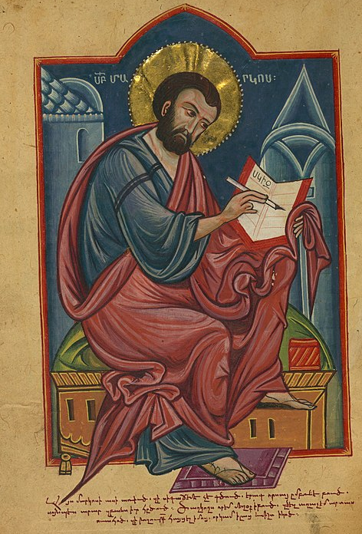
What is unique about the Gospel of
Mark?
Notes:
*Photo Credit: Walters Art Museum Illuminated Manuscripts, Creative Commons Zero, Public Domain Dedication, https://commons.wikimedia.org/wiki/File:Amida_Gospels,_Portrait_of_the_Evangelist_Mark,_Walters_Manuscript_W.541,_fol._70v.jpg
Directions: Have students set up three columns in their notes—one for Matthew, for Mark and for Luke—to be used for the next three slides. As you read the bullet point information aloud (below), ask students to jot down 2 unique items for each Gospel. Follow up with a matching section on the next assessment. Students will match the Gospel to its unique features.
Mark Highlights Jesus’s deeds more than his words and presents a vivid, human, and down-to-earth portrait of Jesus.
Mark likely wrote his Gospel for a Gentile-Christian audience that was undergoing persecution, perhaps in Rome.
Mark’s Central theme: following Jesus often means suffering as Jesus did.
Mark emphasized Jesus Christ’s role as a Suffering Messiah for Christians to imitate.
Mark stressed Jesus’s humanity.
Online Resources: For a more detailed treatment of the differences and what makes each Gospel unique, see the webpage “The Synoptic Gospels: Structural Outlines and Unique Material” by Fr. Felix Just, SJ. URL here: https://catholic-resources.org/Bible/Synoptic_Outlines.htm

Slide 9
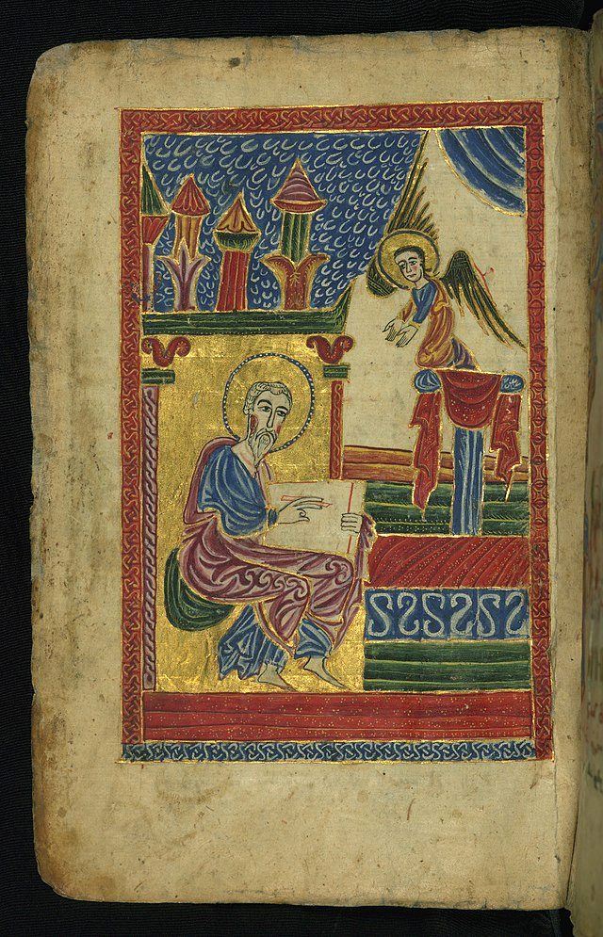
What is unique about the Gospel of Matthew?
Notes:
*Photo Credit:Walters Art Museum Illuminated Manuscripts, Creative Commons Zero, Public Domain Dedication, https://commons.wikimedia.org/wiki/File:Gospel_Book,_Evangelist_portrait_of_St._Matthew,_Walters_Manuscript_W.540,_fol._17v.jpg
Directions: Have students set up three columns in their notes—one for Matthew, for Mark and for Luke—to be used for the next three slides. As you read the bullet point information aloud (below), ask students to jot down 2 unique items for each Gospel. Follow up with a matching section on the next assessment. Students will match the Gospel to its unique features.
Emphasizes the link between Judaism and Christianity.
The Gospel quotes many Old Testament prophecies to proclaim Jesus’s identity as the promised Messiah.
Matthew wrote to at least two different groups: Jews who followed Jesus and Gentiles who followed Jesus.
Matthew’s understanding of the “anointed one” radically differed from that of the people and of his disciples.
Matthew’s Gospel makes several connections between Moses and Jesus, portraying Jesus as the “New Moses”
The Gospel is divided into five sections centered on five important sermons of Jesus, paralleling the five books of the Pentateuch that present the Old Testament Law.
Online Resources: For a more detailed treatment of the differences and what makes each Gospel unique, see the webpage “The Synoptic Gospels: Structural Outlines and Unique Material” by Fr. Felix Just, SJ. URL here: https://catholic-resources.org/Bible/Synoptic_Outlines.htm

Slide 10
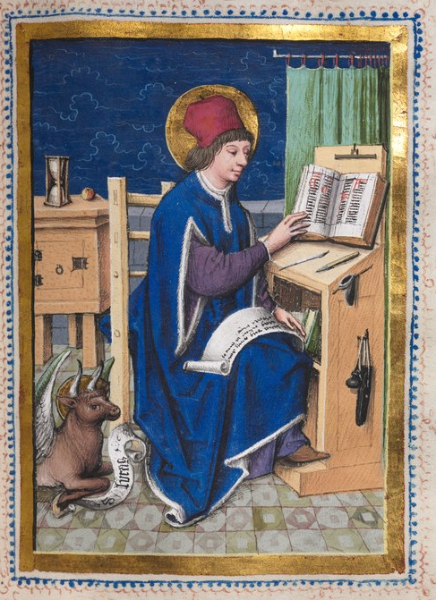
What is unique about the Gospel of
Luke?
Notes:
*Photo Credit:Hausbuch Master, Creative Commons Zero, Public Domain Dedication, https://commons.wikimedia.org/wiki/File:Hausbuch_Master_-_Gospel_Book_with_Evangelist_Portraits-_Saint_Luke_-_1952.465.86.a_-_Cleveland_Museum_of_Art.tif
Directions: Have students set up three columns in their notes—one for Matthew, for Mark and for Luke—to be used for the next three slides. As you read the bullet point information aloud (below), ask students to jot down 2 unique items for each Gospel. Follow up with a matching section on the next assessment. Students will match the Gospel to its unique features.
Luke also wrote the Acts of the Apostles; he thus wrote about one-fourth of the New Testament.
Luke wrote to a largely Gentile-Christian audience in about AD 75–90, perhaps around 85.
He featured the city of Jerusalem as an important symbol in both of his works.
Two points of emphasis: 1) Jesus is a universal Savior who brings salvation to Jew and Gentile alike and 2) repentance brings great joy.
Luke’s Gospel stresses Jesus’s practice of looking out for everyone: Jew and Gentile, rich and poor, women and men.
Luke’s infancy narrative is focused on the perspective of Mary and the words of Mary spoken in a canticle known as the Magnificat.
Online Resources: For a more detailed treatment of the differences and what makes each Gospel unique, see the webpage “The Synoptic Gospels: Structural Outlines and Unique Material” by Fr. Felix Just, SJ. URL here: https://catholic-resources.org/Bible/Synoptic_Outlines.htm

Slide 11
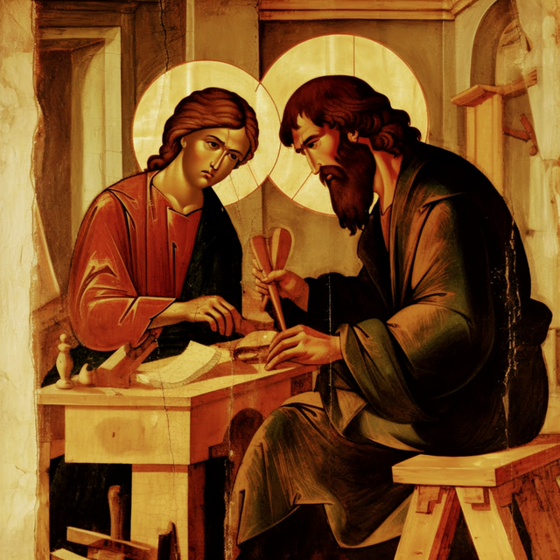
One of the first teachers of Jesus was Saint Joseph, his earthly father. What skills did Jesus learn about the craft of teaching from Saint Joseph?
Notes:
*Photo Credit: RosaryTeam, Creative Commons Zero, Public Domain Dedication, https://commons.wikimedia.org/wiki/File:Rosary_Team_-_St_Joseph_in_Workshop_with_Jesus_Christ_Our_Lord_-_Holy_Family.png
Directions: After asking students to write down an answer to the question on the slide, ask “What were some of the key teachings that Jesus gave to his disciples?” Share answers below.
Jesus, the Revelation of the Father, came to deliver the essential message that the Kingdom of God is at hand.
He ushered in the Kingdom by following the will of the Father.
Our participation in God’s Kingdom requires the initial step of repentance and belief.
Jesus used parables, pronouncement stories, and independent sayings to help people understand the Kingdom of God. These elements were arranged by the evangelists into narratives.
Matthew and Luke highlight essential teachings—including moral teachings—in discourses. Matthew sets a primary discourse on a mountain, Luke on a plain.

Slide 12
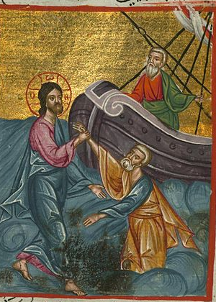
Miracles of
Jesus in the Synoptics
Notes:
*Photo Credit: Ilyas Basim Khuri Bazzi Rahib - Jesus Walks on Water - Walters W59241A - Full Page.jpg, Public domain, https://commons.wikimedia.org/wiki/File:Ilyas_Basim_Khuri_Bazzi_Rahib_-_Jesus_Walks_on_Water_-_Walters_W59241A_-_Full_Page.jpg
Directions: Have students copy any three bullet points in their notes as you read all six aloud.
Miracle stories showcased the divine, supernatural aspect of the Kingdom.
Physical healings, nature miracles, exorcisms, and raisings from the dead are various types of miracles performed by Jesus.
Jesus does more miracles in the synoptics than in John
Instead of all being spectacular signs, the synoptic miracles vary in style and substance.
Jesus will downplay or hide his identity after performing miracles in the synoptics.
In John he is open to demonstrating who he is through his miracles.
Online Resources: For a more detailed treatment of this topic, see the webpage “Miracle Stories in the New Testament” by Fr. Felix Just, SJ. URL here: https://catholic-resources.org/Bible/Miracles.htm

Slide 13
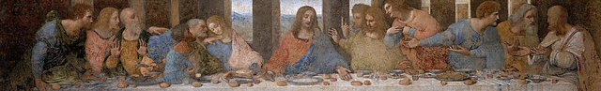
Less than one chapter
Occurred on Passover
Includes Institution Narrative
Words of Consecration
Prediction of Betrayal
Last Supper in Synoptics
Five chapters long—Farewell discourse
Happens before Passover / Jesus seen as Passover Lamb
“Love one another” . . . Washing of the feet
Promises to send the Paraclete (Holy Spirit)
Ends with High Priestly Prayer / Prayer for unity, “That they may all be one”
Last Supper in
John
Notes:
*Photo Credit: Leonardo da Vinci, Public domain, https://commons.wikimedia.org/wiki/File:The_Last_Supper_-_Leonardo_Da_Vinci_-_High_Resolution_32x16.jpg
Directions: Have students create a venn diagram comparing and contrasting the coverage of the Last Supper from the information on the slide.
Online Resources: For a more detailed treatment of the Eucharist and Last Supper in the Gospels, see the webpage “The Feeding of the Multitudes, the Last Supper, the Lord's Supper, and the Eucharist” by Fr. Felix Just, SJ. URL here: https://catholic-resources.org/Bible/Eucharist.htm

Slide 14
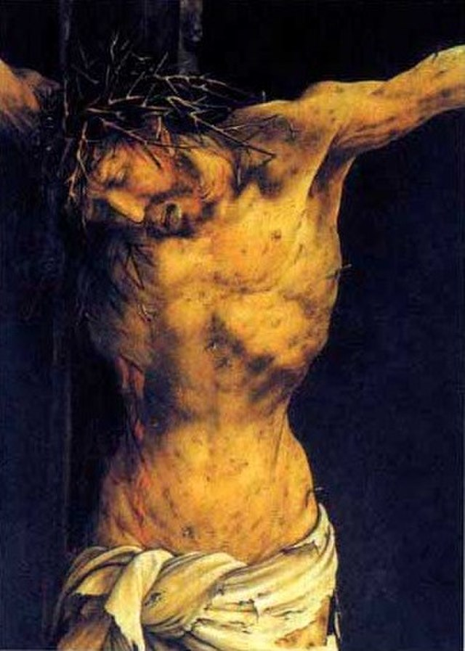
The Passion in the Synoptics
Matthew highlights the kingdom of Jesus.
Mark highlights the suffering of Jesus.
Luke highlights the innocence of Jesus.
Notes:
*Photo Credit:Txllxt TxllxT, Creative Commons Attribution-Share Alike 4.0, https://commons.wikimedia.org/wiki/File:Colmar_-_Unterlinden_Museum_-_The_Isenheim_Altarpiece_1512-16_by_Matthias_Gr%C3%BCnewald_(ca_1470-1528)_-_Details_from_the_Crucifixion_panel_01.jpg
Directions: Complete the bullet points on the slide with the information below.
Matthew highlights the kingdom of Jesus and how Pilate and the Jewish leaders considered him a political threat.
Mark highlights the suffering Jesus, including the tragic nature of his rejection, the misunderstanding of his mission, and his brutal and cruel death.
Luke highlights the innocence of Jesus and how Pilate, Herod Antipas, the centurion, and repentant thief all recognized that he was not deserving of death.
Online Resources: For a more detailed treatment of the Passion of Christ in the Gospels, see the webpage “The Passion and Death of Jesus” by Fr. Felix Just, SJ. URL here: https://catholic-resources.org/Bible/Passion.htm

Slide 15

Turn and Talk
Why do you think each Gospel emphasizes the historical, bodily resurrection of Jesus rather than it being a symbol of new life?
Notes:
Directions: Have students write down the question and then write down their answer. Then have students share their answers with one person close by.

Slide 16

Memorize It
Key
Verse
“Behold, I am with you always, until the end of the age.”
Mt 28:20
Notes:
Directions: Have students copy the quote. Add bonus points to the assessment if they can write it down, demonstrating that they memorized it.

