Slide 1
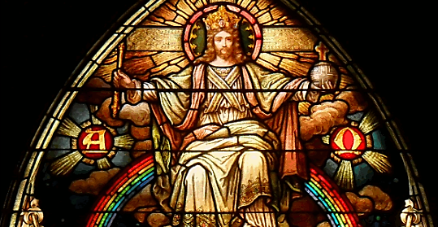
7
The Bible Shares Christ’s Mission as Priest, Prophet, and King
God Reveals: An Introduction to the Bible
Notes:
*Photo Credit: https://commons.wikimedia.org/wiki/File:Jesus_Christ_the_King_in_Glory.png
Suggestions for students’ note taking:
Require students to use a three-ring binder (1/2-1 inches) full of loose-leaf paper (college or wide ruled).
Notes must be taken in pen only and handwritten.
Notebooks should contain information and notes for religion class only.
Notebooks must have a table of contents with topic of notes, dates, and page numbers.
All notes must have a topic and page number.
Students will be required to copy each slide unless the teacher directs students to skip certain slides or parts of slides. Notebooks will be graded based on neatness, completeness, and organization. Notebooks should have a significant point value representing 20-25% of the overall grade.

Slide 2

The Christological Lens
The Christological Lens is a way that we as Catholics view the entire Bible as centering on and culminating in the Person of Jesus.
Notes:
*Photo Credit: Tomomarusan,Creative Commons Attribution 2.5, https://commons.wikimedia.org/wiki/File:Magnifying_glass.jpg
Directions: Review the following points about the christological lens:
Recall the main points about the Road to Emmaus story (see Luke 24).
Jesus, on the road to Emmaus, pointed out everything in the Scriptures (Old Testament) that pointed to him:
“Then beginning with Moses and all the prophets, he interpreted to them what referred to him in all the scriptures” (Luke 24:27).
The Catechism refers to this Christological lens too:
“Through all the words of Sacred Scripture, God speaks only one single Word [Jesus], his one Utterance in whom he expresses himself completely” (CCC, 102).

Slide 3
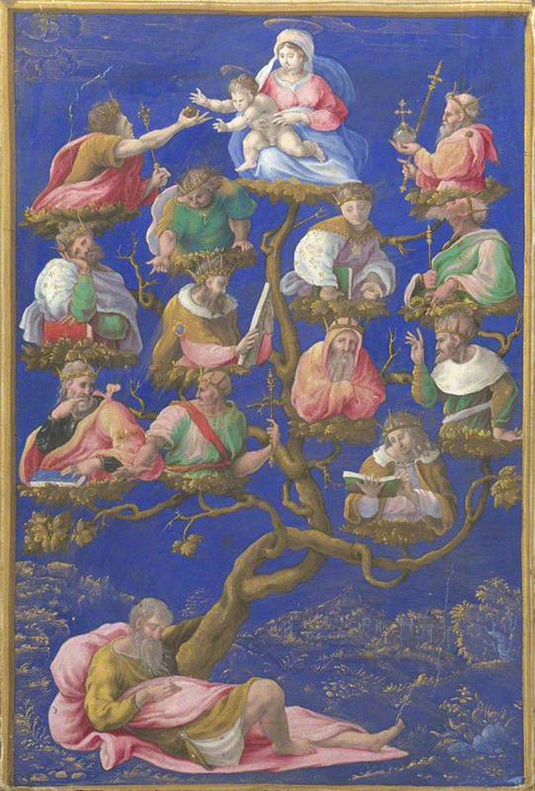
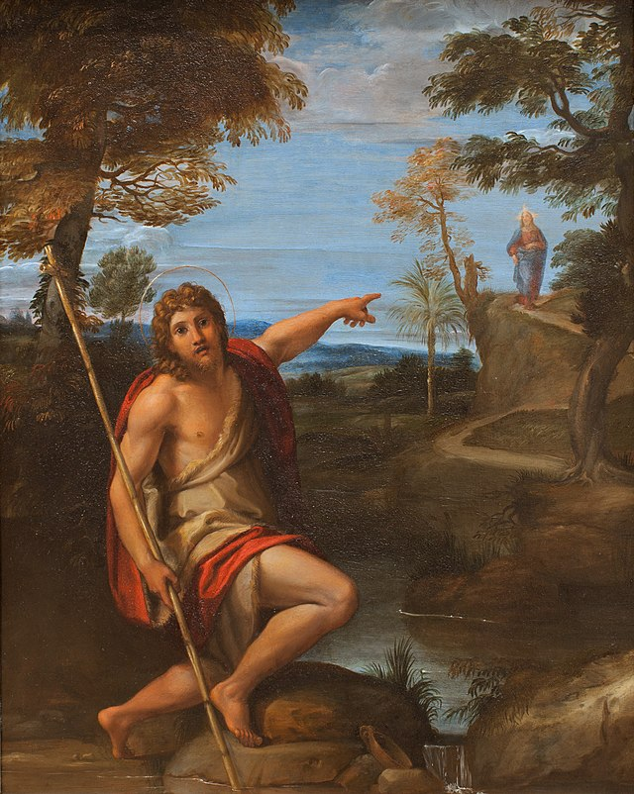
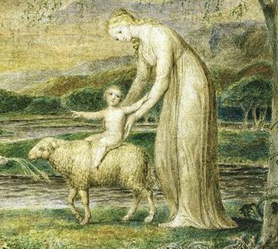
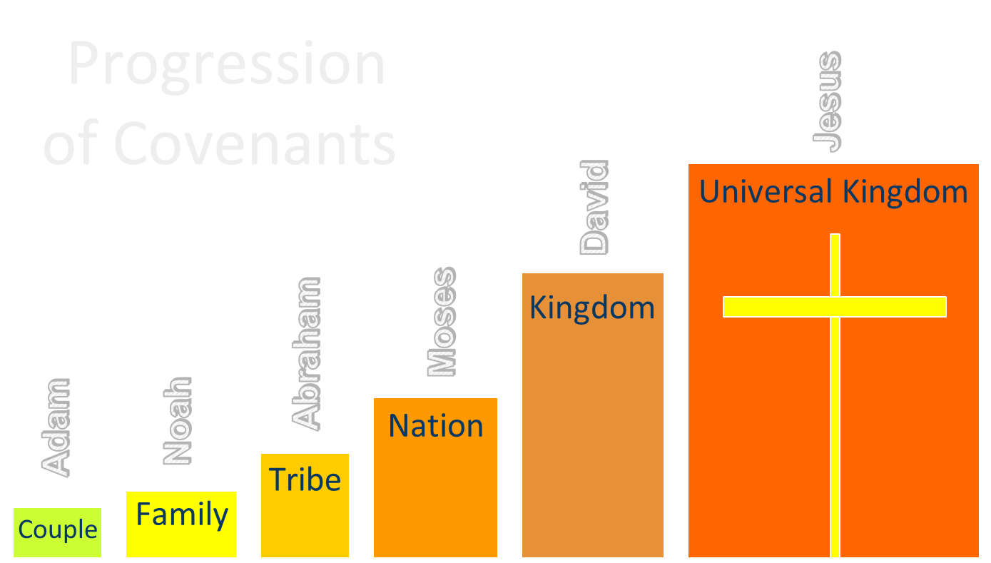
How Jesus Is Present in the Old Testament
Genealogy
Prophecy
Typology
Progression of Covenants
Notes:
*Photo credits (from left to right):
1. https://commons.wikimedia.org/wiki/File:Girolamo_Genga_(1467-1551)_(attributed_to)_-_A_Jesse-Tree_-_NG3119_-_National_Gallery.jpg
2. https://commons.wikimedia.org/wiki/File:Saint_John_the_Baptist_Bearing_Witness_MET_LC-2009_252-1_(Bild).jpg
3. https://commons.wikimedia.org/wiki/File:William_Blake_-_Our_Lady_With_the_Infant_Jesus_Riding_on_a_Lamb_with_St._John.jpg
Directions: Explain each of the ways Jesus is present in the Old Testament.
Genealogy: The Bible tells the story of Jesus’s family tree all the way back to Adam and Eve. His forefathers Abraham and David are highlighted in the genealogies found in the synoptic Gospels.
Prophecy: In Matthew’s Gospel, time after time, Jesus is shown to be fulfilling prophecies that were pointing to him. Some were written thousands of years before he entered human history.
Typology: We can see God’s design and plan unfold over time in the Old Testament through the people, places, and things that pointed to or foreshadowed Jesus.
Progression of Covenants: In the Old Testament, the group of people in the covenants keeps getting larger and larger. God promised Abraham that he would bless him with descendants on a universal scale. When Jesus comes, he establishes a universal covenant. By doing this, he fulfilled that promise.

Slide 4

Memorize It
Key
Quote
“The New Testament lies hidden in the Old and the Old Testament is unveiled in the New.”
CCC, 129
Notes:
Directions: Have students copy the quote. Add bonus points to the assessment if they can write it down, demonstrating that they memorized it.

Slide 5
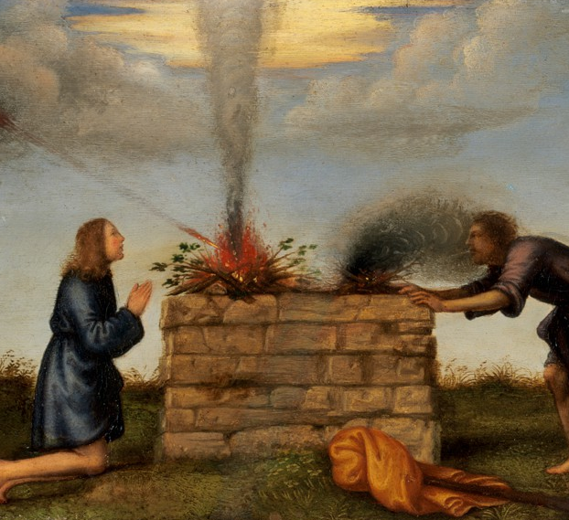
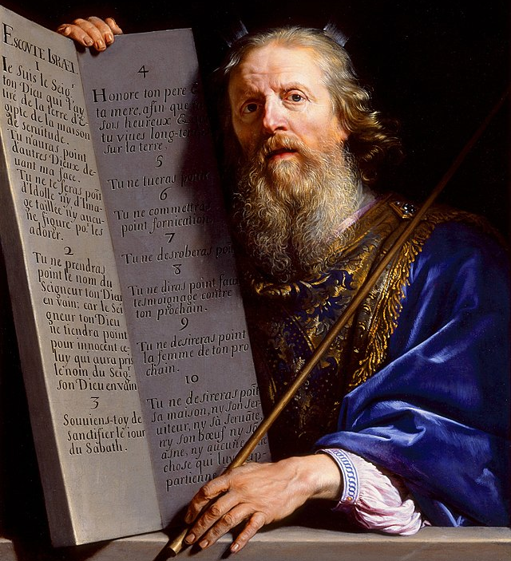
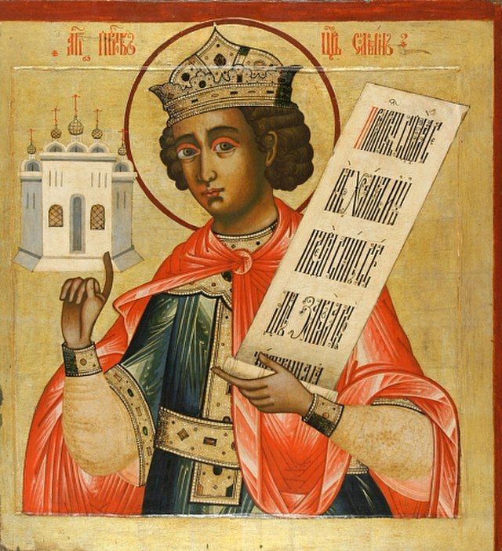
Through the Christological lens, we see a threefold identity of Jesus emerge in the Old Testament:
There were priests such as Abel who offered a pure sacrifice to God in a way that prepared us to see Jesus as a priest.
Prophet
There were prophets such as Moses that spoke as a lawgiver and mediator in a way that prepared us to see Jesus as a prophet.
There were kings such as Solomon who ruled as a son of David, with wisdom in a way that prepared us to see Jesus as the King of kings.
Priest
King
Notes:
*Photo Credits (from left to right):
1. https://commons.wikimedia.org/wiki/File:Mariotto_Albertinelli_-_The_Sacrifice_of_Cain_and_Abel_-_1906.5_-_Fogg_Museum.jpg
2. https://commons.wikimedia.org/wiki/File:Philippe_de_Champaigne_-_Moses_Presenting_the_Tablets_of_the_Law_-_c._1648.jpg
3. https://commons.wikimedia.org/wiki/File:King-Solomon-Russian-icon.jpg
Directions: Share quote from the Catechism:
“Jesus Christ is the one whom the Father anointed with the Holy Spirit and established as priest, prophet, and king. The whole People of God participates in these three offices of Christ and bears the responsibilities for mission and service that flow from them” (CCC, 783).

Slide 6
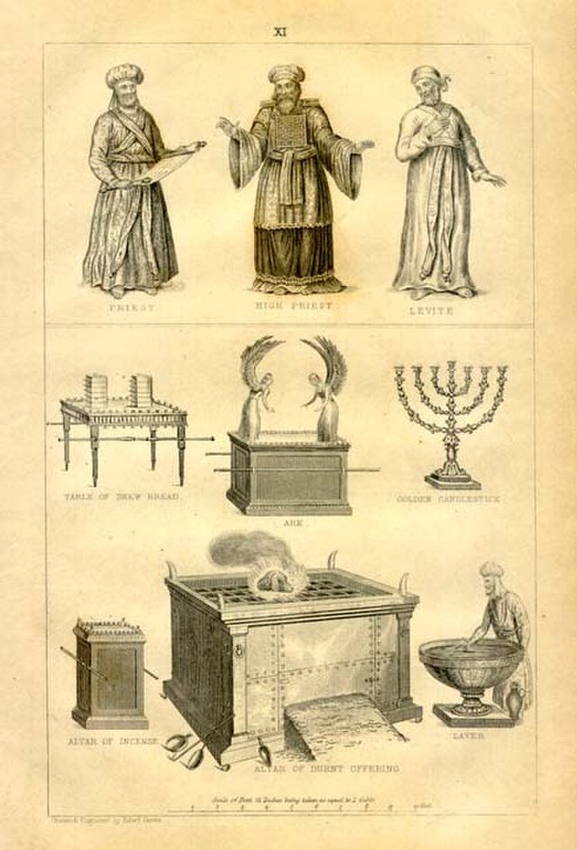
Biblical Priest
Key
Vocab
The biblical role of a priest was to act as a mediator between God and humans. He offered sacrifices to God (crops and animals) on an altar at the temple liturgy.
Notes:
*Photo Credit: Gover, Public domain. https://commons.wikimedia.org/wiki/File:Figures.jpg
Directions: Have students copy down this key term in the vocab section of their notes.

Slide 7
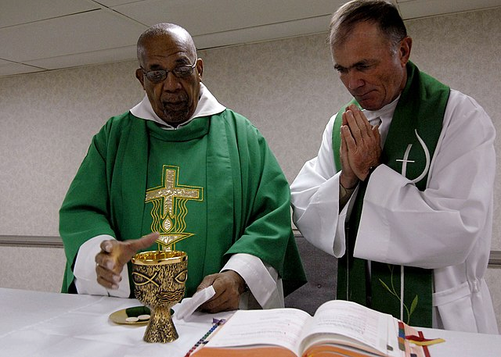
Ministerial Priesthood
Key
Vocab
A unique sharing in the one priesthood of Christ received in the Sacrament of Holy Orders. By his ordination, a man is configured to Christ by a special gift of the Holy Spirit so that he can act as a representative of Christ, Head of the Church. As a representative of Christ, the ordained man is enabled to serve the common priesthood by building up and guiding the Church.
Notes:
*Photo Credit: U.S. Navy photo, Public domain. https://commons.wikimedia.org/wiki/File:US_Navy_070921-N-6278K-004_Father_Joseph_Harris,_left,_a_Roman_Catholic_priest_in_Trinidad_and_Tobago,_celebrates_mass_with_Lt._Cmdr._Paul_Evers.jpg
Directions: Have students copy down this key term in the vocab section of their notes.

Slide 8
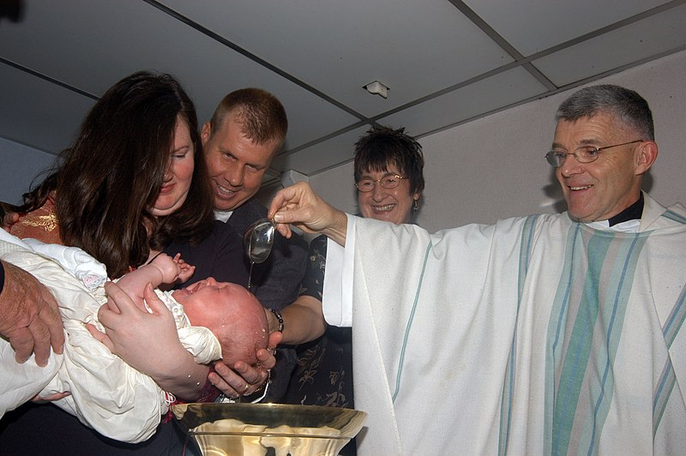
Common Priesthood
Key
Vocab
The priesthood of the laity. Christ has made the Church a “kingdom of priests” who share his priesthood through the Sacraments of Baptism and Confirmation.
Notes:
*Photo Credit: U.S. Navy photo by Photographer's Mate 3rd Class William J. Davis / Released, Public domain. https://commons.wikimedia.org/wiki/File:US_Navy_060430-N-4702D-001_Commander_7th_Fleet_Chaplain,_Capt._Bill_Devine,_performs_the_first_documented_baptism_aboard_the_amphibious-command_ship_USS_Blue_Ridge_(LCC_19).jpg
Directions: Have students copy down this key term in the vocab section of their notes.
Share quote from the Catechism:
“The anointing with sacred chrism, perfumed oil consecrated by the bishop, signifies the gift of the Holy Spirit to the newly baptized, who has become a Christian, that is, one ‘anointed’ by the Holy Spirit, incorporated into Christ who is anointed priest, prophet, and king” (CCC, 1241).

Slide 9

Jesus as Priest
Jesus, as a priest, offers a once and for all, universal sacrifice
"From the East to the West, from the rising of the sun to its setting.”
Priest
Notes:
Directions: Share the following:
The primary function of a priest is to offer sacrifice.
Jesus freely offered and continues to offer the perfect and timeless sacrifice of his own Body and Blood to God the Father on our behalf:
at the Last Supper under the signs of bread and wine.
at Calvary as he hung on the cross.
at Catholic Mass under the signs of the priest, the bread and the wine.
Jesus acted and continues to act as our one true mediator, perpetually representing God the Father to us and us to God the Father through the power of the Holy Spirit.

Slide 10
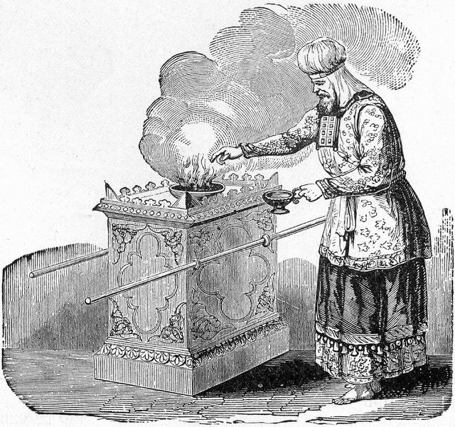
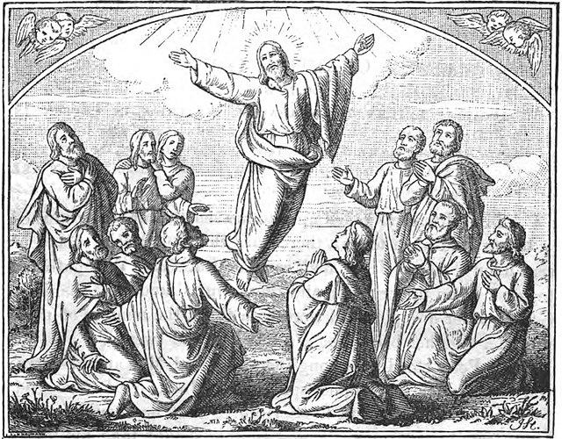
The Levitical High Priest offers sacrifice in the earthly replica of heaven.
Jesus, the High Priest, takes the living sacrifice of his Body and Blood to God the Father in Heaven.
Notes:
*Photo Credits (from left to right):
1. https://commons.wikimedia.org/wiki/File:High_Priest_Offering_Incense_on_the_Altar.jpg
2. https://commons.wikimedia.org/wiki/File:Jesus_ascends_to_heaven.jpg
Directions: Show how Jesus acts as High priest typologically by linking the following by number:
The Levitical High Priest
The Levitical High Priest took the blood of the Atonement Sacrifice into the Holy of Holies one day a year.
The Levitical High Priest passed through the veil.
The Levitical High Priest repeated this ritual every year.
The blood of goats and bulls served as a graphic symbol of sin.
The animals were thought of as a substitute victim taking on the guilt of all the sinners, including the priest.
_________________________________________
Jesus, the High priest
Jesus took his Body and Blood into heaven when he ascended.
Jesus passed through the invisible veil that separates heaven and earth.
Jesus did this once and for all and continues to make perpetual atonement for sin.
Jesus’ precious blood was shed for our sins.
Jesus freely chose to do the Father’s will and accepted the suffering and death as a perfect, infinite sacrifice to take away our sins.
Online Resource: To reinforce Jesus as High Priest, have students view the video “The Ascension.” URL here: https://youtu.be/0uM9ByIh6qU

Slide 11
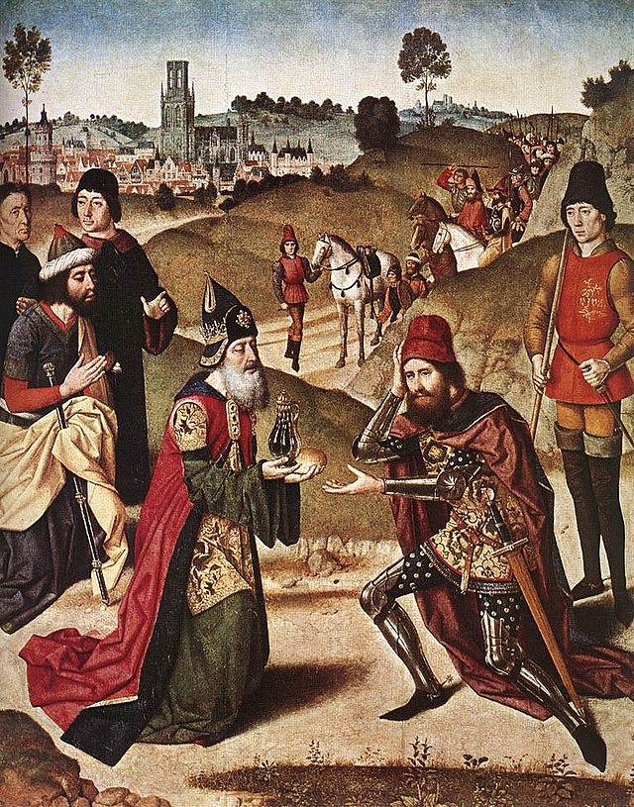
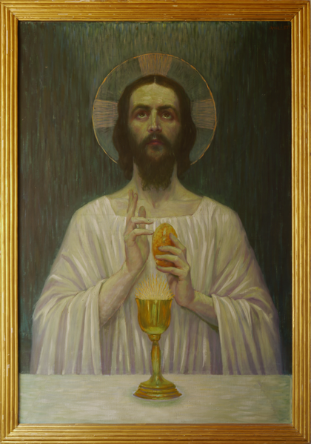
Melchizedek, king of Salem and priest of God Most High, offers sacrifice in the form of bread and wine.
Jesus, King of Peace and High Priest, offers the sacrifice of his Body and Blood under the signs of bread and wine.
Notes:
*Photo Credits (from left to right):
https://commons.wikimedia.org/wiki/File:Dieric_Bouts_-_The_Meeting_of_Abraham_and_Melchizedek_-_WGA03010.jpg
https://commons.wikimedia.org/wiki/File:Jesus_mit_Brot_und_Wein_von_Wilhelm_List.png
Directions: Show how Jesus acts as a type of Melchizedek typologically by linking the following by number:
Melchizedek is a mysterious priest-king who was said to be without beginning and without end (see Genesis 14:18–20 and Hebrews 7:1–3).
Melchizedek was the king of Salem; (peace: shalom) Jerusalem.
Melchizedek came before the Levitical Priesthood. Non-Levitical.
Melchizedek offered bread and wine.
_________________________________________________
Jesus is the eternal Son of God without beginning and without end.
Jesus is the King of Peace.
Jesus is born outside the tribe of Levi. He was a Judahite. Non-Levitical.
Jesus consecrated bread and wine as a priest.
Online Resources: Have students view the video “Melchizedek Priesthood.” URL here: https://youtu.be/Zih9pv74hpM?list=PLMp6rMU0-TTItIr0FM6-8p7zSiXy6J5NT

Slide 12
Jesus as Prophet
He taught as one who had authority. Greater than any other prophet or king.
Prophet
Notes:
Directions: Share the following extra information about Jesus as a prophet:
Moses and Jeremiah were two Old Testament prophets that had similarities to Jesus.
Jesus said he was sent by God the Father to reveal his Word.
He said that he was in the Father and the Father was in him.
Like the other prophets, Jesus would be rejected by many and suffer.
Jesus came to serve and not be served. He is called the “Suffering Servant.”

Slide 13
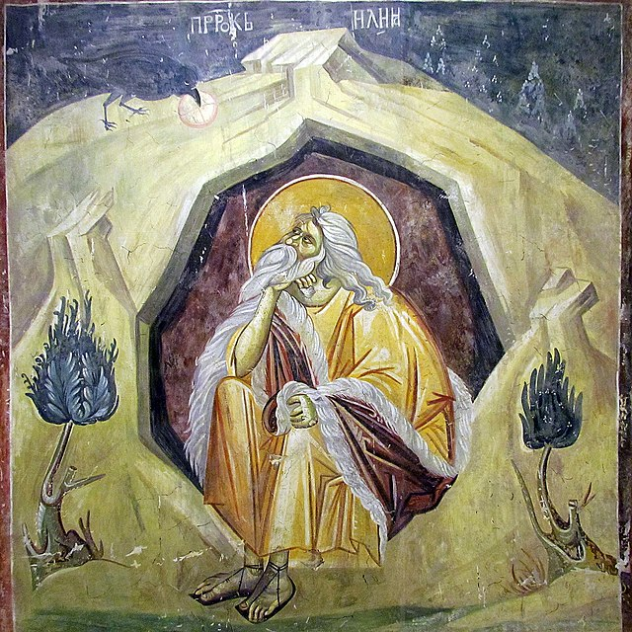
Prophet
Key
Vocab
A person who speaks on behalf of God to illuminate his will and his designs. It may or may not involve foretelling future events.
Notes:
*Photo Credit: Gmihail at Serbian Wikipedia,Creative Commons Attribution-Share Alike 3.0 rs. https://commons.wikimedia.org/wiki/File:Elijah,_a_prophet_and_a_miracle_worker.jpg
Directions: Have students copy down this key term in the vocab section of their notes. It is important to point out that the term prophet does not only mean someone who predicts the future. Primarily, it is about calling the people back to God.

Slide 14
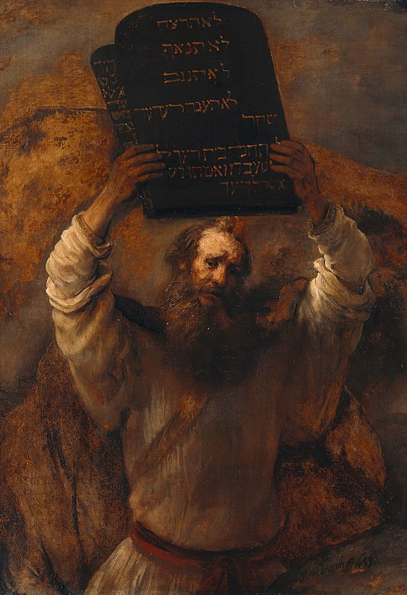
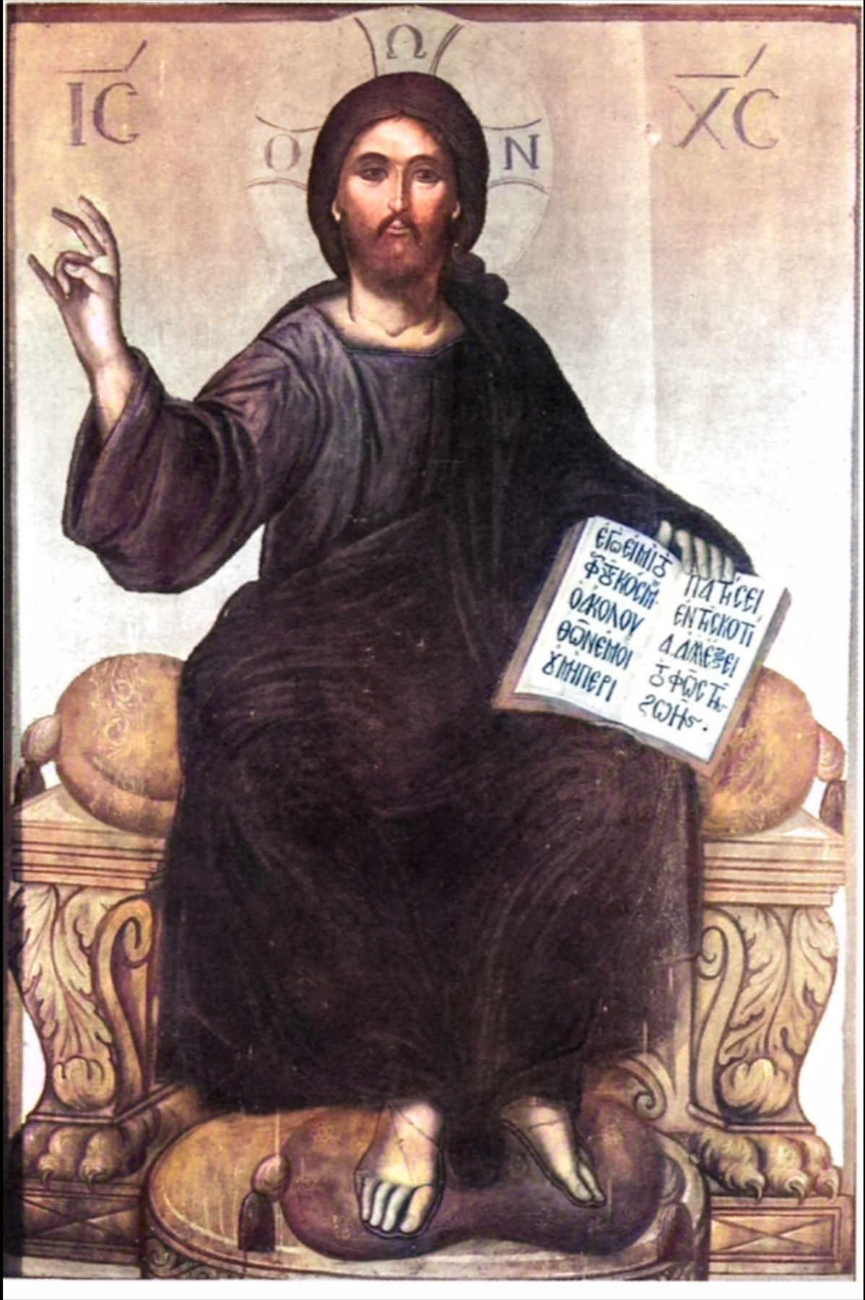
Moses acted as the teacher and mediator giving God’s laws to the people.
Jesus acted as the teacher and mediator giving God’s laws to the people.
Notes:
*Photo Credits (from left to right):
Rembrandt, Public domain. https://commons.wikimedia.org/wiki/File:Rembrandt_-_Moses_with_the_Ten_Commandments_-_Google_Art_Project.jpg.
Thomas Bathas, Public domain. https://commons.wikimedia.org/wiki/File:Thomas_Bathas_Jesus_Enthroned.png
Directions: Show how Jesus acts as a type of Moses typologically by linking the following by number.
Moses was nearly killed as a baby by an evil king (pharaoh).
There was a long period of silence during his childhood.
Moses was adopted by royalty.
Moses delivered the people from the bondage of slavery.
Moses gave laws from a mountain (Mount Sinai).
Moses ratified the covenant with blood, saying, “This is the blood of the covenant.”
Moses led the people to the Promised Land.
____________________________________________________________
Jesus was nearly killed as a baby by an evil king (Herod).
There was a long period of silence during his childhood.
Jesus was adopted by Joseph in the royal line of David.
Jesus delivered the people from the bondage of sin.
Jesus gave laws from a mountain (Sermon on the Mount).
Jesus ratified the covenant with blood, saying, “This is the blood of the covenant.”
Jesus led the people to the Promised Land of Heaven and restored communion with God.
Online Resources: Follow up with this slide by assigning students to read the article “That Moses Thing” by Mark J. Kelly. URL here: https://www.catholic.com/magazine/print-edition/that-moses-thing
Have students view the video “The New and Better Elisha” to get a sense of Jesus as prophet. URL here: https://youtu.be/qMNRi62KhCY

Slide 15
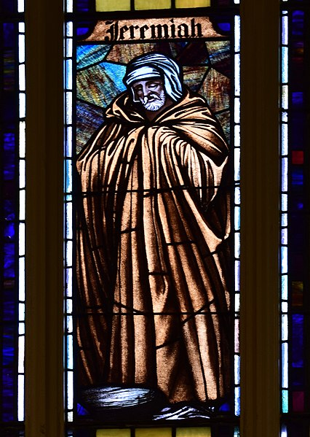
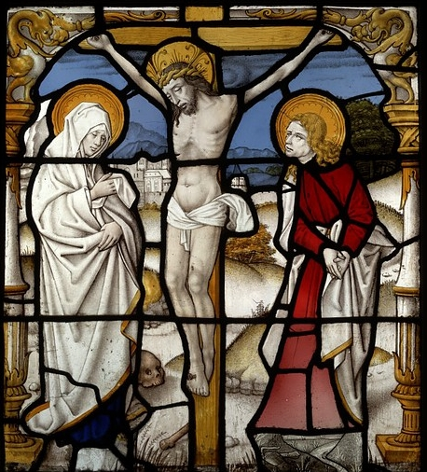
Jeremiah was called to be a prophet and to suffer.
Jesus was sent to reveal God’s Word and to suffer.
Notes:
*Photo Credits (from left to right):
Nheyob,Creative Commons Attribution-Share Alike 4.0. https://commons.wikimedia.org/wiki/File:Immaculate_Conception_Church_(Toledo,_Ohio)_-_stained_glass,_Jeremiah.jpg.
Unknown author, Public domain. https://commons.wikimedia.org/wiki/File:Crucifixion-stained-glass-V%26A.jpg.
Directions: Show how Jesus acts as a type of Jeremiah typologically by linking the following by number:
Jeremiah was chosen by God long before he was conceived.
Jeremiah wept over Jerusalem.
Jeremiah was rejected by his own people.
Jeremiah spoke of the New Covenant.
_________________________________
Jesus was chosen by God from all eternity as he is the pre-existent Word of God.
Jesus wept over Jerusalem.
Jesus was rejected by his own people.
Jesus came to establish the New Covenant.

Slide 16
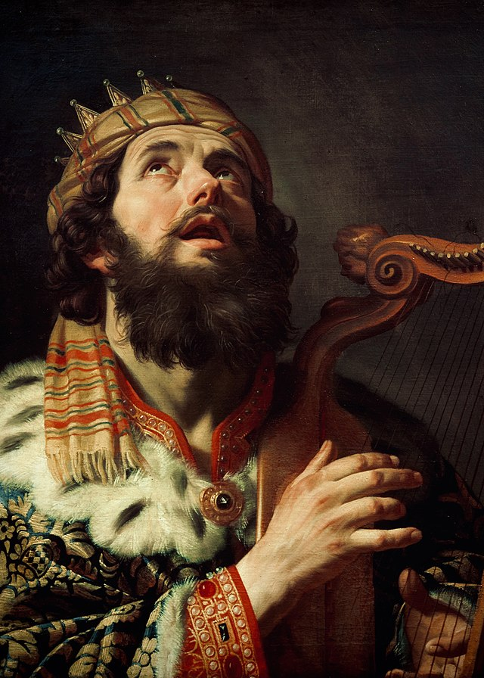
Hasmonean Kings
Key
Vocab
Rulers or monarchs who usually ascended to the throne based on birth and lineage. They attempted to regain the Kingdom of David, but they became worldly and caused moral decay.
Notes:
*Photo Credit: Gerard van Honthorst, Public domain. https://commons.wikimedia.org/wiki/File:King_David,_the_King_of_Israel.jpg.
Directions: Have students copy down this key term in the vocab section of their notes.
Online Resources: Follow up with this slide by having students view the video “Herod the Great.” URL here: https://youtu.be/Xs9NwdJc9QU

Slide 17
Jesus as King
The Kingship of Jesus was a paradox because he cAame in humility to serve and suffer. He will come again in glory to judge the living and the dead.
King
Notes:
Directions: Share this quote by C.S. Lewis:
“Enemy-occupied territory—that is what this world is. Christianity is the story of how the rightful king has landed, you might say landed in disguise, and is calling us to take part in a great campaign of sabotage.”
― C.S. Lewis, Mere Christianity
Follow up question: “What does C.S. Lewis mean that Jesus came to engage in sabotage?”
Share the following extra information about Jesus as a King:
David and Solomon were Old Testament kings that resembled Jesus and were his forefathers.
Born of the tribe of Judah. Called the “Lion of Judah.”
The three “kings” of the East, the Magi, honored the King of Kings with gifts such as gold.
Announced and instituted the Kingdom of God on earth.
Anointed with oil.
Crowned with thorns.
The sign on the Cross called Jesus “the King of the Jews.”
Online Resources: Follow up by having students view the short video “Christ the King.” URL here: https://youtu.be/yirXiU7TVM4

Slide 18
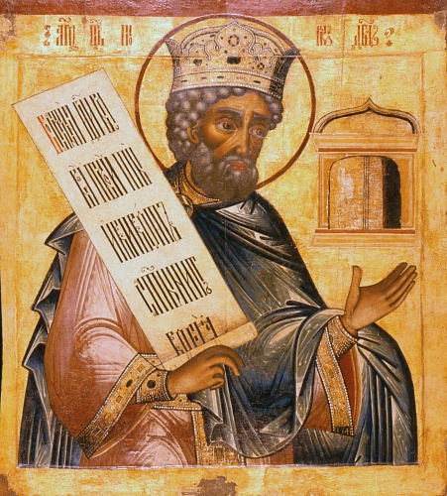
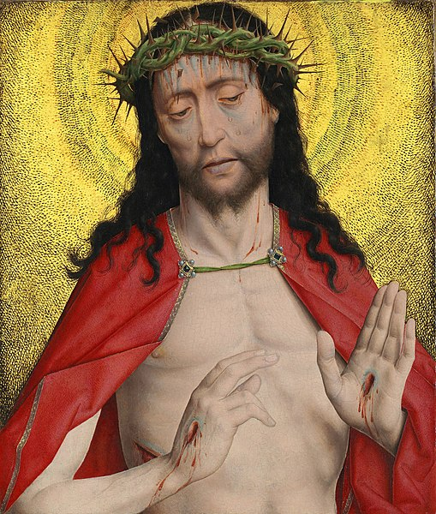
David was anointed as King of Israel. He was a good and just judge whose lineage would produce the Messiah.
Jesus, the Messiah, ‘Son of David’ is the King of the Universe. He is a good and just King who will reign forever.
Notes:
*Photo Credits (from left to right):
https://commons.wikimedia.org/wiki/File:David-icon.jpg
https://commons.wikimedia.org/wiki/File:Dirk_Bouts_Christ_Crowned_With_ThornsFXD.jpg
Directions: Show how Jesus acts as a type of David typologically by linking the following by number:
David was from Bethlehem and from the tribe of Judah.
David wanted God at the center of his kingdom by planning the Temple in Jerusalem.
David was a good, brave shepherd who battled and defeated his enemies: lions, bears and Goliath.
David ruled as a just king.
____________________________________
Jesus was born in Bethlehem and was a descendant of David from the tribe of Judah.
Jesus came to put God at the center of the created world by establishing his Kingdom on earth.
Jesus is the Good Shepherd who battles and defeats his enemies, the Devil and sin.
Jesus is the Just Judge and the King of Kings.
Online Resources: Have students view the video “Christ the King.” URL here: https://youtu.be/QVZEJ9UDDgs?list=PLMp6rMU0-TTItIr0FM6-8p7zSiXy6J5NT

Slide 19

Turn and Talk
Priest, Prophet or King . . . Which do you personally connect to most? Why?
Notes:
Directions: Have students write down the question and then write down their answer. Then have students share their answers with one person close by.

Slide 20
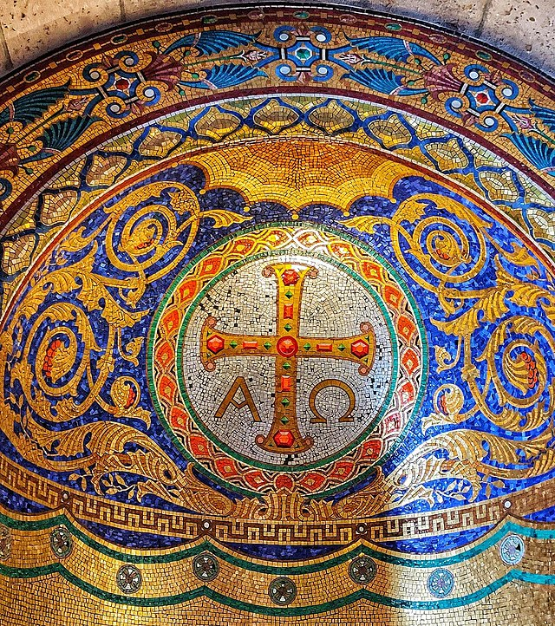
Jesus as
Alpha
and
Omega
Alpha
Omega
Notes:
*Photo Credit: Gre regiment,Creative Commons Attribution-Share Alike 4.0. https://commons.wikimedia.org/wiki/File:Alpha-omega-Sacre-Coeur-Paris.jpg
Directions: Share the following extra information about Jesus as Alpha and Omega:
Alpha: First letter of Greek alphabet
Omega: Last letter of Greek alphabet
Jesus gives himself this title when he promises to return in the Second Coming.
In Jesus is the summation and culmination of time—the beginning, the end, and everything in between.
This is also why the last Sunday of the liturgical year is called Christ the King Sunday.
At the end of time his Kingdom is complete.

