Slide 1
1
Jesus Is the Way, the Truth, and the Life
God Loves: Jesus Christ Enters the World
Notes:
Photo Credit: Madonna and Child. Duccio di Buoninsegna. Public domain.
https://commons.wikimedia.org/wiki/File:Duccio_Di_Buoninsegna_-_Madonna_col_Bambino.jpg
Suggestions for students’ note taking:
●Require students to use a three ring binder (1/2-1 inches) full of loose leaf paper (college or wide ruled).
●Notes must be taken in pen only and hand written.
●Notebooks should contain information and notes for religion class only.
●Notebooks must have a table of contents with topic of notes, dates and page numbers.
●All notes must have a topic and page number.
●Students will be required to copy each slide unless the teacher directs students to skip certain slides or parts of slides. Notebooks will be graded based on neatness, completeness and organization. Notebooks should have a significant point value representing 20-25% of the overall grade.
The videos linked in this presentation file may contain copyright material. Such material is made available for educational purposes only. This constitutes a “fair use” of any such copyright material as provided for in Title 17 U.S.C. section106A-117 of the US Copyright Law.

Slide 2
Original Sin
Key
Vocab
Refers to the personal sin of the first two people, called Adam and Eve, which, in an analogous way, describes the fallen state of human nature into which all generations are born. Adam and Eve transmitted Original Sin to their descendants. Jesus as Messiah saves us from all sin.
Notes:
Photo Credit: Michelangelo, Fall and Expulsion from Garden of Eden 00.jpg. Michelangelo. Public domain. https://commons.wikimedia.org/wiki/File:Michelangelo,_Fall_and_Expulsion_from_Garden_of_Eden_00.jpg. Cropped.
Directions: Have students write down the term and definition as part of a Key Vocab section in their notes.
The videos linked in this presentation file may contain copyright material. Such material is made available for educational purposes only. This constitutes a “fair use” of any such copyright material as provided for in Title 17 U.S.C. section106A-117 of the US Copyright Law.

Slide 3
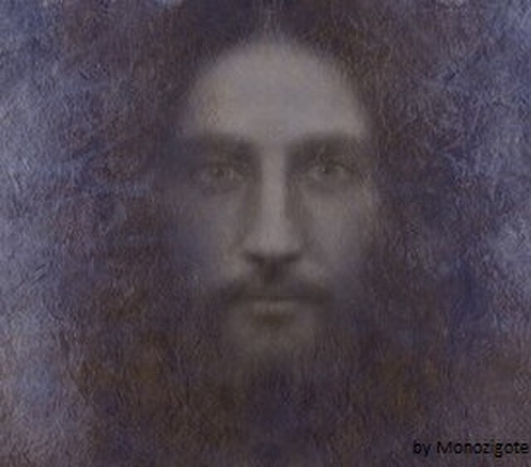
Messiah
Key
Vocab
The Hebrew word masiah translates to the Greek word Christos (Christ), which means “anointed one.” At first, the title messiah applied to the king of Israel, Christians apply the title to Jesus as the only Savior.
Notes:
Photo Credit: Yeshua1 Messiah.jpg. Artistic image of Jesus from multiple sources, including the Shroud of Turin (XIV century). Monozigote. Creative Commons Attribution-Share Alike 4.0. https://commons.wikimedia.org/wiki/File:Yeshua1_Messiah.jpg
Directions: Have students write down the term and definition as part of a Key Vocab section in their notes.
The videos linked in this presentation file may contain copyright material. Such material is made available for educational purposes only. This constitutes a “fair use” of any such copyright material as provided for in Title 17 U.S.C. section106A-117 of the US Copyright Law.

Slide 4
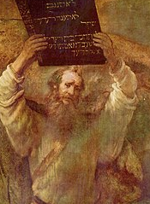
The Progression of Covenants
When Jesus said, ‘I am the way, the truth and the life’, he was, in part, referring to the fact that he is the culmination of the covenantal relationship between God and humanity.
Notes:
Photo Credit (top): Moses Breaking the Tablets of the Law (cropped). Rembrandt. Public domain.
https://commons.wikimedia.org/wiki/File:Rembrandt_Harmensz._van_Rijn_079.jpg
Photo Credit (bottom): Última Cena (cropped). Juan de Juanes. Public domain.
https://commons.wikimedia.org/wiki/File:%C3%9Altima_Cena_-_Juan_de_Juanes.jpg
Directions: Have students copy information from the slide into their notes.
Teaching Points: The context of the Messianic identity of Jesus are the various covenants that build up to the New Covenant. There were messianic prophecies, typology featuring people who foreshadow Jesus and genealogy linking Jesus to the family at the center of the biblical narrative which all point to Jesus as the Way, the Truth and the Life as Messiah.
Online Resources: View video, Gospel of Matthew: The Messiah and the Fulfillment of the Old Covenant. URL here: https://youtu.be/DhB-ZMiPasM
Assign article, The Old Testament Covenants Were Fulfilled by Christ. URL here:
https://www.catholic365.com/article/39102/the-old-testament-covenants-were-fulfilled-by-christ.html
The videos linked in this presentation file may contain copyright material. Such material is made available for educational purposes only. This constitutes a “fair use” of any such copyright material as provided for in Title 17 U.S.C. section106A-117 of the US Copyright Law.

Slide 5
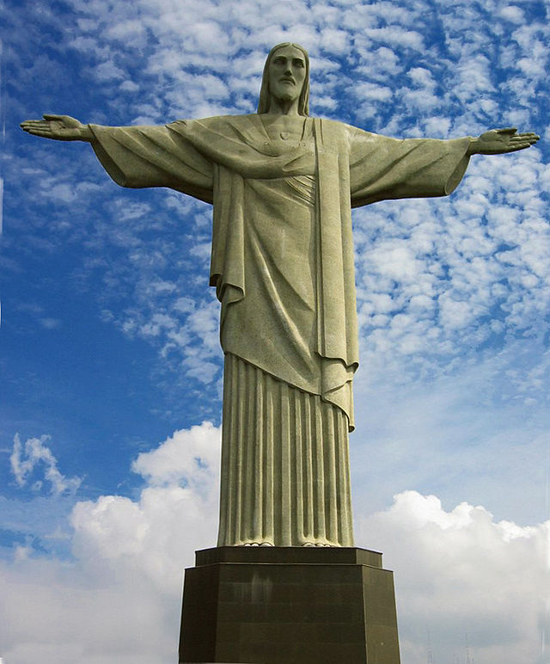
Jesus Is True God
Jesus Christ is truly God: 100% Divine and 100% Human.
He fulfilled prophecies and performed miracles.
He forgave sins and taught with authority.
He used language and titles for himself that imply he is divine.
Other credible sources tell us he is God.
He rose from the dead as a real historical event.
Notes:
Photo Credit: Cristo Redentor - Rio.jpg. Cristo Redentor, statue on Corcovado mountain in Rio de Janeiro, by Paul Landowski. Sean Vivek Crasto. Public domain. https://commons.wikimedia.org/wiki/File:Cristo_Redentor_-_Rio.jpg
Directions: Have students copy information from the slide into their notes.
Teaching Points: Review the section of the Nicene Creed which speaks about the identity of Jesus, “I believe in one Lord Jesus Christ,
the Only Begotten Son of God, born of the Father before all ages. God from God, Light from Light, true God from true God, begotten, not made, consubstantial with the Father; through him all things were made. For us men and for our salvation he came down from heaven, and by the Holy Spirit was incarnate of the Virgin Mary, and became man.”
These words were written into the Creed to affirm Jesus as 100% God and 100% man and as a refutation of the Arian heresy which denied Jesus’s divinity.
Online Resources: View video, True God from True God. URL here: https://youtu.be/oNbnnV_N5qk Assign article, The Divinity of Christ (Kreeft). URL here: https://www.peterkreeft.com/topics/christ-divinity.htm
The videos linked in this presentation file may contain copyright material. Such material is made available for educational purposes only. This constitutes a “fair use” of any such copyright material as provided for in Title 17 U.S.C. section106A-117 of the US Copyright Law.

Slide 6
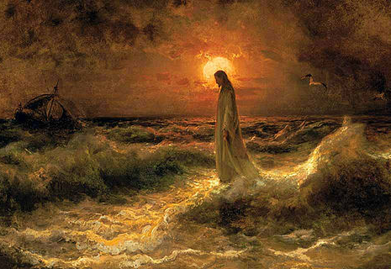
Signs of Jesus’s Divinity
Fulfilling of Prophecy and Performing Miracles were a sign that Jesus is the long-awaited Messiah. They are a signs of His identity, His authority, His power, and His glory. And they are a signs of God's love for us, a sign that we can trust Him.
Notes:
Photo Credit: Christ Walking on the Water. Julius Sergius von Klever. Public domain. https://commons.wikimedia.org/wiki/File:Christ_Walking_on_the_Waters,_Julius_Sergius_Von_Klever.jpg.cropped.
Directions: Have students copy information from the slide into their notes.
Teaching Points: CCC 548: The signs worked by Jesus attest that the Father has sent him. They invite belief in him. To those who turn to him in faith, he grants what they ask. So miracles strengthen faith in the One who does his Father's works; they bear witness that he is the Son of God. But his miracles can also be occasions for "offence"; they are not intended to satisfy people's curiosity or desire for magic. Despite his evident miracles some people reject Jesus; he is even accused of acting by the power of demons.
Miracles will always have as their primary purpose the glorification of God and the calling of people to salvation. The signs worked by Jesus attest to His divine authority and invite belief in Him (cf. Catechism, no. 548). After His Ascension and Pentecost, Christ's disciples worked miracles in the name of Christ, thus giving the people signs of His divinity and proofs that He is who they said He is. In the same way later saints worked miracles to testify to a higher authority and that people are called to His kingdom.
Miracles can also have secondary purposes. They can attest to the divine authority of a mission. The miracles Moses performed not only showed that God wanted Pharaoh to release His people; they also showed that Moses was from God. Further, these miracles, indelibly inscribed in the memory of the Jews, prepared them to understand the signs given to show them that Jesus was sent by the Father. The miracle of the sun at Fatima was a sign to the people that the messages given through the children were of divine origin.
Online Resources: Assign article, The Church’s Teaching on Miracles. URL here: https://www.catholiceducation.org/en/controversy/common-misconceptions/the-churchs-teaching-on-miracles.html
The videos linked in this presentation file may contain copyright material. Such material is made available for educational purposes only. This constitutes a “fair use” of any such copyright material as provided for in Title 17 U.S.C. section106A-117 of the US Copyright Law.

Slide 7
Docetism
Key
Vocab
A first-century heresy that taught that Jesus only “seemed” to be human. Docetism comes from a Greek word meaning “to seem.”
Notes:
Photo Credit: Ambigram Magic / Dream. Basile Morin. Creative Commons Attribution-Share Alike 4.0. https://commons.wikimedia.org/wiki/File:Ambigram_Magic_Dream_-_mirror_symmetry_with_a_handheld_pattern_giving_a_reversed_shadow_on_a_blue_wall.jpg
Directions: Have students write down the term and definition as part of a Key Vocab section in their notes.
Teaching Points: Jesus is both human and divine. The heresy that denies his humanity is called Docetism, the heresy that denies his divinity is called Arianism.
Online Resources: Assign article, A Heresy as Evidence of the Historical Jesus. URL here: https://www.catholic.com/magazine/online-edition/a-heresy-as-evidence-of-the-historical-jesus
The videos linked in this presentation file may contain copyright material. Such material is made available for educational purposes only. This constitutes a “fair use” of any such copyright material as provided for in Title 17 U.S.C. section106A-117 of the US Copyright Law.

Slide 8
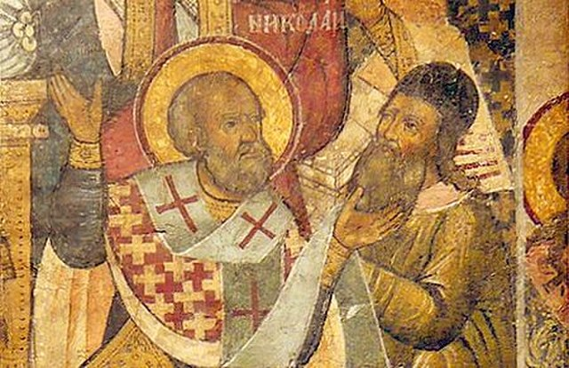
Arianism
Key
Vocab
A heresy common in certain times and places during the early Church that denied that Jesus was truly God. It is named after Arius (AD 250–336), a priest and popular preacher from Alexandria, Egypt.
Notes:
Photo Credit: Saint Nicholas of Myra slapping Arius at the Council of Nicaea. Byzantine Icon-Painter. Public domain. https://commons.wikimedia.org/wiki/File:Saint_Nicholas_of_Myra_slapping_Arius_at_the_Council_of_Nicaea_Greek_Icon.jpg
Directions: Have students write down the term and definition as part of a Key Vocab section in their notes.
Teaching Points: Jesus is both human and divine. The heresy that denies his humanity is called Docetism, the heresy that denies his divinity is called Arianism.
Online Resources: Have students view video, Arianism, Then and Now. URL here: https://youtu.be/oH6_ZPiay9g
The videos linked in this presentation file may contain copyright material. Such material is made available for educational purposes only. This constitutes a “fair use” of any such copyright material as provided for in Title 17 U.S.C. section106A-117 of the US Copyright Law.

Slide 9
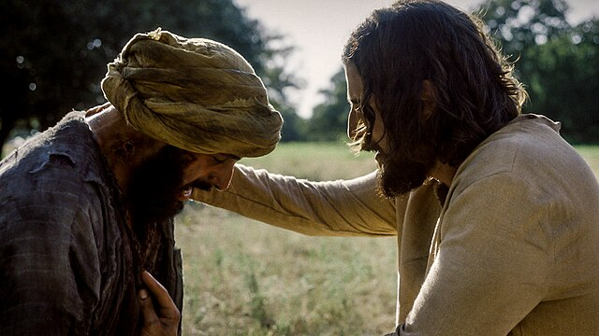
Jesus Is Truly Human
Jesus Christ is truly Human: 100% Divine and 100% Human.
He has a human body and soul.
He grew in knowledge and wisdom.
He wept and he laughed.
He got angry and distressed.
Notes:
Photo Credit: The Chosen press photos (press.thechosen.tv). Creative Commons Attribution-Share Alike 4.0. The Chosen - Jesus touches the leper. https://commons.wikimedia.org/wiki/File:The_Chosen_-_Jesus_touches_the_leper.jpg
Directions: Have students copy information from the slide into their notes.
Teaching Points: CCC 470 : Because "human nature was assumed, not absorbed", in the mysterious union of the Incarnation, the Church was led over the course of centuries to confess the full reality of Christ's human soul, with its operations of intellect and will, and of his human body. In parallel fashion, she had to recall on each occasion that Christ's human nature belongs, as his own, to the divine person of the Son of God, who assumed it. Everything that Christ is and does in this nature derives from "one of the Trinity". The Son of God therefore communicates to his humanity his own personal mode of existence in the Trinity. In his soul as in his body, Christ thus expresses humanly the divine ways of the Trinity:
The Son of God. . . worked with human hands; he thought with a human mind. He acted with a human will, and with a human heart he loved. Born of the Virgin Mary, he has truly been made one of us, like to us in all things except sin.
How The Chosen portrays Jesus humanness: ‘Because The Chosen doesn't have to worry about suggesting Jesus' divinity by characterizing him as lofty and inaccessible, it's also free to make him humble and human. His appearance is unremarkable, just as Isaiah foretold, and he comes across as earthy, physical, and genuinely focused on the people and events surrounding him. People recognize him from his youth and from construction jobs that they worked on with him. He doesn't come off as a ghost who descended from heaven just before his human ministry and who is floating a foot off the ground. Yet unlike other adaptations that try to humanize Jesus by making him self-doubting, Jesus in The Chosen clearly knows who he is and the purpose given to him by his heavenly Father.’ (see article below).
Online Resources: Have students view video, Truly Human Jesus. URL here: https://youtu.be/tDPbeKgwwhU
Assign article, Jesus in the Chosen. URL here: https://www.thebibleartist.com/post/jesus-in-the-chosen-adapting-biblical-characters
The videos linked in this presentation file may contain copyright material. Such material is made available for educational purposes only. This constitutes a “fair use” of any such copyright material as provided for in Title 17 U.S.C. section106A-117 of the US Copyright Law.

Slide 10
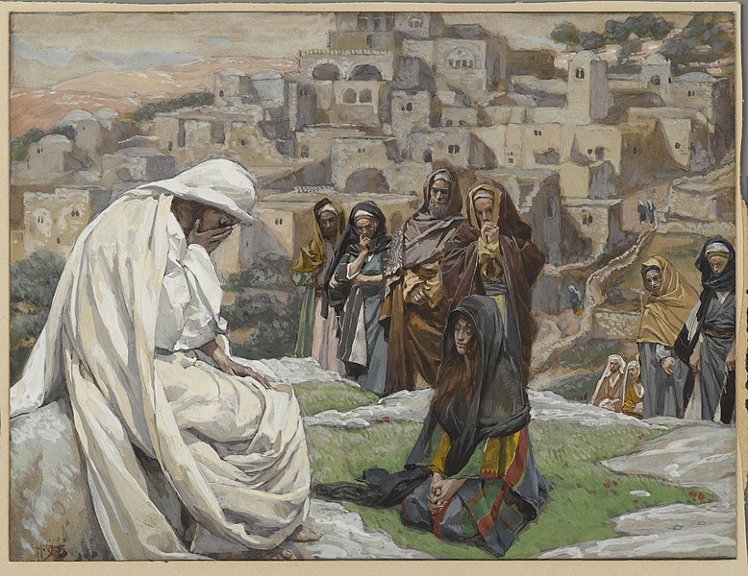
Jesus Wept
For Jesus had not yet come into the village, but was still where Martha had met him. So when the Jews who were with her in the house comforting her saw Mary get up quickly and go out, they followed her, presuming that she was going to the tomb to weep there.
When Mary came to where Jesus was and saw him, she fell at his feet and said to him, ‘Lord, if you had been here, my brother would not have died.’
When Jesus saw her weeping and the Jews who had come with her weeping, he became perturbed and deeply troubled and said, “Where have you laid him?” They said to him, ‘Sir, come and see.’ And Jesus wept. John 11 :30-35
Notes:
Photo Credit: Brooklyn Museum - Jesus Wept (Jésus pleura) - James Tissot.jpg. James Tissot. Public domain. https://commons.wikimedia.org/wiki/File:Brooklyn_Museum_-_Jesus_Wept_(J%C3%A9sus_pleura)_-_James_Tissot.jpg
Directions: Have a student read aloud the scripture passage on the slide. Ask, “Why did Jesus weep?’ ( Because he had a human nature, Jesus experienced human emotions like anyone else).
The videos linked in this presentation file may contain copyright material. Such material is made available for educational purposes only. This constitutes a “fair use” of any such copyright material as provided for in Title 17 U.S.C. section106A-117 of the US Copyright Law.

Slide 11
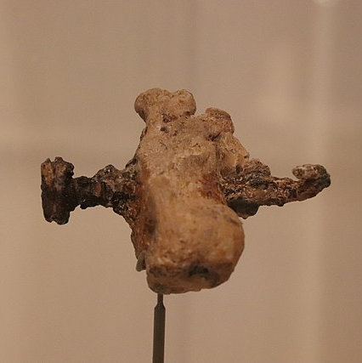
Historical Evidence and the Existence of Jesus
Relics: The Shroud of Turin, True Cross, Crown of Thorns, Veil of Veronica, Holy Grail
Archeology: Coins with Pontius Pilate, Fishing Boats, House of Peter, Signs of Roman Crucifixion
Non-Christian Historians: Josephus, Tacitus, Pliny the Younger and others.
Heel bone of a crucified man, with an iron nail, from Givat Ha’mivtar, Israel, 1st century AD
Notes:
Photo Credit: Nail & Heel Bone Only Known Evidence of Crucifixion, Jerusalem, 1st C. AD (29347803498).jpg
Israel Museum, Jerusalem, Israel. Complete indexed photo collection at WorldHistoryPics.com
Gary Todd from Xinzheng, China. Creative Commons Zero, Public Domain Dedication. https://commons.wikimedia.org/wiki/File:Nail_%26_Heel_Bone_Only_Known_Evidence_of_Crucifixion,_Jerusalem,_1st_C._AD_(29347803498).jpg
Directions: Have students copy information from the slide into their notes.
Teaching Points: Today there are no serious scholars who deny the existence of Jesus as a historical person. See article: https://www.abc.net.au/news/2014-10-17/dickson-ill-eat-a-page-from-my-bible-if-jesus-didnt-exist/5820620
Relics: Everyone passing away leaves behind material traces of their life. The existence of a Jewish man, called Jesus of Nazareth, is supported by strong historical evidence. The question therefore is raised: Are the various artifacts associated with his life truly authentic? Apart from this question, the history of relics — authentic or fake — is an amazing, fascinating chapter of Christian history through the centuries, especially the relics of Jesus Christ, which remain the most venerated and famous. (see article below). See video, True Relics of Jesus. URL here: https://youtu.be/uI_km3GC-7Q?list=PLwc-AI_1rnmXOXi0i3oZFu1prv3y2Gqbt
Archeology: View video, Seven Amazing Archeological Finds that Support the Bible. URL here: https://youtu.be/ZCwkuNj-btk
Other Online Resources: Assign article, The Relics of Christ. URL here: https://www.oursundayvisitor.com/the-relics-of-christ/
A series of articles on the historicity of Jesus. URL here: https://strangenotions.com/jesus/jesus-jesus/ and here: https://www.catholic.com/search?q=evidence%20for%20the%20existance%20of%20Jesus&l=en
The videos linked in this presentation file may contain copyright material. Such material is made available for educational purposes only. This constitutes a “fair use” of any such copyright material as provided for in Title 17 U.S.C. section106A-117 of the US Copyright Law.

Slide 12
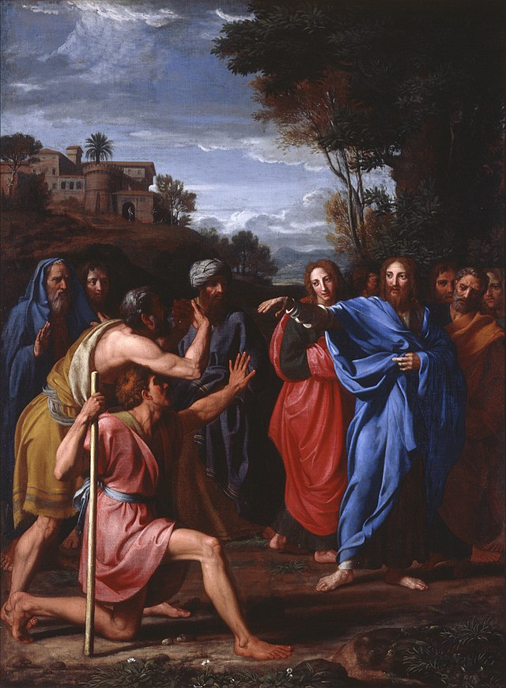
The Church Hands on the Experience of Jesus
‘What was from the beginning, what we have heard,
what we have seen with our eyes, what we looked upon
and touched with our hands concerns the Word of life—
for the life was made visible; we have seen it and testify to it and proclaim to you the eternal life that was with the Father and was made visible to us—
What we have seen and heard we proclaim now to you,
so that you too may have fellowship with us; for our fellowship is with the Father and with his Son, Jesus Christ. We are writing this so that our joy may be complete.’
- 1 John 1-4
Notes:
Photo Credit: Christ Healing the Blind. Nicolas Colombel. Public domain. https://commons.wikimedia.org/wiki/File:Nicolas_Colombel_-_Christ_Healing_the_Blind.jpg
Directions: Have a student read aloud the scripture passage on the slide. Read poem aloud below. After poem, ask question, “How was Jesus able to change the whole world?”
Teaching Points: To have students consider how the life of Jesus has affected the whole world because of the spread of his life, message and grace in the Church, read the following poem…
One Solitary Life. (By Dr James Allen Francis)
He was born in an obscure village, The child of a peasant woman. He grew up in still another village, Where he worked in a carpenter shop Until he was thirty. Then for three years He was an itinerant preacher. He never wrote a book. He never held an office. He never had a family or owned a house. He didn’t go to college. He never visited a big city. He never traveled two hundred miles From the place where he was born. He did none of the things One usually associates with greatness.He had no credentials but himself. He was only thirty-three When the tide of public opinion turned against him. His friends ran away. He was turned over to his enemies.And went through the mockery of a trial. He was nailed to a cross Between two thieves. While he was dying, His executioners gambled for his clothing, The only property he had on Earth. When he was dead, He was laid in a borrowed grave Through the pity of a friend.
Over Twenty centuries have come and gone, And today he is the central figure Of the human race, And the leader of mankind’s progress. All the armies that ever marched, All the navies that ever sailed, All the parliament that ever sat, All the kings that ever reigned, Put together have not affected The life of man on Earth As much as Jesus.
The videos linked in this presentation file may contain copyright material. Such material is made available for educational purposes only. This constitutes a “fair use” of any such copyright material as provided for in Title 17 U.S.C. section106A-117 of the US Copyright Law.

Slide 13
Turn and Talk
What do you think is the most convincing evidence for the existence of Jesus and why?
Notes:
Directions: Have students write down the question and then write down their answer….Then have students share their answers with one person close by.
The videos linked in this presentation file may contain copyright material. Such material is made available for educational purposes only. This constitutes a “fair use” of any such copyright material as provided for in Title 17 U.S.C. section106A-117 of the US Copyright Law.

Slide 14
Memorize It
Key
Verse
“And the Word became flesh*
and made his dwelling among us, and we saw his glory,
the glory as of the Father’s only Son, full of grace and truth”
-John 1:4
Notes:
Directions: Have students write down the verse and commit it to memory. Bonus points may be awarded if they can add it to the end of the chapter assessment.
The videos linked in this presentation file may contain copyright material. Such material is made available for educational purposes only. This constitutes a “fair use” of any such copyright material as provided for in Title 17 U.S.C. section106A-117 of the US Copyright Law.

Slide 15
Challenge
Question
Isn’t Jesus just a good and wise human religious leader like Confucius or Ghandi?
“No. Christ either deceived mankind by conscious fraud, or he was himself deluded and self-deceived, or he was Divine. He cannot be both good and wise and also a liar. He claimed to be God and he is good and wise. Therefore he is God.
Notes:
Directions: Use the animation feature to have the yellow answer box appear after you ask the students to respond out loud to the question on the left.
Online Resources: Learn more about C.S. Lewis’s Trilemma, in video, Liar, Lunatic, Lord. URL here: https://youtu.be/x9Y6_W_sEH8
The videos linked in this presentation file may contain copyright material. Such material is made available for educational purposes only. This constitutes a “fair use” of any such copyright material as provided for in Title 17 U.S.C. section106A-117 of the US Copyright Law.

