Slide 1
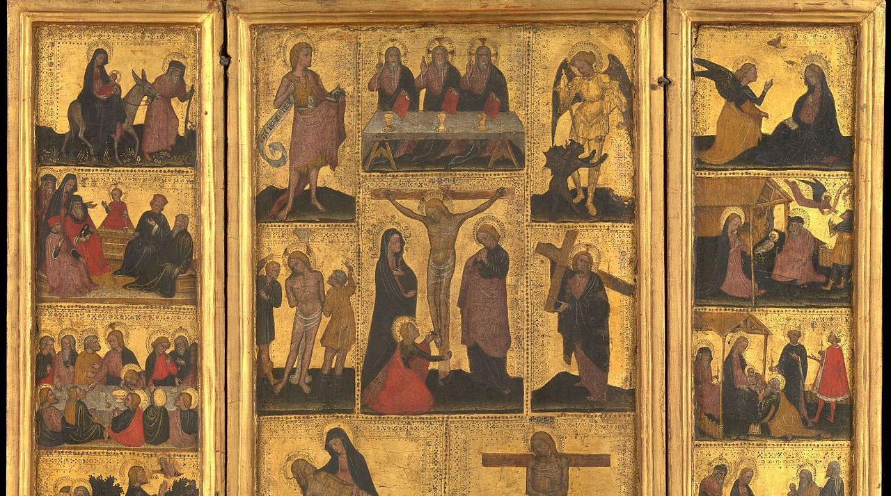
4
Jesus’s Own Life Reveals More about the Nature of God
God Loves: Jesus Christ Enters the World
Notes:
Photo Credit: The Life of Christ. Unknown. Public Domain.
Suggestions for students’ note taking:
●Require students to use a three ring binder (1/2-1 inches) full of loose leaf paper (college or wide ruled).
●Notes must be taken in pen only and hand written.
●Notebooks should contain information and notes for religion class only.
●Notebooks must have a table of contents with topic of notes, dates and page numbers.
●All notes must have a topic and page number.
●Students will be required to copy each slide unless the teacher directs students to skip certain slides or parts of slides. Notebooks will be graded based on neatness, completeness and organization. Notebooks should have a significant point value representing 20-25% of the overall grade.
The videos linked in this presentation file may contain copyright material. Such material is made available for educational purposes only. This constitutes a “fair use” of any such copyright material as provided for in Title 17 U.S.C. section106A-117 of the US Copyright Law.

Slide 2
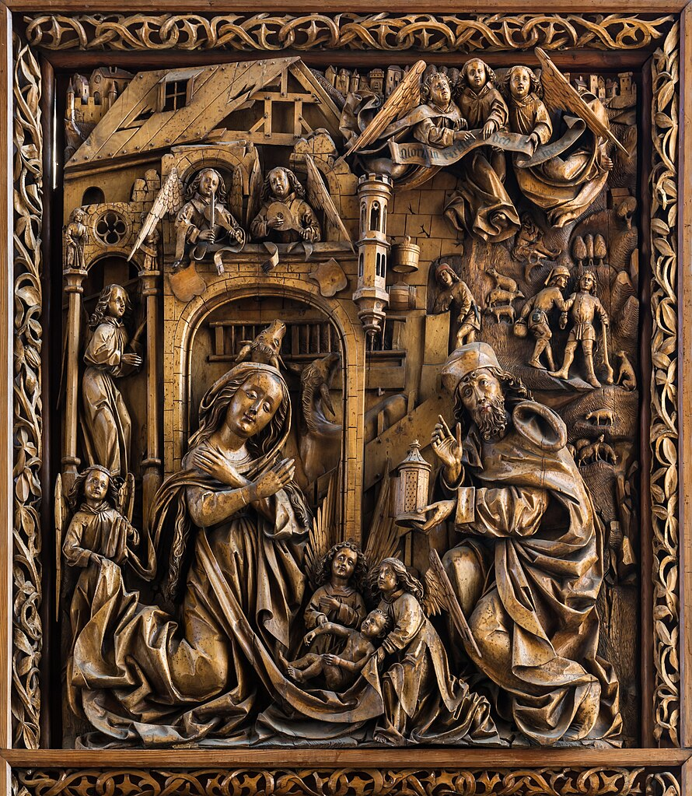
When God Entered Human History
“But when the fullness of the time came, God sent His Son, born of a woman, born under the Law, so that He might redeem those who were under the Law, that we might receive the adoption as sons and daughters.” -Galatians 4:4-5
Notes:
Photo Credit: Nativity of Christ. Unknown. Public Domain.
Directions: Have students copy the information from the slide into their notes.
Teaching points: The Incarnation happened at the perfect time, appointed by God. God could have become man earlier in history or later in history, but he did not. The moment he entered was purposefully chosen by the wisdom of God. Thus, it is important to examine the facts and details surrounding Christ’s historical presence.
In Sacred Scripture, God speaks to man in a human way. To interpret Scripture correctly, the reader must be attentive to what the human authors truly wanted to affirm, and to what God wanted to reveal to us by their words. In order to discover the sacred author's' intention, the reader must take into account the conditions of their time and culture, the literary genres in use at that time, and the modes of feeling, speaking and narrating then current. "For the fact is that truth is differently presented and expressed in the various types of historical writing, in prophetical and poetical texts, and in other forms of literary expression." -CCC 109-110
Be especially attentive "to the content and unity of the whole Scripture". Different as the books which compose it may be, Scripture is a unity by reason of the unity of God's plan, of which Christ Jesus is the center and heart… -CCC 112
Online Resources: Assign article, Why Jesus Came When He DId. URL here: https://media.ascensionpress.com/2019/03/13/why-jesus-came-when-he-did/
Assign article, The Scandal of Christ’s Humanity. URL here: https://www.catholic.com/magazine/print-edition/the-scandal-of-christs-humanity
The videos linked in this presentation file may contain copyright material. Such material is made available for educational purposes only. This constitutes a “fair use” of any such copyright material as provided for in Title 17 U.S.C. section106A-117 of the US Copyright Law.

Slide 3
Turn & Talk
Turn and Talk
While the name Jesus was a common name, from the moment it was bestowed on the Son of God Incarnate, it took on a forevermore unique meaning. The literal meaning of “Jesus” is “YHWH saves.” What is the story behind your name? Explain.
Notes:
Directions: Have students write down the question and then write down their answer….Then have students share their answers with one person close by.
Online Resources: Have students view video, What was Jesus Real Name?. URL here: https://youtu.be/GNQwiiWPg6Q
The videos linked in this presentation file may contain copyright material. Such material is made available for educational purposes only. This constitutes a “fair use” of any such copyright material as provided for in Title 17 U.S.C. section106A-117 of the US Copyright Law.

Slide 4
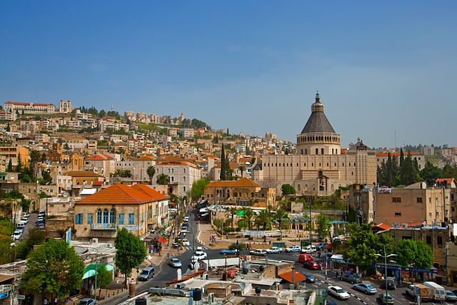
Where Jesus Walked
A Divine Person who entered history named Jesus who lived in a small village called Nazareth near the eastern shores of the Mediterranean Sea. This isn’t a made-up place. It still exists today.
Modern day Nazareth
Notes:
Photo Credit: Creative Commons Attribution-Share Alike 2.0. Nazareth Panorama Dafna Tal IMOT. https://commons.wikimedia.org/wiki/File:Nazareth_Panorama_Dafna_Tal_IMOT_(14532097313).jpg
Directions: Have students copy the side information in their notebooks.
Online Resources: Have students view video, Top 10 Sites in the Holy Land. URL here: https://youtu.be/nyzvKB2W-aQ
The videos linked in this presentation file may contain copyright material. Such material is made available for educational purposes only. This constitutes a “fair use” of any such copyright material as provided for in Title 17 U.S.C. section106A-117 of the US Copyright Law.

Slide 5
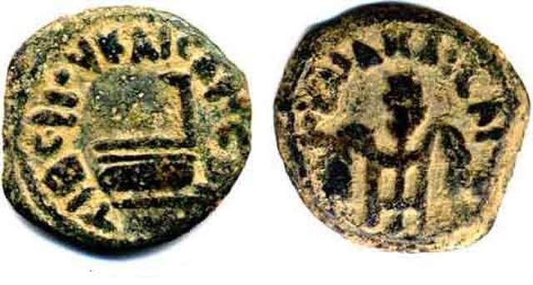
Historicity
Key
Vocab
The question of whether the Bible is historically reliable and accurate in its description of people, places and events. Historicity is determined through archaeology, the testimony of secular historical records etc..
Notes:
Photo Credit: Jack1956 at English Wikipedia. Public domain. Coin-of-Pilate.jpg. https://commons.wikimedia.org/wiki/File:Coin-of-Pilate.jpg
Directions: Have students copy the key vocabulary in their notes.
Online Resources:
View video, The Case for Jesus: The Reliability of the Gospels and the Jewish Roots of Jesus' Divinity . URL here:https://youtu.be/GS7I5Q7f06Y
See The Case for Christ PDF. URL here: https://stuarthoughton.wordpress.com/wp-content/uploads/2017/07/the-case-for-christ.pdf View video, The Case For Christ. URL here: https://youtu.be/HFgDpeZgbn8
The videos linked in this presentation file may contain copyright material. Such material is made available for educational purposes only. This constitutes a “fair use” of any such copyright material as provided for in Title 17 U.S.C. section106A-117 of the US Copyright Law.

Slide 6
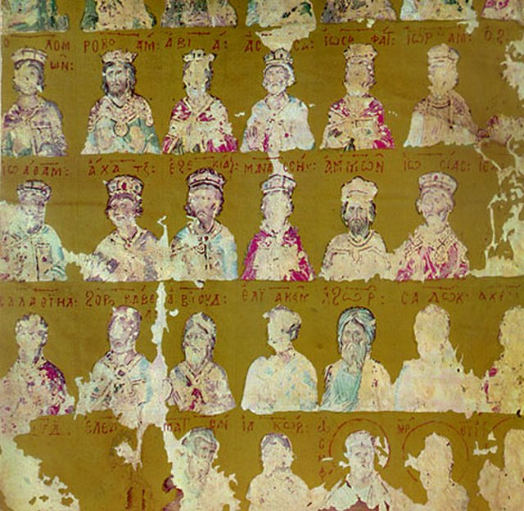
Jesus’s Ancestry
“If the Word truly became flesh, then God had, not only a mother, but also a grandmother, cousins, great-aunts, and weird uncles. If the Word truly dwelt among us, then he was part of a family that, like most, was fairly dysfunctional, a mix of the good and bad, the saintly and the sinful, the glorious and the not so glorious. And this is such good news for us”. -Bishop Barron
Notes:
Photo Credit: Genealogy of Christ (part) (The Mokvi Four Gospels 1300).jpg. The Mokvi Four Gospels 1300 Genealogy of Christ (part). Unknown author. Public domain. https://commons.wikimedia.org/wiki/File:Genealogy_of_Christ_(part)_(The_Mokvi_Four_Gospels_1300).jpg
Directions: Have students copy the information from the slide into their notes.
Teaching points: Jesus included some rather ordinary people among his disciples. There were sinners in Jesus’s family tree. The fact is that God chooses whomever he wants to do his work, sinners included. This theme is supported throughout the Gospels. Jesus associated with the poor, with people whom society rejected, with prostitutes, and with sinners of all kinds. Jesus came to save everyone: Jews, Gentiles, men, and women alike.
Jesus family tree traces all the way back to Adam because Jesus is the New Adam. Other key figures are Abraham, Isaac, Jacob, Judah, David and Mary. Along the these descendants of Jesus are mentioned in many of the prophecies regarding the coming of the Royal Messiah. For example: “All this took place to fulfill what the Lord had said through the prophet: ‘Behold, the virgin shall be with child and bear a son, and they shall name him Emmanuel,’ which means ‘God is with us’” (Mt 1:22–23).
Online Resource: Have students view video, Bishop Barron on the Genealogy of Jesus. URL here: https://youtu.be/S8F8fUlI3kg
The videos linked in this presentation file may contain copyright material. Such material is made available for educational purposes only. This constitutes a “fair use” of any such copyright material as provided for in Title 17 U.S.C. section106A-117 of the US Copyright Law.

Slide 7
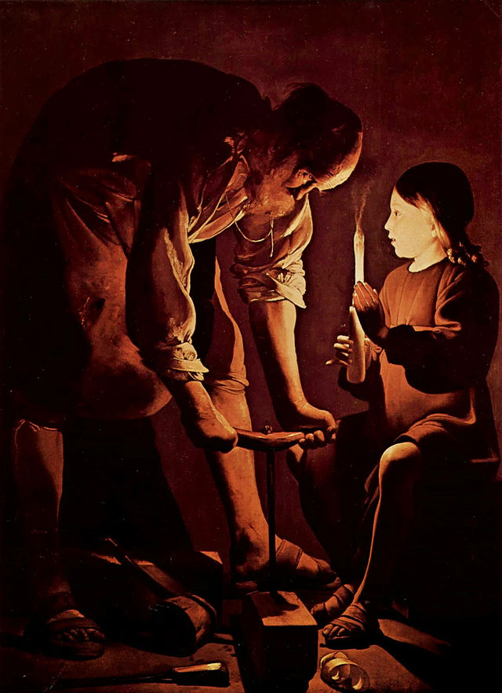
Nazareth and the Carpenter Shop
Jesus grew up in Nazareth, a small and insignificant rural village.
In Nazareth Jesus “grew and became strong, filled with wisdom; and the favor of God was upon him” (Lk 2:40)
Jesus was known as the “carpenter’s son” (Mt 13:55) and the “son of Joseph, from Nazareth”
Jesus studied Hebrew and spoke Aramaic, the common language of the Jewish villagers in Nazareth.
Notes:
Photo Credit: St. Joseph the Carpenter. Georges de La Tour. Public Domain.
Directions: Have students copy the side information in their notebooks.
Teaching Points: Jesus was known as the “carpenter’s son” (Mt 13:55) and the “son of Joseph, from Nazareth” (Jn 1:45; 6:42; Lk 4:22). It is likely that Joseph died before Jesus began his public ministry. Evidence for this is that when Jesus returned to Nazareth with a new reputation for preaching and healing and went to his hometown synagogue, he was identified as “the carpenter, the son of Mary” (Mk 6:3).
Jesus learned how to be physically and mentally strong, reliable and faithful from his human father. Thanks to Joseph, Jesus used many metaphors and analogies from the carpentry trade in his teaching. He spoke about entering by the narrow gate (see Matthew 7:13–14) and of building one’s house on rock, not sand (see Matthew 7:24–27). In one parable, he told of a vineyard owner who built a tower for produce (see Matthew 21:33).
Online Resources: Have students view video, Saint Joseph Our Spiritual Father Documentary. URL here: https://youtu.be/AC-_o2S7JJA
The videos linked in this presentation file may contain copyright material. Such material is made available for educational purposes only. This constitutes a “fair use” of any such copyright material as provided for in Title 17 U.S.C. section106A-117 of the US Copyright Law.

Slide 8
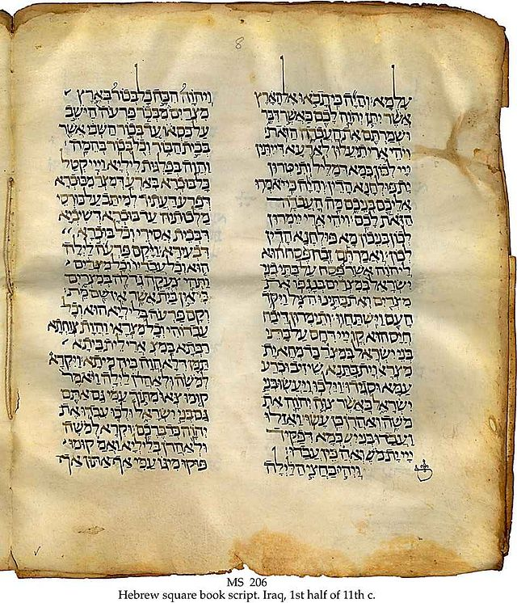
Targums
Key
Vocab
The name for Aramaic paraphrases or translations of the Jewish Bible that came into prominence in the first century when Hebrew was declining as the spoken language in and around Palestine.
Notes:
Photo Credit: Targum.jpg. Public domain.https://commons.wikimedia.org/wiki/File:Targum.jpg. Cropped.
Directions: Have students copy down the key Vocabulary in their notes.
Teaching Points: The Gospels themselves, though written in Greek, retain several Aramaic sayings (Targums) of Jesus, including Ephphatha (“Be opened”) and Talitha koum (“Little girl, get up”). The Gospels also contain Aramaic place names such as Gethsemane (“Oil Press”) and Golgotha (“Place of the Skull”). They also use the Aramaic word bar for “son of,” as in Bar-Jonah, Bartholomew, and Barabbas. The most important use of an Aramaic word is when Jesus addressed God as Abba (“Father”).
Online Resources: View video, What are the Aramaic Targums?. URL here: https://youtu.be/loGrB4FvfYs
The videos linked in this presentation file may contain copyright material. Such material is made available for educational purposes only. This constitutes a “fair use” of any such copyright material as provided for in Title 17 U.S.C. section106A-117 of the US Copyright Law.

Slide 9
Jesus and the Jewish Faith
Jesus was born of a Jewish mother, in Galilee, a Jewish part of the world.
All of his friends, associates, colleagues, disciples were Jews.
He regularly worshipped in Jewish communal worship, what we call synagogues.
He observed Jewish holidays and festivals.
Notes:
Photo Credit: Arch of Titus. Photo by Steerpike, shared under CC BY 3.0 (Deed - Attribution 3.0 Unported - Creative Commons).
Directions: Have a students copy down information from their slides into their notes.
Teaching Points: Much of our Catholic Faith is rooted in the Jewish religion of Jesus’ time. We have priests, altars, bread, wine, priestly vestments, incense, sacred texts, preaching and teaching, moral codes, festivals and holy days….all of this is rooted in 1st Century Judaism. To better understand Jesus we must understand his Jewish faith and culture.
Online Resources: View video, The Ancient Jewish Roots of the Catholic Faith. URL here: https://youtu.be/i2Uvzo83hPI
View video, If Jesus Was Jewish Why Aren’t We. URL here: https://youtu.be/NQtMQdECx8U
Assign article, If Jesus was a Jew, Why are We Catholic?. URL here: https://www.catholic.com/qa/if-jesus-was-a-jew-why-are-we-catholic
The videos linked in this presentation file may contain copyright material. Such material is made available for educational purposes only. This constitutes a “fair use” of any such copyright material as provided for in Title 17 U.S.C. section106A-117 of the US Copyright Law.

Slide 10
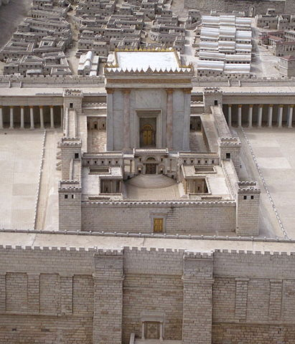
The Temple in Jesus’s Time
The Temple was where the Jews offered sacrifices to God. It was the holiest place where Jews believed God dwelt in a special way.
Jesus was presented at the Temple when he was a small child.
Jesus called the Temple his Father’s House and he wept over it.
Jesus defended and cleansed the Temple from the money changers.
Notes:
Photo Credit: Second Temple Model, Israel Museum. Jerusalem Leah Jones from Chicago, USA.
Creative Commons Attribution 2.0. https://commons.wikimedia.org/wiki/File:Second_Temple_Model,_Israel_Museum_(8529914300).jpg
Directions: Have a students copy down information from their slides into their notes.
Teaching Points: It cannot be overstated how important the Temple was to 1st century Judaism. It was the center of the Jewish world. It’s important for Christians too.
Jesus, the Messiah, demonstrated zeal for the House of the Lord, the biblical Temple in Jerusalem because he loved it. Afterall, he found refuge there as a ‘lost’ 12 year old boy. He said to Mary his mother, “Did you not know I would be in my Father’s house?” Prior to that episode, both Jesus and Mary as toddlers were presented to God at the Temple. It was their home.
Elsewhere in the Gospels, Jesus said of the Temple that it would be torn down but then raised again in three days (Jn 2:19). He literally predicted the destruction of the Temple and by doing so, he figuratively predicted his own death and resurrection. In saying these words, Jesus gives us a clue. He wants us to see his historical body, his resurrected body and his mystical body, the Church, as the New Temple where the presence of God can be found on earth.
Online Resources: View video, The Temple: Herod’s Crowning Glory. URL here: https://youtu.be/ElAMqb5Jc78
View video: Herod’s Temple: The Temple Jesus Knew. URL here: https://youtu.be/J83PhBQWiKQ
Assign article, Why We Too Should Have Zeal for the Temple. URL here: https://www.catholic365.com/article/36817/5-reasons-we-should-have-zeal-for-the-temple-too.html
The videos linked in this presentation file may contain copyright material. Such material is made available for educational purposes only. This constitutes a “fair use” of any such copyright material as provided for in Title 17 U.S.C. section106A-117 of the US Copyright Law.

Slide 11
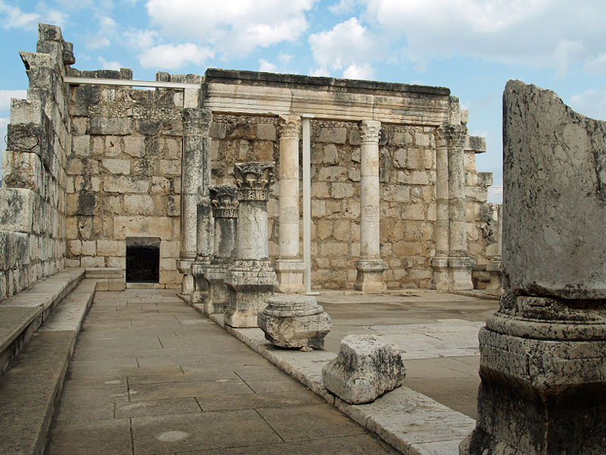
The Synagogues in Jesus’s Time
The synagogue served three main purposes:
It was a house of prayer where Scriptures were read and YHWH was worshipped.
It was a place of discussion for settling legal disputes.
It was the local school
Ancient ruins of a synagogue in Capernaum, near Peter’s house and Jesus’s ‘ headquarters’.
Notes:
Photo Credit: Ruins of the synagogue in w:Capernaum. David Shankbone. Creative Commons Attribution-Share Alike 3.0. https://commons.wikimedia.org/wiki/File:Capernaum_synagogue_by_David_Shankbone.jpg
Directions: Have a students copy down information from their slides into their notes.
Teaching Points: Synagogue comes from the Greek word for “assembly.” Many larger towns had more than one synagogue, and Jerusalem may have had hundreds. According to the New Testament, Jesus spent a significant amount of time in synagogues, which were Jewish community centers that also served as schools, courts, places of study, and places of prayer:
Teaching
Jesus taught in synagogues, including reading from the scrolls in his hometown of Nazareth. In Luke 4:20-21, Jesus sat down after reading and explained the scripture, telling the congregation that it was fulfilled in their presence.
Healing
Jesus performed exorcisms and healings in synagogues, such as in Mark 1:21-28, Mark 3:1-6, and Luke 13:10-17. In Mark 1:21-26, Jesus cast an impure spirit out of a man in the synagogue of Capernaum, leaving the people amazed.
Debating
Jesus debated the interpretation and practice of Jewish law in synagogues, such as in Mark 3:1-6, Luke 13:14-17, and John 6:30-59.
Online Resources: Have students view video, Capernaum. URL here: https://youtu.be/ifTro5uRaT8
The videos linked in this presentation file may contain copyright material. Such material is made available for educational purposes only. This constitutes a “fair use” of any such copyright material as provided for in Title 17 U.S.C. section106A-117 of the US Copyright Law.

Slide 12
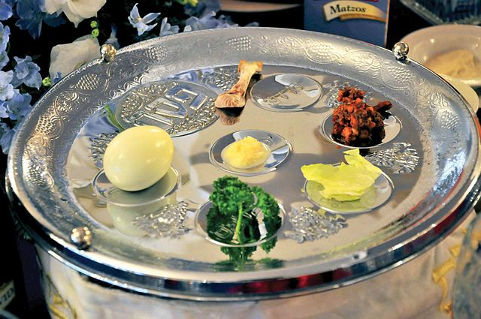
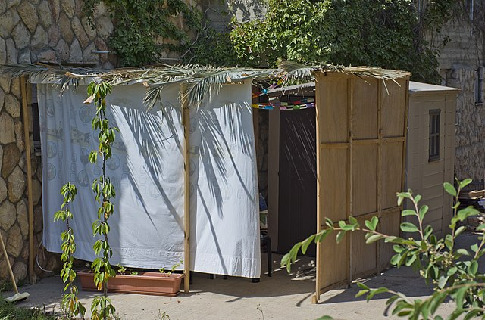
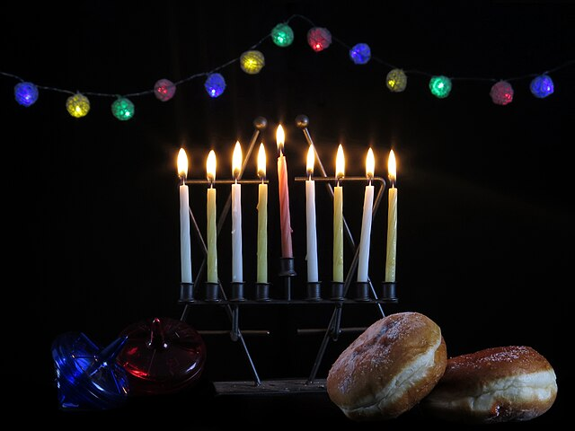
Jewish Festivals and Feasts
Celebrating and Keeping Alive the Story of Salvation
Passover
Tabernacles
Hanukkah
Notes:
Photo Credit: Cpl. Brandon Saunders. Public domain. Rabbi visits Okinawa to celebrate Passover. Zachi Evenor
Creative Commons Attribution 2.0, Sukkoth. YB13D. Creative Commons Attribution-Share Alike 4.0.Hanukkah.https://commons.wikimedia.org/
Directions: Have students copy down the information from the slide in their notes.
Teaching Points: Like Catholicism’s liturgical year which centers on Easter and Christmas, Jewish holidays are important because they keep the tradition of the story of God’s saving actions in the Bible alive.They fortify the community and give the people a sense of identity and belonging…
Passover: Celebrated the Chosen People’s liberation from slavery in Egypt. Involved the ritual slaughter of the paschal lamb and the eating of a Seder meal .
Tabernacles: A fall harvest celebration. Pilgrims in Jerusalem built huts out of branches to recall the time that Jews spent in the wilderness.
Hanukkah: Celebrated to commemorate the Temple’s rededication in 164 BC after it was profaned by foreign ruler Antiochus IV.
Online Resource: Have students view video, A Crash Course in Jewish Feasts and Holidays. URL here: https://youtu.be/fVoeoPc_wkQ
See article, Jewish Religious Year. URL here: https://www.britannica.com/topic/Jewish-religious-year
The videos linked in this presentation file may contain copyright material. Such material is made available for educational purposes only. This constitutes a “fair use” of any such copyright material as provided for in Title 17 U.S.C. section106A-117 of the US Copyright Law.

Slide 13
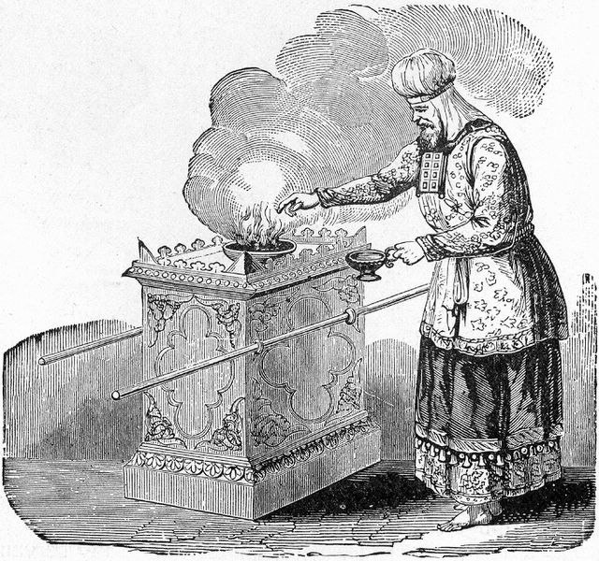
The Day of Atonement
Key
Vocab
Only the high priest could enter the most sacred space inside the Temple—the Holy of Holies—once a year on Yom Kippur, ‘the Day of Atonement’. He splashed blood on the ark to atone for sin.
Notes:
Photo Credit: Illustrator of Henry Davenport Northrop's 'Treasures of the Bible', 1894. Public domain. https://commons.wikimedia.org/wiki/File:High_Priest_Offering_Incense_on_the_Altar.jpg
Directions: Have students copy down key vocabulary while you read the quote below…
Teaching Points: Yom Kippur also known as The Day of Atonement, is the most solemn of Jewish religious holidays, when Jews seek to expiate their sins and achieve reconciliation with God. It concludes the “10 days of repentance” that begin with Rosh Hashana on the first day of Tishri.
The way Jews dealt with the sin problem is to offer sacrifice to atone for sins on a special day called Yom Kippur. In Bible times they offered animal sacrifices and today they offer prayer and fasting as sacrifice. Jesus, as the New High Priest offers an efficacious not just symbolic atonement in Heaven before the throne of God perpetually.
Online Resources: View video, Jesus, The New High Priest. URL here: https://youtu.be/_2cceI0EIYs
The videos linked in this presentation file may contain copyright material. Such material is made available for educational purposes only. This constitutes a “fair use” of any such copyright material as provided for in Title 17 U.S.C. section106A-117 of the US Copyright Law.

Slide 14
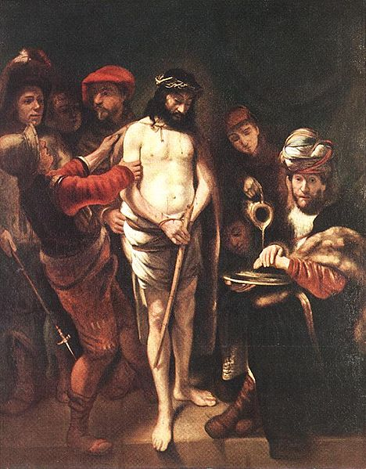
The Public Ministry of Jesus
Jesus’s life and ministry were covered mostly in the four Gospels.
In three years Jesus was baptized, was tempted in the desert, went to the wedding at Cana, proclaimed the kingdom in words and deeds, was transfigured on Mnt. Tabor and celebrated the Last Supper.
The Paschal Mystery centers around Jesus suffering, death, resurrection and ascension.
Notes:
Photo Credit: Christ before Pilate. Nicolaes Maes. Public Domain.
Directions: Have students copy down the information from the slide in their notes.
Teaching Point: The four gospel accounts are the most important part of the New Testament. There are four Gospels because they were each written for a different audience. However, Jesus is the single Word of all Scripture. Reading, studying, and praying with the Gospels can help us understand the basic elements of Christology.
Online Resource: Have students view video, Overview of the Gospel of Mark. URL here: https://youtu.be/HGHqu9-DtXk
The videos linked in this presentation file may contain copyright material. Such material is made available for educational purposes only. This constitutes a “fair use” of any such copyright material as provided for in Title 17 U.S.C. section106A-117 of the US Copyright Law.

Slide 15
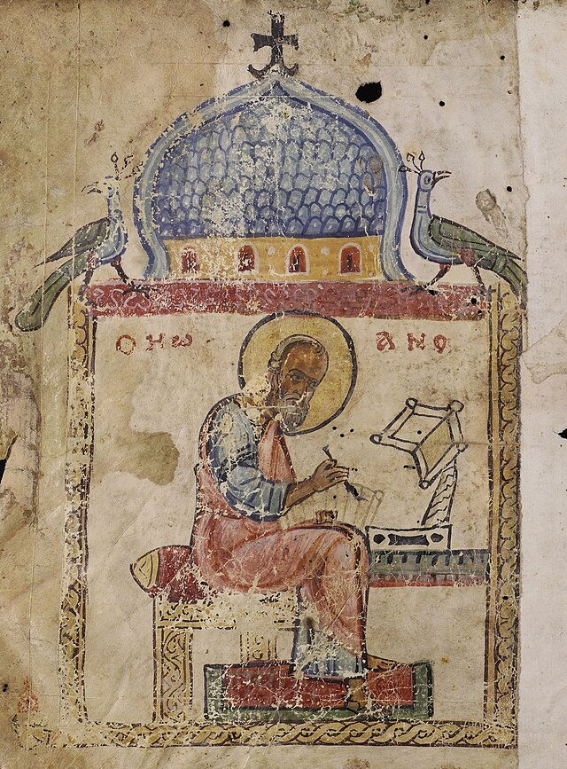
The Stages of the Gospel
Key
Vocab
The first stage of the formation of the Gospels was the public life and teaching of Jesus.
The second stage of formation of the Gospels was the preaching of the Apostles.
The third stage was the period in which the Gospels were written.
Notes:
*Photo Credit: Paulus San Giovanni in Laterano 2006-09-07.jpg.St. Paul by Pierre-Étienne Monnot. Nave of the Basilica of St. John Lateran (Rome).Jastrow. Creative Commons Attribution 2.5. https://commons.wikimedia.org/wiki/File:Paulus_San_Giovanni_in_Laterano_2006-09-07.jpg
Directions: Have students copy down key vocabulary in their notes.
Online Resource: Assign article, The Evolution of the Gospels. URL here: https://www.catholic.com/magazine/print-edition/the-evolution-of-the-gospels
The videos linked in this presentation file may contain copyright material. Such material is made available for educational purposes only. This constitutes a “fair use” of any such copyright material as provided for in Title 17 U.S.C. section106A-117 of the US Copyright Law.

Slide 16
Memorize It
Key
Verse
“There are also many other things that Jesus did, but if these were to be described individually, I do not think the whole world would contain the books that would be written. ”
-Jn 21:25
Notes:
Directions: Have students copy the quote. Add bonus points to the assessment if they can copy it down demonstrating that they memorized it.
The videos linked in this presentation file may contain copyright material. Such material is made available for educational purposes only. This constitutes a “fair use” of any such copyright material as provided for in Title 17 U.S.C. section106A-117 of the US Copyright Law.

