Slide 1
Chapter 2 PowerPoint

Slide 2
[Design to mirror this page in the student text. ]

Slide 3
Four Marks of the Church of Christ
One
Holy
Apostolic
Catholic
Solidarity

Slide 4
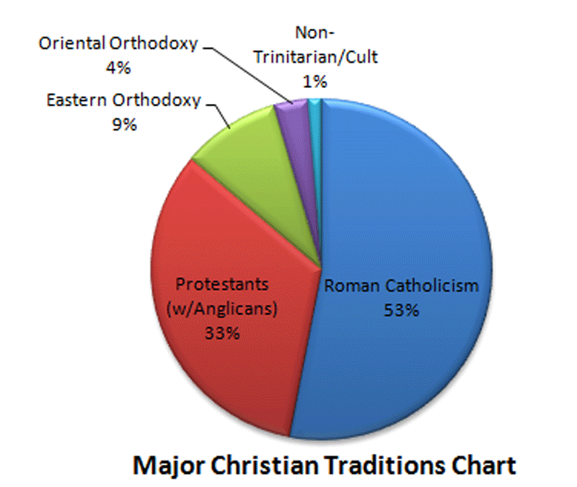
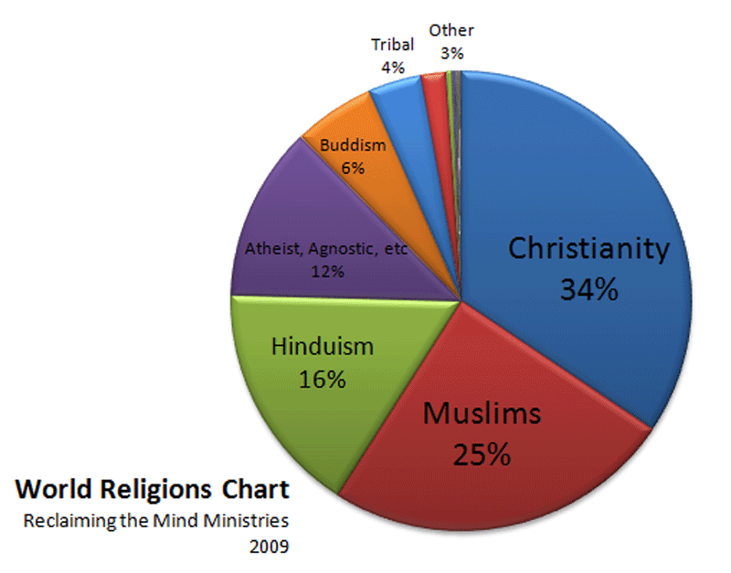
Solidarity

Slide 5
Jesus Christ: Sacrament of God
The Church: Sacrament of Jesus Christ
Holy Orders
Baptism
Confession
Confirmation
Matrimony
Eucharist
Anointing of the Sick
Solidarity

Slide 6
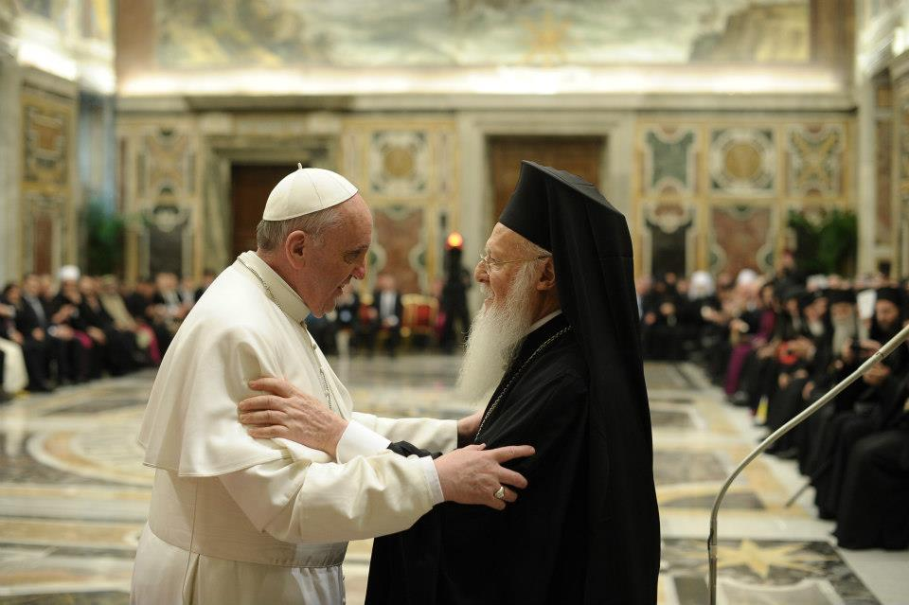
Patriarch of Constantinople Bartholomew I and Pope Francis
Vatican City, March 20, 2013
Unity in God

Slide 7
Unity in God

Slide 8
The Blessed Trinity
The Holy Spirit the shared bond of love
The Father
“the Lover”
The Son
“the Beloved”
Unity in God

Slide 9
The Apostle’s Creed
I believe in God, the Father almighty, Creator of heaven and earth, and in Jesus Christ, his only Son, our Lord, who was conceived by the Holy Spirit, born of the Virgin Mary, suffered under Pontius Pilate, was crucified, died and was buried; he descended into hell; on the third day he rose again from the dead; he ascended into heaven, and is seated at the right hand of God the Father almighty; from there he will come to judge the living and the dead. I believe in the Holy Spirit, the holy catholic Church, the communion of saints, the forgiveness of sins, the resurrection of the body, and life everlasting. Amen.
The Nicene Creed
I believe in one God, the Father almighty, maker of heaven and earth, of all things visible and invisible.
I believe in one Lord Jesus Christ, the Only Begotten Son of God, born of the Father before all ages. God from God, Light from Light, true God from true God, begotten, not made, consubstantial with the Father; through him all things were made. For us men and for our salvation he came down from heaven, and by the Holy Spirit was incarnate of the Virgin Mary, and became man. For our sake he was crucified under Pontius Pilate, he suffered death and was buried, and rose again on the third day in accordance with the Scriptures. He ascended into heaven and is seated at the right hand of the Father. He will come again in glory to judge the living and the dead and his kingdom will have no end.
I believe in the Holy Spirit, the Lord, the giver of life, who proceeds from the Father and the Son, who with the Father and the Son is adored and glorified, who has spoken through the prophets.
I believe in one, holy, catholic and apostolic Church. I confess one Baptism for the forgiveness of sins and I look forward to the resurrection of the dead and the life of the world to come. Amen.
Unity in God

Slide 10
The Church’s Unity
Unity in God
Unity in belief
Unity in common worship
Unity with Apostolic Succession
Unity of Belief

Slide 11
The
Father
The
Father
The
Son
Orthodox
Catholic
The
Son
The Holy Spirit
The Holy Spirit
Unity of Belief

Slide 12
Unity in Common Worship

Slide 13
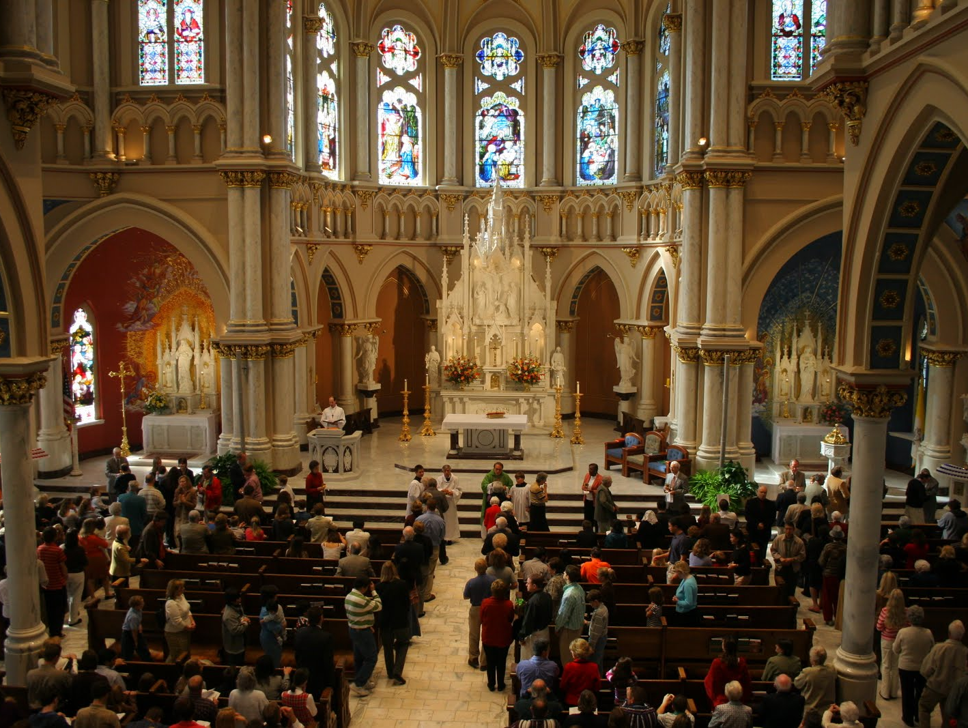
Outline of the Mass
Introductory Rites
Processional
Greeting
Penitential Rite
Glory to God
Opening Prayer
Liturgy of the Word
First Reading
Responsorial Psalm
Second Reading
Gospel Acclamation
Gospel
Homily
Prayer of the Faithful
Liturgy of the Eucharist
Presentation of the Gifts
Preparation of the Gifts
Prayer over the Gifts
Eucharistic Prayer
Eucharistic Acclamation
Lord’s Prayer
Sign of Peace
Lamb of God
Communion
Prayer after Communion
Concluding Rite
Final Blessing
Dismissal
Recessional
Unity in Common Worship

Slide 14
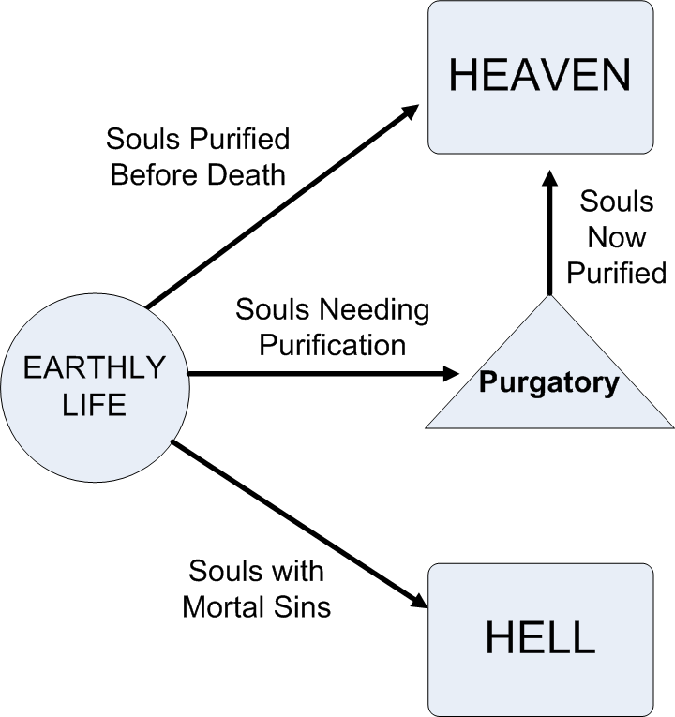
The Communion
of Saints
Unity in Common Worship

Slide 15
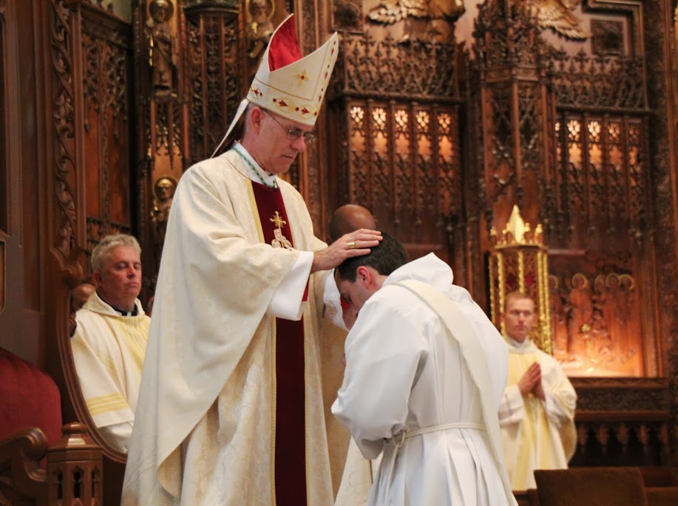
Three degrees of ordination:
† Bishops receive the fullness of sacred orders through an unbroken succession of the apostolic line.
† Priests serve as co-workers of the bishop to fulfill the Church’s apostolic mission by acting in the person of Christ.
† Deacons have a special attachment to the bishop and assist him in the Eucharist and other select sacraments, and performs works of charity.
Unity in Common Worship

Slide 16
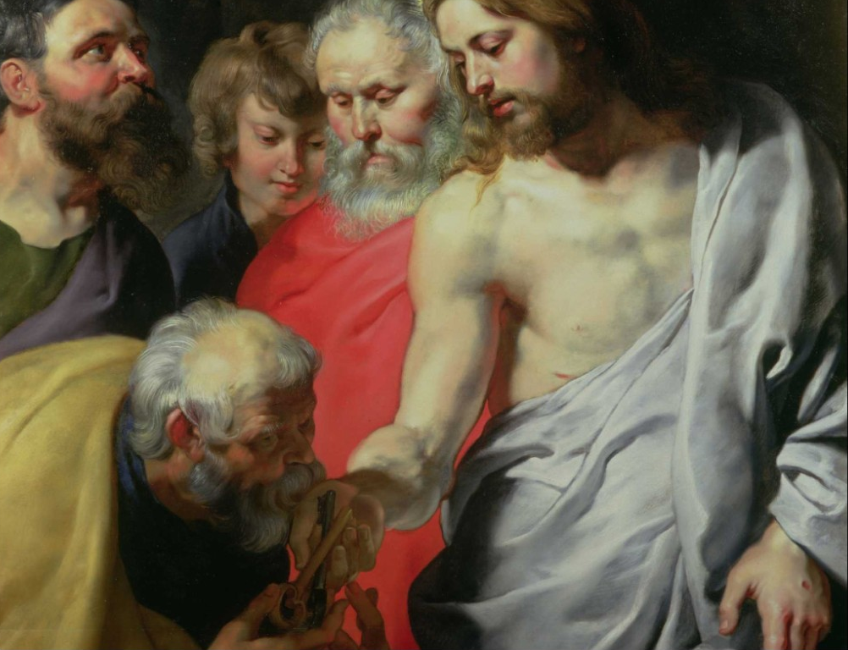
“Blessed are you, Simon son of Jonah. For flesh and blood has not revealed this to you, but my heavenly Father. And so I say to you, you are Peter, and upon this rock I will build my church, and the gates of the netherworld shall not prevail against it. I will give you the keys to the kingdom of heaven. Whatever you bind on earth shall be bound in heaven; and whatever you loose on earth shall be loosed in heaven.”
(Mt. 16:17-19)
Unity with Apostolic Succession

Slide 17
Unity with Apostolic Succession

