Slide 1
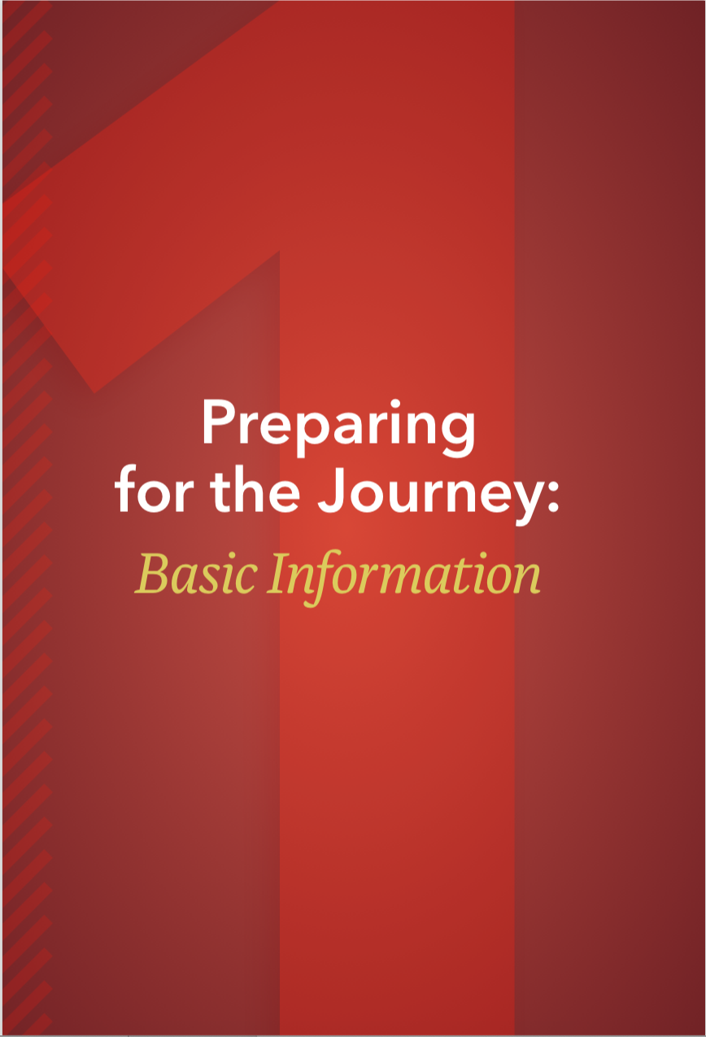
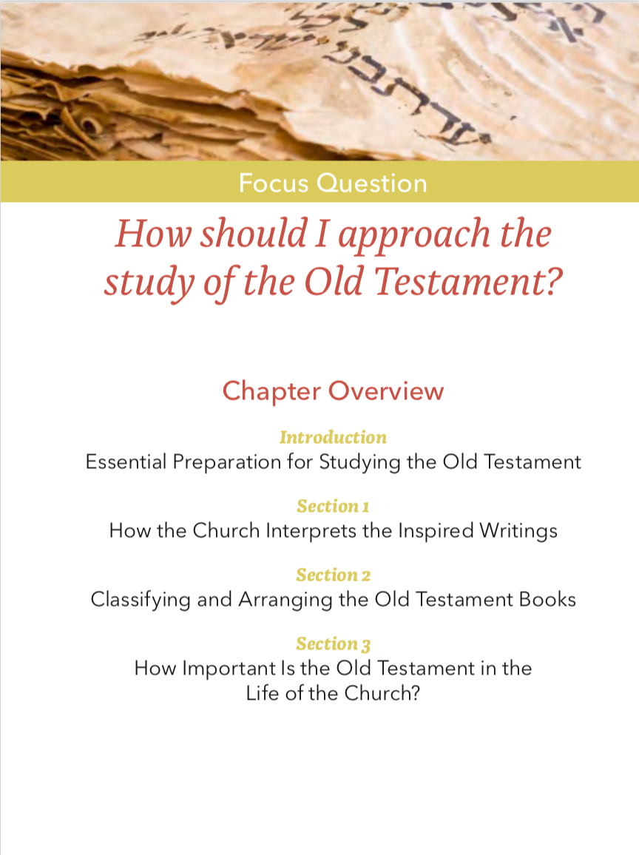
The Old Testament
Chapter One

Slide 2
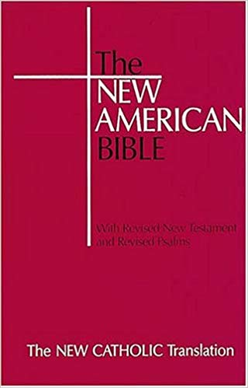
Deuterocanonical
A term meaning “of the second canon”; designates writings included in the Catholic Old Testament but not in the Hebrew Bible.
Tobit, Judith, 1 and 2 Maccabees, Wisdom, Sirach, Baruch and parts of Esther and Daniel
Essential Preparation for Studying the Old Testament
Notes:
See Dr. Taylor Marshall’s Youtube video about why Catholics have the seven extra books: https://www.youtube.com/watch?v=3Dc-TBqtyiI

Slide 3
Hebrew Canon
Catholic Canon (including ”apocrypha”)
1. Torah
  Genesis
  Exodus
  Leviticus
  Numbers
  Deuteronomy
2. The Twelve Prophets
  Hosea
  Joel
  Amos
  Obadiah
  Jonah
  Micha
  Nahum
  Habakkuk
  Zephaniah
  Haggai
  Zechariah
  Malachi
3. Nevi’im
  Joshua
  Judges
  Samuel (I&II)
  Kings (I&II)
  Isaiah
  Jeremiah
  Ezekiel
4. Books of Truth
  Psalms
  Proverbs
  Job
5. Five Scrolls
  Song of Songs
  Ruth
  Lamentations
  Ecclesiastes
  Esther
6. The Rest of the Writings
  Daniel
  Ezra-Nehemiah
  Chronicles (I&II)
1. Pentateuch
  Genesis
  Exodus
  Leviticus
  Numbers
  Deuteronomy
2. Poetry and Wisdom
  Job
  Psalms
  Proverbs
  Ecclesiastes
  Song of Solomon
  Wisdom of Solomon*
  Ecclesiasticus
  (Wisdom of Ben Sirach)*
3. History
  Joshua
  Judges
  Ruth*
  Samuel (I&II)
  Kings (I&II)
  Chronicles *
  Ezra and Nehemiah*
  Tobit*
  Judith*
  Esther + additions to Esther
4. Prophets
  Isaiah
  Jeremiah
  Lamentations*
  Baruch, + The Letter of Jeremiah*
  Ezekiel
  Daniel, + Additions to Daniel Hosea
  Joel
  Amos
  Abidas (Obadiah)
  Jonas (Jonah)
  Micheas (Micah)
  Nahum
  Habucuc (Habakkuk)
  Sophonias (Zephaniah)
  Aggeus (Haggai)
  Zacharias (Zechariah)
  Malachias (Malachi)
  1 Maccabees *
  2 Maccabees*
Essential Preparation for Studying the Old Testament

Slide 4

Y H W H
I am and will be
Essential Preparation for Studying the Old Testament
Notes:
See the explanations for the meaning of YHWH on pages 4-5. Ask students their thoughts on the meaning of the name of YHWH. Have them reflect on the phrase above and record their thoughts.

Slide 5
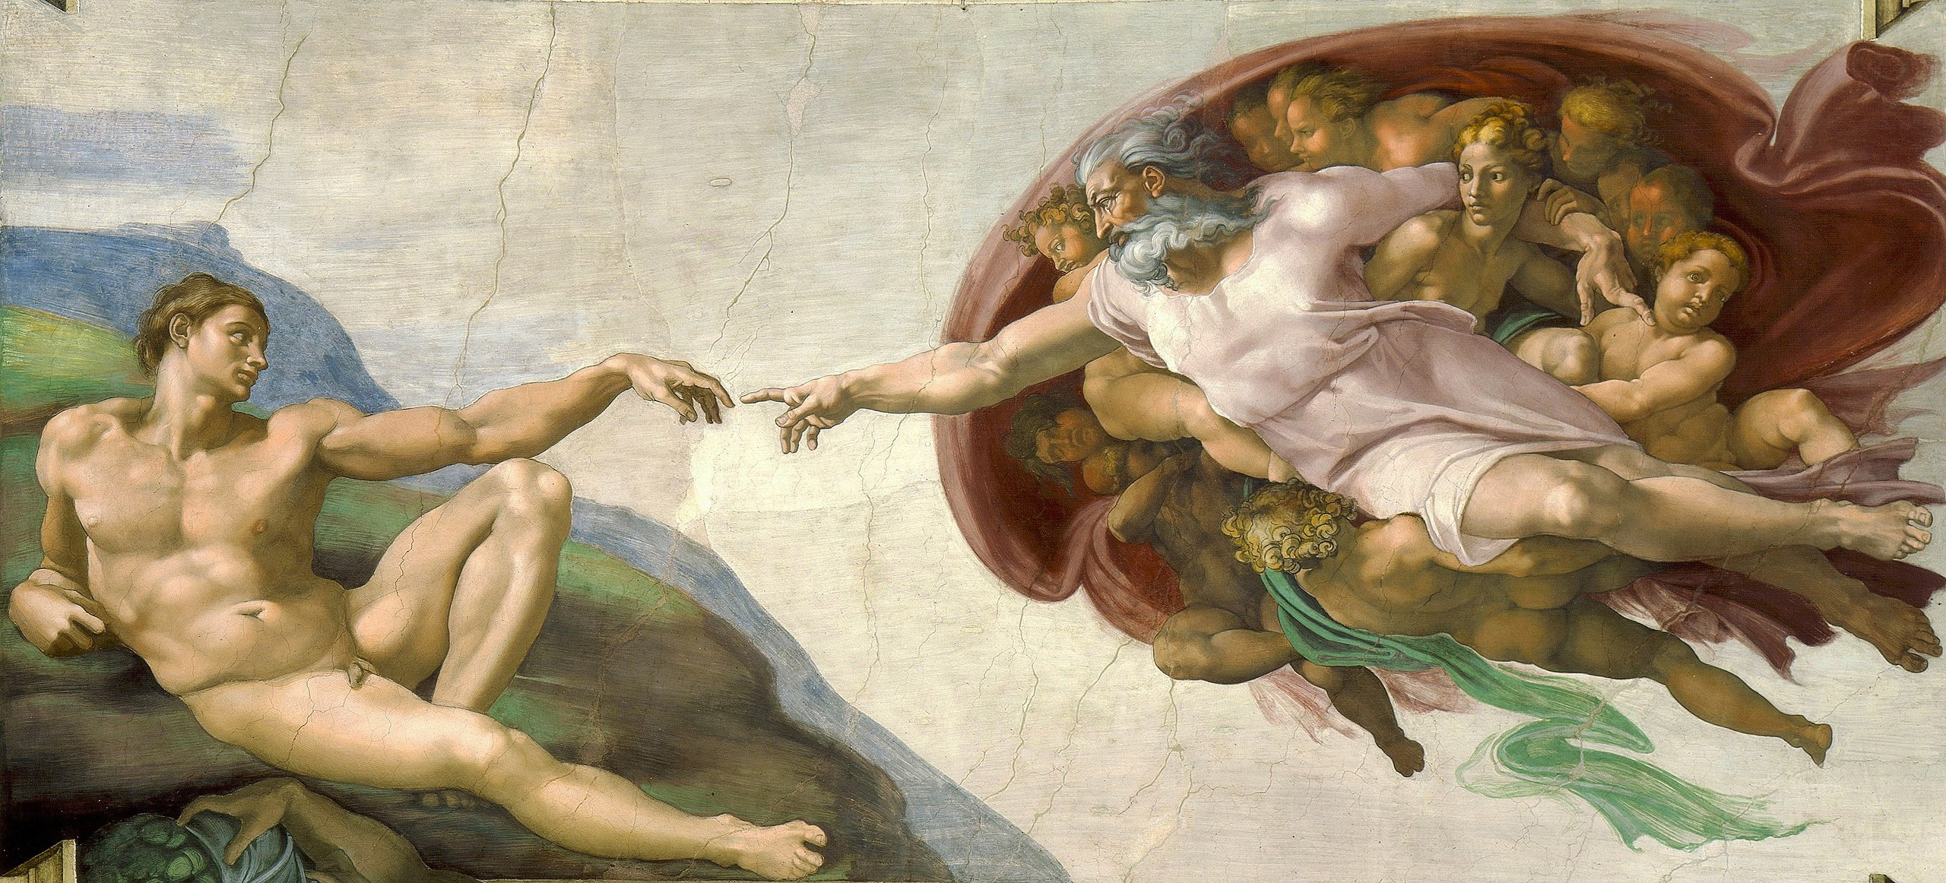
Divine-Human Relationship
Sin
An offense against God. Sin is a deliberate thought, word, deed, or omission against the eternal law of God.
Essential Preparation for Studying the Old Testament
Notes:
Discuss sin in the context of the Divine-Human Relationship as well as the context of how sin can create discord in any relationship, becoming an offense against God. Have students suggest examples for each type of sin mentioned in the definition: deliberate thoughts, words, and deeds that are an offense against God as well as sins of omission.

Slide 6
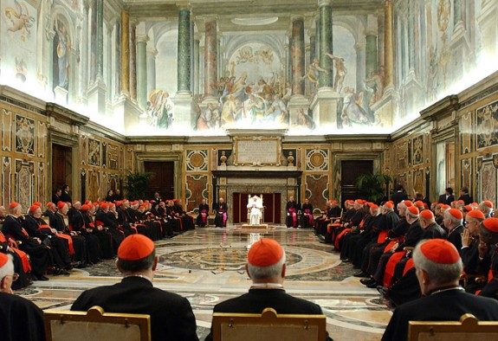
Magisterium
The teaching authority of the Church concerning issues of faith and morals. The Magisterium consists of the pope and the college of bishops acting together.
Essential Preparation for Studying the Old Testament
Notes:
In January of 2020, Pope Francis spoke about the importance of the Magisterium when he addressed his audience at the Congregation for the Doctrine of the Faith. “It is a dynamic reality that, staying faithful to its foundation, is renewed from generation to generation and is summed up in one face, one body and one name - the risen Jesus Christ,” he said. Reference the Church’s teaching on God’s Revelation in both Sacred Scripture and Sacred Tradition. Review teachings from the Catechism of the Catholic Church: https://www.vatican.va/archive/ccc_css/archive/catechism/p1s1c2a2.htm

Slide 7

Three Rules for Interpreting Scripture
1. Look closely at the content and unity of the whole of Scripture.
2. Read Scripture within the “living Tradition of the whole Church.”
3. Be attentive to the analogy of faith—the unity of the truths of faith among themselves and within the whole context of God’s Revelation.
Essential Preparation for Studying the Old Testament
Notes:
1. Look closely at the content and unity of the whole of Scripture
2. Read Scripture within “the living Tradition of the whole Church.”
3. Be attentive to the analogy of faith—the unity of the truths of faith among themselves and within the whole context of God’s Revelation.
Share a Bible Reading Plan from the United States Conference of Catholic Bishops:
http://www.usccb.org/bible/understanding-the-bible/index.cfm

Slide 8
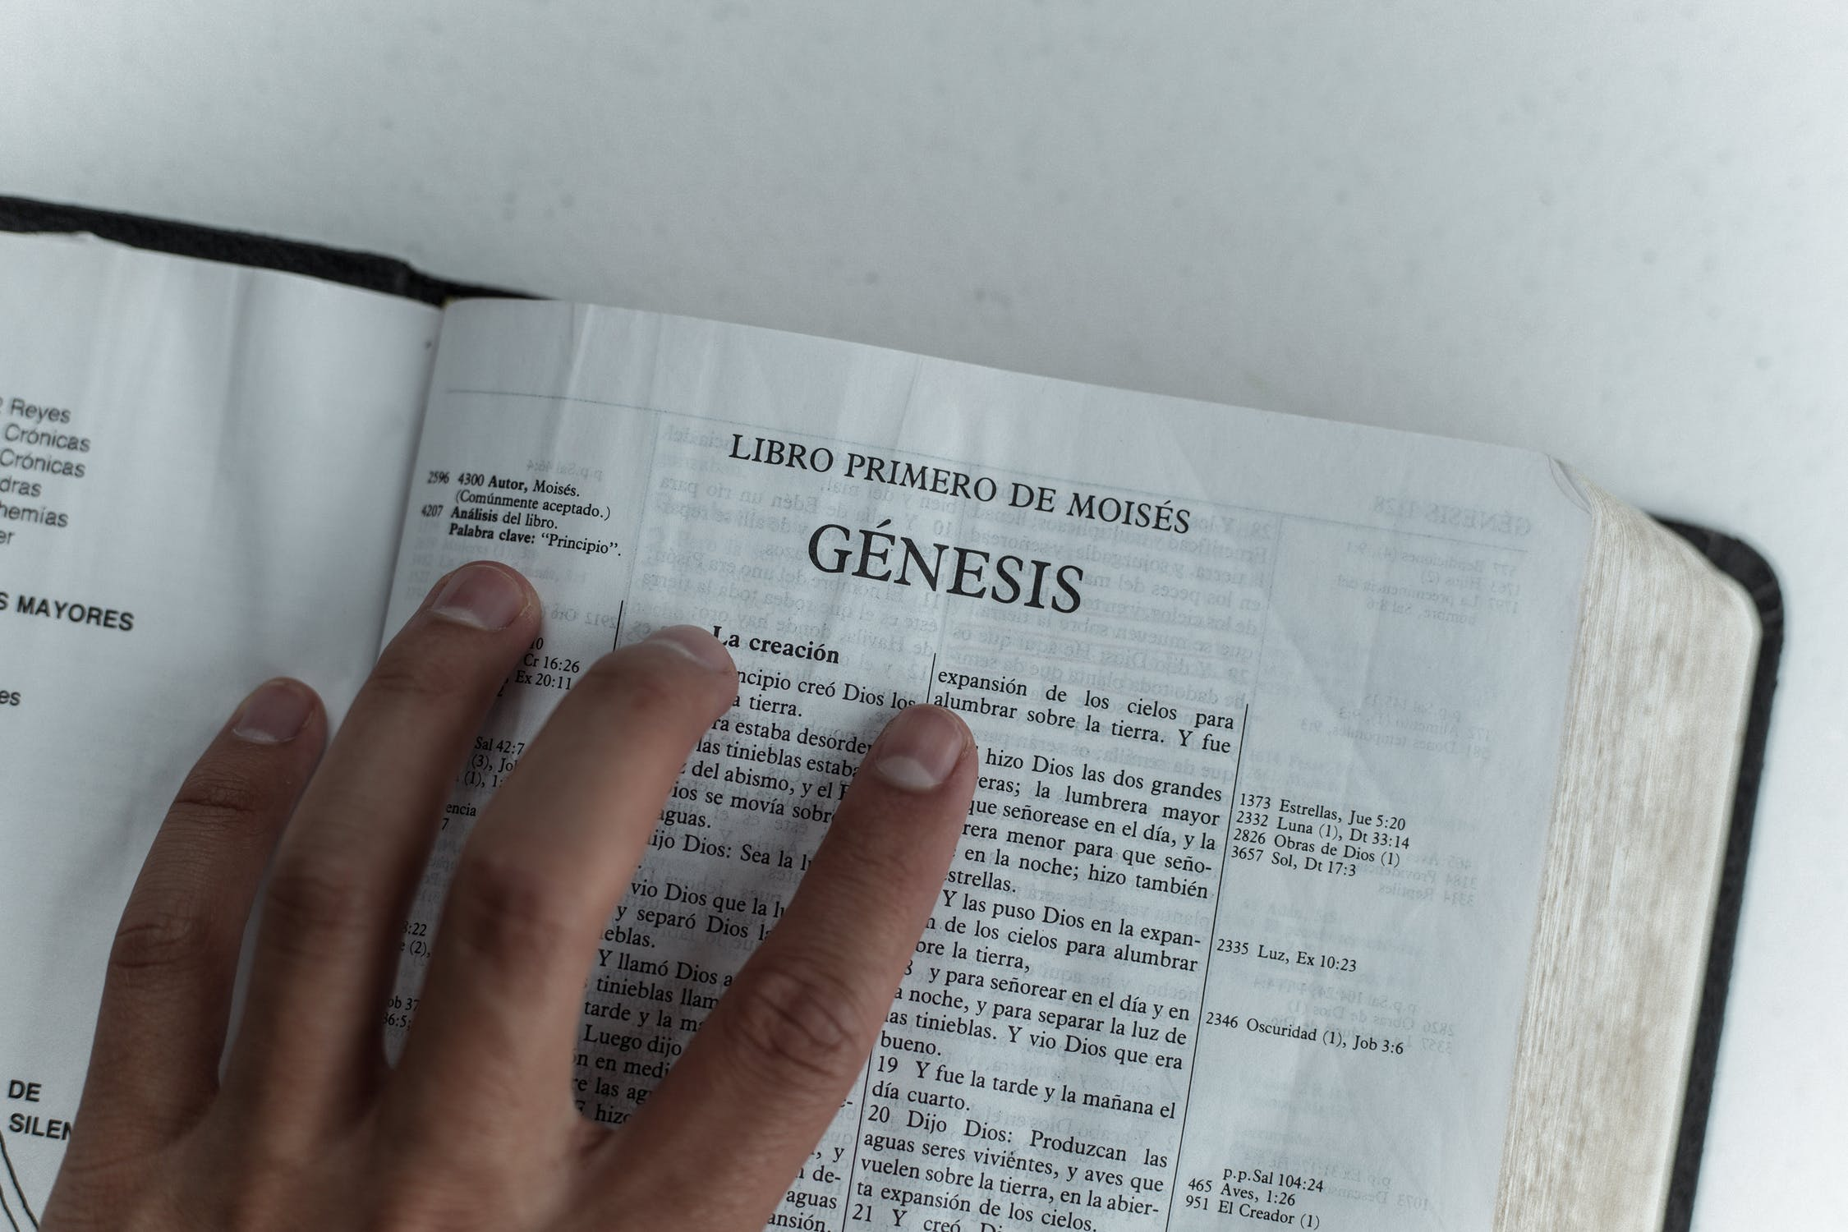
TWO SENSES OF SCRIPTURE
Literal Sense
Refers to what words directly mean either in a precise sense or a figurative sense.
Spiritual Sense
The spiritual sense has three parts:
Allegorical
Moral
Anagogical
How the Church Interprets the Inspired Writings
Notes:
Examples:
Literal sense: “I am the vine, you are the branches” (John 15:5) , God appears to Abram as “a smoking brazier and a flaming torch” (Genesis 15:17)
Spiritual sense (allegorical): The Story of the Israelites crossing the Red Sea (Ex 14)
Spiritual sense (moral): “But I say to you, offer no resistance to one who is evil. When someone strikes you on [your] right cheek, turn the other one to him as well.“ (Mt 5:39)
Spiritual sense (anagogical) Revelation 21:1–22:5; Heb 3:1–4:11, 1 Cor 10:2, 11 (see CCC 117)

Slide 9
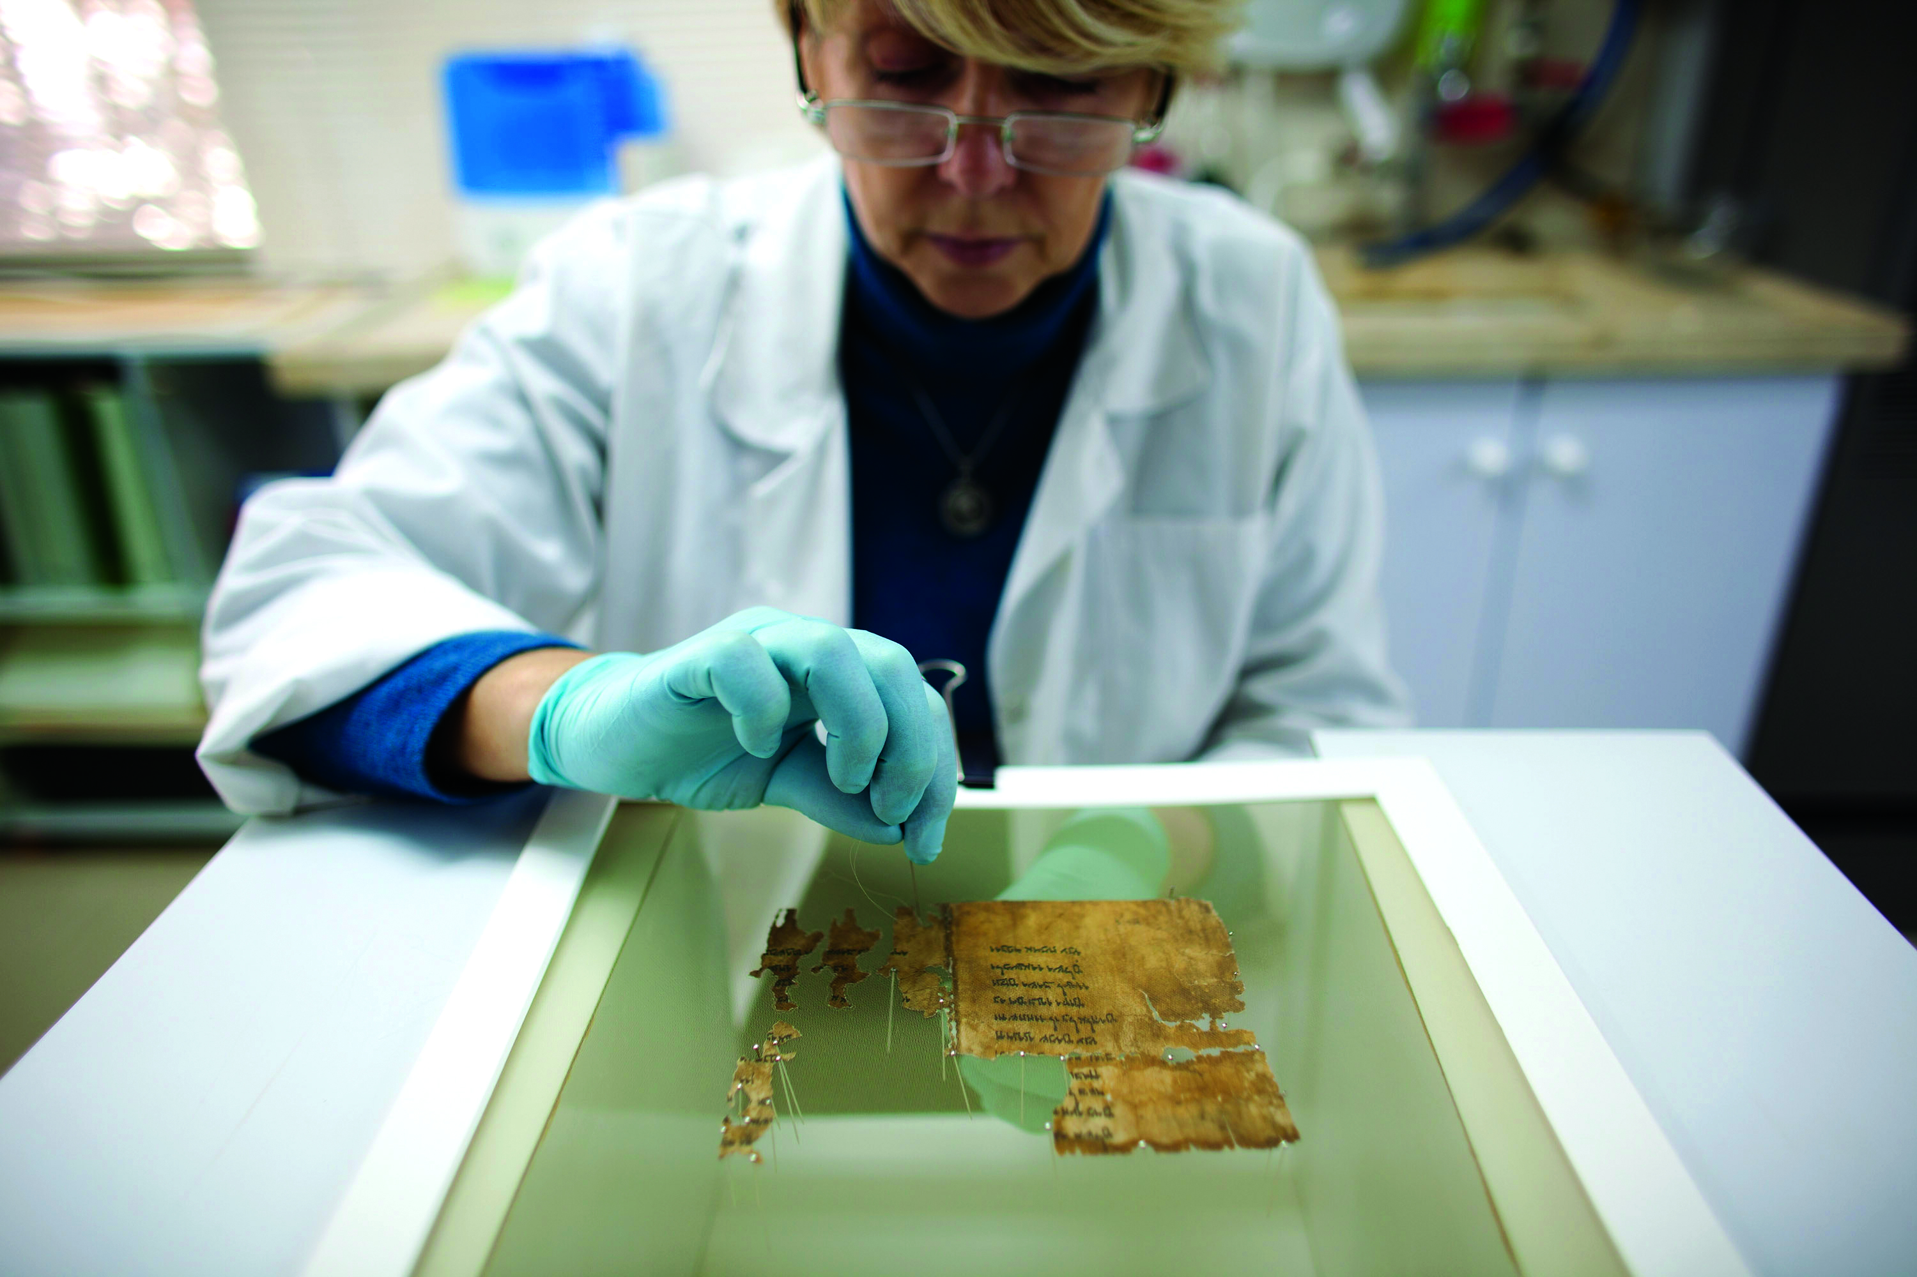
Skills Necessary for Bible Study
Background in biblical languages
Knowledge of contemporary religious writings
Archeological knowledge
How the Church Interprets the Inspired Writings
Notes:
See Chapter 1, Section 1, Teaching Approach 2 for a lesson to accompany this slide.

Slide 10
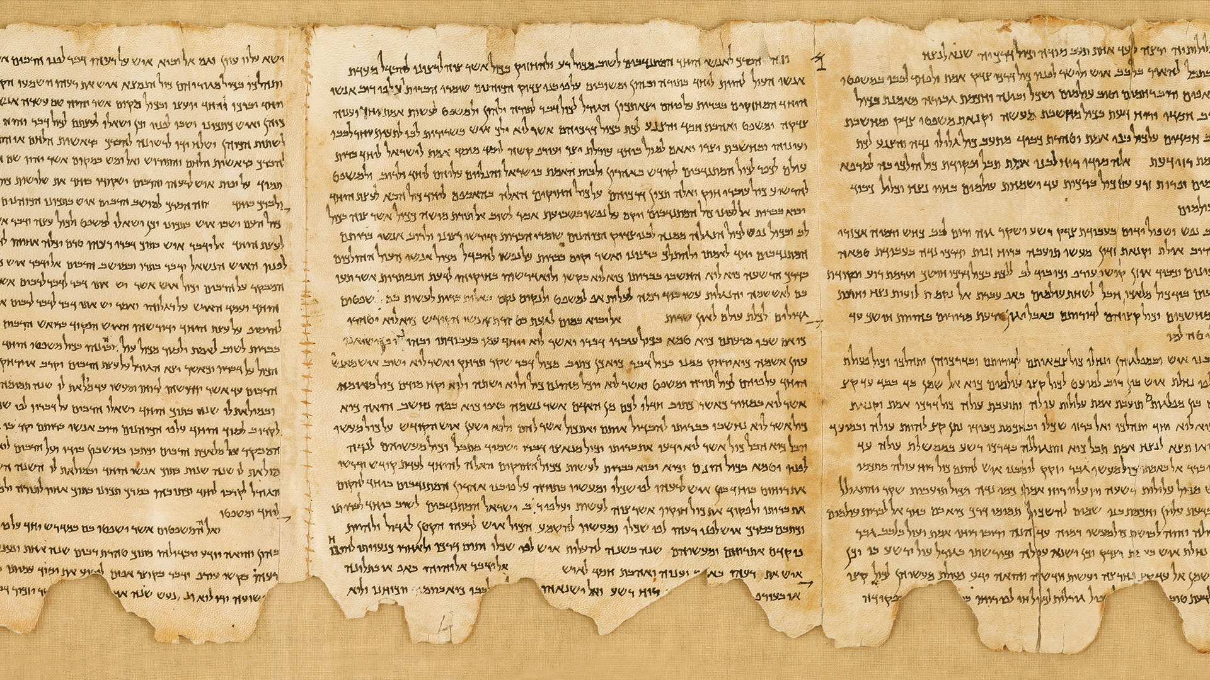
Dating the Old Testament
Defeat of Judah by the Babylonians; Solomon’s temple destroyed
The Reign of Josiah and Deuteronomic Reform
Solomon dies and Hebrew people are divided
Destruction of the second temple and a scattering of Jerusalem Christians
The Exodus of the Hebrew Slaves under Moses
The Fall of the Northern Kingdom to Assyrians
Palestine under direct and full Roman control
Alexander the Great’s invasion of Palestine
Forced Hellenism, oppression of Jews, Maccabean revolt
Missions of Nehemiah and Ezra,
The people of “Israel” are mentioned in a carving found around this time.
Defeat of the Babylonians by Cyrus. Captive people allowed to return
Birth of Jesus Christ
Hebrew Monarchs: Saul, David, Solomon
Building of the Second Temple
1260 BC 1208-1207 1030 930 772 640-609 587-586 539 520-515 450 333 167 63 6-4 70AD
Classifying and Arranging the Old Testament Books
Notes:
Review the Section 2 Comprehension questions 2 and 3 as you display this slide: Comprehension
2. Why is it difficult to pinpoint when a specific Old Testament book was written? It is difficult to pinpoint when a specific Old Testament book was written because ancient writings required institutions—a scribal class—and not merely a few literate persons. The dating continues to be debated today, with some believing Solomon would have been the first king of Israel who had scribes to do some of the writing, while others maintain that most of the early writings come from later on—the eighth or seventh century BC—when there is more evidence of widespread literacy and of royal administrations that would have kept such written records.
3. Using the timeline in this section as a guide, describe the key moments in the history of the Jerusalem Temple.
587–586 BC: The Jerusalem Temple built by Solomon was destroyed.
520–515 BC: The most probable date for the building of the Second Temple in Jerusalem.
AD 70: The destruction of the Second Temple by the Romans.

Slide 11
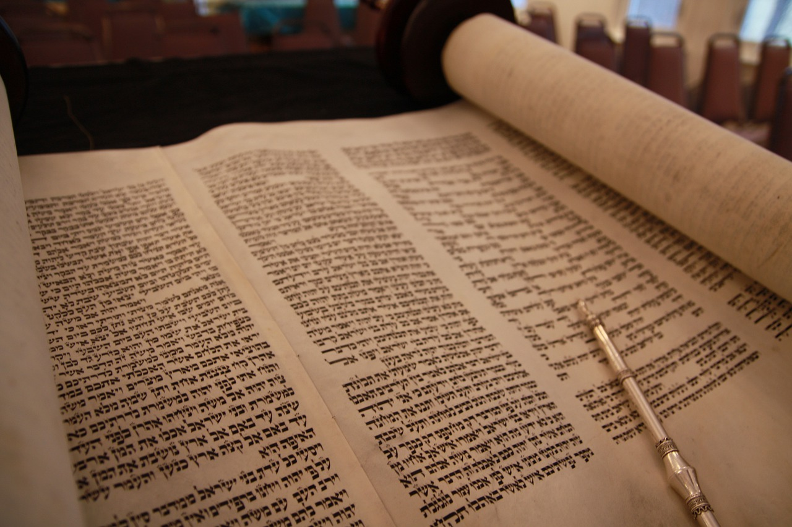
Hebrew and Catholic
Canonical
Differences
Hebrew Canon
The Law | 5 Books of the Torah
The Prophets Nevi’im | 11 Books Former, Latter and the Minor
The Writings Ketuvim | Psalms, Proverbs, Job, Song of Songs, Ruth, Lamentations, Ecclesiastes, Esther, Daniel, Ezra/Nehemiah, and Chronicles
New American Bible Classification
The Pentateuch
The Historical Books
The Wisdom Books
The Prophetic Books
Classifying and Arranging the Old Testament Books
Notes:
Jimmy Akin discusses how the Old Testament came to be as we know it. https://www.youtube.com/watch?v=dF5NYPENhp4

Slide 12
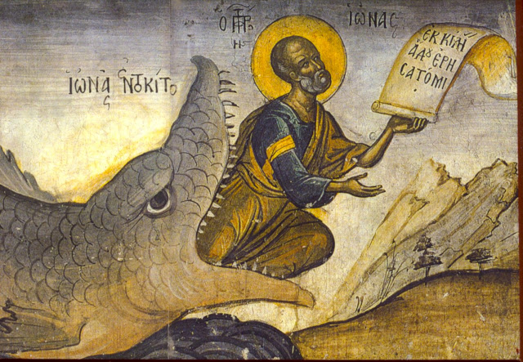
Typology
The study of prefigured patterns of divine activity
How Important is the Old Testament in the Life of the Church
Notes:
Discuss escalation of types from the Old Testament such as Adam prefiguring Christ followed by the other “little Adams’ (Noah, Abraham, David) finally coming to fruition with the Lord Jesus Christ.

Slide 13
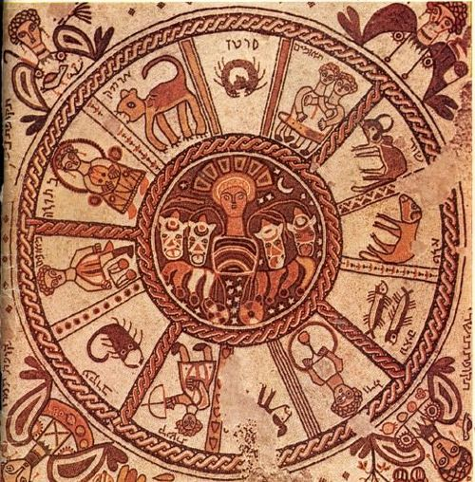
Pseudepigrapha
“False Name”
Ancient books from the same time frame as the books of the Bible, especially the New Testament.
Zodiac Wheel Mosaic
How Important is the Old Testament in the Life of the Church
Notes:
The “Beginners Guide to the Gnostic Gospels” provides an excellent background on the Nag Hammadi texts. https://overviewbible.com/gnostic-gospels/

Slide 14

Critical Reading
B
A number of methods of studying the Bible that aim to discover what God is communicating—both to the people of biblical times and to people today.
How Important is the Old Testament in the Life of the Church
Notes:
Introduce students to Lectio Divina, a four part way to pray and read the Bible. See https://www.benedictinecenter.org/sustained-lectio-divina-lecture/

Slide 15

Word of God
Word of God
Faith and prayer
How Important is the Old Testament in the Life of the Church
Notes:
The Word of God is a “light for our path” see page 29 of textbook. The referenced Catechism passage: “In the formation of conscience the Word of God is the light for our path; we must assimilate it in faith and prayer and put it into practice. We must also examine our conscience before the Lord’s Cross. We are assisted by the gifts of the Holy Spirit, aided by the witness or advice of others and guided by the authoritative teachings of the Church” (CCC 1785).

Slide 16

Journal Question
How can studying the Old Testament deepen our understanding of the promise of salvation and its fulfillment in Jesus Christ?
Notes:
Students might respond about the prefiguring of Christ through Adam, Noah, Moses or discuss the promise God made to his people, those who would be faithful. Students might also reflect on the love of God for them personally and how their Old Testament ancestors of faith have helped them to know of God’s love.

Slide 17
References
Slide 8: http://www.catholiccrossreference.com/biblestudy/four-senses-of-scripture/

Slide 18
Images
Slide 4: https://www.pexels.com/photo/rocky-mountain-671658/
Slide 5: https://en.wikipedia.org/wiki/The_Creation_of_Adam#/media/File:Michelangelo_-_Creation_of_Adam_(cropped).jpg
Slide 6: https://www.patheos.com/blogs/deaconsbench/2012/06/what-exactly-is-the-magesterium/
Slide 7: https://pixabay.com/photos/bible-book-close-up-document-1868359/
Slide 8: https://www.pexels.com/photo/photo-of-person-holding-a-bible-2294873/
Slide 11: https://www.needpix.com/photo/download/1891213/torah-scroll-israel-jewish-religion-synagogue-free-pictures-free-photos-free-images
Slide 12: https://viaemmaus.files.wordpress.com/2014/07/typology.jpg
Slide 13: https://www.ancient.eu/article/893/old-testament-pseudepigrapha/
Slide 14: https://pixabay.com/photos/book-read-book-pages-literature-3964050/
Slide 15: https://www.pexels.com/photo/landscape-photo-of-pathway-between-green-leaf-trees-615348/
Slide 16: https://www.pexels.com/photo/top-view-photo-of-man-reading-a-book-2574619/

