Slide 1

Chapter 6 PowerPoint

Slide 2

[Design to mirror this page in the student text. ]

Slide 3
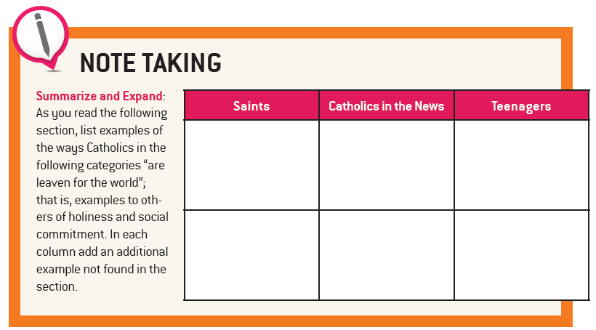
Christ Has No Body But Yours

Slide 4

Christ Has No Body But Yours

Slide 5

Christ Has No Body But Yours

Slide 6

Christ Has No Body But Yours

Slide 7
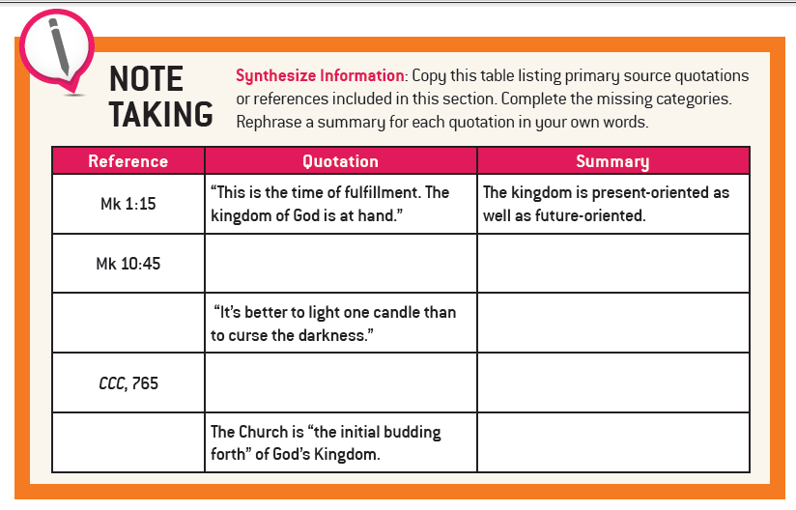
The Church’s Divine Purpose and Mission

Slide 8

The Church’s Divine Purpose and Mission

Slide 9

Parables of the Kingdom of God (Mt 13:44-50)
† The kingdom of
heaven is like a treasure buried in a field, which a person finds and hides again, and out of joy goes and sells all that he has and buys that field.
† Again, the kingdom of heaven is like a merchant searching for fine pearls. When he finds a pearl of great price, he goes and sells all that he has and buys it.
† Again, the kingdom of heaven is like a net thrown into the
sea, which collects fish of every kind. When it is full they haul
it ashore and sit down to put what is good into buckets. What
is bad they throw away. Thus it will be at the end of the age.
The angels will go out and separate the wicked from the
righteous and throw them into the fiery furnace, where
there will be wailing and grinding of teeth.
The Church’s Divine Purpose and Mission

Slide 10
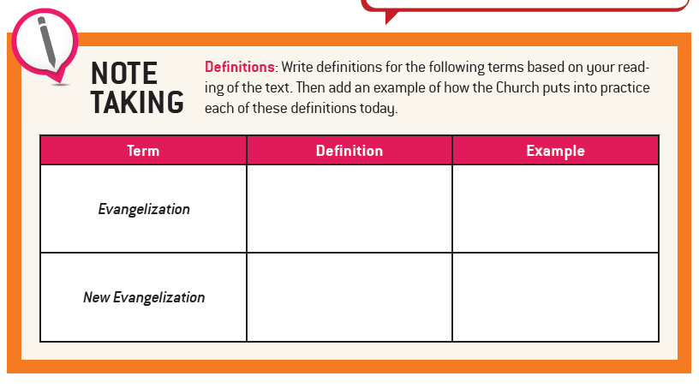
A New Evangelization

Slide 11

A New Evangelization

Slide 12
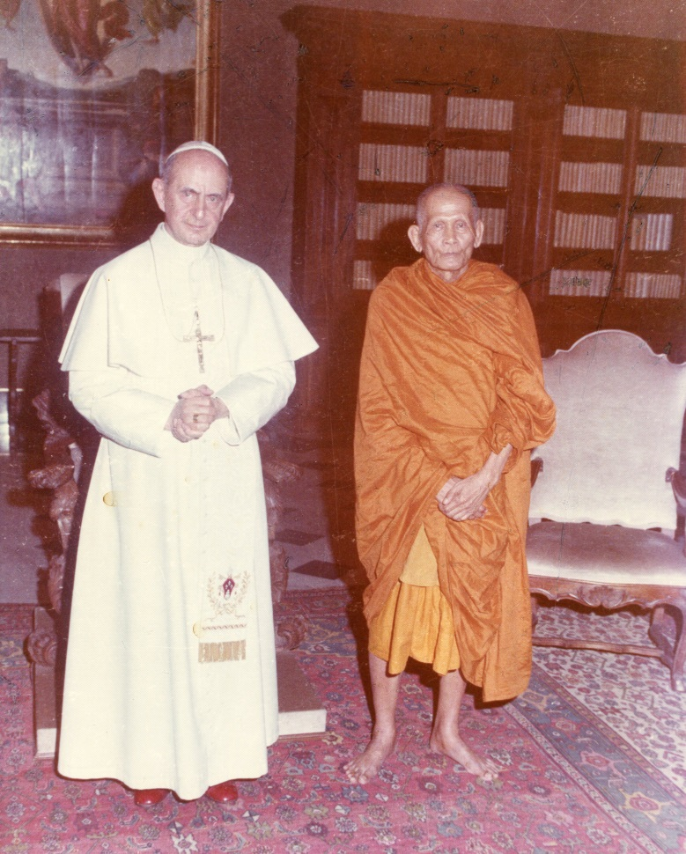
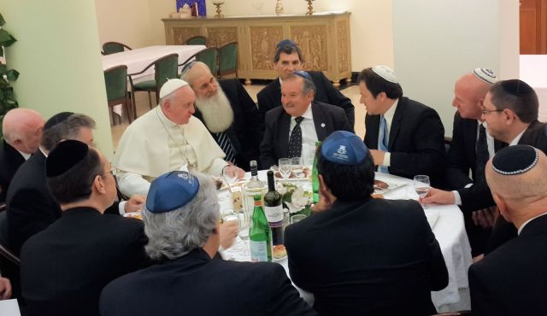
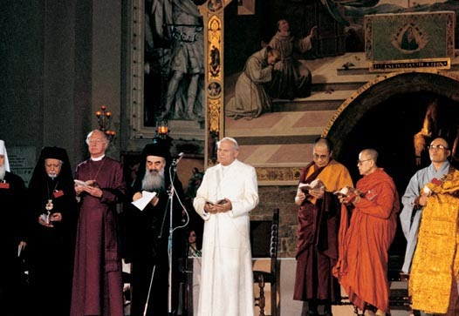
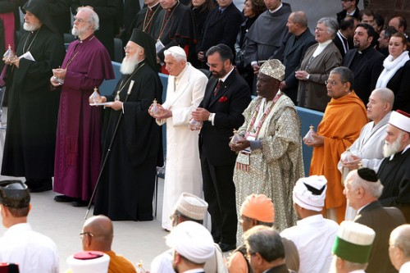
Interreligious dialogue among the recent popes
A New Evangelization

Slide 13
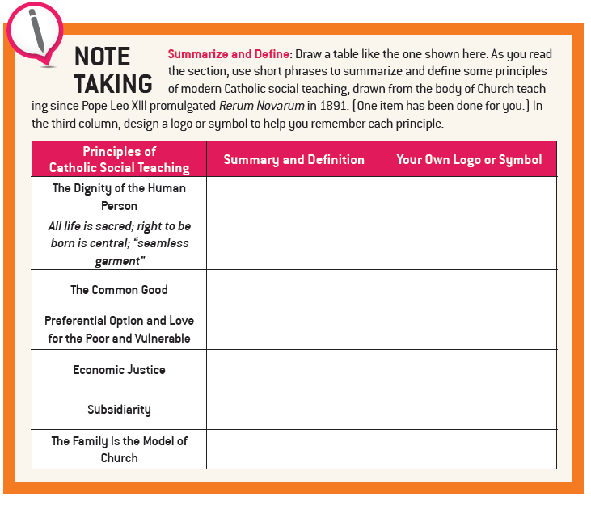
The Visible Witness of Faith

Slide 14
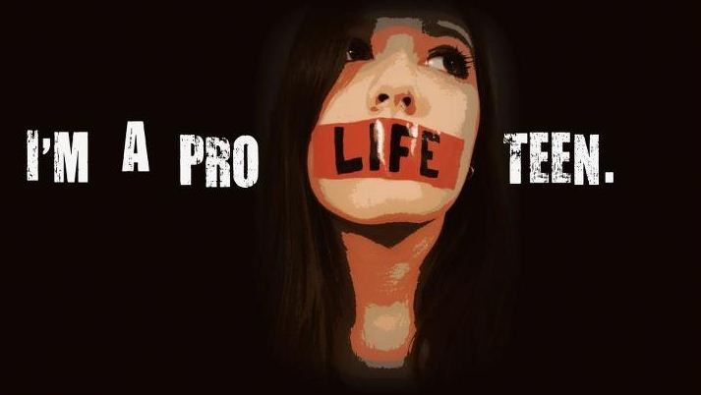
d
The Visible Witness of Faith

Slide 15
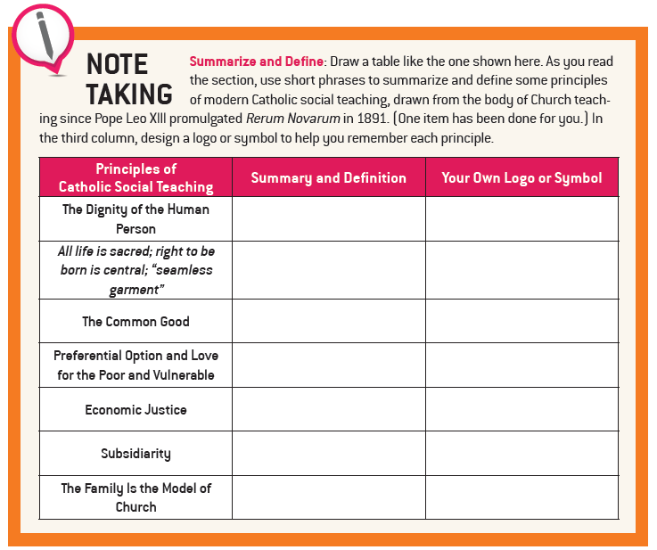
The Visible Witness of Faith

Slide 16
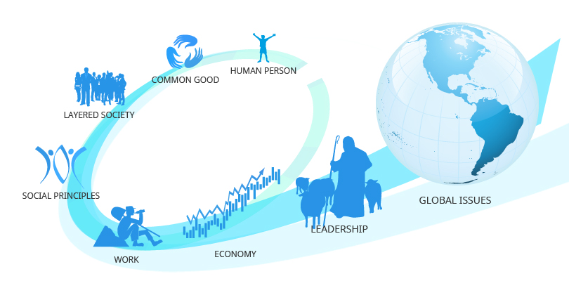
How do we connect our faith with everyday life?
How does our faith help us to build a better world?
The Visible Witness of Faith

Slide 17

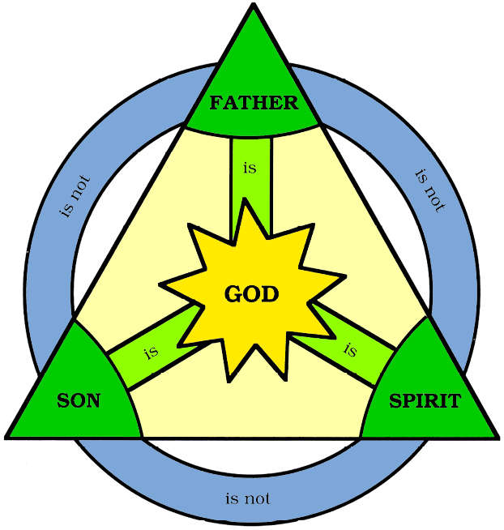


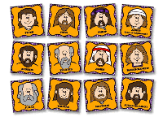
I Believe in One, Holy, Catholic, and Apostolic Church

