Slide 1
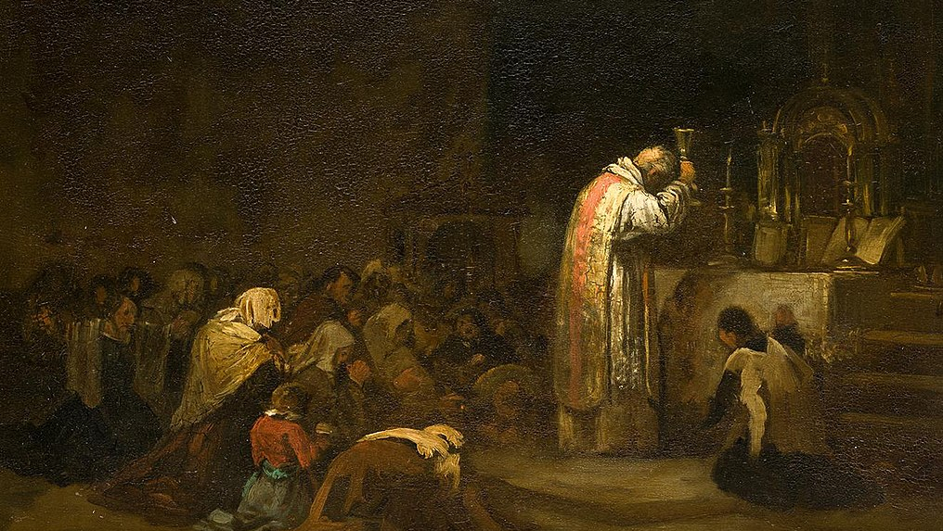
6
Jesus Calls Us to Faith
God Loves: Jesus Christ Enters the World
Notes:
Photo Credit: Mass (The Elevation). Lucas Velázquez. Public Domain.
Suggestions for students’ note taking:
●Require students to use a three ring binder (1/2-1 inches) full of loose leaf paper (college or wide ruled).
●Notes must be taken in pen only and hand written.
●Notebooks should contain information and notes for religion class only.
●Notebooks must have a table of contents with topic of notes, dates and page numbers.
●All notes must have a topic and page number.
●Students will be required to copy each slide unless the teacher directs students to skip certain slides or parts of slides. Notebooks will be graded based on neatness, completeness and organization. Notebooks should have a significant point value representing 20-25% of the overall grade.
The videos linked in this presentation file may contain copyright material. Such material is made available for educational purposes only. This constitutes a “fair use” of any such copyright material as provided for in Title 17 U.S.C. section106A-117 of the US Copyright Law.

Slide 2
“Lord, if it’s you,” Peter replied,
“tell me to come to you on the water.”
“Come!” he said.
-Mt 14:18-19
Notes:
Photo Credit: Christ Walking on the water. Julius Sergius von Klever.Public domain. Cropped.https://commons.wikimedia.org/wiki/File:Christ_Walking_on_the_Waters,_Julius_Sergius_Von_Klever.jpg
Directions: Have students copy information from slide into their notes.
Teaching Points: Jesus himself taught and demonstrated that with faith, what might be deemed impossible is possible:
After Jesus tells him to come and gives him confidence, Peter is able “to walk on the water toward Jesus.
Jesus says that “if you have faith the size of a mustard seed, you will say to this mountain, ‘Move from here to there,’ and it will move. Nothing will be impossible for you” (Mt 17:20).
Jesus’s actions were impacted by the faith—or lack of faith—of others. When he returned home to Nazareth, some of his neighbors “took offense at him . . . so he was not able to perform any mighty deed there, apart from curing a few sick people by laying his hands on them. He was amazed at their lack of faith” (Mk 6:3, 5–6).
Why did Jesus need the faith of others to do miracles of healing and other miracles?
Online Resources: Have students view video, Why is Faith a Virtue? Do we need Faith?. URL here: https://youtu.be/U7O9tUueDJ8
The videos linked in this presentation file may contain copyright material. Such material is made available for educational purposes only. This constitutes a “fair use” of any such copyright material as provided for in Title 17 U.S.C. section106A-117 of the US Copyright Law.

Slide 3
Faith is a Gift that Requires a Response
Imagine receiving a gift from a grandparent with a new laptop inside for you to use at school and help with your studies.
The gift is wrapped beautifully with shiny paper and a colorful bow. The package looks too nice to open. But open it you must if you are to get the benefits of the laptop for your studies.
Faith is like that. The gift from God is great indeed, but we must unwrap it—in other words, respond to it—in order to use it.
Notes:
Photo Credit: rawpixel.com rawpixel. Creative Commons Zero, Public Domain Dedication. Shopping for gifts. https://commons.wikimedia.org/w/index.php?search=+laptop+computer+gift&title=Special:MediaSearch&go=Go&type=image
Directions: Have students summarize the information from the slide into their notes.
Teaching Points: St. Paul referred to our human response to God’s Revelation as “the obedience of faith” (Rom 1:5). Matthew 13:58 reports that Jesus did not work “many mighty deeds” in Nazareth because of the “lack of faith.”
The disciple of Christ must not only keep the faith and live on it, but also profess it, confidently bear witness to it, and spread it: "All however must be prepared to confess Christ before men and to follow him along the way of the Cross, amidst the persecutions which the Church never lacks." Service of and witness to the faith are necessary for salvation: "So everyone who acknowledges me before men, I also will acknowledge before my Father who is in heaven; but whoever denies me before men, I also will deny before my Father who is in heaven.” - CCC 1816
Online Resources: Assign article, Turn to God for the Supernatural Gift of Faith. URL here: https://www.sfcatholic.org/bishopsbulletin/turn-to-god-for-the-supernatural-gift-of-faith/
The videos linked in this presentation file may contain copyright material. Such material is made available for educational purposes only. This constitutes a “fair use” of any such copyright material as provided for in Title 17 U.S.C. section106A-117 of the US Copyright Law.

Slide 4
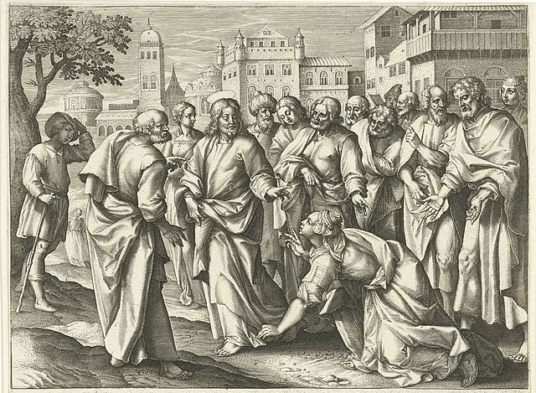
“Your Faith Has Saved You.”
Notes:
Photo Credit: Genezing van de vrouw die aan bloedvloeiingen leed Vita, passio et Resurrectio Iesv Christi (serietitel) Leven, passie en wederopstanding van Christus (serietitel) A woman suffering from bleeding constantly touches the hem of the garment of Christ. Manufacturer : printmaker Jacques de Bie (listed property) designed by: Marten de Vos (listed building) publisher: Adriaen Collaert (listed property) Place manufacture: Antwerp Date: 1598 - 16 Contributor: Art World / Alamy Stock Photo.File size: 891.4 KB jpeg.This image is a public domain image, which means either that copyright has expired in the image or the copyright holder has waived their copyright.
Directions: Have students view the slide into their notes.Ask them to locate one interesting detail as you read the Gospel below Then discuss the image.
When she heard about Jesus, she came up behind him in the crowd and touched his cloak, because she thought, “If I just touch his clothes, I will be healed.”
Immediately her bleeding stopped and she felt in her body that she was freed from her suffering.
At once Jesus realized that power had gone out from him. He turned around in the crowd and asked, “Who touched my clothes?” “You see the people crowding against you,” his disciples answered, “and yet you can ask, ‘Who touched me?’ ” But Jesus kept looking around to see who had done it. Then the woman, knowing what had happened to her, came and fell at his feet and, trembling with fear, told him the whole truth. He said to her, “Daughter, your faith has healed you. Go in peace and be freed from your suffering.”- Luke 8:43-38
Teaching Points: The power of Jesus is released seemingly without his awareness because the woman’s faith is so strong. There’s a connection to the sacraments because she touches his tassel and grace runs out through it into her. The tassel is a material object that transmits God’s grace. The sacraments, to be efficacious, also depend on the recipient’s disposition which is primarily faith.
Online Resources: Have students view video, Jesus and the Woman with the Hemorrhage. URL here:https://youtu.be/rI5xVihFIwI
The videos linked in this presentation file may contain copyright material. Such material is made available for educational purposes only. This constitutes a “fair use” of any such copyright material as provided for in Title 17 U.S.C. section106A-117 of the US Copyright Law.

Slide 5
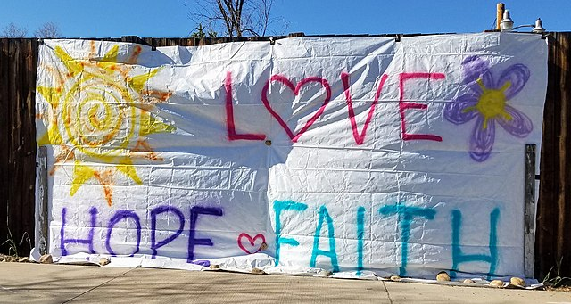
Theological Virtues
Key
Vocab
The theological virtues dispose Christians to live in a relationship with the Holy Trinity. They have God for their origin, their motive, and their object - God known by faith, God hoped in and loved for his own sake. -CCC 1840
Notes:
Photo Credit: Love, Hope & Faith sign during the pandemic. Xnatedawgx. Creative Commons Attribution-Share Alike 4.0. https://commons.wikimedia.org/wiki/File:Love,_Hope_%26_Faith_sign_during_the_pandemic._2020-05-04.jpg
Directions: Have students add this vocabulary term to their notes.
Teaching Points: God has spoken to people—including many saints—through visions, revelations, and apparitions. The Church, through local bishops, has approved several specific times God has spoken in these ways to individuals and disapproved of many others
Online Resources: Have students view video, Faith, Hope and Love. URL here: https://youtu.be/F3m2sWf4Lko
The videos linked in this presentation file may contain copyright material. Such material is made available for educational purposes only. This constitutes a “fair use” of any such copyright material as provided for in Title 17 U.S.C. section106A-117 of the US Copyright Law.

Slide 6
Three Theological Virtues
01
FAITH
We believe in God and believe all that he has said and revealed to us, and that Holy Church proposes for our belief, because he is truth itself.
02
We desire and seek our ultimate good and happiness which is eternal life in the kingdom of heaven.
HOPE
03
LOVE
We choose to follow Jesus’s command to love God and others in a selfless and sacrificial way.
Notes:
Directions: Have students copy down information from the slide into their notes.
Online Resources: Have students watch video, Theological Virtues. URL here: https://youtu.be/mm5joP0zlqc
The videos linked in this presentation file may contain copyright material. Such material is made available for educational purposes only. This constitutes a “fair use” of any such copyright material as provided for in Title 17 U.S.C. section106A-117 of the US Copyright Law.

Slide 7
Faith Has Essential Elements
Faith is a gift but your response must be free.
Faith is illumination and does not conflict with true science.
Faith is reasonable, not a blind leap.
Faith is certain and yet grows with understanding.
Faith is an act of the Church that brings us closer to God.
Notes:
Directions: Have students copy information from the slide into their notes.
Teaching Points: Pope John Paul II wrote, “Faith and reason are like two wings on which the human spirit rises to the contemplation of truth”. According to Hebrews 11:1-3, ‘Faith is the realization of what is hoped for and evidence of things not seen’. This implies an assurance and an inner conviction associated with one’s belief. For Catholics faith is NOT and never will be a blind leap. Because faith is reasonable and evidence based, faith is certain.
The CCC says that we can be certain of God and his existence based on reason. “By natural reason man can know God with certainty, on the basis of his works”. We can reason about God's existence by simply looking around at the amazing order, design and beauty in nature. We can say something like, ‘This sunset is better than any painting. It is a work of art, a masterpiece, therefore there must be an uppercase A, Artist who created it’. We may also say’, ‘Since I am seeing complex structures and machines in the cell which require a knowledge of engineering principles to comprehend, there must be an uppercase E, Engineer behind its design’. There is another way of knowing God and that is through believing what God has said and what others have said. We believe in the truth of the Gospel message handed on by the Church.
Online Resources: Assign article, Faith is Not a Blind Leap.URL here: https://www.catholic365.com/article/30598/for-catholics-faith-is-not-a-blind-leap.html
The videos linked in this presentation file may contain copyright material. Such material is made available for educational purposes only. This constitutes a “fair use” of any such copyright material as provided for in Title 17 U.S.C. section106A-117 of the US Copyright Law.

Slide 8
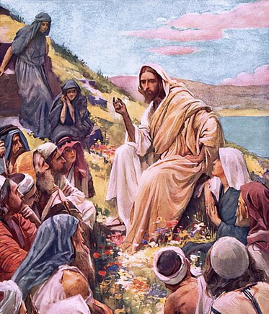
“Come to Me, all you who are weary and burdened, and I will give you rest. Take My yoke upon you and learn from Me;
for I am gentle and humble in heart.”
-Mt 11:28
Notes:
Photo Credit: The sermon on the mount. Unknown. Public Domain (US).
Directions: Have students copy information from slide into their notes.
Teaching Points: Because faith is a free gift from God and one that demands our response, faith is personal. It is our personal decision whether or not to surrender ourselves to the mystery of God that has been revealed to us. When we do make a conscious decision to trust and believe, our faith is deepened. This personal response to God’s mystery must occur before we can act in communion with others in the Church, the Body of Christ. God must touch us with the gift of faith, and only then will we experience the fullness of faith, which is unity with Christ, the head of the Body. Many times faith comes down to trusting in the goodness of Jesus. How would trusting Jesus lead to rest and an unloading of a burden?
Online Resources: Have students view video, Peter Walking on Water Scene of the Chosen. URL here: https://youtu.be/O7WWi65gb14
The videos linked in this presentation file may contain copyright material. Such material is made available for educational purposes only. This constitutes a “fair use” of any such copyright material as provided for in Title 17 U.S.C. section106A-117 of the US Copyright Law.

Slide 9
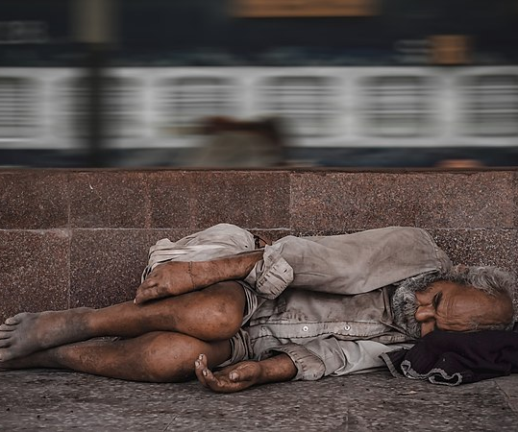
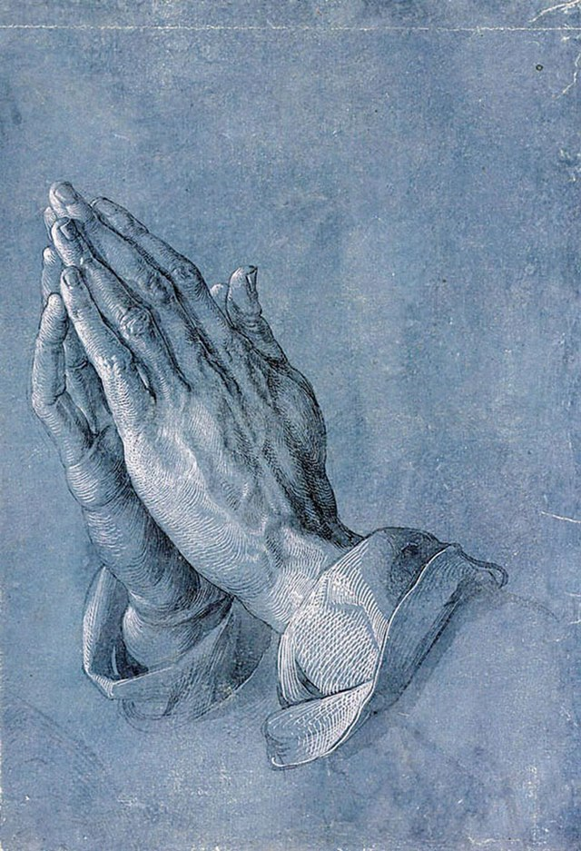
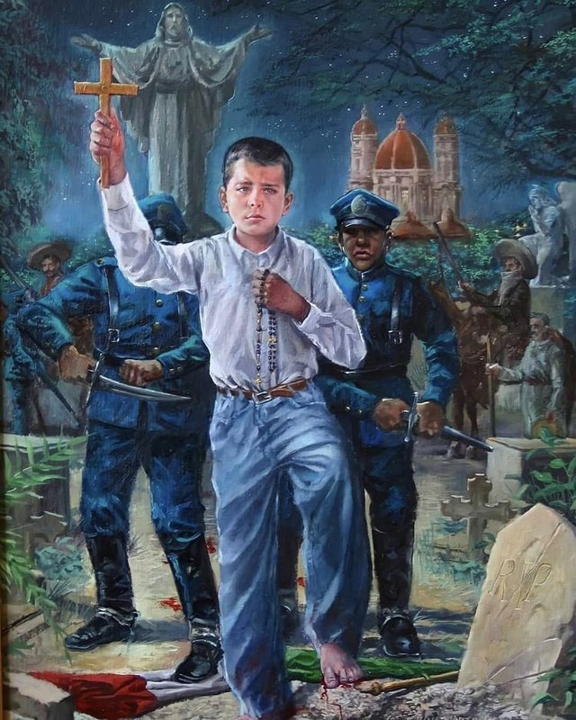
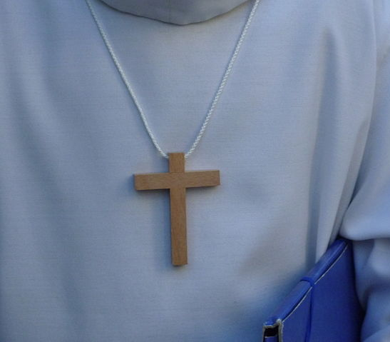
Signs of Personal Faith
We model personal faith by thinking of others and embracing the spirit of poverty and justice.
We demonstrate personal faith in our daily prayer life.
We exemplify our personal faith by taking a stand for what is right and overcoming fear.
We show personal faith by sharing our beliefs with others in a way that is convincing.
Notes:
Photo Credit: Raazsingh007. Creative Commons Attribution-Share Alike 4.0. A poor man. Duerer-Prayer.jpg
Public domain.Martirio de San José Sánchez del Río. Public domain. France before the Palm Sunday procession. Paterm. Creative Commons Attribution-Share Alike 4.0.
Directions: Have students summarize into a few words the four ways Catholics can show their personal faith. .
Teaching Points: The disciple of Christ must not only keep the faith and live on it, but also profess it, confidently bear witness to it, and spread it: "All however must be prepared to confess Christ before men and to follow him along the way of the Cross, amidst the persecutions which the Church never lacks" Service of and witness to the faith are necessary for salvation: "So everyone who acknowledges me before men, I also will acknowledge before my Father who is in heaven; but whoever denies me before men, I also will deny before my Father who is in heaven.-CCC 1816. These external signs of personal faith are a result of a strong internal faith. Faith leads to good works.
Online Resources: Have students view video, What You Need to be Saved (Faith v. Works). URL here: https://youtu.be/ixHGR2wL7_o
The videos linked in this presentation file may contain copyright material. Such material is made available for educational purposes only. This constitutes a “fair use” of any such copyright material as provided for in Title 17 U.S.C. section106A-117 of the US Copyright Law.

Slide 10
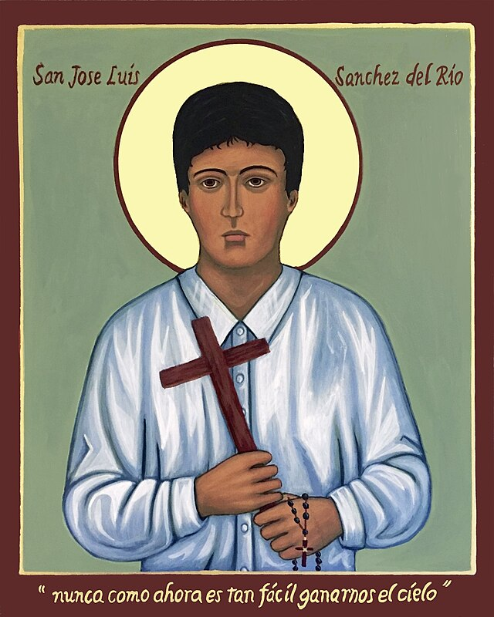
“Take Heart… I have Conquered The World!”
Asking for an increase in the virtue of courage can lead the way to doing brave and meaningful things in our lives, much like St. José Sánchez del Río, who lived only a century ago. With this holy martyr, we too exclaim, “Viva Cristo Rey!”
Saint Jose Sanchez
Notes:
Photo Credit: San-Jose-Luis-Sanchez-del-Rio.jpg. Recently canonized Mexican saint. Citromike. Creative Commons Attribution 4.0
Directions: Have students copy the information from the slide into their notes.
Teaching Points: The Latin root of courage is ‘cor’, which means “heart.” With this virtue of the Holy Spirit, we can “take heart” and be encouraged even when facing our greatest fears.
Jesus encouraged his followers to have faith and courage. “Now we realize that you know everything and that you do not need to have anyone question you. Because of this we believe that you came from God.” Jesus answered them, “Do you believe now? Behold, the hour is coming and has arrived when each of you will be scattered to his own home and you will leave me alone. But I am not alone, because the Father is with me. I have told you this so that you might have peace in me. In the world you will have trouble, but take courage, I have conquered the world.” -Jn 16:30-33.
Saints also gives us confidence in our faith: On October 16, 2016, Pope Francis canonized José Sánchez del Río. In 2021, Cardinal Francisco Robles Ortega dedicated a statue of the new saint in Guadalajara, Mexico. The cardinal commented, “There are many young men and women today who are not finding what to do with their lives. They don’t know what they are in this world for. They are not discovering what they came into this world for and they live an existential void,” which only “produces a deeper void.” He encouraged young people to look to the powerful witness of José Sánchez del Río.
Online Resources: Have students view video, Young Saints- Jose Sanchez del Rio.URL here: https://youtu.be/mr3fwyohZx0
The videos linked in this presentation file may contain copyright material. Such material is made available for educational purposes only. This constitutes a “fair use” of any such copyright material as provided for in Title 17 U.S.C. section106A-117 of the US Copyright Law.

Slide 11
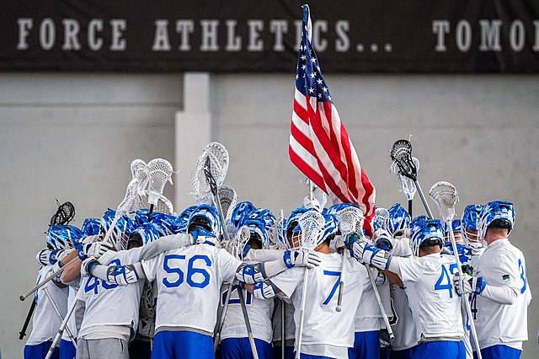
“We Believe…”
“For where two or three are gathered together in my name, there am I in the midst of them”
-Mt 18:20
Notes:
Photo Credit: Trevor Cokley. Public domain.Air Force Falcons lacrosse players huddle. https://commons.wikimedia.org/wiki/File:Air_Force_Falcons_lacrosse_players_huddle.jpg
Directions: Have students copy the information from the slide into their notes.
Teaching Points: Catholic Faith is never just ‘me, my bible and God”. It is always a ‘we, the Church seeking salvation as a community’.
The idea of communal faith is that our lives are interconnected, and that we can't live completely independent lives. It's based on the idea that community allows people to support each other through difficult times, celebrate together, and help each other meet their needs.
The Church, therefore, from the beginning is the place of faith, the place for the transmission of the faith, the place in which, through Baptism, we are immersed in the Paschal Mystery of the Death and Resurrection of Christ, who frees us from the slavery of sin, gives us the freedom of children and introduces us into communion with the Trinitarian God. At the same time, we are immersed in communion with other brothers and sisters of the faith, with the entire Body of Christ, brought out of our isolation.
Online Resources: Assign article, Faith Both Individual and Communal. URL here: https://www.ewtn.com/catholicism/library/faith-both-individual-and-communal-22879
Assign article, Catholicism is Caught not Taught. URL here: https://aleteia.org/2016/07/07/handing-down-the-faith-catholicism-is-caught-not-taught
The videos linked in this presentation file may contain copyright material. Such material is made available for educational purposes only. This constitutes a “fair use” of any such copyright material as provided for in Title 17 U.S.C. section106A-117 of the US Copyright Law.

Slide 12
Turn and Talk
Turn & Talk
Think about a group you belong to (e.g., team, band, or class at school). Draw comparisons between belonging to that group and belonging to the Church as the Body of Christ. How are the experiences similar? How are they different?
Notes:
Directions: Have students write down the question and then write down their answer….Then have students share their answers with one person close by.
The videos linked in this presentation file may contain copyright material. Such material is made available for educational purposes only. This constitutes a “fair use” of any such copyright material as provided for in Title 17 U.S.C. section106A-117 of the US Copyright Law.

Slide 13
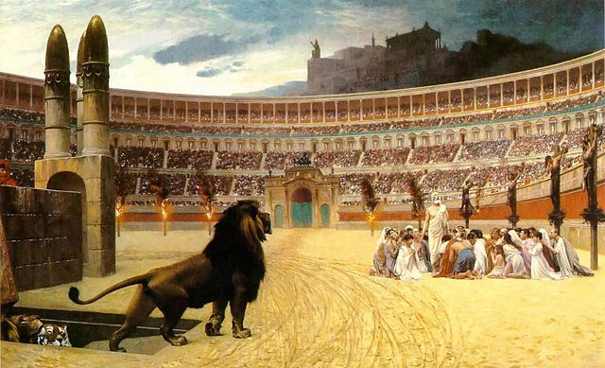
The Courageous Church
St. Irenaeus of Lyons pointed out the beauty of the Church believing, preaching, and handing on the faith with a “unanimous voice, as if possessing only one mouth.” Sometimes, in the history of the Church, the unanimous voice rises in a courageous action of communal faith that can be witnessed by all.
Notes:
Photo Credit: Jean-Léon Gérôme. Public domain. The Christian Martyrs Last Prayer. https://commons.wikimedia.org/wiki/File:The_Christian_Martyrs_Last_Prayer.jpg
Directions: Have students copy information from the slide into their notes.
Teaching Points: The Gift of Fortitude underscores the concomitant virtue of courage—the virtue of the heart—giving us strength to stand for Jesus in times of trial and temptation. Fortitude comes from the Latin fortis, meaning “strong”—the ability of having strength against force or attack. The strength we need so much in today’s world is found in the ability to resist basic human weaknesses—particularly fear. We all naturally fear danger and suffering; but sometimes we have to endure such things for a greater good or for someone else’s well-being.
Like the early Church which was openly persecuted and many martyrs gave all for the witness to the Faith, we have recent example of courage in the Church when we recall John Paul II’s visit to Poland when it was controlled by the USSR. For a Polish Pope to go there it was like entering the lion’s den.
Online Resources: Have students view video, John Paul II in Poland. URL here: https://youtu.be/vQyfju4byCg
Assign article, “We Want God’, The Sermon in Victory Square. URL here: https://breakingground.us/we-want-god/
Have students view video, St. Irenaeus of Lyon. URL here: https://youtu.be/h-eVqKmwZec
The videos linked in this presentation file may contain copyright material. Such material is made available for educational purposes only. This constitutes a “fair use” of any such copyright material as provided for in Title 17 U.S.C. section106A-117 of the US Copyright Law.

Slide 14
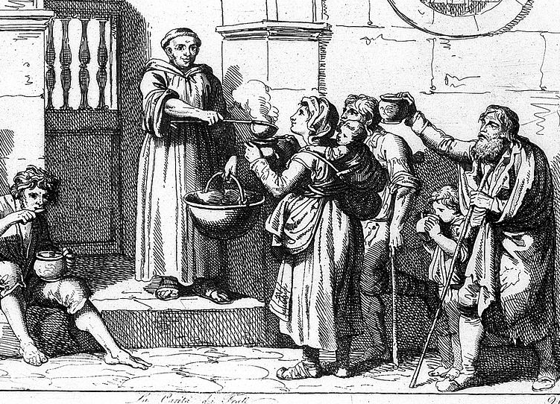
Poverty and Communal Faith
The Church has stressed the responsibility of all Catholics, not just priests and religious, to carry out a common mission of caring for the poor. Caring for the poor is no longer viewed as a work of charity but as a matter of justice.
Notes:
Photo Credit: Child welfare: Monk giving out food to poor. Raccolta. CC BY 4.0 (Deed - Attribution 4.0 International - Creative Commons).
Directions: Have students copy information from the slide into their notes.
Teaching Points: The Church sees that part of her task is to restore the world to the state of equality God intended, especially in the areas of freedom and opportunity.
All people should be able to meet their basic needs without undue hardship and that their lives should not be reduced to a day to-day fight for survival.
All people should be able to participate in the economic life of their nation. Economic policy should not be decided only by those who have wealth, and opportunities for advancement should not go primarily to those who already have the most.
Pope John Paul II, Pope Benedict, Pope Francis and other popes have challenged government to provide a “preferential option for the poor.”
Online Resources: Have students view video, USCCB: Option for the Poor and the Vulnerable. URL here: https://youtu.be/cWuoECvwjUA
The videos linked in this presentation file may contain copyright material. Such material is made available for educational purposes only. This constitutes a “fair use” of any such copyright material as provided for in Title 17 U.S.C. section106A-117 of the US Copyright Law.

Slide 15
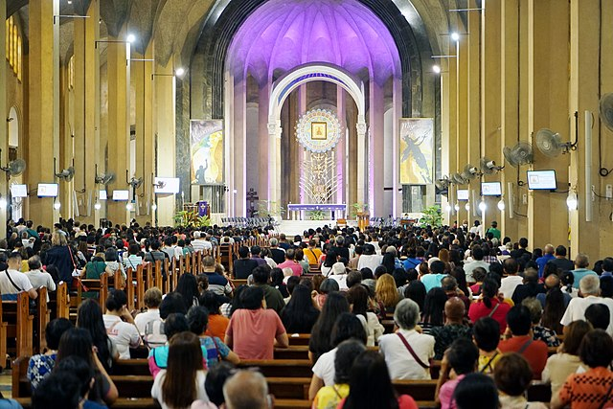
The Liturgy Reshapes the Word
The liturgy is the place to which we bring the activity of the world so that it may be reshaped by the mystery of Christ and then returned to the world as something new.
Notes:
Photo Credit: PNA photo by Ben Briones. Public domain. Catholic devotees attend the 7 a.m. Mass inside the Baclaran Church in Parañaque City. https://commons.wikimedia.org/wiki/File:Catholic_devotees_attend_the_7_a.m._Mass_inside_the_Baclaran_Church_in_Para%C3%B1aque_City_on_April_6,_2022_(53876).jpg
Directions: Have students copy information from the slide into their notes.
Teaching Points: Christ and will be completed at the time of his Second Coming. The Church uses the public liturgy to enact the world as God intends it to be. The liturgy is the place to which we bring the activity of the world so that it may be reshaped by the mystery of Christ and then returned to the world as something new. In the liturgical life of the Church, all of the basic elements of communal life take on new meaning. Birth and death, eating and drinking, greeting one another, communication in marriage, forgiveness—all are transformed in the presence of Jesus. The liturgical life of the Church helps us to see and understand that transformation; what is more, it gives us the grace to live our new life in Christ in the world.
Online Resources: Have students view video, Motivation to go to Catholic Mass. URL here: https://youtu.be/FuyxQvb9Ayw
The videos linked in this presentation file may contain copyright material. Such material is made available for educational purposes only. This constitutes a “fair use” of any such copyright material as provided for in Title 17 U.S.C. section106A-117 of the US Copyright Law.

Slide 16
Memorize It
Key
Verse
"Truly I tell you, if you have faith as small as a mustard seed, you can say to this mountain, 'Move from here to there,' and it will move. Nothing will be impossible for you".
-Mt 17:20
Notes:
Directions: Have students copy the quote. Add bonus points to the assessment if they can copy it down demonstrating that they memorized it.
The videos linked in this presentation file may contain copyright material. Such material is made available for educational purposes only. This constitutes a “fair use” of any such copyright material as provided for in Title 17 U.S.C. section106A-117 of the US Copyright Law.

