Slide 1
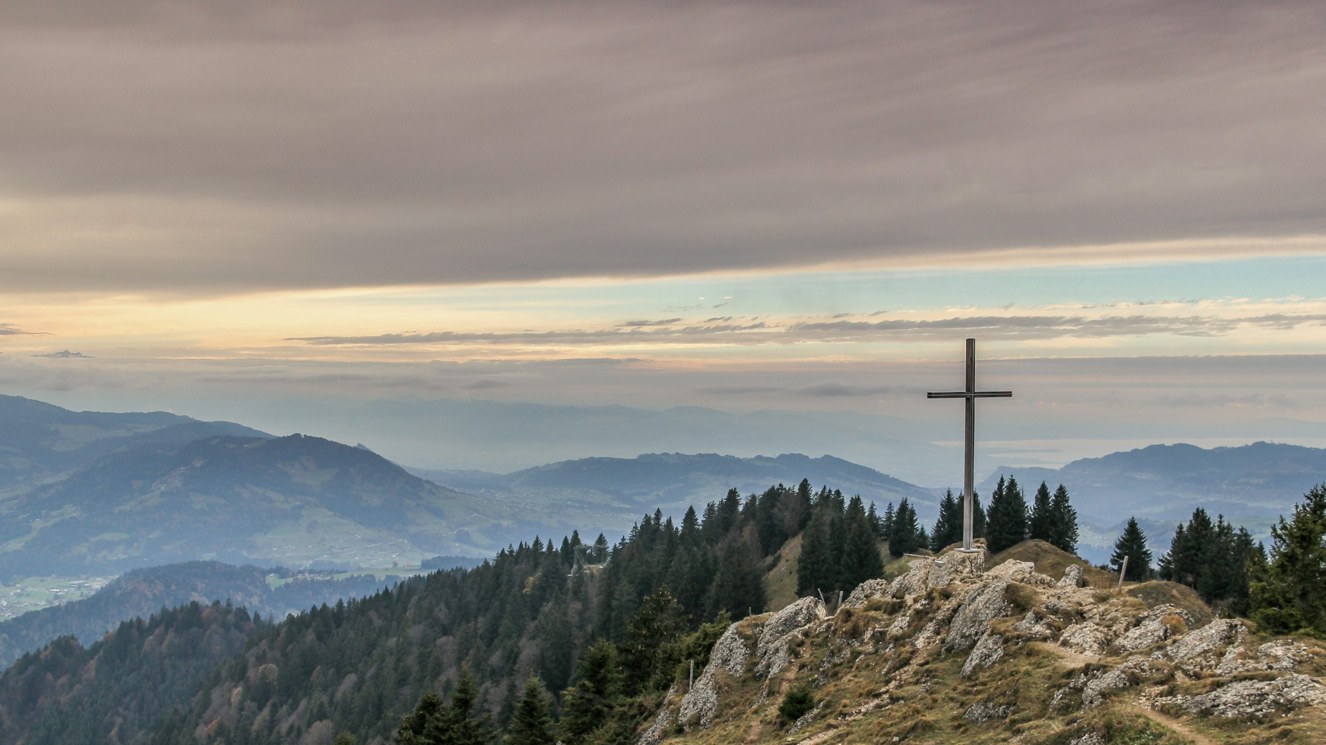
7
Picking Up the Cross: Martyrdom
God Saves: We Are Redeemed through the Paschal Mystery
Notes:
Image Source: https://unsplash.com/photos/gray-cross-near-tall-green-trees-U_b-eSviHvs
Suggestions for students’ note taking:
●Require students to use a three ring binder (1/2-1 inches) full of loose leaf paper (college or wide ruled).
●Notes must be taken in pen only and hand written.
●Notebooks should contain information and notes for religion class only.
●Notebooks must have a table of contents with topic of notes, dates and page numbers.
●All notes must have a topic and page number.
●Students will be required to copy each slide unless the teacher directs students to skip certain slides or parts of slides. Notebooks will be graded based on neatness, completeness and organization. Notebooks should have a significant point value representing 20-25% of the overall grade.
The videos linked in this presentation file may contain copyright material. Such material is made available for educational purposes only. This constitutes a “fair use” of any such copyright material as provided for in Title 17 U.S.C. section106A-117 of the US Copyright Law.

Slide 2

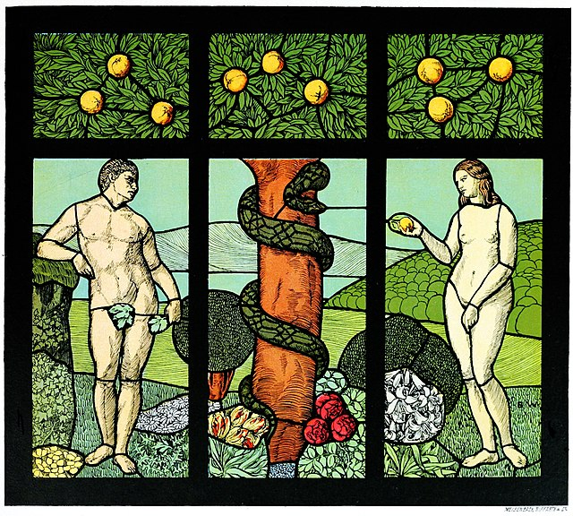
Why is there Suffering?
Christians have a good answer to this big question. It is found throughout Scripture beginning with Adam and Eve.
Notes:
Photo Credit: Adam and Eve. Hans Christiansen.Public domain. https://commons.wikimedia.org/wiki/File:Adam_and_Eve_-_design_for_a_stained-glass_window_by_Hans_Christiansen.jpg
Directions: Have students copy the side information in their notebooks.
Read quote, “In the Garden of Eden, before sin, there was no suffering, because there was no cause of suffering, and no need for suffering. Once we became alienated from God, we also became alienated from God's world, and from our own bodies. The alienation from the world is pain, and the alienation from our own bodies is death. What Christ did about this on the cross was to change the meaning of pain by removing its first cause, its ultimate cause separation from God. The word for that in Christian theology is sin. Sin doesn't just mean no-no's. It's an ontological term. It's like divorce from God, the source of all good.” -Peter Kreeft
Teaching Point:
It is important to know that God did not plan for pain, suffering, sickness or death.
He took a risk in giving humans free will because that is the only way they could participate in receiving and giving love.
After humans abided this gift of freewill by choosing against God they brought about human suffering in this world.
God then made it possible for suffering to be turned into a greater good and it can be redemptive rather than meaningless.
The issue of suffering and evil in the world is one of the greatest, if not the greatest, stumbling blocks of faith. The question that is asked is, ‘How can an all good and holy God allow the suffering of innocent people in his world?’. You learned previously that the presence of suffering and evil is explained by the fact that
(1) For humans to have the gift of free will, the choice of evil leading to suffering will be an option and
(2) God can use evil to create an even greater good.
-In the story of Job God allowed him to suffer for a greater good but Job lacked the viewpoint of time that God has. He could not see the bigger picture.
Online Resources: Assign article, ‘Why does God allow sin and suffering’. URL Here: https://strangenotions.com/why-does-god-allow-sin-and-suffering/
View video, ‘The Book of Job, Wisdom on How God Runs the World’. URL here: https://youtu.be/GswSg2ohqmA
The videos linked in this presentation file may contain copyright material. Such material is made available for educational purposes only. This constitutes a “fair use” of any such copyright material as provided for in Title 17 U.S.C. section106A-117 of the US Copyright Law.

Slide 3

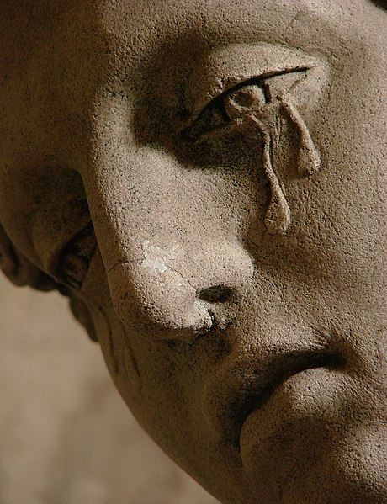
How Humans Suffer
physical suffering
mental suffering
emotional suffering
spiritual suffering
Notes:
Photo Credit: Entombment of Christ, 1672, in Saint-Martin Church in Arc-en-Barrois (Haute-Marne, France).
Vassil.Creative Commons Attribution 3.0. https://commons.wikimedia.org/wiki/File:S%C3%A9pulcre_Arc-en-Barrois_111008_12.jpg
Directions: Have students copy the side information in their notebooks. Give a real life example for each kind of human suffering listed.
Physical - toothache, broken bones, wound.
Mental - stress, depression, eating disorder, insomnia.
Emotional - despair, grief, shame, guilt, rejection, loneliness, embarrassment
Spiritual - feeling abandoned by God, questioning the meaning of life, giving up hope, suicidal idiation
Teaching Point: Because we are made in the Image and Likeness of God, human suffering can be more deep and more spiritual and more painful. Our suffering “can henceforth configure us to [Christ] and unite us with his redemptive Passion” (CCC, 1505). Now, when we suffer, we share in the sufferings of Christ. If we believe his suffering has meaning, then so shall ours.
The videos linked in this presentation file may contain copyright material. Such material is made available for educational purposes only. This constitutes a “fair use” of any such copyright material as provided for in Title 17 U.S.C. section106A-117 of the US Copyright Law.

Slide 4

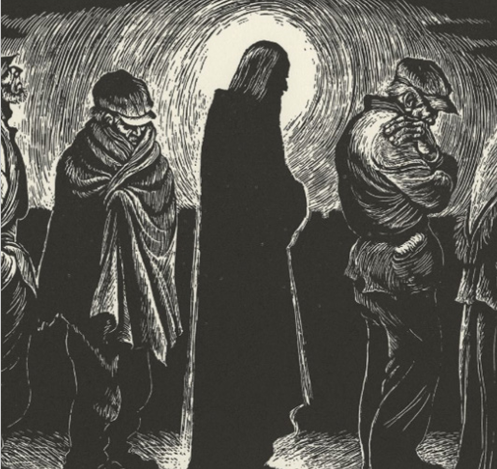
God Participates in Our Suffering as a Co-Sufferer
Christianity affirms that God himself came to earth and became one of us, not just to stand by our side and teach us things, but to suffer alongside us.
Notes:
Photo Credit: AMP Textbook p. 322
Directions: Have students copy the side information in their notebooks. Have student read aloud the biography on Fritz Eichenberg on pg. 323 of the AMP textbook.
Teaching Point:The picture on the slide called The Christ of the Breadlines, taken from a woodcarving Eichenberg completed in 1951. The black-and-white print portrays Christ as one of the needy seeking bread from an urban charity house. Artist, Fritz Eichenberg was convinced that Christ shared in our human suffering as we shared in his own Passion and Death. When we suffer, Christ strengthens us and gives us courage so that we can participate in his suffering, which will lead us with him into eternal life. Eternal life with God in heaven gives us an entirely new perspective on suffering, letting us see it as part of a battle worth engaging in for the sake of our own destiny and the destinies of others as well
Online Resources: Have students view video, ‘Rebellious Visionary Jesus: The Art of Fritz Eichenberg’
URL Here: https://youtu.be/TPglUOvB8aw
The videos linked in this presentation file may contain copyright material. Such material is made available for educational purposes only. This constitutes a “fair use” of any such copyright material as provided for in Title 17 U.S.C. section106A-117 of the US Copyright Law.

Slide 5
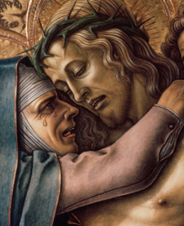
Why was the Son of God Allowed to Suffer?
To form solidarity with us sinners
To reverse the effects of sin
To show us how love works
To transform human suffering into something meaningful and spiritually powerful
Notes:
Photo Credit: AMP Textbook. Pg. 332
Directions: Have students copy the side information in their notebooks. Go over each point from the slide…
Teaching Point:
To form solidarity with sinners: ‘The wages (cost) of sin is death’. Jesus voluntarily took the penalty of sin upon himself. Just like when he was baptized, he did so because he wanted to show us how to defeat sin and death. As the Catechism of the Catholic Church teaches, “By sending his own Son in the form of a slave, in the form of a fallen humanity, on account of sin, God ‘made him to be sin who knew no sin, so that in him we might become the righteousness of God’” (CCC, 603, quoting 2 Corinthians 5:21).
To reverse the effects of sin: Pain and suffering are a result of sin. Jesus dismantled the effects of sin by entering into them from the inside out and he paid a ransom for us with his blood so that we may be able to be saved. “For the sake of accomplishing his plan of salvation, God permitted the acts that flowed from [human] blindness” (CCC, 600). The blindness was apparent at the time in those who handed Jesus over, falsely convicted him, and carried out his execution. But in actuality, all sinners over all time are the instruments of Christ’s Death (see CCC, 598).
To show us how love works: Jesus freely accepted his Passion and Death on the Cross because he loved us as friends. As Jesus himself said, “No one has greater love than this, to lay down one’s life for one’s friends” (Jn 15:13).
To Transform our human suffering: Share quote, “God's answer to our pain was not a philosophy, but a person. I like to see Christ as the tears of God. Instead of telling us why not to weep, he wept, and transformed human tears into divine tears. Christians believe that in Christ God shared our human nature, so that we could share his divine nature. And so he also shared our human pain, so that we could share his divine pain, so that our very pains could become divine. He suffered for us not to make our sufferings go away, but to make them enter him to make them his own. He changed not the existence, but the essence, of suffering.”- Peter Kreeft
Online Resources: View video, ‘Why Jesus had to die for our sins instead of simply forgiving us’. URL here: https://youtu.be/Jt1smPQwd20
The videos linked in this presentation file may contain copyright material. Such material is made available for educational purposes only. This constitutes a “fair use” of any such copyright material as provided for in Title 17 U.S.C. section106A-117 of the US Copyright Law.

Slide 6
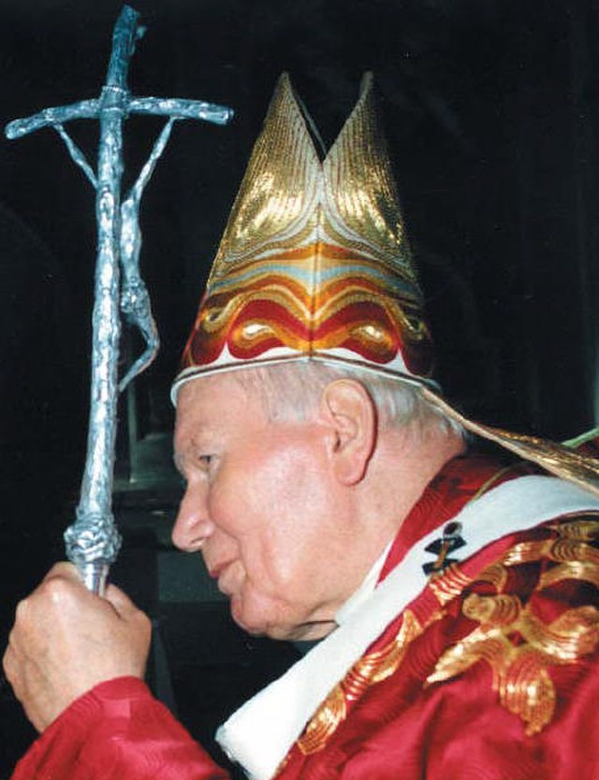
“Human suffering has reached its culmination in the Passion of Christ. And at the same time it has entered into a completely new order: it has been linked to love . . . to that love which creates good, drawing it out by means of suffering, just as the supreme good of the Redemption of the world was drawn from the Cross of Christ, and from that Cross constantly takes beginning.”
- Pope John Paul II
Notes:
Photo Credit: Mass of Edith Stein (Saint Teresia Benedicta of the Cross), October 11, 1998.Chidiu. Creative Commons Attribution-Share Alike 4.0. https://commons.wikimedia.org/wiki/File:Pope_John_Paul_II_portrait.jpg
Directions: Have students copy the side information in their notebooks.
Teaching Point: All of the Saints had suffering in common. They all taught us how to carry the cross with Joy. Pope John Paul II is a good example of how to do redemptive suffering.
Online Resources: View video, John Paul II/Suffering. URL here: https://youtu.be/4_n6dCIfkFg
Assign article, ‘John Paul II and Suffering’.. URL Here: https://www.franciscanmedia.org/st-anthony-messenger/notes-from-a-friar-pope-john-paul-ii-and-suffering/#:~:text=In%201992%2C%20the%20pope%20had,An%20appendectomy%20followed%20in%201996.
The videos linked in this presentation file may contain copyright material. Such material is made available for educational purposes only. This constitutes a “fair use” of any such copyright material as provided for in Title 17 U.S.C. section106A-117 of the US Copyright Law.

Slide 7
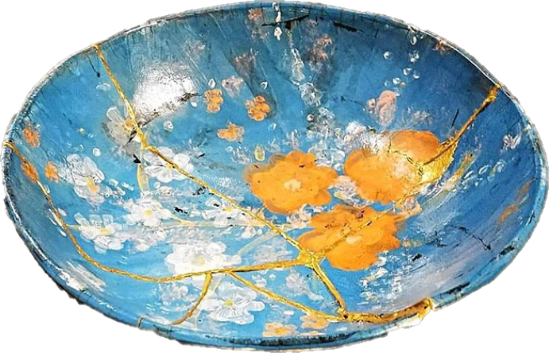
A New Meaning of Suffering
“Happy are they who mourn (suffer), for they shall be comforted.” - Matthew 5:4
“Now I rejoice in what I am suffering for you… for the sake of his body, which is the church.”
- Saint Paul
"I saw His glory in my wounds and it dazzled me" - Saint Augustine
Kintsugi: the Japanese method of repairing this broken pottery bowl with lacquer mixed with powdered gold.
Notes:
Photo Credit: Kintsugi: the Japanese method of repairing broken pottery with lacquer mixed with powdered gold.
Ruthann Hurwitz. Creative Commons Attribution-Share Alike 4.0. https://commons.wikimedia.org/wiki/File:Hand_Pinted_Kintsugi_Pottery_Bowl.jpg. cropped.
Directions: Have students copy the side information in their notebooks. Ask what all three quotes have in common. Ask, “How is the the bowl in the picture like Jesus after the resurrection?” ( When Jesus rose from the dead he still had his wounds but they too became glorious. Our wounds and scars will be glorified in our risen bodies too showing that we offered our suffering in union with His).
Teaching Point: Instead of concealing or disguising the cracks in broken pottery, Kintsugi accentuates them with precious metals, such as gold or silver. Similarly, Christianity teaches that we are all imperfect, marked by our sins and spiritual scars. Kintsugi like Jesus, shows the power of redemption and the transformation that can come from being broken in suffering.
The new meaning of suffering is that it is itself redemptive and therefore paradoxically, it can become joyful. Suffering, previously worthless, is now the source of something great: our redemption and eternal life. Our suffering “can henceforth configure us to [Christ] and unite us with his redemptive Passion” (CCC, 1505). Now, when we suffer, we share in the sufferings of Christ. If we believe his suffering has meaning, then so shall ours.
Online Resources: Have students view video, ‘Finding Joy in the Midst of Suffering’. URL here:https://youtu.be/st8dTPRIxS0
Assign article, ‘Finding Joy in the Darkest Night’. URL here: https://www.catholiceducation.org/en/faith-and-character/faith-and-character/finding-joy-in-the-darkest-night.html
The videos linked in this presentation file may contain copyright material. Such material is made available for educational purposes only. This constitutes a “fair use” of any such copyright material as provided for in Title 17 U.S.C. section106A-117 of the US Copyright Law.

Slide 8

Memorize It
Key
Quote!
“I saw His glory in my wounds and
it dazzled me.”
-Saint Augustine
Notes:
Directions: Have students copy the quote. Add bonus points to the assessment if they can copy it down demonstrating that they memorized it.
The videos linked in this presentation file may contain copyright material. Such material is made available for educational purposes only. This constitutes a “fair use” of any such copyright material as provided for in Title 17 U.S.C. section106A-117 of the US Copyright Law.

Slide 9
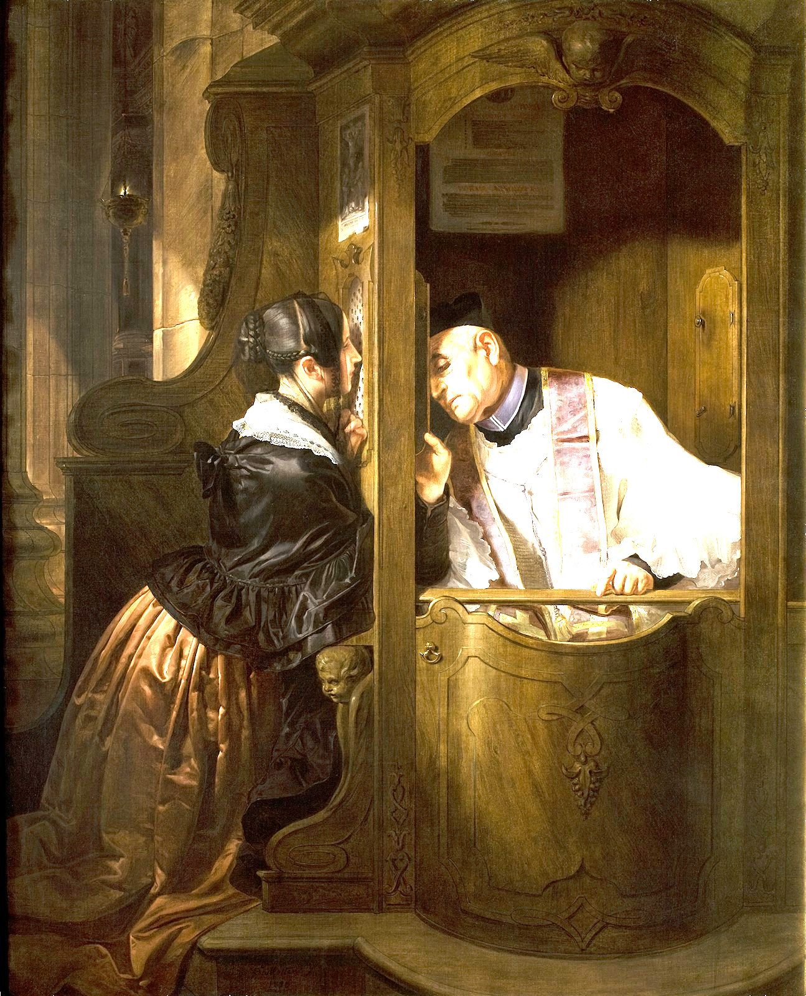
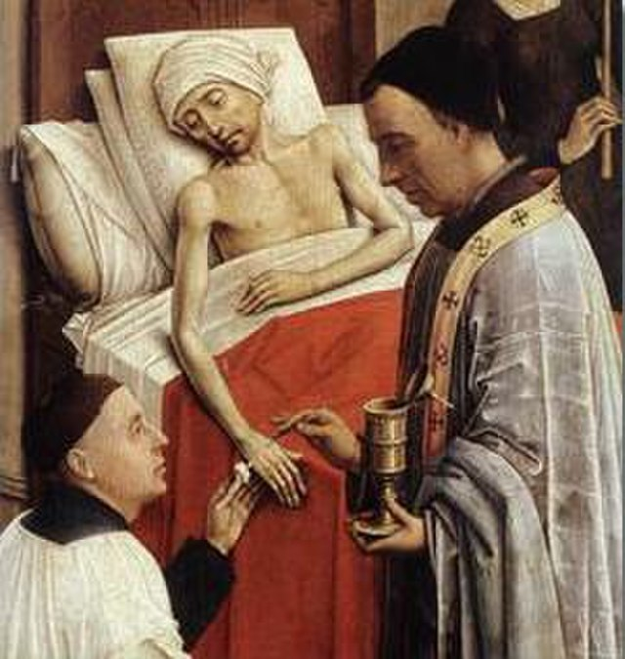
Our Suffering and The Sacraments of Healing
Jesus responds to our suffering today in his Mystical Body (the Church) the way he responded to those he encountered in his Historical Body in the Gospels:
With MERCY and COMPASSION.
Reconciliation
Anointing of the Sick
Notes:
*Photo credits: Giuseppe Molteni.Creative Commons Attribution-Share Alike 3.0. https://commons.wikimedia.org/wiki/File:Artgate_Fondazione_Cariplo_-_Molteni_Giuseppe,_La_confessione.jpg. Extreme Unction Rogier Van der Weyden.jpg. part of The Seven Sacraments.Rogier van der Weyden.Public domain. https://commons.wikimedia.org/wiki/File:Extreme_Unction_Rogier_Van_der_Weyden.jpg
Directions: Have students copy down information from the slide into their notes. Explain each of the way Jesus is present in sacraments of Healing.
Teaching Points:
Reconciliation (Forgiving sins) By God's design, it is the priest's vocation to heal spiritual and mental wounds, renew strength, and "wash the stains of guilt away.” There are four primary actions in the celebration of the Sacrament of Reconciliation, all of which contribute in some way to the healing that takes place: confession of sin; expression of contrition or sorrow for sin; doing penance ("satisfaction"), which expresses a desire to avoid sin; and absolution from sin.
Anointing of the Sick (healing, comforting and strengthening the sick and dying). Jesus, so moved by our suffering when ill, is present in the Sacrament of the Anointing of the Sick where “he not only allows himself to be touched by the sick, but he makes their miseries his own” (CCC, 1505). The Catechism of the Catholic Church (CCC) describes the Anointing of the Sick as a sacrament that provides spiritual and physical strength to the seriously ill. It is one of the last sacraments a person may receive, and is celebrated with three main elements:
Anointing: The sick person is anointed with blessed oil on their forehead and hands, or other parts of the body depending on the rite. The oil is pressed from olives or other plants.
Prayer: The sick person is prayed over.
Laying hands: The priest silently lays their hands on the sick person.
The videos linked in this presentation file may contain copyright material. Such material is made available for educational purposes only. This constitutes a “fair use” of any such copyright material as provided for in Title 17 U.S.C. section106A-117 of the US Copyright Law.

Slide 10
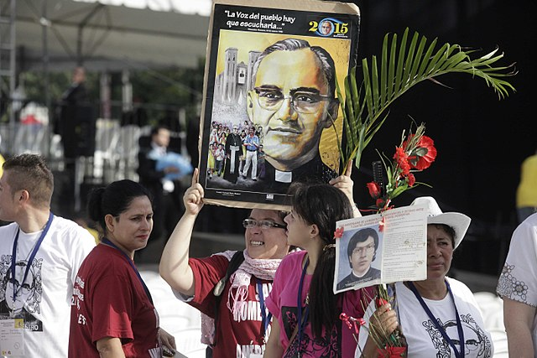
Martyrdom
Key
Vocab!
The witness to the truth of the Faith by Saints who endured suffering and death to be faithful to Christ.
Notes:
*Photo Credit:Gover,Public domain. https://commons.wikimedia.org/wiki/File:Figures.jpg
Directions: Have students copy down this key term in their vocab section of their notes.
Online Resources: Have students watch video, St. Oscar Romero Martyr. URL here: https://youtu.be/hDAUMTIGg2g
The videos linked in this presentation file may contain copyright material. Such material is made available for educational purposes only. This constitutes a “fair use” of any such copyright material as provided for in Title 17 U.S.C. section106A-117 of the US Copyright Law.

Slide 11
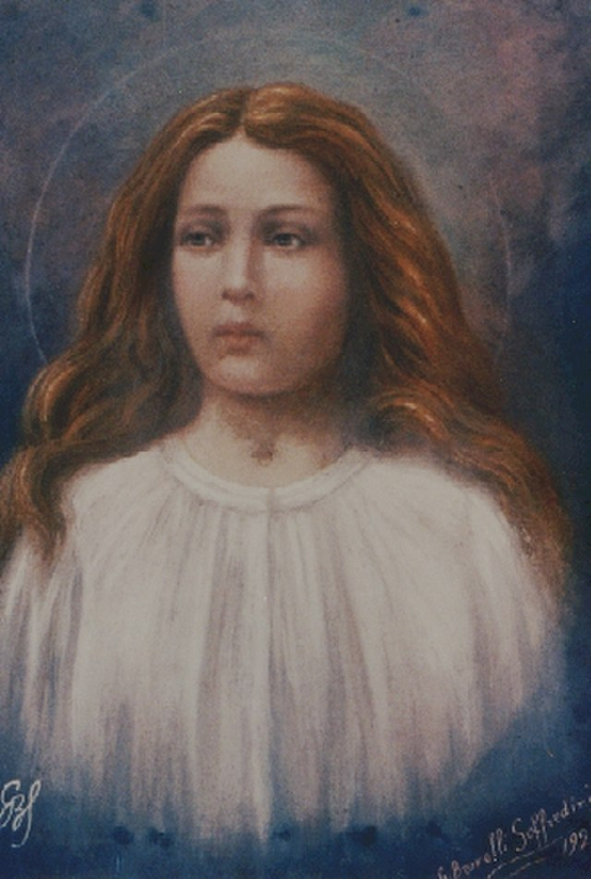
Suffering and Dying For Christ
Christian martyrdom is the act of peacefully offering one’s life for the truth of the Gospels.
Notes:
Photo Credit: St. Maria Goretti (painting 1929). Original uploader was Franciscus at la.wikipedia.Public domain
Directions: Have students copy the side information in their notebooks.
Teaching Points: What needs to be established to meet the definition of martyrdom is that a person voluntarily accepted suffering leading to death on account of his or her faith in Christ. This typically means uttering a spoken testimony to that faith; for example, either clearly stating, “I accept my death for the love of Jesus” or (to the killers) “I forgive you in the name of Christ.” Another factor the Church uses to determine martyrdom is the motivation of the persecutor. Did the person have a “hatred of the Christian faith” (odium Fidei in Latin)? If this element is lacking, there would be no true martyrdom.
Every human being has to go through suffering and eventually death. For Christians this is no different. But because of our identity in Christ through our Baptism and because we are conformed to Christ, we practice everyday the act of dying to oneself which makes it easier to offer our suffering and eventually our death to God as a free act of love. This is what Fr. Peter Joseph called “the martyrdom of daily life.”
When Christianity was illegal in the Roman Empire in the first three centuries, thousands of Christians were killed during the persecutions. It is estimated that in one eighteen-month period beginning in AD 250, 2,500 to 3,000 Christians were killed following an edict by the Emperor Decius. Christians have been killed in every era of the Church since. The twentieth century had more Christian martyrs than all previous nineteen centuries combined. Today, it is estimated that, somewhere in the world, one person is killed for his or her Christian faith every two weeks.
• Martyrdom is associated with the fortitude and endurance to withstand great pain and suffering in the name of Christ to the point of death. There are various types of martyrdom; so-called “red martyrdom” is the only one in which a person gives up his or her life to bear witness to Christ.
• Martyrdom reminds us that though life is sacred, it is not the supreme good. The supreme good is faith and union with God in heaven. The goods of spiritual life that lead us to heaven are worth dying for in Jesus’s name.
Online Resources: Have students view video, ‘St. Maria Goretti’. URL here: https://youtu.be/BnwRvNI7Gn4
The videos linked in this presentation file may contain copyright material. Such material is made available for educational purposes only. This constitutes a “fair use” of any such copyright material as provided for in Title 17 U.S.C. section106A-117 of the US Copyright Law.

Slide 12



Types of Martyrdom
Notes:
Photo Credit:green rose flower. Jesna Thomas.Creative Commons Attribution-Share Alike 4.0. https://commons.wikimedia.org/wiki/File:Green_Rose.jpg. White Rose.Sabina Bajracharya.Creative Commons Attribution-Share Alike 4.0. https://commons.wikimedia.org/wiki/File:White_Rose_062605.jpg Red Rose. Laitche.Creative Commons Attribution-Share Alike 4.0
https://commons.wikimedia.org/wiki/File:Red_rose_with_black_background.jpg….All Cropped
Directions: Have students copy the side information/teaching pints in their notebooks creating three columns. (Red Martyrdom, White Martyrdom, Green Martyrdom)
Teaching Points:
Green martyrdom is the name for those who take on extreme penance and fasting out of their desire to love and serve God. After Christianity was legalized in the Roman Empire in 313, martyrdoms decreased. Christians who wished for extreme discipleship prac ticed asceticism as hermits in the Egyptian desert. These hermits are known as Desert Fathers.
White martyrdom refers to a person who is persecuted for the faith but is never asked to die for it. (The color is white because no blood is shed. In 258, after St. Cyprian, a bishop in the Roman outpost of Tunisia in North Africa, was sentenced to death as an “enemy of the Roman gods,” a large crowd followed him and his executioners to a nearby field where he was to be beheaded. An eyewitness account reported that a “great commotion broke out” between the Romans and the Christians. The Christian “brethren” shouted out “Let us be beheaded with him,” though they eventually dispersed and were not executed. Their willingness to die for their faith, though never being required to do so, is an example of white martyrdom).
Red martyrdom is the actual giving of one’s physical life while bearing witness to Christ up to death. A martyr’s death typically occurs immediately, but if the sufferings inflicted lead to death in a reasonable amount of time (e.g., within a year), then that will count as martyrdom. The crucial question is whether the person is killed for the faith. St. Stephen was the first recorded Christian martyr.
Online Resources: Assign article, ‘True and False Martyrdoms, Fr. Peter Joseph’. URL here: https://www.catholicculture.org/culture/library/view.cfm?id=8633
The videos linked in this presentation file may contain copyright material. Such material is made available for educational purposes only. This constitutes a “fair use” of any such copyright material as provided for in Title 17 U.S.C. section106A-117 of the US Copyright Law.

Slide 13
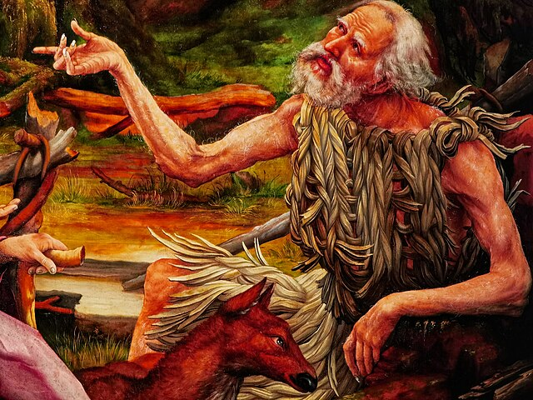
Desert Fathers
Key
Vocab!
Christians of about the fourth century who withdrew into the desert to live an ascetic life of white green martyrdom: prayer, fasting, and abstinence.
Notes:
Photo Credit: Colmar - Unterlinden Museum - The Isenheim Altarpiece 1512-16 by Matthias Grünewald (ca 1470-1528) - Visit of Saint Anthony the Great to Saint Paul the Hermit in the Wilderness - Painting Details (captured with Leica zoom lens). Txllxt TxllxT.Creative Commons Attribution-Share Alike 4.0.https://commons.wikimedia.org/wiki/File:Colmar_-_Unterlinden_Museum_-_The_Isenheim_Altarpiece_1512-16_by_Matthias_Gr%C3%BCnewald_(ca_1470-1528)_-_Visit_of_Saint_Anthony_the_Great_to_Saint_Paul_the_Hermit_in_the_Wilderness_-_Painting_Details_(captured_with_Leica_zoom_lens)_02.jpg
Directions: Have students copy down this key term in their vocab section of their notes.
Online Resources: Have students view, ‘St. Anthony of the Desert’. URL here: https://youtu.be/H6DiwkJeJJI
The videos linked in this presentation file may contain copyright material. Such material is made available for educational purposes only. This constitutes a “fair use” of any such copyright material as provided for in Title 17 U.S.C. section106A-117 of the US Copyright Law.

Slide 14

Turn and Talk
How much would you be willing to lay down your life for Christ and the truth of the Gospel? Explain your answer.
Notes:
Directions: Have students write down the question and then write down their answer….Then have students share their answers with one person close by.
The videos linked in this presentation file may contain copyright material. Such material is made available for educational purposes only. This constitutes a “fair use” of any such copyright material as provided for in Title 17 U.S.C. section106A-117 of the US Copyright Law.

