Slide 1
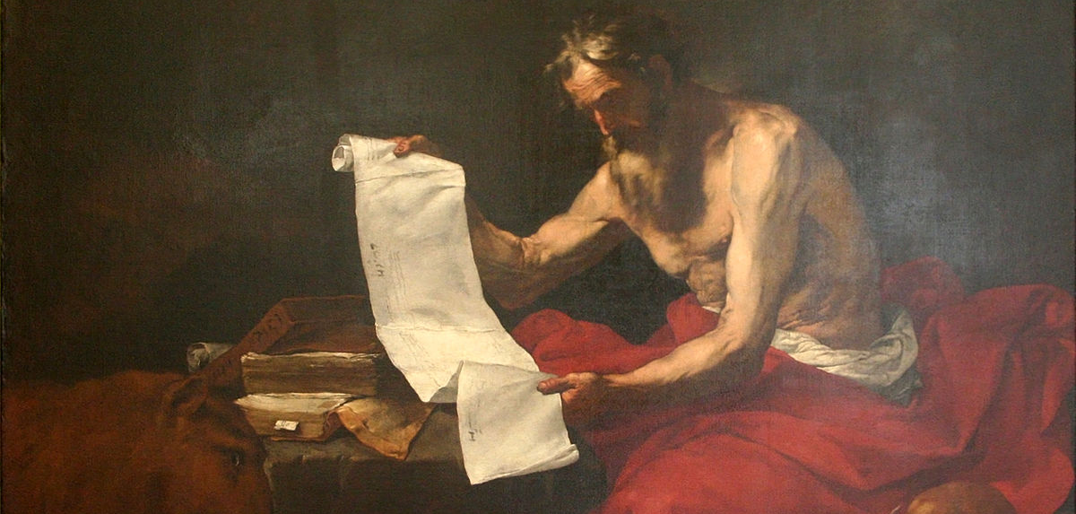
2
How the Bible Came to Be
God Reveals: An Introduction to the Bible
Notes:
*Photo Credit: https://commons.wikimedia.org/wiki/File:Jos%C3%A9_de_Ribera_-_St_Jerome.JPG
Suggestions for students’ note taking:
Require students to use a three-ring binder (1/2-1 inches) full of loose-leaf paper (college or wide ruled).
Notes must be taken in pen only and handwritten.
Notebooks should contain information and notes for religion class only.
Notebooks must have a table of contents with topic of notes, dates, and page numbers.
All notes must have a topic and page number.
Students will be required to copy each slide unless the teacher directs students to skip certain slides or parts of slides. Notebooks will be graded based on neatness, completeness, and organization. Notebooks should have a significant point value representing 20-25% of the overall grade.

Slide 2
Three Stages of Formation of the Gospels
LIFE
ORAL
WRITTEN
The words and deeds of Jesus are what we call the Gospel event. Jesus came to proclaim the Gospel message; the good news that the kingdom of God was at hand.
Those who saw and heard Jesus, eye-witnesses who knew him, began to teach others the same Gospel message that Jesus gave to them. With strict discipline, they memorized sayings and long discourses of Jesus.
The words and deeds of Jesus were written down by the evangelists. They were inspired by the Holy Spirit to write what God wanted them to say as it relates to our faith and salvation.
Notes:
Directions: For each stage ask the following questions. Follow up with your own answer or the answer provided.
LIFE: Given the story of the Bible told in the Old Testament, especially the story of the Fall in Genesis chapter 3, why is the message of Jesus good news?
(Answer: Jesus is the promised Messiah and Savior. He came into the world to be the Mediator of a New Covenant for all people, and he came to save us from our sins and provide a way to regain the life and communion with God that was taken away in the Fall of Adam and Eve).
ORAL: Why was there so much urgency on the part of the apostles to spread the Gospel message?
(Answer: The apostles were filled with the Holy Spirit and understood that the best thing they could do for others was to introduce them to Jesus, who lives on after the Resurrection. They announced the kerygma, preaching to unbelievers, those who had no firsthand knowledge of Jesus).
WRITTEN: In what way did both Jesus’s words and deeds work together to proclaim a reversal of sin and the beginning of the kingdom of God on earth? Why was it important to record both Jesus’ deeds and words?
(Answer: Jesus announced the kingdom and described it through many parables, such as the Prodigal Son, to let us know we may be forgiven of our sins so long as we repent and seek forgiveness. By healing the sick and the dead, driving out demons, and commanding nature, he showed that he had power over sin and that his forgiveness was real. It was important to record both words and deeds because they were all true and they were all conveying the important message to repent and trust in faith that Jesus is our Savior).

Slide 3
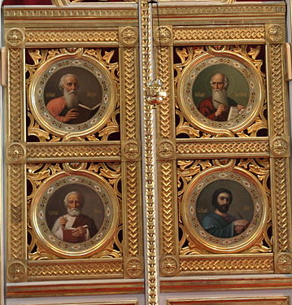
Evangelist
Key
Vocab
The name for one who proclaims in word and deed the Good News of Jesus Christ. The “four evangelists” refers to the authors of the four Gospels: Matthew, Mark, Luke, and John.
Notes:
*Photo Credit: MKFI, Public domain, https://commons.wikimedia.org/wiki/File:Tampereen_ortodoksinen_kirkko_sis%C3%A4lt%C3%A4_13_ikonostaasin_Pyh%C3%A4_portti.JPG
Directions: Share the quote below as students copy down key vocabulary. View video below to supplement understanding of the term evangelist.
“The basic meaning of the ‘Good News’ is the resurrection of Jesus from the dead. When the first Christians announced euangelion (glad tidings), that’s what they meant. ‘You killed him, but God raised him up’ is the basic form of kerygmatic preaching. What this entails is that God’s love is more powerful than sin and death, more powerful than anything that is in the world.” - Bishop Barron, https://www.ewtn.com/catholicism/library/what-precisely-is-the-gospel-3031
Online Resources: View “Mysteries of the Church: The Early Evangelists.” URL here: https://youtu.be/lDZDQZjuo08

Slide 4
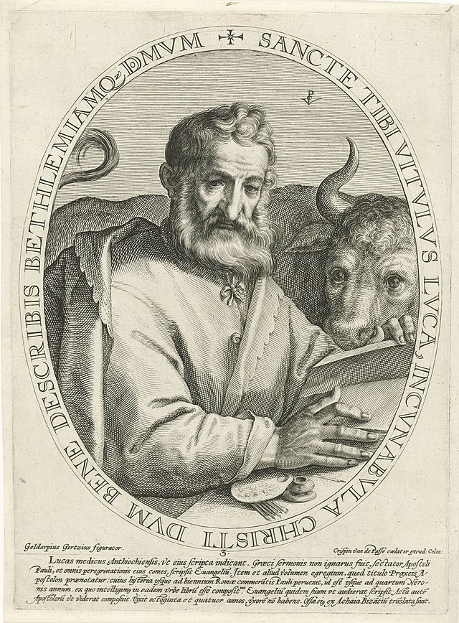
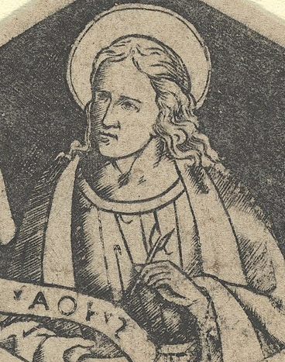
Matthew
Mark
Luke
John
Apostle
Former tax collector known as Levi
Audience: Jews
Synoptic
John Mark
Assistant to Peter
Audience: Romans
Synoptic
Gentile physician
Also wrote Acts of the Apostles
Audience: Greeks
Synoptic
Apostle
Refers to himself as eye witness and beloved disciple
Audience: All
NOT Synoptic
Notes:
*Photo Credit: Gheyn, Jacques II de (1565-1629), Creative Commons Attribution 4.0,, https://commons.wikimedia.org/wiki/File:The_evangelists_in_a_circle_Saint_Matthew_PK-P-100.891,_PK-P-121.745.tiff
Directions: As students copy these notes you may share the following quote:
Quote:
“St. Matthew is represented by a divine man because the Gospel highlights Jesus’ entry into this world, first by presenting His family lineage — ‘A family record of Jesus Christ, Son of David, son of Abraham’ (Mt 1:1) — and His incarnation and birth: ‘Now this is how the birth of Jesus Christ came about’ (Mt 1:18). ‘This then,’ according to St. Irenaeus, ‘is the Gospel of His humanity; for which reason it is, too, that the character of a humble and meek man is kept up through the whole Gospel.’
St. Mark, represented by the winged lion, references the Prophet Isaiah when he begins his gospel: ‘Here begins the Gospel of Jesus Christ, the Son of God. In Isaiah the prophet it is written: “I send my messenger before you to prepare your way: a herald’s voice in the desert, crying, ‘Make ready the way of the Lord, clear Him a straight path.’”’ ‘The voice in the desert crying’ reminds one of a lion’s roar, and the prophetical spirit descending to earth reminds one of a ‘winged message.’ The lion also signified royalty, an appropriate symbol for the Son of God.
The winged ox represents St. Luke. Oxen were used in temple sacrifices. For instance, when the Ark of the Covenant was brought to Jerusalem, an ox and a fatling were sacrificed every six steps (2 Sm 6). St. Luke begins his Gospel with the announcement of the birth of St. John the Baptizer to his father, the priest Zechariah, who was offering sacrifice in the Temple (Lk 1). St. Luke also includes the parable of the Prodigal Son, in which the fatted calf is slaughtered, not only to celebrate the younger son’s return, but also to foreshadow the joy we must have in receiving reconciliation through our most merciful Savior who as Priest offered Himself in sacrifice to forgive our sins. Therefore, the winged ox reminds us of the priestly character of our Lord and His sacrifice for our redemption.
Lastly, St. John is represented by the rising eagle. The Gospel begins with the ‘lofty’ prologue and ‘rises’ to pierce most deeply the mysteries of God, the relationship between the Father and the Son, and the incarnation: ‘In the beginning was the Word, the Word was in God’s presence, and the Word was God. He was present to God in the beginning. Through Him all things came into being, and apart from Him nothing came to be’ (Jn 1:1-3). And ‘The Word became flesh and made His dwelling among us, and we have seen His glory: The glory of an only Son coming from the Father filled with enduring love’ (Jn 1:14). The Gospel of St. John, unlike the other Gospels, engages the reader with the most profound teachings of our Lord, such as the long discourses Jesus has with Nicodemus and the Samaritan woman, and the beautiful teachings on the Bread of Life and the Good Shepherd. Jesus, too, identified Himself as ‘the way, the truth, and the life,’ and anyone who embraces Him as such will rise to everlasting life with Him.”
-St. Irenaeus, https://catholicexchange.com/what-are-the-symbols-of-the-four-evangelists/
Other Online Resources: For a more detailed treatment of this topic, see the webpage compiled by Fr. Felix Just, SJ, URL here: https://catholic-resources.org/Art/Evangelists_Symbols.htm

Slide 5
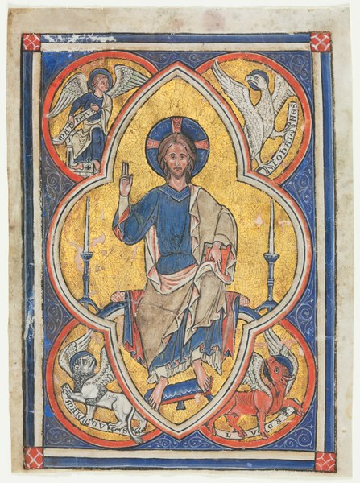
Which evangelist is represented in each corner of the image?
Notes:
*Photo Credit: Cleveland Museum of Art, Creative Commons Zero, Public Domain Dedication, https://commons.wikimedia.org/wiki/File:England,_Abbey_of_Peterborough(%3F),_13th_century_-_Miniature_Excised_from_a_Psalter-_Christ_in_Majesty_with_Symbols_of_the_Fou_-_1945.132_-_Cleveland_Museum_of_Art.tif
Directions: Have students identify which evangelist is represented in each corner of the image. Share details below.
Description of image: Christ is seated within a cusped frame representing his aura. He is surrounded by the four "living creatures"—the gospel writers—as envisioned by Saint John in his Apocalypse: a winged man (St. Matthew), a lion (St. Mark), an ox (St. Luke), and an eagle (St. John).
“St. Matthew is represented by a divine man because the Gospel highlights Jesus’ entry into this world, first by presenting His family lineage — ‘A family record of Jesus Christ, Son of David, son of Abraham’ (Mt 1:1) — and His incarnation and birth: ‘Now this is how the birth of Jesus Christ came about’ (Mt 1:18). ‘This then,’ according to St. Irenaeus, ‘is the Gospel of His humanity; for which reason it is, too, that the character of a humble and meek man is kept up through the whole Gospel.’
St. Mark, represented by the winged lion, references the Prophet Isaiah when he begins his gospel: ‘Here begins the Gospel of Jesus Christ, the Son of God. In Isaiah the prophet it is written: “I send my messenger before you to prepare your way: a herald’s voice in the desert, crying, ‘Make ready the way of the Lord, clear Him a straight path.’”’ ‘The voice in the desert crying’ reminds one of a lion’s roar, and the prophetical spirit descending to earth reminds one of a ‘winged message.’ The lion also signified royalty, an appropriate symbol for the Son of God.
The winged ox represents St. Luke. Oxen were used in temple sacrifices. For instance, when the Ark of the Covenant was brought to Jerusalem, an ox and a fatling were sacrificed every six steps (2 Sm 6). St. Luke begins his Gospel with the announcement of the birth of St. John the Baptizer to his father, the priest Zechariah, who was offering sacrifice in the Temple (Lk 1). St. Luke also includes the parable of the Prodigal Son, in which the fatted calf is slaughtered, not only to celebrate the younger son’s return, but also to foreshadow the joy we must have in receiving reconciliation through our most merciful Savior who as Priest offered Himself in sacrifice to forgive our sins. Therefore, the winged ox reminds us of the priestly character of our Lord and His sacrifice for our redemption.
Lastly, St. John is represented by the rising eagle. The Gospel begins with the ‘lofty’ prologue and ‘rises’ to pierce most deeply the mysteries of God, the relationship between the Father and the Son, and the incarnation: ‘In the beginning was the Word, the Word was in God’s presence, and the Word was God. He was present to God in the beginning. Through Him all things came into being, and apart from Him nothing came to be’ (Jn 1:1-3). And ‘The Word became flesh and made His dwelling among us, and we have seen His glory: The glory of an only Son coming from the Father filled with enduring love’ (Jn 1:14). The Gospel of St. John, unlike the other Gospels, engages the reader with the most profound teachings of our Lord, such as the long discourses Jesus has with Nicodemus and the Samaritan woman, and the beautiful teachings on the Bread of Life and the Good Shepherd. Jesus, too, identified Himself as ‘the way, the truth, and the life,’ and anyone who embraces Him as such will rise to everlasting life with Him.”
-St. Irenaeus, https://catholicexchange.com/what-are-the-symbols-of-the-four-evangelists/

Slide 6
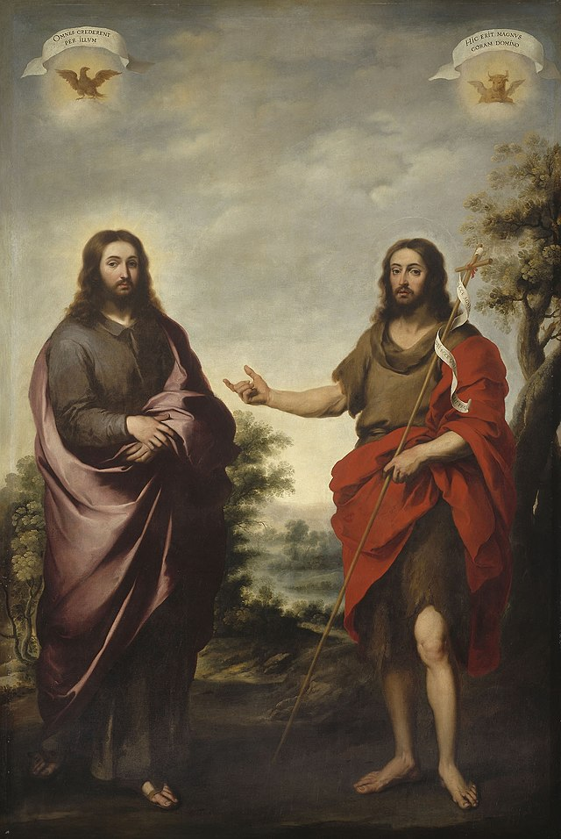
Kerygma
Key
Vocab
Proclamation. The core message of the Gospel which included the life, death, resurrection and ascension of Jesus. Jesus came to save us from our sins.
Notes:
*Photo Credit: Bartolomé Esteban Murillo, Public domain, https://commons.wikimedia.org/wiki/File:Bartolom%C3%A9_Est%C3%A9ban_Murillo_-_Saint_John_the_Baptist_Pointing_to_Christ_-_1960.2_-_Art_Institute_of_Chicago.jpg
Directions: Share the quote below as students copy down key vocabulary.
Quote: “As the apostles began their proclamation of Jesus Christ as Savior of the world (in Greek, the Kerygma), their witness revolved around a simple and direct message that focused on the person of Jesus, his powerful witness and message, the miraculous deeds he worked, and the transformation of lives as they believed in him and became his witnesses to the world. Saints Peter and Paul provide a number of examples of kerygmatic preaching in the Acts of the Apostles.”
- Michael E. Steier, “Kerygmatic Proclamation of Jesus Christ,” USCCB, https://www.usccb.org/beliefs-and-teachings/how-we-teach/catechesis/catechetical-sunday/enlisting-witnesses/kerygmatic-proclamation-of-jesus-christ#:~:text=As%20the%20apostles%20began%20their,lives%20as%20they%20believed%20in.

Slide 7
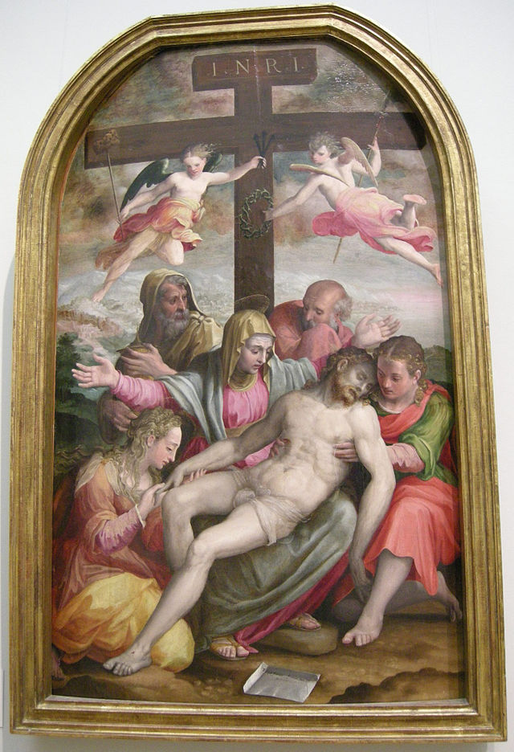
"What we have heard, what we have seen with our eyes, what we have looked upon and touched with our hands … what we have seen and heard we proclaim now to you."
1 John 1-3
Notes:
*Photo Credit: Prospero Fontana, Public domain, https://commons.wikimedia.org/wiki/File:Nswag,_prospero_fontana,_deposizione,_1563.JPG
Directions: Ask students to think about how this Bible verse conveys the meaning of kerygma.

Slide 8
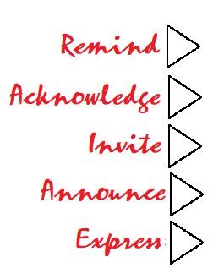
Five Steps to Share the Gospel Message With Others
1. Remind others that we all have a built in, innate desire for God whose love is unconditional and that without Him we are left unsatisfied.
2. Acknowledge the effects of our sin, the pain, the brokenness and our need for God as healer.
3. Invite Jesus and the Holy Spirit to come and remove any obstacles or distractions that would stand in the way of his presence.
4. Announce the Good News of what Jesus accomplished in his Suffering, Death, Resurrection, and Ascension as the source of our salvation.
5. Express, in a prayer, your willingness to trust him, to turn from sin and to give your life to Him.
Notes:
Directions: View video and have students identify the following steps. Beginning at minute 8.30 in the video, Kim Walker Smith's spontaneous, announcement or proclamation of the Good News is given in the form of a colloquial kerygma. In it she takes us through a five-step process of evangelization. URL here: https://youtu.be/RFvDdGO7qMo

Slide 9
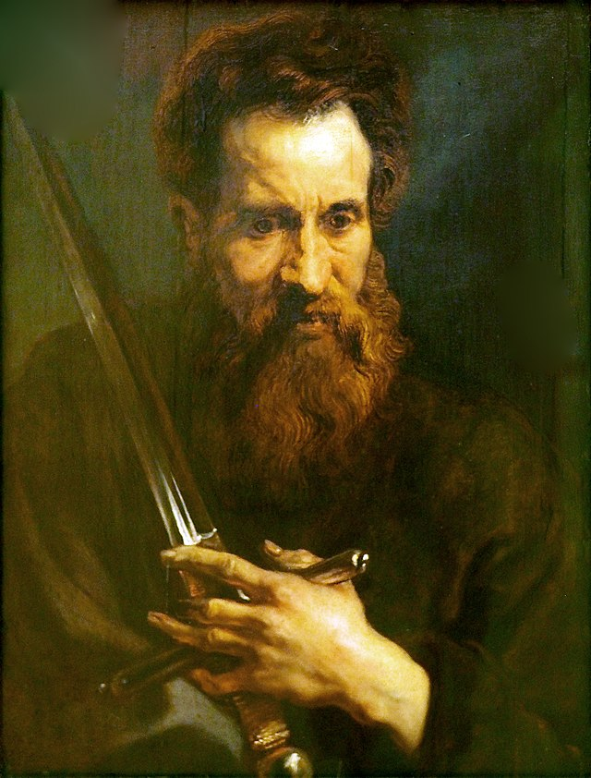
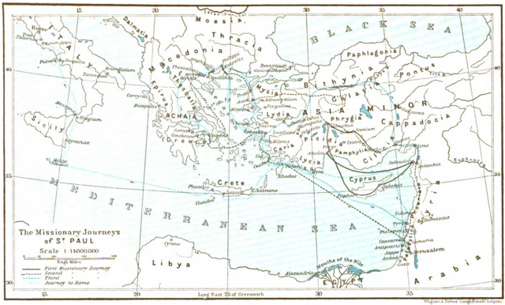
Saint Paul Spread the Gospel to Gentile Lands
Notes:
*Photo Credit: Anthony van Dyck, Public domain, ttps://commons.wikimedia.org/wiki/File:Dyck_Apostel_Paulus@Nieders._Landesmuseum20160811.JPG Book: Friedrich Justus Knecht\
Map: Wagner & Debes, Public domain, https://commons.wikimedia.org/wiki/File:Map_missionary_journeys_stpaul_knecht.png
Directions: Share the key points about Saint Paul and then read an excerpt of Saul’s Conversion (Acts 9:1–19)
Key points about the evangelization efforts of Saint Paul:
Started out as an enemy of the Church
Had a miraculous conversion
Earned the trust of Peter and the other Apostles
Went on three missionary journeys to Turkey, Greece, and Italy
Converted many gentiles to Christianity
Wrote many letters to the church communities that he started
Died in Rome as a saint and martyr
Bible passage:
“Now Saul, still breathing murderous threats against the disciples of the Lord, went to the high priest and asked him for letters to the synagogues in Damascus, that, if he should find any men or women who belonged to the Way, he might bring them back to Jerusalem in chains. On his journey, as he was nearing Damascus, a light from the sky suddenly flashed around him. He fell to the ground and heard a voice saying to him, ‘Saul, Saul, why are you persecuting me?’ He said, ‘Who are you, sir?’ The reply came, ‘I am Jesus, whom you are persecuting. Now get up and go into the city and you will be told what you must do.’ The men who were traveling with him stood speechless, for they heard the voice but could see no one. Saul got up from the ground, but when he opened his eyes he could see nothing; so they led him by the hand and brought him to Damascus. For three days he was unable to see, and he neither ate nor drank.
There was a disciple in Damascus named Ananias, and the Lord said to him in a vision, ‘Ananias.’ He answered, ‘Here I am, Lord.’ The Lord said to him, ‘Get up and go to the street called Straight and ask at the house of Judas for a man from Tarsus named Saul. He is there praying, and [in a vision] he has seen a man named Ananias come in and lay [his] hands on him, that he may regain his sight.’ But Ananias replied, ‘Lord, I have heard from many sources about this man, what evil things he has done to your holy ones in Jerusalem. And here he has authority from the chief priests to imprison all who call upon your name.’ But the Lord said to him, ‘Go, for this man is a chosen instrument of mine to carry my name before Gentiles, kings, and Israelites, and I will show him what he will have to suffer for my name.’ So Ananias went and entered the house; laying his hands on him, he said, ‘Saul, my brother, the Lord has sent me, Jesus who appeared to you on the way by which you came, that you may regain your sight and be filled with the holy Spirit.’ Immediately things like scales fell from his eyes and he regained his sight. He got up and was baptized, and when he had eaten, he recovered his strength” (Acts 9:1-19).

Slide 10
Three Reasons the New Testament Was Written Down
01
The apostles and the first generation of Christians believed Jesus would return in their lifetime. When they began to be martyred they realized they needed a long term plan.
The Second Coming of Jesus was delayed
02
The message needed consistency and it needed to be arranged chronologically.
There were weaknesses in the Oral Tradition
03
The Church began to incorporate scripture into the celebration of the Eucharist and many new converts benefitted from a written narrative.
A catechetical and worship aid was needed
Notes:
Direction: Have students copy the information from the slide in their notes.

Slide 11
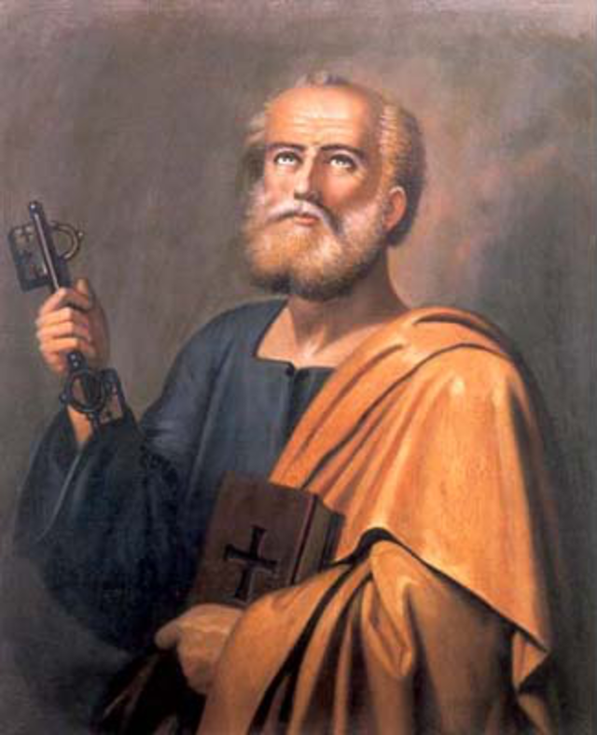
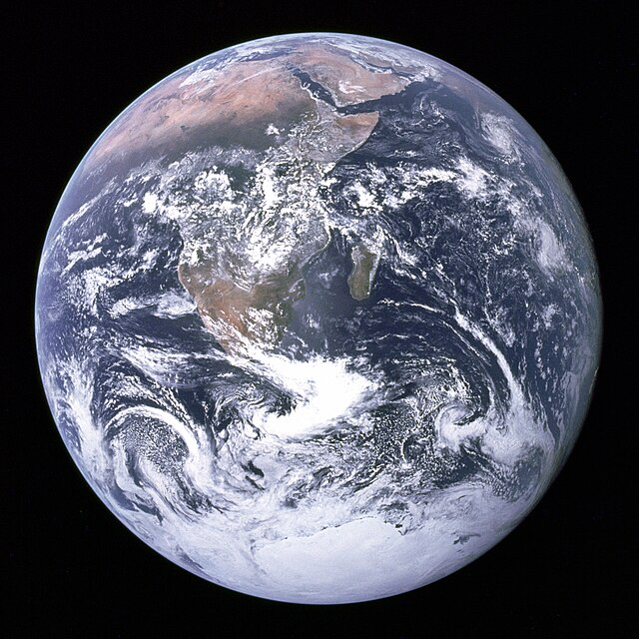
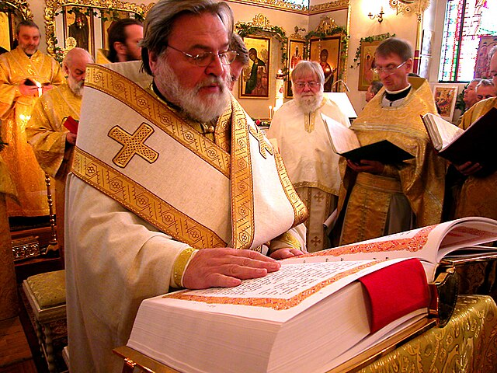

Criteria for Qualifying as a New Testament Book
Apostolic Origin | Universal Acceptance | Liturgical Use | Consistent Message
Notes:
*Photo Credit: Life of Riley, Public domain, https://commons.wikimedia.org/wiki/File:Herringbone_pattern_as_hexagonal_tiling.svg, Velopilger
Public domain, https://commons.wikimedia.org/wiki/File:Liturgy_St_James_4.jpg, NASA/Apollo 17 crew; taken by either Harrison Schmitt or Ron Evans
Public domain, https://commons.wikimedia.org/wiki/File:The_Earth_seen_from_Apollo_17.jpg, Daoud Corm, Public domain, https://commons.wikimedia.org/wiki/File:Saint_Peter_Daoud_Corm.png
Directions: Explain the meaning of each criteria.
Apostolic Origin: attributed to and/or based on the preaching/teaching of the first-generation apostles (or their closest companions).
Universal Acceptance: acknowledged by all major Christian communities in the Mediterranean world (by the end of the fourth century).
Liturgical Use: read publicly along with the Old Testament when early Christians gathered for the Lord's Supper (their weekly worship/Mass).
Consistent Message: contain theological ideas compatible with other accepted Christian writings (incl. the divinity and humanity Jesus).

Slide 12
Composition of the New Testament Books
John, Revelation and Later Letters
The Gospel of John and the book of Revelation are both attributed to the youngest Apostle who died of natural causes. 1 Peter, Jude, and Ephesians date to this time as well.
Life, Death, Resurrection—Oral Tradition
Jesus ascended forty days after the Resurrection and the Holy Spirit descended on Pentecost. The Oral Tradition followed.
Mark, Matthew, and 1 Timothy
The Gospel of Mark is said to have been written first, followed by Matthew. Saint Paul wrote his first letter to Timothy in this decade as well.
40 AD
80 AD
130 AD
20 AD
60 AD
100 AD
Early Letters
1 Thessalonians, Galatians, Philemon, Philippians, 1-2 Corinthians, Romans
Luke, Acts, and other Letters
Colossians, Hebrews, James
Last Letters
From AD 100 to AD 130, 2 Thessalonians, 2 Timothy, Titus, 1-3 John and 2 Peter were written.
Notes:
Direction: Have students copy timeline and include bold type only.

Slide 13


Top 3 Catholic Bible Editions
NABRE: New American Bible Revised Edition.
  Used at Catholic Mass.
  Cited in Textbooks.
NJB: New Jerusalem Bible
NRSV: New Revised Standard Version
Notes:
*Photo Credit: Open bible 01 01.svg, Creative Commons Zero, Public Domain Dedication
Directions: Have students look up https://www.biblegateway.com. Then compare and contrast several translations of the same verse.
Online Resources: NABRE online is available through the USCCB website. URL here: https://bible.usccb.org/bible

Slide 14

Bible Study Tools
Bible Commentary
Bible Atlas
Bible Dictionary
Bible Concordance
Notes:
*Photo Credit: Ben White benwhitephotography, Creative Commons Zero, Public Domain Dedication, https://commons.wikimedia.org/wiki/File:Bible_Study_(Unsplash).jpg
Directions: Discuss the purpose of each tool listed on the slide (see below). If you have any of these tools on hand, hold them up and/or pass them around.
Bible Commentary: Provides explanations and interpretations of scripture.
Bible Atlas: Provides historical maps and a guide to the Holy Land and other biblical areas.
Bible Dictionary: Provides definitions and illustrations of proper names, places, people, animals, and things in the Bible.
Bible Concordance: Provides an index to find keys words and concepts that are found in other books of the Bible.

Slide 15
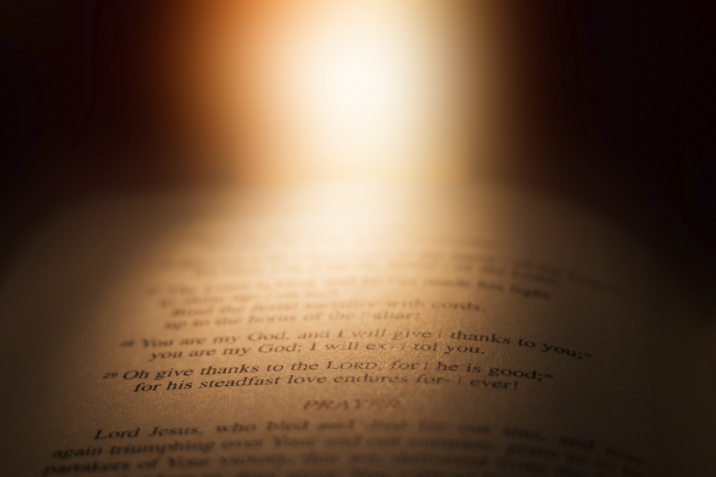
BK CH:VS
Gn 43:8-10
How to Read a Bible Citation
Book Chapter:Verse(s)
“Genesis, chapter forty three, verses eight to ten.”
Notes:
Directions: (supplies needed: one Bible for each student). Have students locate this chapter and verse in their Bibles. Guide students through the slide, explaing book, chapter and verse.

Slide 16
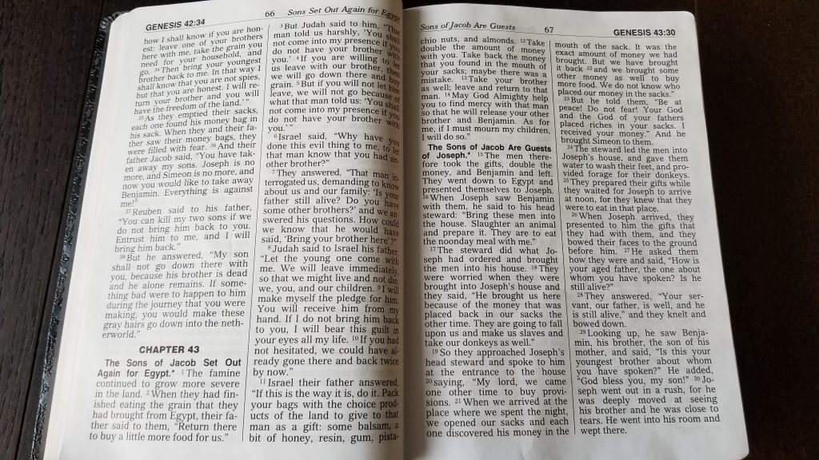

How to Locate a Reading in the Bible
1
1. Locate the book.
3. Locate the first verse.
2. Locate the chapter.
3
4
4. Locate the last verse.
2
Notes:
*Photo Credit: Leif Skoogfors, Public domain, https://commons.wikimedia.org/wiki/File:FEMA_-_3721_-_Photograph_by_Leif_Skoogfors_taken_on_08-09-2001_in_West_Virginia.jpg
Directions: (supplies needed: one Bible for each student). Have students use a hard copy Bible to look up and locate the verse in the image. Then have them practice locating a passage by having them look up John 6:48-53. Have someone read the passage aloud.

Slide 17

Turn and Talk
Why is it important to know that the Bible came from the Church and not the Church from the Bible?
Notes:
Directions: Have students write down the question and then write down their answer. Then have students share their answers with one person close by.

Slide 18

Memorize It
Key
Verse
“For God so loved the world that he gave his only Son, so that everyone who believes in him might not perish but might have eternal life.”
Jn 3:16
Notes:
Directions: Have students copy the quote. Add bonus points to the assessment if they can write it down, demonstrating that they memorized it.

