Slide 1

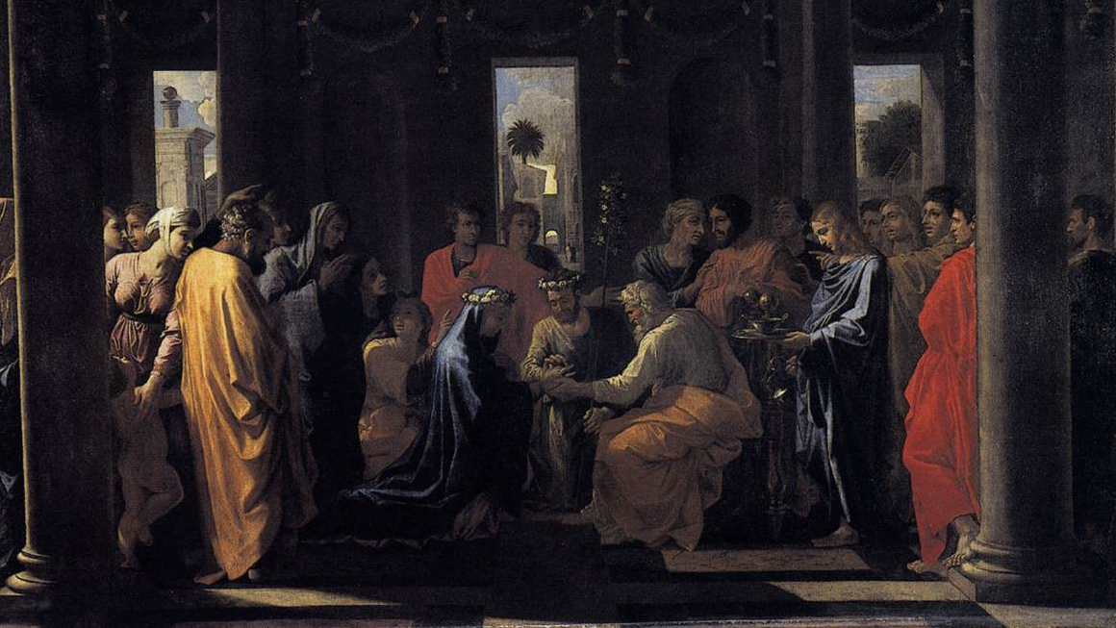
8
8. THE SACRAMENT OF MATRIMONY
The Sacrament of Matrimony
The Seven Sacraments: Signs of God’s Grace
Notes:
Marriage II, Nicolas Poussin, 1647–1648. Public domain.
Suggestions for taking notes on the slides:
Require students to use a three ring binder (1/2-1 inches) full of loose leaf paper (college or wide ruled).
Notes must be taken in pen only and hand written.
Notebooks should contain information and notes for religion class only.
Notebooks must have a table of contents with topic of notes, dates and page numbers.
All notes must have a topic and page number.
Students will be required to copy each slide unless the teacher directs students to skip certain slides or parts of slides.

Slide 2

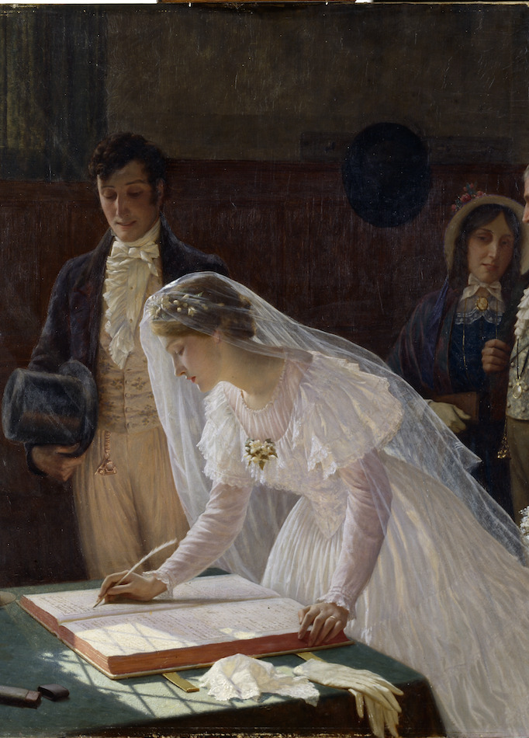
Marriage is God’s Idea
“The vocation to marriage is written in the very nature of man and woman as they came from the hand of the Creator.” —CCC 1503
Genesis 2:4–25 describes Adam’s creation and his loneliness due to not having a partner with whom to share his life. The Lord agreed:
“It is not good for the man to be alone. I will make a helper suited to him.”
Notes:
Photo Credit: The Wedding Registry, Edmund Blair Leighton, 1920. Public domain. https://commons.wikimedia.org/wiki/File:The_Wedding_Register_by_Edmund_Blair_Leighton_-_1920.jpg.
Directions: Have students copy the quotes from the slide into their notes.
Teaching Points: Marriage is not a purely human institution that must adapt to the corruption of sin. Sacred Scripture teaches that God created man and woman for one another: “That is why a man leaves his father and mother and clings to his wife, and the two of them become one body” (Gn 2:24). From the beginning, marriage was intended to be unbreakable: “So they are no longer two, but one flesh” (Mt 19:6).
Online Resources: Assign article, God Made It. We Can’t Change It. URL here: https://www.catholic.com/magazine/print-edition/god-made-it-we-cant-change-it

Slide 3
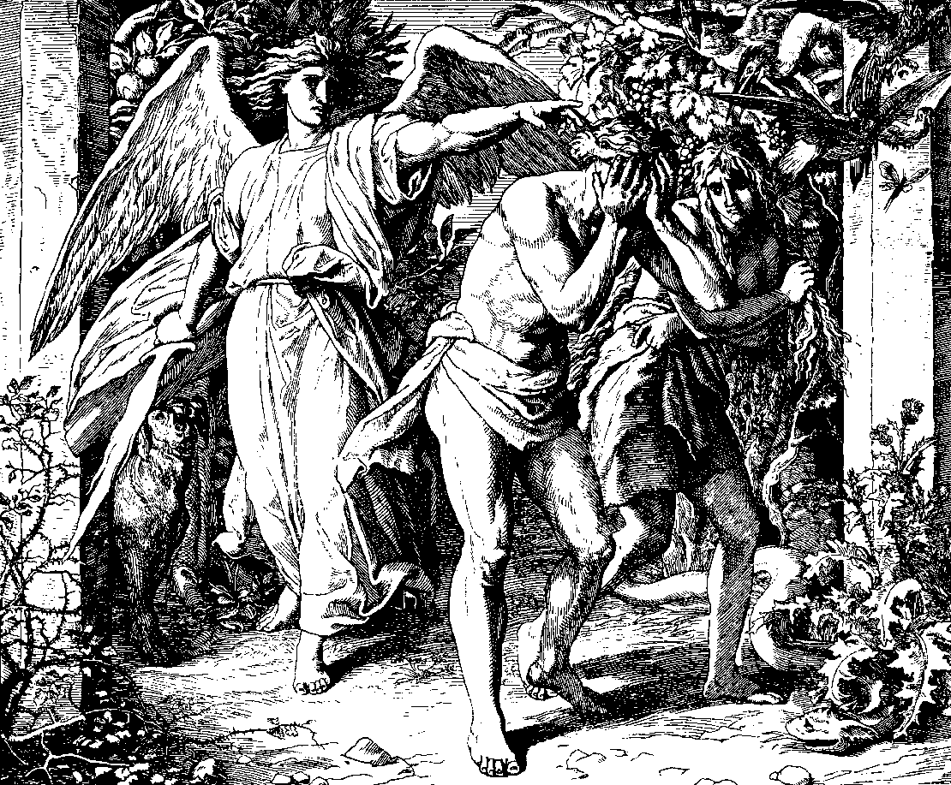
Marriage Is Hurt by Sin
Adam and Eve covered themselves out of shame. Power struggle and discord in their relationship emerged (Gn 3).
Marriages were man-made contracts and polygamy and divorce became the norm.
In the Old Testament, the people of Israel and God had a failed marital covenant. The infidelity of Israel was due to their worship of false gods.
Notes:
Photo Credit: Bibel in Bildern, Julius Schnorr von Carolsfeld, 1860. Public domain. https://commons.wikimedia.org/wiki/File:Schnorr_von_Carolsfeld_Bibel_in_Bildern_1860_010.png.
Directions: Have students put the information from the slide into their notes.
Teaching Points:
Human sinfulness marks the history of marriage. Marriage during the Old Covenant was primarily a private contract initiated between two male heads of families, much like the buying and selling of property.
A father “owned” his daughters and was entitled to any profit they made from working in the fields, sewing, spinning, or cooking. A young man who wanted to marry a girl had to pay her father a “bride price” to compensate him for losing a valuable worker and income producer. Once the bride price was paid, the father escorted the girl to the man’s home.
The Law of Moses was clear in protecting the wife from cruelty and domination by her husband, though it did permit a decree of divorce. Jesus later explained that “hardness of heart,” a residue of sin, had allowed divorce; “from the beginning it was not so” (Mt 19:8).
Polygamy was practiced among the Israelites, but also by neighboring peoples. Polygamy signaled privilege and wealth; it helped to establish political alliances; it also ensured that a man would have male heirs. In ancient Israel, polygamy was allowed in several cases among patriarchs, kings, and others as well. Elkanah in 1 Samuel 1–2 is married to both Peninnah and Hannah, and he is not a patriarch or king. However, Mosaic Law and the teachings of the prophets gradually led toward exclusive and faithful married love far beyond what was being practiced by the Canaanites and other pagans.
Mosaic Law also forbade adultery because, like divorce and polygamy, it gravely offends the dignity of marriage.

Slide 4
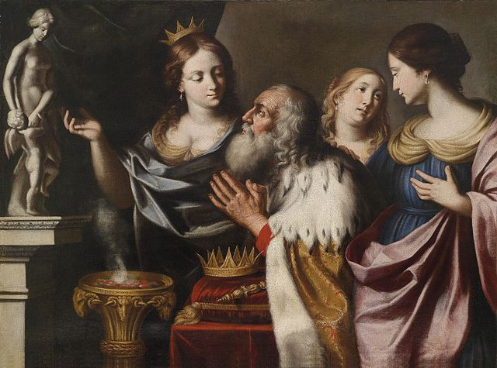
Polygamy
Key
Vocab
Definition: the practice or custom of having more than one wife or husband at the same time
Notes:
Photo Credit: King Solomon in his old age led astray into idolatry by his wives. Giovanni Venanzi. Public domain. wikicommons.org
Directions: Have students copy the vocabulary term and definition from the slide into their notes.

Slide 5

Turn and Talk
Which non-physical characteristics or virtues would you look for in choosing a spouse? Explain.
Notes:
Directions: Have students write down the prompt and then write down their answer. Then, have students share their answers with one person close by.
Online Resources: Have students view video, Choosing Your Spouse, Philip Rivers. URL here: https://youtu.be/4UTsy8y0JRs
The videos linked in this presentation file may contain copyrighted material. Such material is made available for educational purposes only. This constitutes a “fair use” of any such copyrighted material as provided for in Title 17 U.S.C. section 106A-117 of the US Copyright Law.

Slide 6

“Why can’t I live with my girlfriend before we get married?”
You would be sabotaging your marriage before it begins.
Cohabitation before marriage is often associated with a higher risk of divorce compared to couples who don't cohabit before marriage. Specifically, couples who live together before their engagement are more likely to experience marital instability than those who wait until after being engaged or married.
Cohabiters often want steady companionship, cheaper rent, and sexual availability, making cohabitation a utilitarian act. This amounts to a relationship that says, “I’m willing to let you use me, as long as you’re willing to let me using you.” Does that sound like real love?
Notes:
Directions: Use the animation feature to have the answer appear after you ask the students to respond out loud to the question on the left.
Online Resources: Have students view video, Cohabitation URL here: https://youtu.be/3JZoLsY3V34
The videos linked in this presentation file may contain copyrighted material. Such material is made available for educational purposes only. This constitutes a “fair use” of any such copyrighted material as provided for in Title 17 U.S.C. section 106A-117 of the US Copyright Law.

Slide 7
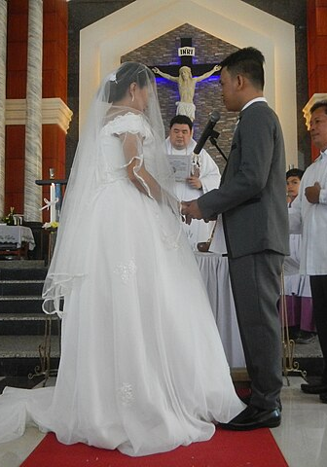
Marriage in the New Covenant
From contract to covenant:
Contract (human): led to polygamy and divorce
Covenant (divine): is unbreakable and faithful
Through his words and actions, Jesus raised marriage back to a covenant and sacrament status:
“What God has joined together, no human being must separate” (Mt 19)
Jesus changed water to wine at a Wedding at Cana (Jn 2)
St. Paul compares Holy Matrimony with the love that Jesus has for his Bride, the Church:
Matrimony mirrors Christ’s covenant with Church (Eph 5)
Notes:
Photo Credit Saint Clare of Assisi Parish Catholic Church. Judgefloro. Creative Commons Zero, Public Domain Dedication. wikicommons.org
Directions: Have students copy information from slide into their notes.
Teaching Points:
The Gospel of John documents Christ’s validation of the goodness of marriage. As he began his public life, Jesus performed his first miracle—at his Mother’s request at a wedding. Christ’s presence at Cana is not only a statement of the goodness of marriage, but a statement that, from then on, marriage would be an efficacious sign of his presence (Jn 2:1–12).
Jesus clearly taught that marriage is indissoluble: “What God has joined together, no human being must separate” (Mt 19:6; CCC, 1664). While that is a difficult command, Jesus comes into the life of the married couple in the Sacrament of Matrimony to help them keep it. The couple receives the effects of the sacrament throughout their marriage, achieving faithfulness that does not end until death, just as Christ was faithful to his mission until his death on the cross.
St. Paul explained that the relationship between a husband and wife in the Sacrament of Matrimony reflects the intimacy and union between Christ and the Church (Eph 5:25–26).
Online Resources: Have students view video, Saying I Do: What Happens at a Catholic Wedding. URL here: https://youtu.be/3uAHwtBRg5c
The videos linked in this presentation file may contain copyrighted material. Such material is made available for educational purposes only. This constitutes a “fair use” of any such copyrighted material as provided for in Title 17 U.S.C. section 106A-117 of the US Copyright Law.

Slide 8
Holy Matrimony Essentials
Minister | Matter | Form
The Bride and Groom | Mutual Consent Consummation | The Exchange of Vows
Notes:
Directions: Have students draw a rough sketch of the map and have students copy down the information from the slide into their notes.
Online Resources: Assign article, Faith Fact: Who administers the Sacrament of Matrimony? URL here: https://catholicecho.org/2023/05/26/faith-fact-who-administers-the-sacrament-of-matrimony/

Slide 9
God’s Plan for Matrimony
Procreative
Have Children
Purpose of Human Sexuality
Unitive Bond
Become One
The Promises Made in Vows
Indissolubility
No Divorce
Faithfulness
No Cheating
Open to Life
No Prevention
Notes:
Directions: Have students copy the information from the slide into their notes.
Online Resources: Have students view video, Bishop Barron on the Sacrament of Marriage URL here: https://youtu.be/JDBhaeus3Sg
The videos linked in this presentation file may contain copyrighted material. Such material is made available for educational purposes only. This constitutes a “fair use” of any such copyrighted material as provided for in Title 17 U.S.C. section 106A-117 of the US Copyright Law.

Slide 10
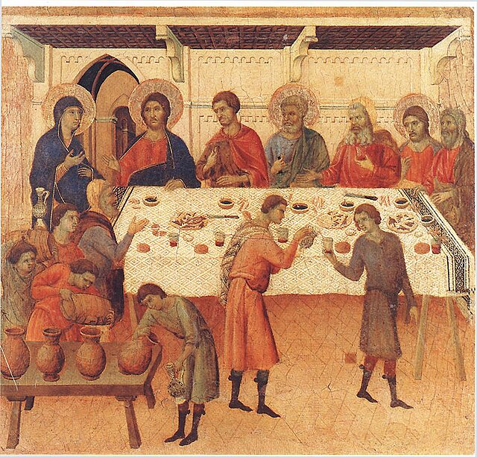
The Transformation of Love
Love changes like water to wine (Jn 2:1–10).
Agape transforms natural loves through grace of the Sacrament
A couple’s love mirrors Christ’s faithful love for the Church.
Love becomes selfless and sacrificial
Love becomes a life-giving love to others
Eros (romantic) and philia (friendship) love between spouses are enhanced, not replaced
Notes:
Photo Credit: Marriage at Cana. Public Domain. Duccio di Buoninsegna. Wikicommons.org
Directions: Read John 2:1–10, the Wedding at Cana aloud and then ask: “Is the change from water to wine symbolic of the change that the love between a couple undergoes in marriage?” Call on students to answer. Direct them to copy information from the slide into their notes.
Teaching Points:
Natural love is universal and engaged in by every human person to one degree or another. There are different types of natural love:
Philia love is also known as friendship love. Two people come together side by side and share as the object of their love a third thing, hobby or interest. This brotherly love is reciprocal. Each party only associates and engages in friendship, philia love, if he is receiving from the other the same or close to the same level of love.
Storge love is also known as family love. It is what C.S. Lewis calls a “need love.” This kind of love begins with a parent's love for his or her child, and then the child's love for the parents. Sibling love and even relationships with animals or objects can fall into this category. It is the most unconditional of the natural loves. For instance,”a mother's love knows no bounds.”
Eros love is also known as romantic love. C.S. Lewis describes this as the kind of love which is the least rational. It is feelings based. When someone uses the expression, “falling in love,” this is what they mean. A man and a woman who can't explain the attraction or the obsession not just with each other's physical attributes but with the person. Eros is a deep desire is to keep thinking about the other as the object of their love. It is a kind of obsession. It is reciprocal and ephemeral. It demands a mutual response from the other and when it doesn't receive eros love in return, it will fade away. No other type of love is written about in poetry or sung of in music as much as eros love.
Supernatural love has God as its source. For example:
Agape love stands apart and above the natural loves because it has a supernatural source. It is also known as Christian love. Agape (charity) upholds and purifies our human ability to love, and raises it to the supernatural perfection of divine love (CCC, 1827). Jesus demonstrated the meaning of agape love par excellence in his Passion and Death on the Cross.
Transformation of love is the process by which natural love is upheld, purified, raised, and perfected by God’s grace in Holy Matrimony.
"This grace proper to the sacrament of Matrimony is intended to perfect the couple's love and to strengthen their indissoluble unity” (CCC, 1641).
Online Resources: Have students view video, Mark Hart - What is love? URL here: https://youtu.be/VcW4LRPgGRI
The videos linked in this presentation file may contain copyrighted material. Such material is made available for educational purposes only. This constitutes a “fair use” of any such copyrighted material as provided for in Title 17 U.S.C. section 106A-117 of the US Copyright Law.

Slide 11

Family Life Teaches Us:
That marriage involves a total self-giving of the husband and wife to each other, emotionally, spiritually, and physically
A healthy understanding of ourselves, including the aspect of sexuality
That sexual intimacy is to be reserved for marriage between a man and a woman
About the complementary nature of masculinity and femininity
How to relate to others based on our own God-given personalities
Notes:
Photo Credit: People.svg,Creative Commons Zero, Public Domain Dedication. https://commons.wikimedia.org/
Directions: Have students copy these quotes on the slide in their notes.
Teaching Points:
Christian marriage is meant to help both spouses grow in spiritual perfection and to serve the common good. The Catechism of the Catholic Church states that “the well-being of . . . both human and Christian society is closely bound up with the healthy state of conjugal and family life” (CCC, 1603). Look around, and you will see that this is true. Stable families, even in struggles and trials, nurture healthy and happy individuals who serve the Church and the world.
Also, it is in the family that children are first prepared for marriage. This remote preparation in families allows children to discover their strengths and weaknesses. It is a time when children learn the necessary skills of loving relationships. No family is perfect, and some families surrounded by trauma. But ideally, it is in the family that we learn lessons of unfailing love and service. We also learn in family life:
how to relate to others based on our own God-given personalities
a healthy understanding of ourselves, including the aspect of sexuality
the complementary nature of masculinity and femininity
that sexual intimacy is to be reserved for marriage between a man and a woman
that marriage involves a total self-giving of the husband and wife to each other, emotionally, spiritually, and physically

Slide 12

Declaration of Nullity
Key
Vocab
Definition: also called an annulment, it is a judgment issued by the Church that says a marriage was never valid, having failed to meet the requirements for a valid marriage in the Church.
Notes:
Photo Credit: A void passport stamp of Republic of China(Taiwan) from Taiwan Taoyuan International Airport
National Immigration Agency, R.O.C. Public domain. wikicommons.org
Directions: Have students copy the vocabulary term and definition from the slide into their notes.
Online Resources: Have students view video, Can Catholics Get Divorced? Annulment Explained | EWTN News In Depth January 5, 2024 URL here: https://youtu.be/7d5CrG9G_7A
The videos linked in this presentation file may contain copyrighted material. Such material is made available for educational purposes only. This constitutes a “fair use” of any such copyrighted material as provided for in Title 17 U.S.C. section 106A-117 of the US Copyright Law.

Slide 13
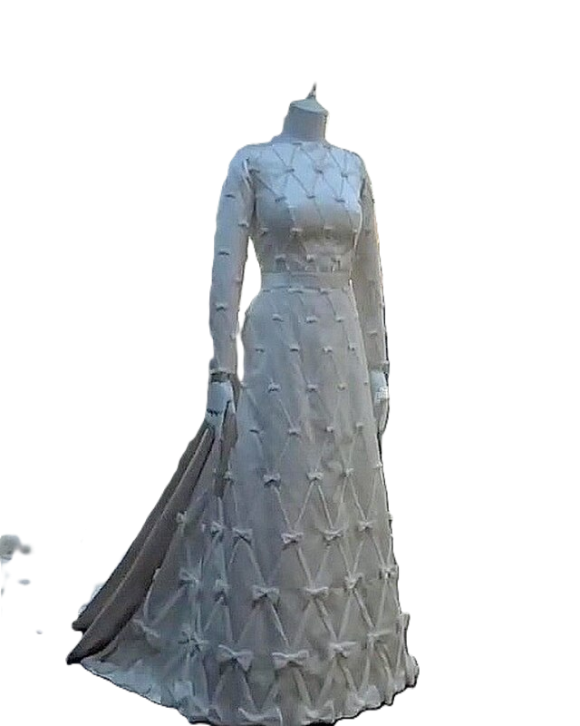
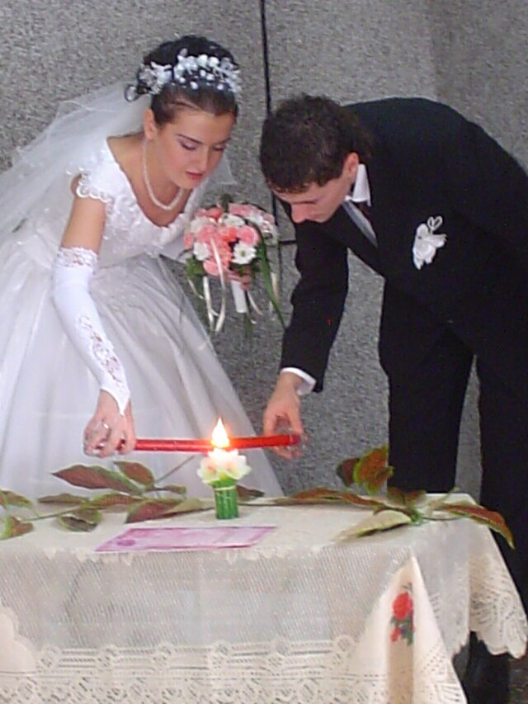
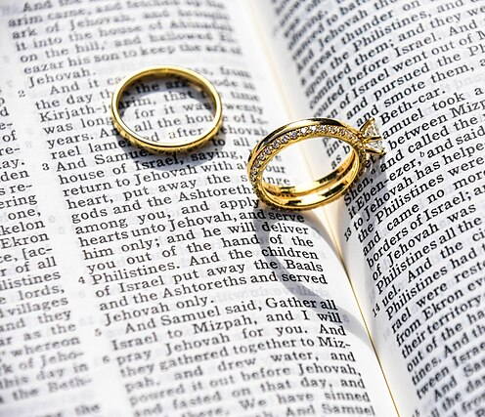
Traditional Wedding Symbols
Notes:
Photo Credit: Wedding Unity Candle.jpg. Sarita ladios from donetsk, ukraine. Creative Commons Attributon 2.0 Generic. https://commons.wikimedia.org/wiki/File:Wedding_unity_candle.jpg. Wedding dress of Mabel Wisse Smit (later Princess Mabel of Orange-Nassau).RoyalblogNL. Creative Commons Attribution 3.0. wikicommons.org. https://commons.wikimedia.org/wiki/File:Wedding_dress_of_Mabel_Wisse_Smit_02.jpg Glen McCallum glen_mccallum. Creative Commons Zero, Public Domain Dedication. wikicommons.org
Teaching Points:
Unity candles Two candles symbolize the couple's individual faith and their commitment to God's light in their lives.
White gown The bride’s traditional white gown symbolizes this consecration. It recalls the white robe of Baptism and the white dress many girls wear for First Communion. It speaks of a bride’s desire to leave behind her old life and begin a new life with her husband in Christ.
Wedding rings A symbol of eternal love, unity, and the couple's commitment to their vows. The circular shape of the ring represents eternity and the unending nature of marriage, while the rings themselves symbolize the couple's joint covenant and united love. They are a tangible reminder of the promises made during the wedding ceremony and the ongoing commitment to fidelity.

Slide 14

Memorize It
Key
Verse
“That is why a man leaves his father and mother and clings to his wife, and the two of them become one body.”
—Genesis 2:24
Notes:
Directions: Have students copy the quote. Add bonus points to the assessment if they can copy it down and demonstrate that they memorized it.

