Slide 1

Chapter 5 PowerPoint

Slide 2
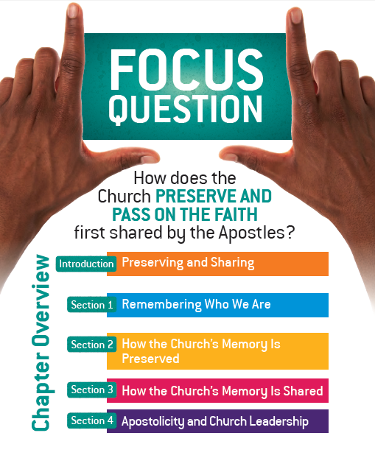
[Design to mirror this page in the student text. ]

Slide 3
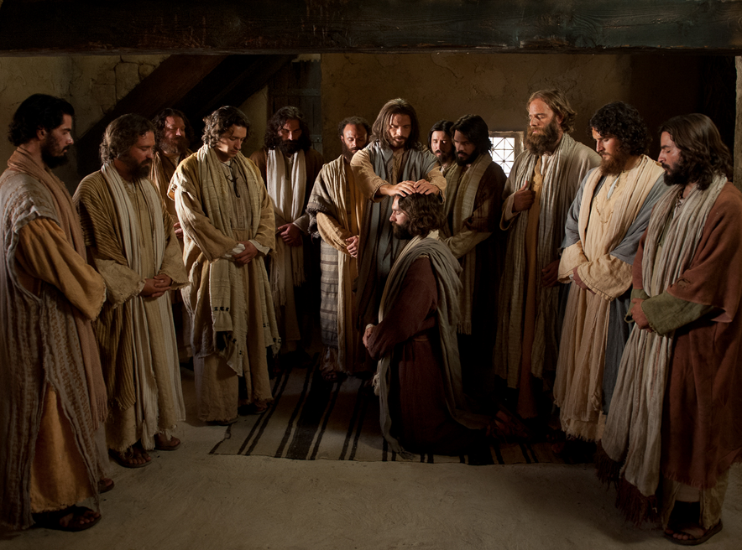
d
“Go, therefore, and make disciples of all nations, baptizing them in the name of the Father, and of the Son, and of the holy Spirit, teaching them to observe all that I have commanded you. And behold, I am with you always, until the end of the age.” Matthew 28:19-20
Preserving and Sharing

Slide 4
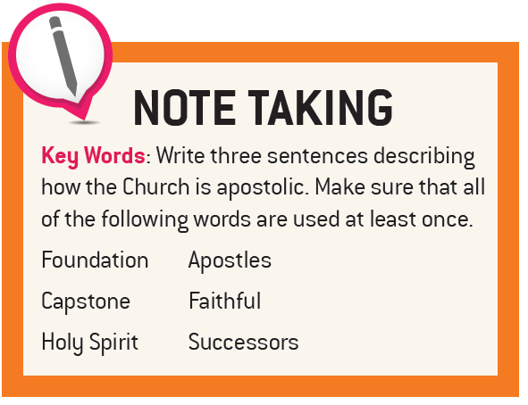
Preserving and Sharing

Slide 5

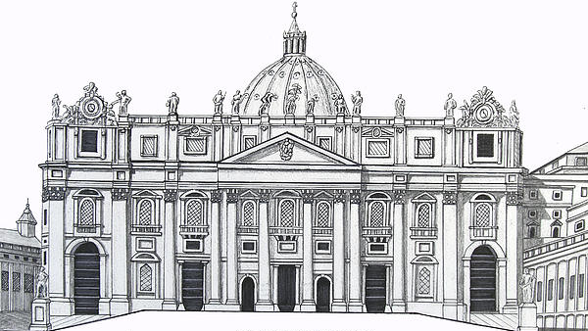
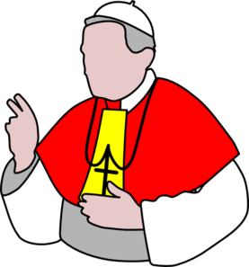

The Apostolic Nature of the Church
The foundation of the Apostles
Preserving and Sharing

Slide 6
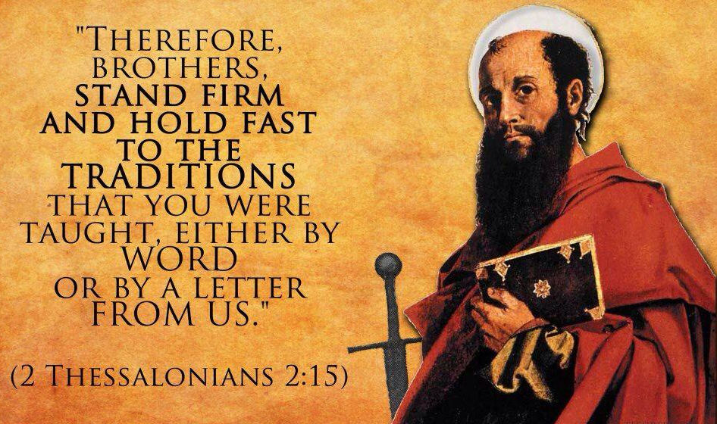
d
Apostolicity and Church Leadership

Slide 7
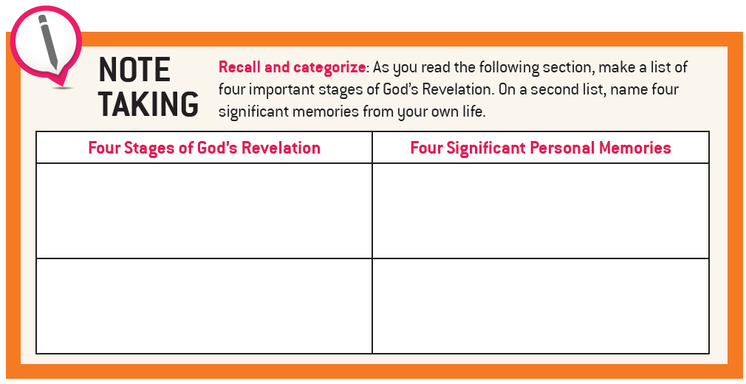
Remembering Who We Are

Slide 8
Public Revelation
Private Revelation
  Revealed by God
  Contains the
  Deposit of Faith
  Catholics must
  be believe
  Ended with the
  death of the last
  Apostle
  Come from private apparitions and communications
  Are not part of the Deposit of Faith
  Catholics are not required to believe
  Can never contradict Scripture or Tradition
  Still occur today
Can
lead
us to deeper faith
Remembering Who We Are

Slide 9

Remembering Who We Are

Slide 10
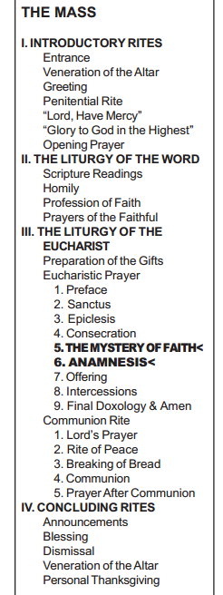
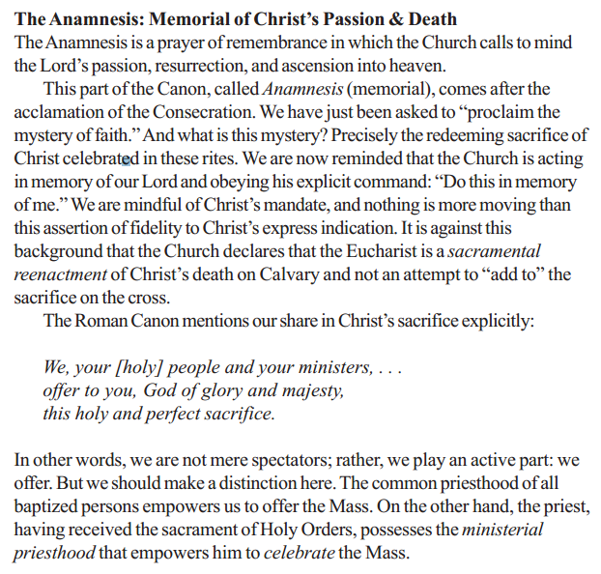
Remembering Who We Are

Slide 11

The History of Salvation:
God’s Plan for His People
Covenant Mediator | Adam | Noah | Abraham | Moses | David | Jesus
Covenant Form | Marriage | Household | Tribe | Nation | Kingdom | Church
Covenant Sign | Sabbath | Rainbow | Circum-cision | Passover | Temple & Throne | Eucharist
Remembering Who We Are

Slide 12
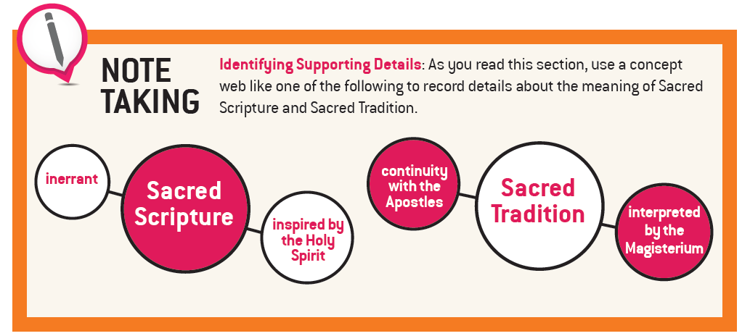
How the Church’s Memory Is Preserved

Slide 13
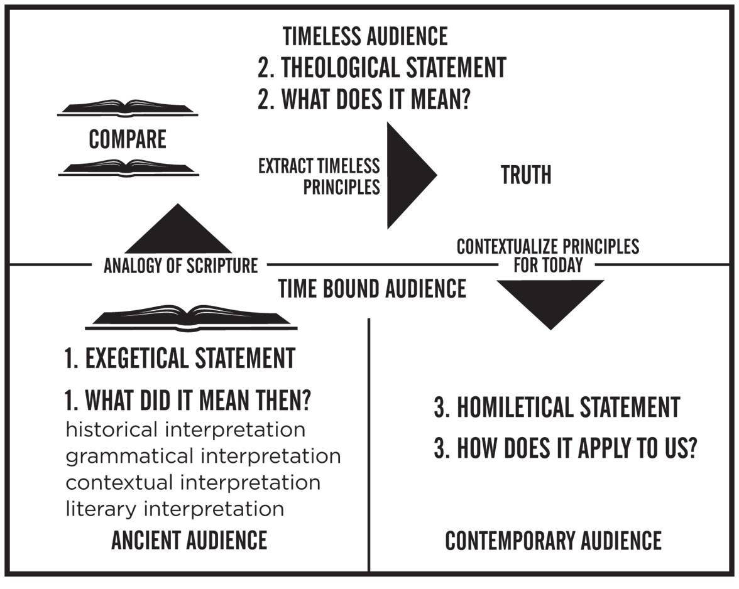
How the Church’s Memory Is Preserved

Slide 14
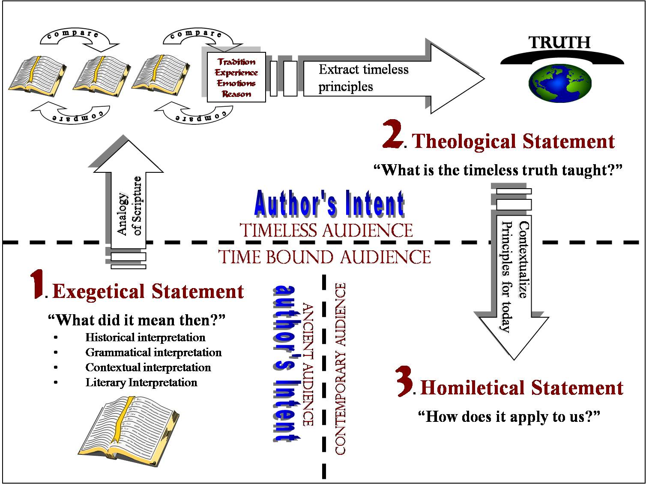
How the Church’s Memory Is Preserved

Slide 15
Dual-Source
Theory
Sacred Tradition
Unwritten Infallible Tradition
… I … encourage you to contend for the faith that was once for all handed down to the holy ones. Jude 1:3
Deposit
of Faith
Magisterial authority interprets both infallibly
Sacred Scripture
Written Infallible Tradition
400 AD 1000 AD
Age of the Apostles Age of the Church
How the Church’s Memory Is Preserved

Slide 16
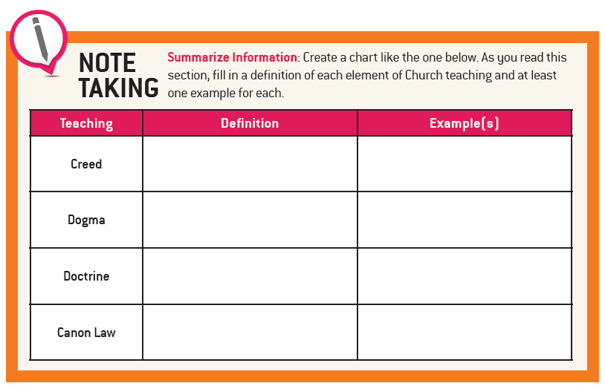
How the Church’s Memory Is Shared

Slide 17
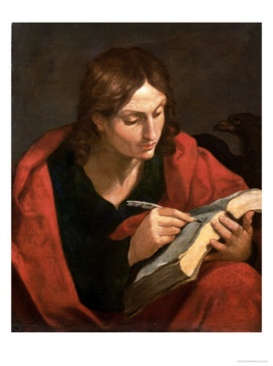
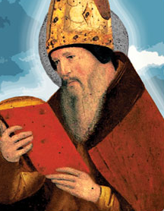
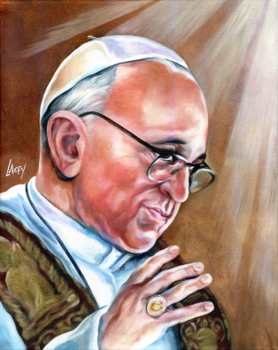
Tradition
Scripture
Magisterium
Scripture, Tradition, and the Magisterium are so closely united with each other that one of them cannot stand without the others.
How the Church’s Memory Is Shared

Slide 18
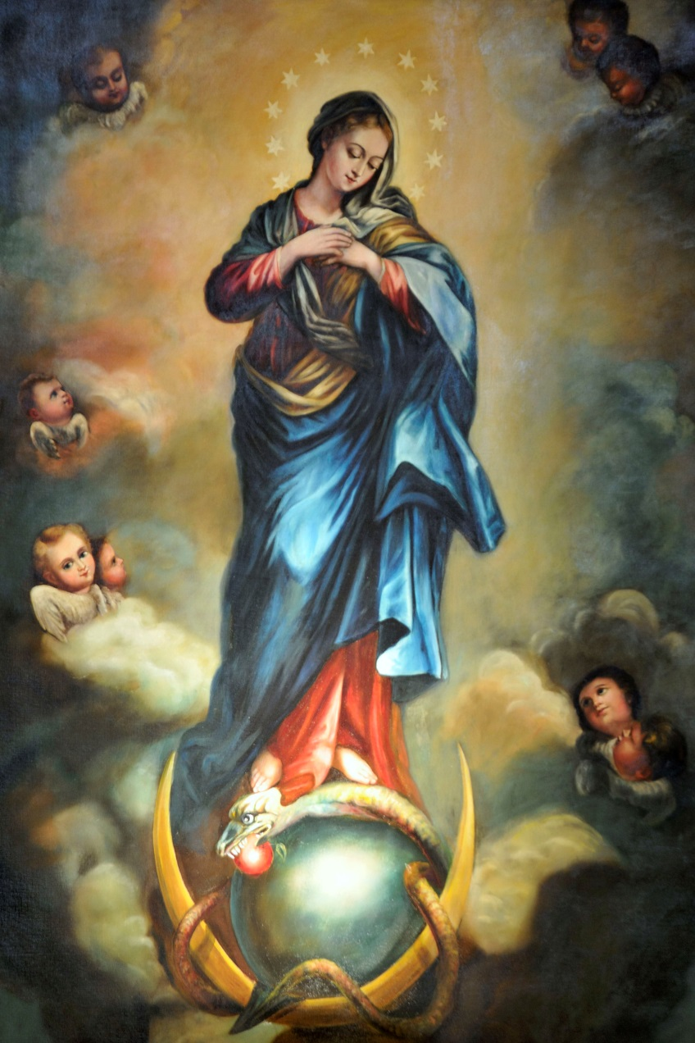
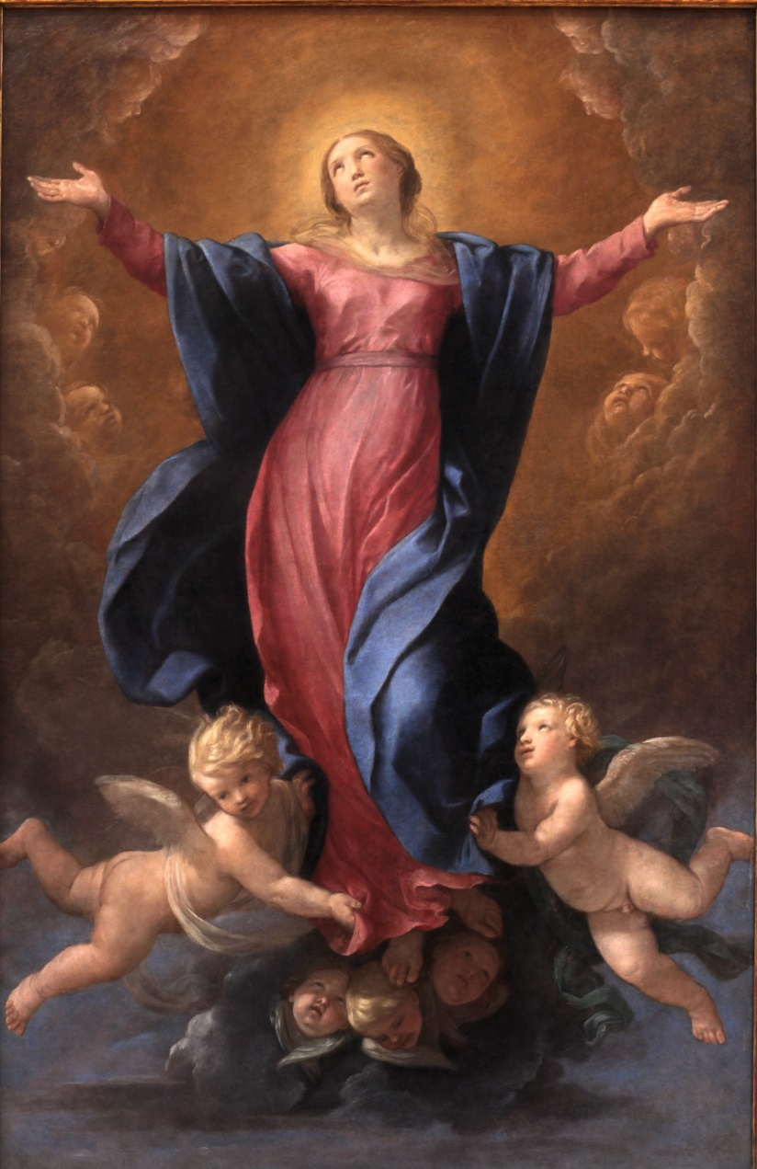
The Immaculate Conception of Mary
The Assumption of Mary
How the Church’s Memory Is Shared

Slide 19
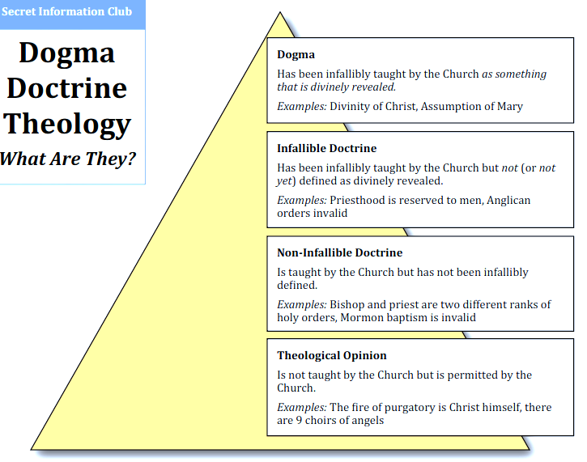
Dogma versus Doctrine
How the Church’s Memory Is Shared

Slide 20
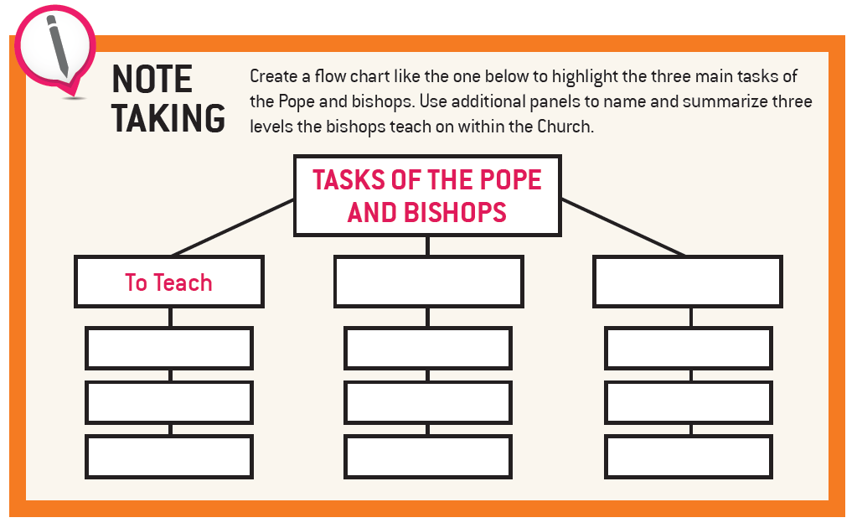
Apostolicity and Church Leadership

Slide 21
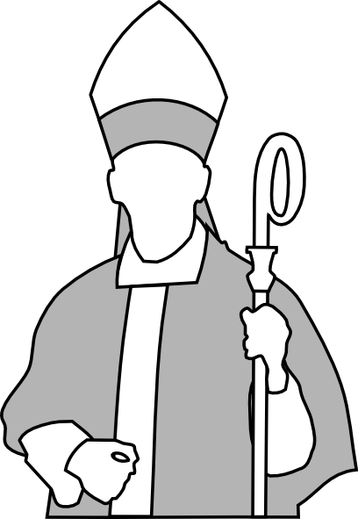
The Main Responsibilities of a Bishop
To Teach
A bishop is the principal teacher in his diocese. He must ensure that those delegated to teach in his name, namely priests, teachers, catechists and others, teach the truth.
To Sanctify
He is responsible for ensuring that the sacraments are administered and has the special authority to ordain priests and to confirm.
To Govern
This refers to meeting the needs of the local community (material, social, personal and spiritual) as well as ensuring that Church laws are observed.
Apostolicity and Church Leadership

