Slide 1
Chapter 6 PowerPoint

Slide 3
Good News

Slide 4
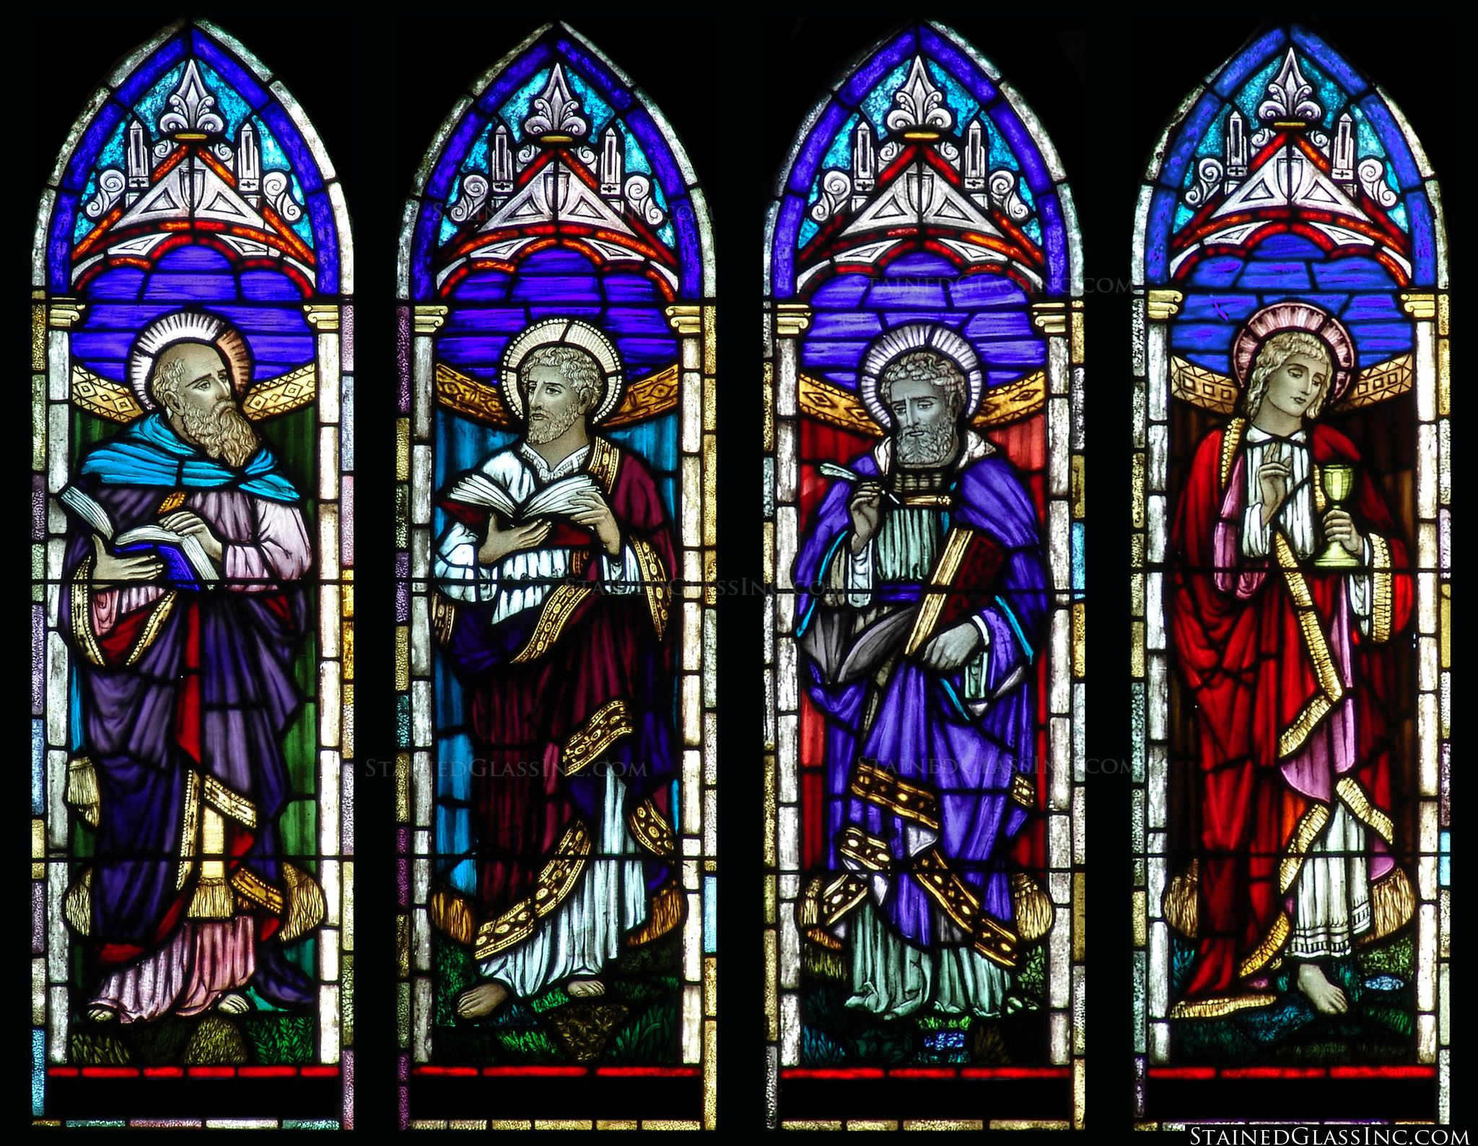
The Four Evangelists
Good News

Slide 5
The Good News: Jesus Christ
Good News

Slide 6
The Synoptic Gospels: An Overview

Slide 7
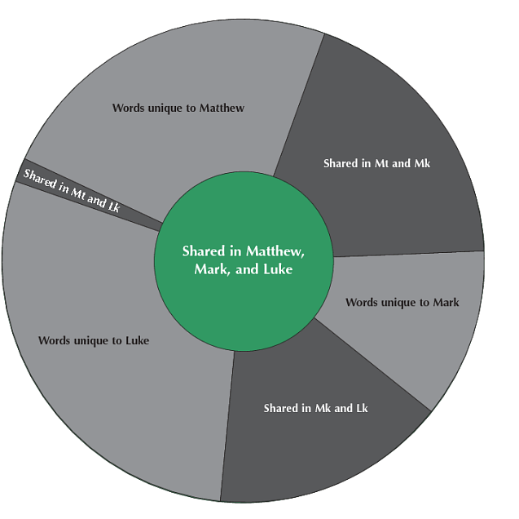
Synoptic Gospels The synoptic Gospels are Matthew, Mark, and Luke. They can be looked at together because they shared some, but not all, of the same sources.
Comparison of Parallel Synoptic Passages’ Vocabulary
The Synoptic Gospels: An Overview

Slide 8
Sources used by Matthew and Luke
The Synoptic Gospels: An Overview

Slide 9
Probable Q passages in both Matthew and Luke
The Beatitudes
Love of Enemies
The Golden Rule
Judge Not, Lest Ye Be Judged
The Test of a Good Person
The Parable of the Wise and the Foolish Builders
The Parable of the Lost Sheep
The Parable of the Wedding Feast
The Parable of the Talents
The Parable of the Leaven
The Parable of the Blind Leading the Blind
The Lord’s Prayer
Expounding of the Law
The Birds of Heaven and the Lilies of the Field
The Synoptic Gospels: An Overview

Slide 10
Jesus’ Early Life

Slide 11
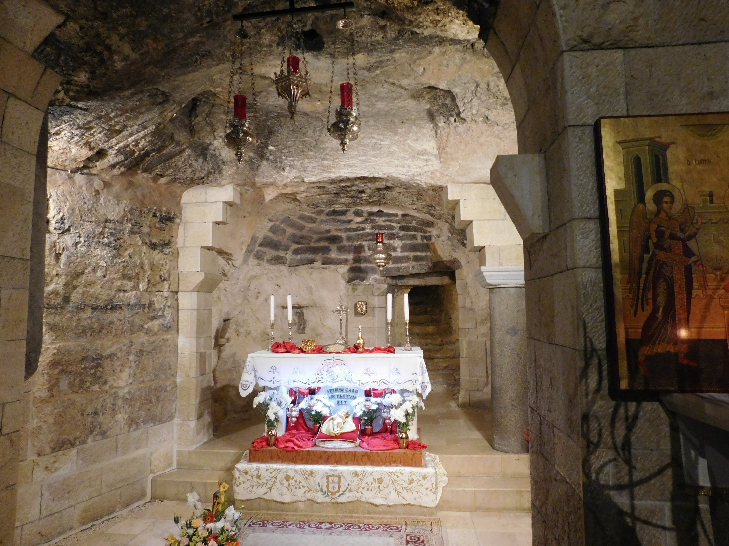
“Here the Word was made flesh”
The lower level of the Basilica of the Annunciation, Nazareth, enshrines a sunken grotto that contains the traditional cave-home of the Virgin Mary. Inside the cave stands an altar with the Latin inscription: “Here the Word was made flesh”.
Jesus’ Early Life

Slide 12
Jesus’ Early Life

Slide 13
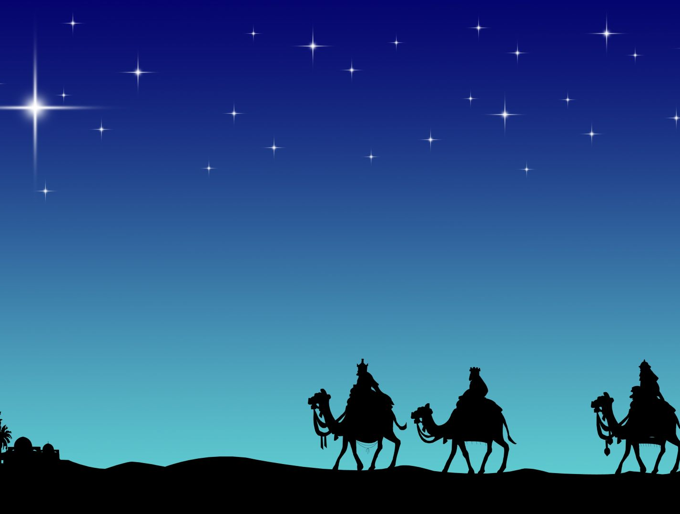
Matthew’s Birth Narrative 1:18-2:23
Announcement of Mary’s pregnancy to Joseph in a dream
Appearance of a star
Visitation of the Magi
Herod’s plot against Jesus
The flight of the Holy Family to Egypt
Massacre of the holy innocents
Return to Nazareth from Egypt
Luke’s Birth Narrative 2:1-39
Jesus’ and John’s births foretold
The Annunciation of Jesus
Mary’s visit to Elizabeth
The Magnificat
The birth of John the Baptist
Jesus is born in Bethlehem
Jesus’ birth is announced to the shepherds
The presentation of Jesus in the Temple/Anna & Simeon
Jesus’ Early Life

Slide 14
Jesus’ Early Life

Slide 15
Jesus’ Public Life

Slide 16
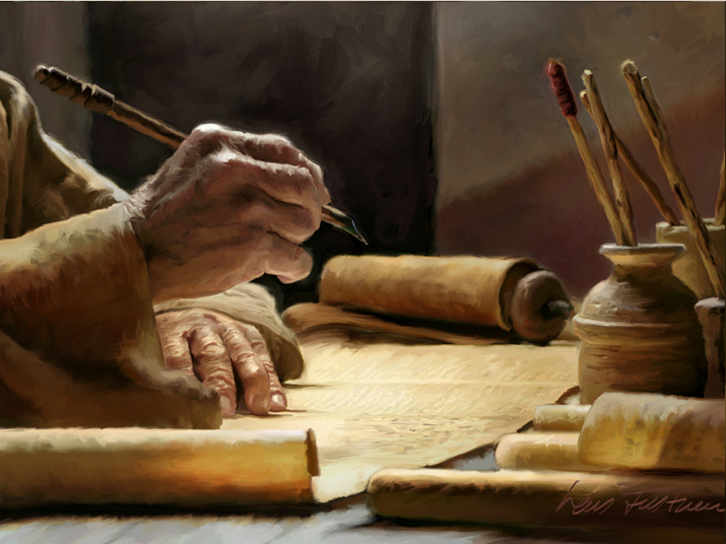
Emmanuel A name for Jesus that means “God is with us.” This is the name given to Jesus as foretold in the Old Testament and recounted to Joseph, the foster father of Jesus, in a dream.
It shall roll on into Judah, it shall rage and pass on—up to the neck it shall reach. But his outspread wings will fill the width of your land, Emmanuel! Isaiah 8:8
Therefore the Lord himself will give you a sign; the young woman, pregnant and about to bear a son, shall name him Emmanuel. Isaiah 7:14
Jesus’ Public Life

Slide 17
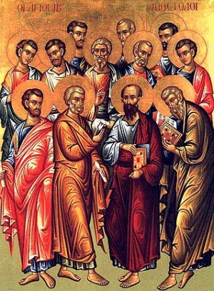
Twelve sons of Jacob
Reuben
Simeon
Levi
Judah
Dan
Naphtali
Gad
Asher
Issachar
Zebulun
Joseph
Benjamin
Twelve Apostles
Simon Peter
James
John
Andrew Philip
Thomas
Bartholomew
Matthew
James Simon the Zealot
Thaddaeus-Judas
Judas Iscariot
When Jesus established the Apostles as shepherds of the Church, he appointed them as symbolic rulers of the twelve tribes of Israel. “Jesus said to them, ‘Amen, I say to you that you who have followed me, in the new age, when the Son of Man is seated on his throne of glory, will yourselves sit on twelve thrones, judging the twelve tribes of Israel.’” (Mt. 19:28)
Jesus’ Public Life

Slide 18
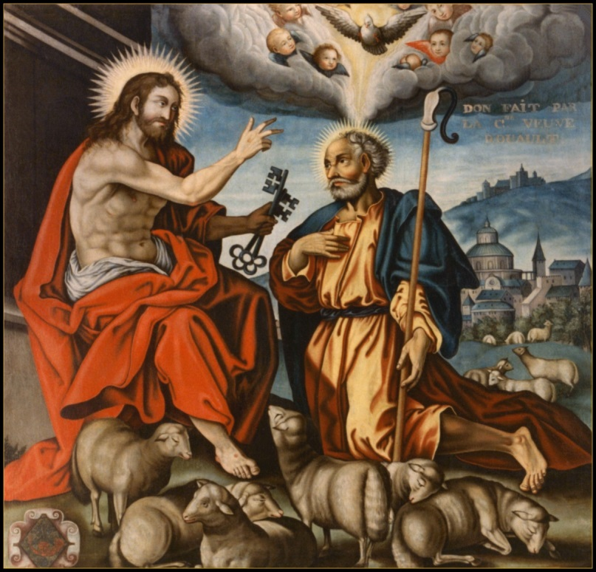
Isaiah 22:22 I will place on his shoulder the key of the house of David; he shall open and none shall shut; and he shall shut and none shall open.
Matthew 16:18-19
And so I say to you, you are Peter, and upon this rock I will build my church, and the gates of the netherworld shall not prevail against it. I will give you the keys to the kingdom of heaven. Whatever you bind on earth shall be bound in heaven; and whatever you loose on earth shall be loosed in heaven.”
Jesus’ Public Life

Slide 19
Jesus’ Public Life

Slide 20
Jesus Proclaims the Gospel

Slide 21
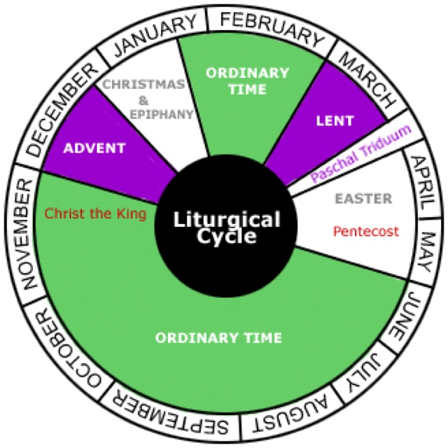
Paschal Mystery Christ’s work of Redemption, accomplished principally by his Passion, Death, Resurrection, and glorious Ascension. This mystery is commemorated and made present through the sacraments, especially the Eucharist.
Jesus Proclaims the Gospel

Slide 22
The Mustard Seed Jesus put another parable before them. He said, “The kingdom of heaven is like a grain of mustard seed that a man took and sowed in his field. It is the smallest of all seeds, but it grows larger than all the garden plants and becomes a tree. The birds of the air can come and make nests in its branches.” (Mt 13:31-32)
The Pearl of Great Price
“Again, the kingdom of heaven is like a merchant in search of fine pearls, who, on finding one pearl of great value, went and sold all that he had and bought it.” (Mt 13:45-46)
Parables of the Kingdom
The Yeast
He told them another parable. “The kingdom of heaven is like leaven that a woman took and hid in three measures of flour, till it was all leavened.” (Mt. 13:33).
The Household Treasures
And he said to them, “Therefore every scribe who has been trained for the kingdom of heaven is like a master of a house, who brings out of his treasure both what is new and what is old.” (Mt 13:52).
The Hidden Treasure
“The kingdom of heaven is like treasure hidden in a field. A man found it, and he concealed it. Then in his joy he goes and sells all that he has and buys that field.” (Mt 13:44).
The Dragnet
Again, said Jesus, “The kingdom of heaven is like a net that fisher-folk threw into the sea. The net gathered all sorts of fish. When the net was full, the fisher-folk drew it ashore. They sat down and sorted the good fish into containers but threw away the bad. So it will be at the end of the age. The angels will come out and separate the evil from the righteous and cast the evil into the fiery furnace. In that place there will be weeping and gnashing of teeth’”(Mt 13:47-50).
The Growing Seed
And Jesus said, “The kingdom of God is like a man scattering seed on the ground. He sleeps and rises night and day, and the seed sprouts and grows —he knows not how. The earth, by itself, produces first the blade, then the ear, then the full grain in the ear. But when the grain is ripe, at once the man puts in the sickle, because the harvest has come.” (Mk 4:26-29).
Jesus Proclaims the Gospel

Slide 23
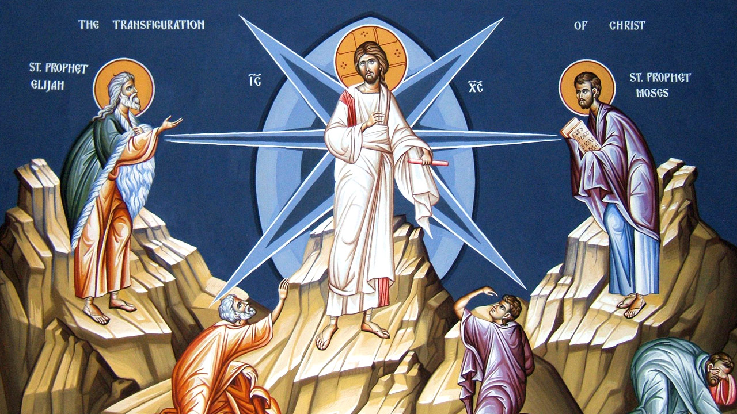
The Transfiguration Matthew 17:1-9; Mark 9:2-10; Luke 9:28-36
Jesus Proclaims the Gospel

Slide 24
Similarities between Jesus and Moses
Moses | Jesus
Narrowly escaped death as a baby | Narrowly escaped death as a baby
Shepherd | The Good Shepherd
Turned water into blood | Turned water into wine and wine into his Blood
Savior of the Israelites | Savior of all mankind
Performed miracles | Performed miracles
Hebrews were slaves to the Egyptians | We are slaves to sin
Led God’s people to freedom through the waters of the Red Sea | Sets us free from sin through the waters of Baptism
Presented the Law at Mount Sinai | Presented the Law at the Mount of the Beatitudes
The face of Moses shown with glory on Mount Sinai | Jesus is shown in his glory at the Transfiguration
Jesus Proclaims the Gospel

Slide 25
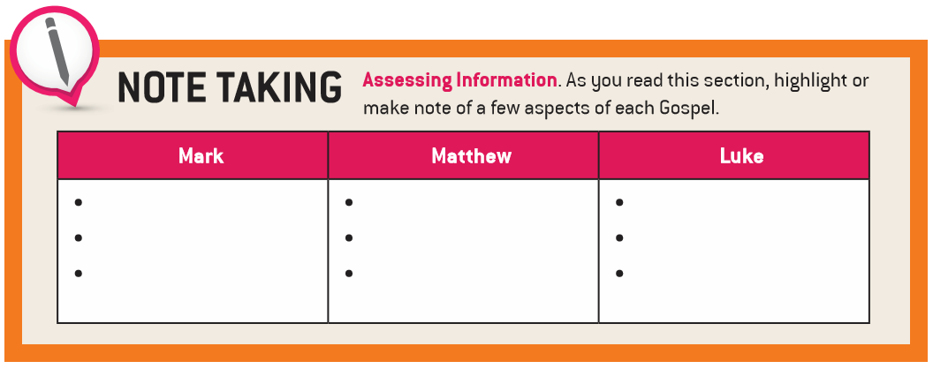
Individual Characteristics of the Synoptic Gospels

Slide 26
A Cycle of Five "Conflict Stories" in Mark (2:1—3:6)
Mark | Title | Who Objects? |  | Against Whom? |  | About What?
2:1-12 | Healing a Paralytic | Scribes |  | Among themselves |  | Forgiving/blaspheming
Jesus’ saying: “the son of Man has authority on earth to forgive sins” (2:10).
2:13-17 | Calling Levi, a Tax Collector |  | Scribes & Pharisees |  | Jesus’ disciples |  | Eating with tax collectors and sinners
Jesus’ sayings: “Those who are well have no need of a physician, but rather, those who are sick” (2:17a); “I have come to call not the righteous but sinners (2:17b).
2:18-22 | About Fasting |  | People |  | Jesus |  | Disciples not fasting
Jesus’ sayings: “The wedding guests cannot fast while the bridegroom is with them” (2:19-20); “No one sews a piece of unshrunk cloth on an old cloak” (2:21-22).
2:23-28 | Plucking grain on the Sabbath |  | Pharisees |  | Jesus |  | Breaking the Sabbath
Jesus’ sayings: “The Sabbath was made for man, and not man for the Sabbath” (2:27); “so the Son of Man is lord even of the Sabbath” (2:28).
3:1-6 | Restoring a Man’s Withered Hand |  | Jesus |  | “them” (Pharisees & Herodians) |  | Healing on the Sabbath
Jesus’ question: “Is it lawful to do good or to do harm on the Sabbath, to save life or to kill?” (3:4)
Individual Characteristics of the Synoptic Gospels

Slide 27
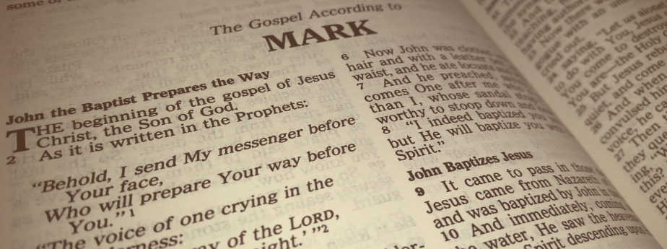
The principal divisions of the Gospel according to Mark:
The Preparation for the Public Ministry of Jesus (1:1-13)
The Mystery of Jesus (1:14-8:26)
The Mystery Begins to Be Revealed (8:27-9:32)
The Full Revelation of the Mystery (9:33-16:8)
The Longer Ending (16:9-20)
The Shorter Ending
The Freer Logion
Individual Characteristics of the Synoptic Gospels

Slide 28
Individual Characteristics of the Synoptic Gospels

Slide 29
Jesus Fulfills Old Testament Prophecies
Matthew | Event | Old Testament
1:22-23 | Jesus born of a virgin | Isaiah 7:14
2:5-6 | Born in Bethlehem | Micah 5:1
2:15 | Flight into Egypt | Hosea 11:1
2:18 | Slaughter of the Innocents | Jeremiah 31:15
4:15-16 | Ministry in Galilee | Isaiah 8:23-9:1
12:18-21 | Leading by Serving | Isaiah 42:1-4
13:14-15 | Spiritual blindness | Isaiah 6:9-10
13:35 | Teaching in parables | Psalm 78:2
21:5 | Entry into Jerusalem on a donkey | Isaiah 62:11; Zachariah 9:9
27:9-10 | Judas betrays Jesus | Zachariah 11:12-13
Individual Characteristics of the Synoptic Gospels

Slide 30
Symmetry in Luke & Acts
LUKE | ACTS
Begins with an address to most excellent Theophilus | Begins with an address to Theophilus
Announcement made by the angel, Gabriel | Announcement made by two angels following the Ascension
Begins in Jerusalem | Begins in Jerusalem
Birth of Jesus as the Spirit comes upon Mary | Birth of the Church as the Spirit comes upon the Church
A general movement towards Jerusalem | A general movement away from Jerusalem
Individual Characteristics of the Synoptic Gospels

Slide 31
Parallels between John the Baptist and Jesus in the Gospel of Luke
Individual Characteristics of the Synoptic Gospels

Slide 32
Jerusalem
Individual Characteristics of the Synoptic Gospels
Individual Characteristics of the Synoptic Gospels

Slide 33
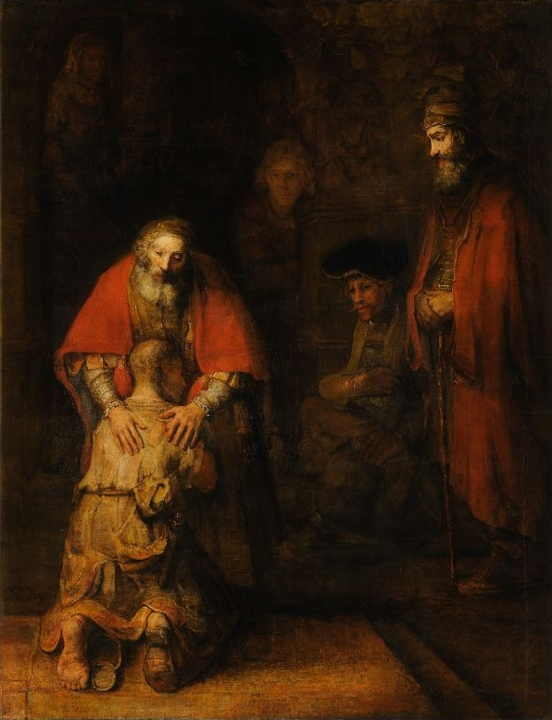
The Prodigal Son
Rembrandt, c. 1669
The Hermitage Museum,
St. Petersburg
Individual Characteristics of the Synoptic Gospels

Slide 34
Endnotes
Quotations from Sacred Scripture come from the New American Bible, Revised Edition (NABRE) http://wwwmigrate.usccb.org/bible/
Quotations from the Catechism of the Catholic Church http://www.vatican.va/archive/ENG0015/_INDEX.HTM
Quotations from Documents of the Second Vatican Council http://www.vatican.va/archive/hist_councils/ii_vatican_council/index.htm

