Slide 1
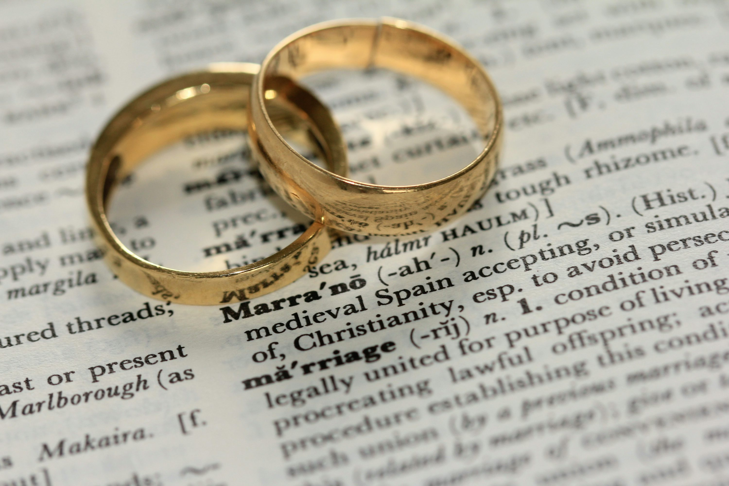
The
SACRAMENT
OF Matrimony
Bobby, Sue, Betty, and Jerry
3rd Block
Intro to the Catechism

Slide 2

Scriptural Foundations
    Textbook is a great resource here for Scripture references!
    1-3 slides
    Where do we find this sacrament in Scripture?
      Choose 1-2 passages to support
      Connect how these passages show God’s transformative grace actively working through this sacrament

Slide 3
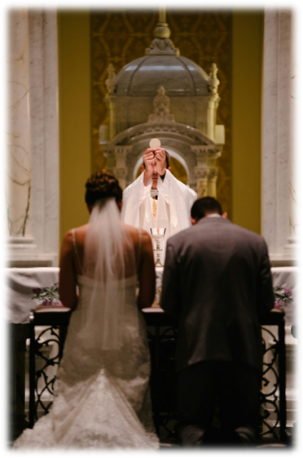
Catechism & Church Teaching
    Textbook is a great resource here for CCC references!
    2-4 slides
    Summarize in bullets the Church’s teaching on this sacrament:
      What is the matter (physical sign)?
      What is the form (words/prayers)?
      Who is the minister? Who can receive it?
      What are its effects (graces)?

Slide 4


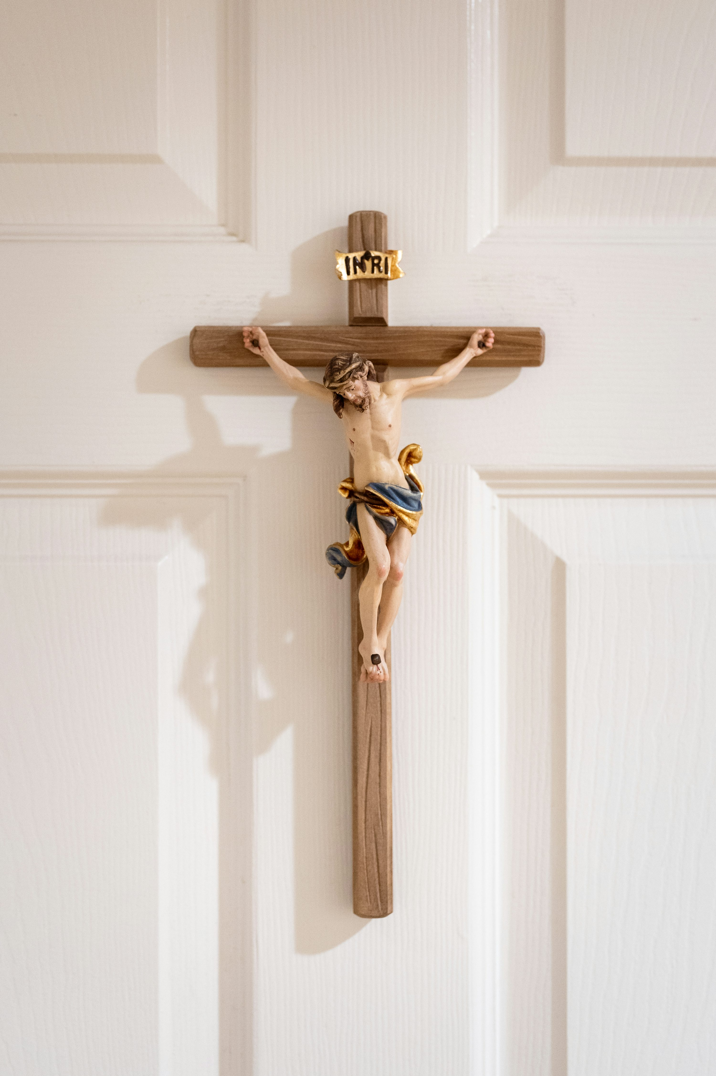
Symbols
Signs &
Traditions
    1-2 slides
    Identify the main signs, gestures, or symbols of this sacrament
      How do these outward signs reveal grace working in us?
      Highlight any connections this sacrament has to the Paschal Mystery—Christ's suffering, death, and resurrection

Slide 5
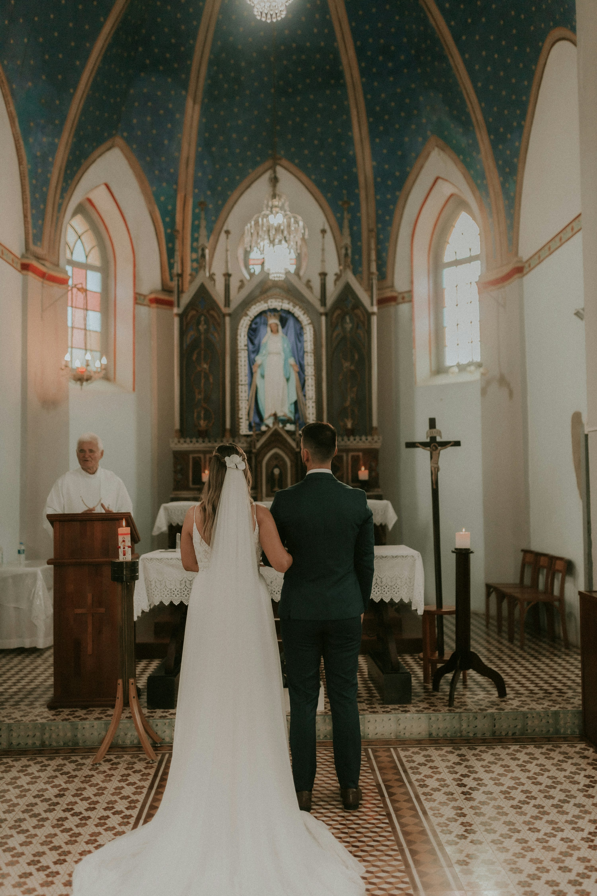

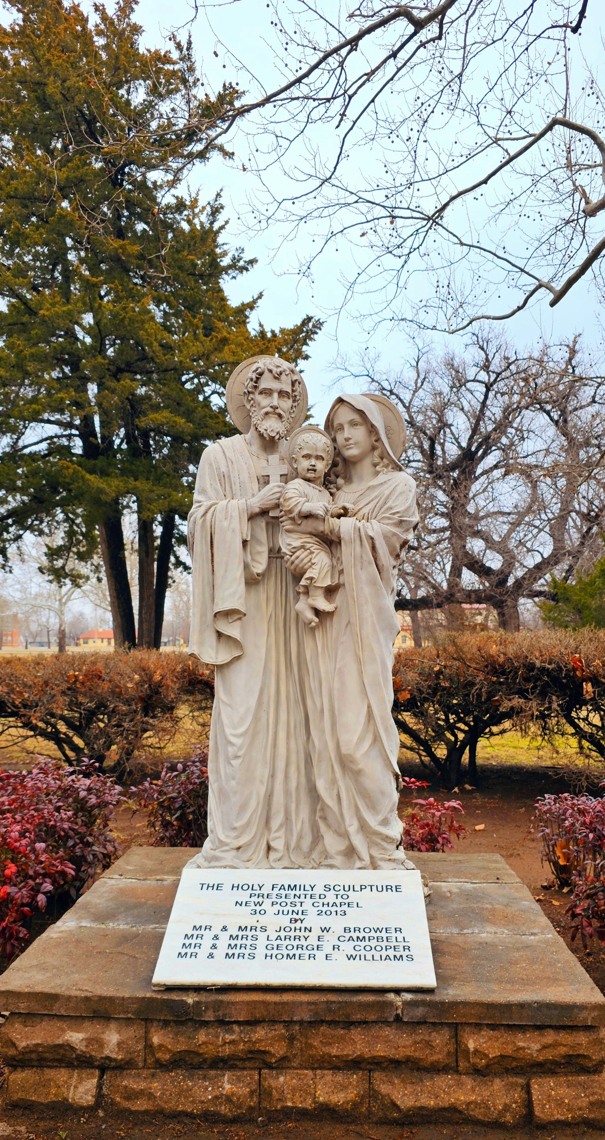
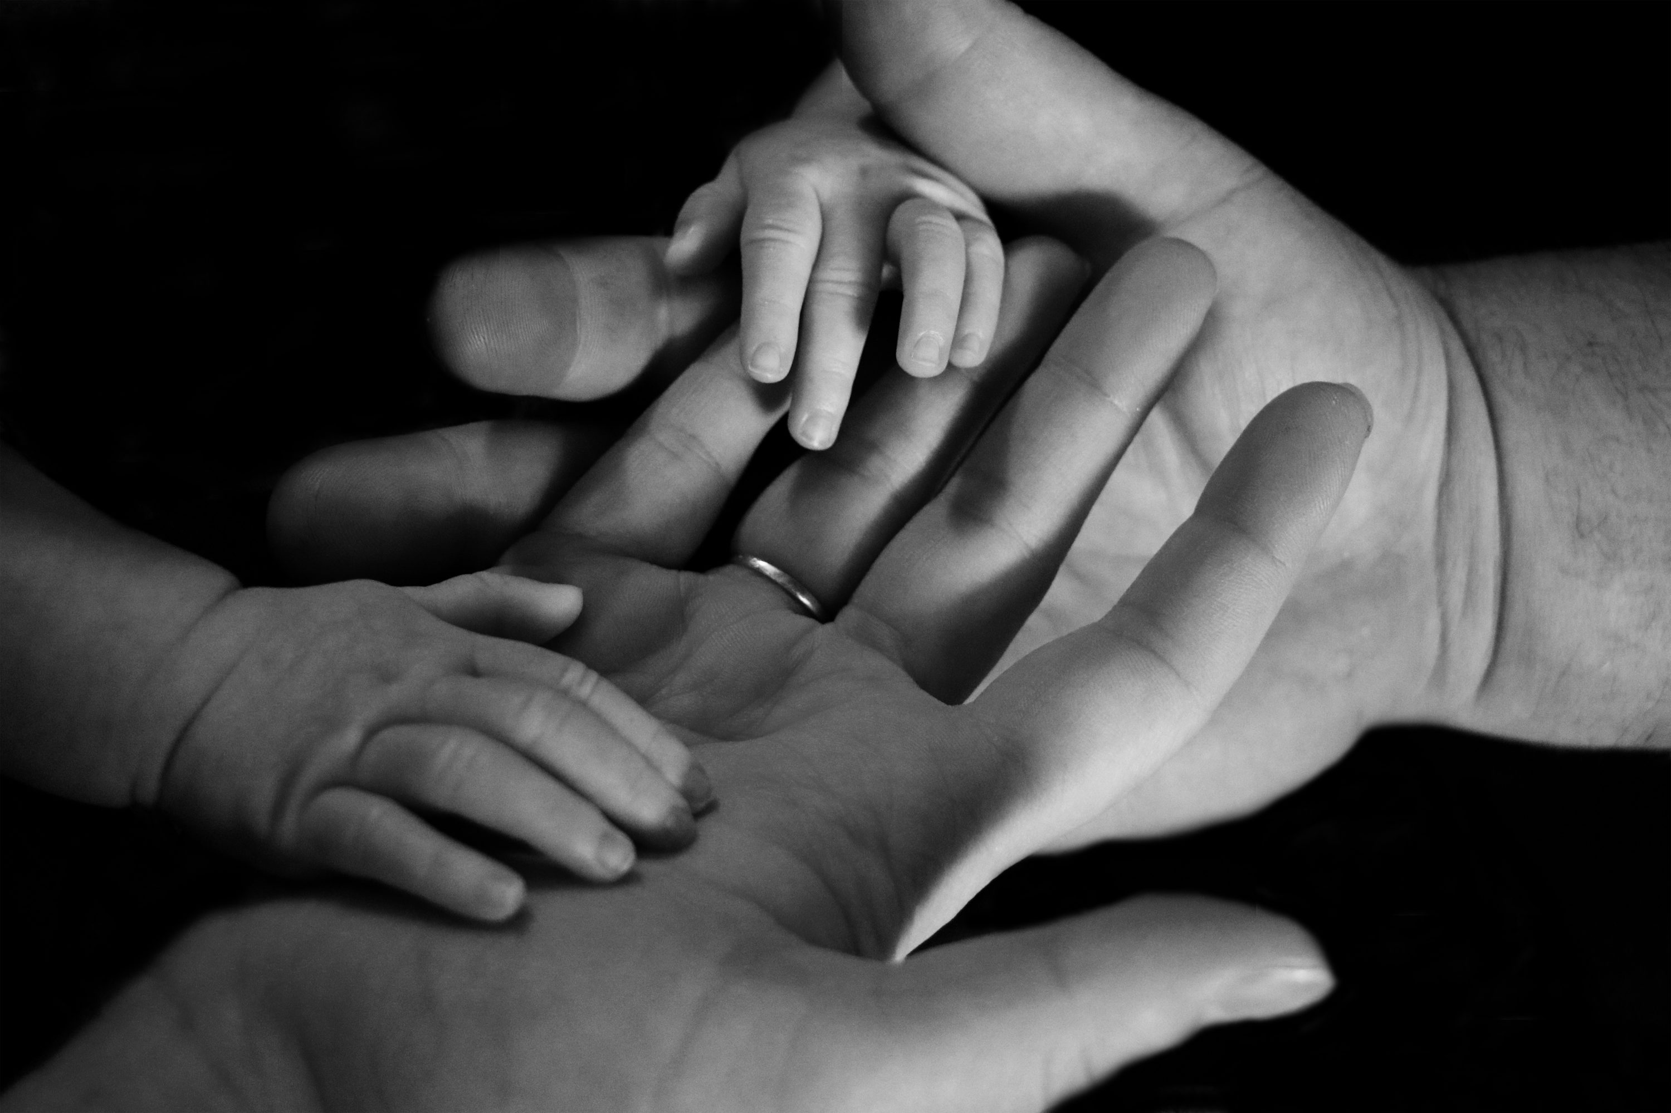
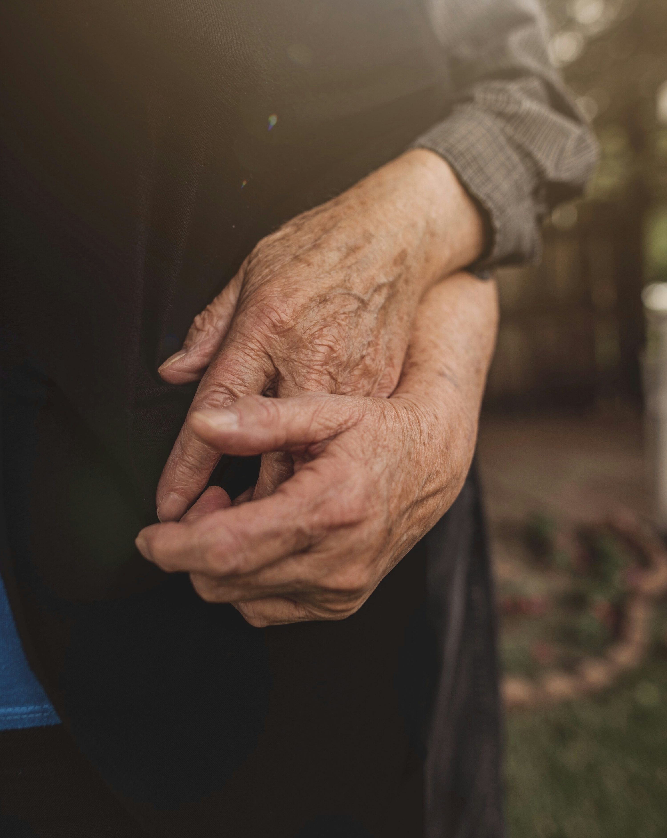
God's Transformative Grace
    1 slide
    Highlight the spiritual transformation that can happen through this sacrament
      How does it help the Church as a whole, as well as individuals, grow in holiness, unity, and mission to serve?

Slide 6

The
Sacramental
Life
    1 slide
    What does it mean to live a sacramental life?
      What attitudes and habits do this sacrament inspire you to live out in daily life?
      How can you continue to live out this sacrament beyond the moment of reception?

Slide 7
Works Cited
Catholic Church. (2000). Catechism of the Catholic Church: revised in accordance with the official Latin text promulgated by Pope John Paul II. United States Catholic Conference.
Place other references used (should be your textbook and the Bible used as well) here in APA format.

