Slide 1
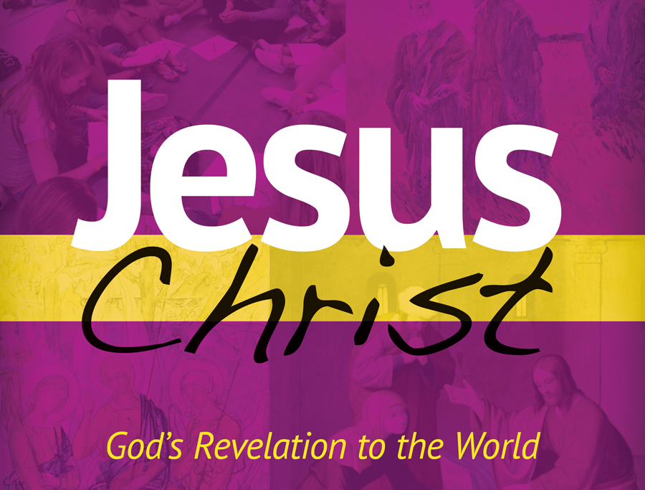
Chapter 5 PowerPoint

Slide 2
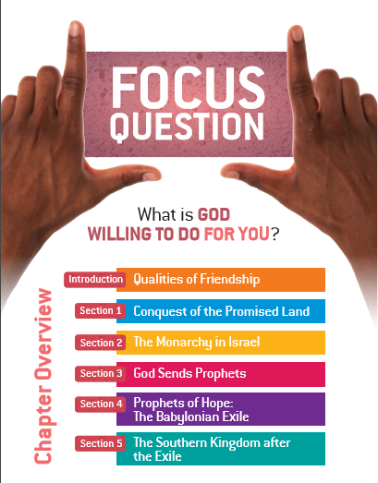

Slide 3
Qualities of Friendship

Slide 4
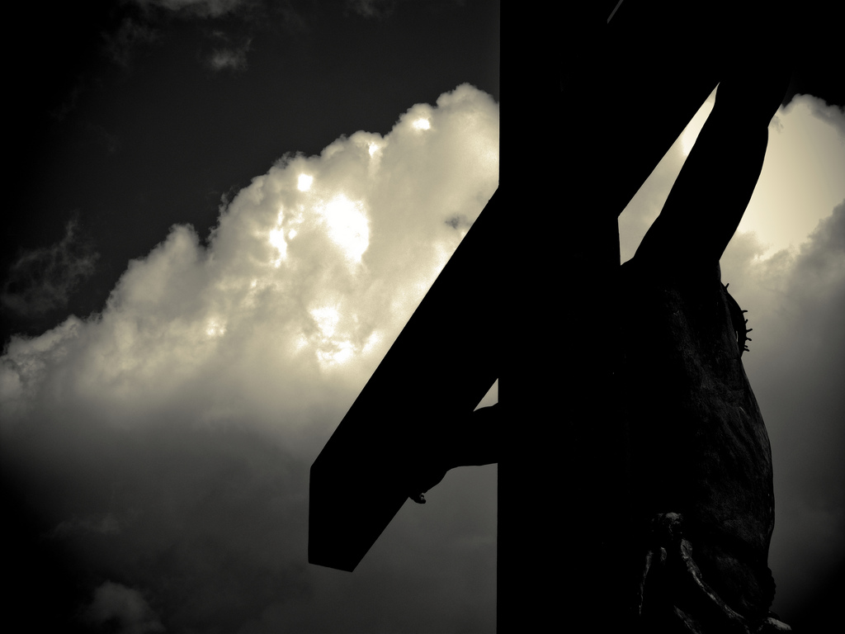
No one has greater love than this,
to lay down one’s life for one’s friends.
John 15:13
Qualities of Friendship

Slide 5
Conquest of the Promised Land

Slide 6
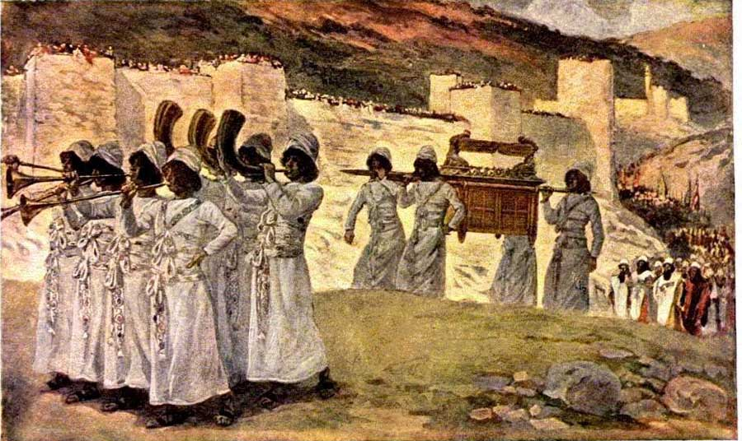
The seven priests bearing the ram’s horns marched in front of the ark of the LORD, blowing their horns. Ahead of these marched the picked troops, while the rear guard followed the ark of the LORD, and the blowing of horns was kept up continually. Joshua 6:13
Conquest of the Promised Land

Slide 7
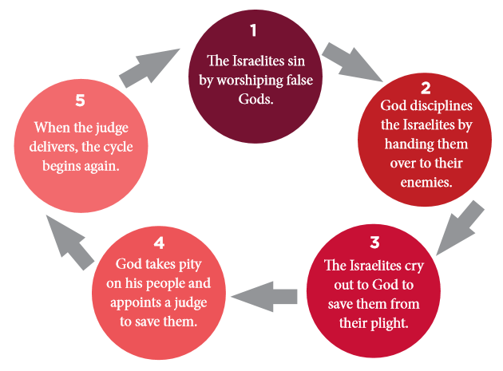
The history of the Israelites during the period of the judges centers around a cycle of apostasy, which typically followed these stages:
Conquest of the Promised Land

Slide 8
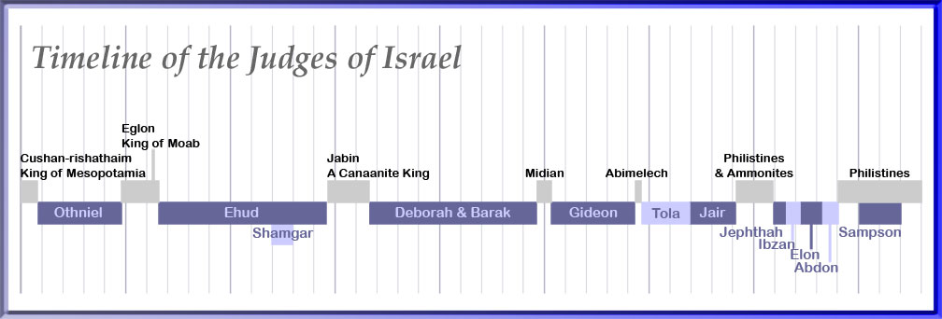
Conquest of the Promised Land

Slide 9
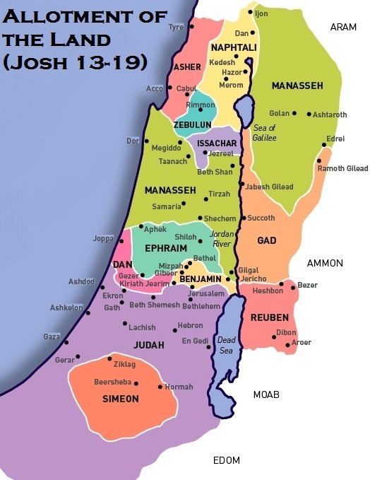
Conquest of the Promised Land

Slide 10
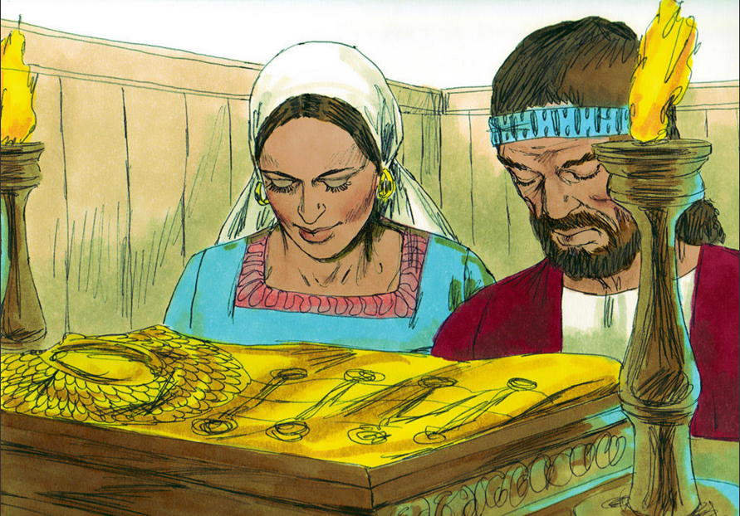
Apostasy The denial of God and the repudiation of faith.
Gideon made an ephod out of the gold and placed it in his city, Ophrah. All Israel prostituted themselves there, and it became a snare to Gideon and his household. Judges 8:27
Conquest of the Promised Land

Slide 11
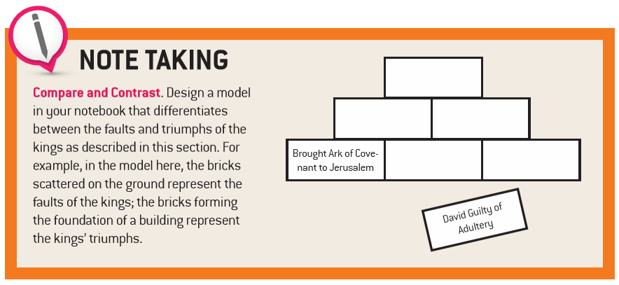
The Monarchy in Israel

Slide 12
Messiah The “anointed one” promised by the Old Testament prophets. He would be a descendant of David who would set up an ideal kingdom ruled by an adopted son. He would preach the Law in truth and would sacrifice his life for the people. Jesus Christ fulfills the prophecies about the Messiah.
The Monarchy in Israel

Slide 13
The Monarchy in Israel
The Monarchy in Israel

Slide 14
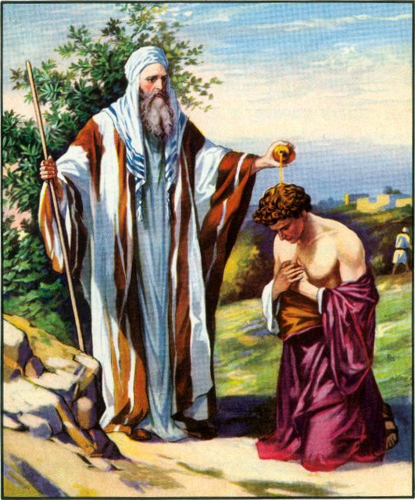
Then, from a flask he had with him, Samuel poured oil on Saul’s head and kissed him, saying: “The LORD anoints you ruler over his people Israel. You are the one who will govern the LORD’s people and save them from the power of their enemies all around them.
1 Samuel 10:1
The Monarchy in Israel

Slide 15
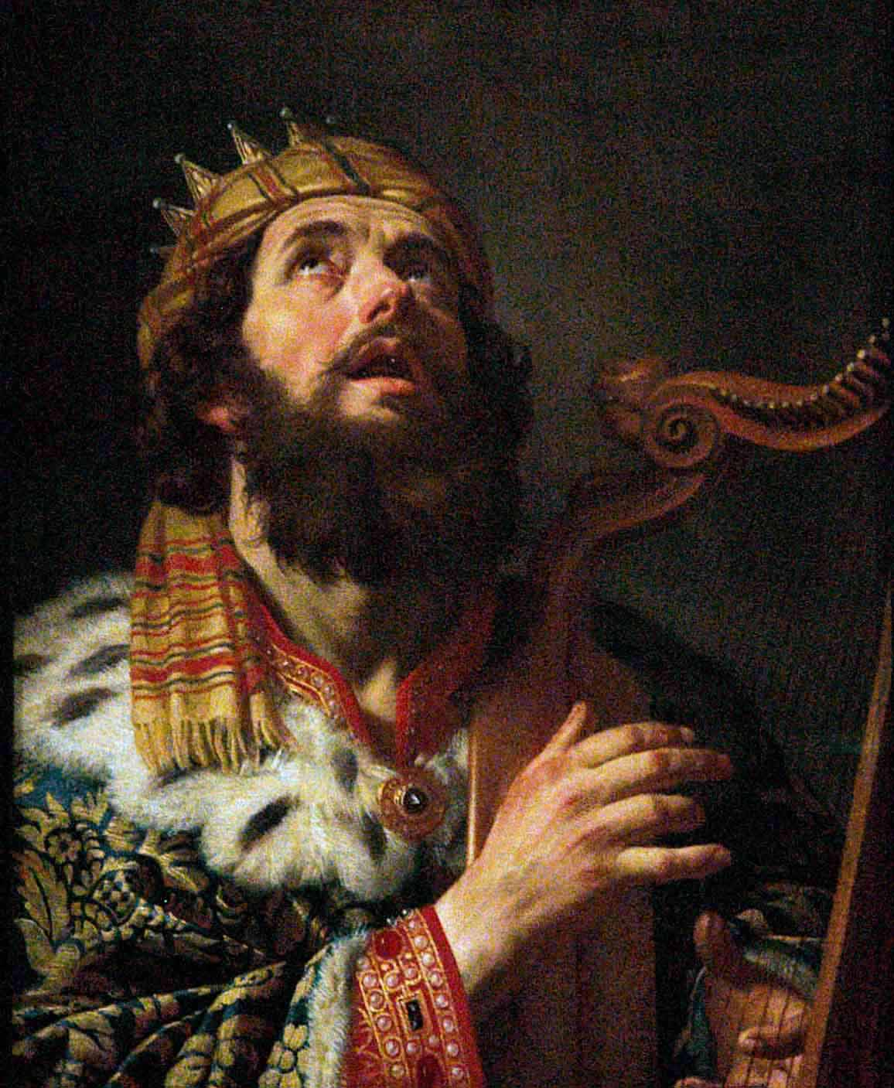
Seven Primary Features of the Davidic Covenant
David’s line would have a kingdom
The covenant established a royal dynasty
The king would be the son of David and the Son of God
The covenant would be unlimited and everlasting
Jerusalem would be Israel’s spiritual center
The Temple would be the visible sign of the covenant
Wisdom would be the law of the covenant
The Monarchy in Israel

Slide 16
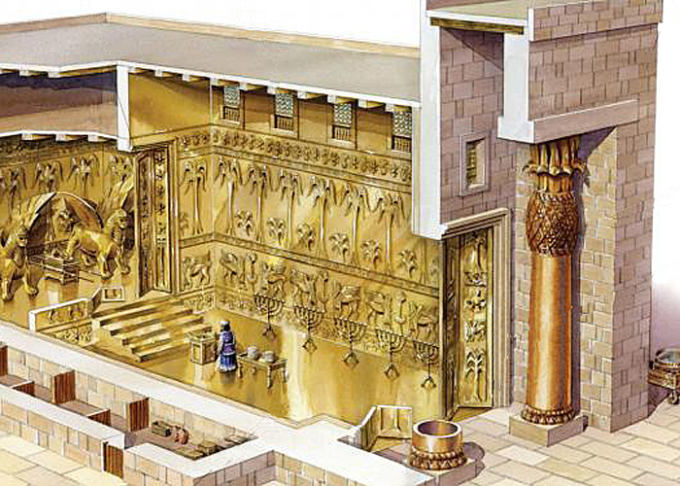
Temple of Solomon
Constructed during the mid 10th century, BC
The Monarchy in Israel

Slide 17
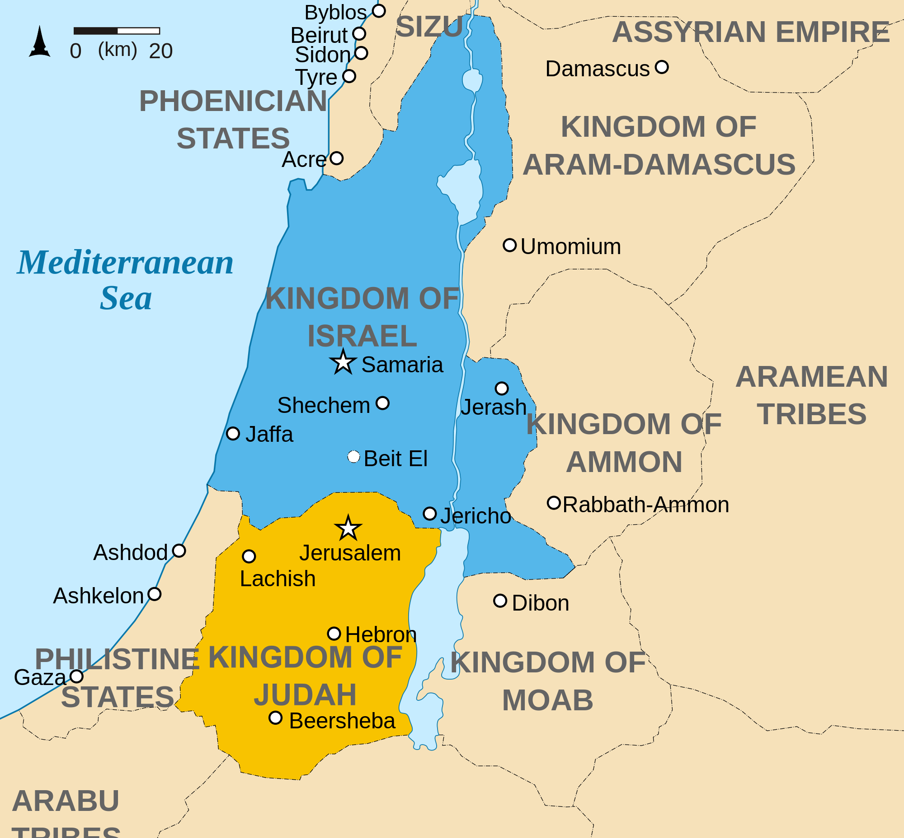
The Divided Kingdom
The Monarchy in Israel

Slide 18
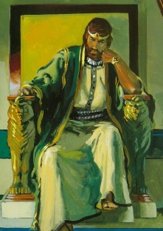
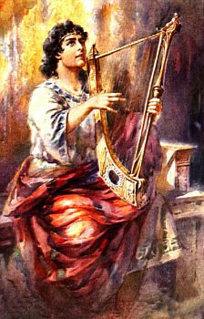
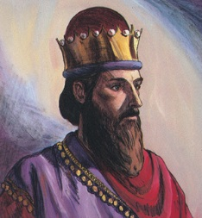
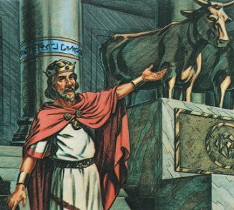
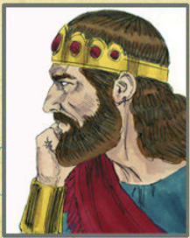
Kings of Israel
Saul
David
Solomon
Rehoboam
Judah
2 tribes
Jeroboam
Israel
10 tribes
Abijah
The Monarchy in Israel

Slide 19
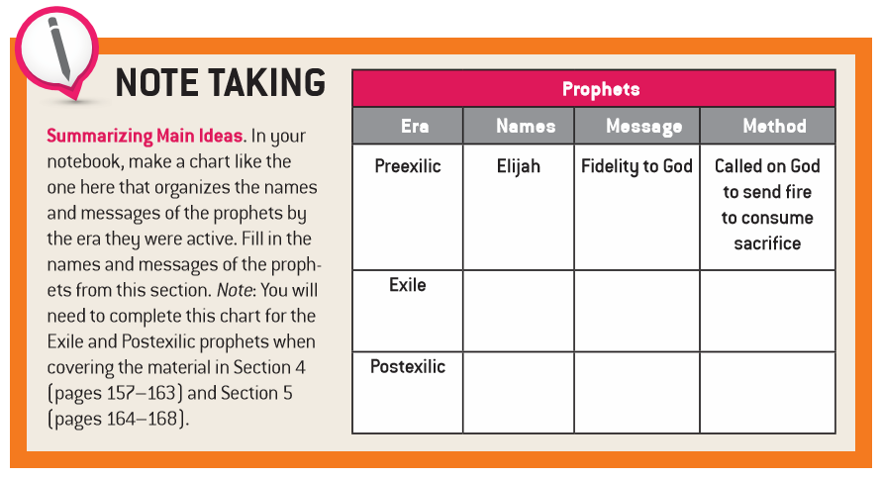
God Sends Prophets

Slide 20
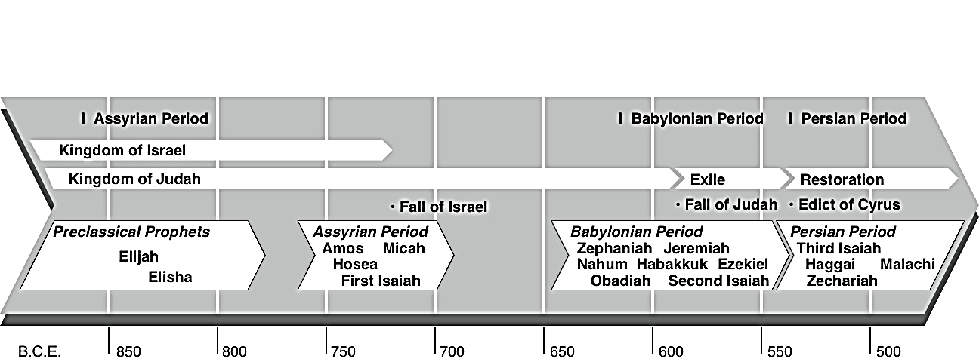
Time Line: The Prophets and Israel’s History
God Sends Prophets

Slide 21
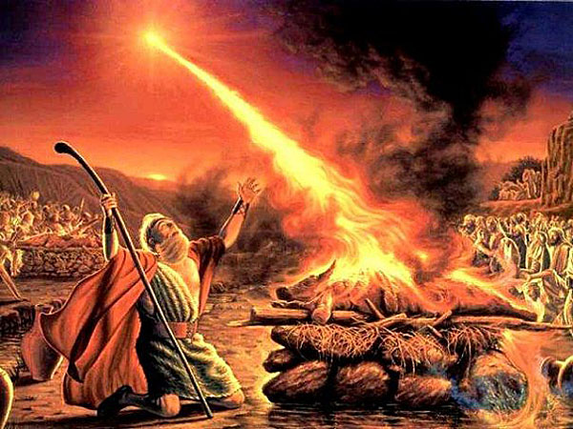
Elijah and the Prophets of Baal
1 Kings 18
Now summon all Israel to me on Mount Carmel, as well as the four hundred and fifty prophets of Baal and the four hundred prophets of Asherah who eat at Jezebel’s table.” So Ahab summoned all the Israelites and had the prophets gather on Mount Carmel.
Elijah approached all the people and said, “How long will you straddle the issue? If the LORD is God, follow him; if Baal, follow him.” But the people did not answer him. So Elijah said to the people, “I am the only remaining prophet of the LORD, and there are four hundred and fifty prophets of Baal. Give us two young bulls. Let them choose one, cut it into pieces, and place it on the wood, but start no fire. I shall prepare the other and place it on the wood, but shall start no fire. You shall call upon the name of your gods, and I will call upon the name of the LORD. The God who answers with fire is God.” All the people answered, “We agree!” (verses 19-24)
God Sends Prophets

Slide 22
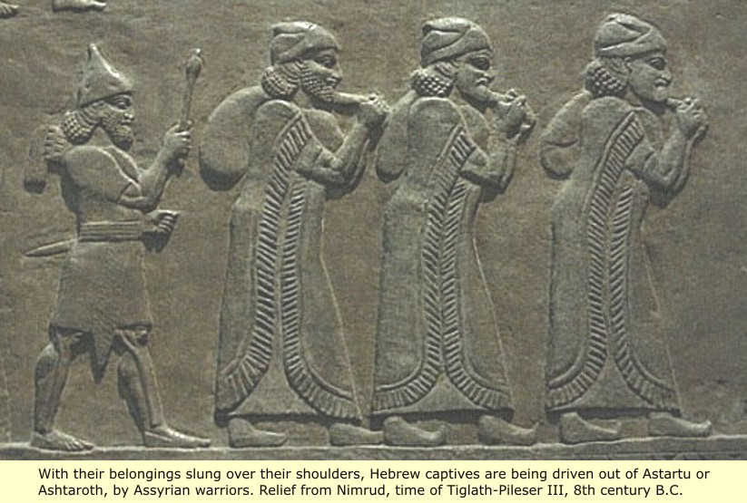
Lost Tribes of Israel The ten tribes of the northern kingdom who disappeared from history after being enslaved and exiled by the Assyrians.
Asher Dan Ephraim Gad Issachar Manasseh Naphtali Reuben Simeon Zebulun
With their belongings slung over their shoulders, Hebrew captives are being driven out by Assyrian warriors.
God Sends Prophets

Slide 23
Prophets of Hope: The Babylonian Exile

Slide 24
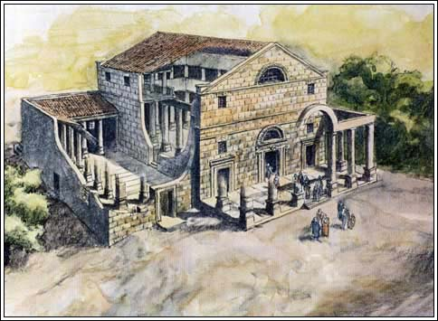
Synagogue A meeting place for Jews for study and prayer to foster study of the Law and adherence to the covenant code.
Prophets of Hope: The Babylonian Exile

Slide 25
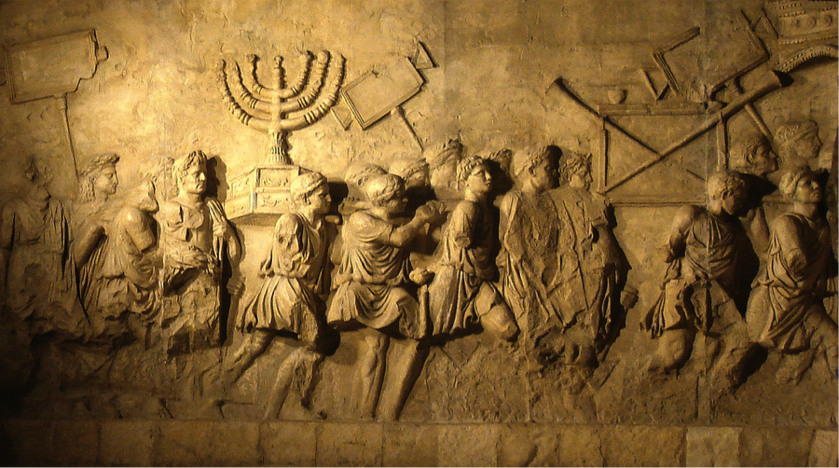
A bas relief on the Arch of Titus in Rome depicts the celebratory procession of Titus’s victorious troops after defeating the First Jewish Revolt (66–70 C.E.). They carry the spoils of the Temple on their shoulders: the Menorah, the Showbread table and the trumpets. The unique tiered octagonal base of the Menorah is considered unrealistic by many scholars.
Prophets of Hope: The Babylonian Exile

Slide 26
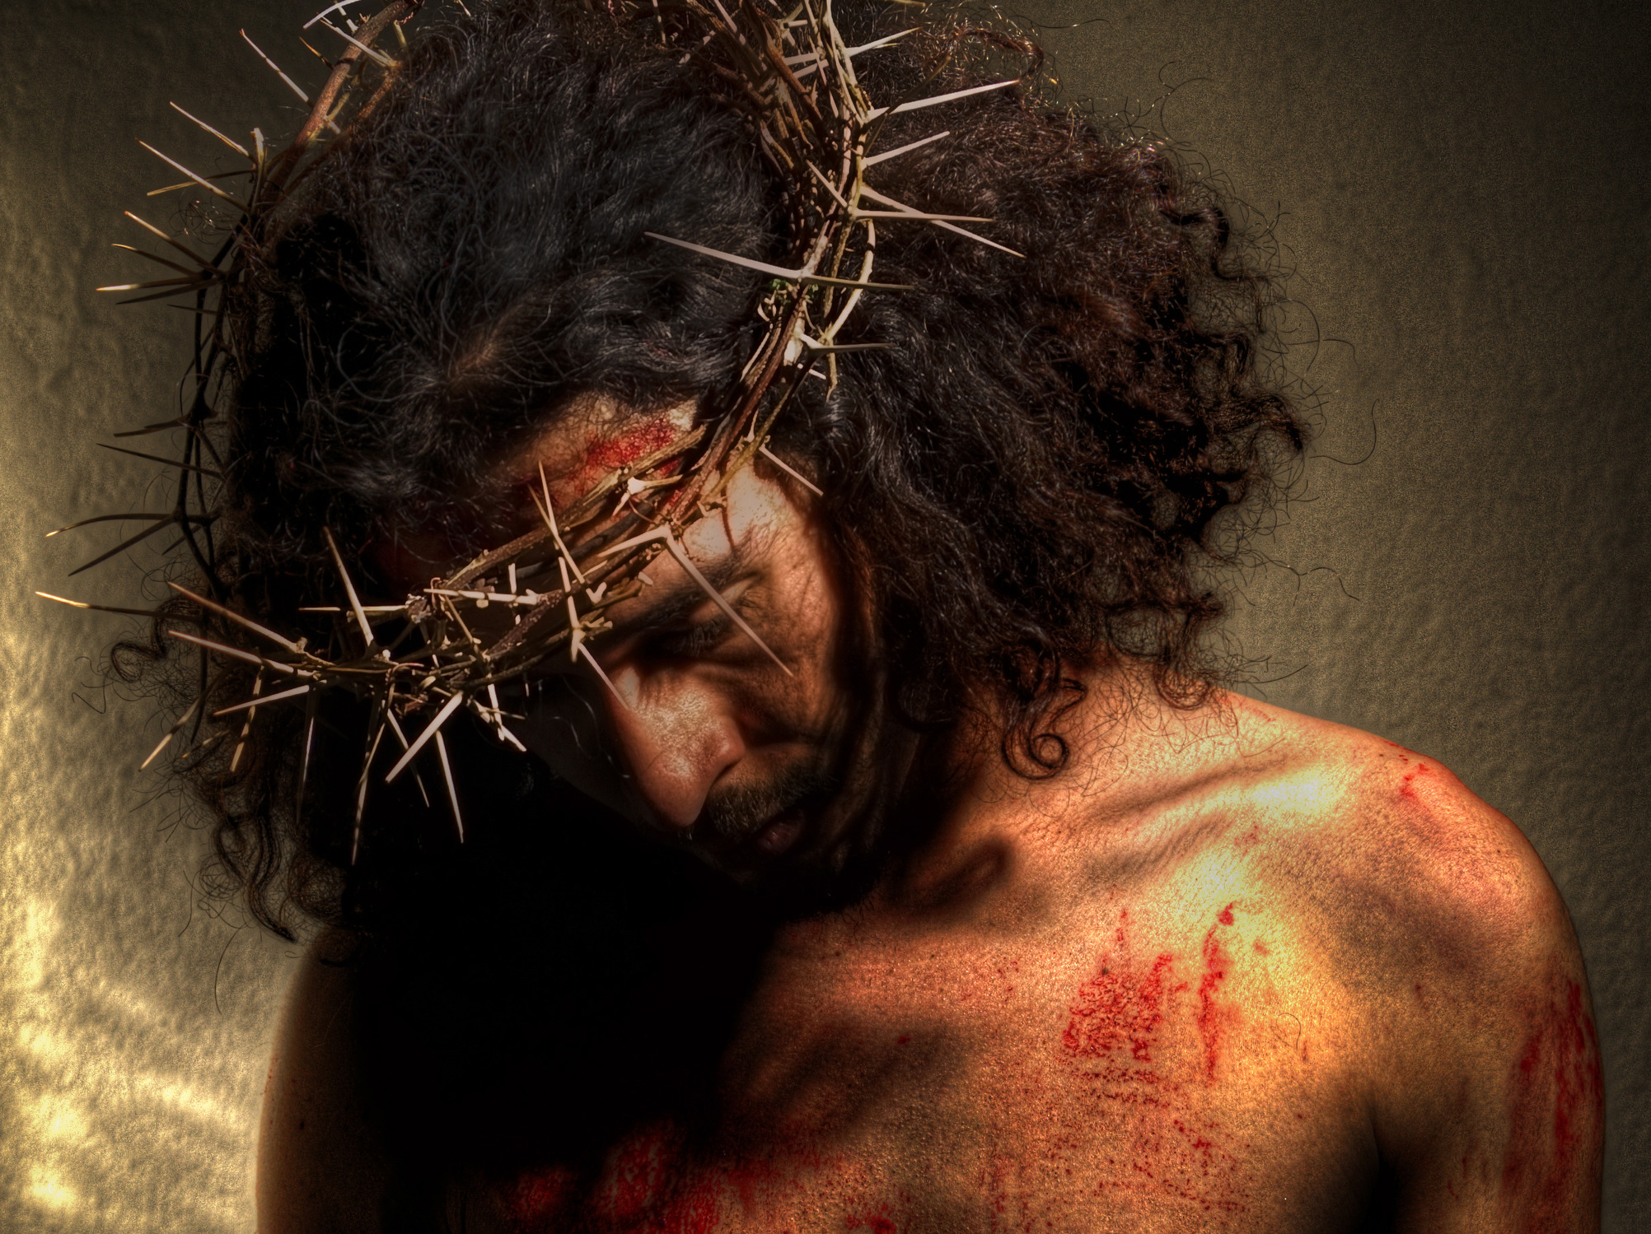
Isaiah 53:3–5
He was spurned and avoided by men, a man of suffering, knowing pain,
Like one from whom you turn your face,
spurned, and we held him in no esteem.
Yet it was our pain that he bore, our sufferings he endured.
We thought of him as stricken,
struck down by God and afflicted,
But he was pierced for our sins, crushed for our iniquity.
He bore the punishment that makes us whole,
by his wounds we were healed.
Prophets of Hope: The Babylonian Exile

Slide 27
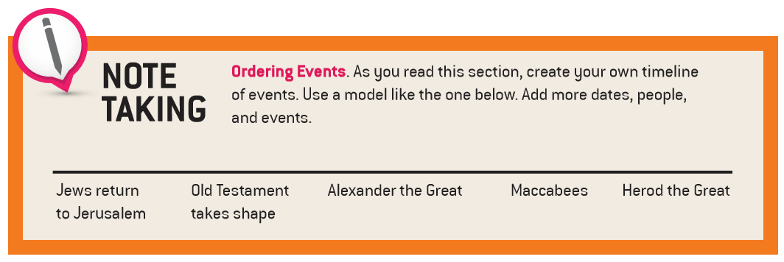
The Southern Kingdom after the Exile

Slide 28
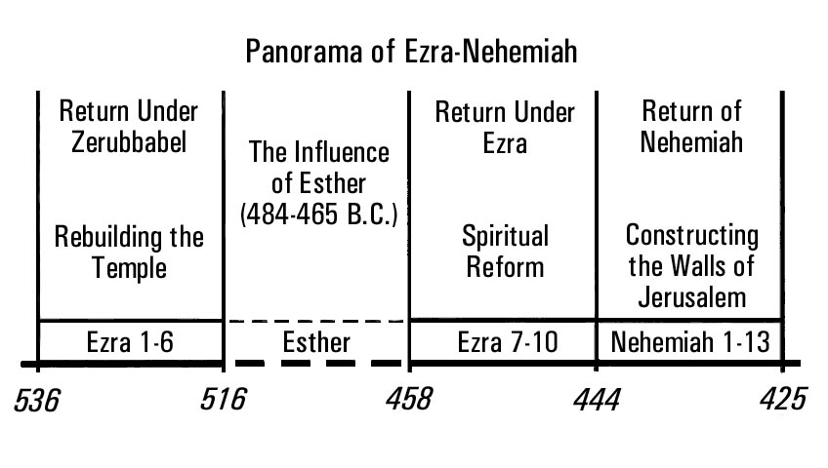
The Southern Kingdom after the Exile

Slide 29
Remnant A name for the exiles and former exiles who remained faithful to God during the time of the Babylonian Captivity and who were expected to restore Jerusalem.
On that day the remnant of Israel, the survivors of the house of Jacob, will no more lean upon the one who struck them; But they will lean upon the LORD, the Holy One of Israel, in truth. Isaiah 10:20
The Southern Kingdom after the Exile

Slide 30
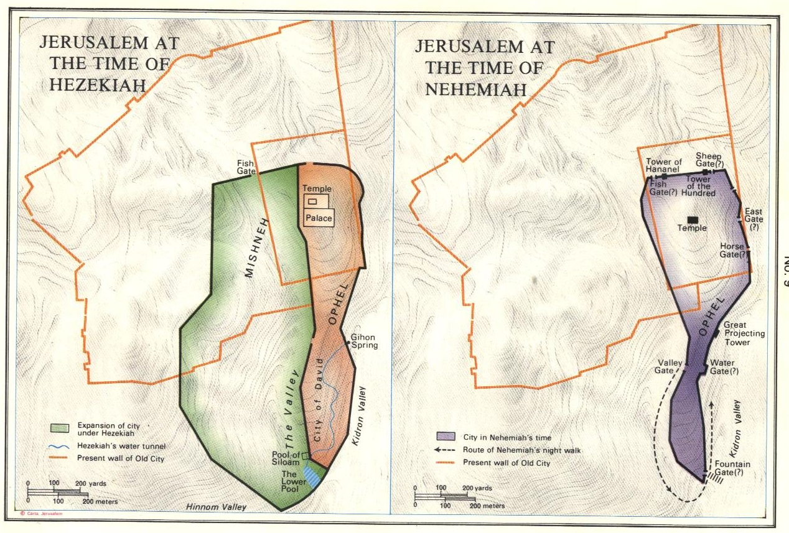
The Southern Kingdom after the Exile

Slide 31
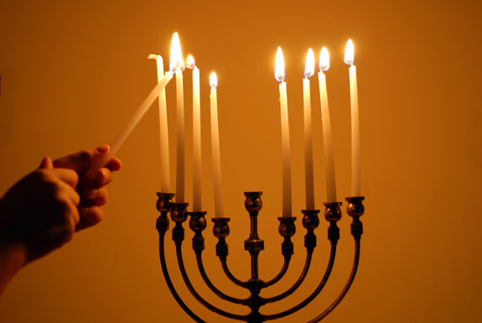
Hanukkah The Jewish Feast of Dedication, which celebrates the recovery and purification of the Temple from the Syrians in 164 BC. It is an eight-day feast that takes place during December. Jews usually give gifts at this time. Hanukkah is also called the Festival of Lights.
The Southern Kingdom after the Exile

Slide 32
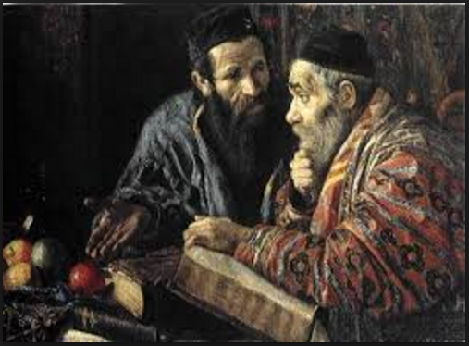
Rabbi
A Hebrew word for a Jewish master or teacher of the Torah.
The Southern Kingdom after the Exile

Slide 33
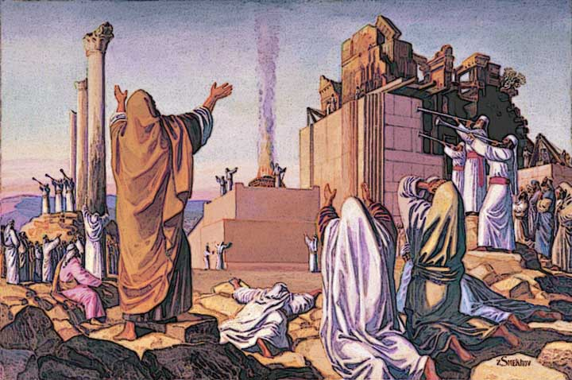
Laying the Foundations of the Temple
They alternated in songs of praise and thanksgiving to the LORD, “for he is good, for his love for Israel endures forever”; and all the people raised a great shout of joy, praising the LORD because the foundation of the LORD’s house had been laid. Many of the priests, Levites, and heads of ancestral houses, who were old enough to have seen the former house, cried out in sorrow as they watched the foundation of the present house being laid. Many others, however, lifted up their voices in shouts of joy. Ezra 3:11-12
The Southern Kingdom after the Exile

Slide 34
Endnotes
Quotations from Sacred Scripture come from the New American Bible, Revised Edition (NABRE) http://wwwmigrate.usccb.org/bible/
Quotations from the Catechism of the Catholic Church http://www.vatican.va/archive/ENG0015/_INDEX.HTM
Quotations from Documents of the Second Vatican Council http://www.vatican.va/archive/hist_councils/ii_vatican_council/index.htm

