Slide 1
Chapter 9 PowerPoint

Slide 2
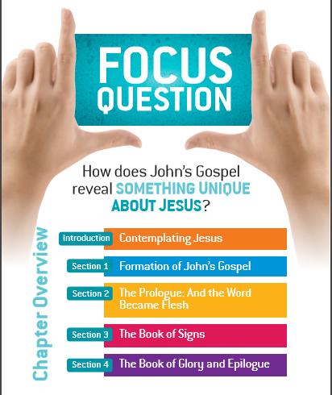

Slide 3
Contemplating Jesus

Slide 4
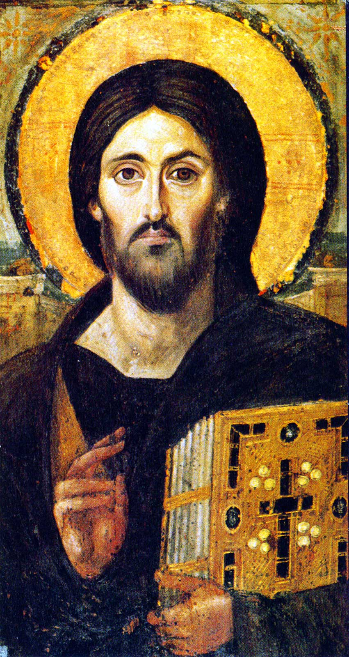
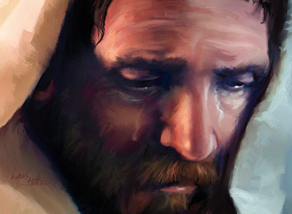
Christology The study of Jesus Christ; the academic effort to understand who he is.
Christology “from below”
Christology “from above”
Contemplating Jesus

Slide 5
The Hypostatic Union
Divine Nature
Human Nature
The One Person
(The Logos)
Contemplating Jesus

Slide 6
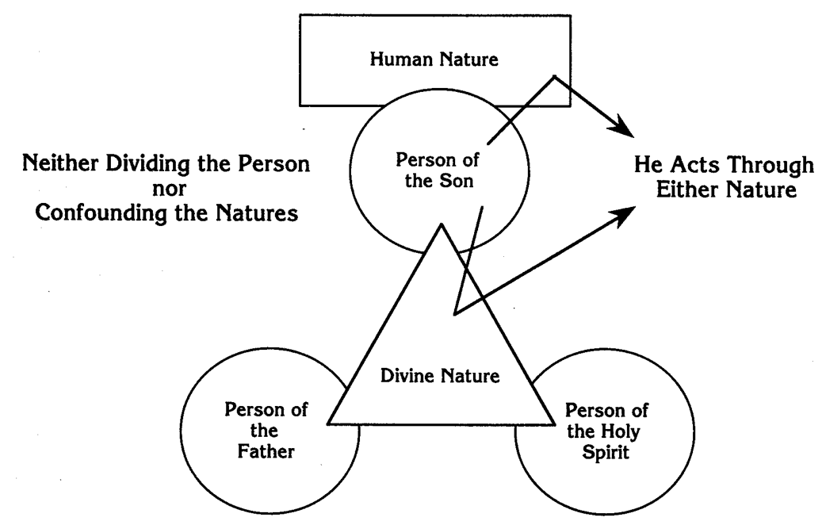
Contemplating Jesus

Slide 7
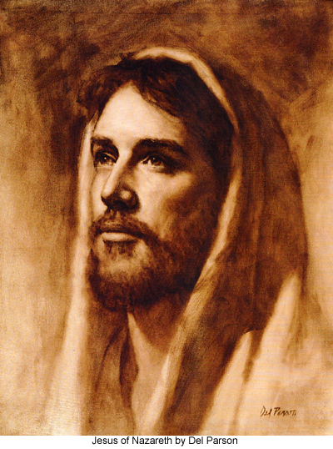
Evidence for the divinity of Jesus:
the prophecies concerning the Messiah which he fulfilled
the accurate prophecies which he himself made about future events
the numerous miracles which he performed
Contemplating Jesus
Contemplating Jesus

Slide 8
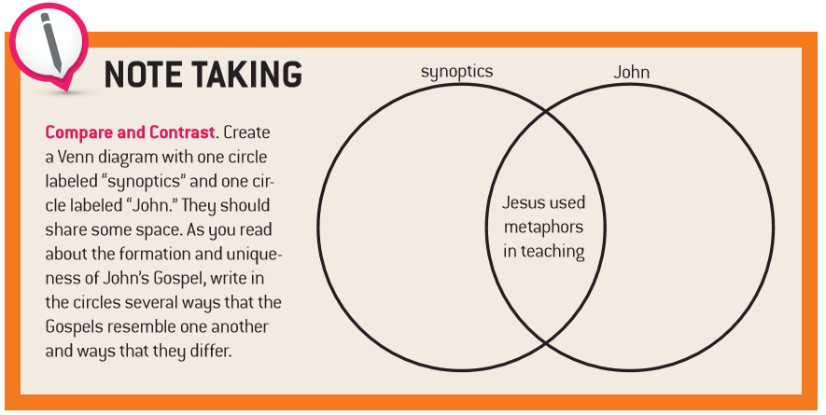
Formation of John’s Gospel

Slide 9
Introduction |  | Book of Signs | Book of Glory | EPILOGUE
PROLOGUE | NARRATIVE INTRODUCTION
1:1–18 | 1:19 –1:51 | 2:1 – 12:50 | 13:1 – 20:31 | 21:1 –25
Formation of John’s Gospel

Slide 10
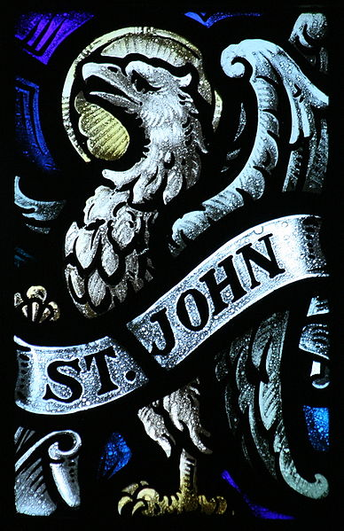
John – Introduction
The fourth gospel is not simply history; the narrative has been organized and adapted to serve the evangelist’s theological purposes as well. Among them are the opposition to the synagogue of the day and to John the Baptist’s followers, who tried to exalt their master at Jesus’ expense, the desire to show that Jesus was the Messiah, and the desire to convince Christians that their religious belief and practice must be rooted in Jesus. Such theological purposes have impelled the evangelist to emphasize motifs that were not so clear in the synoptic account of Jesus’ ministry, e.g., the explicit emphasis on his divinity.
New American Bible Revised Edition
Formation of John’s Gospel

Slide 11
Formation of John’s Gospel

Slide 12
Familiar Christological Titles in the Gospels
Also in the synoptics:
Christ / Messiah
Lord / Sir / Master
King of the Jews
King of Israel
Son of God
Son of Man
Son of David
Savior
Rabbi / Teacher
Unique to John:
The Logos / Word
Only-begotten Son of God
Lamb of God / Passover Lamb
The Way, the Truth, and the Life
Light of the World
Resurrection and the Life
Good Shepherd
Door
I AM
Formation of John’s Gospel

Slide 13
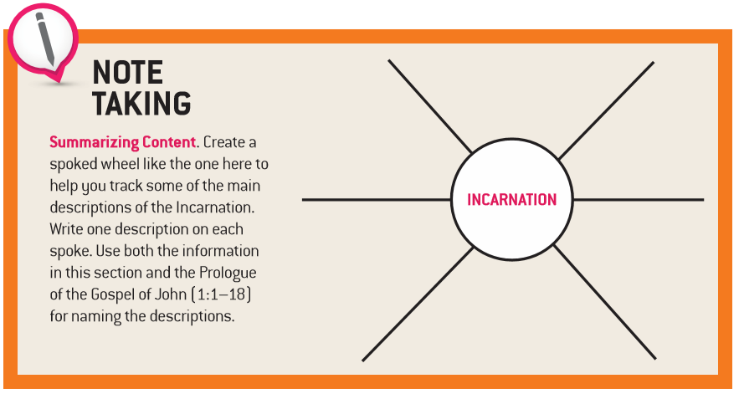
The Prologue: And the Word Became Flesh

Slide 14
Four major Christological Councils
325
381
431
451
Council of Nicaea
Council of Constantinople
Council of Ephesus
Council of Chalcedon
Arianism condemned
Nicaea confirmed,
Apollinarianism
condemned
Nestorianism condemned
Christ is one person with two natures
The Prologue: And the Word Became Flesh

Slide 15
The Prologue in John
The prologue states the main themes of the gospel: life, light, truth, the world, testimony, and the preexistence of Jesus Christ, the incarnate Logos, who reveals God the Father. In origin, it was probably an early Christian hymn. Its closest parallel is in other christological hymns, Col 1:15-20 and Phil 2:6-11. Its core (Jn 1:105, 10-11, 14) is poetic in structure, with short phrases linked by “staircase parallelism,” in which the last word of one phrase becomes the first word of the next. Prose inserts (at least Jn 1:6-8, 15) deal with John the Baptist.
Footnote from the Revised New American Bible
The Prologue: And the Word Became Flesh

Slide 16
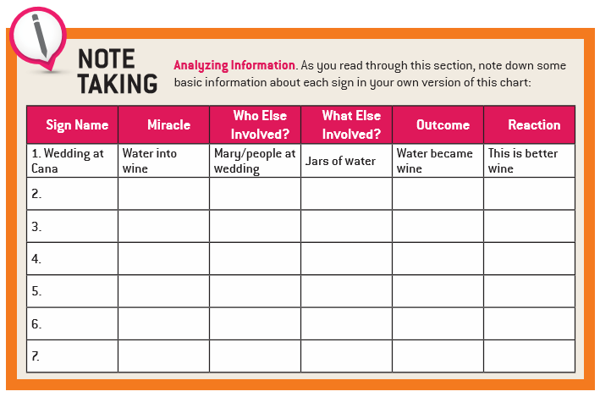
The Book of Signs

Slide 17
Jesus turns water into wine | John 2:1-11
Jesus heals the official’s son | John 4:43-54
Jesus makes the lame walk | John 5:1-15
Jesus walks on water | John 6:16-24
Jesus feeds the multitude | John 6:1-15
Jesus gives site to the blind | John 9:1-38
Jesus raises Lazarus from the dead | John 11:1-44
The Book of Signs

Slide 18
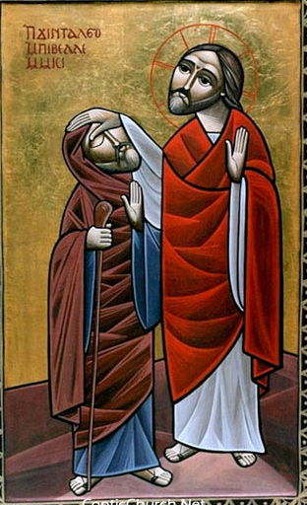
Why Jesus used miracles:
to show the power of God
to alleviate suffering
to invite people to believe in him
to prove his divinity
to confirm his teachings
The Book of Signs

Slide 19
Intercessory prayer The Prayer in which you ask for something on behalf of another person or group of people.
A – Adoration
C – Contrition
T – Thanksgiving
S – Supplication
The Book of Signs

Slide 20
Christ in the Eucharist
Jesus said to them, “Amen, amen, I say to you, unless you eat the flesh of the Son of Man and drink his blood, you do not have life within you. Whoever eats my flesh and drinks my blood has eternal life, and I will raise him on the last day. For my flesh is true food, and my blood is true drink. Whoever eats my flesh and drinks my blood remains in me and I in him. Just as the living Father sent me and I have life because of the Father, so also the one who feeds on me will have life because of me. John 6:53-57
The Book of Signs

Slide 21
The Seven Signs | The Seven "I AM" Sayings
Ch. 2 - Cana: water into wine | 6:35 - I am the bread of life
Ch. 4 - Raising the son of the royal official | 8:12 - I am the light of the world
Ch. 5 - Paralyzed man at the pool of Bethesda | 10:7 - I am the gate for the sheep
Ch. 6 - Multiplication of the loaves | 10:11 - I am the good shepherd
Ch. 6 - Walking on the water | 11:25 - I am the resurrection and the life
Ch. 9 - Healing of the man born blind | 14:6 - I am the way, and the truth and the life
Ch. 11 - Raising of Lazarus | 15:1 - I am the true vine
The Book of Signs

Slide 22
The Book of Glory and Epilogue

Slide 23
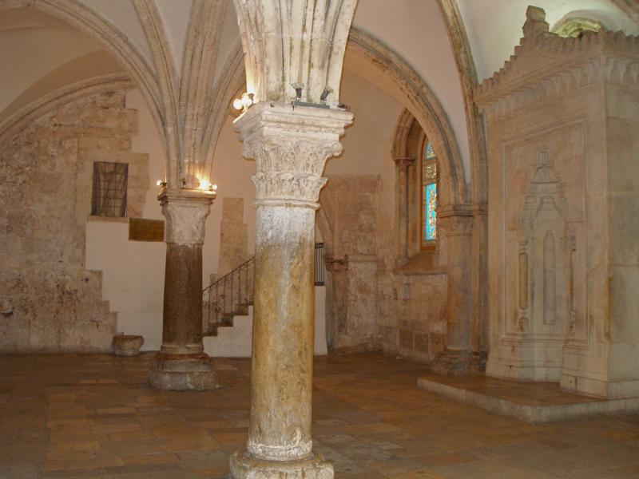
The Cenacle room on Mount Zion in Jerusalem is where two major events in the early Church are commemorated: The Last Supper and Pentecost.
The Book of Glory and Epilogue

Slide 24
Paraclete A name for the Holy Spirit that means “Advocate.” In John 14:26, Jesus promised to send an Advocate, a Helper, who would continue to guide, lead, and strengthen the disciples.
Other titles for the Holy Spirit
Comforter / Counselor / Advocate (John 14:16)
Spirit of Truth (John 16:13)
Spirit of Life (Romans 8:2)
Spirit of Glory (1 Peter 4:14)
Intercessor (Romans 8:2)
Teacher (1 Corinthians 2:13)
Eternal Spirit (Hebrews 9:14)
The Book of Glory and Epilogue

Slide 25
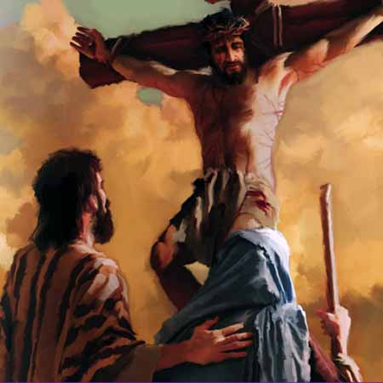
We must remember that, according to tradition, it is John whom the Blessed Virgin in fact recognized as her son; but this privilege has been interpreted by Christians from the beginning as the sign of a spiritual generation in relation to all humanity.
The universal motherhood of Mary, the "Woman" of the wedding at Cana and of Calvary, recalls Eve, "mother of all living" (Gn 3:20). However, while the latter helped to bring sin into the world, the new Eve, Mary, co-operates in the saving event of Redemption. Thus in the Blessed Virgin the figure of "woman" is rehabilitated and her motherhood takes up the task of spreading the new life in Christ among men.
St. John Paul II
To The Disciple he said, Behold your Mother
Taken from: L'Osservatore Romano, 30 April 1997, page 11
The Book of Glory and Epilogue

Slide 26
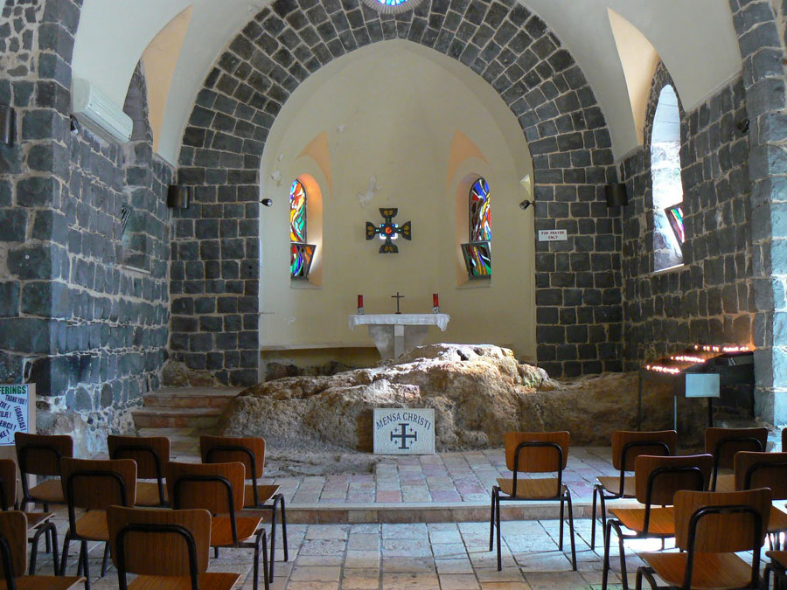
Church of the Primacy of St. Peter
Feed my sheep.
John 21:17
The Book of Glory and Epilogue

Slide 27
There are also many other things that Jesus did, but if these were to be described individually, I do not think the whole world would contain the books that would be written.
John 21:25
The Book of Glory and Epilogue

Slide 28
Endnotes
Quotations from Sacred Scripture come from the New American Bible, Revised Edition (NABRE) http://wwwmigrate.usccb.org/bible/
Quotations from the Catechism of the Catholic Church http://www.vatican.va/archive/ENG0015/_INDEX.HTM
Quotations from Documents of the Second Vatican Council http://www.vatican.va/archive/hist_councils/ii_vatican_council/index.htm

