Slide 1

2. THE CHURCH SETS HER FOUNDATION
Notes:
Suggestions for students’ note taking:
●Require students to use a three ring binder (1/2-1 inches) full of loose leaf paper (college or wide ruled).
●Notes must be taken in pen only and hand written.
●Notebooks should contain information and notes for religion class only.
●Notebooks must have a table of contents with topic of notes, dates and page numbers.
●All notes must have a topic and page number.
●Students will be required to copy each slide unless the teacher directs students to skip certain slides or parts of slides. Notebooks will be graded based on neatness, completeness and organization. Notebooks should have a significant point value representing 20-25% of the overall grade.
The resources linked in this presentation file may contain copyright material. Such material is made available for educational purposes only. This constitutes a “fair use” of any such copyright material as provided for in Title 17 U.S.C. section106A-117 of the US Copyright Law.

Slide 2

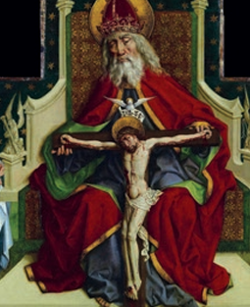
Love is the Source
“God is a ‘family’ of Three Persons who love each other so much as to form into one.” For all of time, God loved in relationship.
The Church was founded in this love before the creation of the world.
Notes:
Photo Credit: AMP Textbook p. 49.
Directions: Have students copy down the information from the slide into their notes.
Teaching Points: The First Divine Person of the Trinity, the Father, who knows himself with infinite knowledge. He speaks this perfect knowledge in a Divine Word that completely reveals itself in another person, the Second Divine Person of the Trinity, the Son. These two Divine Persons look at each other and love one another. Their love for one another is breathed out in the Third Divine Person of the Trinity, the Holy Spirit. After Jesus ascended into heaven, the Father sent the Third Divine Person, the Holy Spirit, to give life to and guide the members of the Church.
Online Resources: Assign article, The Trinity and the Sanctity of Family Life. URL here: https://catholicexchange.com/the-trinity-and-the-sanctity-of-family-life/
The resources linked in this presentation file may contain copyright material. Such material is made available for educational purposes only. This constitutes a “fair use” of any such copyright material as provided for in Title 17 U.S.C. section106A-117 of the US Copyright Law.

Slide 3
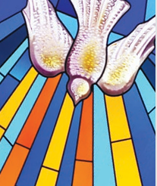
Pentecost: Birth of the Church
“The Spirit of truth, which the world cannot accept, because it neither sees nor knows it. But you know it, because it remains with you, and will be in you…On that day you will realize that I am in my Father and
you are in me and I in you.”
-Jn 14:17-20
Notes:
Photo Credit: AMP Textbook p. 55.
Directions: Have students copy information from the slide into their notes.
Teaching Points:The Holy Spirit revealed the Church to the world at Pentecost, when “the Church was publicly displayed to the multitude [and] the Gospel began to spread among the nations by means of preaching” (Ad Gentes Divinitus, 4).
The coming of the Spirit to the Apostles at Pentecost can be seen as the “birth” of the Church, because from that point forward the followers of Jesus sought to continue his mission on earth.
Online Resources: Have students view, What Happened at Pentecost and Why It’s important. URL here: https://youtu.be/JQhkWmFJKnA
The resources linked in this presentation file may contain copyright material. Such material is made available for educational purposes only. This constitutes a “fair use” of any such copyright material as provided for in Title 17 U.S.C. section106A-117 of the US Copyright Law.

Slide 4

Make Disciples of All Nations
“Go, therefore and make disciples of all nations, baptizing them in the name of the Father, and of the Son, and of
the holy Spirit”.
-Mt 28:19
Notes:
Photo Credit: Problemsmith. Creative Commons Attribution 4.0. Ecology Crossroads 512.png. https://commons.wikimedia.org/wiki/File:Ecology_Crossroads_512.png
Directions: Have students copy information from the slide into their notes.
Teaching Points: Typically, the privilege of baptizing another is reserved for the priest or deacon of the parish welcoming the person into communion with God and the family of God. This doesn’t mean, however, that we’re not called to carry out the “Great Commission” given by Christ to His apostles in Matthew 28.
The Catechism of the Catholic Church, tells us that the Sacrament of Confirmation: “gives us a special strength of the Holy Spirit to spread and defend the faith by word and action as true witnesses of Christ, to confess the name of Christ boldly, and never to be ashamed of the Cross” (CCC 1303).
Online Resources: Have students view video, Journeys of the Apostles. URL here: https://youtu.be/ISB4GTj7sc0
Have students view video, The Spread of Christianity. URL here: https://youtu.be/BJ0dZhHccfU
The resources linked in this presentation file may contain copyright material. Such material is made available for educational purposes only. This constitutes a “fair use” of any such copyright material as provided for in Title 17 U.S.C. section106A-117 of the US Copyright Law.

Slide 5

Four marks of the Church
Key
Vocab
The key attributes or characteristics of the Church that Jesus established which are mentioned in the Nicene Creed: “We believe in one, holy, catholic, and apostolic Church.
Notes:
Photo Credit: CheChe. Creative Commons Zero, Public Domain Dedication. Symbol 4. https://commons.wikimedia.org/wiki/File:Symbol_4.svg
Directions: Have students copy information from the slide in their notes.
Teaching Points: In the Nicene Creed, we profess, "We believe in one, holy, catholic, and apostolic Church": these are the four marks of the Church. They are inseparable and intrinsically linked to each other. Our Lord Himself in founding the Church marked it with these characteristics, which reflect its essential features and mission.
Online Resource:
Have students view video, One, Holy, Catholic , Apostolic. URL here: https://youtu.be/FMgIhdy59oE
Assign article, The Four Marks of the Church. URL here: https://www.catholiceducation.org/en/culture/catholic-contributions/the-four-marks-of-the-church.html
The resources linked in this presentation file may contain copyright material. Such material is made available for educational purposes only. This constitutes a “fair use” of any such copyright material as provided for in Title 17 U.S.C. section106A-117 of the US Copyright Law.

Slide 6
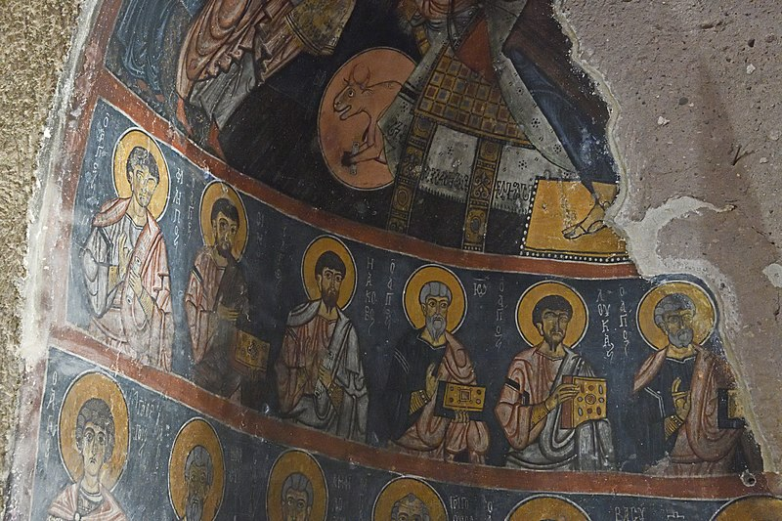
Apostolic
Key
Vocab
The Church is built on the foundation of the Apostles. It hands on the teaching of the Apostles in the Deposit of Faith, The Church is to be “taught, sanctified, and guided” by the Apostles and their successors until Christ’s return.
Notes:
Photo Credit: Dosseman. Creative Commons Attribution-Share Alike 4.0. Gumusler Monastery Main apse Disciples 1151. https://commons.wikimedia.org/wiki/File:Gumusler_Monastery_Main_apse_Disciples_1151.jpg
Directions: Have students copy information from the slide in their notes.
Online Resource: Assign article, What Does it Mean to Say That The Church is Apostolic?. URL Here: https://www.ncregister.com/blog/what-does-it-mean-to-say-the-church-is-apostolic
The resources linked in this presentation file may contain copyright material. Such material is made available for educational purposes only. This constitutes a “fair use” of any such copyright material as provided for in Title 17 U.S.C. section106A-117 of the US Copyright Law.

Slide 7
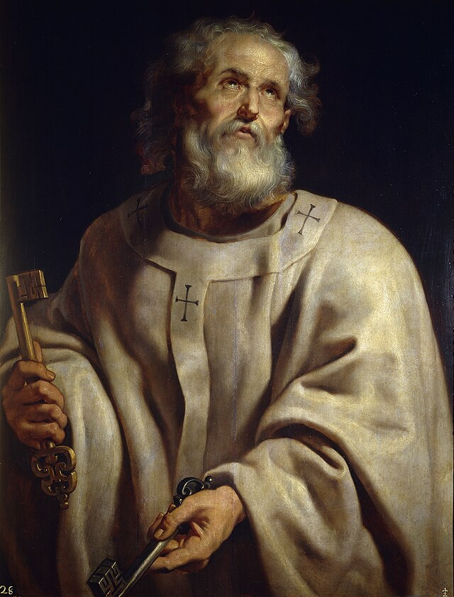
Saint Peter
The ‘Rock’
Leader of the Apostles and early church
Preached, wrote and instructed
Martyred in Rome
Notes:
Photo Credit: The Keys to Heaven.Peter. Paul Rubens.Public domain. https://commons.wikimedia.org/wiki/File:Pope-peter_pprubens.jpg
Directions: Have students copy down the information from the slide into their notes.
Teaching Points:
Peter's original name was Simon. Peter and his brother Andrew were working as fishermen when Jesus called them to join him.
Jesus identifies Peter as the "rock" upon which he will build his church.
Peter was the leader of the Church and he was martyred in Rome.
He and Saint Paul are considered the two most important early church figures.
Online Resources: Assign article, Origins of Peter as Pope. URL here: https://www.catholic.com/tract/origins-of-peter-as-pope
The resources linked in this presentation file may contain copyright material. Such material is made available for educational purposes only. This constitutes a “fair use” of any such copyright material as provided for in Title 17 U.S.C. section106A-117 of the US Copyright Law.

Slide 8
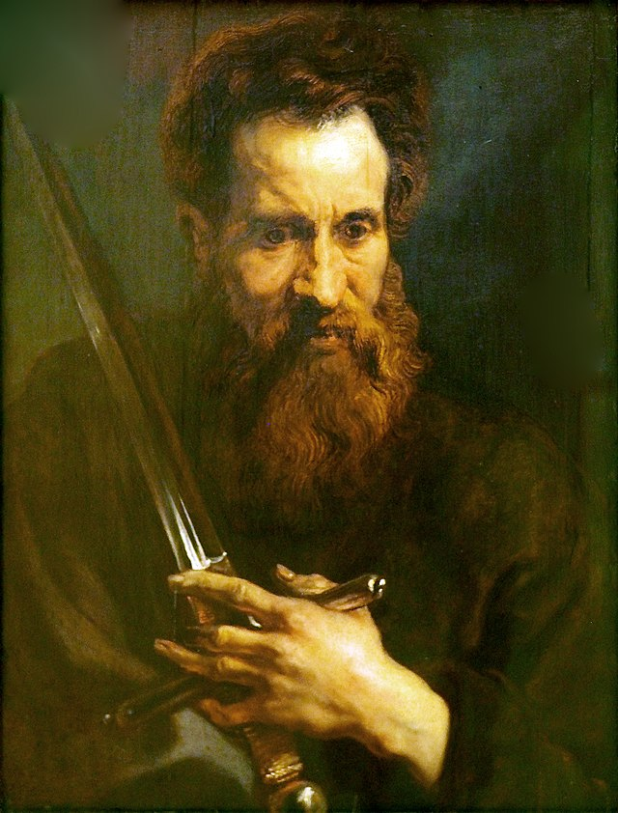
Saint Paul
Convert
Preacher
Writer
Missionary
Theologian
Notes:
Photo Credit: Anthony van Dyck. Public domain. Dyck Apostel Paulus@Nieders. Landesmuseum20160811. https://commons.wikimedia.org/wiki/File:Dyck_Apostel_Paulus@Nieders._Landesmuseum20160811.JPG
Directions: Have students copy down the information from the slide into their notes.
Teaching Points: He profoundly influenced the early Church in two ways: he spread the faith by preaching, and he taught the faith by writing.
He traveled over 10,000 miles by foot to preach in public squares or wherever he could find an audience. Most of Paul’s listeners were Gentiles who converted to faith in Jesus.
Paul wrote about half of the 27 books in the New Testament. He is considered to be the most important theologian. The sword signifies both the written word of God and his martyrdom.
Online Resource: Have students view video, 10 Things You Didn’t Know About Saint Paul the Apostle. URL here: https://youtu.be/r5oICFshh2g
The resources linked in this presentation file may contain copyright material. Such material is made available for educational purposes only. This constitutes a “fair use” of any such copyright material as provided for in Title 17 U.S.C. section106A-117 of the US Copyright Law.

Slide 9
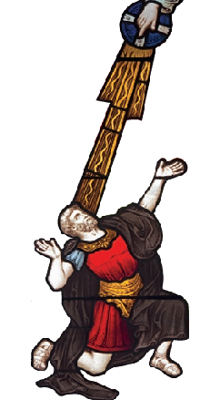
From Saul
to Saint Paul
BEFORE
A Pharisee and scholar
Persecuted members of the Church
Participated in the martyrdom of Stephen
AFTER
Became the “Apostle to the Gentiles”
One of the Church’s greatest theologians
Wrote a large part of New Testament
Notes:
Photo Credit: AMP Textbook p. 51.
Directions: Have students copy down the information from the slide into their notes.
Teaching Points: In one of the most surprising and dramatic religious conversions in all of history, Saul would become the greatest missionary in the Church. Although St. Paul was not one of the Twelve Apostles called personally by Jesus in the Gospels, the Risen Christ appeared to him on the road to Damascus and brought about his conversion. This is why St. Paul is called an Apostle. His missionary zeal and his prominent role in the newborn Church meant that he shared closely in the apostolic ministry of the Twelve.
St. Paul, a Jewish convert and Roman citizen who visited local churches, wrote letters of instruction and exhortation to these new Christian communities after he left, and ultimately was arrested and martyred for his faith. St. Paul is known as the “Apostle to the Gentiles” and as one of the Church’s greatest theologians. His writings and example had a formative and lasting impact on the character of the Church.
Story of his conversion: Acts 9:1-9 Saul’s Conversion
9 Meanwhile, Saul was still breathing out murderous threats against the Lord’s disciples. He went to the high priest 2 and asked him for letters to the synagogues in Damascus, so that if he found any there who belonged to the Way, whether men or women, he might take them as prisoners to Jerusalem. 3 As he neared Damascus on his journey, suddenly a light from heaven flashed around him. 4 He fell to the ground and heard a voice say to him, “Saul, Saul, why do you persecute me?”
5 “Who are you, Lord?” Saul asked.
“I am Jesus, whom you are persecuting,” he replied. 6 “Now get up and go into the city, and you will be told what you must do.”
7 The men traveling with Saul stood there speechless; they heard the sound but did not see anyone. 8 Saul got up from the ground, but when he opened his eyes he could see nothing. So they led him by the hand into Damascus. 9 For three days he was blind, and did not eat or drink anything.
Online Resources: Have students view video, The Apostle Paul Acts 8-12. URL here: https://youtu.be/oiVAbkINtRU
The resources linked in this presentation file may contain copyright material. Such material is made available for educational purposes only. This constitutes a “fair use” of any such copyright material as provided for in Title 17 U.S.C. section106A-117 of the US Copyright Law.

Slide 10
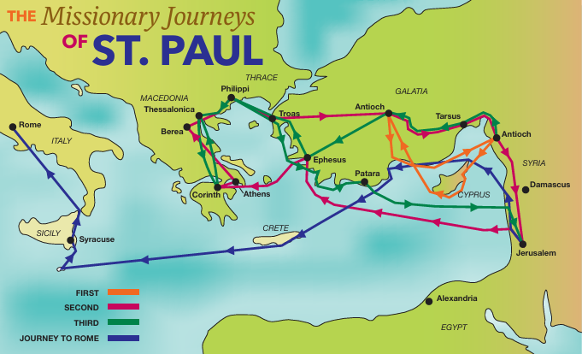
Saint Paul’s Mission to the Gentiles
‘For I am already being poured out like a libation,
and the time of my departure
is at hand’.
-2 Tim 4:6
Notes:
Photo Credit: AMP Textbook p. 72.
Directions: Have draw a rough sketch of the map and have students copy down the information from the slide into their notes.
Online Resources: Assign, AMP Worksheet, St. Paul’s Missionary Journeys. URL here: https://www.avemariapress.com/engagingfaith/st-pauls-missionary-journeys
The resources linked in this presentation file may contain copyright material. Such material is made available for educational purposes only. This constitutes a “fair use” of any such copyright material as provided for in Title 17 U.S.C. section106A-117 of the US Copyright Law.

Slide 11

Church Foundations Timeline
30-33AD
33-36 AD
37-47 AD
48-64 AD
65-110 AD
111-254 AD
Peter Given Keys
Jesus’ Death, Resurrection and Ascension
Pentecost
Stoning of Stephen
Paul’s Conversion
Saint Paul’s Apostolic Missions
Letters of Paul
Council of Jerusalem
Letters of Paul
Acts of Apostles
Persecution under Nero
Martyrdom of Peter and Paul
Other Gospels
Gospel of John
Revelation
Fall of Temple
Death of John
Didache
Ignatius of Antioch
Polycarp
Clement of Rome
Spread of Christianity
Irenaeus
Writings of Justin Martyr
Persecutions under Marcus Aurelius
Life of Origen
*Dates are approximate
Notes:
Photo Credit: Inside Sacred Heart of Mary Catholic Church in Boulder, Colorado. Let Ideas Compete. Public domain. https://commons.wikimedia.org/wiki/File:The_Crucified_Jesus_(26617883608).jpg
Directions: Have students copy information from the slide into their notes.
Teaching Points: The Church came before the Gospels and the completion of the Canon or list of official books. The whole message of Jesus was first passed on orally then written down. The apostles had immediate successors who led the church as early bishops or ‘overseers’. The Apostolic Fathers were disciples of individual apostles (example: Polycarp was a disciple of John). The more the church was persecuted the more it spread.
Online Resources: Have students view video, The Early Church was 100% Catholic. URL here: https://youtu.be/Z4bIcU2JO4Y
The resources linked in this presentation file may contain copyright material. Such material is made available for educational purposes only. This constitutes a “fair use” of any such copyright material as provided for in Title 17 U.S.C. section106A-117 of the US Copyright Law.

Slide 12
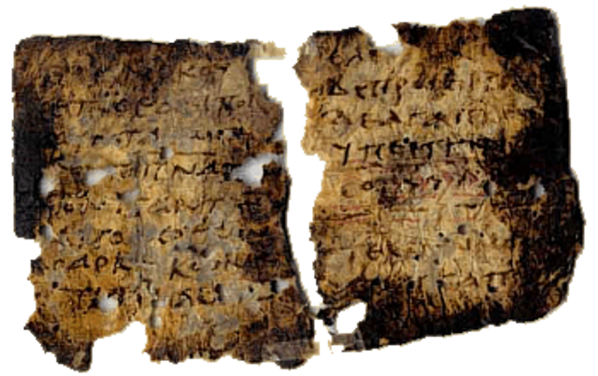
Didache
Key
Vocab
The Didache (did-ah-kay) is also known as “The Teaching of the Apostles.” It dates from the late first century and describes early Christian belief and practice including the Trinitarian formula, moral teachings and it explains the rites of Baptism and the Eucharist.
Notes:
Photo Credit: Manuscript of Didache. Didachist. Public domain. https://commons.wikimedia.org/wiki/File:Didache.png
Directions: Have students copy information from the slide in their notes.
Teaching Points: The Didache is probably the oldest patristic document. Its full title originally was, "The Lord's Instruction to the Gentiles Through the Twelve Apostles." The author and place of origin are unknown. In fact the work itself was discovered only at the end of the last century. The place of origin of the little book was probably Syria, though Egypt is not entirely out of question because of its popularity there. It was written some years before the end of the first century.
Online Resource: Have students view video, What’s the Didache?. URL here: https://youtu.be/zuBLCKo7FJU
Have students view English translation of the Didache. URL here: https://www.ewtn.com/catholicism/library/didache-12503
The resources linked in this presentation file may contain copyright material. Such material is made available for educational purposes only. This constitutes a “fair use” of any such copyright material as provided for in Title 17 U.S.C. section106A-117 of the US Copyright Law.

Slide 13
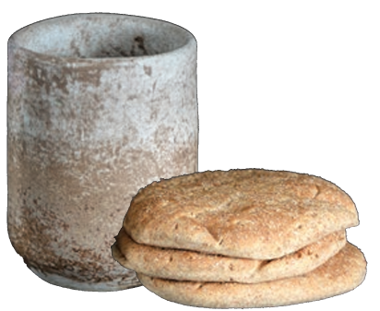
The Eucharist in the Early Church
“The historical record is clear about this: Wherever Christianity spread, the Church immediately established the liturgy—‘the breaking of the bread and the prayers’—on the ‘Lord’s day’ which was Sunday.” -Mike Aquilina
Notes:
Photo Credit: AMP Textbook p. 92.
Directions: Have students copy information from the slide into their notes.
Teaching Points:
The Eucharistic gathering would usually take place at a believer’s house, but don’t imagine a small, one-room shelter. Rather, houses were usually sizable, with a central courtyard and one large room for the gathering.
The Christians did not sit; they stood and faced east, or in the direction of Jerusalem.
The bishop or presbyter leading the liturgy also faced east, and the altar was set up against the east wall.
There was a chair reserved for the bishop or presbyter.
Deacons usually stood either near the bread and wine or outside the door watching and welcoming those who entered.
As the phrase “breaking of the bread” indicates, these Eucharistic meals always included at least one key ingredient: bread.
After the prayers, the Body and Blood of Christ (Holy Communion) would be distributed, probably by deacons.
Online Resources: Assign Article, St. Justin Martyr on the Eucharist and the Ancient Mass. URL here: https://www.wordonfire.org/articles/contributors/st-justin-martyr-on-the-eucharist-and-the-ancient-mass/
The resources linked in this presentation file may contain copyright material. Such material is made available for educational purposes only. This constitutes a “fair use” of any such copyright material as provided for in Title 17 U.S.C. section106A-117 of the US Copyright Law.

Slide 14
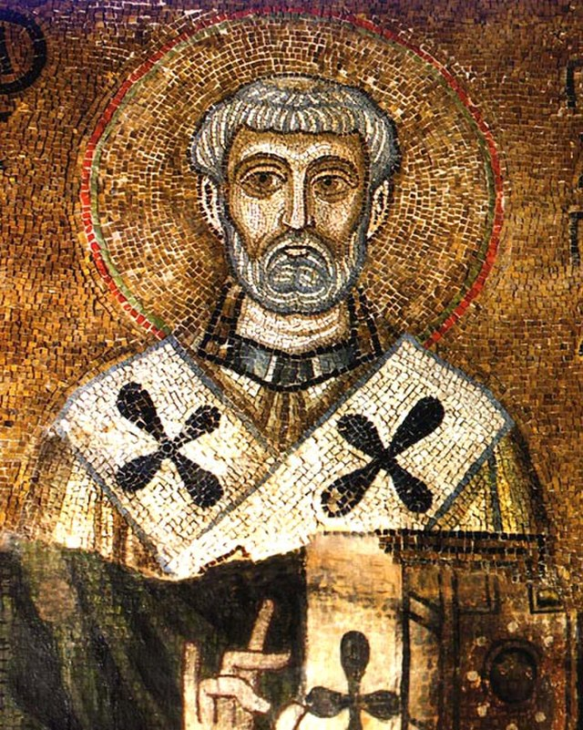
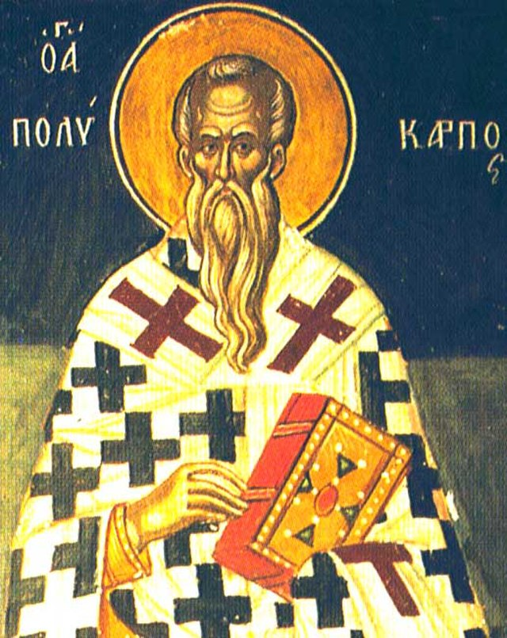
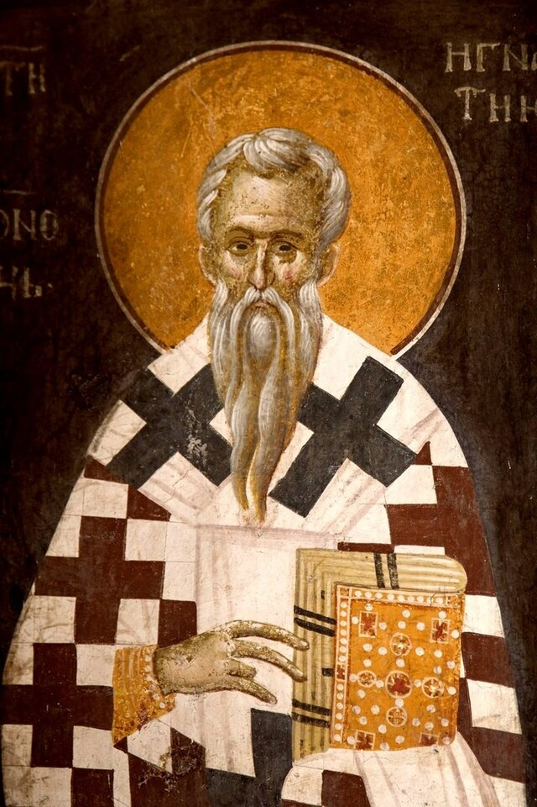
The Apostolic Fathers
Clement of Rome
Polycarp
Ignatius of Antioch
Notes:
Photo Credit: Unknown. Public domain. Clemens Romanus. Polycarp.jpg. Public domain. Polycarp. Wikivorker. Creative Commons Zero, Public Domain Dedication.Ignatius of Antioch. https://commons.wikimedia.org
Directions: Have students copy information from the slide into their notes.
Teaching Points: Have students view video, Discovering the Catholic Apostolic Fathers. URL here: https://youtu.be/LatPsJUfMU0
Have students view video, Ignatius of Antioch. URL here: https://youtu.be/qsE_QmjXKZM
Have students view video, Polycarp of Smyrna. URL here: https://youtu.be/mIwFr1UE7Nk
Have students view video, Clement of Rome. URL here: https://youtu.be/GuXhOs8IcVE
The resources linked in this presentation file may contain copyright material. Such material is made available for educational purposes only. This constitutes a “fair use” of any such copyright material as provided for in Title 17 U.S.C. section106A-117 of the US Copyright Law.

Slide 15
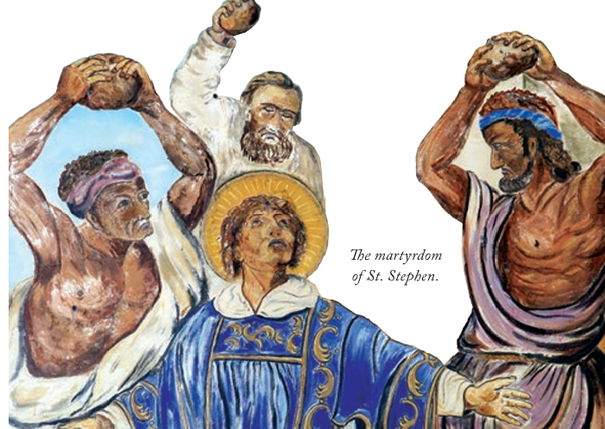
Three Elements of Christian Martyrdom
1. The person must be put to death.
2. The person must die for Christ and the faith.
3. The person does not die out of hatred for the enemy, but in joy out of love for Christ and the truth of the faith.
Notes:
Photo Credit: AMP Textbook p. 70.
Directions: Have students copy information from the slide into their notes.
Teaching Points: Christian martyrs were always peaceful, non-violent victims giving their life as a supreme witness to the truth of the Christian faith.
Online Resources: Have students view video, Mysteries of the Church, Martyrs. URL here: https://youtu.be/dm9LJrwUvNE
The resources linked in this presentation file may contain copyright material. Such material is made available for educational purposes only. This constitutes a “fair use” of any such copyright material as provided for in Title 17 U.S.C. section106A-117 of the US Copyright Law.

Slide 16
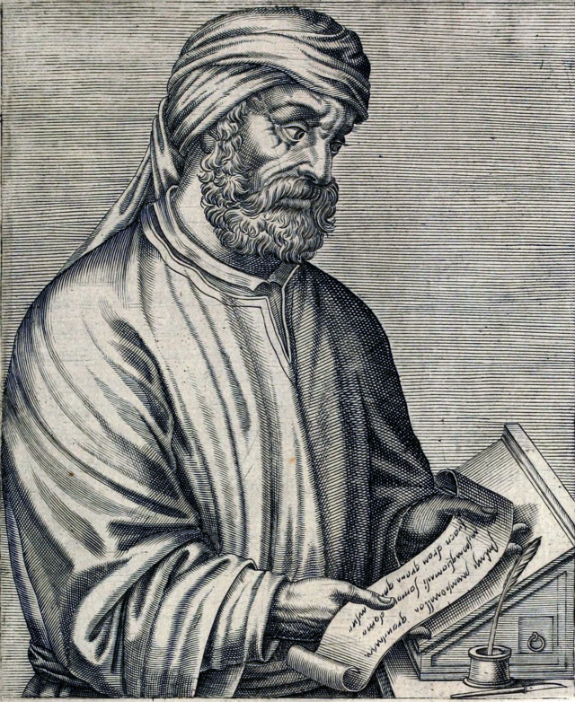
Tertullian
“The blood of the martyrs is the seed
of the church”
-Tertullian 187 AD
Notes:
Photo Credit: Portrait of Tertullian, prolific early Christian author from Carthage. André Thevet. Public domain.https://commons.wikimedia.org/wiki/File:Tertullian2.png
Directions: Have students copy information from the slide into their notes.
Teaching Points: The second-century church father Tertullian lived in Carthage, North Africa, when persecution of Christians was at its apex. In those days, the blood of martyrs soaked the earth as believers were fed to the lions, beaten, whipped, sawed in half, put to death by sword, burned in the fire, and chained in prisons. Tertullian maintained that the more Christians were persecuted and “mown down,” the more they would multiply because “the blood of Christians is seed”.
Online Resources: View video, Tertullian. URL here: https://youtu.be/_Vng2h15wEE
Read article, The Blood of Martyrs is the Seed of the Church. URL here: https://www.gotquestions.org/blood-martyrs-seed-church.html
The resources linked in this presentation file may contain copyright material. Such material is made available for educational purposes only. This constitutes a “fair use” of any such copyright material as provided for in Title 17 U.S.C. section106A-117 of the US Copyright Law.

Slide 17

Memorize It
Key
Quote
“Wherever the bishop appears, there let the people be; as wherever Jesus Christ is, there is the catholic Church.”
-Ignatius of Antioch
Notes:
Directions: Have students write down the quote and commit it to memory. Bonus points may be awarded if they can add it to the end of the chapter assessment.
The resources linked in this presentation file may contain copyright material. Such material is made available for educational purposes only. This constitutes a “fair use” of any such copyright material as provided for in Title 17 U.S.C. section106A-117 of the US Copyright Law.

