Slide 1
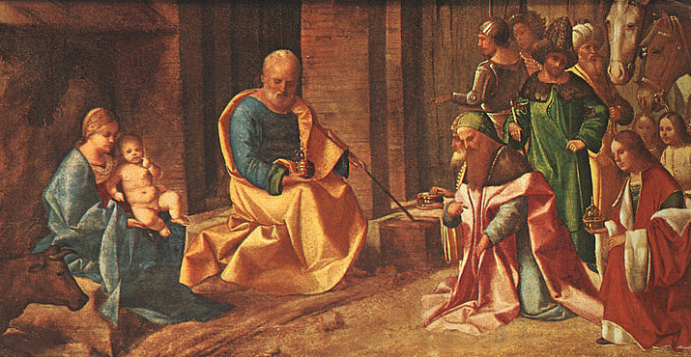
3
The New Covenant:
Why Did God Become Man?
God Saves: We Are Redeemed through the Paschal Mystery
Notes:
Photo Credit: https://commons.wikimedia.org/wiki/File:Giorgione,_Adoration_of_the_Magi.jpg
Suggestions for students’ note taking:
●Require students to use a three ring binder (1/2-1 inches) full of loose leaf paper (college or wide ruled).
●Notes must be taken in pen only and hand written.
●Notebooks should contain information and notes for religion class only.
●Notebooks must have a table of contents with topic of notes, dates and page numbers.
●All notes must have a topic and page number.
●Students will be required to copy each slide unless the teacher directs students to skip certain slides or parts of slides. Notebooks will be graded based on neatness, completeness and organization. Notebooks should have a significant point value representing 20-25% of the overall grade.
The videos linked in this presentation file may contain copyright material. Such material is made available for educational purposes only. This constitutes a “fair use” of any such copyright material as provided for in Title 17 U.S.C. section106A-117 of the US Copyright Law.

Slide 2

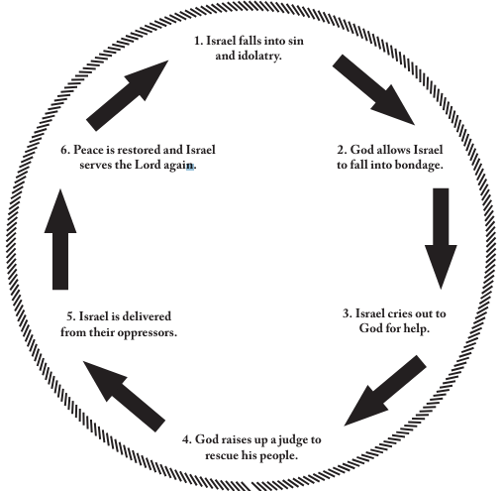
Old Testament Cycle of Sin
Jesus became man to save us from sin by becoming the Perfect Mediator of an unbreakable Covenant.
Notes:
Photo Credit: AMP handout. https://resources.avemariapress.com/dynamicmedia/files/da623b431323ef47d276e16708124523/OT_Handout_5D.pdf
Directions: Have students copy the side information in their notebooks.
Teaching points:
All of the Old Covenants were broken by the people and imperfect human mediators with whom God initiated the covenant. They became trapped in a cycle of sin and were in need of God to save us by becoming man and the Mediator of a new, unbreakable Covenant.
(1) Israel falls into sin and idolatry, and does “what was evil in the sight of the Lord” (Jgs 6:1);
(2) God allows his people to fall into bondage as a consequence of their disobedience;
(3) realizing the errors of their ways, Israel cries out to God for help;
(4) God raises up a judge to rescue them;
(5) Israel is delivered from their oppressors;
(6) peace is restored in the land and Israel again serves the Lord; and then the cycle repeats.
The reason the New Covenant is different is because the Law is written in our hearts and we can have communion with God through a perfect Mediator. When God the Father sees us he first sees our mediator Jesus and the perfect sacrifice that Jesus made on our behalf. In spite of our many sins, we have forgiveness and redemption through Jesus. Therefore, the New Covenant is eternal and unbreakable.
The New Covenant is a covenant of redemption. Jesus redeemed, or paid the ransom for, humans to release them from their sins. He did not merely lessen our obligation for our sins; he paid the debt in full. But the New Covenant was not completed when God entered the world on Christmas Day. It was not completed until the events of the Paschal Mystery: Christ’s Passion, Death, and Resurrection.
The videos linked in this presentation file may contain copyright material. Such material is made available for educational purposes only. This constitutes a “fair use” of any such copyright material as provided for in Title 17 U.S.C. section106A-117 of the US Copyright Law.

Slide 3

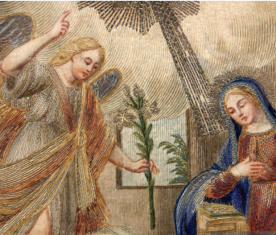
Annunciation
And the angel said unto her: Hail, full of grace, the Lord is with thee: blessed art thou among women.
Luke 1:28
Notes:
Photo Credit: AMP textbook, p.110.
Directions: Have students copy the side information in their notebooks.
Teaching Point:
The definitive moment where God fulfilled his promise of sending a Savior and where he intervened in human history to stop the cycle of sin and our separation from him began on the day we call ‘the Annunciation’.
The day we celebrate the Annunciation is March 25 exactly nine months before December 25.
Ask students what the connection is between the Annunciation and Christmas.
The Annunciation is not just a visit by the Angel Gabriel and an announcement.
By Mary’s ‘yes’ to God’s plan of salvation, she permitted the Holy Spirit to overshadow her and she became pregnant with Jesus.
This is why the Annunciation is also the Incarnation.
Jesus’ life, like our life, began in his mother’s womb at conception.
There’s an old saying, “All of creation held its breath waiting for Mary’s ‘yes’.
This means that the entrance of God into our world in the flesh, in the person of the unborn Jesus, marked the beginning of salvation and redemption offered to all.
The videos linked in this presentation file may contain copyright material. Such material is made available for educational purposes only. This constitutes a “fair use” of any such copyright material as provided for in Title 17 U.S.C. section106A-117 of the US Copyright Law.

Slide 4
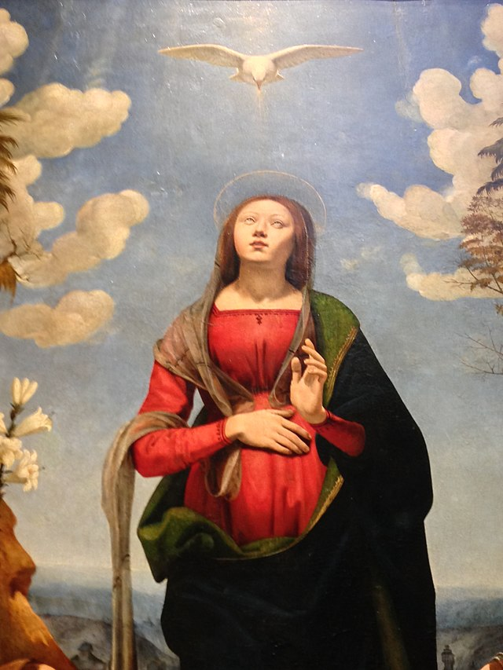
Incarnation
Key
Vocab!
God became a human being through the person of Jesus. It is called 'the incarnation' because God became human 'in the flesh' in the person of Jesus.
Protestants who interpret each word or phrase in the
Bible from a literalist point of view.
Notes:
Photo Credit: Dimitris Kamaras ,Creative Commons Attribution 2.0. https://commons.wikimedia.org/wiki/File:Immaculate_Conception_with_Saints_aka_The_Incarnation_of_Jesus_(Incarnazione_di_Cristo),_Galleria_degli_Uffizi,_Florence_-detail-_(26509662612).jpg
Directions: Have students add this vocabulary term to their notes.
Teaching Point:
By becoming flesh, Christ became our model of holiness. He teaches us that to love means to offer ourselves
for others as he did. By sharing in our human nature, Christ invites us to “share in the divine nature, after escaping from the corruption that is in the world because of evil desire” (2 Pt 1:4).
The videos linked in this presentation file may contain copyright material. Such material is made available for educational purposes only. This constitutes a “fair use” of any such copyright material as provided for in Title 17 U.S.C. section106A-117 of the US Copyright Law.

Slide 5

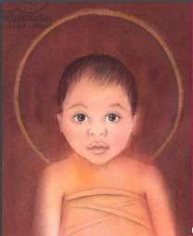
THE WORD BECAME FLESH
…so that we may know God’s
love for us!
Notes:
Photo Credit: AMP Textbook p.112.
Directions: Have students copy information down in their notes. Teaching point:
In CCC 458, it says, “The Word became flesh so that thus we might know God's love: "In this the love of God was made manifest among us, that God sent his only Son into the world, so that we might live through him. For God so loved the world that he gave his only Son, that whoever believes in him should not perish but have eternal life” (Jn 3:16).
In the Incarnation we see that Jesus who existed as the Word of God in pure spirit form took on a human nature and he therefore was is both human and divine.
Jesus of Nazareth was truly a man. He lived over two thousand years ago
in the Middle East and grew up in a village called Nazareth. Both those
who followed him and were his disciples and those who were his opponents
and enemies testified to his historical existence. Each group left
written records of his life.
Jesus Christ is truly God. The best evidence that Jesus is God is that he
rose from the dead. Again, both his disciples and his enemies who discovered
that his tomb was empty after his Death testified to this event.
The videos linked in this presentation file may contain copyright material. Such material is made available for educational purposes only. This constitutes a “fair use” of any such copyright material as provided for in Title 17 U.S.C. section106A-117 of the US Copyright Law.

Slide 6
Jesus Lived a Human Life
Jesus was literate
Jesus lived in a poor town
Jesus had a
large extended
family
Protestants who interpret each word or phrase in the
Bible from a literalist point of view.
Jesus
was a carpenter
Jesus spoke Aramaic, Hebrew,
and some Koine Greek
Jesus was a Middle Eastern
man.
Jesus was an outdoorsman
Notes:
Photo Credit: Dimitris Kamaras ,Creative Commons Attribution 2.0. https://commons.wikimedia.org/wiki/File:Immaculate_Conception_with_Saints_aka_The_Incarnation_of_Jesus_(Incarnazione_di_Cristo),_Galleria_degli_Uffizi,_Florence_-detail-_(26509662612).jpg
Directions: Have students add this vocabulary term to their notes.
Teaching Point:
By becoming flesh, Christ became our model of holiness. He teaches us that to love means to offer ourselves
for others as he did. By sharing in our human nature, Christ invites us to “share in the divine nature, after escaping from the corruption that is in the world because of evil desire” (2 Pt 1:4).
The videos linked in this presentation file may contain copyright material. Such material is made available for educational purposes only. This constitutes a “fair use” of any such copyright material as provided for in Title 17 U.S.C. section106A-117 of the US Copyright Law.

Slide 7
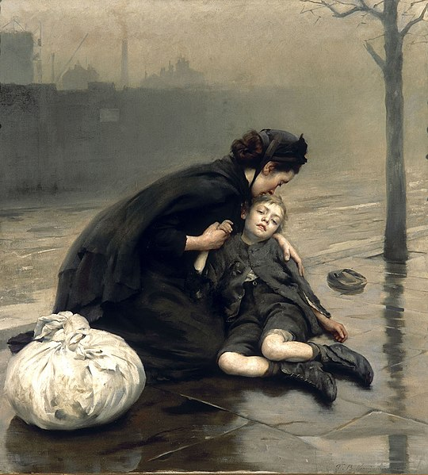
Jesus Taught Compassion
Jesus Healed the Sick
Jesus Fed the Hungry
Raised the Dead
Jesus Taught the Crowds
“None should have to feel there is no room for them on this earth.”
- Pope Francis
Notes:
Photo Credit: Thomas Benjamin Kennington,Public domain. https://commons.wikimedia.org/wiki/File:Thomas_Kennington_-_Homeless_(1890).jpg
Directions: Ask Question: In what way was Jesus’ compassion expressed in a hands on way? Read: Mt 8:1-4 for an example…”When Jesus came down from the mountainside, large crowds followed him. A man with leprosy came and knelt before him and said, “Lord, if you are willing, you can make me clean.” Jesus reached out his hand and touched the man. “I am willing,” he said. “Be clean!” Immediately he was cleansed of his leprosy. Then Jesus said to him, “See that you don’t tell anyone. But go, show yourself to the priest and offer the gift Moses commanded, as a testimony to them.”
Teaching points: For the sick, refugees, toward those facing tragedy, the poor, or those in our own families, our compassion is to be concrete and “hands on.” This we learned from the Son of God when he was in the flesh during his time on earth.
The videos linked in this presentation file may contain copyright material. Such material is made available for educational purposes only. This constitutes a “fair use” of any such copyright material as provided for in Title 17 U.S.C. section106A-117 of the US Copyright Law.

Slide 8
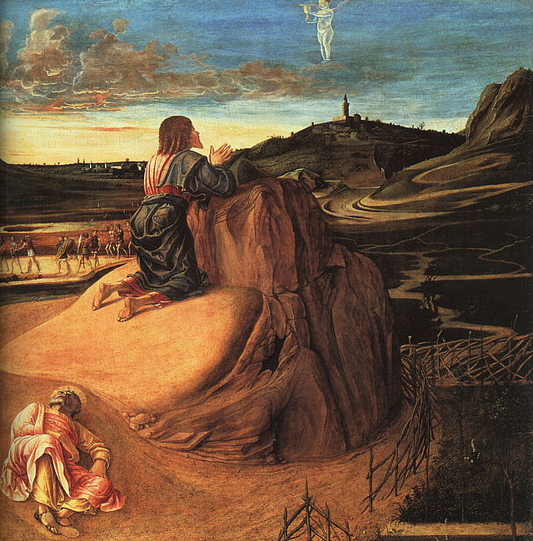
Jesus Taught Obedience
Jesus obeyed his mother
Jesus learned from Joseph
Jesus said he came to do the will of his Father in heaven
Jesus accepted the Cross
“Not my will but yours be done.”
Luke 22:42
Notes:
Photo Credit: Giovanni Bellini,Public domain. https://commons.wikimedia.org/wiki/File:Giovanni_Bellini_-_Agony_in_the_Garden_(detail)_-_WGA1646.jpg
Directions: Share quote by Saint Josemaria Escriva,
“God does not impose a blind obedience on us. He wants us to obey
intelligently, and we have to feel responsible for helping others with the intelligence
we do have. But let’s be sincere with ourselves; let’s examine, in every
case, whether it is love for the truth which moves us or selfishness and attachment
to our own judgment. When our ideas separate us from other people,
when they weaken our communion, our unity with others, it is a sure sign that
we are not doing what God wants.”
Online Resources: Pray aloud, ‘The Litany of Humility’ with your students. URL here: https://www.ewtn.com/catholicism/devotions/litany-of-humility-245
The videos linked in this presentation file may contain copyright material. Such material is made available for educational purposes only. This constitutes a “fair use” of any such copyright material as provided for in Title 17 U.S.C. section106A-117 of the US Copyright Law.

Slide 9
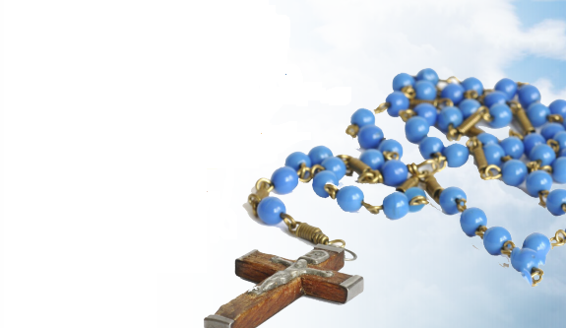
The Luminous Mysteries Illumines the Life of Jesus
His baptism in the Jordan River, his miracles and exorcisms, his preaching of God’s Kingdom in parables, his wondrous Transfiguration, and his institution of the Eucharist at the Last Supper
Notes:
Photo Credit: AMP textbook p.127
Directions: Have students turn to pages 126-129 in their textbooks. As they view those pages, share paragraph 25 of Rosarium Virginis Mariae. In it are these words of Saint John Paul II:
“In my testimony of 1978 mentioned above, where I described the Rosary as my favourite prayer, I used an idea to which I would like to return. I said then that “the simple prayer of the Rosary marks the rhythm of human life”.
Anyone who contemplates Christ through the various stages of his life cannot fail to perceive in him the truth about man. This is the great affirmation of the Second Vatican Council which I have so often discussed in my own teaching since the Encyclical Letter Redemptor Hominis: “it is only in the mystery of the Word made flesh that the mystery of man is seen in its true light”.
The Rosary helps to open up the way to this light. Following in the path of Christ, in whom man's path is “recapitulated”, revealed and redeemed, believers come face to face with the image of the true man. Contemplating Christ's birth, they learn of the sanctity of life; seeing the household of Nazareth, they learn the original truth of the family according to God's plan; listening to the Master in the mysteries of his public ministry, they find the light which leads them to enter the Kingdom of God; and following him on the way to Calvary, they learn the meaning of salvific suffering. Finally, contemplating Christ and his Blessed Mother in glory, they see the goal towards which each of us is called, if we allow ourselves to be healed and transformed by the Holy Spirit. It could be said that each mystery of the Rosary, carefully meditated, sheds light on the mystery of man.
At the same time, it becomes natural to bring to this encounter with the sacred humanity of the Redeemer all the problems, anxieties, labours and endeavours which go to make up our lives. “Cast your burden on the Lord and he will sustain you” (Ps 55:23). To pray the Rosary is to hand over our burdens to the merciful hearts of Christ and his Mother. Twenty-five years later, thinking back over the difficulties which have also been part of my exercise of the Petrine ministry, I feel the need to say once more, as a warm invitation to everyone to experience it personally: the Rosary does indeed “mark the rhythm of human life”, bringing it into harmony with the “rhythm” of God's own life, in the joyful communion of the Holy Trinity, our life's destiny and deepest longing.”
The videos linked in this presentation file may contain copyright material. Such material is made available for educational purposes only. This constitutes a “fair use” of any such copyright material as provided for in Title 17 U.S.C. section106A-117 of the US Copyright Law.

Slide 10
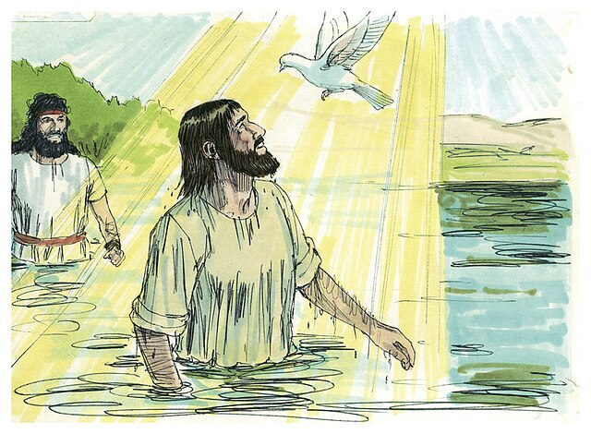
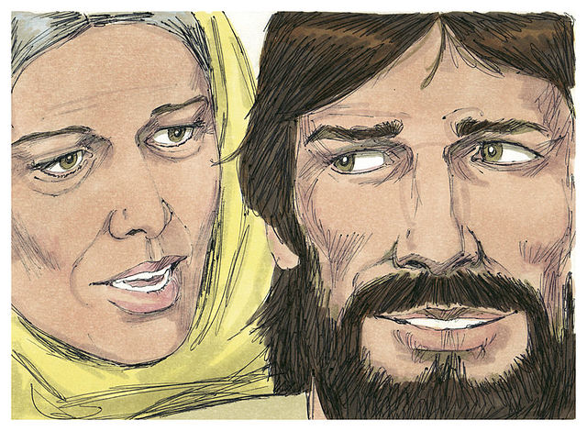
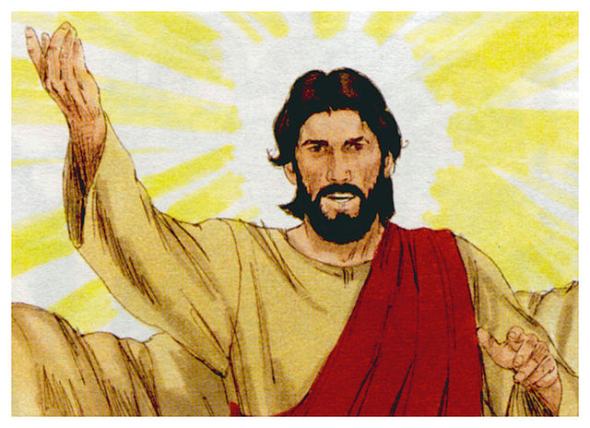
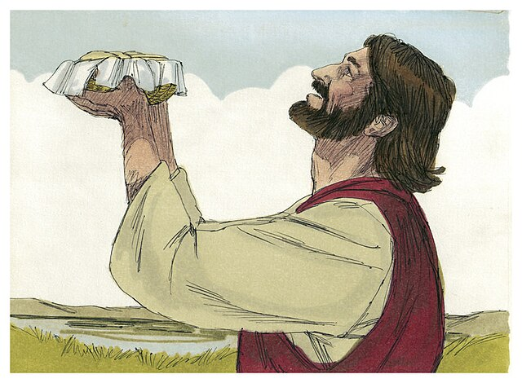
Redemption Stages & Destruction of Evil
At his Baptism, Christ already lets himself be counted among sinners.
Jesus is the New Adam faithful to God, whereas the first Adam gave in to temptation.
The Transfiguration provides a foretaste of Christ’s glorious body following his Resurrection.
By giving them his Body and his Blood. Jesus gave the Passover a new meaning, fulfilling the Jewish Passover.
Notes:
Photo Credit: Jim Padgett, Gospel of John. Creative Commons Attribution-Share Alike 3.0. https://commons.wikimedia.org
Teaching points:
At his Baptism, Christ already lets himself be counted among sinners.
He is the Lamb of God who will take away the sins of the world..
His Baptism in water anticipates the bloody baptism of his death.
Through our own Baptism, we are sacramentally united to Jesus and assimilated
into his Paschal Mystery.
Jesus is the New Adam who remained faithful to God, whereas the first
Adam gave in to temptation. Likewise, Jesus's faithfulness is also unwavering,
unlike that of the Israelites, who often turned against God during
their forty years in the desert. Jesus's response to Satan’s temptations in
the desert prove that he is the Son of God who can vanquish Satan from
our lives.
The Transfiguration provides a foretaste of both Christ’s glorious body following
his Resurrection and how our own resurrection will change “our
lowly body to conform with his glorified body by the power that enables
him also to bring all things into subjection to himself” (Phil 3:21).
Christ chose the time of the Passover to do what he had previously told
his disciples he would do: give them his Body and his Blood. Jesus gave
the Passover a new meaning, fulfilling the Jewish Passover and anticipating
the final Passover of the Church into the glory of the Kingdom of God.
The videos linked in this presentation file may contain copyright material. Such material is made available for educational purposes only. This constitutes a “fair use” of any such copyright material as provided for in Title 17 U.S.C. section106A-117 of the US Copyright Law.

Slide 11
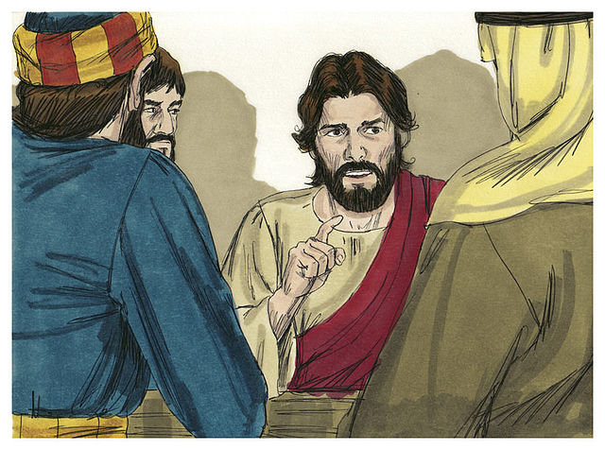
Parables
Key
Vocab!
Short stories resembling allegories that Jesus used to teach spiritual lessons.
Parables incorporated everyday people and events and often had a surprising ending.
Protestants who interpret each word or phrase in the
Bible from a literalist point of view.
Notes:
Photo Credit: Jim Padgett,Creative Commons Attribution-Share Alike 3.0. https://commons.wikimedia.org/wiki/File:Gospel_of_John_Chapter_13-4_(Bible_Illustrations_by_Sweet_Media).jpg
Directions: Have students add this vocabulary term to their notes.
Online Resources: View video, Brant Pitre He Who Has Ears, Let Him Hear (Part 1) URL here: https://youtu.be/Im-OXXexbUM
The videos linked in this presentation file may contain copyright material. Such material is made available for educational purposes only. This constitutes a “fair use” of any such copyright material as provided for in Title 17 U.S.C. section106A-117 of the US Copyright Law.

Slide 12




The Kingdom of God is Like…
Farming
Shepherds
and Sheep
Seeds,
Bread,
Wine
Jesus told many
parables using
everyday
agrarian life
to reveal what
the Kingdom
of God was like.
Fishing
Land and Landowners
Weddings
Fathers and Sons
Notes:
Teaching points: Jesus used short stories resembling allegories to teach spiritual lessons about the Kingdom of God. Parables incorporated everyday people, things and events and often had a surprising ending.Through his parables, Jesus invites us to enter the Kingdom of God. This invitation is not without requirements. To gain the Kingdom of God requires more than just a token acceptance. We must give up everything in order to follow Jesus and gain the Kingdom.The coming of God’s Kingdom means the defeat of Satan. The Kingdom of God is finally and definitively established through Christ’s Passion,
Death, and Resurrection.
Online Resources: View video, Bishop Barron on the Parable of the Talents. URL here: https://youtu.be/bXC_qB8xfYQ
The videos linked in this presentation file may contain copyright material. Such material is made available for educational purposes only. This constitutes a “fair use” of any such copyright material as provided for in Title 17 U.S.C. section106A-117 of the US Copyright Law.

Slide 13

“How can the Kingdom of God be now but not yet?”
It began with the Church…
“To fulfill the Father’s will, Christ ushered in the Kingdom of heaven on earth.” CCC 763
The seed and beginning of the Kingdom is the Church.
It will be complete at the end of time…
The Kingdom of God will come in glory when Christ hands it over to his Father at the end of time. Until then, we have much work to do.
Notes:
Directions: Begin by asking the question on the screen. After calling on students to respond, have the answer fly in using the animation feature.
The videos linked in this presentation file may contain copyright material. Such material is made available for educational purposes only. This constitutes a “fair use” of any such copyright material as provided for in Title 17 U.S.C. section106A-117 of the US Copyright Law.

Slide 14

Turn and Talk
Read Luke 15,
The Parable of the Lost Son.
Who in the story do you identify with the most? The father, the prodigal son or the brother?
When at the Last Supper Jesus said about the Eucharist, “This is my Body” why do you think most Protestants do not interpret that as literal and Catholics do?
Notes:
Directions: Have students write down the question and then write down their answer….Then have students share their answers with one person close by. Call on volunteers to share with the whole class. End by asking, ‘What does this parable teach about the Kingdom of God?’.
The videos linked in this presentation file may contain copyright material. Such material is made available for educational purposes only. This constitutes a “fair use” of any such copyright material as provided for in Title 17 U.S.C. section106A-117 of the US Copyright Law.

Slide 15

Memorize It
Key
Verse!
“For God so loved the world that he gave his only Son, so that everyone who believes in him might not perish but might have eternal life.”
-John 3:16
Notes:
Directions: Have students copy the quote. Add bonus points to the assessment if they can copy it down demonstrating that they memorized it.
The videos linked in this presentation file may contain copyright material. Such material is made available for educational purposes only. This constitutes a “fair use” of any such copyright material as provided for in Title 17 U.S.C. section106A-117 of the US Copyright Law.

