Slide 1
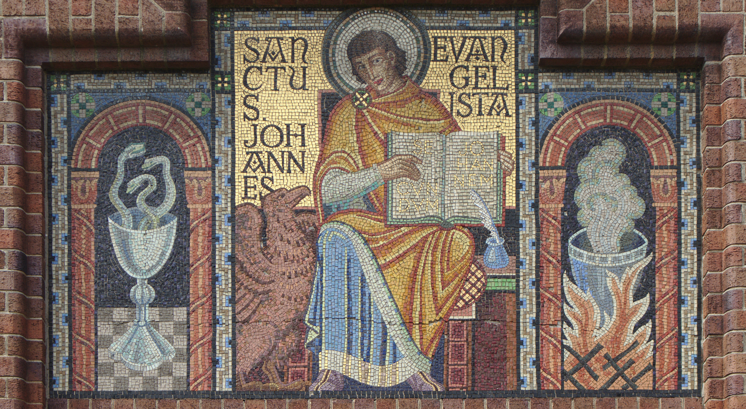
6
Christology in the Gospel of John
God Reveals: An Introduction to the Bible
Notes:
*Photo Credit: Rodhullandemu, Creative Commons Attribution-Share Alike 4.0 International license, https://commons.wikimedia.org/wiki/File:Mosaic_at_St_John_the_Evangelist_Church,_New_Ferry.jpg
Suggestions for students’ note taking:
Require students to use a three-ring binder (1/2-1 inches) full of loose-leaf paper (college or wide ruled).
Notes must be taken in pen only and handwritten.
Notebooks should contain information and notes for religion class only.
Notebooks must have a table of contents with topic of notes, dates, and page numbers.
All notes must have a topic and page number.
Students will be required to copy each slide unless the teacher directs students to skip certain slides or parts of slides. Notebooks will be graded based on neatness, completeness, and organization. Notebooks should have a significant point value representing 20-25% of the overall grade.

Slide 2
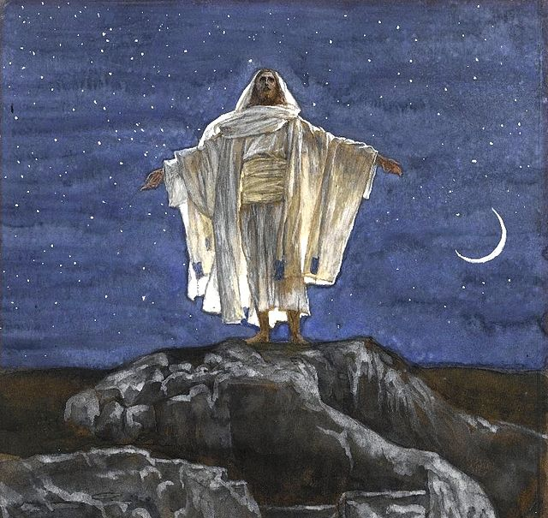
Christology
Key
Vocab
A branch of theology that studies the meaning of the Divine Person of Jesus Christ.
John stresses Jesus’s heavenly origins.
Notes:
*Photo Credit: James Tissot, Public domain, https://commons.wikimedia.org/wiki/File:Brooklyn_Museum_-_Jesus_Goes_Up_Alone_onto_a_Mountain_to_Pray_(J%C3%A9sus_monte_seul_sur_une_montagne_pour_prier)_-_James_Tissot_-_overall.jpg
Directions: Have students copy down key vocabulary in their notes.

Slide 3
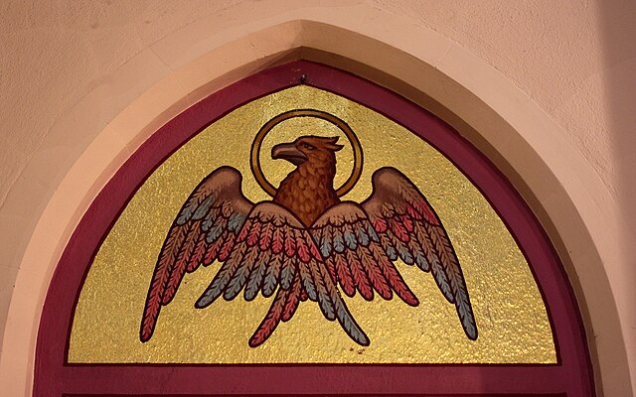
Gospel of John
Key
Vocab
The fourth and final Gospel in the New Testament canon. Written later than the synoptics by the apostle and evangelist John.
Notes:
*Photo Credit: Nheyob, Creative Commons Attribution-Share Alike 4.0, https://commons.wikimedia.org/wiki/File:Saint_John_the_Evangelist_Church_(Covington,_Kentucky)_-_apse,_Gospel_of_John.jpg
Directions: Have students copy down key vocabulary in their notes.

Slide 4
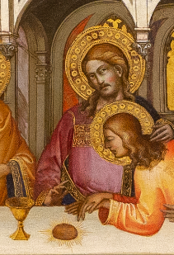
Why was John referred to as the beloved disciple?
Notes:
*Photo Credit: Lorenzo Monaco, Creative Commons Attribution-Share Alike 4.0, https://commons.wikimedia.org/wiki/File:The_Last_Supper_by_Lorenzo_Monaco.jpg
Directions: Have students copy three bullet points of information to answer the question, “Why was John called the beloved disciple?” as you read the information below.
John called himself “the beloved disciple”
He wrote the Gospel of John, letters of John, and the Book of Revelation
He was the youngest apostle—painted with no beard—and died a natural death
He witnessed the Crucifixion and empty tomb
He took Mary into his home
He is usually pictured resting his head close to the heart of Jesus in the Last Supper paintings

Slide 5
Top 5 Memorable Quotes in John’s Gospel
“I am the way and the truth and the life. No one comes to the Father except through me” (Jn 14:6).
“Amen, amen, I say to you, unless you eat the flesh of the Son of Man and drink his blood, you do not have life within you” (Jn 6:53).
  “I am the light of the world. Whoever follows me will not walk in darkness, but will have the light of life” (Jn 8:12).
“For God so loved the world that he gave his only Son, so that everyone who believes in him might not perish but might have eternal life” (Jn 3:16).
“I am the resurrection and the life; whoever believes in me, even if he dies, will live” (Jn 11:25).
Notes:
Directions: Have students copy one of the quotes that they think is most important from John’s Gospel in their notes and ask them to share why they chose that quote.

Slide 6
Mt, Mk, Lk (Synoptics) vs. John
SYNOPTICS
JOHN
One Journey to Jerusalem
Short sayings, many parables
Focus is on Kingdom of God
Not explicitly claiming divinity
Many stories in common
Miracles = “dunamis” (power)
Three Journeys to Jerusalem
Long discourses, parables
Focus is NOT on Kingdom of God
Explicitly claiming divinity, Heavenly Origin
Few stories in common
Miracles = Signs
Notes:
Directions: Have students copy the chart in their notes.
Online Resources: For a more detailed treatment of this topic, have students see the webpage “Contrasts between John and the Synoptics” by Fr. Felix Just, SJ. URL here: https://catholic-resources.org/John/Synoptic-Differences.htm

Slide 7

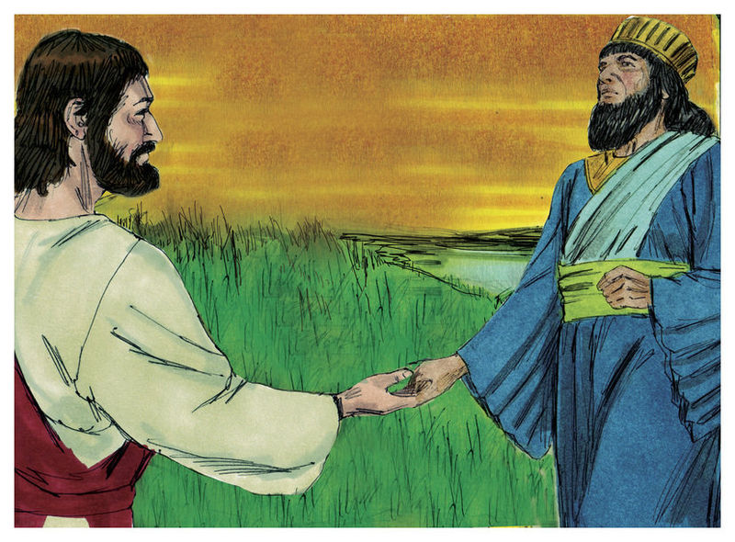
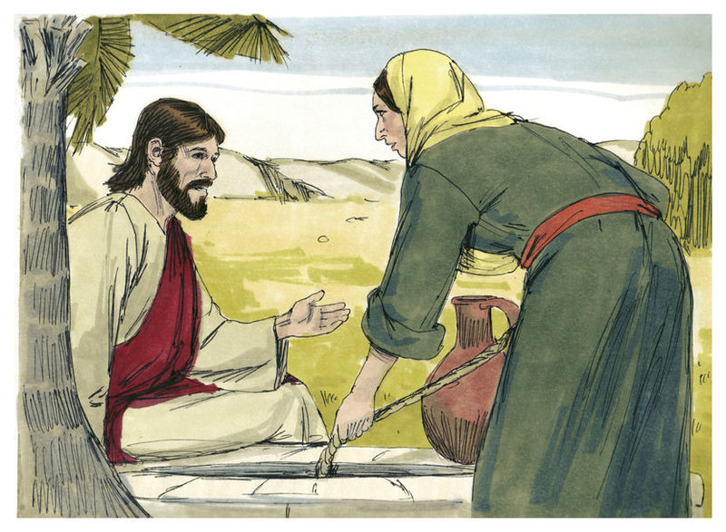
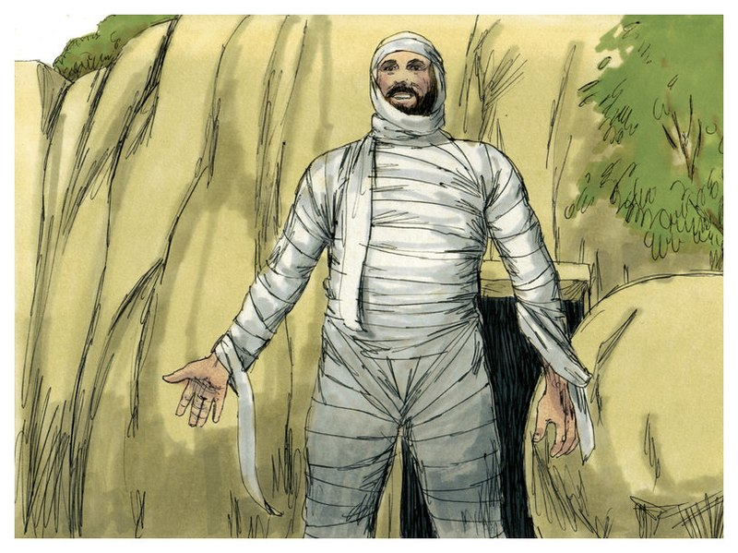
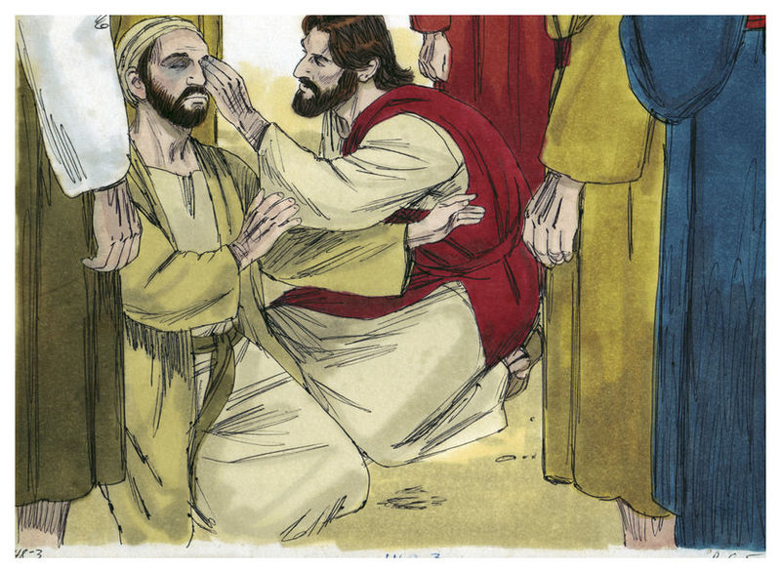
New Characters Introduced in the Gospel of John
Nicodemus
a scholar who had difficulty understanding the mystery of Jesus. He becomes humble.
Woman at the Well
a person who goes beyond her past sinfulness to proclaim the coming of Christ.
Lazarus
a person who befriended Jesus and for whom, Jesus wept. He gets a second chance at life.
The Man Born Blind
ignored and harassed only to become strong in his faith.
Notes:
*Photo Credit: Jim Padgett, Biblical Illustrations/Gospel of John, Creative Commons Attribution-Share Alike 3.0
https://commons.wikimedia.org/wiki/File:Gospel_of_John_Chapter_3-2_(Bible_Illustrations_by_Sweet_Media).jpg
https://commons.wikimedia.org/wiki/File:Gospel_of_John_Chapter_4-2_(Bible_Illustrations_by_Sweet_Media).jpg
https://commons.wikimedia.org/wiki/File:Gospel_of_John_Chapter_11-11_(Bible_Illustrations_by_Sweet_Media).jpg
https://commons.wikimedia.org/wiki/File:Gospel_of_John_Chapter_9-2_(Bible_Illustrations_by_Sweet_Media).jpg
Directions: Ask students to list these names in their notes and then, using a Bible, locate in which chapter of John each person is mentioned.

Slide 8
The 7 Signs in John’s Gospel
Turning Water Into Wine (John 2:1–12)
Healing the Nobleman's Son (John 4:46–54)
Healing the Man at the Pool (John 5:1–11)
Feeding of the 5,000 (John 6:1–15)
Walking on Water (John 6:16–21)
Healing a Man Born Blind (John 9:1–12)
Resurrecting Lazarus (John 11:1–44)
Notes:
Directions: Have students copy one of these seven signs in their notes based on which one they think is most significant. Have students share with the person next to them which sign they chose and why.
Online Resources: For a more detailed treatment of this topic, see the webpage “’Signs’ in the Fourth Gospel” by Fr. Felix Just, SJ. URL here: https://catholic-resources.org/John/Themes-Signs.htm

Slide 9
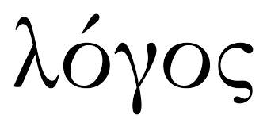
The Logos (Pronounced: “Low Goes”)
Key
Vocab
More than just “Word” in English
Self Expression, God’s thoughts, his mind
God’s thoughts that come into being when he thinks; complete, perfect
Jesus: God the Son is the most complete expression of God
  Pre-existence, “through Him all things were made.”
  All order and design in the cosmos is stamped by Jesus, the LOGOS
Some English Words that have the Greek root LOGOS:
logic
logical
apology
logarithm
analogy
logistic
decalogue
Notes:
Directions: Have students copy down the information in their notes. View video below to reinforce understanding.
Online Resource: View the Catholic Answers Video “What Does the ‘Word of God’ mean in the Bible?” URL here: https://www.catholic.com/magazine/print-edition/what-word-of-god-means

Slide 10

The “I AM” in Exodus was now revealed in Jesus invoking the Name and declaring that I AM.
I AM WHO AM
Exodus 3:14
“I AM . . .
The Good Shepherd
The Door to the Father
The Life
The Vine
The Light
The Bread of Life
The Truth”
Notes:
*Photo Credit: LRW2020, Creative Commons Zero, Public Domain Dedication. https://commons.wikimedia.org/wiki/File:Wood_and_Flame.png
Other Online Resource(s) for this Slide: For a more detailed treatment of this topic, see the webpage “’I AM’ Sayings in the Fourth Gospel” by Fr. Felix Just, SJ. URL here: https://catholic-resources.org/John/Themes-IAM.htm
Online Resources: View the video “Prince of Egypt Burning Bush Scene.” URL here: https://youtu.be/g5BQWubuC8g?list=TLPQMTYwMjIwMjRaQUXa8gQouA

Slide 11

Memorize It
Key
Verse
“Amen, amen, I say to you, before Abraham came to be,
I AM.”
Jn 8:58
Notes:
Directions: Have students copy the quote. Add bonus points to the assessment if they can write it down, demonstrating that they memorized it.

Slide 12
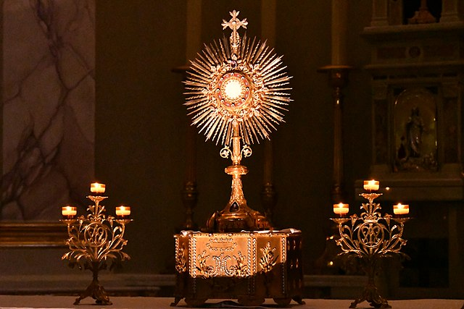
The Bread of Life Discourse (Jn 6:22–71)
This is where Jesus gives the clearest and most thorough teaching on the Real Presence: “My flesh is true food, and my blood is true drink.”
“I Am the Bread of Life”
Notes:
*Photo Credit: Willuconquer, ,Creative Commons Attribution-Share Alike 4.0, https://commons.wikimedia.org/wiki/File:Adoration_du_Saint_Sacrement_%C3%A0_l%27Eglise_du_Sacr%C3%A9-Coeur_de_Monaco.jpg
Directions: 1. As students take notes, read aloud the the key points here:
Discourse: A lengthy lesson taught with authority.
Happens after the multiplication of the loaves miracle, in the Capernaum synagogue
The crowd that followed Jesus wanted him to repeat that miracle to eat again
Jesus gives the clearest and most thorough teaching on the Real Presence: “My flesh is true food, and my blood is true drink.”
When the crowd rejects that teaching, Jesus lets them go.
When he said they had to eat his flesh and drink his blood, he wasn’t being symbolic and they knew it.
2. Have students locate the Bread of Life Discourse in the 6th chapter of John in their Bibles. Have students take turns reading it aloud.
3. To reinforce understanding, view the Brant Pitre Video “The Bread of Life Discourse Explained.” URL here: https://youtu.be/bpvq5jy2_Vs

Slide 13
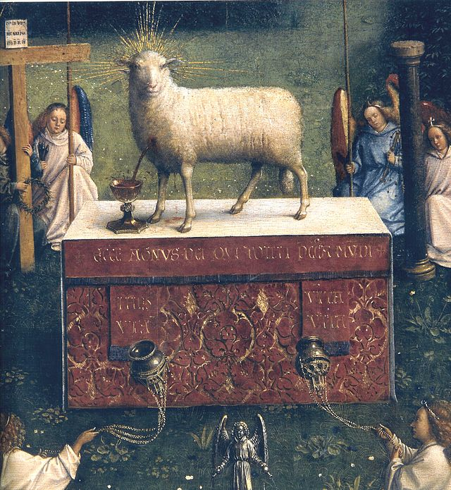
Real Presence
Key
Vocab
The doctrine that Jesus Christ is truly present in his Body and Blood under the form of bread and wine in the Eucharist. The Bible is clear in declaring this teaching (e.g., 1 Corinthians 10:16–17; 11:23–29; and most definitively in John 6:32–71).
Notes:
*Photo Credit: Jan van Eyck, Public domain, https://commons.wikimedia.org/wiki/File:Ghent_Altarpiece_D_-_Lamb.jpg
Directions: Have students copy down key vocabulary in their notes. View the video below to reinforce understanding.
Online Resources: View the video “Bishop Barron on the Sacrament of the Eucharist as Real Presence.” URL here: https://youtu.be/sgy_TFeIyiM

Slide 14

Turn and Talk
Why do you think some people had difficulty in accepting or believing Jesus when he taught about the Real Presence?
Notes:
Directions: Have students write down the question and then write down their answer. Then have students share their answers with one person close by.

Slide 15
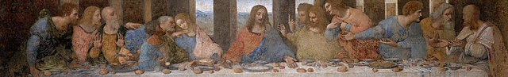
Less than one chapter
Occurred on Passover
Includes Institution Narrative
Words of Consecration
Prediction of Betrayal
Last Supper in Synoptics
Five chapters long—Farewell discourse
Happens before Passover / Jesus seen as Passover Lamb
“Love one another” . . . Washing of the feet
Promises to send the Paraclete (Holy Spirit)
Ends with High Priestly Prayer / Prayer for unity, “That they may all be one.”
Last Supper in
John
Notes:
*Photo Credit: Leonardo da Vinci, Public domain, https://commons.wikimedia.org/wiki/File:The_Last_Supper_-_Leonardo_Da_Vinci_-_High_Resolution_32x16.jpg
Directions: Have students create a Venn diagram comparing and contrasting the coverage of the Last Supper from the information on the slide.
Online Resources: For a more detailed treatment of the Eucharist and Last Supper in the Gospels, see the webpage “The Feeding of the Multitudes, the Last Supper, the Lord's Supper, and the Eucharist” by Fr. Felix Just, SJ. URL here: https://catholic-resources.org/Bible/Eucharist.htm

Slide 16
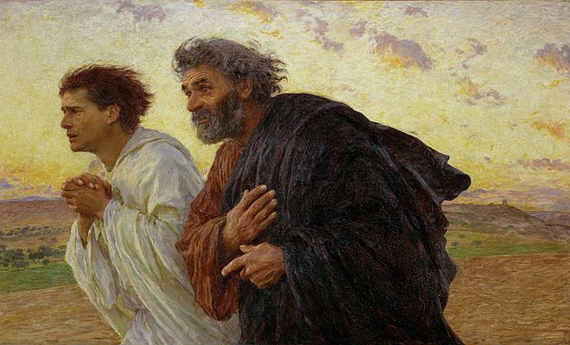
Resurrection in John’s Gospel
Notes:
*Photo Credit: Eugène Burnand, Public domain, https://commons.wikimedia.org/wiki/File:BurnandJeanPierre.jpg
Directions: Based on the image, ask the question, “Which is Peter and which is John?” Point out that John was the youngest apostle, and he outran Peter according to his own account in his Gospel: ”They both ran, but the other disciple ran faster than Peter and arrived at the tomb first”(Jn 20:4).
Have students copy down at least two details as you read the list of Resurrection narrative details that we find only in John’s Gospel. After that, view the webpage and see the compare and contrast chart between the 4 Gospels.
Mary Magdalene (alone) is the first to see the Resurrected Jesus.
Both Peter and John run to the Tomb
Jesus appears to disciples in Upper Room
Institution of Reconciliation: “Whose sins you forgive are forgiven them, and whose sins you retain are retained” (Jn 20:23).
Doubting Thomas
Reinstates Peter: “Simon, son of John, do you love me?” (Jn 21:17).
Online Resources: For a more detailed treatment of this topic, see the webpage “The Resurrection of Jesus in the New Testament” by Fr. Felix Just, SJ. URL here: https://catholic-resources.org/Bible/Resurrection.htm

Slide 17
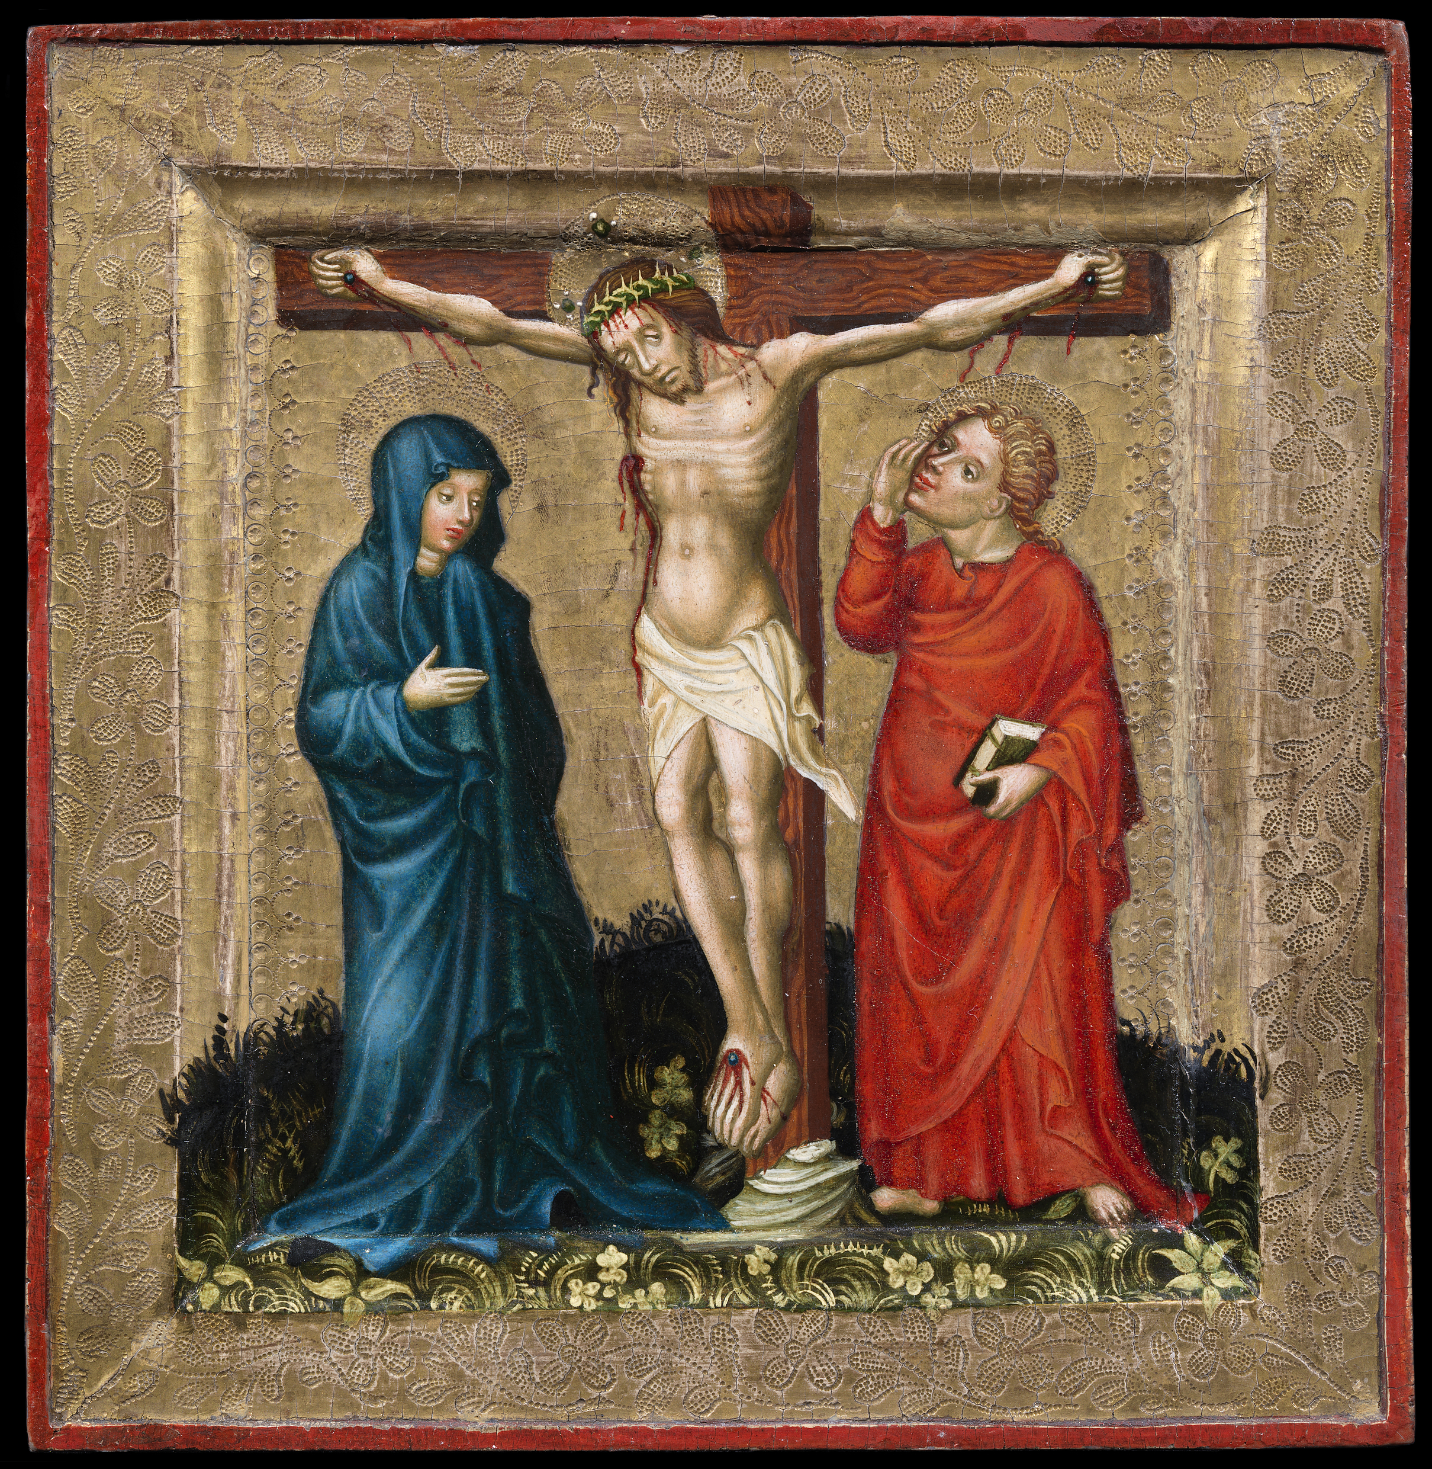
Mary, “The Woman” in John’s Writings
When Jesus saw his mother and the disciple there whom he loved, he said to his mother, “Woman, behold, your son.”
Jn 19:26
Notes:
*Photo Credit: Anonymous, Public domain, https://commons.wikimedia.org/wiki/File:Christ_on_the_Cross_with_the_Virgin_Mary_and_John_P1920.jpg
Directions: Begin with the question “Both at the Wedding at Cana in John ch.2 and at the Crucifixion in John ch.19, Jesus called his mother Mary ‘Woman.’ Why?” (The answer is found in the bullets below).
God told the Devil in Genesis 3:15: “I will put enmity between you and the woman, and between your offspring and hers.” We know that woman is Mary because her offspring (Jesus) crushes the head of the Serpent.
Here, the Hebrew word ha-ishah, which we translate as “woman,” actually means “woman of distinction.” Mary is the Woman of Distinction because she is full of grace.
Later, the same writer of the Gospel of John speaks of a cosmic woman standing on the moon, clothed with the sun and a crown of twelve stars, in the Book of Revelation (see Revelation 12:1).
You may want to follow up on this topic by assigning students to read and outline the article below.
Online Resources: For a more detailed treatment of this topic, see the Catholic365 article “Teaching Mary the Woman to a Doubting Thomas.” URL here: https://www.catholic365.com/article/30167/the-woman-of-distinction-introducing-mary-in-four-biblical-steps.html

Slide 18
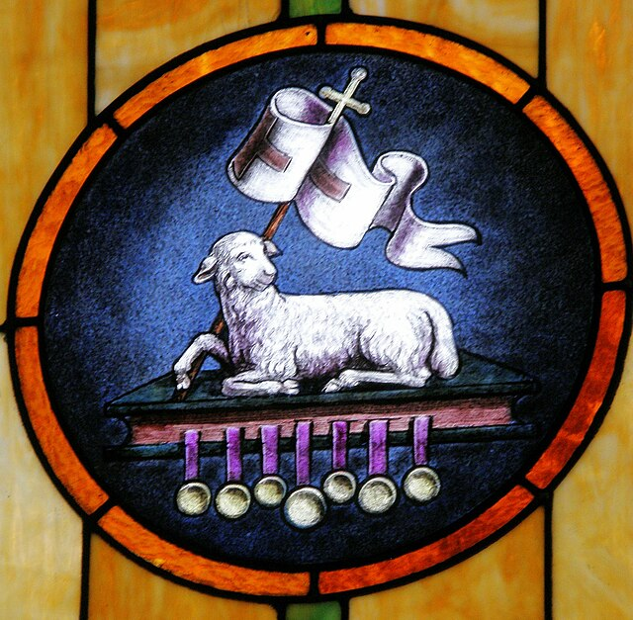
Jesus, ‘The Lamb of God’ in John’s Writings
“Isaac continued, ‘Here are the fire and the wood, but where is the sheep for the burnt offering?’ ‘My son,’ Abraham answered, ‘God will provide the sheep for the burnt offering.’”
Gen 22:8
Notes:
*Photo Credit: Nheyob, Creative Commons Attribution-Share Alike 3.0, , https://commons.wikimedia.org/wiki/File:Saint_Aloysius_Catholic_Church_(Shandon,_Ohio)_-_interior,_stained_glass,_Lamb_of_God_%26_Seven_Seals_detail.jpg
Directions: Ask students “What does it mean to say that Jesus is the Lamb of God?” (share answers below).
John the Baptist identified Jesus as that lamb. He said, “Behold, the Lamb of God” (Jn 1:29).
Later, during Jesus’s trials and Crucifixion, John keeps reminding the reader that Jesus is the New Passover Lamb whose bones are not broken (see John 19:36).
In the Book of Revelation, John features the Lamb of God being adored and worshipped in heaven: “Then I saw standing in the midst of the throne and the four living creatures and the elders a Lamb that seemed to have been slain” (Rv 5:6).
Print out the biblical narrative from the online resource below and have students read it aloud.
Online Resources: For a more detailed treatment of this topic, see the Catholic 365 webpage “Jesus and the Passover Lamb: A Biblical Narrative” by Gary Sullivan. URL here: https://www.catholic365.com/article/32633/jesus-and-the-passover-lamb-a-biblical-narrative.html

