Slide 1
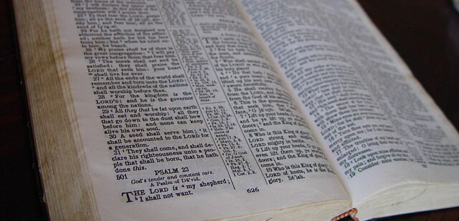
4
What Is in the Bible
God Reveals: An Introduction to the Bible
Notes:
*Photo Credit: https://commons.wikimedia.org/wiki/File:Holy_bible_book.jpg
Suggestions for students’ note-taking:
●Require students to use a three-ring binder (1/2-1 inches) full of loose-leaf paper (college or wide ruled).
●Notes must be taken in pen only and handwritten.
●Notebooks should contain information and notes for religion class only.
●Notebooks must have a table of contents with topic of notes, dates, and page numbers.
●All notes must have a topic and page number.
●Students will be required to copy each slide unless the teacher directs students to skip certain slides or parts of slides. Notebooks will be graded based on neatness, completeness, and organization. Notebooks should have a significant point value representing 20-25% of the overall grade.

Slide 2

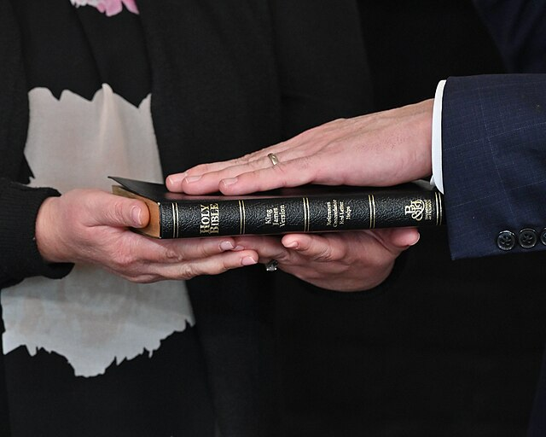
Testament
Key
Vocab
To give witness. A covenant. There are two Testaments that compose the Christian Bible, the Old Testament and the New Testament.
Notes:
*Photo Credit: Maryland GovPics, Creative Commons Attribution 2.0, https://commons.wikimedia.org/wiki/File:Swearing_in_Judge_Fader_(52006818284).jpg
Directions: Have students copy down key vocabulary as you share the definition from Google Dictionary below.
"Testament” noun: plural noun: testaments
1. a person's will, especially the part relating to personal property.
"father's will and testament"
2. something that serves as a sign or evidence of a specified fact, event, or quality.
"growing attendance figures are a testament to the event's popularity"
3. (in biblical use) a covenant
a division of the Bible.
noun: Testament; plural noun: Testaments
a copy of the New Testament.
noun: Testament
"he was able to buy a New Testament"
(https://languages.oup.com/google-dictionary-en/)

Slide 3
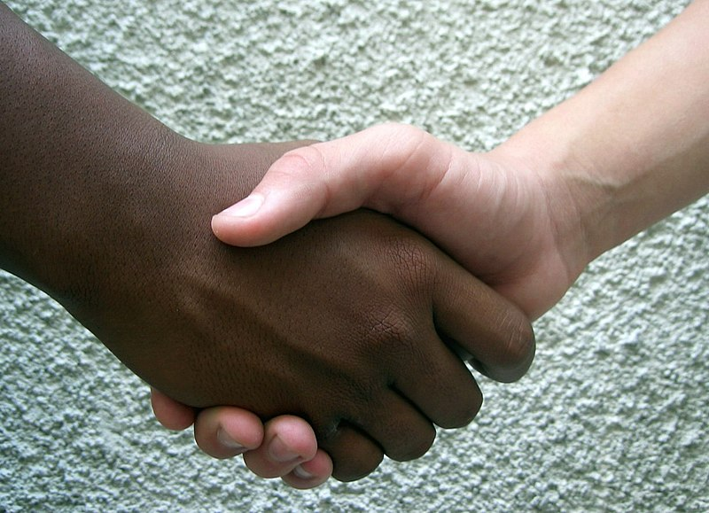
Covenant
Key
Vocab
A binding and solemn agreement between human beings or between God and people, holding each other to a particular course of action.
Notes:
*Photo Credit: Rufino, Creative Commons Attribution-Share Alike 2.0, https://commons.wikimedia.org/wiki/File:Hermandad_-_friendship.jpg
Directions: Have students copy down key vocabulary while you read the quote below.
Quote: “A covenant is more than a mere impersonal contract, in which two parties agree to an exchange of goods and services. A covenant binds persons together beyond the mere contractual agreement. Marriage is a prime example. While Holy Matrimony has “contractual” elements and promises, it is a covenant that binds two persons together. Marriage obviously binds two persons in a unique way, but all covenants bind persons together in some way.”
- CE Editors, https://catholicexchange.com/what-does-covenant-mean/

Slide 4
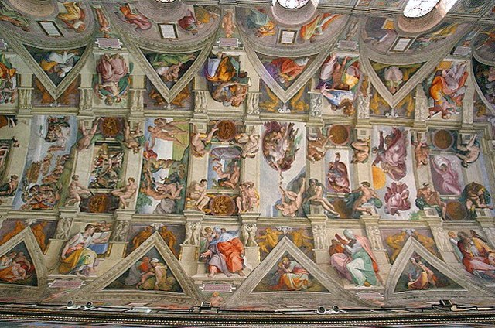
Salvation History
Key
Vocab
The term used to describe God’s presence and work throughout all of human history.
Notes:
*Photo Credit: By Aaron Logan, Sistine Chapel Ceiling from http://www.lightmatter.net/gallery/italy/4_G & Talmoryair, Public domain
Directions:
1. Have students copy down key vocabulary while you read the quote.
Quote: “The History of Salvation not a small event, on a poor planet, in the immensity of the universe. It is not a minimal thing which happens by chance on a lost planet. It is the motive for everything, the motive for creation. Everything is created so that this story can exist, the encounter between God and his creature.”
—Pope Benedict XVI, address at the opening of the 12th Ordinary General Assembly of the Synod of Bishops, October 6, 2008
2. Explain that the image is from the Sistine Chapel Ceiling which features the highlights of salvation history. Why is the History of Salvation an appropriate meditation during the celebration of the sacraments in the chapel? Have students answer aloud after viewing the Khan Academy video on the ceiling. URL here: https://youtu.be/PEE3B8Fsuc0
Online Resources: Take a virtual tour of the Sistine Chapel, URL here: https://www.vatican.va/various/cappelle/index_sistina_en.htm

Slide 5

Six Major Covenants in the Bible
Old Testament Covenants between…
Adam, Eve, and God
Noah, his family, and God
Abraham, his tribe, and God
Moses, the Nation of Israel, and God
David, the Kingdom of Israel, and God
New Testament Covenant between…
Jesus, the Church, and God the Father
“For there is one God. There is also one mediator between God and the human race, Christ Jesus, himself human, who gave himself as a ransom for all. This was the testimony at the proper time.”
1 Tim 2:5-6
Notes:
Directions: Share the CCC (Catechism of the Catholic Church) sections below as students copy notes.
The Covenant with Noah
CCC, 56: “After the unity of the human race was shattered by sin God at once sought to save humanity part by part. The covenant with Noah after the flood gives expression to the principle of the divine economy toward the ‘nations,’ in other words, towards men grouped ‘in their lands, each with (its) own language, by their families, in their nations.’”
CCC, 57: “This state of division into many nations, each entrusted by divine providence to the guardianship of angels, is at once cosmic, social and religious. It is intended to limit the pride of fallen humanity united only in its perverse ambition to forge its own unity as at Babel. But, because of sin, both polytheism and the idolatry of the nation and of its rulers constantly threaten this provisional economy with the perversion of paganism.”
CCC, 58: “The covenant with Noah remains in force during the times of the Gentiles, until the universal proclamation of the Gospel. The Bible venerates several great figures among the Gentiles: Abel the just, the king priest Melchisedek—a figure of Christ—and the upright ‘Noah, Daniel, and Job.’ Scripture thus expresses the heights of sanctity that can be reached by those who live according to the covenant of Noah, waiting for Christ to ‘gather into one the children of God who are scattered abroad.’”
God chooses Abraham
CCC, 59: “In order to gather together scattered humanity God calls Abram from his country, his kindred and his father’s house and makes him Abraham, that is, ‘the father of a multitude of nations.’ ‘In you all the nations of the earth shall be blessed.’”
CCC, 60: “The people descended from Abraham would be the trustee of the promise made to the patriarchs, the chosen people, called to prepare for that day when God would gather all his children into the unity of the Church. They would be the root onto which the Gentiles would be grafted, once they came to believe.”
CCC, 61: “The patriarchs, prophets and certain other Old Testament figures have been and always will be honored as saints in all the Church’s liturgical traditions.”
God forms his people Israel
CCC, 62: “After the patriarchs, God formed Israel as his people by freeing them from slavery in Egypt. He established with them the covenant of Mount Sinai and, through Moses, gave them his law so that they would recognize him and serve him as the one living and true God, the provident Father and just judge, and so that they would look for the promised Saviour.”
CCC, 64: “Through the prophets, God forms his people in the hope of salvation, in the expectation of a new and everlasting Covenant intended for all, to be written on their hearts. The prophets proclaim a radical redemption of the People of God, purification from all their infidelities, a salvation which will include all the nations. Above all, the poor and humble of the Lord will bear this hope. Such holy women as Sarah, Rebecca, Rachel, Miriam, Deborah, Hannah, Judith and Esther kept alive the hope of Israel’s salvation. The purest figure among them is Mary.”

Slide 6
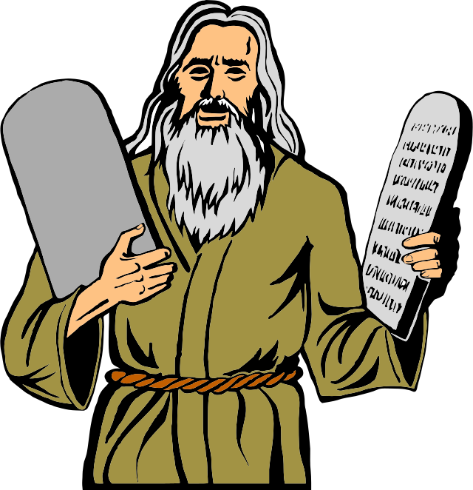
Ratification
Key
Vocab
Both the Old Covenant and the New Covenant were ratified or sealed in a legal way through blood. Both Moses and Jesus said, “This is the blood of the covenant.”
Notes:
*Photo Credit: ArtsyBee, Creative Commons Zero, Public Domain Dedication, https://commons.wikimedia.org/wiki/File:Moses_with_The_Ten_Commandments_stones.svg
Directions: Have students copy down the key vocabulary in their notes as you share the quote below.
Quote: “Every covenant is sealed or ratified by the blood of the victim offered. The blood is sprinkled or splashed on the altar or sometimes on the people signifying that a pact is legally in effect. Blood also makes atonement for sin, spiritually and legally cleansing the place of worship, the altar and by extension, those engaging in the sacrifice. ‘Since the life of a living body is in its blood, I have made you put it on the altar, so that atonement may thereby be made for your own lives, because it is in the blood, as the seat of life, that makes atonement’ (Lev 17:11).
When Moses mediated the Old Covenant, he used blood to ratify or seal the covenant. By splashing it on the people, he made the promises binding and sacred. ‘Then, having sent young men of the Israelites to offer burnt offerings and sacrifice young bulls as communion offerings to the LORD, Moses took half of the blood and put it in large bowls; the other half he splashed on the altar. Taking the book of the covenant, he read it aloud to the people, who answered, “All that the LORD has said, we will hear and do.” Then he took the blood and splashed it on the people, saying, “This is the blood of the covenant which the LORD has made with you according to all these words”’ (Ex 24:5-8).
Jesus ratified and sealed the New Covenant with his own blood at the Last Supper. He uses the same wording as Moses, but he adds that it is also an atonement sacrifice (to take away sin). ‘Then he took a cup, gave thanks, and gave it to them, saying, “Drink from it, all of you, for this is my blood of the covenant, which will be shed on behalf of many for the forgiveness of sins”’ (Mt 26:27-28). Unlike the Old covenant in which animal blood is splashed in a temporary, external way, those who partake of the Eucharist drink the blood of an eternal God in an internal way.
This qualitative difference between these two blood sacrifices is made crystal clear in the letter to the Hebrews. ‘But when Christ came as high priest of the good things that have come to be . . . he entered once for all into the sanctuary, not with the blood of goats and calves but with his own blood, thus obtaining eternal redemption. For if the blood of goats and bulls and the sprinkling of a heifer’s ashes can sanctify those who are defiled so that their flesh is cleansed, how much more will the blood of Christ, who through the eternal spirit offered himself unblemished to God, cleanse our consciences from dead works to worship the living God’ (Heb 9:11-14).”
-Gary Sullivan, ”The Biblical Meaning of Blood,” Catholic365
Online ResourceS: See “The Biblical Meaning of Blood” https://www.catholic365.com/article/30215/theology-of-the-blood.html

Slide 7
Six Major Covenants in the Bible
DAVIDIC
MOSAIC
CHRISTIAN
GOD
ADAMIC
ABRAHAMIC
NOAHIC
Notes:
Directions: The purpose of this slide is to reinforce the six covenants with slightly different names. Ask, “Where does this cycle of covenants begin and where does it end?” ( Answer: It begins with ‘Adamic’ and ends with ‘Christian’).

Slide 8
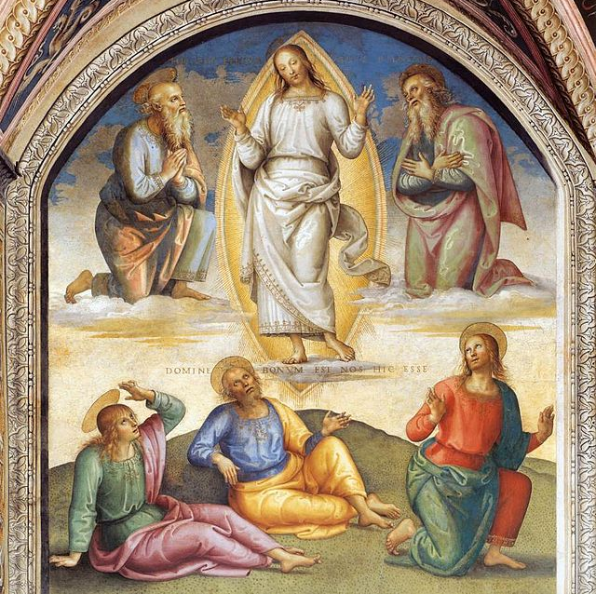
Jesus as Fulfillment
Key
Vocab
The person of Jesus is the fulfillment of the Old Testament or Old Covenant. He is anticipated, foreshadowed, and expected as the Messiah or Savior.
Notes:
*Photo Credit: Pietro Perugino, Public domain, https://commons.wikimedia.org/wiki/File:Pietro_Perugino_-_The_Transfiguration_of_Christ_-_WGA17248.jpg
Directions: As students copy down the key vocabulary, read this section from the student text. Follow up with video below.
“Jesus is the New Testament—that is, God’s New Covenant with all humanity. As the prophet Jeremiah foretold, Jesus is the New Covenant, signed and sealed in the blood he shed on the Cross. His Resurrection ratified—that is, proved—the truth of this covenant. Jesus initiates a law of love that requires a change of heart. He is the perfect prophet who, through his life and ministry, fulfills all the Old Testament prophecies concerning the Messiah’s birth, his teaching and healing, his rejection by the leaders, and his Passion, Death, and Resurrection. The New Testament writings show how his words and actions reveal God’s active presence in the world: saving, redeeming, and healing people” (God Reveals student text, 168).
Online Resources: View video: “Jesus Old testament Fulfilled.” URL here: https://youtu.be/qlqVyqBhR_U

Slide 9
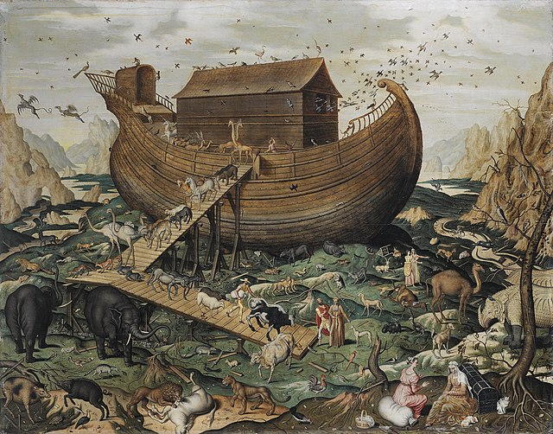
Typology
Key
Vocab
A form of biblical exegesis in which Old Testament people and events (types) are seen as preceding or foreshadowing New Testament people and events.
Noah’s ark was an Old Testament type of New Testament church.
Notes:
*Photo Credit: Simon de Myle, Public domain, https://commons.wikimedia.org/wiki/File:Noah%27s_Ark_on_Mount_Ararat_by_Simon_de_Myle.jpg
Directions: Have students copy the key vocabulary in their notes. Reinforce understanding with the video below.
Online Resources: View video on typology by Scott Hahn, “Is Jesus the New Moses?” URL here: https://youtu.be/brXcLmpZCO8

Slide 10
Progression of Covenants
Jesus
Universal Kingdom
David
Kingdom
Moses
Abraham
Noah
Nation
Adam
Tribe
Family
Couple
Notes:
Directions: The purpose of this slide is to show “the progression of covenants.” This shows that:
God was patient and faithful to his promises over the many years to bring about his plan for the Church.
The “people of God” grew in numbers over time.
The men listed acted as mediators of the covenant, representing God to the people and the people to God.
The universal covenant in Christ breaks the barriers of ethnicity (Hebrew/Jewish) and includes all people everywhere (Jew and Gentile).
The universal covenant in the Catholic Church is the fulfillment of the promise made to Abraham that his descendants would be as numerous as the stars of the sea and the sand on the shore (see Genesis 22:17).
Online Resources: See Felix Just, “Covenants, Pillars and Theologies in Ancient Judaism.” URL here: https://catholic-resources.org/Bible/Covenants.htm

Slide 11
4 Ways the New Covenant in Jesus Fulfills
the Old Covenant
Genealogy:
The Old Testament is about the family of Jesus.
Prophecy: The Old Testament predicts Jesus.
Typology:
People, places and things in the O.T. foreshadow Jesus.
Progression of Covenants:
The universal kingdom fulfills the promises of all the covenants.
Notes:
Directions: The Christological focus in the Old Testament is not just on one thing such as prophecy. It is a combination of all four ways. Share the following details or create assignments from the resources listed below.
Genealogy: View “Bishop Barron on The Genealogy of Jesus,” a video discussing the family tree of Jesus. See URL here: https://youtu.be/S8F8fUlI3kg
Prophecy: View the list of Messianic prophecies fulfilled by Jesus at Scripture Catholic. URL here: https://www.scripturecatholic.com/messianic-prophecies-fulfilled-jesus-christ/
Typology: For a good example of typology which focuses on Moses and Jesus, see the article “That Moses Thing” on Catholic Answers. URL here: https://www.catholic.com/magazine/print-edition/that-moses-thing

Slide 12

Genre
Key
Vocab
The Bible is a library of books and it contains different genres. A genre is a particular writing style, form, structure, or content. The Bible contains wise sayings, proverbs, songs, poems, legal codes. narratives, genealogies, and more.
Notes:
*Photo Credit: Eady, Creative Commons Zero, Public Domain Dedication,
Directions: For a learning video on the topic of genre in the Bible, see the video “Writing Styles of the Bible & Why They're Important to Understand” from The Bible Project (https://www.youtube.com/@bibleproject). URL here: https://youtu.be/oUXJ8Owes8E
Online Resources: Students may also view this webpage covering the term ‘biblical genre’ in detail. URL here: https://catholic-resources.org/Bible/Biblical-Genres.htm

Slide 13
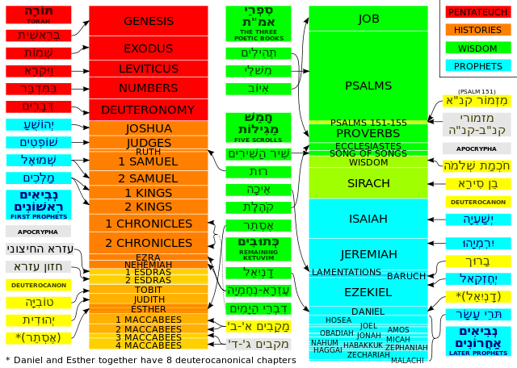
Old Testament
Key
Vocab
The first half of the Christian Bible. The Old Covenant in written form. Sometimes referred to as Hebrew Scriptures.
Notes:
*Photo Credit: Speltdecca, Creative Commons Attribution-Share Alike 3.0, , https://commons.wikimedia.org/wiki/File:Development_of_the_Old_Testament.svg
Directions: Have students copy the key vocabulary in their notes.

Slide 14
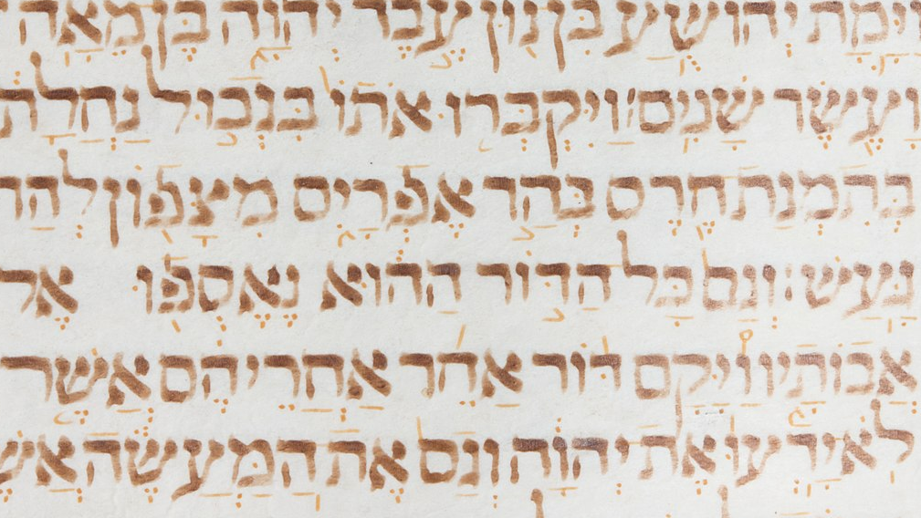
Old Testament Categories and Canon
Pentateuch
Historical Books
Wisdom Books
Prophetic Books
Genesis
Exodus
Leviticus
Numbers
Deuteronomy
Joshua
Judges
Ruth
1 Samuel
2 Samuel
1 Kings
2 Kings
1 Chronicles 2 Chronicles Ezra Nehemiah Tobit
Judith
Esther
1 Maccabees
2 Maccabees
Job
Psalms
Proverbs
Ecclesiastes
Song of Songs
Wisdom
Sirach
Isaiah
Jeremiah Lamentations
Baruch
Ezekiel
Daniel
Hosea
Joel
Amos
Obadiah
Jonah
Micah
Nahum
Habakkuk Zephaniah
Haggai
Zechariah
Malachi
Mostly Written in Hebrew
Notes:
*Photo Credit: https://commons.wikimedia.org/wiki/File:Hebrew_Bible_MET_LC_TR_50_2018s40.jpg
Directions: Have students view the table of contents of their Bibles as you use this slide to review the canon (list of books) of the Old Testament. View video of modern-day scribe writing the Torah in ancient Hebrew below.
Online Resources:
For a more detailed treatment of this topic on the Old Testament canon, see the webpage “Jewish and Christian Bibles: A Comparative Chart” by Fr. Felix Just, SJ. URL here: https://catholic-resources.org/Bible/Heb-Xn-Bibles.htm
View video: “Modern Day Scribe writing the Torah in ancient Hebrew.” URL here: https://youtu.be/a5Brbqgngrc
View video: “How Did the Old Testament Canon Develop?” https://youtu.be/dF5NYPENhp4?list=TLPQMTYwMjIwMjRaQUXa8gQouA

Slide 15
Old Testament Story Line
EARLY WORLD
PATRIARCHS
EGYPT-DESERT
CONQUEST
DIVISION
Creation
Original Sin
Cain and Abel
Spread of Sin
Noah and the Flood
Abraham
Sarah
Isaac
Jacob
Joseph
Moses
Exodus
Desert Wandering
The Tabernacle
Judges
Kings
David and Solomon
The Temple
Divided Kingdom
Exile
Return
Maccabees
Notes:
Directions: For an overview of the story of the Bible, have students view the video “The Story of the Bible: What’s it About from Beginning to the End” from the Bible Project. URL here: https://youtu.be/7_CGP-12AE0
Online Resources: Students may also read an overview of the Bible titled “The Story of the Bible in 2000 Words” from Catholic365. URL here: https://www.catholic365.com/article/30256/the-story-of-the-bible-in-2000-words.html
Also see the article “Seeing the Big Picture of Scripture” by Tim Gray. URL here: https://www.catholiceducation.org/en/culture/catholic-contributions/seeing-the-big-picture-in-scripture.html

Slide 16

Turn and Talk
Why do you think it is important to know the story of the Bible rather than to know parts of it?
Notes:
Directions: Have students write down the question and then write down their answer. Then have students share their answers with one person close by.

Slide 17
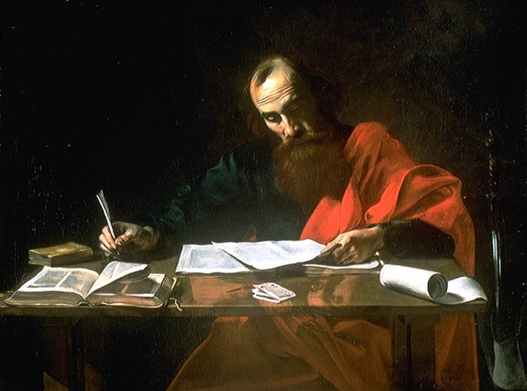
New Testament
Key
Vocab
The second half of the Christian Bible. The New Covenant in written form. Sometimes referred to as Christian Scriptures.
Notes:
*Photo Credit: Valentin de Boulogne, Public domain, https://commons.wikimedia.org/wiki/File:File%22-Saint_Paul_Writing_His_Epistles%22_by_Valentin_de_Boulogne.jpg
Directions: Have students copy the key vocabulary in their notebooks.

Slide 18
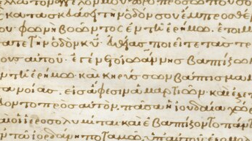
New Testament Categories and Canon
Gospels
Acts of the Apostles
Letters
Revelation
Matthew
Mark
Luke
John
Acts of the Apostles (Luke)
Romans
1 Corinthians
2 Corinthians
Galatians
Ephesians
Philippians
Colossians
1 Thessalonians
2 Thessalonians
1 Timothy
2 Timothy
Titus
Philemon
Hebrews
James
1 Peter
2 Peter
1 John
2 John
3 John
Jude
Book of Revelation (John)
Mostly Written in Greek
Notes:
*Photo Credit: https://commons.wikimedia.org/wiki/File:Byzantium,_Constantinople,_11th_century_-_Gospel_Book_with_Commentaries-_Portrait_of_Mark_-_1942.152.132.a_-_Cleveland_Museum_of_Art.tif
Directions: Have students view the table of contents of their Bibles as you use this slide to review the canon (list of books) of the New Testament.
Online Resources: For a more detailed treatment of this topic on the New Testament canon, see the webpage “The New Testament Canon” by Fr. Felix Just, SJ. URL here: https://catholic-resources.org/Bible/NT_Canon.htm

Slide 19
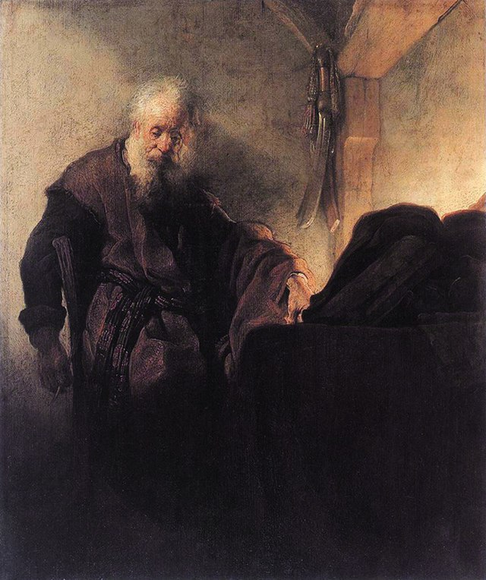
Four Parts of Saint Paul’s Letters
Opening Address
Thanks
Giving
Main
Body
Final Salutations
1
2
3
4
The opening
salutation
gives the name of the sender, the receiver, and a short greeting.
Words of thankfulness sets the tone of the letter and what is to follow.
The bulk of the letter has two parts to it: doctrinal teaching and encouragement.
Paul concludes his letters by giving personal news on specific
advice to individuals and a blessing.
Rembrandt: Saint Paul at His Writing Desk, 1620-24
Notes:
*Photo Credit: Rembrandt, Public domain, https://commons.wikimedia.org/wiki/File:Saint_Paul_at_his_Writing-Desk,_by_Rembrandt.jpg
Directions: After copying this information in their notes, have students read from their Bibles the shortest letter of Saint Paul, Saint Paul’s Letter to Philemon. The Epistle to Philemon was composed around AD 57–62 by Paul. Ask them to identify the four parts shown in the slide in Philemon.

Slide 20
New Testament Story Line
EARLY LIFE
MINISTRY
MIRACLES
LAST WEEK
CHURCH
Annunciation
Birth
Flight to Egypt
Presentation at Temple
Found in Temple
Baptism
Wilderness
Wedding at Cana
Proclaims Kingdom
Parables
Healing the Sick
Curing the Blind
Exorcisms
Raising the Dead
Feeding 5000
Walking on Water
Enters Jerusalem
Cleansing of Temple
Last Supper
Arrest
Crucifixion
Resurrection
Ascension
Pentecost
Paul’s Journeys
Baptism of Cornelius
Letters of Paul
Arrest of Peter and Paul
Notes:
Directions: Have students copy down the information on the slide and then have them view “New Testament Summary: A Complete Animated Overview” from the Bible Project. URL here: https://youtu.be/Q0BrP8bqj0c

Slide 21

Memorize It
Key
Verse
“Stand firm and hold fast to the traditions that you were taught, either by an oral statement or by a letter of ours.”
2 Thes 2:15
Notes:
Directions: Have students copy the quote. Add bonus points to the assessment if they can write it down, demonstrating that they memorized it.

Slide 22

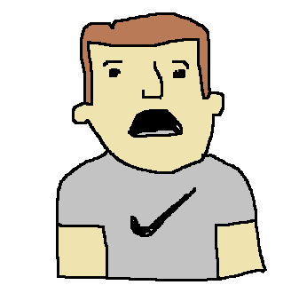
“Isn’t the Bible just another piece of literature?”
Challenge
Question
No. While Scripture contains various types of literary forms and genres, it is more than just literature. It is the inspired Word of God (CCC, 135).
Notes:
Directions: Use the animation feature to have the yellow answer box appear after you ask the students to respond out loud to the question on the left.

