Slide 1

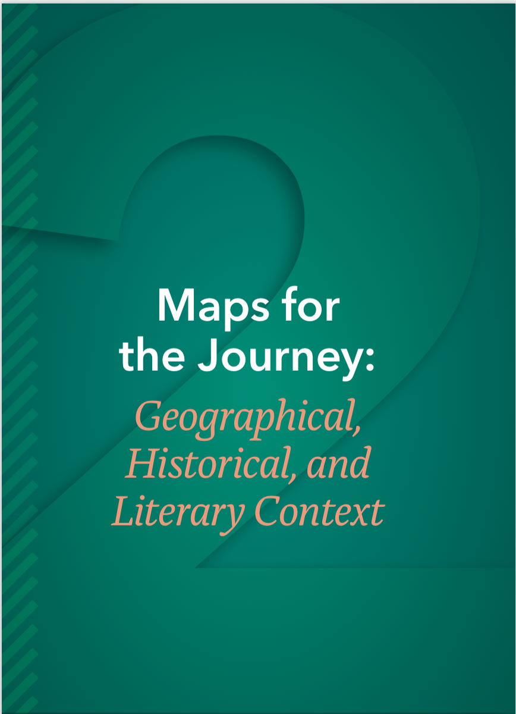
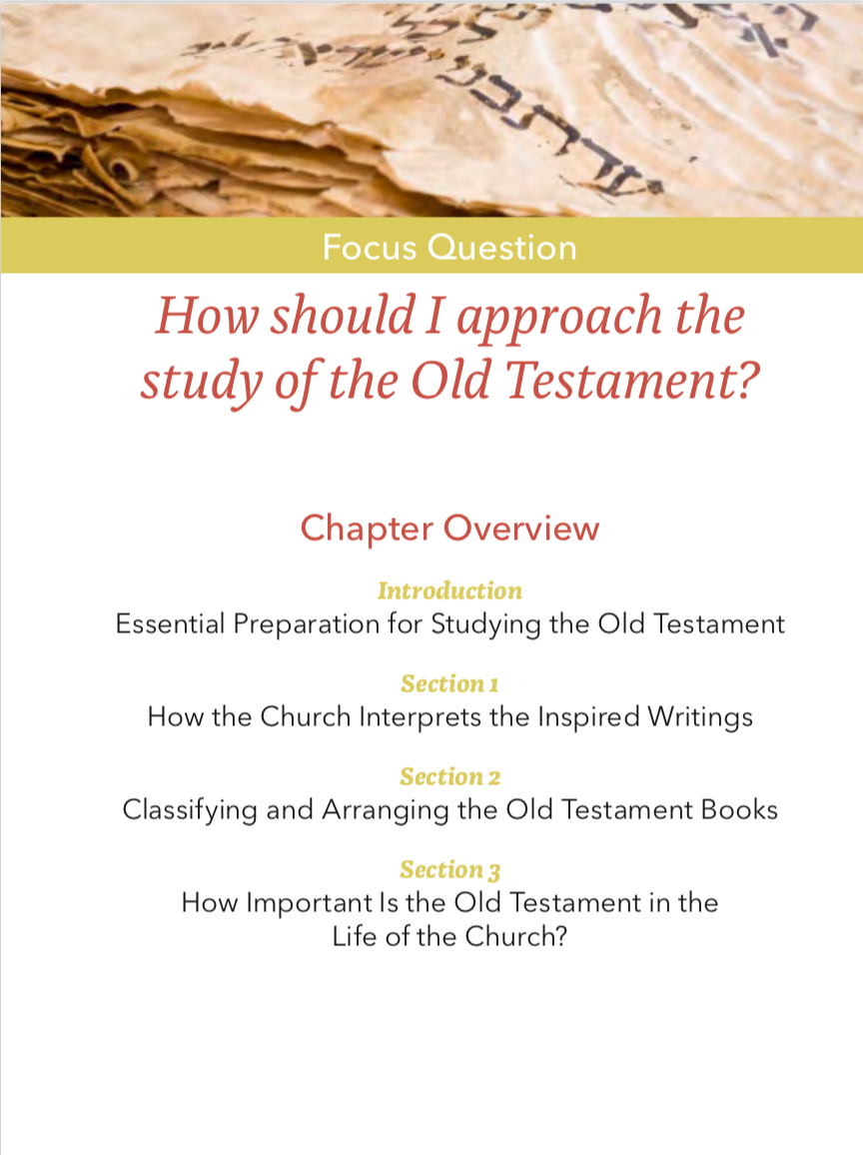
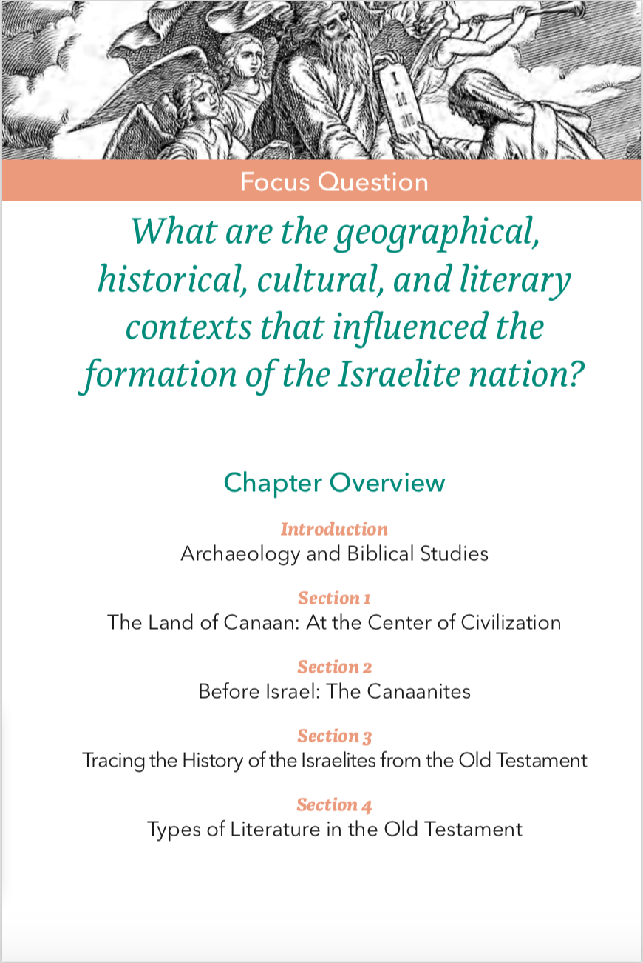
The Old Testament

Slide 2
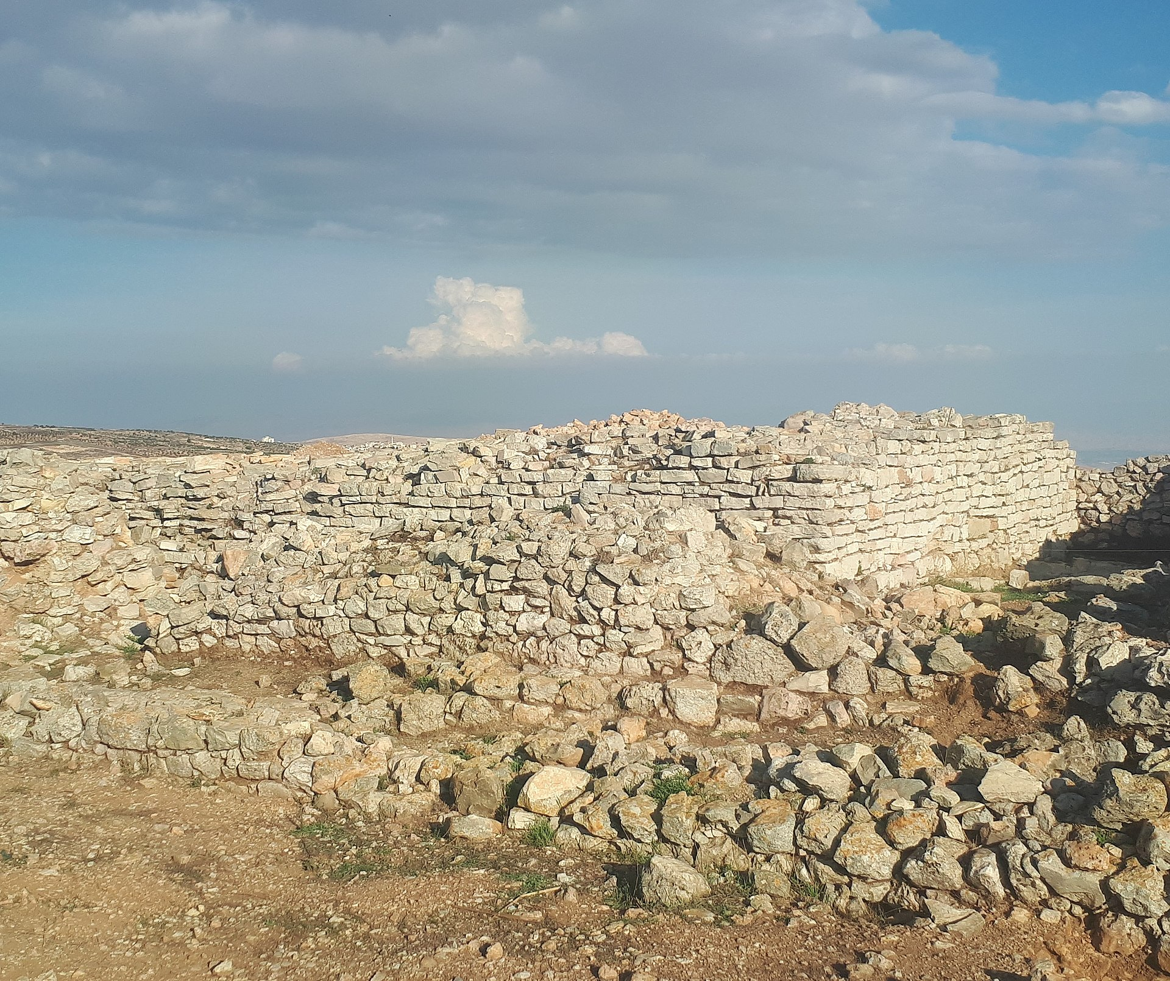
“Then Joshua destroyed Ai by fire, reducing it to an everlasting mound of ruins, as it remains today.” Joshua 8:28
Modern Day archeological site of Et-Tell (possibly Ai)
Archaeology and Biblical Studies
Notes:
Recount the story of Et-Tell from this link: https://www.seetheholyland.net/tag/el-tell/. The modern day archeological site of Et-Tell gives some clues into the the context that we are studying here. There is some debate among historians whether or not Et-Tell is the biblical city of Ai, but there is no doubt that it was inhabited and left to ruins by the ancient peoples of Canaan. From the context of the passage and the photo, have the students make guesses to why Et-Tell might have not have ever been rebuilt. Discuss with students context as explained on page 40.

Slide 3
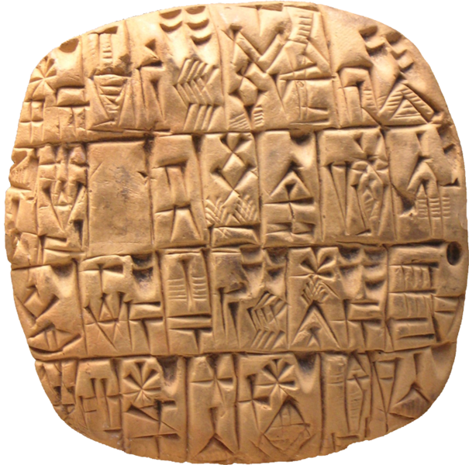
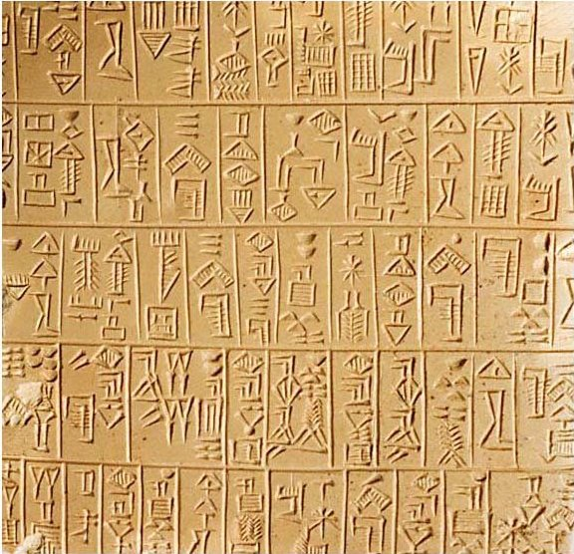
Pictograms
The earliest form of writing, in which pictures represented words or ideas.
Archaeology and Biblical Studies
Notes:
Early pictograms included pictures to represent words. They later gave way to cuneiform and script. As a short in-class assignment, have the students create their own pictogram in their notes or journal, perhaps to represent a simple message like “God loves all people” or “I am part of a large family of faith.”

Slide 4
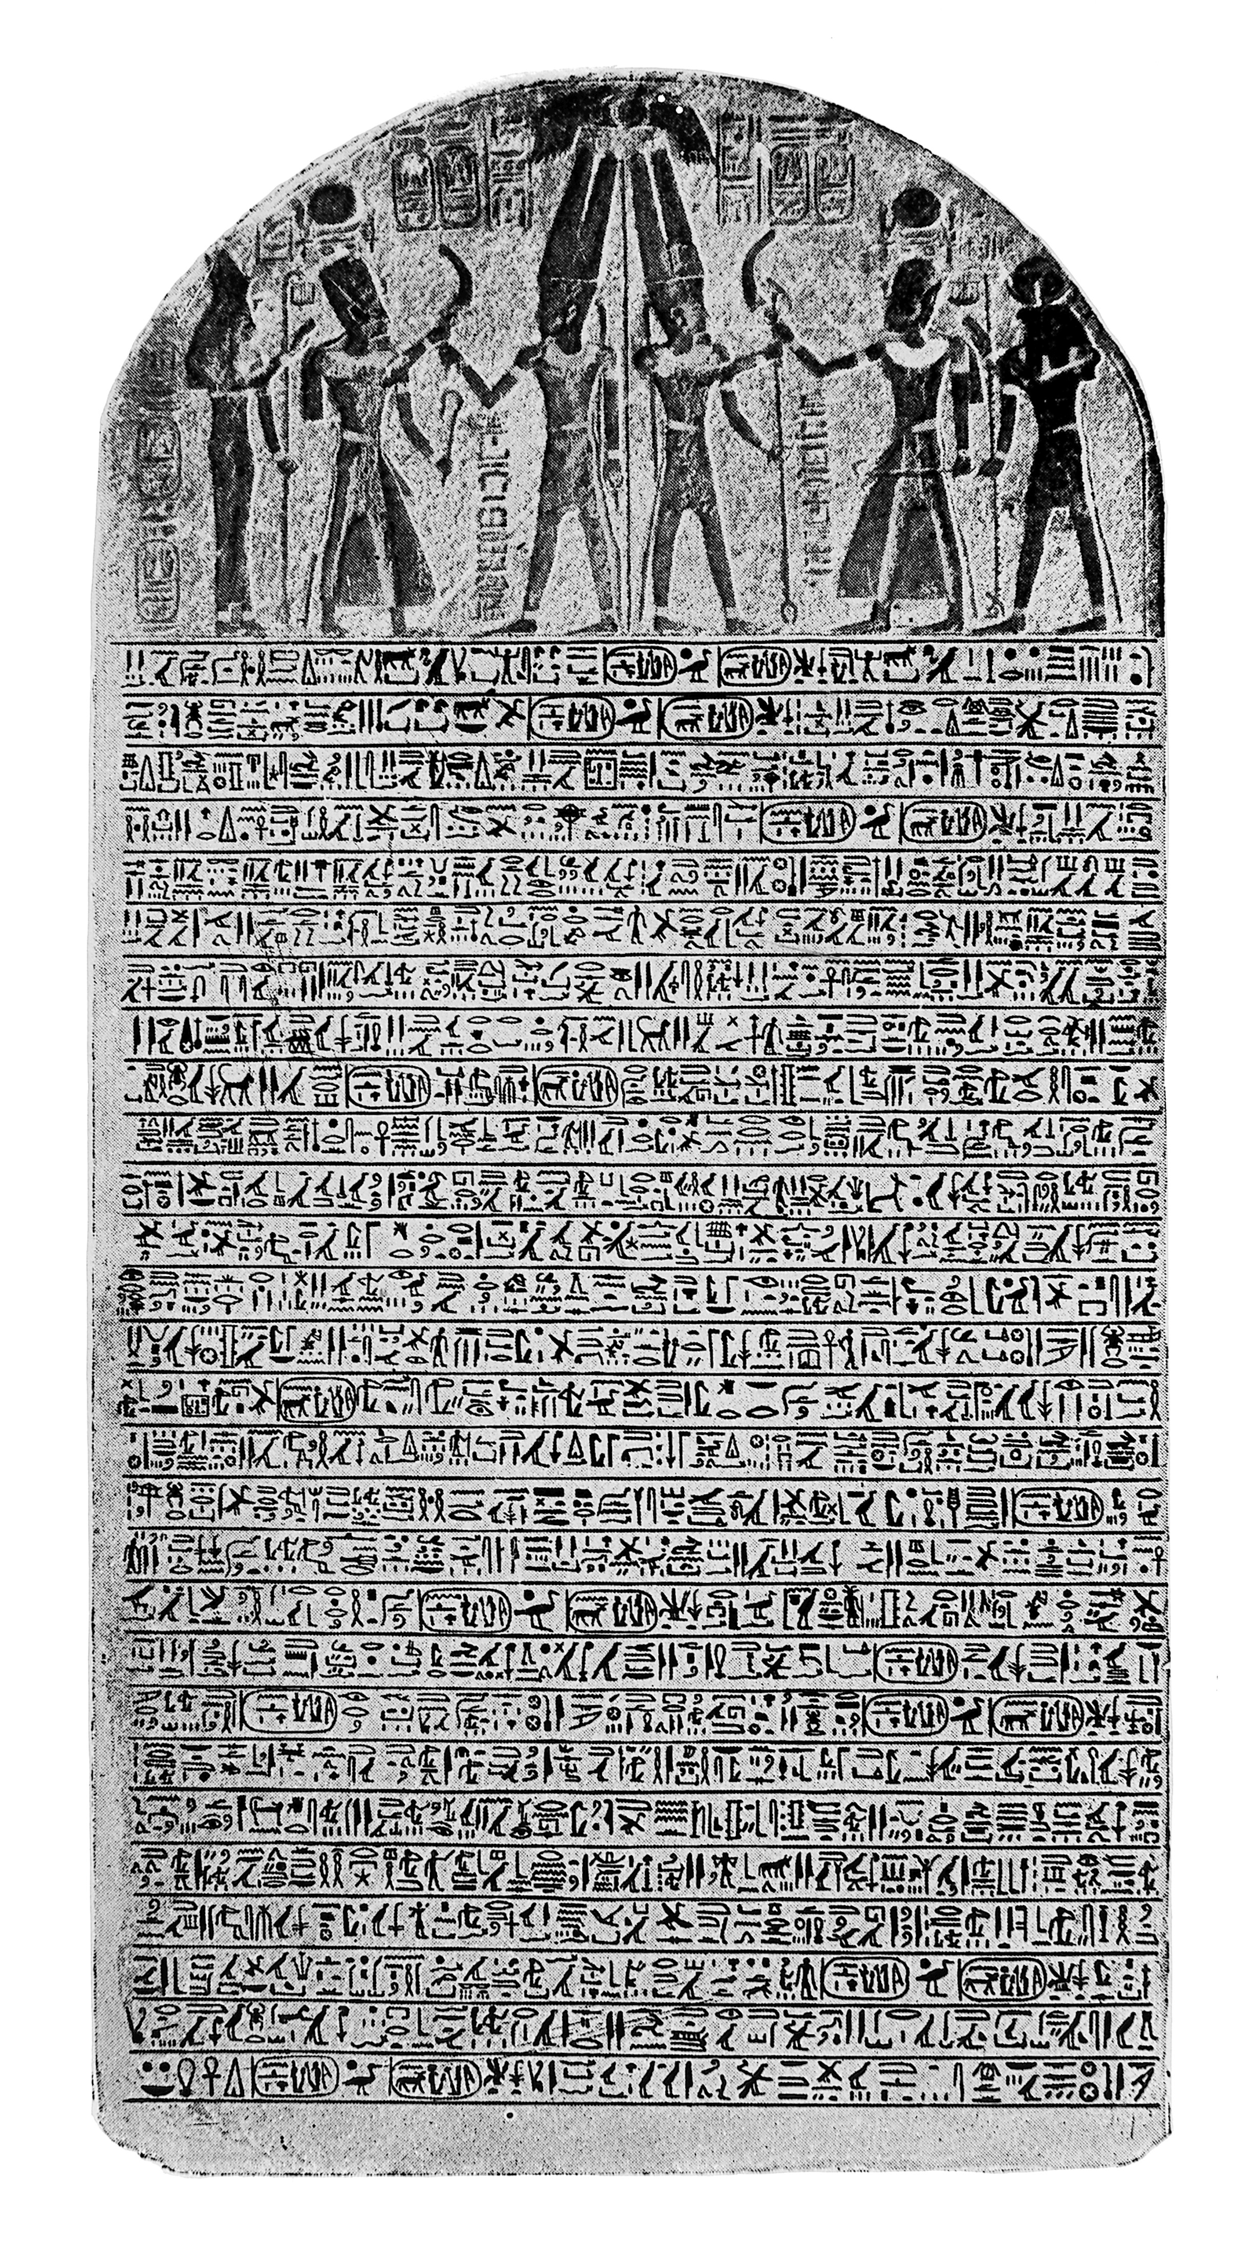
Inscription discovered by Sir Flinders Petrie dating to 1207 BC. Merneptah, an Egyptian pharaoh brags about defeating a “people” called Israel.
Merneptah Stele
Archaeology and Biblical Studies
Notes:
Before this discovery in 1896 by an British professor and archeologist, there had not been a connection outside of the Bible made between the Egyptians and Israelites. This archeological discovery supported the writings of the Bible in this way, acknowledging the existence of the people of Israel.

Slide 5
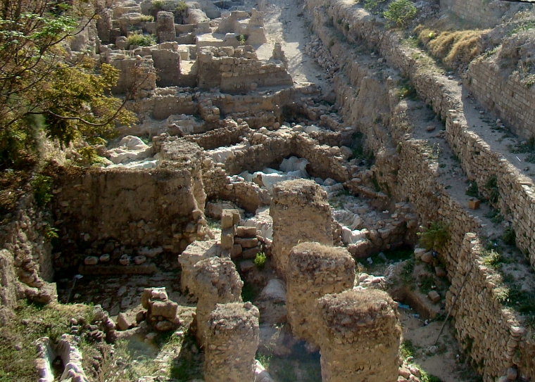
Archeological Timeline of the People of Canaan
10,000 BC 9,000 BC 5,000 BC 4,000 BC
Archaeology and Biblical Studies
Notes:
This excavation site at Sidon in modern day Lebanon (the name of the city corresponds to the biblical character Sidon, a descendent of Noah) provides many clues to the timeline of the Canaanite culture.
10,000 BC Ice Age ends, climate is more hospitable, people live in groups
9,000 BC engaged in agriculture (settlements near Tigris and Euphrates River)
5,000 BC evidence of pottery
4,000 BC large territories represented by cities, writing developed out of trade or business necessity

Slide 6
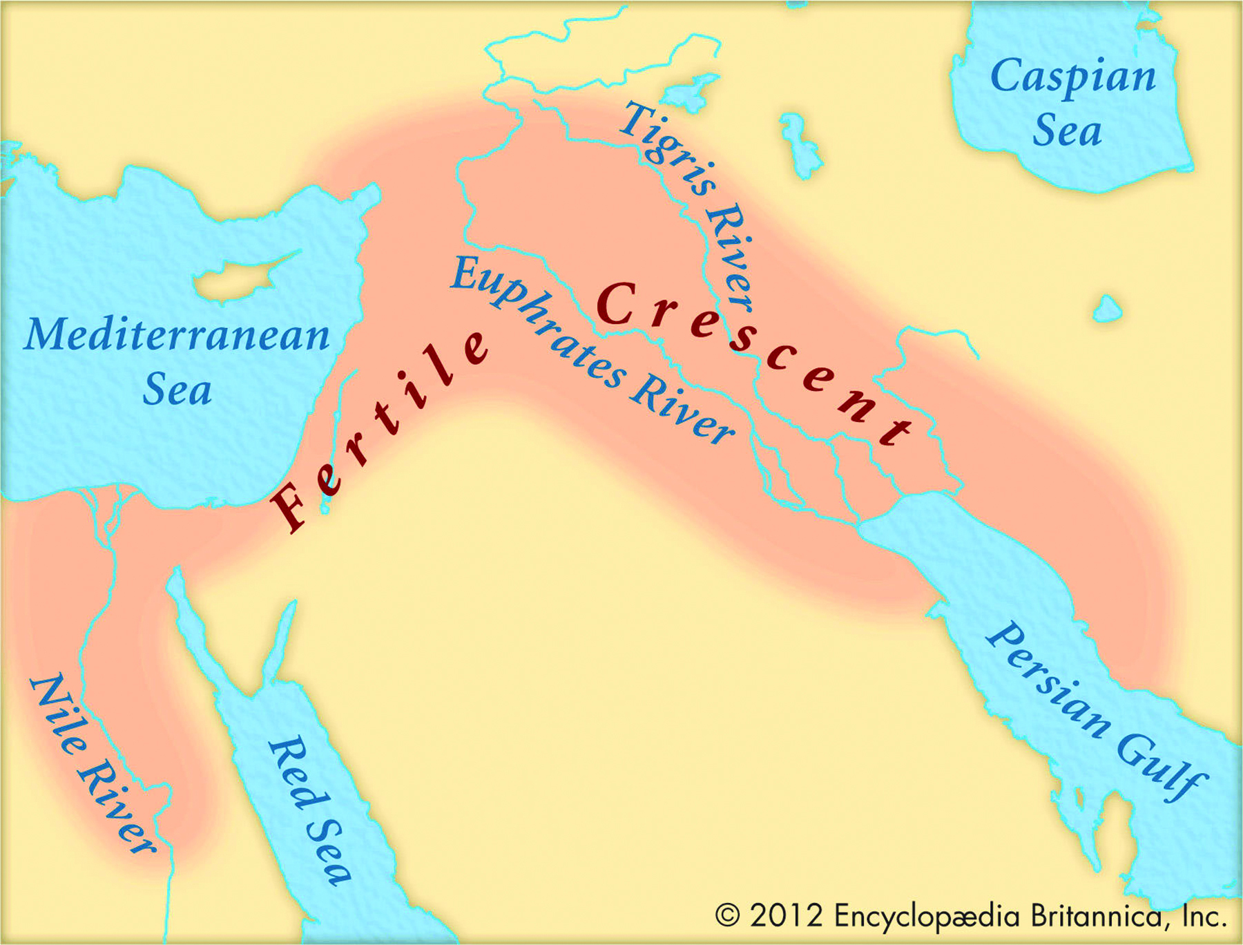
Mesopotamia Map of Tigris and Euphrates Rivers
Archaeology and Biblical Studies
Notes:
Examine the waterways, discuss their importance for civilization. Share the video “Ancient Mesopotamia” (9:23) from the Khan Academy: https://www.khanacademy.org/humanities/world-history/world-history-beginnings/ancient-mesopotamia/v/ancient-mesopotamia.

Slide 7
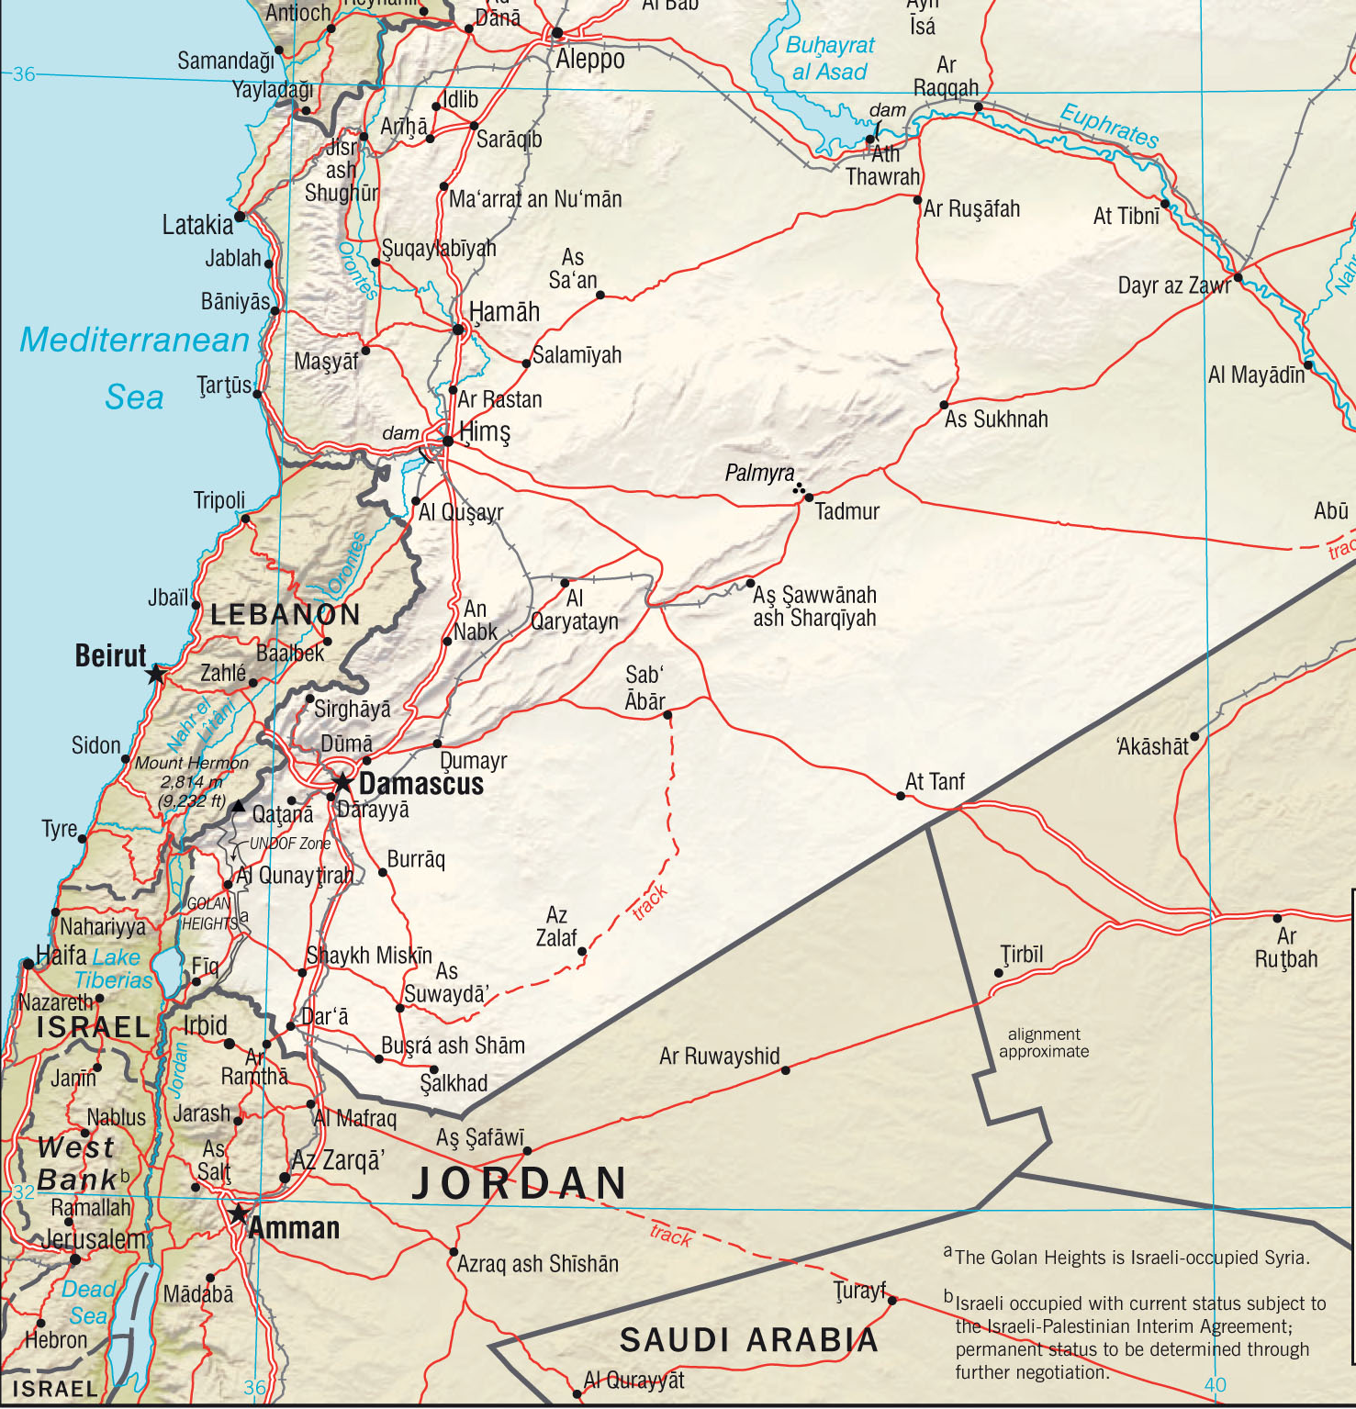
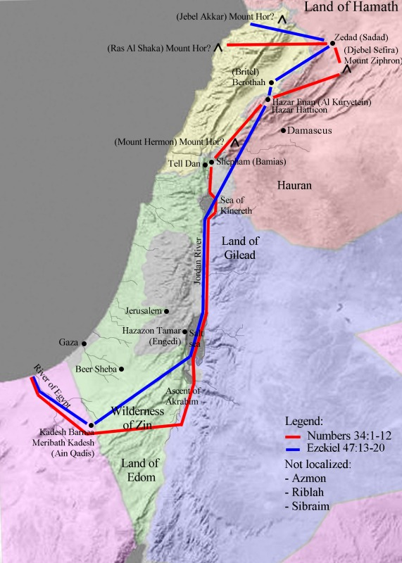
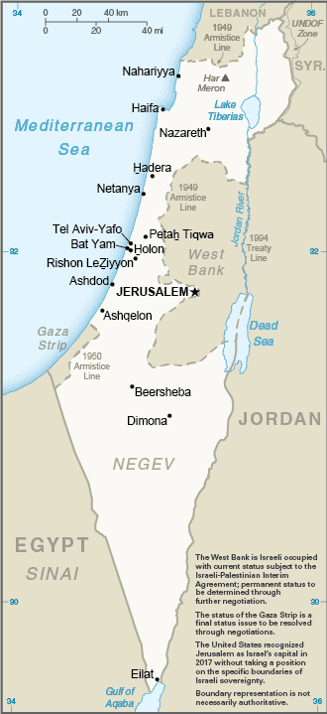
Where was Canaan?
The land nestled between two great centers of civilization: Egypt and Mesopotamia
The Land of Canaan: At the Center of Civilization
Notes:
The maps on the left image modern day lands with the political borders of Israel, Lebanon, Syria, and Palestine. This is known as Syro-Palestine or Palestine. The map on the right is taken from Wikipedia Commons and is the border of Canaan as explained in the Bible. A modern day examination of maps over the past many centuries will indicate ever-changing borders. Explain that as the students study the Old Testament they will further begin to understand the lands and the people today that fight over these lands. The video “History of the Empires” (3:07) provides an overview: https://www.youtube.com/watch?v=_lTduTwqtjY.

Slide 8
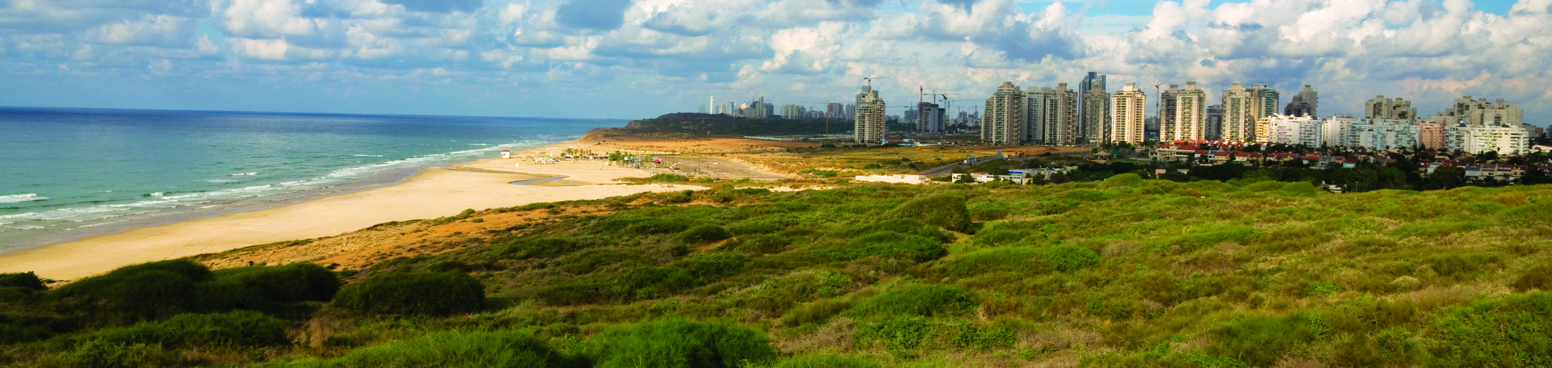
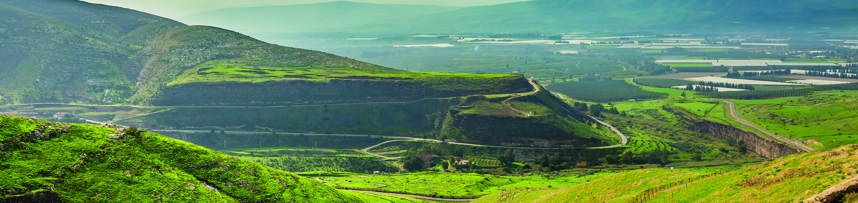
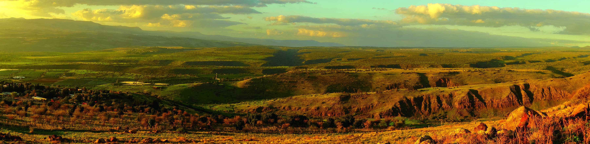
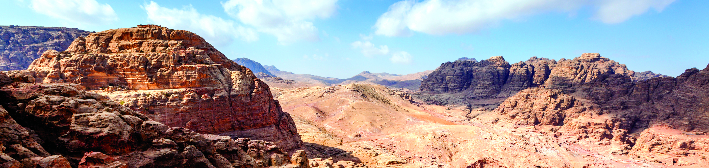
The Landscapes of Canaan
1. coastal plains 2. hill country 3. Jordan River Valley 4. Transjordan Plateau
The Land of Canaan: At the Center of Civilization
Notes:
See also Chapter 2, Section 1, Teaching Approach 3 from the Teacher’s Wraparound Edition.

Slide 9
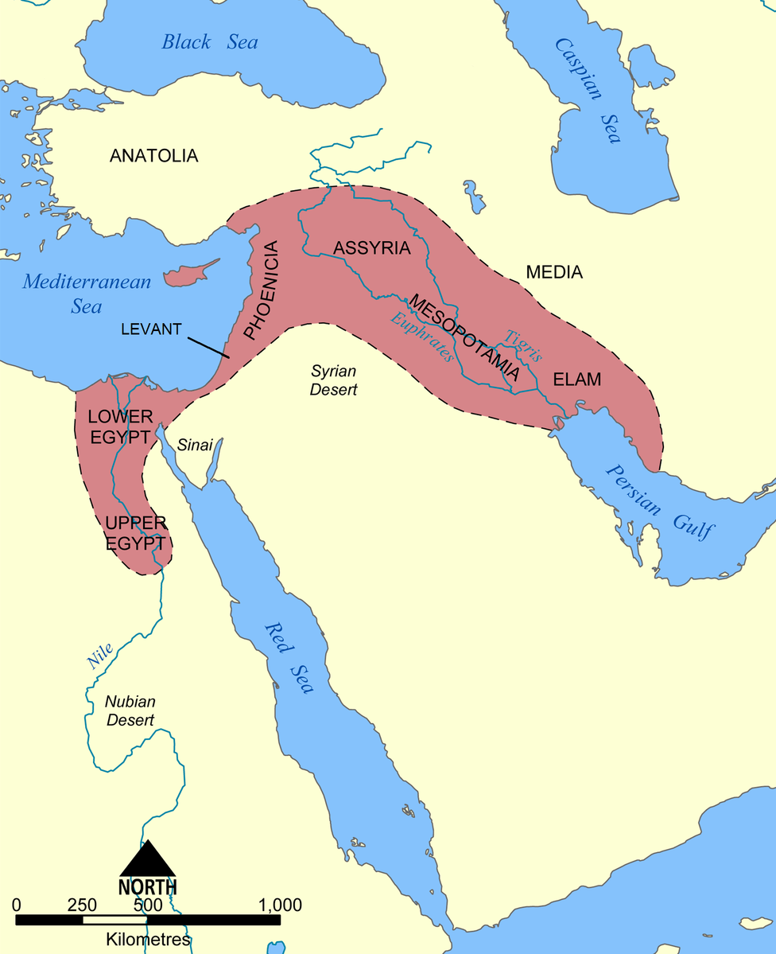
Fertile Crescent
The Land of Canaan: At the Center of Civilization
Notes:
Review with students the geography of this area and the powerful civilizations that controlled most of the fertile crescent with the exception of the lands the Israelites settled in. Explain that the Israelites were not a military people, so YHWH, was portrayed as a powerful warrior who would protect them. See page 55 of the Student Text and Chapter 2, Section 1, Teaching Approach 1 in the TWE.

Slide 10
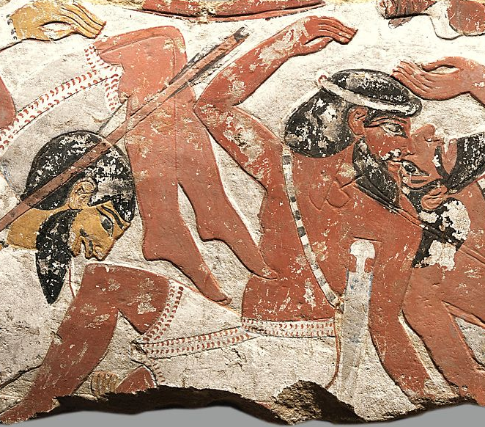
Canaanite Civilization
Descendants of son of Ham, grandson of Noah
Polytheistic (multiple gods)
Their religion prized the rich and powerful
Before Israel: the Canaanites
Notes:
This fragment of a painted limestone relief dating to about 1400 B.C. from Thebes in Egypt depicts defeated Canaanites, housed at the Met. Image above is one of the pieces of artwork from the Hyskos period discussed on page 56. Much of what we know about the Canaanites is left from ancient texts/art found by people who came into contact with them such as the Egyptians and the people of the Old Testament.

Slide 11
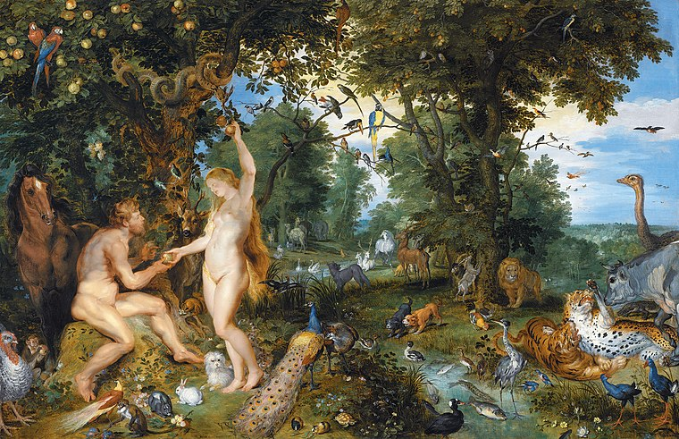
Primeval History
Stories or myths about the origins of the earth, humans, other creatures, languages, and cultures.
Tracing the History of the Israelites from the Old Testament
Notes:
See Chapter 2, Section 3, Teaching Approach 2 of the TWE.

Slide 12
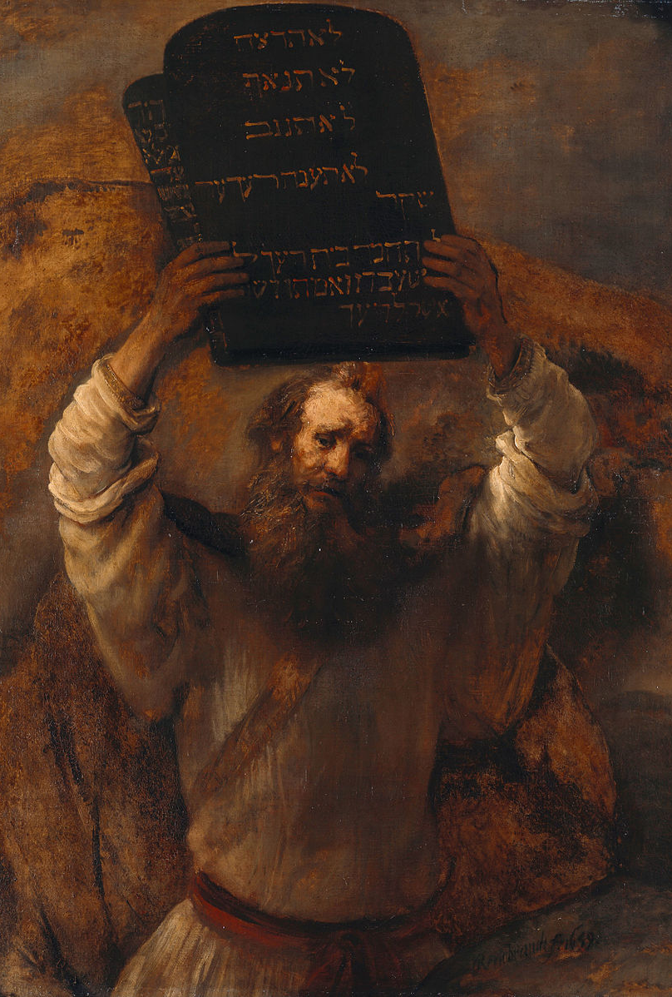
Early Israelite Faith was based on the following:
a relationship with a God named YHWH
worship in a movable shrine or tent
basic moral expectations (laws)
Tracing the History of the Israelites from the Old Testament
Notes:
Syncretism is a blending of two or more religious traditions. See pages 64-65 of the Student Text. The next slide lists differences between Canaanite and early Israelites religions.

Slide 13
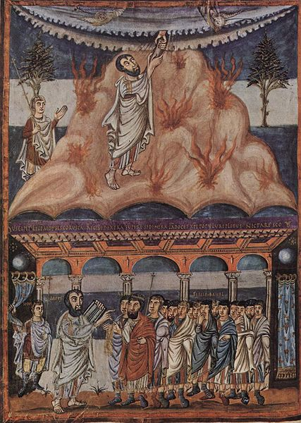
Canaanites
Israelites
Baal (storm god)
Asherah (fertility goddess)
Worshipped gods in temples
YHWH
Justice and care for others
Only one god
Joshua and the Israelite People
Korolingischer Buchmaler,
ca. 840
Tracing the History of the Israelites from the Old Testament
Notes:
This Catholic Answer to the question “Is Judaism, and therefore Christianity, just the result of the evolution of ancient Canaanite mythology?” is helpful to remind our students that the answer is a resounding “no.” https://www.catholic.com/qa/did-judaism-and-christianity-develop-from-canaanite-religion

Slide 14
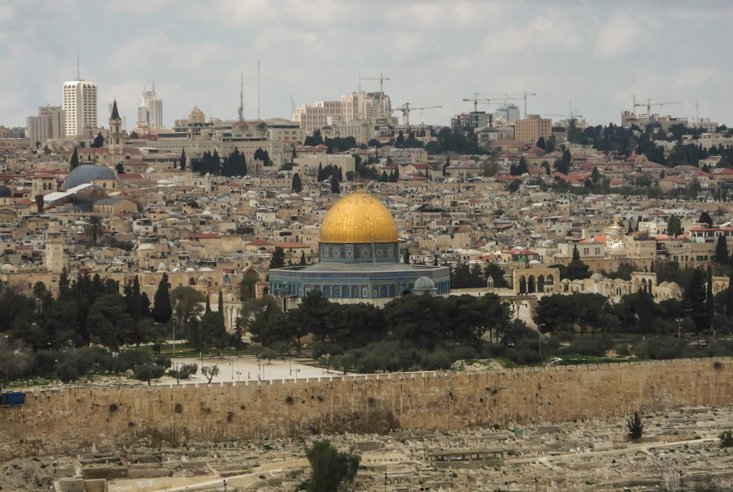
The Israelite Monarchy
The monarchy began with Saul, anointed by Samuel.
King David established a strong monarchy.
King Solomon (son of David) built a Temple modeled on Canaanite structures.
After Solomon’s death Israel split into two lands (Northern Kingdom of Israel and Southern Kingdom of Judah.
Tracing the History of the Israelites from the Old Testament
Notes:
This video “Overview: 1 Samuel” (7:18) from the Bible Project discusses Israel’s request for a king and the reigns of Saul and David. https://www.youtube.com/watch?v=QJOju5Dw0V0

Slide 15
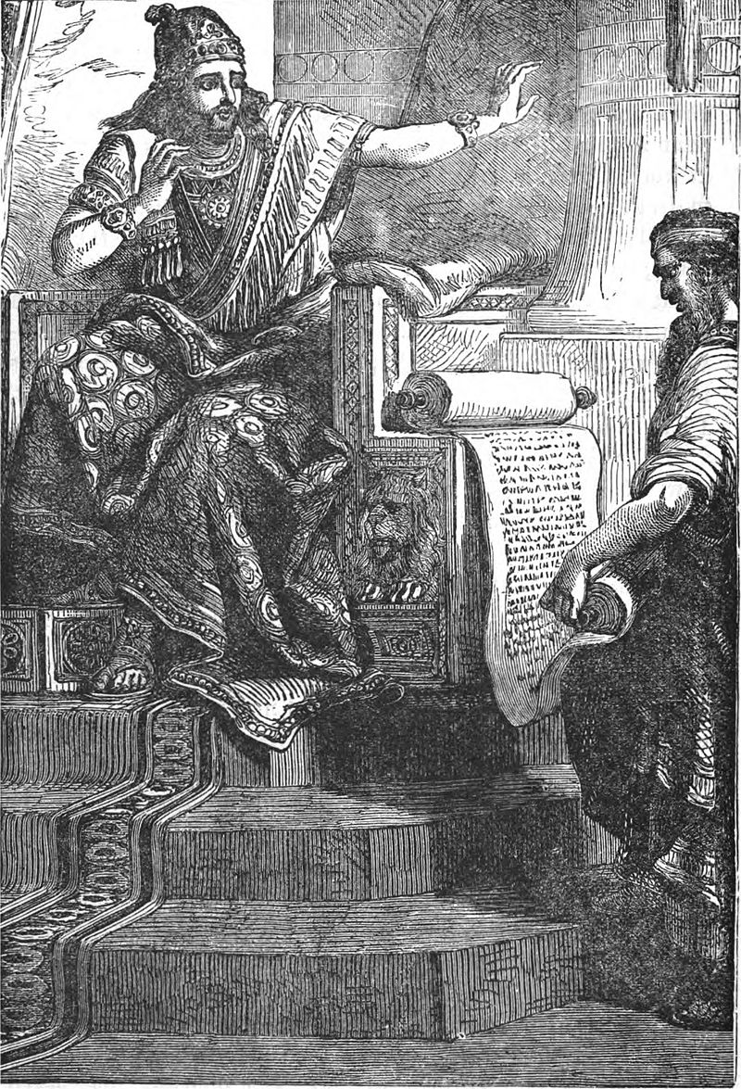
King Josiah and Deuteronomic Reform
Tracing the History of the Israelites from the Old Testament
Notes:
Deuteronomic Reform refers to the Deuteronomic Law. King Josiah centralized the Israelite faith in YHWH. See pages 68-72 of the Student Text.

Slide 16
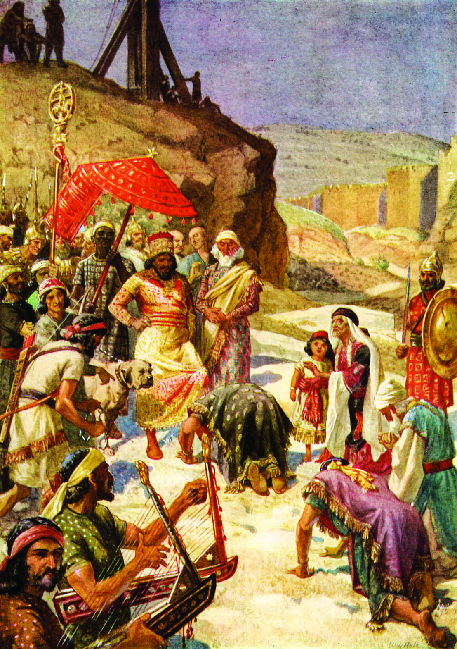
Assyrian and Babylonian Exiles
Marks the beginning of the time span until the 21st Century when the Jewish People remained politically and socially subordinate to non-Jews
Notes:
As part of their Note Taking, students are to list important dates of these two periods of exile:
722 BC, Assyrian Empire crushes the northern state of Israel
640–609 BC, Josiah reigns as the king of the Southern Kingdom of Judah and initiates the Deuteronomic Reform
609 BC, Babylonians defeat the Assyrians
597 BC, Jehoiachin, king of Judah, surrenders to Nebuchadnezzar; Judah becomes a vassal state of the Babylonians; the beginning of the Babylonian Exile
587–586 BC, Jerusalem is destroyed by the Babylonians
539 BC, Persian emperor Cyrus conquers the Babylonians and allows Judeans to return to Palestine if they wish
Ask students to write one to two paragraphs of 1) what it would be like to live in exile and 2) what it would be like to live in a place where your religion was subordinate to the majority.

Slide 17
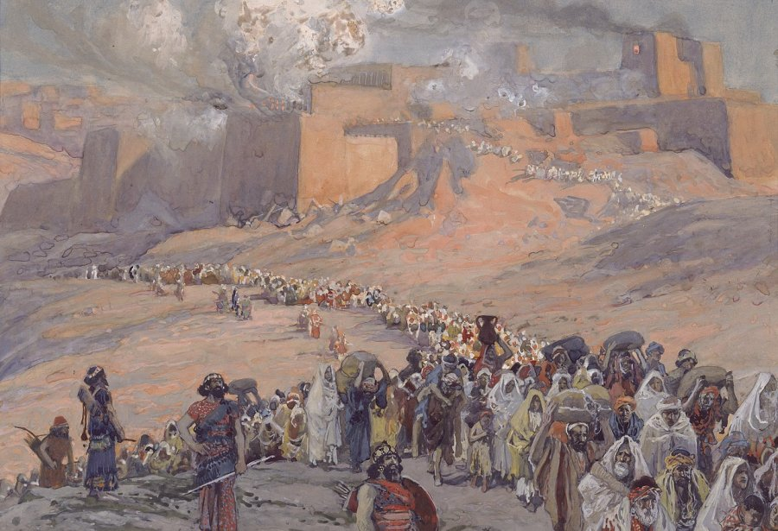
Diaspora
A group migration or flight away from the homeland into one or more other countries. The word can also refer to people who have maintained their separate identity
Tracing the History of the Israelites from the Old Testament
Notes:
More information about the Diaspora:
Daniel Esther, Tobit describe a people living in other countries
Those living their faith and cultural practices separate from the lands in which they live
Jewish people lived in subordination to non-Jews
YHWH was a God of the politically disadvantaged, one who judges the rich and powerful
The video “Early Judaism, part 2” (7:44) from the Kahn Academy covers the origins of the Diaspora. https://www.khanacademy.org/humanities/world-history/ancient-medieval/judaism/v/overview-of-early-judaism-part-2

Slide 18
Pentateuch
Genesis
Exodus
Leviticus
Numbers
Deuteronomy
Types of Literature in the Old Testament
Notes:
Have students copy the graphic in their book. From their notes organize the types of laws and codes in each book from Chapter 2, Section 4 of the Student Text.

Slide 19
Books of the Old Testament
HISTORICAL | Joshua and Judges | 1 and 2 Samuel 1 and 2 Kings 1 and 2 Chronicles | 1st and 2nd Maccabees
 | Collection of tribes | Royal state led by a king | Jewish revolt against Seleucids and Hellenistic Greek culture
WISDOM | Job, Ecclesiastes, Song of Songs, Wisdom, and Sirach | Psalms | Proverbs
 | religious hymns, stories, and wise advice | Religious poetry | Wisdom of basic human nature
PROPHETIC | Minor Prophets | Major Prophets | 1 & 2 Kings
 | Messengers of God, God’s prosecutors delivering judgment, advocates for the less fortunate of Israelite society
APOCALYPTIC | Daniel 7-12
 | Daniel’s dream of four beasts

Slide 20
Images
Slide 2: https://en.wikipedia.org/wiki/Et-Tell#/media/File:Et-Tell_(Ai)_ruins.jpg
Slide 3:
https://commons.wikimedia.org/wiki/File:Sumerian_account_of_silver_for_the_govenor_(background_removed).png
https://en.wikipedia.org/wiki/Cuneiform#/media/File:Sumerian_26th_c_Adab.jpg
Slide 4: https://commons.wikimedia.org/wiki/File:The_Merneptah_stele,_including_inscription._Wellcome_M0008443.jpg
Slide 5: https://commons.wikimedia.org/wiki/File:Sidon_College_site.jpg
Slide 7: https://www.cia.gov/library/publications/resources/cia-maps-publications/map-downloads/Syria_Physiography.jpg/image.jpg
Slide 7: https://commons.wikimedia.org/wiki/File:Map_Land_of_Israel.jpg
Slide 9: https://commons.wikimedia.org/wiki/File:Map_of_fertile_cresent.png
Slide 10: https://www.metmuseum.org/art/collection/search/544720?searchField=All&amp;sortBy=Relevance&amp;ft=egypt+defeats+canaan&amp;offset=0&amp;rpp=20&amp;pos=5
Slide 11: https://en.wikipedia.org/wiki/Forbidden_fruit#/media/File:Jan_Brueghel_de_Oude_en_Peter_Paul_Rubens_-_Het_aards_paradijs_met_de_zondeval_van_Adam_en_Eva.jpg
Slide 12 : https://commons.wikimedia.org/wiki/File:Rembrandt_-_Moses_with_the_Ten_Commandments_-_Google_Art_Project.jpg
Slide 13: https://grace.allpurposeguru.com/2015/08/did-god-command-genocide-in-canaan/
Slide 14: https://www.publicdomainpictures.net/en/view-image.php?image=54520&picture=temple-mount-jerusalem-israel
Slide 15: https://en.wikipedia.org/wiki/Monolatry#/media/File:Josiah_hearing_the_book_of_the_law.jpg
Slide 17: https://sv.m.wikipedia.org/wiki/Fil:Tissot_The_Flight_of_the_Prisoners.jpg

