Slide 1

3. THE CHURCH GROWS AND DEFINES HERSELF
Notes:
Suggestions for students’ note taking:
●Require students to use a three ring binder (1/2-1 inches) full of loose leaf paper (college or wide ruled).
●Notes must be taken in pen only and hand written.
●Notebooks should contain information and notes for religion class only.
●Notebooks must have a table of contents with topic of notes, dates and page numbers.
●All notes must have a topic and page number.
●Students will be required to copy each slide unless the teacher directs students to skip certain slides or parts of slides. Notebooks will be graded based on neatness, completeness and organization. Notebooks should have a significant point value representing 20-25% of the overall grade.
The resources linked in this presentation file may contain copyright material. Such material is made available for educational purposes only. This constitutes a “fair use” of any such copyright material as provided for in Title 17 U.S.C. section106A-117 of the US Copyright Law.

Slide 2
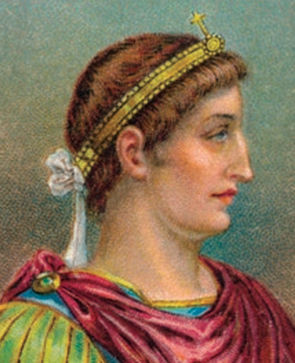
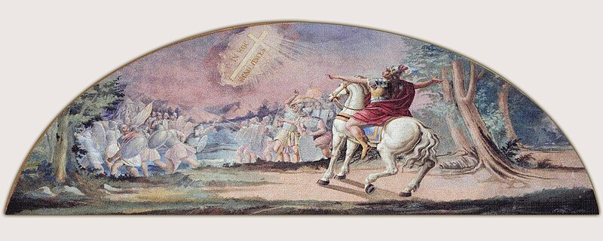
Constantine
“In this sign you will conquer.”
Notes:
Photo Credit: AMP Textbook p. 113. Ettore Tommaso Fantoni. Public domain. Tomaž Fantoni - Križeva legenda. https://commons.wikimedia.org/wiki/File:Toma%C5%BE_Fantoni_-_Kri%C5%BEeva_legenda.jpg
Teaching Points: Constantine was nervous as he pondered what the next day would bring. He and his army were camped just outside the imperial capital of Rome, preparing to cross the Milvian Bridge to enter the city and take full control of the mighty Roman Empire. In their way stood the army of Constantine’s rival, Maxentius. As he fretted on the eve of the battle that would determine the future of the empire, Constantine wondered whether the heavens would bless him with a victory. Accounts of what happened next vary, but according to two early Church historians who knew Constantine, the emperor beheld a vision that depicted the Chi-Rho symbol, meaning Jesus Christ, accompanied by the words “In this sign you will conquer.” Constantine instructed his men to adopt the symbol as their standard and enter battle under the sign of Christianity. Against all odds he defeated his enemies. He attributed his subsequent victory to the God of the Christians.This battle marked a turning point in the relationship between the Roman Empire and the Church.It marked a new phase in church history.
The conversion of Constantine began when he saw a vision of a cross and heard a voice say. “In this sign you will conquer”. Under the persuasion of his mother Helena who had already converted, he eventually was baptized on his deathbed.
He issued the Edict of Milan and enacted many reforms that helped to transform the pagan culture of the empire into the Christian culture that took its place. The age of persecution was over, and the Church enjoyed the freedom to grow and prosper.
He added the authority of the state to the custom of Sunday as a holy day by prohibiting commercial activity on Sunday.
His reforms lessened the severity of slavery. . For example, he forbade the previously common practice of branding slaves’ faces, on the grounds that the face reflected the image of God.
He increased the public visibility of the Church by donating prominent buildings, some of which were former pagan temples, to the Church.
He built the first St. Peter’s Basilica on the site of Peter’s grave.
Online Resources: View video, Did Constantine Found the Catholic Church? URL here: https://youtu.be/oqLBeCmyaKY
The resources linked in this presentation file may contain copyright material. Such material is made available for educational purposes only. This constitutes a “fair use” of any such copyright material as provided for in Title 17 U.S.C. section106A-117 of the US Copyright Law.

Slide 3
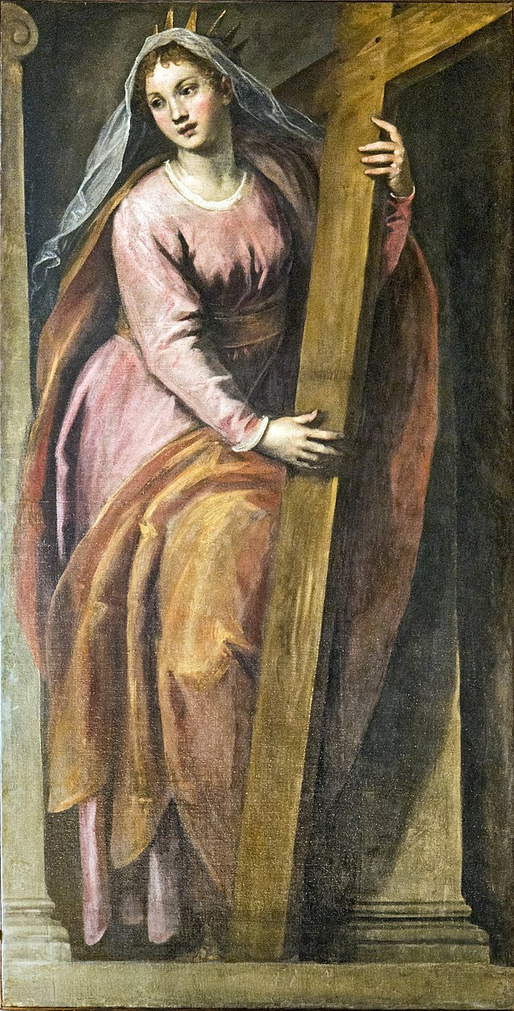
Saint Helena
Mother of Constantine
Constantine became a Christian himself at the end of his life due in great part to the encouragement of his mother, St. Helena.
According to legend, she discovered the actual cross of Jesus in Jerusalem.
Notes:
Photo Credit: - Saint Helena - 1592-1593 - by Palma il Giovane.jpg. Didier Descouens.Public domain. https://commons.wikimedia.org/wiki/File:Interior_of_Chiesa_dei_Gesuiti_(Venice)_-_sacristy_-_Saint_Helena_-_1592-1593_-_by_Palma_il_Giovane.jpg
Teaching Points: The discovery of the true cross legend: Several traditions have developed around St. Helen’s visit to Jerusalem. One story, recounted in a medieval Christian hagiography called the Golden Legend, holds that the Cross of Christ was hidden under stones in a ditch near a pagan shrine to the goddess Venus and that Christians came to the site to venerate the Cross. Because of the persecutions, Christians shared the location of the Cross by word of mouth, and a Christian from the area reportedly shared this information with St. Helen. According to the Golden Legend, a man named Judas dug up the site and found three crosses. Not knowing which one was the authentic Cross, he laid each on the corpse of a young man about to be buried. When he laid the third cross on the man, the dead man came to life.
Online Resources: Have students view video, Legend of the True Cross. URL here: https://youtu.be/oCLOneJmQ1c
The resources linked in this presentation file may contain copyright material. Such material is made available for educational purposes only. This constitutes a “fair use” of any such copyright material as provided for in Title 17 U.S.C. section106A-117 of the US Copyright Law.

Slide 4
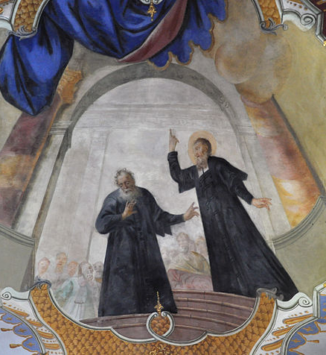
Heresy
Key
Vocab
Protestants who interpret each word or phrase in the
Bible from a literalist point of view.
False teachings taught after the Church debated and defined orthodox (“right belief”) doctrine. Heretics did not accept these magisterial decisions, creating confusion and division in the Church.
Notes:
Photo Credit: Augustinus im Disput mit dem Irrlehrer. Johannes Zick. Public domain. https://commons.wikimedia.org/wiki/File:Schussenried_Klosterkirche_Fresken_A5_Augustinus_Disput_mit_dem_Irrlehrer.jpg. cropped.
Directions: Have students add this vocabulary term to their notes.
The resources linked in this presentation file may contain copyright material. Such material is made available for educational purposes only. This constitutes a “fair use” of any such copyright material as provided for in Title 17 U.S.C. section106A-117 of the US Copyright Law.

Slide 5
Early Church Heresies
Nestorianism
Gnosticism
Arianism
Monophysitism
Apollinarianism
Notes:
Directions:. Have students copy the side information in their notebooks.
Teaching points: Relieved of the constant threat of persecution, Christians began to squabble among themselves about the correct way to understand the identity and teachings of Jesus. The Church was compelled to debate and define orthodox (“right belief”) doctrine. Some believers (heretics) did not accept these decisions, creating confusion and division in the Church.
Gnosticism: Gnostics tended to believe that salvation was attained through a process of understanding secret knowledge and awakening the divine spark within the self.They view matter, including the human body, as evil and spirit as good.
Monophysitism: The idea that Jesus had only one nature, either human or divine. This idea had little support, as it was consistently rejected by many church leaders during the establishment of doctrine.
Apollinarianism: Christological heresy proposed by Apollinaris of Laodicea (died 390) that argues that Jesus was divine but not human (the opposite of Arianism) and that Jesus did not have a human soul.
Nestorianism: Nestorius, Patriarch of Antioch (fl. 410), taught that Jesus was a human person joined to the Divine Person of the Son. Nestorians also believed that Mary was the mother only of the human person Jesus, not of the Divine Person.
Arianism: Arianism is named after Arius (c. 250 - c. 336), a priest in Alexandria. This is considered the most serious heresy. Jesus Christ was thought of as a special creation by God for man's salvation.
Online Resources: View video: Five Ancient Heresies Alive Today. URL here: https://youtu.be/TIts9ihEwfQ
The resources linked in this presentation file may contain copyright material. Such material is made available for educational purposes only. This constitutes a “fair use” of any such copyright material as provided for in Title 17 U.S.C. section106A-117 of the US Copyright Law.

Slide 6
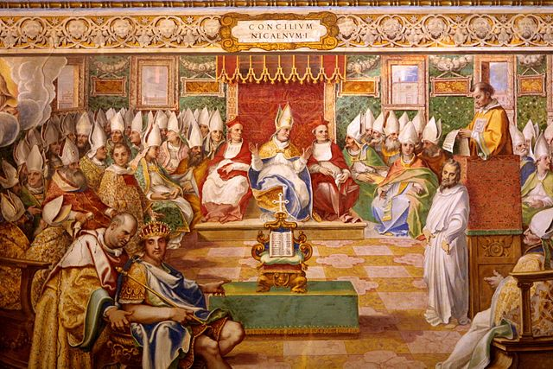
Creeds, Dogmas and Councils
There have been twenty-three ecumenical councils in the Church’s history, the most recent being the Second Vatican Council, which was held between 1962 and 1965.
The Apostles Creed and the Nicene Creed are two separate prayers which contain the basic doctrines of the Faith.
Notes:
Photo Credit: Council of Nicaea 325 AD. Fresco in Salone Sistino, Vatican.Giovanni Guerra (1544-1618), Cesare Nebbia (1534-1614) e aiuti.Public domain. https://commons.wikimedia.org/wiki/File:Nicea.jpg
Directions: Have a student read aloud the story on the slide then ask students, What is the moral of the story?
Teaching Points:
Ecumenical Councils: Gatherings of all Catholic bishops of the world under the authority of the pope (Collectively, these church leaders are called the Magisterium or teaching office) to discuss and make decisions about teachings, dogmas and practices that apply to all local churches (dioceses). They addressed and condemned heresies (false teachings that were gaining steam at the time).
Dogma: The name for truths that the Church teaches that have been specifically revealed by God. Acceptance of dogma is essential for complete faith and the deepest possible relationship with God. Denial of dogma is heresy.
Acceptance of the tenets of the Apostles’ Creed, Nicene Creed, and other Church dogmas is essential for Catholics to have a complete faith and the deepest possible relationship with God. There are two things to keep in mind about Church dogmas:
1. They are infallible and irreformable.
2. They cannot change in their essence because the truth, which has been revealed by God, remains for all eternity.
Online Resources: Have students view video; What’s up With All The Councils?. URL here: https://youtu.be/TU81QIvQue0
The resources linked in this presentation file may contain copyright material. Such material is made available for educational purposes only. This constitutes a “fair use” of any such copyright material as provided for in Title 17 U.S.C. section106A-117 of the US Copyright Law.

Slide 7

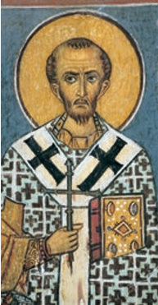
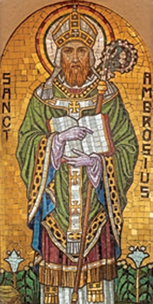
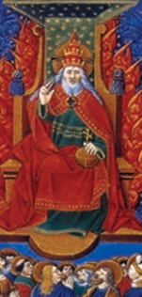
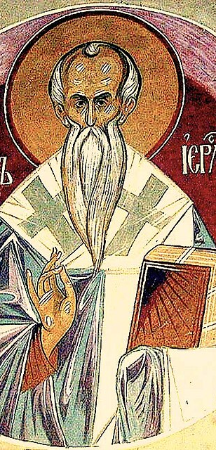
Post-Nicene Church Fathers
Saint John Chrysostom
Saint Ambrose
Saint Augustine
Saint Cyril of Jerusalem
Notes:
Photo Credit: AMP textbook pgs. 137-142. Saint Cyril of Jerusalem, fresco at a greek orthodox church.
Unknown author. Public domain. https://commons.wikimedia.org
Directions: Have a students copy down information from the slide into their notes.
Teaching Points: In the continued growth and development of these early centuries of the Church’s existence, the Church Fathers played a major role. Figures such as St. John Chrysostom, St. Basil, and St. Augustine of Hippo interpreted and elaborated on the Bible and the teaching tradition. They also criticized the problems they noticed among fellow Christians, including sexual immorality, jealousy, and vanity.
The Church Fathers thus guided the Church’s growth and furnished a rich and extensive set of theological and spiritual writings that would challenge and edify Christian believers in the centuries that followed. The early Church “was the story of a family, and of how the ‘fathers’ of that family strove to keep their household together, to preserve the family’s patrimony, to teach and discipline their children, and to protect the family from danger.”
Post-Nicene fathers came after the Council of Nicea 325 AD as compared with apostolic fathers who preceded the council.
Criteria to be considered a church father…
1. held orthodox doctrine
2. exhibited holiness of life
3. been approved by the Church
4. lived in the early centuries of the Church.
The resources linked in this presentation file may contain copyright material. Such material is made available for educational purposes only. This constitutes a “fair use” of any such copyright material as provided for in Title 17 U.S.C. section106A-117 of the US Copyright Law.

Slide 8
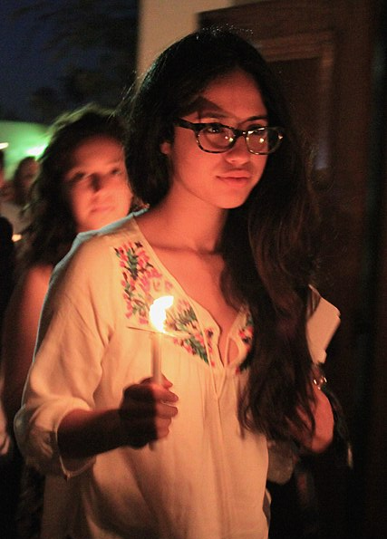
CATECHUMENS
Those converts preparing to be received into the Catholic Church through a process of catechetical instruction and prayer.
Notes:
Photo Credit:Thank You (24 Millions ) views from Fresno, USA.Creative Commons Attribution 2.0.Easter Vigil. https://commons.wikimedia.org/wiki/File:Easter_Vigil_(13978535375).jpg
Directions: Have a students copy down information from the slide into their notes.
Teaching Points: In this picture two young ladies (catechumens) are entering into the church at an Easter Vigil Mass with the flame lit from the Paschal Candle. The Catholic tradition of fire at the Easter Vigil is a ceremony called the Service of Light that uses fire as a symbol of the Resurrection of Jesus:
Lighting: The ceremony begins with a priest lighting a large, open fire outside the church. The fire's warmth, light, and beauty draw the congregation together.
Blessing: The priest blesses the fire.
Lighting the Paschal candle: The Paschal candle is lit from the fire.
Entering the church: The community then enters the dark church in a procession, chanting "Lumen Christi" and "Deo gratias"
For new converts to Christianity in the early Church, accepting the faith meant more than merely saying, “I believe in Jesus.” It meant learning the doctrines of the Church and training to live according to her precepts. Those who were “in training” to become Christian were known as catechumens.
Eventually, on Saturday evening, at Easter Vigil Mass, they received the sacraments of initiation. We still find this general approach in the Church today. In most parishes, catechumens (the unbaptized) as well as candidates (non-Catholic Christians) who wish to become Catholic go through a period of education and preparation typically known as the Order of Christian Initiation of Adults (OCIA). Commonly, they are baptized or profess their faith as Catholics, and then receive their First Holy Communion, during the Easter Vigil Mass, held the night before Easter Sunday.
Online Resources: Have students view, Rites of Acceptance and Welcome. URL here: https://youtu.be/2amUyk2Duic
The resources linked in this presentation file may contain copyright material. Such material is made available for educational purposes only. This constitutes a “fair use” of any such copyright material as provided for in Title 17 U.S.C. section106A-117 of the US Copyright Law.

Slide 9

Church Members as ‘Salt and Light’
“You are the salt of the earth. But if salt loses its taste, with what can it be seasoned? It is no longer good for anything but to be thrown out and trampled underfoot.” -Mt 5:13
Notes:
Photo Credit: Salts seen using a polarized light microscope. Juan Carlos Fonseca Mata.Creative Commons Attribution-Share Alike 4.0. https://commons.wikimedia.org/wiki/File:Polarized_light_microscopy_-_04.jpg
Directions: Have a students copy information from the slide into their notes.
Teaching Points: The extraordinary picture on this slide is showing salt illuminated by light under a microscope.
Early Christians were ‘confirmed Catholic’ and not ‘conformed Catholics’ who followed the world. They acted in ways that set them apart from the dominant Roman culture and drew attention to the Gospel. The metaphor of salt was an easy one for first-century inhabitants of Palestine to understand. Salt was essential not only for flavoring, but as a preservative for first-century Mediterranean staples like fish and olives.
To be salt was to stand out through modeling a better moral way of life of hope and love. “They will know we are Christians by our love’ was a common saying regarding early Christians. .
To be light was to lead others to faith and truth through an illuminative holiness.
Jesus said to his disciples, “You are the light of the world.” He went on to explain that people do not “light a lamp and then put it under a bushel basket; it is set on a lampstand, where it gives light to all in the house. Just so, your light must shine before others, that they may see your good deeds and glorify your heavenly Father” (Mt 5:14–16).
Online Resources: Assign article, You are Salt and Light. URL here: https://integratedcatholiclife.org/2023/02/dambrosio-you-are-salt-and-light/
The resources linked in this presentation file may contain copyright material. Such material is made available for educational purposes only. This constitutes a “fair use” of any such copyright material as provided for in Title 17 U.S.C. section106A-117 of the US Copyright Law.

Slide 10

Turn and Talk
As a young Catholic (Christian) which would you say you are…
Salt, Light, or Both? Explain.
When at the Last Supper Jesus said about the Eucharist, “This is my Body” why do you think most Protestants do not interpret that as literal and Catholics do?
Notes:
Directions: Have students write down the question and then write down their answer….Then have students share their answers with one person close by. Call on volunteers to share with the whole class.
The resources linked in this presentation file may contain copyright material. Such material is made available for educational purposes only. This constitutes a “fair use” of any such copyright material as provided for in Title 17 U.S.C. section106A-117 of the US Copyright Law.

Slide 11
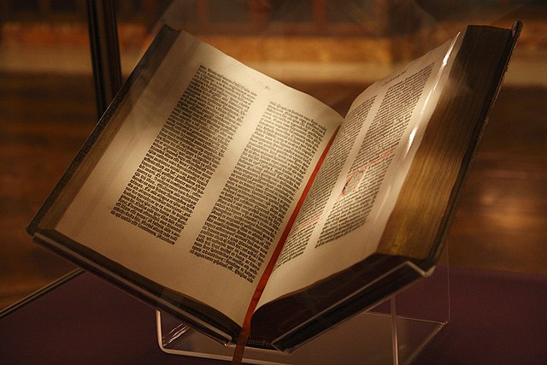
Canon
Key
Vocab
Protestants who interpret each word or phrase in the
Bible from a literalist point of view.
A name for the official list of those books of the Bible that have been accepted as normative for the faith by the Catholic bishops at church councils.
Notes:
Photo Credit: Joshua Keller. Creative Commons Attribution 2.0.Gutenberg Bible, New York Public Library, USA..https://commons.wikimedia.org/wiki/File:Gutenberg_Bible,_New_York_Public_Library,_USA._Pic_01.jpg
Directions: Have students add this vocabulary term to their notes.
The resources linked in this presentation file may contain copyright material. Such material is made available for educational purposes only. This constitutes a “fair use” of any such copyright material as provided for in Title 17 U.S.C. section106A-117 of the US Copyright Law.

Slide 12
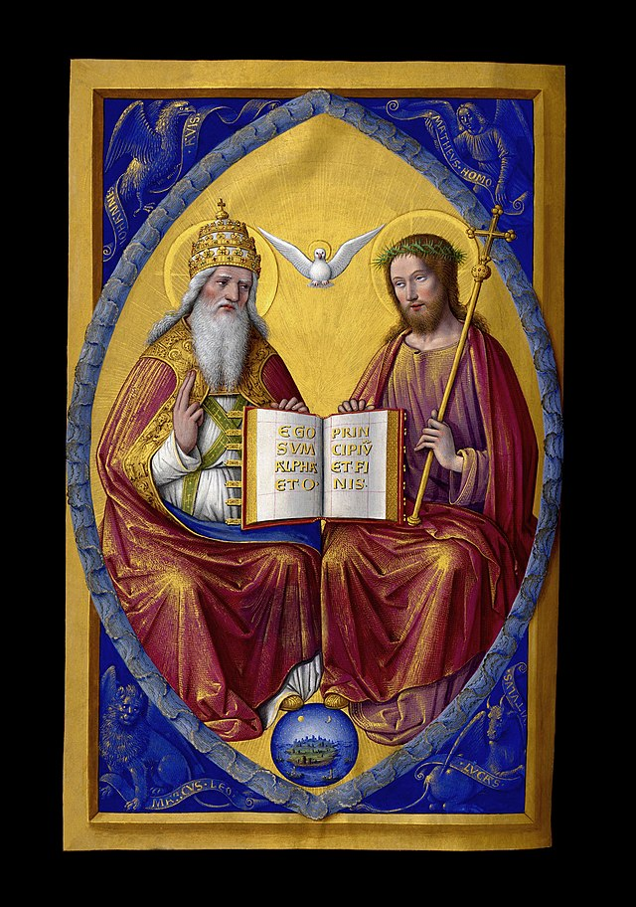
The Church Established the Canon of Scriptures
It was through a series of councils, in conjunction with the approval of the pope, that the Church established the canon of the Bible.
Using a set of criteria they chose which books belonged and which ones didn’t.
These Catholic Church councils took place at cities in Asia Minor (Turkey) and North Africa in the final decades of the fourth century.
Notes:
Photo Credit: Trinité Grandes Heures Anne de Bretagne.jpg. Jean Bourdichon. Public domain. https://commons.wikimedia.org/wiki/File:Trinit%C3%A9_Grandes_Heures_Anne_de_Bretagne.jpg
Directions: Have students copy information down in their notes. Teaching point:
Teaching Points: “The Christian faith is not a ‘religion of the book, rather, the Bible is the “book of the Church.” -CCC 108
The Catholic church councils of Hippo (393) and Carthage (397), used several criteria to determine the canonicity of books in the New Testament, including:
Authenticity: Based on the experiences of people who knew Jesus
Authoritativeness: Accurately teaches God's will
Inspiration: Written by people with guidance from the Holy Spirit
Apostolicity: Authored by an apostle or someone in the "apostolic circle"
Orthodoxy: Consistent with the rest of the canon
Widespread use: Used by early church fathers
Online Resources: View video: How Did the Church Know Which Books to Put in the Bible?. URL here: https://youtu.be/N-87dq2q7Wc
The resources linked in this presentation file may contain copyright material. Such material is made available for educational purposes only. This constitutes a “fair use” of any such copyright material as provided for in Title 17 U.S.C. section106A-117 of the US Copyright Law.

Slide 13
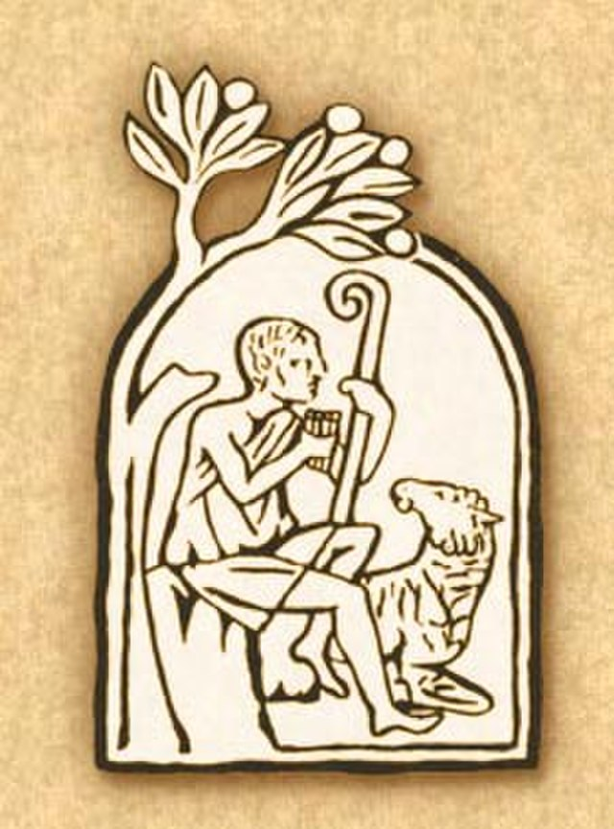
Sacred Tradition
Key
Vocab
Church teachings and practices that have been passed down by the popes and bishops, the successors of the Apostles. Along with Scripture, Tradition makes up the deposit of faith.
Protestants who interpret each word or phrase in the
Bible from a literalist point of view.
Notes:
Photo Credit: Emblem of the Catechism of the Catholic Church.jpg. pedra sepulcral cristã das catacumbas de Domitila (Roma), do final do século III. Unknown author. Public domain. https://commons.wikimedia.org/wiki/File:Emblem_of_the_Catechism_of_the_Catholic_Church.jpg
Directions: Have students add this vocabulary term to their notes.
Online Resources: Have students view, Why Catholics Have Both Scripture and Tradition. URL here: https://youtu.be/mTBud-9Vlzo
The resources linked in this presentation file may contain copyright material. Such material is made available for educational purposes only. This constitutes a “fair use” of any such copyright material as provided for in Title 17 U.S.C. section106A-117 of the US Copyright Law.

Slide 14
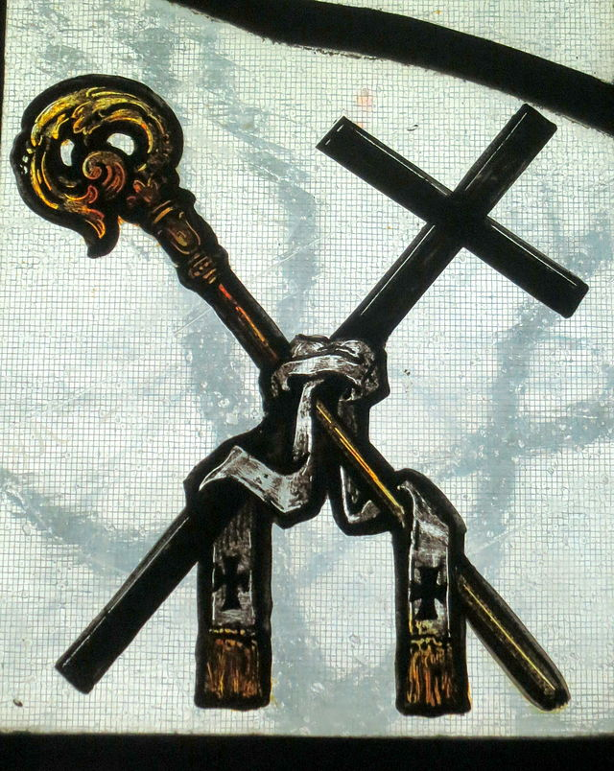
Magisterium
Key
Vocab
Protestants who interpret each word or phrase in the
Bible from a literalist point of view.
The teaching authority of the Church held by the pope and bishops. They “preserve God’s people from deviations and defections and to guarantee them the objective possibility of professing the true faith without error.”
Notes:
Photo Credit: Pallium Crosier and Cross.Nheyob.Creative Commons Attribution-Share Alike 4.0. https://commons.wikimedia.org/wiki/File:Ohio_Dominican_University_(Columbus,_Ohio)_-_Christ_the_King_Chapel_in_Sansbury_Hall,_stained_glass,_Pallium_Crosier_and_Cross.jpg
Directions: Have students add this vocabulary term to their notes.
Teaching Points: Trusting in Jesus’s promise to be “with you always” (Mt 28:20), the Church holds that Jesus did not leave his people without a way to definitively know the truths of the faith. Instead, he bestowed on the Apostles the authority to teach sound doctrine guarded and guided by the Holy Spirit- this is called the charism of infallibility. The Apostles, in the form of their successors, the pope and bishops, guide the Church in this way. Through this process of Apostolic Succession, the Magisterium is the teaching authority (office) of the Church. This preservation from error assures the indefectibility of the Church, that is, the principle that the Church herself, in her teaching office, will be reliable, even as members of the Church individually will sin, make mistakes, and hold faulty views.
Online Resources: Have students view video: What is the Catholic Magisterium? URL here: https://youtu.be/2uV3gHSbUwY
The resources linked in this presentation file may contain copyright material. Such material is made available for educational purposes only. This constitutes a “fair use” of any such copyright material as provided for in Title 17 U.S.C. section106A-117 of the US Copyright Law.

Slide 15
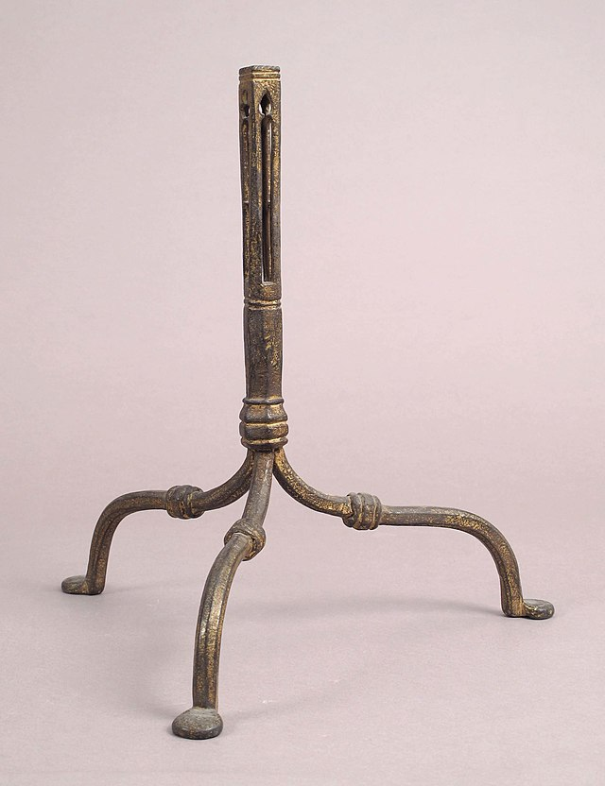
The “Tripod of Truth”
“Sacred Tradition, Sacred Scripture and the Magisterium … are so linked and joined together that one cannot stand without the others.”
- Dei Verbum, Vatican II
Notes:
Photo Credit: Tripod MET sf17-190-855bs1.jpg. Italian; Tripod; Metalwork-Iron. Creative Commons Zero, Public Domain Dedication. https://commons.wikimedia.org/wiki/File:Tripod_MET_sf17-190-855bs1.jpg
Directions: Have students draw a tripod in their notes. Label each leg one of the words on the slide and at the top of the tripod write the word ‘truth’.
Teaching Points: CCC 80-87:
Sacred Tradition and Sacred Scripture are bound closely together, and communicate one with the other. For both of them, flowing out from the same divine well-spring, come together in some fashion to form one thing, and move towards the same goal
Each of them makes present and fruitful in the Church the mystery of Christ, who promised to remain with his own always, to the close of the age.
Sacred Scripture is the speech of God as it is put down in writing under the breath of the Holy Spirit.
Holy Tradition transmits in its entirety the Word of God which has been entrusted to the apostles by Christ the Lord and the Holy Spirit. It transmits it to the successors of the apostles so that, enlightened by the Spirit of truth, they may faithfully preserve, expound and spread it abroad by their preaching.
The Tradition here in question comes from the apostles and hands on what they received from Jesus' teaching and example and what they learned from the Holy Spirit. The first generation of Christians did not yet have a written New Testament, and the New Testament itself demonstrates the process of living Tradition.
The Magisterium has the task of giving an authentic interpretation of the Word of God, whether in its written form or in the form of Tradition, has been entrusted to the living teaching office of the Church alone. Its authority in this matter is exercised in the name of Jesus Christ." This means that the task of interpretation has been entrusted to the bishops in communion with the successor of Peter, the Bishop of Rome.
Yet this Magisterium is not superior to the Word of God, but is its servant. It teaches only what has been handed on to it. At the divine command and with the help of the Holy Spirit, it listens to this devotedly, guards it with dedication and expounds it faithfully.
Online Resources: Have students view video: The Big 3. URL here: https://youtu.be/7R9CfQQchU8
The resources linked in this presentation file may contain copyright material. Such material is made available for educational purposes only. This constitutes a “fair use” of any such copyright material as provided for in Title 17 U.S.C. section106A-117 of the US Copyright Law.

Slide 16
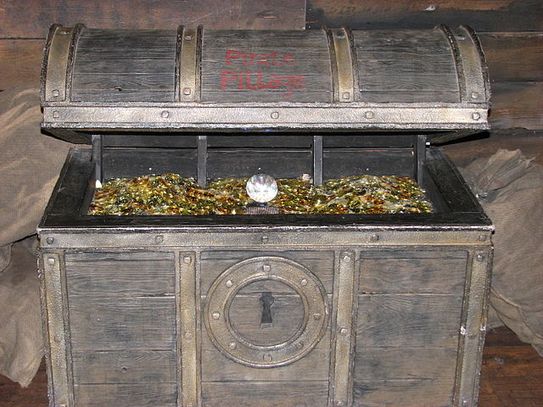
Deposit of Faith
Key
Vocab
Protestants who interpret each word or phrase in the
Bible from a literalist point of view.
The name for the source that contains all of God’s revelation— Sacred Tradition and Sacred Scripture. The Magisterium draws from the Deposit of Faith, and all that it teaches must be accepted by Catholics as being divinely revealed.
Notes:
Photo Credit: Pirates treasure. Cristian Bortes from Cluj-Napoca, Romania. Creative Commons Attribution 2.0
.https://commons.wikimedia.org/wiki/File:Madame_Tussaud_-_London_(2326690731).jpg
Directions: Have students add this vocabulary term to their notes.
Teaching Points: The deposit of faith is like a treasure box, but instead of being filled with gold, it is filled with the truth. “She is the treasure chamber in which the Apostles have laid up the truth, which is Christ” (Henri de Lubac, Splendor of the Church, 40).. When these truths are lived out to the fullest, they will bring us everlasting life because all the truths contained in the deposit of faith point to the one Truth, Jesus Christ ,who is “the way the truth and the life” (John 14:6). Therefore to encounter the deposit of faith is to encounter Christ himself.
Online Resources: Assign article, Why the Church is Like My Wife. URL here: https://sjvlaydivision.org/deposit-of-faith/
The resources linked in this presentation file may contain copyright material. Such material is made available for educational purposes only. This constitutes a “fair use” of any such copyright material as provided for in Title 17 U.S.C. section106A-117 of the US Copyright Law.

Slide 17

So, like, everything the pope says has to be true because he’s ‘infallible’?
No. Non-Catholics and Catholics alike often misunderstand the meaning of infallibility related to Church teaching. First, infallibility is not a magic wand that the pope and bishops get to wave over their teachings to make them inviolable and true. Rather, infallibility is God’s promise to the Church that when it comes to matters pertaining to faith and morals and salvation, Catholics can be confident that Church teaching will be a definitive guide. This gift does not apply to other statements the pope or bishops make.
Challenge
Question
Notes:
Directions: Begin by asking the question on the screen. After calling on students to respond, have the answer fly in using the animation feature.
Online Resources: Have students view video, What is Papal Infallibility? URL here: https://youtu.be/dDcgjxs6Zl0
The resources linked in this presentation file may contain copyright material. Such material is made available for educational purposes only. This constitutes a “fair use” of any such copyright material as provided for in Title 17 U.S.C. section106A-117 of the US Copyright Law.

