Slide 1

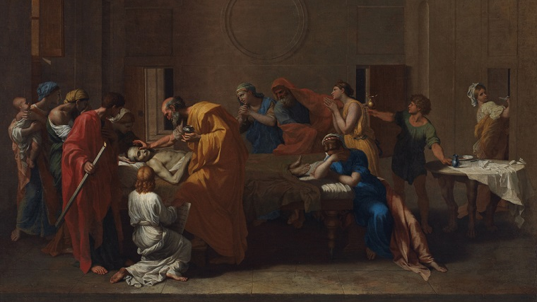
6. THE SACRAMENT OF THE ANOINTING OF THE SICK
6
The Sacrament of the Anointing of the Sick
The Seven Sacraments: Signs of God’s Grace
Notes:
Nicolas Poussin, Extreme Unction, 1638. Public domain United States. {{PD-US}}
Suggestions for taking notes on the slides:
Require students to use a three ring binder (1/2-1 inches) full of loose leaf paper (college or wide ruled).
Notes must be taken in pen only and hand written.
Notebooks should contain information and notes for religion class only.
Notebooks must have a table of contents with topic of notes, dates and page numbers.
All notes must have a topic and page number.
Students will be required to copy each slide unless the teacher directs students to skip certain slides or parts of slides. Notebooks will be graded based on neatness, completeness and organization.

Slide 2
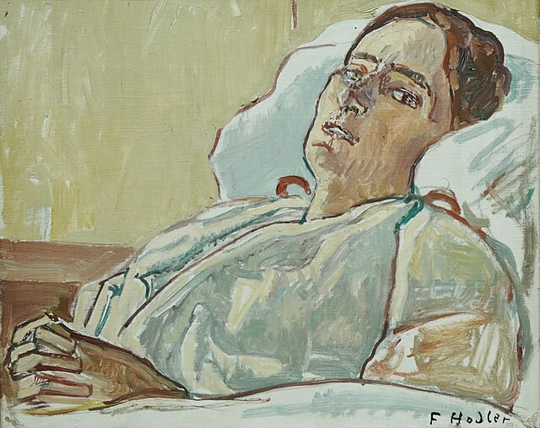
The Meaning of Suffering
St. Teresa of Calcutta told a story of meeting a woman who had terminal cancer. The woman was in pain and suffering terribly. Mother Teresa told her: “Now you come so close to Jesus on the cross that he is kissing you.” The woman took Mother Teresa’s hand and said, “Mother, please tell Jesus to stop kissing me.”
Notes:
Photo Credit: Portrait of a sick woman (1914) by Ferdianand Hodler. Oil on Canvas. Paradise Chronicle. Public domain. wikicommons.org
Directions: Have students copy the slides information into their notes.
Teaching Points:
What does Mother Teresa’s story say about suffering? Both the woman with cancer and Mother Teresa made three important points in this short conversation: (1) We do not want to suffer; (2) Our suffering does have meaning: (3) Suffering and illness are a reality of our world.
People in every generation have looked to God to provide some clue to why people suffer. In the Old Testament this is partly what the story of Job is about.
In other faith traditions:
Buddhists believe that, according to the first of two Noble Truths, that all life is suffering caused by reliance on worldly possessions and attachments. It can take the form of greed, hatred, or ignorance, which, unless they are alleviated, can return to the person in the form of karma, the action that causes the entire cycle of cause and effect.
Hindus understand suffering as a punishment for bad actions committed in this life or past lives.
Muslims attribute some suffering to Satan or other evil spirits and believe suffering allowed by Allah as a test of humility and faith.
Jews, in general, hold that suffering is caused by a weakness in one’s relationship with God and that God himself suffers along with the person.
Jesus’s primary response to human suffering was to put an end to it, which he did very directly through his healings. Though teaching about suffering came second to actively alleviating it, Jesus did make several important points about suffering in his teaching:
Sickness and death are not God’s ways of punishing people.
God loves the sick and disabled just as much as he loves healthy people.
God’s love is stronger than sickness, pain, suffering, and death.
God does not abandon you when you are sick or suffering. Rather, he shares your suffering, above all through the Cross.
The sick should not be treated as outcasts; instead, they have an important role to play in the community
Online Resources: Have students view video, The Meaning of Suffering. URL here: https://youtu.be/tR25hk8NVio
The videos linked in this presentation file may contain copyrighted material. Such material is made available for educational purposes only. This constitutes a “fair use” of any such copyrighted material as provided for in Title 17 U.S.C. section 106A-117 of the US Copyright Law.

Slide 3
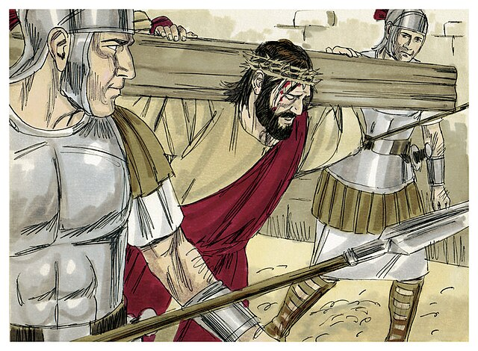
Redemptive Suffering
“Ultimately, Jesus demonstrated the meaning of suffering through his own Passion and Death, through which he ‘took upon himself the whole weight of evil and took away the sin of the world,’ of which illness is only a consequence.”
—CCC, 1505
Notes:
Photo Credit: Bible Illustrations by Sweet Media. Gospel of Mark ch 27-28. Jim Padgett. Creative Commons Attribution-Share Alike 3.0. https://commons.wikimedia.org https://commons.wikimedia.org/wiki/File:Gospel_of_Matthew_Chapter_27-8_(Bible_Illustrations_by_Sweet_Media).jpg
Directions: Have students summarize the main points of the quote on the slide in their notes.
Teaching Points:
Jesus showed how much God truly loves people: enough to endure the Cross for our sake. You are invited to take up your cross as his disciple. By this act, you can unite your sufferings with Jesus’s sacrifice, become more like him, and contribute to the redemption of the world. Jesus is with us in our sufferings; he will never abandon or forget us.
Under the leadership and example of Jesus, we accept our suffering, our cross, and we turn it into a great blessing for others. Sickness and suffering are opportunities to die to one’s self. In this way, suffering is a ratification or a seal of one’s heroic, sacrificial love. A love that has been elevated and perfected through the purgative fires of suffering. The Paschal Mystery becomes something that we enter into in a bodily way as well as spiritual. We enter into Christ’s suffering and death so that we may also be united to him in our own resurrection.
This is why St. Paul says he rejoices in his own suffering since it was offered, in Christ, for the sake of the Church. He says, “Now I rejoice in my sufferings for your sake, and in my flesh I am filling up what is lacking in the afflictions of Christ on behalf of his body, which is the church” ( Col 1:24).
Online Resources: View video, Scott Hahn on the Value and Meaning of Suffering. URL here: https://youtu.be/9z7fW7pU4mQ
The videos linked in this presentation file may contain copyrighted material. Such material is made available for educational purposes only. This constitutes a “fair use” of any such copyrighted material as provided for in Title 17 U.S.C. section 106A-117 of the US Copyright Law.

Slide 4

Turn and Talk
In what ways could you unite your own physical, mental, or spiritual suffering to Jesus’s suffering? Explain.
Notes:
Directions: Have students write down either question and their answer and then share their answer with one person close by.

Slide 5

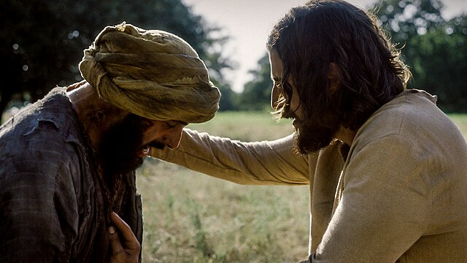
Jesus the Compassionate Messiah
“And he said to them in reply, ‘Go and tell John what you have seen and heard: the blind regain their sight, the lame walk, lepers are cleansed, the deaf hear, the dead are raised, the poor have the good news proclaimed to them.’”
—Luke 7:22
Notes:
Photo Credit: Jesus (Jonathan Roumie) heals the leper (Stephen Hailo) in episode 6 of The Chosen. The Chosen press photos (press.thechosen.tv). Creative Commons Attribution-Share Alike 4.0. https://commons.wikimedia.org/wiki/File:The_Chosen_-_Jesus_touches_the_leper.jpg.
Directions: Have students read aloud and copy the information from the slide into their notes.
Teaching Points:
Jesus cured the physical ailments of others both because of (1) his compassion for them and (2) to show clearly that he was the Messiah. Jesus pointed out that he was fulfilling a prophecy about the Messiah as a compassionate healer.
Jesus answered John’s messengers in a powerful way that left no doubt to any faithful Jew that he was indeed the Messiah: “Go and tell John what you have seen and heard: the blind regain their sight, the lame walk, lepers are cleansed, the deaf hear, the dead are raised, the poor have the good news proclaimed to them.”
His answer pointed to the prophecy of Isaiah, and Jesus’s listeners would have recalled these words: “Then the eyes of the blind shall see, and the ears of the deaf be opened; Then the lame shall leap like a stag, and the mute tongue sing for joy. For waters will burst forth in the wilderness, and streams in the Arabah” (Is 35:5-6).
Online Resources: Have students view video, Why Haven’t You Healed Me? (The Chosen Scene) URL here: https://youtu.be/KZDvcEkjthA

Slide 6

Anointing of the Sick in the Bible
“Is anyone among you sick? He should summon the presbyters of the church, and they should pray over him and anoint [him] with oil in the name of the Lord, and the prayer of faith will save the sick person, and the Lord will raise him up. If he has committed any sins, he will be forgiven.”
—Jas 5:14–15
Notes:
Photo Credit: Open Bible. Creative Commons Zero, Public Domain Dedication. wikicommons.org
Directions: Have students summarize the information from the slide into their notes.
Online Resources: Have students view video, Anointing of the Sick. URL here: https://youtu.be/7HgEXIKH3ig
The videos linked in this presentation file may contain copyrighted material. Such material is made available for educational purposes only. This constitutes a “fair use” of any such copyrighted material as provided for in Title 17 U.S.C. section 106A-117 of the US Copyright Law.

Slide 7
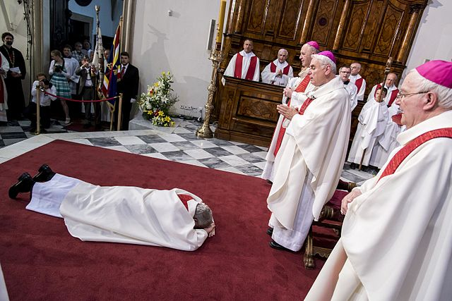
Presbyter
Key
Vocab
Definition: The term “presbyter” originates from the Greek word presbyteros, meaning “elder” or “respected elder,” and historically denoted a priest within the Catholic church.
Notes:
Photo Credit: Holy Orders prostration ritual. Fotografie z biskupského svěcení Pavla Konzbula v Brně 29. června 2016. Autor: Vít Kobza.Creative Commons Attribution-Share Alike 4.0. https://commons.wikimedia.org/wiki/File:Pavel_Konzbul,_biskupsk%C3%A9_sv%C4%9Bcen%C3%AD_02.jpg.
Directions: Have students add this vocabulary term to their notes.

Slide 8
Anointing of the Sick Essentials
Minister | Matter | Form
Bishop or Priest | Oil of the Sick and Anointing | "Through this holy anointing may the Lord in his love and mercy help you with the grace of the Holy Spirit. May the Lord who frees you from sin, save you, and raise you up."
Notes:
Directions: Have students copy down the information from the slide into their notes.
Online Resources: Assign article, Anointing of the Sick. URL here: https://www.usccb.org/about/justice-peace-and-human-development/upload/Anointing-of-the-Sick.pdf
Have students view video, The Healing Power of Anointing of the Sick | EWTN News In Depth April 21, 2023. URL here: https://youtu.be/aJF_ntZiJsk
The videos linked in this presentation file may contain copyrighted material. Such material is made available for educational purposes only. This constitutes a “fair use” of any such copyrighted material as provided for in Title 17 U.S.C. section 106A-117 of the US Copyright Law.

Slide 9

Oil of the Sick
Key
Vocab
Definition: One of three oils used in the sacraments, along with chrism oil and oil of catechumens. Made of olive oil and blessed by the Bishop, it is used to anoint the head and hands of the sick and dying as a sign of strengthening and healing.
Notes:
Photo Credit: Three sacramental oils which were blessed by the bishop at the Chrism mass stored in glass bottles in on a wall of the ambry near the baptistery in the Roman Catholic Church of St. John the Evangelist in Rochester, Minnesota, United States. Jonathunder
GNU Free Documentation License 1.2. https://commons.wikimedia.org/wiki/File:3HolyOils.jpg.
Directions: Have students add this vocabulary term to their notes.
Online Resources: Have students view video, The Olive and the Ambry - Sacramental Oils. URL here: https://youtu.be/mKa76D35uIc

Slide 10
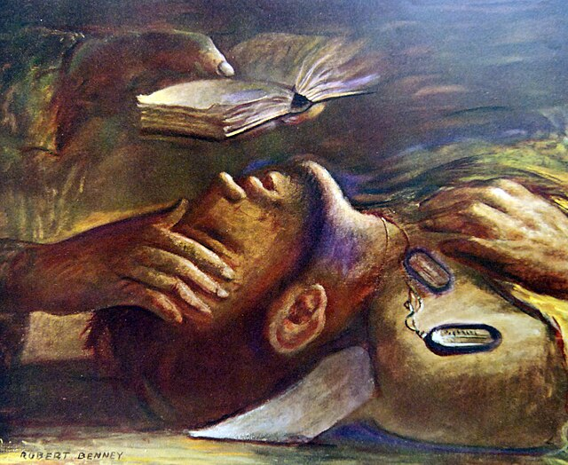
Holy Viaticum
Key
Vocab
Definition: The last Holy Communion received by a dying person before their death. It's considered “provisions for a journey” or “bread for the journey” to strengthen the soul for the passage to eternity. It is part of the Last Rites, which may include the Sacrament of Anointing and the Sacrament of Penance.
Notes:
Photo Credit: National Museum of the U.S. Navy. Public domain.“Men with God," artwork by Robert Benny showing soldier being given last rites. https://commons.wikimedia.org/
Directions: Have students add this vocabulary term to their notes.
Online Resources: Have students view video, Mass in a Minute: Viaticum/Last Rites. URL here: https://youtu.be/HMCi9rBahnc
The videos linked in this presentation file may contain copyrighted material. Such material is made available for educational purposes only. This constitutes a “fair use” of any such copyrighted material as provided for in Title 17 U.S.C. section 106A-117 of the US Copyright Law.

Slide 11
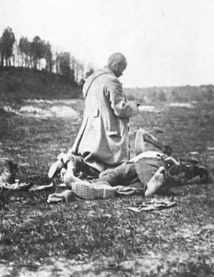
The Rite of Anointing
The Rite of the Anointing of the Sick consists in the anointing of the forehead and hands of the sick person while saying:
"Through this holy anointing may the Lord in his love and mercy help you with the grace of the Holy Spirit. May the Lord who frees you from sin, save you, and raise you up."
Notes:
Photo Credit: Photo Credit: Extreme Unction Rogier Van der Weyden.jpg. Public domain. https://commons.wikimedia.org/
Directions: Have students summarize the information from the slide into their notes.
Teaching Point
The essential Rite of the Anointing of the Sick consists in the anointing of the forehead and hands of the sick person (in the Roman Rite), or other parts of the body (in the Eastern rite) while the celebrant prays for the special grace of the sacrament. The Rite of the Anointing of the Sick consists of eight parts: Introductory Rites, Liturgy of the Word, Litany or Prayer of the Faithful, Laying on of Hands, Blessing of Oil, Prayer of Thanksgiving, Anointing with Oil of the Sick, and Prayer after Anointing.

Slide 12

Who May Receive Anointing?
Those who are dangerously ill due to sickness or old age
Those whose illness recurs or becomes more serious
Those about to undergo serious surgery
Those who are growing weaker due to old age
Children who have reached the age of reason and who are seriously ill
Sick people who have lost consciousness or the use of reason, but who would have asked for the sacrament if they were able to do so
Notes:
Directions: Have students copy information from slide into their notes.
Teaching Points
In the past, this sacrament was usually associated only with people who were dying as ‘Last Rites’. Since Vatican Council II, the Church has once again begun to think of anointing as part of the mission of everyone in the Church. The pastoral document approved by the council states that it is “especially fitting that all baptized Christians share in this ministry of mutual charity within the Body of Christ by doing all that they can to help the sick return to health, by showing love for the sick, and by celebrating the sacraments with them.” —Pastoral Care of the Sick: Rites of Anointing and Viaticum The Roman Ritual Revised by Decree of the Second Vatican Council, 33
Online Resources: Have students view video, Who can receive the Sacrament of the sick? URL here; https://youtu.be/owlORxkpjr8
The videos linked in this presentation file may contain copyrighted material. Such material is made available for educational purposes only. This constitutes a “fair use” of any such copyrighted material as provided for in Title 17 U.S.C. section 106A-117 of the US Copyright Law.

Slide 13

Why and when should we receive the Sacament of the Anointing of the Sick?
“Why I receive the Anointing of the Sick before giving birth”
Article by Theresa Civantos Barber
Notes:
Photo Credit: Happy-mother-with-baby.jpg. Mark Befur. Creative Commons Attribution-Share Alike 4.0. https://commons.wikimedia.org/wiki/File:Happy-mother-with-baby.jpg.
Directions: Have students copy information from slide into their notes.
Teaching Points:
According to Theresa Civantos Barber’s article, other Catholic women also shared some reasons for receiving the sacrament before giving birth:
“It’s a surgery. I could die. Why not?”
“Being absolved of my sins right before a major surgery is a plus.”
“My sixth c-section was a wakeup call to how our lives are on the line with these high-risk pregnancies.”
“My babies were both preemies so it was as much for them as me.”
“The sacramental grace gave me grace and created a space of complete trust in the Lord without anxiety. It also helped me physically heal at a much faster rate than my previous time.”
Online Resources: Assign article, Why I receive the Anointing of the Sick before giving birth. Article here: https://aleteia.org/2021/03/27/why-i-receive-the-anointing-of-the-sick-before-giving-birth/

Slide 14

Memorize It
Key
Verse
“Is anyone among you sick? He should summon the presbyters of the church, and they should pray over him and anoint [him] with oil in the name of the Lord.” — James 5:14
Notes:
Directions: Have students copy the quote. Add bonus points to the assessment if they can copy it down and demonstrate that they memorized it.

