Slide 1

8. THE CHURCH CONTINUES
HER MISSION
Notes:
Suggestions for students’ note taking:
●Require students to use a three ring binder (1/2-1 inches) full of loose leaf paper (college or wide ruled).
●Notes must be taken in pen only and hand written.
●Notebooks should contain information and notes for religion class only.
●Notebooks must have a table of contents with topic of notes, dates and page numbers.
●All notes must have a topic and page number.
●Students will be required to copy each slide unless the teacher directs students to skip certain slides or parts of slides. Notebooks will be graded based on neatness, completeness and organization. Notebooks should have a significant point value representing 20-25% of the overall grade.
The resources linked in this presentation file may contain copyright material. Such material is made available for educational purposes only. This constitutes a “fair use” of any such copyright material as provided for in Title 17 U.S.C. section106A-117 of the US Copyright Law.

Slide 2

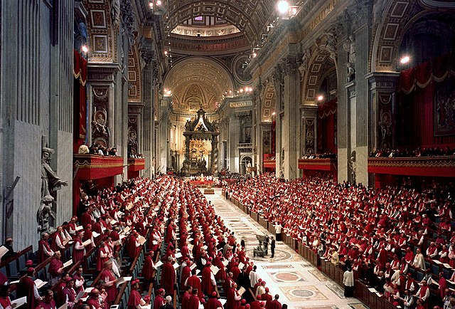
VATICAN II
“What a treasure there is, dear brothers and sisters, in the guidelines offered to us by the Second Vatican Council.... a sure compass by which to take our bearings in the century now beginning.” -Saint Pope John Paul II
Notes:
Photo Credit: A public session: see television camera. Date unknown. Catholic Press Photo. Public domain. https://commons.wikimedia.org/wiki/File:Vatican_II_in_session.jpg
Directions: Have students copy information from the slide into their notes.
Teaching Points: Pope John XXIII called the Second Vatican Council, expressing his view that the Church needed to be “updated” so that it could respond more effectively to the world of the twentieth century. The pope called for a renewal of enthusiasm for embracing and sharing the faith in new ways to reach the contemporary world more effectively.
The Second Vatican Council (or Vatican II) was the most recent (twenty-first) ecumenical council of the Catholic Church. It lasted for four sessions from 1962 through 1965. It produced a series of documents to direct the life of the Church in the twentieth century and beyond.
Online Resources: Have students view video, Vatican II in Brief. URL here: https://youtu.be/3OGl5Ys-_nQ
Have students view video, What was Vatican II?. URL here: https://youtu.be/jyVq1hnxAqg
The resources linked in this presentation file may contain copyright material. Such material is made available for educational purposes only. This constitutes a “fair use” of any such copyright material as provided for in Title 17 U.S.C. section106A-117 of the US Copyright Law.

Slide 3
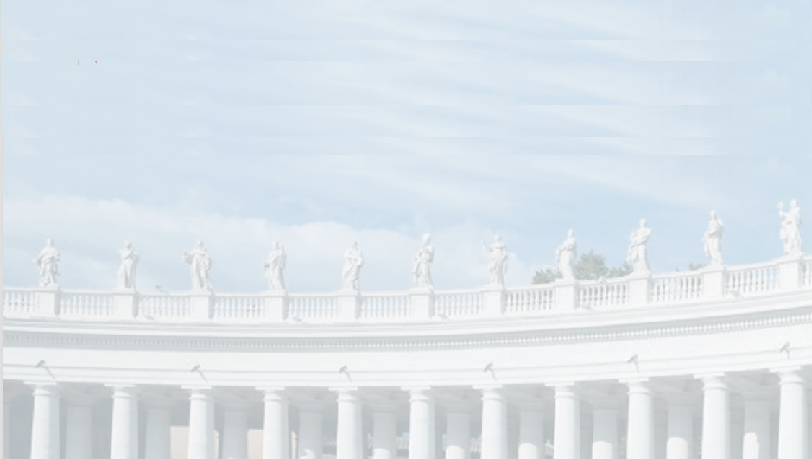
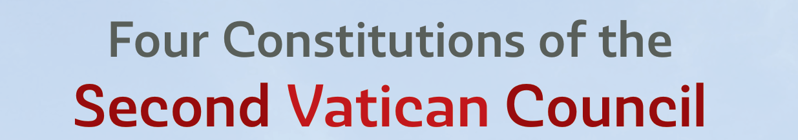
Dei
Verbum
Revelation
Lumen Gentium
The Church
Sacrosanctum Concilium
Liturgy
Gaudium
et Spes
The Modern World
Notes:
Photo Credit: AMP Textbook 416.
Directions: Have students copy quote from the slide into their notes.
Teaching Points: The constitutions and other documents of the Second Vatican Council are unique in that they contain only positive doctrine and no canons. To be made official, a constitution must be formally approved by the pope. The four constitutions of the Second Vatican Council were approved by Pope Paul VI…
Dei Verbum: This constitution emphasizes revelation as God’s disclosure of himself. It encourages all Catholics, especially the laity, to read, study, and pray with the Bible. It also reinforces the close relationship between Sacred Scripture and Sacred Tradition.
Lumen Gentium: This constitution gives special attention to the image of the Church as the People of God: lay, consecrated religious, and ordained. It teaches that all members of the Church have a responsibility for carrying out the Church’s mission.
Sacrosanctum Concilium: This constitution emphasizes that the liturgy is the pinnacle of the Church’s activity, stresses the vital importance of the Eucharist, and introduces permission to use vernacular languages in the liturgy, instead of only Latin, although Latin remains the official language of the Church.
Gaudium et Spes: This constitution holds that every member of the Church is called to bear witness to Christ and to help in his or her own way to bring about the transformation of the modern world in a spirit of joy and hope.
Online Resources: Have students view video, EWTN: Documents of Vatican II. URL here: https://youtu.be/hN55SuVD7VQ
The resources linked in this presentation file may contain copyright material. Such material is made available for educational purposes only. This constitutes a “fair use” of any such copyright material as provided for in Title 17 U.S.C. section106A-117 of the US Copyright Law.

Slide 4

Positive Fruits of Vatican II
Lay people have leadership roles
There is more dialogue with others
Language is Understandable
Lay Apostolates
Bible study has grown
Notes:
Photo Credit: People.svg,Creative Commons Zero, Public Domain Dedication. https://commons.wikimedia.org/wiki/File:People.svg
Directions: Have students copy these quotes on the slide in their notes.
Teaching Points: Positive Fruits of Vatican II:
The liturgy has become more accessible through the use of local languages and congregational singing.
The empowerment of the laity is everywhere on display, as the non-ordained have taken on leadership roles in the Church.
Laity have advanced in society through education and economic progress and have created important apostolates to assist both Catholics and non-Catholics in various ways.
Many Catholics have gained an appreciation for the Bible, and cooperation with non-Catholics has increased.
The resources linked in this presentation file may contain copyright material. Such material is made available for educational purposes only. This constitutes a “fair use” of any such copyright material as provided for in Title 17 U.S.C. section106A-117 of the US Copyright Law.

Slide 5
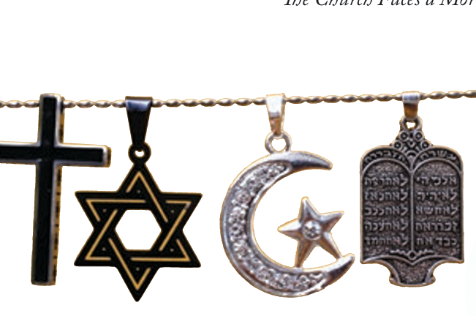
Nostra Aetate
Key
Vocab
Nostra Aetate pronounced, no-struh-ah-taught-tay. A Vatican II declaration on the relation of the Church to non-Christian religions. It affirmed many positive qualities of other religions.
Notes:
Photo Credit: AMP textbook pg. 375.
Directions: Have students copy vocabulary term and definition from the slide into their notes.
Teaching Points: Vatican II's Declaration on the Relation of the Church to Non-Christian Religions (Nostra aetate; Latin: “In Our Era”) is a landmark document that rejected the accusation that the Jews killed Christ, recognized the legitimacy of Judaism, and condemned anti-Semitism as well as outreach in dialogue with other non-christian religions such as Islam.
Online Resources: View video, Nostra Aetate 50th Anniversary. URL here: https://youtu.be/_LCYRRR7Lfc
Have students view video, Documents of Vatican II: Nostra Aetate. URL here: https://youtu.be/kpjXWchrYJA
The resources linked in this presentation file may contain copyright material. Such material is made available for educational purposes only. This constitutes a “fair use” of any such copyright material as provided for in Title 17 U.S.C. section106A-117 of the US Copyright Law.

Slide 6
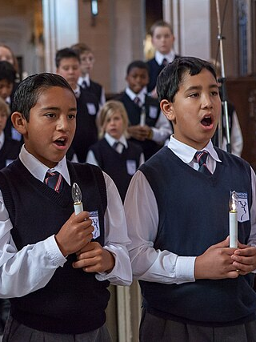
Liturgy: The Call for active Participation
“All the faithful should be led to that fully conscious, and active participation in liturgical celebrations which is demanded by the very nature of the liturgy” -Sacrosanctum Concilium 14
Notes:
Photo Credit: San Francisco Boys Chorus at St Dominic's Catholic Church. Pax Ahimsa Gethen. Creative Commons Attribution-Share Alike 3.0. https://commons.wikimedia.org/wiki/File:San_Francisco_Boys_Chorus_at_St_Dominic%27s_Catholic_Church.jpg
Directions: Have students copy quote from the slide into their notes.
Teaching Points: Before the Second Vatican Council, the Mass was normally said in Latin. The altar servers, not the congregation, responded to the priest’s invocations. Most Masses (i.e., low Mass) did not have music.
The typical high Mass did have music, but most or all of the singing was done by choirs and ministers, not the congregation. Sacrosanctum Concilium recommended that more of the Mass be presented in the vernacular language (the language spoken by the people in a region, such as English in most of the United States).
It also called for “dialogue” Masses, where the people would join the servers in giving the responses. and it encouraged more congregational singing. The goal of all these reforms was “that all the faithful should be led to that fully conscious, and active participation in liturgical celebrations which is demanded by the very nature of the liturgy” (SC, 14).
Most parts of the Mass are now a dialogue between the priest and the congregation. Even the longer Eucharistic Prayer, which seems to be a monologue given by the priest, is actually a dialogue. The congregation responds with its agreement to what the priest has prayed in the Eucharistic Prayer with the “Great Amen.”
Online Resources: Assign article, Full, Active, Conscious: Liturgy and Life. URL here: https://www.catholicapostolatecenter.org/blog/full-active-conscious-liturgy-and-life
Assign article, Four Ways Lay Peoples can be a part of the Mass. URL here: https://catholic-link.org/lay-liturgical-ministries-catholic-mass/
The resources linked in this presentation file may contain copyright material. Such material is made available for educational purposes only. This constitutes a “fair use” of any such copyright material as provided for in Title 17 U.S.C. section106A-117 of the US Copyright Law.

Slide 7
Struggles Since Vatican II
Shortage of Priests
Mass attendance has dropped
Lack of Solid Catechesis
Need More Evangelization
Rise of the ‘Nones’
Notes:
Photo Credit: People.svg,Creative Commons Zero, Public Domain Dedication. https://commons.wikimedia.org/wiki/File:People.svg
Directions: Have students copy these quotes on the slide in their notes.
Teaching Points: Struggles since Vatican II:
Fewer Catholics attend Mass regularly, and in many areas there is a shortage of priests.
In some places, many Catholics have not learned the Church’s teaching well and neglect Catholic moral principles.
Large numbers of Catholics have left the Catholic Church in favor of other Christian denominations or abandoned altogether the practice of religious faith.
This often called the rise of the ‘Nones”. Those who check the box ‘none’ when asked about their religious affiliation.
The peoples of the world—Christian, Jewish, Muslim, Hindu, atheist—still need to hear the message of the Gospel, and Catholics themselves need to become better disciples through the continual process of repentance and reform.
.
Online Resources: Have students view video, Bishop Barron: Rise of the Nones. URL here: https://youtu.be/pG2mtELrxkg
The resources linked in this presentation file may contain copyright material. Such material is made available for educational purposes only. This constitutes a “fair use” of any such copyright material as provided for in Title 17 U.S.C. section106A-117 of the US Copyright Law.

Slide 8
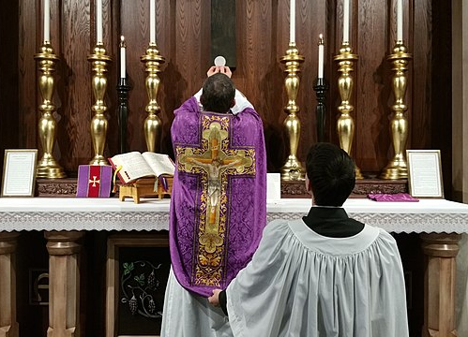
Traditional Latin Mass
Latin
Organ Music
Ad Orientum
Gregorian Chant
Kneeling for Communion
Notes:
Photo Credit: Traditional Latin Mass - Elevation. Andrewgardner1. Creative Commons Attribution 4.0. https://commons.wikimedia.org/wiki/File:Traditional_Latin_Mass_-_Elevation.jpg
Directions: Have students copy information from the slide into their notes. Ask, ‘On a scale of 1 to 10, rate yourself on how well you make Jesus the center of your life.’ Be ready to explain your rating.
Teaching Points: The debates and differences over the liturgical reform emerging out of the Second Vatican Council explain why, still today, people may experience very different kinds of Masses depending on which Catholic church they attend.
In some churches, parts of the Mass may be said in Latin, while in others everything is in English (or Spanish or another modern language).
In some, an organ may accompany ancient hymns, while in others guitars accompany contemporary worship songs. The priest may face the altar with his back toward the people, or he may face the congregation. Communicants might receive the Body of Christ on their tongues, possibly while kneeling, or they may receive in their hands while standing.
A growing segment of the Church has intentionally preserved the “Mass of the Ages” which is the Mass celebrated before Vatican II. Some have gravitated to this older version of Mass as a way to protest Vatican II as a whole. Others prefer the Traditional Latin Mass because they feel that it is more sacred, mysterious and reverent. The Church has placed restrictions on where and when these Masses may take place.
Online Resources: Have students view video, This is the Latin Mass. URL here: https://youtu.be/p8m8Fq8eKXI
The resources linked in this presentation file may contain copyright material. Such material is made available for educational purposes only. This constitutes a “fair use” of any such copyright material as provided for in Title 17 U.S.C. section106A-117 of the US Copyright Law.

Slide 9

Turn and Talk
Which parts of the Mass that you have attended are the most meaningful to you?
Notes:
Directions: Have students write down the prompt and then write down their answer….Then have students share their answers with one person close by.
The resources linked in this presentation file may contain copyright material. Such material is made available for educational purposes only. This constitutes a “fair use” of any such copyright material as provided for in Title 17 U.S.C. section106A-117 of the US Copyright Law.

Slide 10
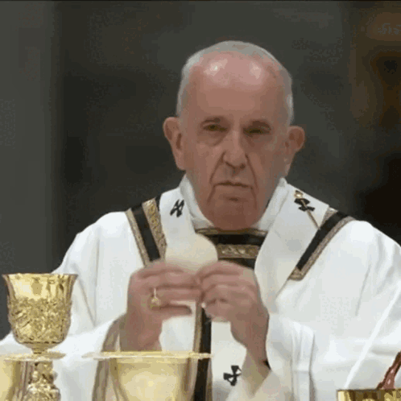
Source and Summit
Key
Vocab
Despite any outward differences in how the Mass is celebrated, the Eucharist is, according to Lumen Gentium, the “source and summit of the Christian life”.
Notes:
Photo Credit: Google Slides GIF.
Directions: Have students copy vocabulary term and definition from the slide into their notes.
Teaching Points:
The source: The Eucharist is the source of grace and Christian spirituality. It's the culmination of God's saving actions in Jesus Christ.
The summit: The Eucharist is the highest form of thanksgiving and the completion of sacramental initiation. It's the culmination of worship and union with Christ, who leads us to the Father.
All of the liturgy, and especially the Eucharist, is the heart of Catholic prayer life and the primary means by which we are united to each other and to Christ.
Whether it is in Latin, English, Spanish, or Chinese, the Mass is a reenactment of the Passion of Jesus.
Whether we stand or kneel to receive the host, it is the Real Presence, the Body and Blood of Christ.
Whether the songs we sing are a thousand years old or were composed in the twenty-first century, the purpose of our singing is to worship God.
In a global Church that encompasses people of all races, languages, and cultures, the “common celebration of divine worship” is one of the “visible bonds of communion” (CCC, 815) that assure the unity of the Church—one of her four essential marks.
Christians in the first century celebrated the Mass, and fellow Catholics across the world today celebrate the Mass; it is the link that connects the People of God across time and space.
Online Resources: Assign CCC article, Source and Summit. URL here: https://www.vatican.va/content/catechism/en/part_two/section_two/chapter_one/article_3/i_the_eucharist_-_source_and_summit_of_ecclesial_life.html
The resources linked in this presentation file may contain copyright material. Such material is made available for educational purposes only. This constitutes a “fair use” of any such copyright material as provided for in Title 17 U.S.C. section106A-117 of the US Copyright Law.

Slide 11
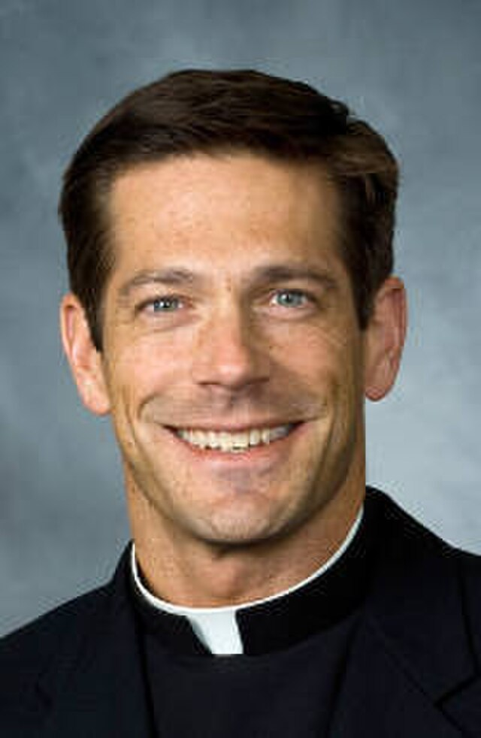
Testimony of the
Real Presence
“My mind was blown. This is real. What we’ve been doing at Mass. When the priest says this is my Body, this is my Blood, that bread becomes the Body of Christ. The wine becomes the Blood of Christ. That changed everything.”
-Fr. Mike Schmitz
Notes:
Photo Credit: Father Mike Schmitz. Diocese of Duluth. Creative Commons Attribution-Share Alike 4.0. https://commons.wikimedia.org/wiki/File:Father_Mike_Schmitz.jpg
Directions: Have students copy quote from the slide into their notes.
Teaching Points: Fr. Mike Schmitz, the personality behind The Bible in a Year podcast, was not always enthusiastic about the faith. “I was raised Catholic, but I didn’t really care about the Catholic Church,” he recalls. “Had to go to Mass every Sunday . . . hated going to Mass every Sunday. Went to Mass at Catholic elementary school . . . hated going to Mass at Catholic elementary school.” But when he was fifteen, “everything changed for me.” The experiences that ignited his faith revolved around Confession and the Eucharist.
He remembers picking up a book that was lying around his house and reading a chapter on the Eucharist. “My mind was blown. This is real. What we’ve been doing at Mass. When the priest says this is my Body, this is my Blood, that bread becomes the Body of Christ. The wine becomes the Blood of Christ. That changed everything.”
As a teenager, Fr. Mike gained a deep faith in the presence of Jesus in the Church. He realized, “The Eucharist we’ve had in every Catholic church for the last two thousand years is really Jesus.”
Online Resources: Have students view video, Fr. Mike Schmitz: How the Eucharist Changed My Life. URL here: https://youtu.be/_yKi2OJ7oqE
Assign article: Jonathan Roumie: 'If it’s a symbol to hell with it'. URL here: https://www.catholic365.com/article/41743/jonathan-roumi-if-its-a-symbol-to-hell-with-it.html
Have students view video Jonathan Roumi address at the at the National Eucharistic Revival Congress.URL here: https://youtu.be/H7iZEOxAWoE
The resources linked in this presentation file may contain copyright material. Such material is made available for educational purposes only. This constitutes a “fair use” of any such copyright material as provided for in Title 17 U.S.C. section106A-117 of the US Copyright Law.

Slide 12
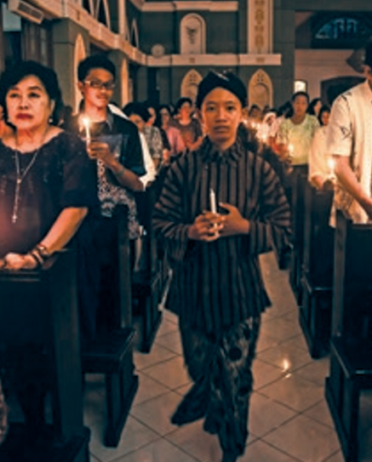
The Universal Call to Holiness
“Everyone, whether belonging to the hierarchy or being cared for by it, is called to holiness, according to the saying of the Apostle: ‘For this is the will of God, your sanctification.’” -Lumen Gentium 39
Notes:
Photo Credit: AMP Textbook pg. 427.
Directions: Have students copy quote from the slide into their notes.
Teaching Points: The vocation given to Catholics in Baptism is part of the common priesthood of the faithful. Living this gift is “exercised by the unfolding of the bap tismal grace—a life of faith, hope, and charity, a life according to the Spirit” (CCC, 1547).
Common priesthood of the faithful: The priesthood of the baptized. Christ has made the Church a “kingdom of priests” who share in his priesthood through the Sacraments of Baptism and Confirmation.
The Sacrament of Baptism calls all Catholics to live holy lives and, further, to consider how the vocations of the ordained ministry, consecrated life, marriage and family life, or a single life dedicated to a life of chastity and service to others is connected with holiness and their individual purpose in the Church.
Online Resources: Have students view video, What are the Laity are Supposed to Be?. URL here: https://youtu.be/hvUaSMZPJHc
The resources linked in this presentation file may contain copyright material. Such material is made available for educational purposes only. This constitutes a “fair use” of any such copyright material as provided for in Title 17 U.S.C. section106A-117 of the US Copyright Law.

Slide 13
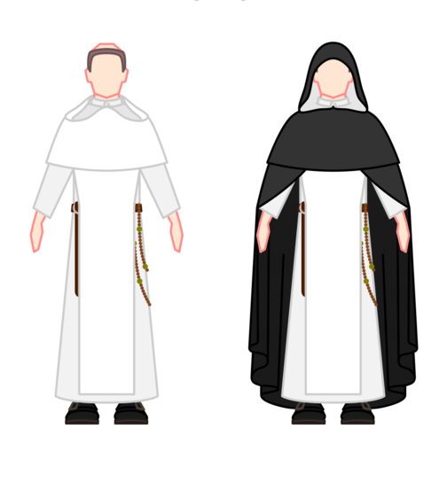
Religious Life
Religious Counsels: Vows to live a life of poverty, chastity and obedience.
Service to the Church
A Life of Prayer
Conformity to Christ
Notes:
Photo Credit: Habit of the Dominican priest-friars. (1) Habit for the house, (2) habit for the world and for choir.David Abreu Acosta
Creative Commons Attribution-Share Alike 4.0 (cropped). https://commons.wikimedia.org/wiki/File:Habit_of_the_Dominican_priest-friars.png
Directions: Have students copy quote from the slide into their notes.
Teaching Points: All Catholics are called to live the evangelical counsels.
For consecrated religious, this takes the form of a vow. Some, but not all, members of the clergy (bishops, priests, and deacons) are consecrated religious.
Each of the counsels stands in opposition to a temptation that can draw a person away from God.
A commitment to poverty frees one from the temptation to sin for the sake of material wealth.
A commitment to chastity frees one from the temptation to sin for the sake of physical pleasure. In the Latin Church, celibacy, the state of being unmarried for the sake of the Kingdom of God, is required for bishops and priests.
A commitment to obedience frees one from the temptation to sin for the sake of power. These evangelical counsels also make up the heart of consecrated, or religious, life, described in the following subsection.
Religious life is devoted to the welfare of the Church through the practice of the evangelical counsels.
The practice of these counsels through various ministries performed by religious always lead to charity, which inspires others to seek out Christ and the Church.
Lumen Gentium teaches, religious life is “not an intermediate state between the clerical and lay states. But, rather, the faithful of Christ are called by God from both these states of life so that they might enjoy this particular gift in the life of the Church and thus each in one’s own way, may be of some advantage to the salvific mission of the Church” (LG, 43).
Religious life is a sign of the bridge between heaven and earth. In a secular world in which the minds of many are primarily on the cares of this time and space, religious sisters, brothers, and priests are asked to keep in mind “the fact that the Church presents Christ to believers and non-believers alike in a striking manner daily through them” (LG, 46).
Online Resources: View video, What is Consecrated Life?. URL here: https://youtu.be/cuMS5nVeUEw
The resources linked in this presentation file may contain copyright material. Such material is made available for educational purposes only. This constitutes a “fair use” of any such copyright material as provided for in Title 17 U.S.C. section106A-117 of the US Copyright Law.

Slide 14
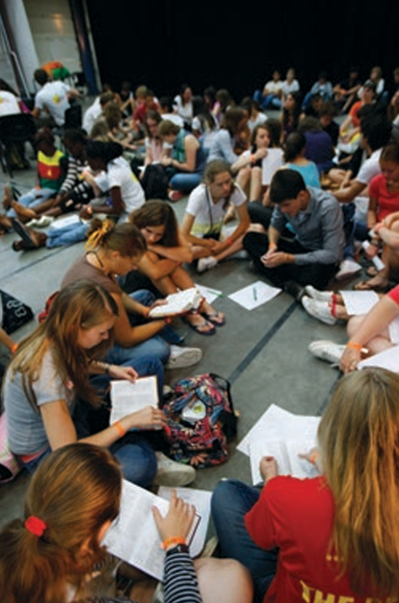
Scriptural Renewal
“The force and power in the word of God is so great that it stands as the support and energy of the Church, the strength of faith for her sons, the food of the soul, the pure and everlasting source of spiritual life.” -Dei Verbum 21
Notes:
Photo Credit: AMP Textbook p. 444.
Directions: Have students copy information from the slide into their notes.
Teaching Points: ” The Second Vatican Council urged all Catholics to “remember that prayer should accompany the reading Sacred Scripture, so that God and man may talk together” (Dei Verbum, 25). This was something new for many Catholics in the 1960s, when the Council was taking place. Many Catholics did not even own a Bible at the time, and the only time they heard anything from the Bible in their own language was when small snippets of Scripture would be read to them at Mass.
Thankfully had has changed. There has been an ongoing renewal of scripture studies within the Catholic Church by both religious and laity.
Catholics have been reminded to…
Pay attention to the Bible as a whole, not just individual passages or even books. he entirety of Scripture is a unity of God’s plan, and Christ is at the center of it.
Read the Bible in light of the Sacred Tradition of the Church: The Holy Spirit inspired the authors of Scripture. Scripture remains alive because it is interpreted by the Holy Spirit through the Church: It must be read from the perspective of the Church rather than individualistically, that is, you must consider what the Church says about its meaning.
Be attentive to the analogy of faith: The hierarchy of truths of faith, of which the Scriptures are a part, must be placed in the context of the whole of God’s revelation. The Scriptures must be understood within the whole plan of God’s revelation.
Online Resources: View video, Documents of Vatican II: Dei Verbum. URL here: https://youtu.be/ShjlGEVYRUQ
View video, Dr. Bergsma: Seven Verses Every Catholic Should Know. URL here: https://youtu.be/L1LK90dnRkI
The resources linked in this presentation file may contain copyright material. Such material is made available for educational purposes only. This constitutes a “fair use” of any such copyright material as provided for in Title 17 U.S.C. section106A-117 of the US Copyright Law.

Slide 15
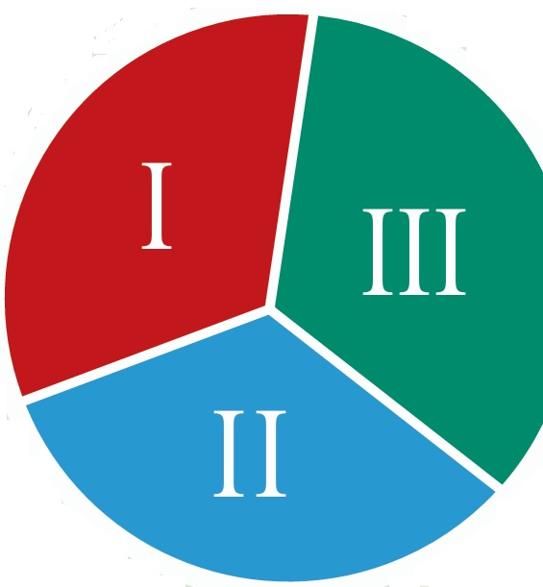
Lectio Divina
Reading
Meditation
Prayer
Notes:
Photo Credit: AMP Textbook p. 443.
Directions: Have students copy quote from the slide into their notes.
Teaching Points: There has been a renewed interest in Lectio divina which means “divine reading” in Latin. You can also think of it as “prayerful reading.
Lectio divina can be divided into three steps:
I. The first step, lectio (reading), involves selecting a spiritual reading, in this case Scripture. Once you select a passage read the passage until a verse or phrase strikes you. At this point, stop and begin your meditation.
II. The second step, meditatio (meditation), asks you to pause and to let the meaning sink into your mind and heart. Mentally repeat the words over and over. Let them become part of you. Appreciate what they are saying. After spending some time pondering the meaning of the words, turn to prayer.
III. The third step, oratio (prayer) has you speak to God about the phrase, or simply sit in God’s presence and let him speak to you. When you find that you have exhausted your prayer, or when you become distracted, return to the passage again, and begin to read until you come to another phrase that seems to be speaking directly to you. T hen continue the process as before.
Online Resources: Have students view video, Central Catholic: Lectio Divina. URL here: https://youtu.be/lt2iGxLlqNY
The resources linked in this presentation file may contain copyright material. Such material is made available for educational purposes only. This constitutes a “fair use” of any such copyright material as provided for in Title 17 U.S.C. section106A-117 of the US Copyright Law.

Slide 16

“Why does it feel like being serious about living my Catholic Faith is so counter-cultural?”
The United States and other modern nations have entered into an era that can be called post-Christian. A term often applied to Western cultures and nations that were historically Christian but now reject the authority of the Church in particular, and Christianity in general.
There are many who do not pray or attend church regularly, do not accept the teachings of the Church, or do not try to live according to Gospel morality. Some resent those who still do.
Notes:
Directions: Use the animation feature to have the yellow answer box appear after you ask the students to respond out loud to the question on the left.
Online Resources: Have students view video The Catholic Family in a Post-Christian World. URL here: https://youtu.be/V2_fVfgVpRg
Have students view, Is it Cool to Be Catholic?. URL here: https://youtu.be/WVWHhDeHPGs
The resources linked in this presentation file may contain copyright material. Such material is made available for educational purposes only. This constitutes a “fair use” of any such copyright material as provided for in Title 17 U.S.C. section106A-117 of the US Copyright Law.

Slide 17

Memorize It
Key
Quote
“Now we must help each other get to heaven”
-Karl von Habsburg said upon marrying Empress Zita
Notes:
Directions: Have students copy the quote. Add bonus points to the assessment if they can copy it down demonstrating that they memorized it.
Online Resources: Have students view video, Blessed Charles of Hapsburg. URL here: https://youtu.be/wYiDt0it_ko
The resources linked in this presentation file may contain copyright material. Such material is made available for educational purposes only. This constitutes a “fair use” of any such copyright material as provided for in Title 17 U.S.C. section106A-117 of the US Copyright Law.

