Slide 1
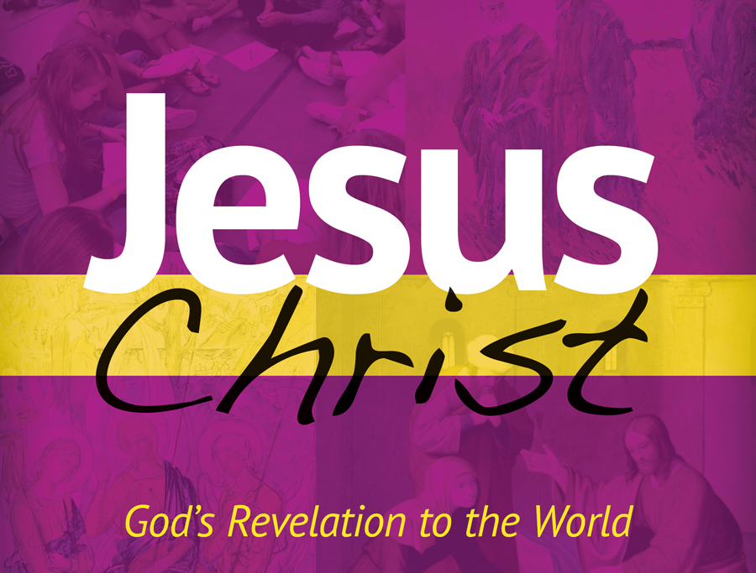
Chapter 4 PowerPoint

Slide 2
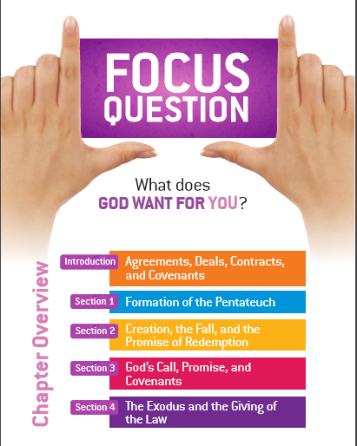

Slide 3
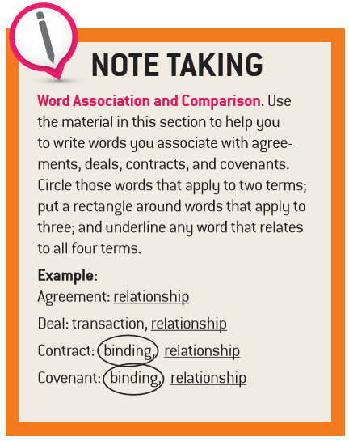
Introduction: Agreements, Deals, Contracts, and Covenants

Slide 4
Covenant A binding and solemn agreement between human beings or between God and people, holding each other to a particular course of action.
Old Testament Covenants
Noah | Genesis 9:8-17
Abraham | Genesis 15:8-18
Moses | Exodus 24:3-8
David | 2 Samuel 7:4-29
Introduction: Agreements, Deals, Contracts, and Covenants

Slide 5
The History of Salvation: God’s Plan for His People
Covenant Mediator | Adam | Noah | Abraham | Moses | David | Jesus
Covenant Form | Marriage | Household | Tribe | Nation | Kingdom | Church
Covenant Sign | Sabbath | Rainbow | Circum-cision | Passover | Temple & Throne | Eucharist
Introduction: Agreements, Deals, Contracts, and Covenants

Slide 6
Formation of the Pentateuch

Slide 7
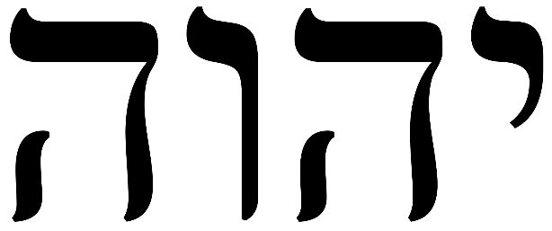
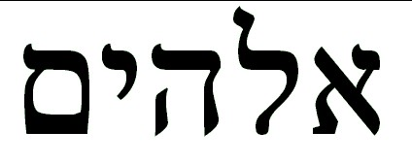
YHWH God’s sacred name, revealed to Moses; it means “I am who I am” or “I AM” and is never pronounced by Jews.
Elohim A common Semitic word for God used in the Bible. Elohim appears in Hebrew names like Mich-a-el, Dan-i-el, and Ari-el.
Formation of the Pentateuch

Slide 8
The Pentateuch (Torah) at a Glance
Genesis | 50 chapters | Origin of the human race Stories of the Patriarchs
Exodus | 40 chapters | The suffering of the Israelites The exodus The covenant and the Law
Leviticus | 27 chapters | Laws of Sacrifice Consecration of the Priesthood Law of clean and unclean The holiness code
Numbers | 36 chapters | Census Historical narratives
Deuteronomy | 34 chapters | Moses’ address to the Israelites Revised laws
Formation of the Pentateuch

Slide 9
Creation, the Fall, and the Promise of Redemption

Slide 10
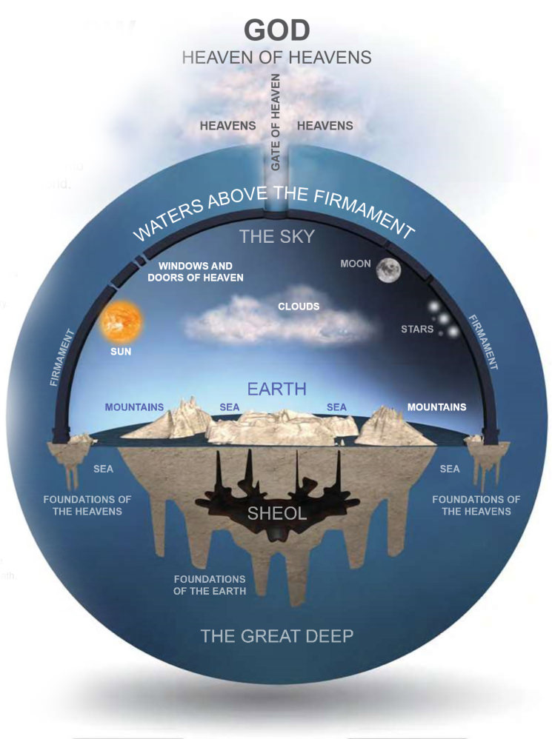
Creation, the Fall, and the Promise of Redemption

Slide 11
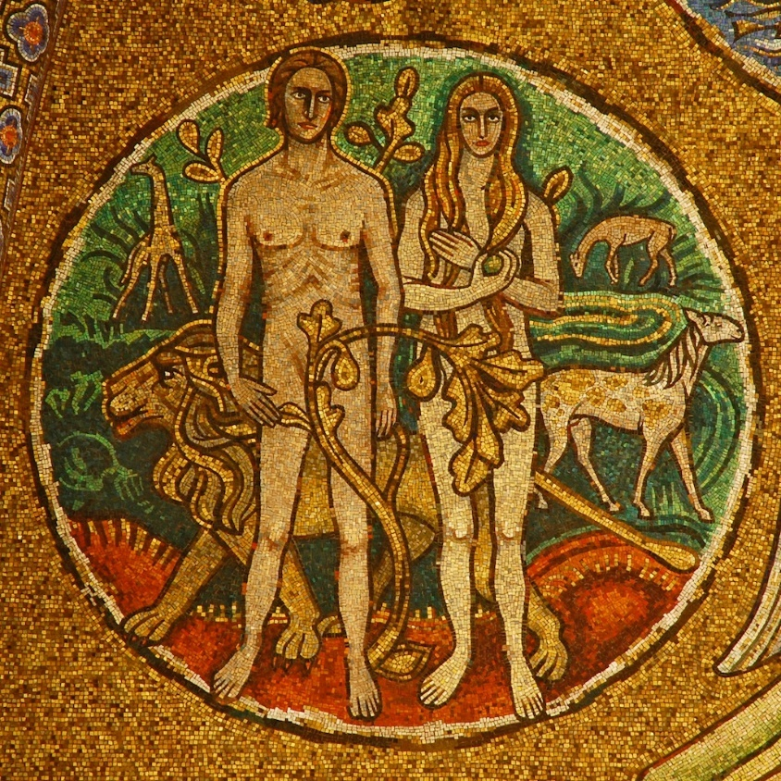
Original Holiness & Original Justice The state of Adam and Eve before sin. The grace of Original Holiness was for people to share in God’s life. The main gifts of Original Justice were that people would not have to suffer or die. Original Justice also guaranteed an inner harmony of the human person, the harmony between man and woman, and the harmony between Adam and Eve and all of creation.
Creation, the Fall, and the Promise of Redemption

Slide 12
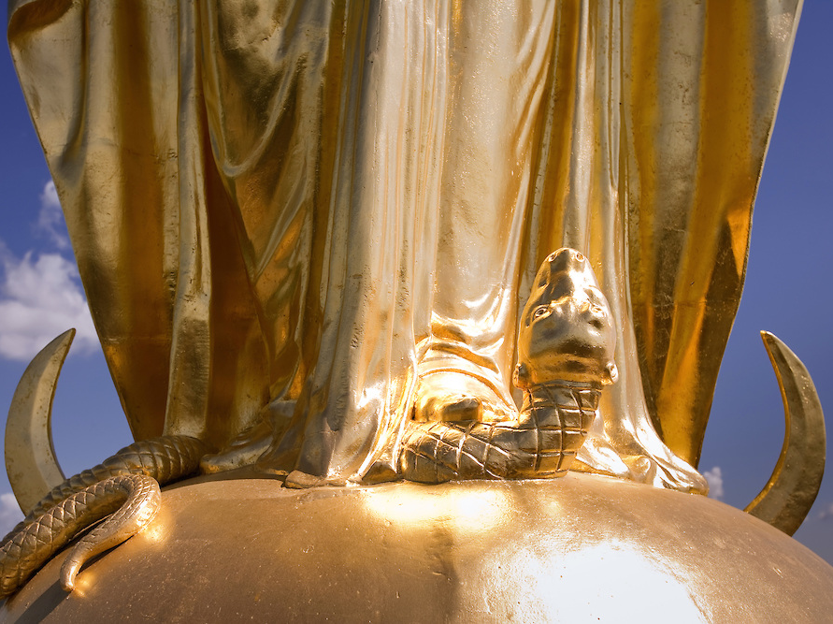
Protoevangelium: “I will put enmity between you and the woman, and between your offspring and hers; He will strike at your head, while you strike at his heel. (Genesis 3:15)
Creation, the Fall, and the Promise of Redemption

Slide 13
God’s Call, Promise, and Covenants

Slide 14
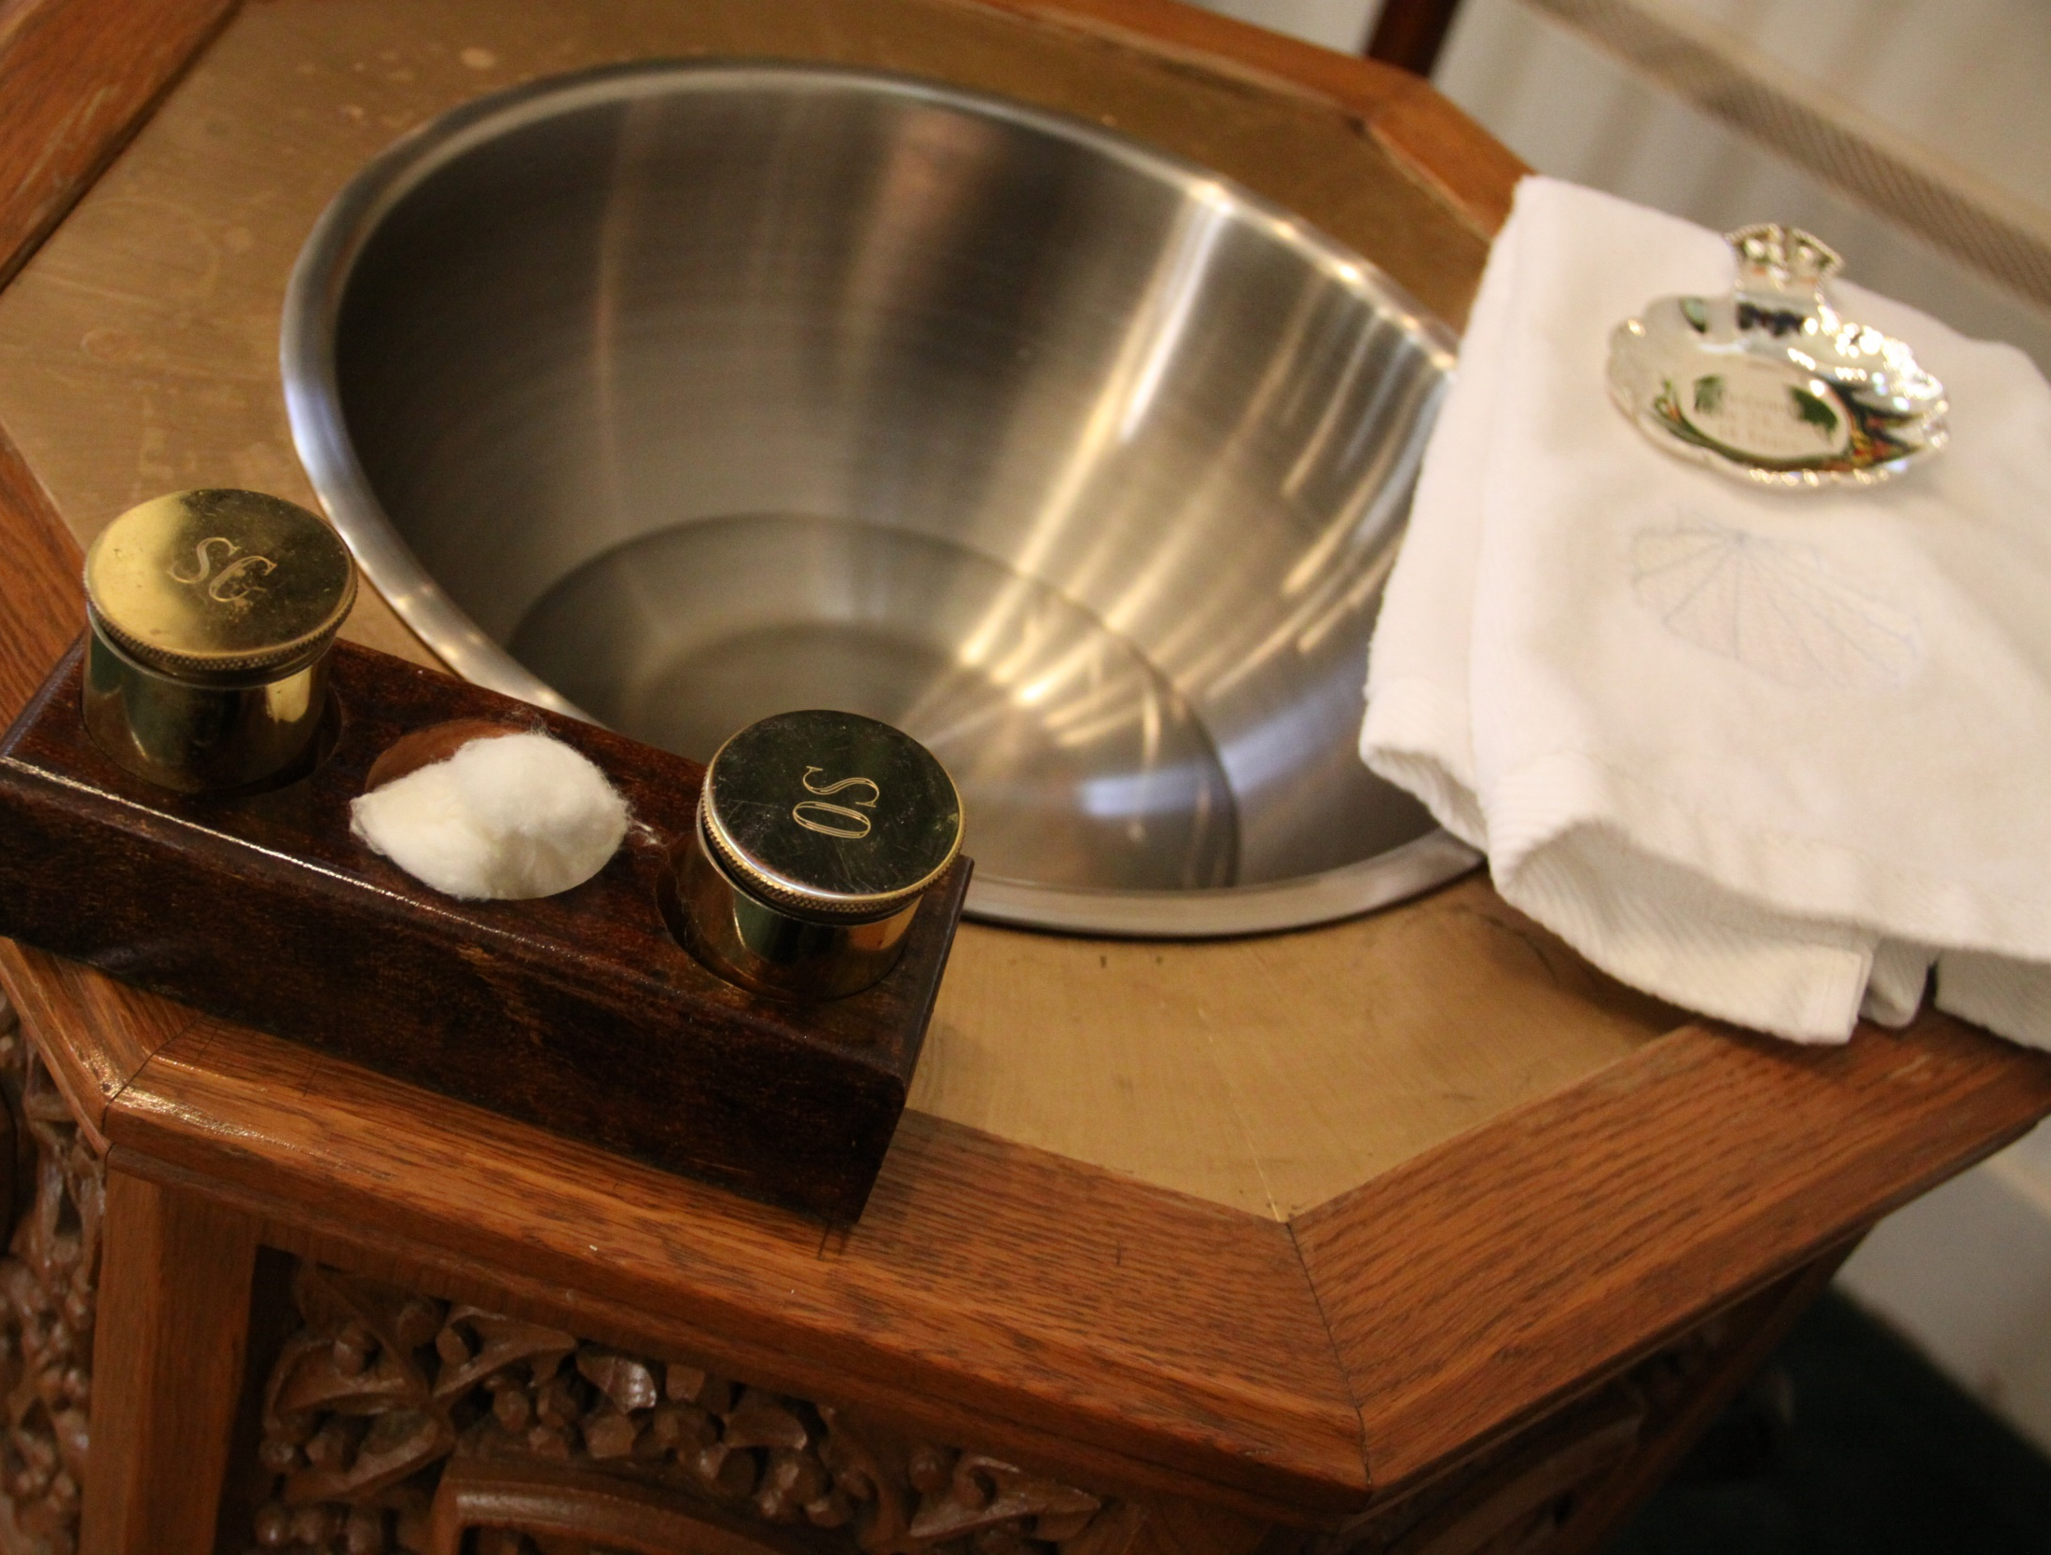
In him you were also circumcised with a circumcision not administered by hand, by stripping off the carnal body, with the circumcision of Christ. You were buried with him in baptism, in which you were also raised with him through faith in the power of God, who raised him from the dead. Colossians 2:11-12
God’s Call, Promise, and Covenants

Slide 15
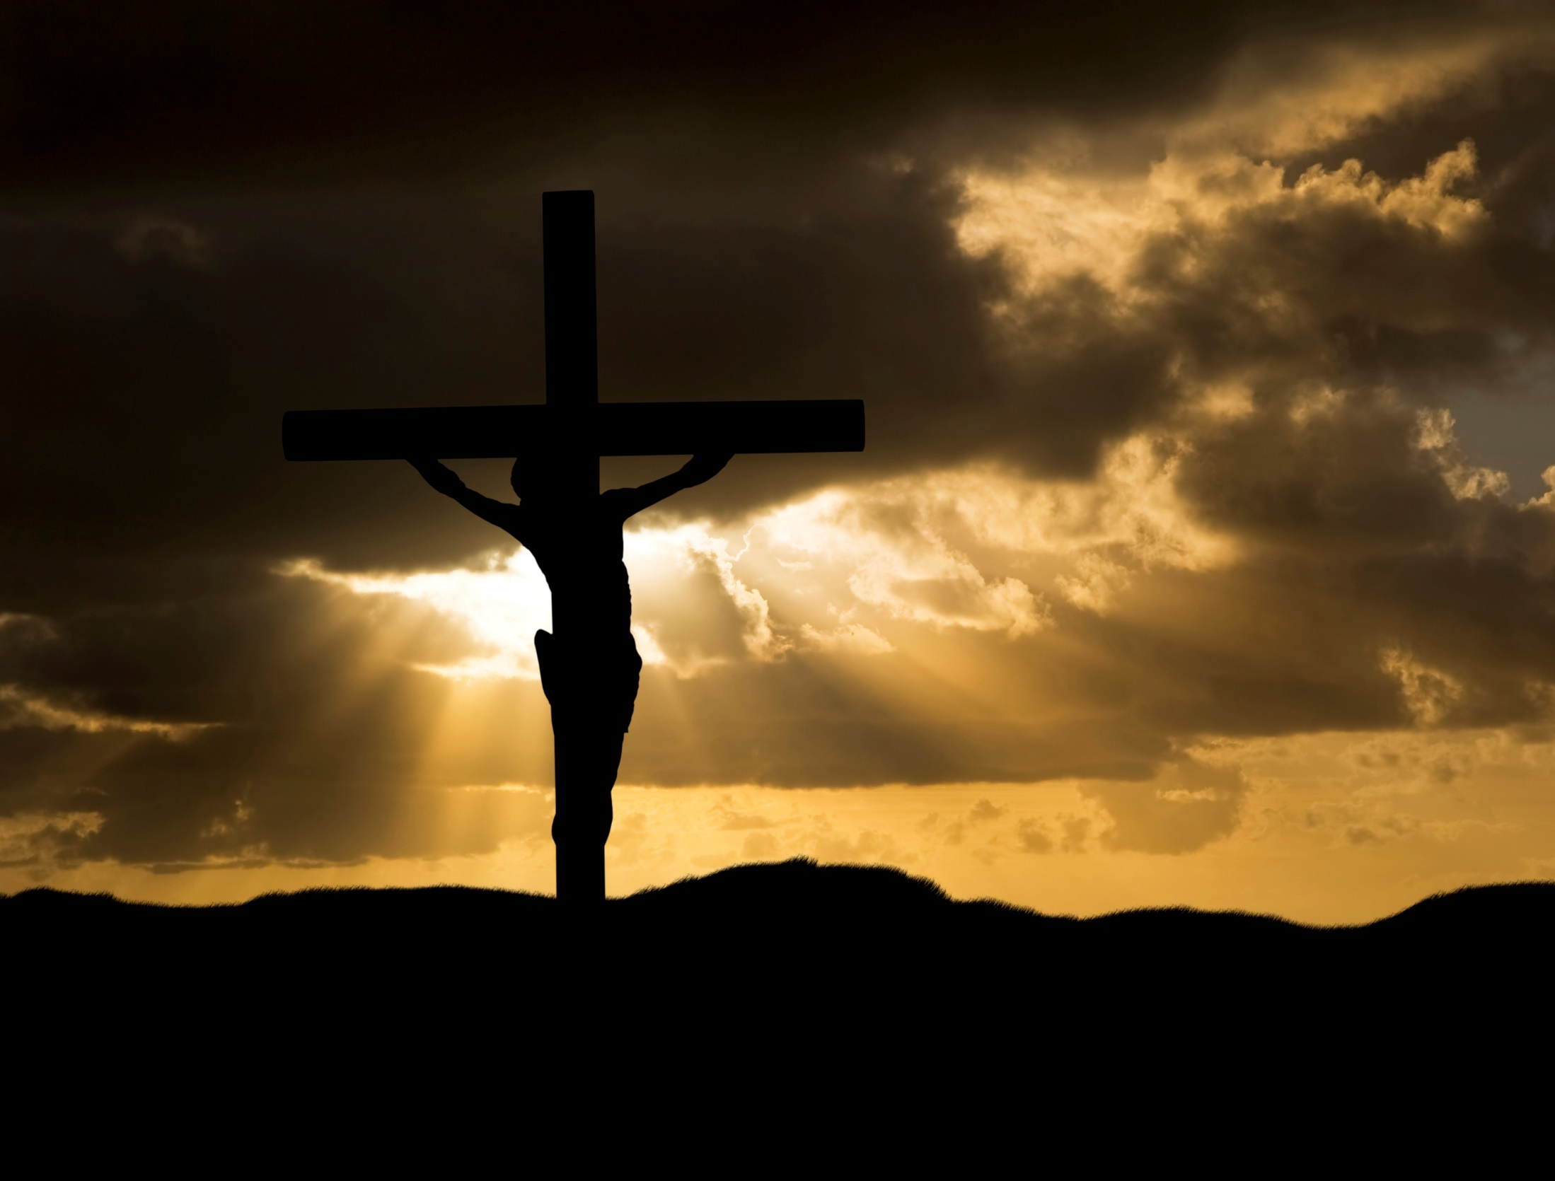
The sacrifice of Isaac is a foreshadowing of the sacrifice of Christ
Biblical Type (Gen 22) | Fulfillment
Abraham offers his only son | God offers his only Son
Isaac carries the wood for sacrifice | Jesus carries the cross
Isaac escapes death after 3 days | Jesus rises from dead on 3rd day
Abraham tells Isaac that God will provide a lamb | Jesus is the Lamb of God
God provides a male ram as a substitutionary sacrifice | God provides a male, Jesus, as a substitutionary sacrifice
The ram is caught by its horns in a thicket | Jesus wears a crown of thorns
A sacrifice is offered at Mt Moriah | Jesus is crucified at Mt Moriah
God’s Call, Promise, and Covenants

Slide 16
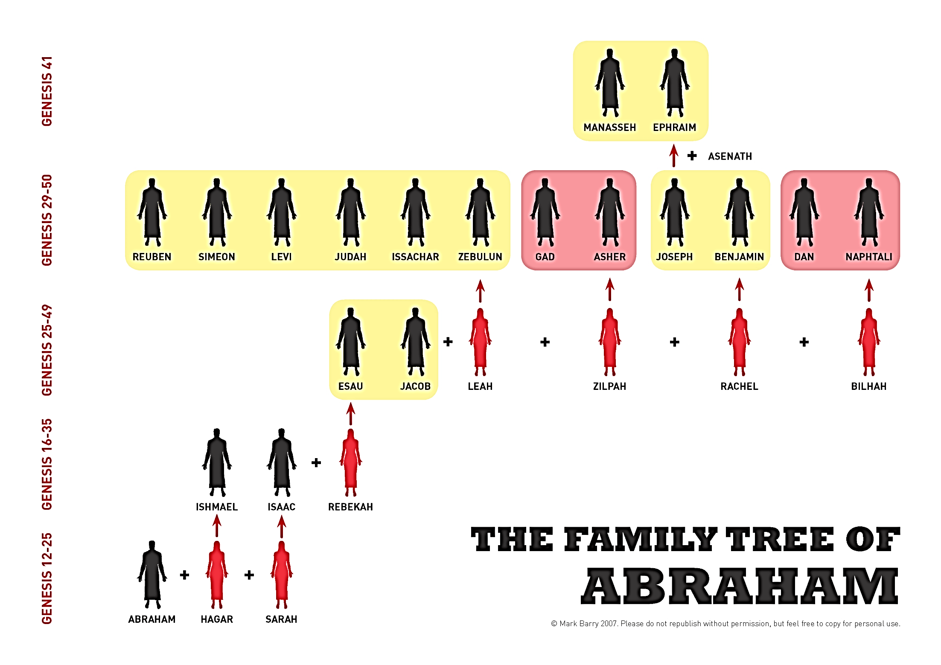
God’s Call, Promise, and Covenants

Slide 17
God’s Call, Promise, and Covenants

Slide 18
The Exodus and the Giving of the Law

Slide 19
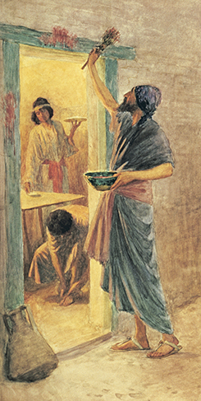
Passover A sacred feast that first occurred prior to God’s saving the Israelites from the Egyptians. The angel of death “passed over” the houses with lambs’ blood smeared on their doorposts and lintels. The Passover then became a religious celebration reminding the Chosen People of God’s deliverance, Salvation, fidelity, and love.
But for you the blood will mark the houses where you are. Seeing the blood, I will pass over you; thereby, when I strike the land of Egypt, no destructive blow will come upon you. Exodus 12:13
The Exodus and the Giving of the Law

Slide 20
The Exodus and the Giving of the Law

Slide 21
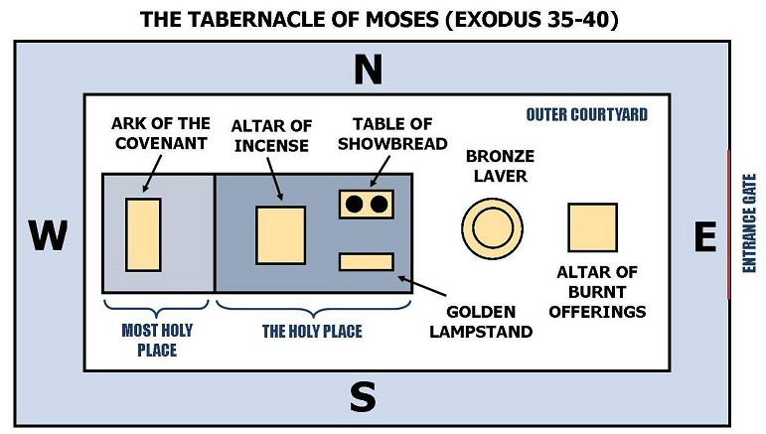
Tabernacle The portable sanctuary in which the Jews carried the Ark of the Covenant throughout their travels in the desert.
The Exodus and the Giving of the Law

Slide 22
The Exodus and the Giving of the Law

Slide 23
Endnotes
Quotations from Sacred Scripture come from the New American Bible, Revised Edition (NABRE) http://wwwmigrate.usccb.org/bible/
Quotations from the Catechism of the Catholic Church http://www.vatican.va/archive/ENG0015/_INDEX.HTM
Quotations from Documents of the Second Vatican Council http://www.vatican.va/archive/hist_councils/ii_vatican_council/index.htm

