Slide 1
CHAPTER 9

Slide 2
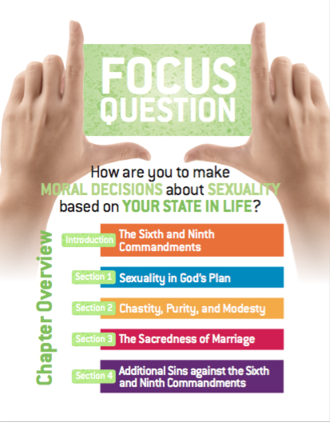
Chapter 9
Respect
for the Gift of Sexualtiy

Slide 3
Marriage
In marriage, a husband and wife make a total gift of self to each other. Since the human person is, indeed, both body and soul, this self-gift involves the entire person. The intimate act of sexual intercourse, in which a husband and wife give themselves totally and exclusively to each other, is the essence of their relationship. That is why the Church teaches that sex is reserved exclusively for marriage: “Sexuality is ordered to the conjugal love of man and woman.” Catechism of the Catholic Church, 2360
The Sixth and Ninth Commandments

Slide 4
Two Purposes of Sex in Marriage
Unitive: intending to communicate love and to unify a husband and wife in the most intimate way
Procreative: allowing the possibility for producing children
The Sixth and Ninth Commandments

Slide 5
What Does the Sixth Commandment Forbid?
Adultery (sexual intercourse between a man and woman who are married to other people, or intercourse between an unmarried person and a married person).
Fornication (sexual relations between unmarried people)
Homosexual activity
Masturbation
The Sixth and Ninth Commandments

Slide 6
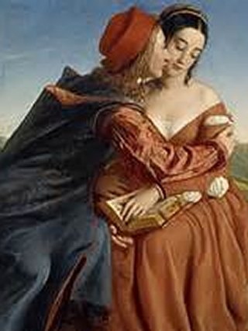
Lessons Associated with the Ninth Commandment
1. Actions flow from your desires.
“You have heard that it was said, ‘You shall not commit adultery.’ But I say to you, everyone who looks at a woman with lust has already committed adultery with her in his heart.” (Mt 5:27–28)
2. Covetousness = Concupiscence
“Live by the Spirit and you will certainly not gratify the desire of the flesh.” (Gal 5:16)
The Sixth and Ninth Commandments

Slide 7
Chastity: A virtue to help you control your sexual desires to be used according to your state in life. Ways to practice chastity:
Avoid pornography.
Practice self-denial to strengthen your will.
Practice moral virtues especially acts of charity toward others.
Know yourself well enough to avoid situations that might lead you to lose control in the area of sexuality.
Strive to live all of God’s commandments.
Pray daily for God’s graces.
Celebrate the Sacrament of Penance.
Receive the Eucharist frequently.
Chastity, Purity and Modesty

Slide 8
Purity: “The glory of the human body before God” (TOB, 57:3)
Ways to practice purity:
Aspire to do the right thing at all times, in all areas of life.
Make the effort to live chastely.
Seek God’s will in prayer.
Discipline your feelings and imagination.
Turn away from impure thoughts when they arise.
Chastity, Purity and Modesty

Slide 9
Modesty: A virtue to help you control your sexual desires to be used according to your state in life.
Ways to practice chastity:
Be patient in your relationships.
Be decent in the clothes you wear.
Be restrained in how you talk about sex.
Chastity, Purity and Modesty

Slide 10
The virtue of FIDELITY in marriage
Marital faithfulness, in good times and in bad, between a husband and wife; fidelity requires reserving all sexual activity and affection for each other.
The Sacredness of Marriage

Slide 11
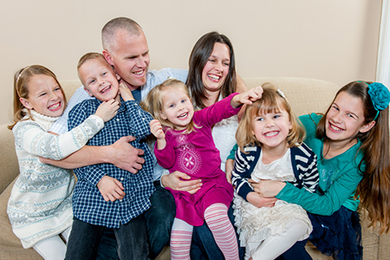
Child Spacing
The Church permits such spacing, provided the couple’s desire “is not motivated by selfishness but is in conformity with the generosity appropriate to responsible parenthood” (CCC, 2368).
The Sacredness of Marriage

Slide 12
Contraception: "any action which, either in anticipation of the conjugal act [sexual intercourse], or in its accomplishment, or in the development of its natural consequences, proposes, whether as an end or as a means, to render procreation impossible" (Humanae Vitae 14).
Contraception by its very nature is closed off to God’s gift of life and plan for marriage and thus is condemned by God and his Church.
The Sacredness of Marriage

Slide 13
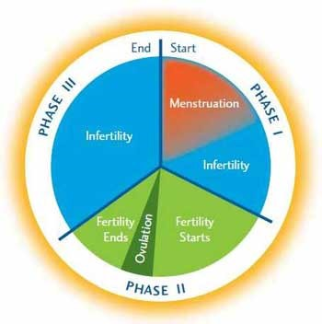
Natural Family Planning (Not Contraception)
NFP requires “self-control” or awareness of the God-given gift of fertility.
NFP uses what St. John Paul II called “intentional child-spacing” and does not circumvent the life-giving potential of sex
NFP asks for temperance, prudence and delay of gratification
NFP requires couples to prayerfully discern their role in God’s creative mission and offer abstinence up when appropriate
The Sacredness of Marriage

Slide 14
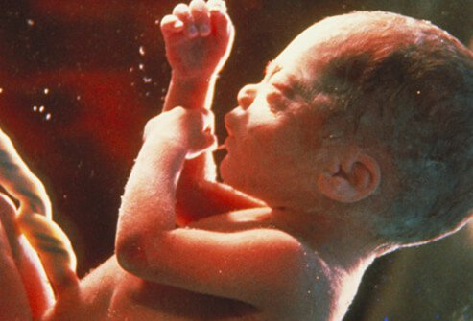
Infertility: The physical incapacity of a female or male to procreate.
The Church approves morally sound methods to to help couples overcome fertility.
The Church does not approve of immoral means that interfere with the bond of husband and wife such as sperm donation, artificial insemination or surrogacy.
The Pope Paul VI Institute for the Study of Human Reproduction (www.popepaulvi.com) is a Catholic sanctioned organization that helps couples overcome infertility in line with Catholic teaching.
The Sacredness of Marriage

Slide 15
Offenses against the Dignity of Marriage
Offense | Result of the Offense
Adultery | Undermines the marriage bond and the stability of the family.
Divorce | Has tragic consequences for family unity and stability of society.
Polygamy | Marriage is intended to be between one man and one woman, equal in dignity, who share a total and exclusive love.
Incest | Refers to sexual activity between close relatives who are legally unable to marry.
Free Unions | Free unions are relationships in which couples refuse to have their commitment sanctioned by law.
Trial Marriages | Marriage-like relationships with sexual relationships intended only for the full commitment of marriage.
Same-Sex Unions | Because marriage by nature is between a man and a woman and procreative, same-sex unions can never be considered to be a marriage.
The Sacredness of Marriage

Slide 16
Marriage between a man and a woman is not discriminatory.
Contrary to objections, marriage between one man and one woman does not discriminate against any group of individuals. The natural definition of marriage implies certain parameters that apply equally to everybody. Anyone who wishes to marry must:
• be of marriageable age; • not be a close relative of the intended spouse;
• not be married already; and • be the opposite sex of the intended spouse.
If any person claims the “right to be married” outside of these parameters, he or she is demanding not equal rights but additional rights.
The Sacredness of Marriage

Slide 17
Vice of Lust
Virtue of Chastity
Directing one’s sex drive beyond the reasonable boundaries of healthy and moral sexual attraction.
The love of
God, self, and others.
Additional Sins Against the Sixth and Ninth Commandment

Slide 18
Sins that Violate the 6th and 9th Commandments
Sin that violates the 6th and 9th Commandments | Effect or consequence of the sin
Masturbation | Contrary to God’s intent for sexual activity to be relational
Fornication | A selfish sin; those who engage in it use the other person for self-gratification. It distorts the meaning of marriage.
Pornography | Disrespects and harms those who create it, sell it, and view it.
Prostitution | Debases and dehumanizes those who sell their bodies. It is a serious sin for all parties involved.
Rape | Intrinsically evil act, always a grave sin. Violates the respect, freedom, and physical and moral integrity to which every person has a right.
Homosexual Activity | Gravely contrary to what God intended for human sexuality. Sacred Scripture refers to such acts as unnatural.
Additional Sins Against the Sixth and Ninth Commandment

Slide 19
References
https://www.catholicnewsagency.com/cw/post.php?id=822

