Slide 1

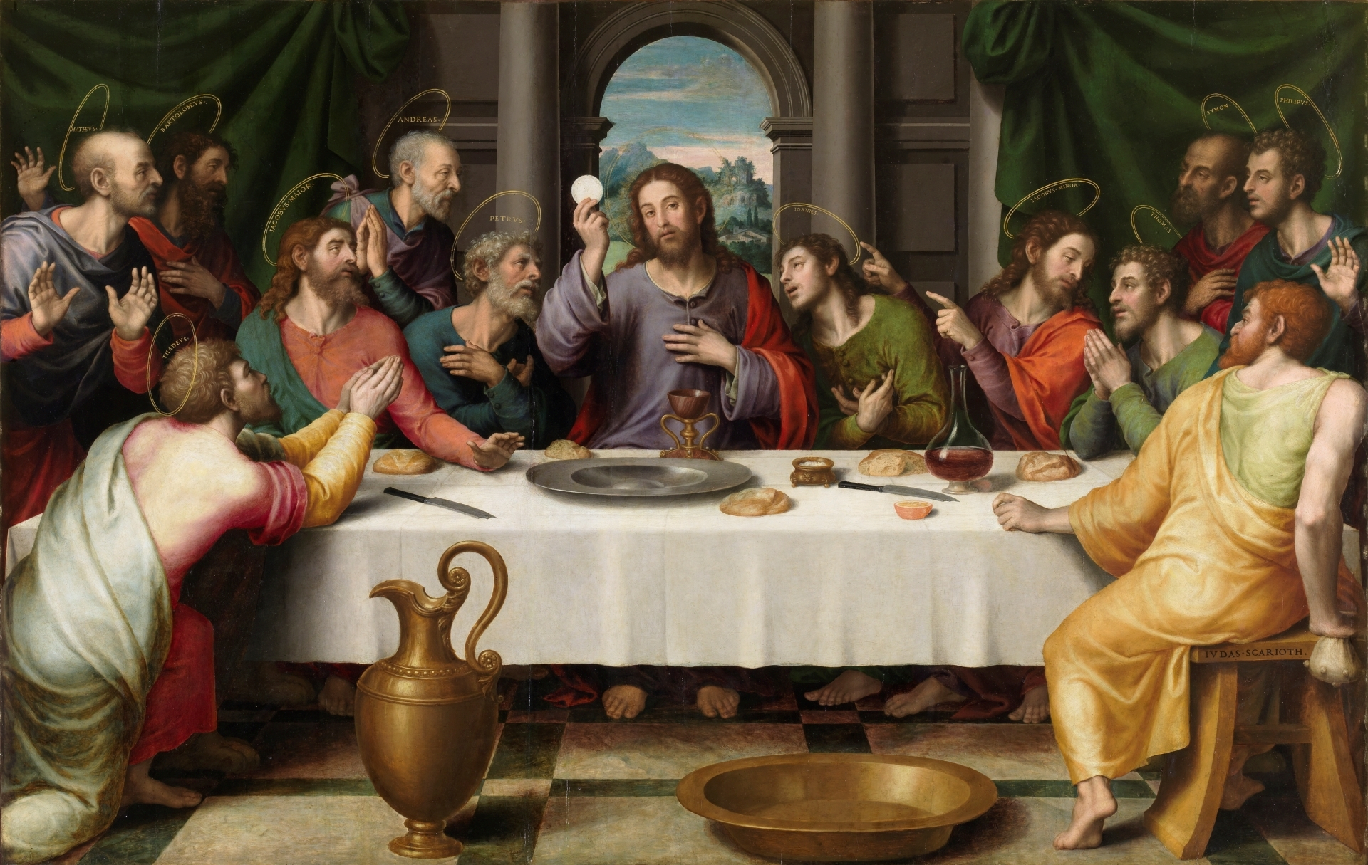
1
Jesus Christ and the
Sacramental Life of the Church
The Seven Sacraments: Signs of God’s Grace
Notes:
Photo Credit: Wikimedia Commons, The Last Supper, by Juan de Juanes, https://commons.wikimedia.org/wiki/File:%C3%9Altima_Cena_-_Juan_de_Juanes.jpg
Suggestions for taking notes on the slides:
Require students to use a three ring binder (1/2-1 inches) full of loose leaf paper (college or wide ruled).
Notes must be taken in pen only and handwritten.
Notebook binders should contain information and notes for religion class only.
Notebook binders must have a table of contents with topics of notes, dates, and page numbers.
All notes must have a topic and page number.
Students will be required to copy each slide unless the teacher directs students to skip certain slides or parts of slides. Binder notebooks will be graded based on neatness, completeness and organization.

Slide 2

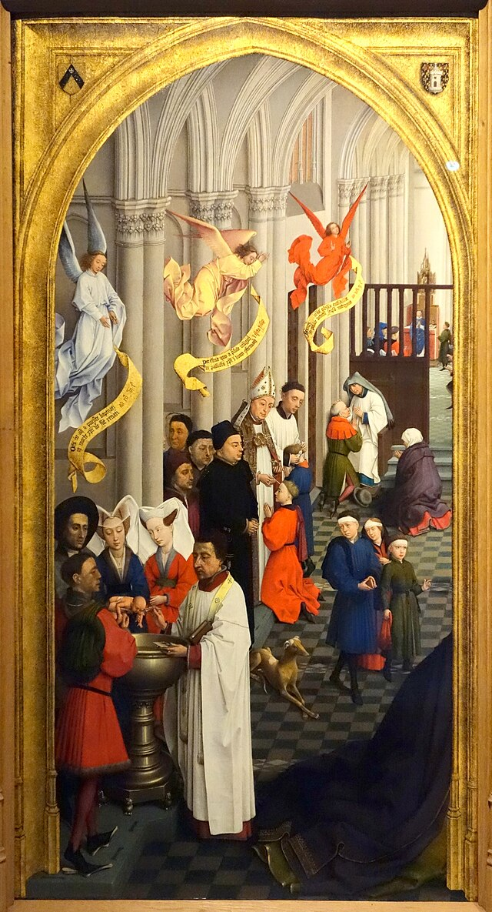
The Sacraments Defined…
The sacraments are efficacious signs of grace, instituted by Christ and entrusted to the Church, by which divine life is dispensed to us.
They are visible rituals celebrated to signify and make present the graces proper to each sacrament.
They bear fruit in those who receive them with the required dispositions.
Notes:
Photo Credit: Wikimedia Commons, The Seven Sacraments (cropped), Rogier van der Weyden, https://commons.wikimedia.org/wiki/File:Seven_Sacraments_Rogier.jpg.
Directions: Have students copy the information from this slide into their notes.

Slide 3

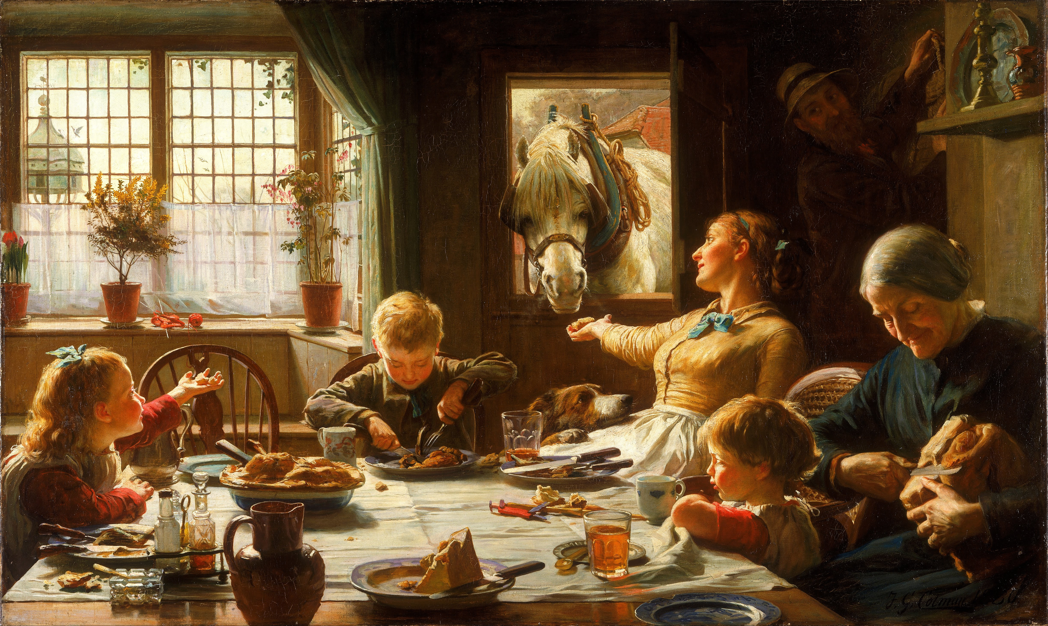
The Sacraments and Life Stages
3. We are fed. (Eucharist)
4. We are healed. (Penance)
5. We recover. (Anointing of
the Sick)
6. We need and form family. (Matrimony)
7. We need and respond to leaders. (Holy Orders)
1. We are born. (Baptism)
2. We grow. (Confirmation)
Notes:
Photo Credit: Wikimedia Commons, One of the Family, Frederick George Cotman, https://commons.wikimedia.org/wiki/File:Frederick_George_Cotman_-_One_of_the_Family_-_Google_Art_Project.jpg.
Directions: Have students copy information from the slide into their notes.
Teaching Points: The life we receive in the Sacraments (divine life) parallels biological life. Have students answer either “divine life” or “biological life” to the following statements:
We must be physically born. (biological life)
We must be spiritually born. (divine life)
We must mature physically. (biological life)
We must grow in spiritual maturity and assume full responsibilities in the Church. (divine life)
We must be physically nourished with food, drink, and exercise. (biological life)
We must nourish the life in the soul. (divine life)
We must be heal of our physical wounds when we are sick or injured. (biological life)
We must be healed of our spiritual wounds. (divine life)
We must have our disease cured and put in remission. (biological life)
We must drive out all traces of our physical and spiritual disease. (divine life)

Slide 4
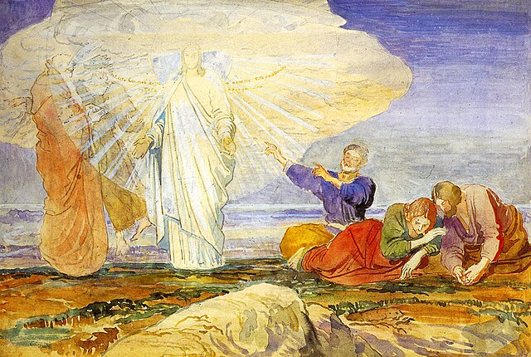
A Newer, Higher Life of Grace
“I came so that they might have life and have it more abundantly.”
(Jn 10:10)
Notes:
Photo Credit: Wikimedia Commons, Преображение (Transfiguration), Alexander Ivanov, https://commons.wikimedia.org/wiki/File:Alexandr_Ivanov_015.jpg.
Directions: Have students copy information from this slide into their notes.
Teaching Points:
The divine life of Christ is a newer, higher life of grace communicated through his Church in exactly the same way as his divine life was communicated when he walked on the earth. By grace, we too become sharers in God’s divine life.
What Jesus of Nazareth once did on earth with his human body he continues to do with his mystical body (the Church) as his instrument on earth.

Slide 5

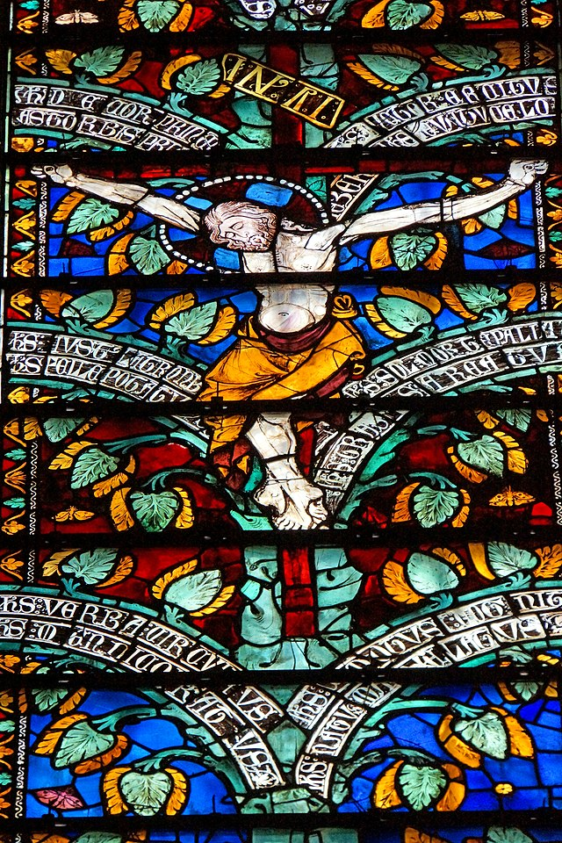
Sacramental Economy
Key
Vocab
Definition: the way God's divine life is given to humans through visible sacraments, like Baptism and the Eucharist, which are signs and instruments of Christ's Paschal Mystery
Notes:
Photo Credit: Wikimedia Commons, Dennis G. Jarvis, “This window represents the tree of life. This theme stems from the meditations of the Franciscan saint Bonnaventure (1221-1274) on the virtues and kindness of the Redeemer,” https://commons.wikimedia.org/wiki/File:France-002170_-_Christ_(15781224056).jpg. License: https://creativecommons.org/licenses/by-sa/2.0/deed.en
Directions: Have students write down the term and definition as part of a Key Vocab section in their notes.

Slide 6
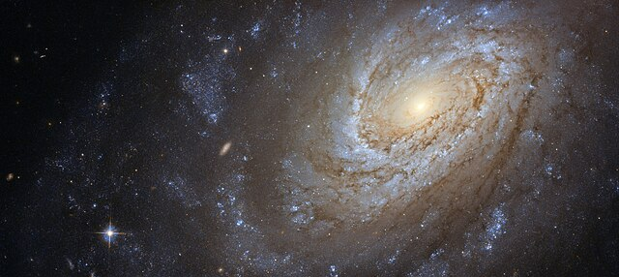
The Paschal Mystery is Timeless
The Paschal Mystery is not just a past event; it is made present in the sacraments, particularly the Eucharist, and through the liturgical year.
Notes:
Photo Credit: Wikimedia Commons, “Spiral galaxy Messier 83,” NASA, ESA, and the Hubble Heritage Team (STScI/AURA) with acknowledgment to William Blair (Johns Hopkins University), https://commons.wikimedia.org/wiki/File:Messier83_-_Heic1403a.jpg.
Directions: Have students copy information from this slide into their notes.
Teaching Points:
From a historical perspective, the events of the Paschal Mystery and our salvation—Christ’s Passion, Death, Resurrection, and Ascension—occurred only once. But by the power of the Holy Spirit, these events, commemorated in the liturgy, are present and real for us today. We remain in intimate communion with God and with one another when we participate in the liturgy. At the liturgy, we are also able to participate in Christ’s prayer to the Father, made in the Holy Spirit.
The Catechism of the Catholic Church teaches: “This “today” of the living God which man is called to enter is “the hour” of Jesus’s Passover, which reaches across and underlies all history: Life extends over all beings and fills them with unlimited light; the Orient of orients pervades the universe, and he who was "before the daystar" and before the heavenly bodies, immortal and vast, the great Christ, shines over all beings more brightly than the sun. Therefore a day of long, eternal light is ushered in for us who believe in him, a day which is never blotted out: the mystical Passover." (CCC, 1165).
Online Resources: Assign article, Catholic Time Travel. URL here: https://www.catholic365.com/article/30129/the-paschal-mystery-time-machine.html

Slide 7
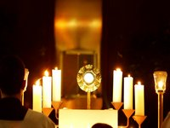
Efficacious Signs
Key
Vocab
Definition: Signs in the sacraments that are capable of producing a desired spiritual effect. In the sacraments, the signs become what they signify.
Notes:
Photo Credit: Wikimedia Commons, “Eucharistic Adoration,” Melchior2008, https://commons.wikimedia.org/w/index.php?search=Eucharistic+Adoration+Melchior2008&title=Special%3AMediaSearch&type=image.
Directions: Have students write down the term and definition as part of a Key Vocab section in their notes.
Online Resources: Assign article, The Eucharist Sign or Symbol Why it Matters. URL here: https://www.catholic365.com/article/30092/eucharist-symbol-or-sign-why-it-matters.html

Slide 8
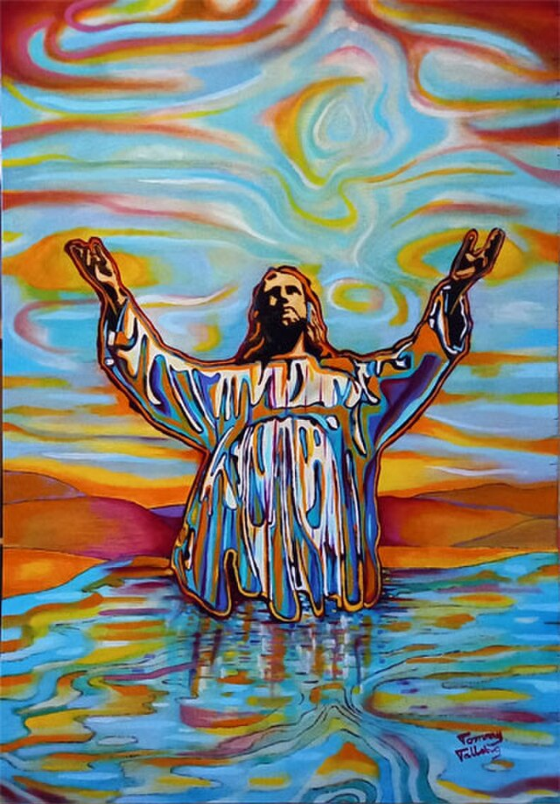
In Liturgy, Jesus is Really Present
Jesus is present in the minister of the sacrament.
Jesus is present in Scripture.
Jesus is present in the Church as members of his Body.
Jesus is especially present in the Eucharist, his own Body and Blood.
Notes:
Photo Credit: Wikimedia Commons, “Jesus Christ I’m the way the truth and the life, painting by tommy tallstig,” Tomtall, https://commons.wikimedia.org/wiki/File:Jesus_Christ_i%27m_the_way_the_truth_and_the_life,_painting_by_tommy_tallstig.jpg. License: https://creativecommons.org/licenses/by-sa/4.0/deed.en
Directions: Have students copy information from the slide into their notes.
Teaching Points:
Jesus Christ is present in the minister of the sacrament.
Through the Sacrament of Holy Orders, Christ is present in the ordained minister who offers the Sacrifice of the Mass. In fact, it is Christ himself who is the minister of the sacrament. By his ordination, the priest is given particular grace to act in persona Christi capitis (a Latin phrase meaning “in the person of Christ, Head [of the Body, the Church]”); that is to serve the Body, the Church, in Jesus’s name by the celebration of the sacraments, which is the distinctive work of Holy Orders. Take into account that Jesus is also present “when anybody baptizes” (CCC, 1088, quoting Sacrosanctum Concilium, 7). Note that “anybody” does not have to be an ordained minister.
Jesus Christ is present in Scripture.
It is Christ who speaks when the Scriptures are read at the liturgy. Jesus Christ is the Word of God made flesh (Jn 1:14). As God himself, Christ alone has “the words of eternal life” (Jn 6:68).
Jesus Christ is present in the Church as members of his Body.
Jesus told his disciples, “For where two or three are gathered together in my name, there am I in the midst of them” (Mt 18:20).
Jesus Christ is especially present in the Eucharist, his own Body and Blood.
This mystery is called the Real Presence of Christ in the Eucharist because it is Christ’s presence in the fullest sense: “It is a substantial presence by which Christ, God and man, makes himself wholly and entirely present” (CCC, 1374).

Slide 9
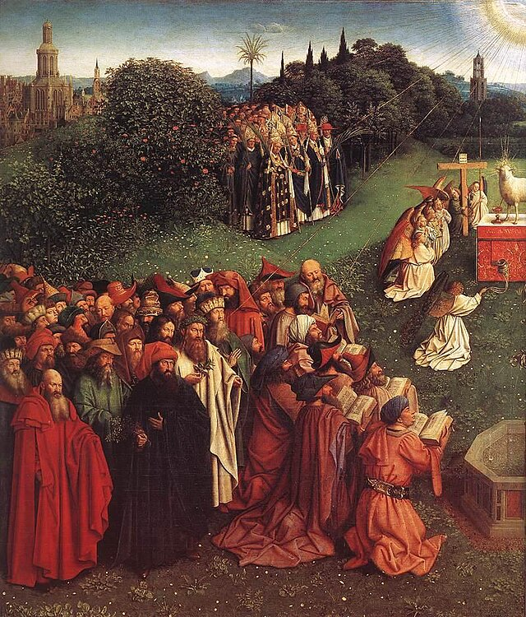
Angels and Saints Are Present Too
“In the earthly liturgy we take part in a foretaste of that heavenly liturgy which is celebrated in the holy city of Jerusalem toward which we journey as pilgrims, where Christ is sitting at the right hand of God, a minister of the holies and of the true tabernacle; we sing a hymn to the Lord's glory with all the warriors of the heavenly army; venerating the memory of the saints, we hope for some part and fellowship with them; we eagerly await the Savior, Our Lord Jesus Christ, until He, our life, shall appear and we too will appear with Him in glory” (Sacrosanctum Concilium, 8)
Notes:
Photo Credit: Wikimedia Commons, The Ghent Alterpiece Adoration of the Lamb (detail), Jan Van Eyck, https://commons.wikimedia.org/wiki/File:Jan_van_Eyck_-_The_Ghent_Altarpiece_-_Adoration_of_the_Lamb_(detail)_-_WGA07655.jpg.
Directions: Have students read aloud the information from this slide.

Slide 10
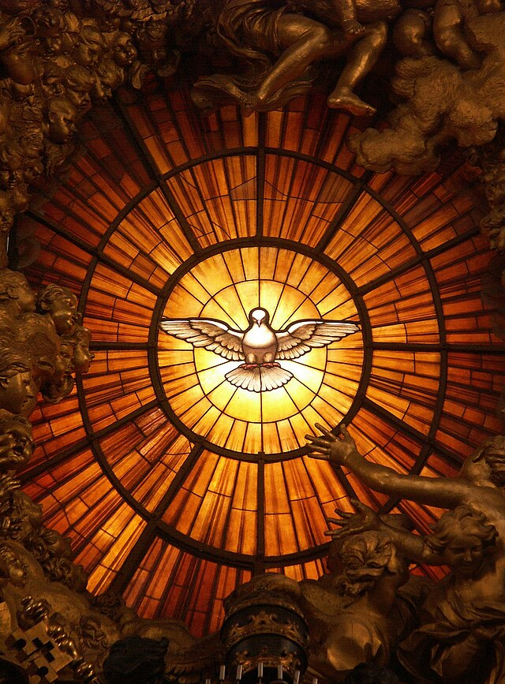
Sacramental Grace
Key
Vocab
Definition: Sacramental grace is the grace of the Holy Spirit and proper to each sacrament. For example, the sacramental grace proper to Reconciliation is forgiveness.
Notes:
Photo Credit: Wikimedia Commons, “Dove of the Holy Spirit (alabaster stained glass, Chair of Saint Peter, Saint Peter's Basilica, Vatican City) ca. 1660,” Gian Lorenzo Bernini, https://commons.wikimedia.org/wiki/File:Rom,_Vatikan,_Basilika_St._Peter,_Die_Taube_des_Heiligen_Geistes_(Cathedra_Petri,_Bernini).jpg. License: https://creativecommons.org/licenses/by-sa/3.0/at/deed.en
Directions: Have students write down the term and definition as part of a Key Vocab section in their notes.

Slide 11
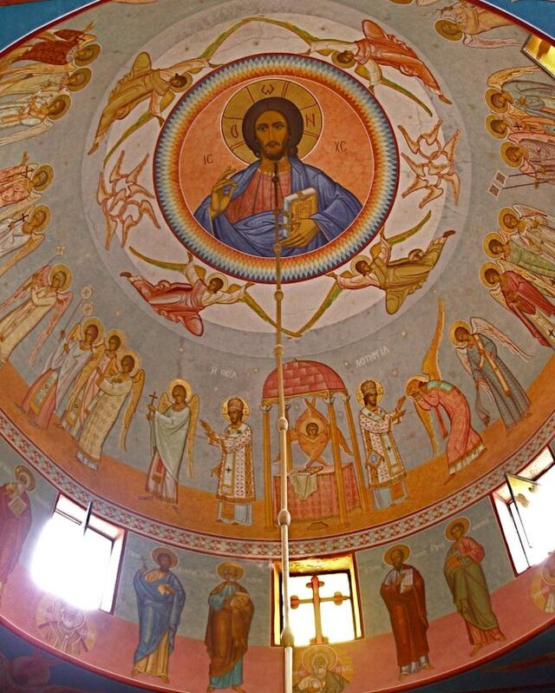
The Church is a Sacrament of Christ
As Christ is the sacrament of God—the visible and incarnate, efficacious and gratuitous bestowal of divine grace and life, so is the Church the sacrament of Christ in human history.
Notes:
Photo Credit: Wikimedia Commons, “Annunciation Cathedral (Jerusalem) Fresco of Christ Pantocrator,” See The Holy Land, https://commons.wikimedia.org/wiki/File:Annunciation_Cathedral_(Jerusalem)_Fresco_of_Christ_Pantocrator.jpg. License: https://creativecommons.org/licenses/by-sa/2.0/deed.en
Directions: Have students copy the information from this slide into their notes.
Teaching Points:
The Church makes Christ present in today’s world.
The Church (people, buildings, sacraments, etc.) is a visible sign of Jesus’s invisible presence.

Slide 12
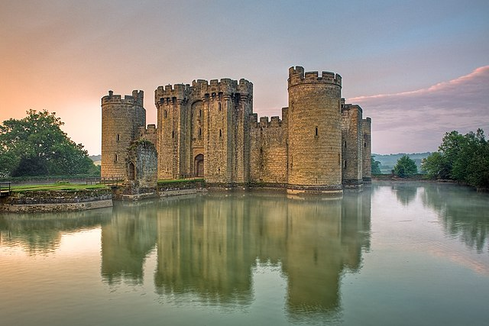
The Communion of Saints
Key
Vocab
Definition: The “unity of all the redeemed, those on earth and those who have died.” The seen and unseen members of the Church united as the family of God.
Notes:
Photo Credit: Wikimedia Commons, “Bodiam Castle East Sussex England UK,” Antony McCallum, https://commons.wikimedia.org/wiki/File:Bodiam-castle-10My8-1197.jpg. License: https://creativecommons.org/licenses/by-sa/3.0/deed.en
Directions: Have students write down the term and definition as part of a Key Vocab section in their notes.
Teaching Points:
Everyone in the Church shares a communion in spiritual goods. Among these goods are the following:
Communion in the faith. The faith we share with other Catholics today is the same faith inherited from the Apostles.
Communion of the sacraments. The sacraments of the Church unite us to the Communion of Saints because they unite us to God in Christ. The term communion is applicable to all of the sacraments, but it “is better suited to the Eucharist than to any other, because it is primarily the Eucharist that brings this communion about” (CCC, 950).
Communion of charisms. A charism is a special gift, talent, or ability given to each Church member by the Holy Spirit. Charisms are intended to help build up the Church; they are for the good of all. The Church collectively shares the charisms her members have received individually.
Communion of goods. The early Christians held everything in common. So, too, “all Christians should be ready and eager to come to the help of the needy” (CCC, 952).
Communion of charity. Every act of charity performed by Catholics benefits the entire Body of Christ. Every sin harms this communion.
Communion of all holy people. We are united with the Church in heaven, the Church in purgatory, and the Church on earth. The saints in heaven intercede for those who are living and for the dead who are still being purified. The living can receive strength and aid from the saints in heaven, and living members of the Church can pray for those who have died. “Our prayer for them is capable not only of helping them, but also of making their intercession for us effective” (CCC, 958).
Online Resources: Assign article, The Communion of Saints. URL here: https://www.catholic.com/magazine/print-edition/the-communion-of-saints

Slide 13

Turn and Talk
Reflect on a special gift, or charism, the Holy Spirit has given you. Explain how you can use this charism in a way that benefits others and builds up the Church.
Notes:
Directions: Have students write their reflection and then share it with a person nearby.

Slide 14

Challenge
Question
Do Catholics believe the sacraments are magical?
No, but they are supernatural. No created object, spoken word, or ritualized action can ever “force” God to be present. Nothing anyone says or does can control what God himself says or does.
Instead, God comes to us in the sacraments because he has chosen these rituals and times, places, and ways to be present. A sacrament always involves a relationship between God and humanity. God takes the initiative of being present, of offering us a share in his own life and love. We, in turn, open our heart to the divine, giving to God through our worship and by accepting God’s Word as the truth on which to base our life.
Notes:
Directions: Use the animation feature to have the yellow answer box appear after you ask the students to respond out loud to the question on the left.

