Slide 1
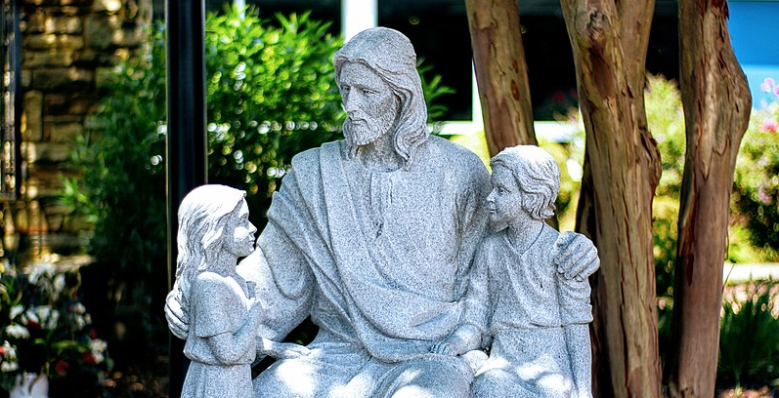
8
Jesus Calls You
God Loves: Jesus Christ Enters the World
Notes:
Photo Credit: Jesus and Infants. Ariyandhamma. Public Domain.
Suggestions for students’ note taking:
●Require students to use a three ring binder (1/2-1 inches) full of loose leaf paper (college or wide ruled).
●Notes must be taken in pen only and hand written.
●Notebooks should contain information and notes for religion class only.
●Notebooks must have a table of contents with topic of notes, dates and page numbers.
●All notes must have a topic and page number.
●Students will be required to copy each slide unless the teacher directs students to skip certain slides or parts of slides. Notebooks will be graded based on neatness, completeness and organization. Notebooks should have a significant point value representing 20-25% of the overall grade.
The videos linked in this presentation file may contain copyright material. Such material is made available for educational purposes only. This constitutes a “fair use” of any such copyright material as provided for in Title 17 U.S.C. section106A-117 of the US Copyright Law.

Slide 2
Jesus Our Bridge
God also told St. Catherine, “My Son’s having made himself of a bridge for you could not bring you to life unless you make your way along that bridge.”
Notes:
Photo Credit: Sant'Angelo bridge. Jebulon. Public Domain.
Directions: Have students copy information from the slide into their notes.
Teaching Points: The theme of Christ as a bridge has been popular among the saints. For example, St. Catherine of Siena recorded a conversation she had with God while in ecstasy in which she saw that Jesus, through obedience to the Father, made himself a bridge between heaven and earth. She wrote that it was necessary for Jesus to become a bridge “so that you might pass over the bitterness of the world and reach life.” God also told St. Catherine, “My Son’s having made himself of a bridge for you could not bring you to life unless you make your way along that bridge.”
Online Resources: Assign article, Bridge of Salvation. URL here: https://sjvlaydivision.org/bridge-of-salvation-2/
Have students watch video, The Bridge Gospel Illustration. URL here: https://youtu.be/7gr0xXfR3L8
The videos linked in this presentation file may contain copyright material. Such material is made available for educational purposes only. This constitutes a “fair use” of any such copyright material as provided for in Title 17 U.S.C. section106A-117 of the US Copyright Law.

Slide 3
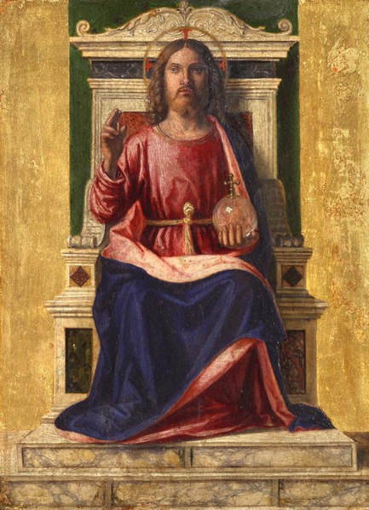
Jesus at the Center
“Is Jesus Christ at the center of my life? And what is my relationship with Jesus Christ?
Notes:
Photo Credit: Christ Enthroned. Giovanni Battista Cima da Conegliano. Public Domain.
Directions: Have students copy information from the slide into their notes. Ask, ‘On a scale of 1 to 10, rate yourself on how well you make Jesus the center of your life.’ Be ready to explain your rating.
Teaching Points:Pope Francis said at World Youth Day to one million young Catholics on Copacabana Beach at Rio de Janeiro, Brazil, in 2013,, “With Christ at the center of your life, you will never be disappointed. Put on Christ and you will find a friend in whom you can always trust and your life will be full of his love. Your journey will be joyful because you will find many friends to journey with.Your horizon will never be dark.”
Online Resources: View video, Making Christ the Center of Your Life. URL here: https://youtu.be/cVZVWVeAslM
Have students view, Seven Reasons You Should Love Jesus. URL here: https://youtu.be/7x7MVCDyFuk
The videos linked in this presentation file may contain copyright material. Such material is made available for educational purposes only. This constitutes a “fair use” of any such copyright material as provided for in Title 17 U.S.C. section106A-117 of the US Copyright Law.

Slide 4
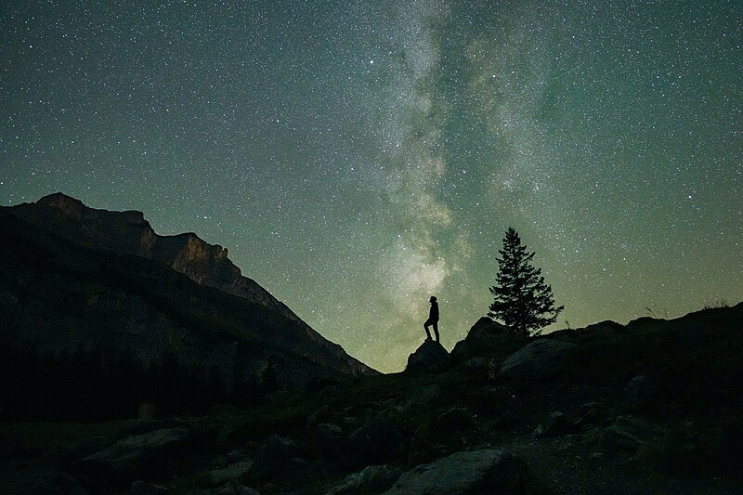
Created in the likeness of God
“About Jesus Christ and the Church, I simply know they are one thing and we shouldn’t complicate the matter.”
-St. Joan of Arc
Notes:
Photo Credit: Human looking at the stars during Perseids with the Milky Way in the background Photo by Giles Laurent. Creative Commons Attribution-Share Alike 4.0 International . https://commons.wikimedia.org/wiki/File:018_Human_looking_at_the_stars_during_Perseids_with_the_Milky_Way_in_the_background_Photo_by_Giles_Laurent.jpg
Directions: Have students copy information from the slide into their notes.
Teaching Points: Genesis 1:26 tells us what sets human beings apart from the rest of the created world: “Then God said: Let us make human beings in our image, after our likeness.” We are created in the likeness of God. Because of this, each of us possesses “the dignity of a person, who is not just something, but some one” (CCC, 357). As someone created in the image of God, you are capable of knowing yourself, of being in control of your own life, of giving yourself to others, and of responding to God, your Creator, with faith. People are the only visible creatures who can know and love God.
Ask, ‘What are some things that only humans can do?’ (choose out of free will, think rationally, create art, speak language, relate with other humans, love God and others, offer sacrifice to God)
Online Resources: Assign article, Made in God’s Image and Likeness. URL here: https://www.catholiceducation.org/en/religion-and-philosophy/the-human-person/made-in-god-s-image-and-likeness.html
The videos linked in this presentation file may contain copyright material. Such material is made available for educational purposes only. This constitutes a “fair use” of any such copyright material as provided for in Title 17 U.S.C. section106A-117 of the US Copyright Law.

Slide 5
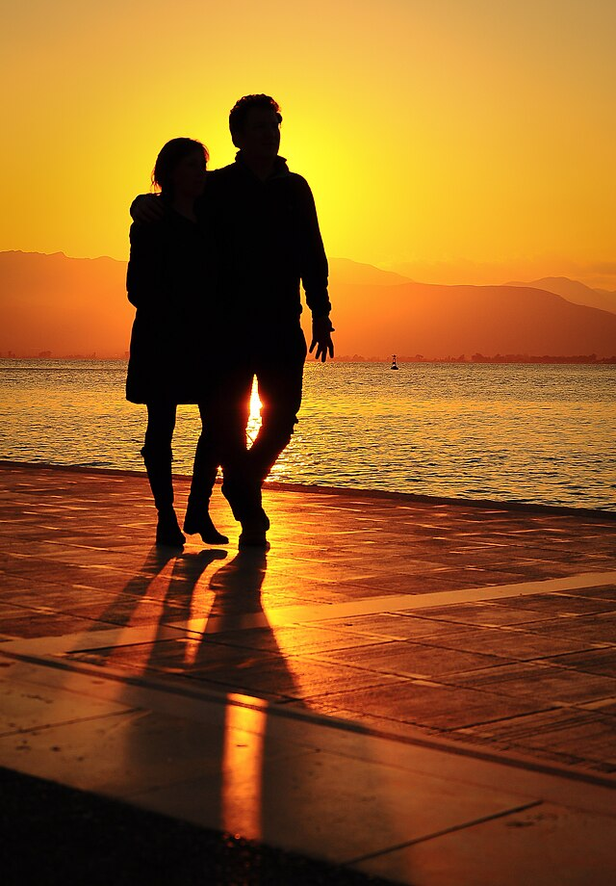
Humans Are Made
Male and Female
Man and woman are both with one and the same dignity in the image of God.
Equal in dignity does not mean the same.
Complementary: Made for eachother to become one.
Notes:
Photo Credit: Mhd.magayda. Creative Commons Attribution-Share Alike 3.0. Couple at sunset on the beach. https://commons.wikimedia.org/wiki/File:Couple_at_sunset_on_the_beach.jpg
Directions: Have students copy quote from the slide into their notes.
Teaching Points: The cooperation between man and woman is truly an equal one. Neither male nor female is superior or inferior to the other. God created man and woman equal in dignity and worthy of the same esteem and respect. The Catechism of the Catholic Church teaches that “man and woman are both with one and the same dignity ‘in the image of God.’ In their ‘being-man’ and ‘being-woman,’ they reflect the Creator’s wisdom and goodness”
Male-Female Complementarity:
God created two opposite genders. “God created man in his own image male and female he created them.” (Gn.1:27) Male and Female, together image God because God is a lover, a beloved and a relationship of Persons.
Males and females when united in the marital act mirror the relationship of the three Persons in the Trinity held together as one by Love. the two shall become one flesh'; so then they are no longer two, but one flesh.Therefore what God has joined together, let not man separate.” (Mk 10:8-10)
Male and female, when united as husband and wife are given the dignity of being co-creators with God of human life. Their leros love and friendship love becomes sanctified as ‘life-giving love’ which is one aspect of divine, agape love.
Sexual difference corresponds to the vocation of mutual self-giving and happiness. “At last this one is bone of my bones and flesh of my flesh; This one shall be called 'woman,' for out of man this one has been taken.” (Gn 2:23). “It is not good for the man to be alone.” (Gn 2:18).
The family unit under the headship of the father, who loves his wife as his own body, becomes the building block of a life-affirming culture and civilization which points to and facilitates reaching our end which is heaven.
The Church opposes what is sometimes known as “gender ideology,” which holds that humans can choose their own sex. “Gender ideology is one of the most dangerous ideological colonizations,” Pope Francis said in a 2023 interview. “Why is it dangerous? Because it blurs the differences and value between men and women.” At the same time, Pope Francis showed great pastoral care for those who call themselves “transgender.” On numerous occasions—and usually out of the public eye—the pope met with transgender people in Rome. “Pope Francis didn’t judge us— he listened,” said Minerva Motta, a Peruvian. “He told me: ‘Remember that we are all equal before the eyes of God.’” After that visit, the pope continued to send cards and prayers to those whom he met.
.
Online Resources: View video, Men and Women are Equal and Complimentary. URL here: https://youtu.be/qxV7XSZ_pRw
View video, The Catholic Guide to Gender Theory. URL here: https://youtu.be/9LtUsTYItVA
The videos linked in this presentation file may contain copyright material. Such material is made available for educational purposes only. This constitutes a “fair use” of any such copyright material as provided for in Title 17 U.S.C. section106A-117 of the US Copyright Law.

Slide 6
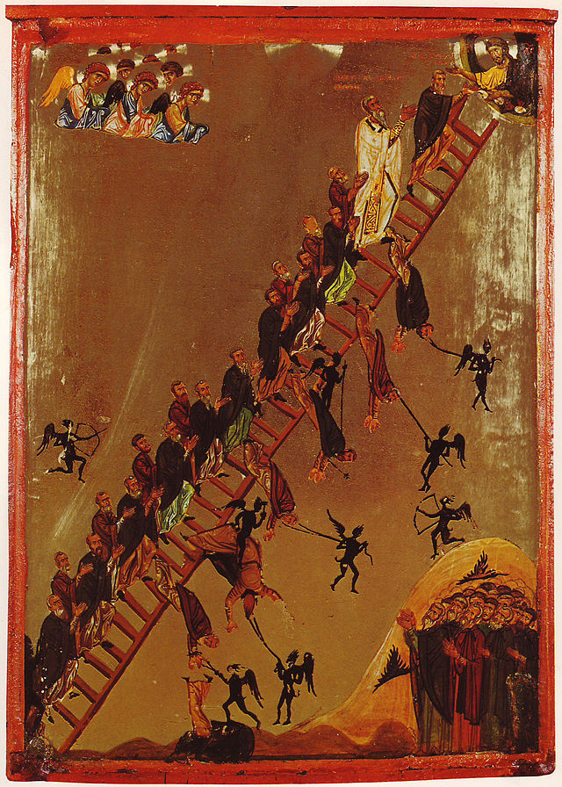
We All Need A Savior
"There is salvation in no one else, for there is no other name under heaven given among men by which we must be saved"
-Acts 4:12
Original Sin is a catastrophe for every human…
Humanity is alienated from God.
Subject to pain, sickness, suffering and death.
Prone to sin.
Must climb our way back to God with the help of grace
Notes:
Photo Credit: Unknown author. Public domain. Ladder of Divine Ascent Sinai 12th century. https://commons.wikimedia.org/wiki/File:Ladder_of_Divine_Ascent_Sinai_12th_century.jpg
Directions: Have students copy quote from the slide into their notes.
Teaching Points: Why We Need a Savior: At the beginning of time, human beings were wounded by sin and inclined toward evil and selfishness. Genesis 2:15–3:24 reports that Adam and Eve chose to follow their own desires and ignore God’s plan for them. The sin of pride led to their downfall and expulsion from the Garden of Eden. There were many consequences: them. The sin of pride led to their downfall and expulsion from the Garden of Eden. There were many consequences: They were alienated from God. They were subject to suffering and death. Their ancestors—the whole human race—became prone to sin. All of this translates to our life in the form of concupiscence.
.
Online Resources: View video, Original Sin. URL here: https://youtu.be/jdtD05zX0AA
Have students view video, Icons Explained: The Ladder of Divine Ascent. URL here: https://youtu.be/3rgGoVWmUww
The videos linked in this presentation file may contain copyright material. Such material is made available for educational purposes only. This constitutes a “fair use” of any such copyright material as provided for in Title 17 U.S.C. section106A-117 of the US Copyright Law.

Slide 7
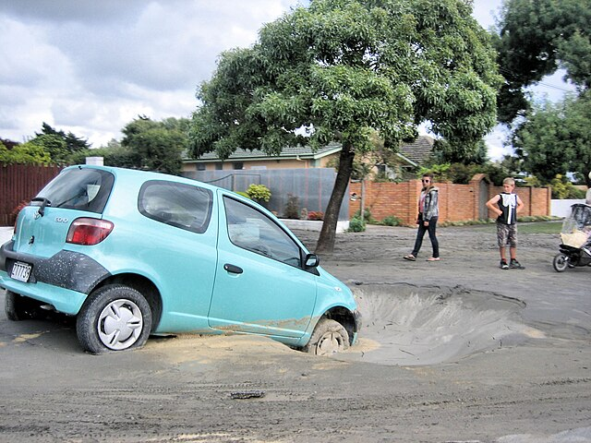
Concupiscence
Key
Vocab
Even though we often have good intentions, we have trouble resisting temptation and thus sometimes commit personal sins. This inclination can lead to many types of sin (cowardice, selfishness, deceit, anger, violence, jealousy).
Notes:
Photo Credit: Martin Luff. Creative Commons Attribution-Share Alike 2.0. Sink holes and liquefaction North New Brighton. https://commons.wikimedia.org/wiki/File:Sink_holes_and_liquefaction_North_New_Brighton_Feb_2011.jpg
Directions: Have students copy vocabulary term and definition from the slide into their notes.
Teaching Points: Saint Paul has a very early definition of his personal struggle with concupiscence in his letter to the Romans.
‘ I do not understand what I do. For what I want to do I do not do, but what I hate I do. And if I do what I do not want to do, I agree that the law is good. As it is, it is no longer I myself who do it, but it is sin living in me. For I know that good itself does not dwell in me, that is, in my sinful nature. For I have the desire to do what is good, but I cannot carry it out. For I do not do the good I want to do, but the evil I do not want to do—this I keep on doing. Now if I do what I do not want to do, it is no longer I who do it, but it is sin living in me that does it’ -Rm 7:15-20.
Online Resources: Assign article, Cursing and Christian Living. URL here: https://www.catholiceducation.org/en/faith-and-character/faith-and-character/cursing-and-christian-living.html
The videos linked in this presentation file may contain copyright material. Such material is made available for educational purposes only. This constitutes a “fair use” of any such copyright material as provided for in Title 17 U.S.C. section106A-117 of the US Copyright Law.

Slide 8
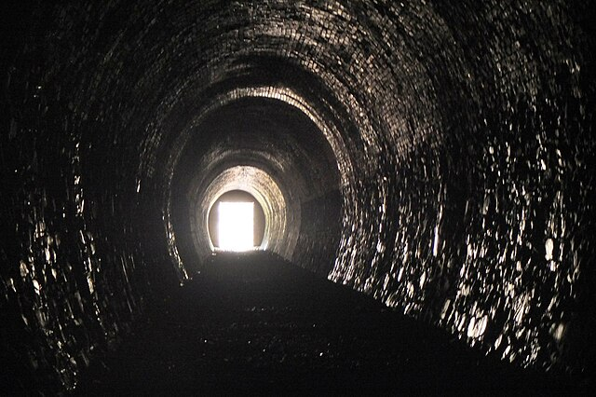
Metanoia
Metanoia
Key
Vocab
A change of heart from sin to the practice of virtue. Literally, “repentance” or “penance.” A complete turn around from sin and darkness to Jesus and light.
Notes:
Photo Credit: Jim Barton, Light at the End of the Tunnel. Creative Commons Attribution-Share Alike 2.0. https://commons.wikimedia.org/wiki/File:Light_at_the_end_of_Neidpath_Tunnel_-_geograph.org.uk_-_4351013.jpg
Directions: Have students copy vocabulary term and definition from the slide into their notes.
Online Resources: Assign article, The Joy of Repentance. URL here: https://www.catholiceducation.org/en/religion-and-philosophy/apologetics/the-joy-of-repentance.html
The videos linked in this presentation file may contain copyright material. Such material is made available for educational purposes only. This constitutes a “fair use” of any such copyright material as provided for in Title 17 U.S.C. section106A-117 of the US Copyright Law.

Slide 9
Christian Joy
Only God’s goodness and love can satisfy our deepest hunger for true and lasting happiness.
Notes:
Directions: Have students copy information from the slide into their notes.
Teaching Points: One of the signs that someone has Christ in their heart is their outward display of joy or happiness. It is so common that it takes on the name, ‘Christian Joy’. This joy, in part , stems from the knowledge that this world is not our true home and that we are not going to become attached to worldly desires and the inevitable disappointments that come with it.
.
God wants us to focus on the rewards of Christ’s victory. Our goal of knowing, loving, and serving God through his Son, Jesus, is eternal happiness in heaven. In a sense, God programmed us with a desire for eternal happiness. Nothing in this world can fully satisfy this quest to be happy. Not wealth, not straight As, not getting into the best college, not fame, not power, not a huge bank account, not awesome looks for you or a spouse. None of these things are bad, but they can’t really quench the desire for happiness. Only God’s goodness and love can satisfy our deepest hunger for true and lasting happiness.
Online Resources: View video, Why Joy is More Christian Than Happiness. URL here: https://youtu.be/1RleRm-GBOA
The videos linked in this presentation file may contain copyright material. Such material is made available for educational purposes only. This constitutes a “fair use” of any such copyright material as provided for in Title 17 U.S.C. section106A-117 of the US Copyright Law.

Slide 10
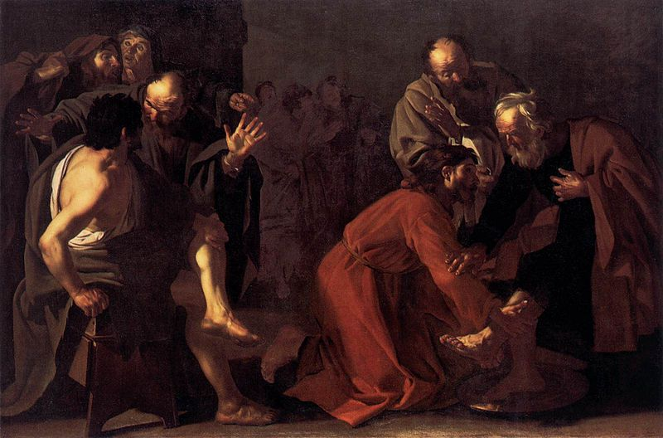
The Beatitudes are a Prescription for Happiness
Recall that the word beatitude means “supreme happiness.” The Beatitudes direct our lives away from an overconsumption of worldly possessions and toward a participation in God’s nature and the Kingdom of God. They condition us to love.
Notes:
Photo Credit: Christ Washing the Apostles Feet. Dirck van Baburen. Public Domain.
Directions: Have students copy quote from the slide into their notes.
Teaching Points: “I have told you this so that my joy may be in you and your joy may be complete” (Jn 15:11).
Based on this verse we can conclude that Jesus wants us to share in his joy. The Beatitudes teach us how.
Reflection: Students of the Ukrainian Catholic University come to help prepare meals at the Lviv Volunteer Kitchen on September 23, 2022 in Lviv, Ukraine. Volunteers prepare distributes food to needy people in Barcelona, Spain….Why do they look happy? Which beatitude does this kind of Christian Service connect with? See below.
The Poor in Spirit • How do I recognize God as the source of everything in my life? • How do I share my gifts with others?
Those Who Mourn • How do I empathize with others? • How do I help those less fortunate than I am?
The Gentle • How am I a gentle and kind person? • How do I respect others?
The Righteous • How do I show that I am Christlike? • How do I grow in holiness?
The Merciful • How do I forgive others when they hurt me? • How do I show compassion?
The Clean of Heart • How do I live an honest life? • How am I counted on and trusted?
Peacemakers • How do I go out of my way to resolve conflicts? • How do I often “turn the other cheek”?
The Persecuted • How do I unite my suffering with Jesus’s Cross? • How do I think of difficulties and challenges as gifts from God?
Online Resources: Have students view video, The Key to Happiness. URL here: https://youtu.be/m6245-7y9vo
The videos linked in this presentation file may contain copyright material. Such material is made available for educational purposes only. This constitutes a “fair use” of any such copyright material as provided for in Title 17 U.S.C. section106A-117 of the US Copyright Law.

Slide 11
Turn and Talk
Finish a necessary and new Beatitude for the world today: “Blessed are . . .”
Notes:
Directions: Have students write down the prompt and then write down their answer….Then have students share their answers with one person close by.
The videos linked in this presentation file may contain copyright material. Such material is made available for educational purposes only. This constitutes a “fair use” of any such copyright material as provided for in Title 17 U.S.C. section106A-117 of the US Copyright Law.

Slide 12
“I can’t have a relationship with Jesus because he is not here with me in the flesh”.
Jesus rose from the dead in the resurrection which means he is still alive. He has become one with the Church and he still acts in and through the Church. He has the ability to be physically present to us in the Eucharist and spiritually present in our hearts. We simply have to desire that and act on it.
Notes:
Directions: Use the animation feature to have the yellow answer box appear after you ask the students to respond out loud to the question on the left.
Online Resources: Assign article, The Real Presence and Our Personal Relationship With Jesus. URL here: https://youtu.be/kTjo10yneD0
The videos linked in this presentation file may contain copyright material. Such material is made available for educational purposes only. This constitutes a “fair use” of any such copyright material as provided for in Title 17 U.S.C. section106A-117 of the US Copyright Law.

Slide 13
Memorize It
Key
Quote
“But do we not have in the Eucharist a living, true, and real Jesus present before us?
Why look for more?”
-St. Theresa of Avila
Notes:
Directions: Have students copy the quote. Add bonus points to the assessment if they can copy it down demonstrating that they memorized it.
The videos linked in this presentation file may contain copyright material. Such material is made available for educational purposes only. This constitutes a “fair use” of any such copyright material as provided for in Title 17 U.S.C. section106A-117 of the US Copyright Law.

Slide 14
What are the Fruits of the Eucharist?
Strengthening
the Soul
Unity with the Church
Union With Christ
Separation from sin
Spiritual Nourishment
Notes:
Photo Credit: People.svg,Creative Commons Zero, Public Domain Dedication. https://commons.wikimedia.org/wiki/File:People.svg
Directions: Ask students if they can add another fruit of the Eucharist that they have experienced in their lives.
Teaching Points:
Union with Christ: The Eucharist sacramentally unites us with Christ, as we hope to become one with him for eternity.
Separation from sin: The Eucharist separates us from sin, both past and future. It can wash away past venial sins and protect us from mortal sin in the future.
Strengthening the soul:The Eucharist strengthens our will to pursue the Gospel and to live a life of virtue. It also strengthens all the virtues and gifts of the Holy Spirit.
Spiritual nourishment:The Eucharist nourishes us spiritually, just as material food nourishes us physically.
Unity with the Church: The Eucharist can unite us to all other members of the Church and inspire us to pray for the unity of all Christians.
Online Resources: View video, The Fruits of the Eucharist. URL here: https://youtu.be/raSkrYIn9m4
The videos linked in this presentation file may contain copyright material. Such material is made available for educational purposes only. This constitutes a “fair use” of any such copyright material as provided for in Title 17 U.S.C. section106A-117 of the US Copyright Law.

