Slide 1

5. THE CHURCH
READDRESSES HER UNITY
Notes:
Suggestions for students’ note taking:
●Require students to use a three ring binder (1/2-1 inches) full of loose leaf paper (college or wide ruled).
●Notes must be taken in pen only and hand written.
●Notebooks should contain information and notes for religion class only.
●Notebooks must have a table of contents with topic of notes, dates and page numbers.
●All notes must have a topic and page number.
●Students will be required to copy each slide unless the teacher directs students to skip certain slides or parts of slides. Notebooks will be graded based on neatness, completeness and organization. Notebooks should have a significant point value representing 20-25% of the overall grade.
The resources linked in this presentation file may contain copyright material. Such material is made available for educational purposes only. This constitutes a “fair use” of any such copyright material as provided for in Title 17 U.S.C. section106A-117 of the US Copyright Law.

Slide 2

catholic
Key
Vocab
From the Greek meaning "through the whole," that is "universal," "world-wide," "all inclusive." The Church is catholic- universal in time and space.
Notes:
Photo Credit: NASA Earth Observatory. Public domain. Featured picture, Picture of the day. City Lights of Asia and Middle East 2016.png https://commons.wikimedia.org/wiki/File:City_Lights_of_Asia_and_Middle_East_2016.png
Directions: Have students copy the term and the definition in the vocabulary section of their notes.
Teaching Points: Teaching Points:
Jesus commanded the apostles to go out into the whole world baptizing ALL Nations
The Church spread throughout the world over time
There are many types of Catholics (27 Rites) with the Roman Rite being the largest.
The Church is also universal in time. It was prefigured by Israel and it will be eternal as the Bride at the Wedding Feast of the Lamb (Heaven).
Online Resources: Have students view video, What Does the Word Catholic Mean?. URL here: https://youtu.be/m_XuzsDEWHQ
Have students view video, The Meaning of Catholic. URL here: https://youtu.be/3NBYfYTOeJI
The resources linked in this presentation file may contain copyright material. Such material is made available for educational purposes only. This constitutes a “fair use” of any such copyright material as provided for in Title 17 U.S.C. section106A-117 of the US Copyright Law.

Slide 3
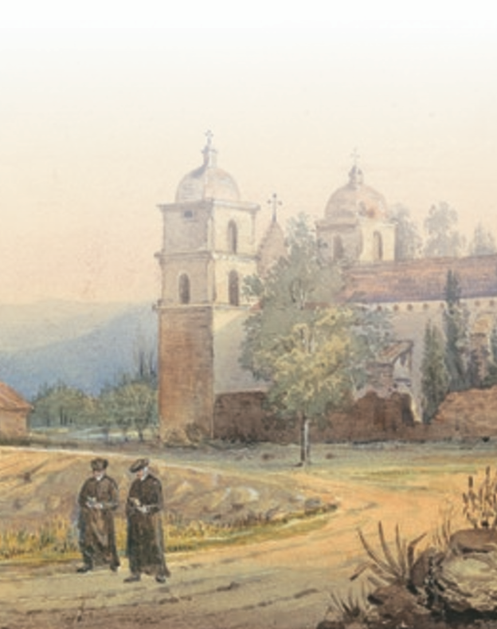
Missionary Efforts
“All power in heaven and on earth has been given to me. Go, therefore, and make disciples of ALL NATIONS baptizing them in the name of the Father, and of the Son, and of the holy Spirit…”
-Mt 28:18-19
Notes:
Photo Credit: AMP Textbook pg. 236, Santa Barbara Mission California.
Directions: Have students copy information from the slide into their notes.
Teaching Point: Whenever and wherever the Church is healthy and vibrant, Catholics are impelled to share their faith with others.
This based on the words Jesus spoke to his apostles before ascending into heaven to go out and baptize all nations teaching them the Faith. This is called the great commissioning. We can see this beginning to happen when we look at the spreading out of the apostles and their individual missionary efforts around the world known to them.
While new Catholic missions to the Americas, Africa, and Asia were exciting, they also presented certain challenges. European missionaries struggled to communicate effectively with native populations who spoke differ ent languages, practiced different religions, and had deeply ingrained habits that might not conform to Christian morality.
European colonists and soldiers often had priorities, such as increasing political power or acquiring wealth, that collided with the missionaries’ aim of inculcating the faith. Missionaries themselves caused scandal by failing to live up to the moral codes they taught or by treating indigenous people harshly.
Missionaries are still active in the Catholic Church
Online Resources: Have students view website, Catholic World Missions. URL here: https://catholicworldmission.org/online-guides/what-do-missionaries-do/
The resources linked in this presentation file may contain copyright material. Such material is made available for educational purposes only. This constitutes a “fair use” of any such copyright material as provided for in Title 17 U.S.C. section106A-117 of the US Copyright Law.

Slide 4
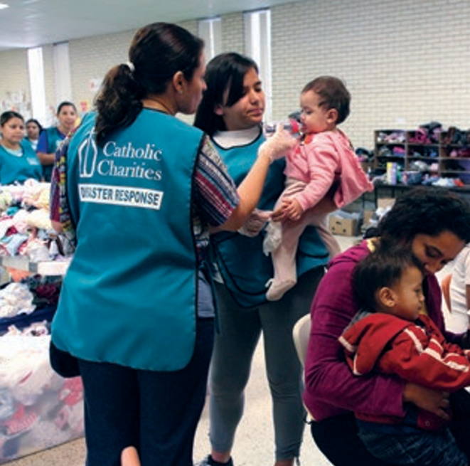
Re-Evangelization
“Instead of being just a church that welcomes and receives by keeping the doors open, let us try also to be a church that finds new roads, that is able to step outside itself and go to those who do not attend Mass, to those who have quit or are indifferent. The ones who quit sometimes do it for reasons that, if properly understood and assessed, can lead to a return. But that takes audacity and courage.”
-Pope Francis
Notes:
Photo Credit: AMP Textbook pg. 272.
Directions: Have students copy information from the slide into their notes.
Teaching Point: Pope Francis has also spoken about those leaving the Catholic Church— in Latin America and elsewhere—and how the Church can help them find their way back to the faith: “Instead of being just a church that welcomes and receives by keeping the doors open, let us try also to be a church that finds new roads, that is able to step outside itself and go to those who do not attend Mass, to those who have quit or are indifferent. The ones who quit sometimes do it for reasons that, if properly understood and assessed, can lead to a return. But that takes audacity and courage.”
Re-evangelization:
requires more than a welcoming spirit;
it requires action.
It requires evangelizers who will go to those who have wandered away from the Church and minister to them with warmth and mercy.
The Catholic Church in the United States has not been immune to a decline among those who actively participate in the sacraments and Church life, but recent years have brought some positive trends. For example, not only has the influx of immigrants from Latin America offset the loss of Catholics who have fallen away, but in many parts of the country their participation has reinvigorated the Church.
Archdioceses and dioceses in the United States with large Latin American and other immigrant populations have focused more attention on these new Americans through such initiatives…
offering comprehensive social services
referrals to the proper local agencies
advocating politically for immigrant rights
recruiting seminarians from among the immigrants
Online Resources: Assign article, 10 Things Pope Francis Wants You to Know About Evangelization. URL here: https://focusequip.org/10-things-pope-francis-wants-you-to-know-about-evangelization/
The resources linked in this presentation file may contain copyright material. Such material is made available for educational purposes only. This constitutes a “fair use” of any such copyright material as provided for in Title 17 U.S.C. section106A-117 of the US Copyright Law.

Slide 5
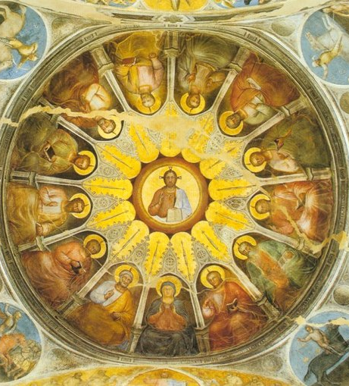
The Church is One
“I pray not only for them, but also for those who will believe in me through their word, so that they may all be one, as you, Father, are in me and I in you.” -Jn 17:20–21
Notes:
Photo Credit: Giusto de Menabuoi. Public domain. Descent of the Holy Spirit, Battistero di Padova.jpg. https://commons.wikimedia.org/wiki/File:Descent_of_the_Holy_Spirit,_Battistero_di_Padova.jpg
Directions: Have students copy information from the slide into their notes.
Teaching Point: Taking to heart the prayer of Jesus, we believe the Church is to be one. Unity, or oneness, is a mark of the Church. T he Church’s unity emanates from the unity of God, Three Divine Persons living in community with one another. The Second Person of the Trinity, Jesus Christ, came to earth to heal division; he “reconciled all men to God by the cross, . . . restoring the unity of all in one people and one body” (Gaudium et Spes, 78). It is the Church’s “soul,” the Holy Spirit, who is a force for unity, bringing about a “wonderful communion of the faithful” (CCC, 813).
Over her long history the Church has struggled to maintain both its universal mission to be a world-wide church and yet remain united as one.
Online Resources: Assign Ephesians chapter 4, What does Saint Paul say about the unity of the Church?. URL here: https://www.biblegateway.com/passage/?search=Ephesians%204&version=NABRE
The resources linked in this presentation file may contain copyright material. Such material is made available for educational purposes only. This constitutes a “fair use” of any such copyright material as provided for in Title 17 U.S.C. section106A-117 of the US Copyright Law.

Slide 6

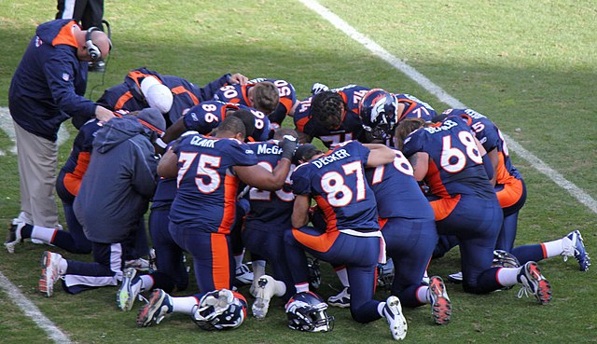
‘The Bond of Perfection’
St. Paul teaches that love is the “bond of perfection” (Col 3:14)
Notes:
Photo Credit: Jeffrey Beall from Denver, Colorado, USA. Creative Commons Attribution-Share Alike 2.0. Huddle, or Prayer Session. https://commons.wikimedia.org/wiki/File:Huddle,_or_Prayer_Session_%3F_(6656097729).jpg
Directions: Have students copy information from the slide into their notes.
Teaching Points: The unity of the Church is realized above all through love…
When people truly love one another, they want what is best for the other.
They are willing to sacrifice their own preferences for the sake of the other.
They derive satisfaction and joy from seeing the happiness of the other.
When people relate to each other this way, they feel a strong connection.
They tend to work together toward common aims, and they understand that their own well-being is closely tied to the well-being of others.
The resources linked in this presentation file may contain copyright material. Such material is made available for educational purposes only. This constitutes a “fair use” of any such copyright material as provided for in Title 17 U.S.C. section106A-117 of the US Copyright Law.

Slide 7

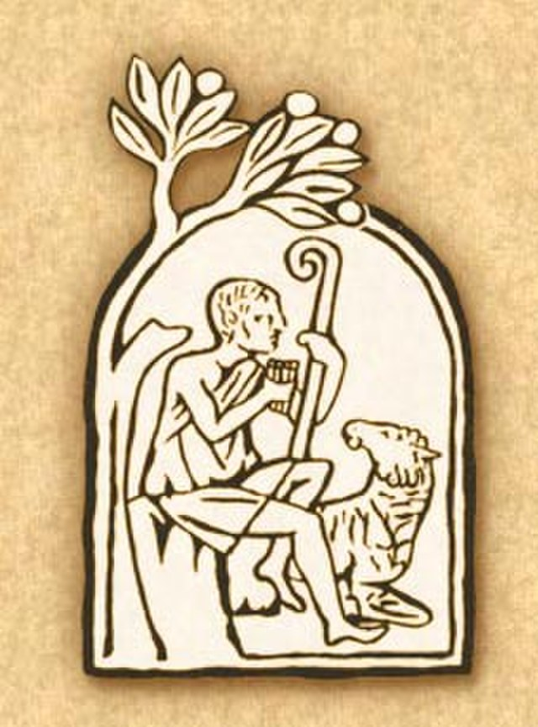
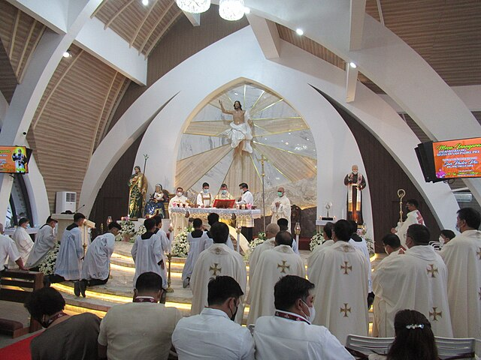
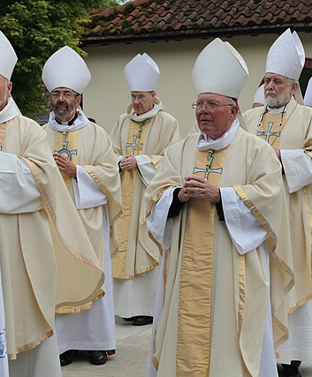
Three Visible Bonds of Communion
Profession of Faith
Liturgy
Apostolic Succession
Notes:
Photo Credit:Unknown author. Public domain. Emblem of the Catechism of the Catholic Church. RamaGaspar/ Creative Commons Attribution-Share Alike 4.0. Inaugural Mass and Solemn Dedication of Saint Padre Pio Chapel. Robin Myerscough.Creative Commons Attribution 2.0. Bishops at Walsingham. https://commons.wikimedia.org/
Directions: Have students copy down information from the slide into their notes.
Teaching Points: The unity created by the bond of love is evident in three “visible bonds of communion” (CCC, 815)—ways of showing that the Church is genuinely and concretely one. First, we are united by professing the faith taught by the Apostles. Second, unity is achieved through celebrating together the liturgies of the Mass and other sacraments. Third, unity is maintained by the unbroken line of apostolic succession, as the pope and bishops preserve the teaching of Jesus and provide a solid structure for the Church
Online Resources: Assign article, On Your Marks, The Church is One. URL here: https://www.catholic.com/magazine/online-edition/on-your-marks-the-church-is-one
The resources linked in this presentation file may contain copyright material. Such material is made available for educational purposes only. This constitutes a “fair use” of any such copyright material as provided for in Title 17 U.S.C. section106A-117 of the US Copyright Law.

Slide 8
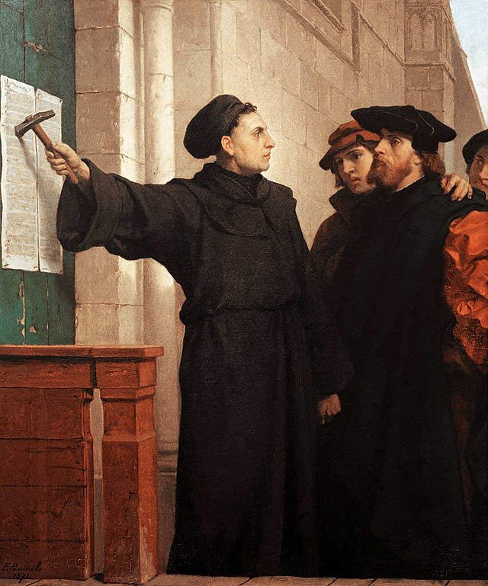
Protestant Reformation
Key
Vocab
The religious movement which made its appearance in Western Europe in the sixteenth century, and which, while ostensibly aiming at an internal renewal of the Church, really led to a great revolt against it, and an abandonment of some of the principal beliefs.
Notes:
Photo Credit: Ferdinand Pauwels. Public domain. Ferdinand Pauwels - Luther hammers his 95 theses to the door. https://commons.wikimedia.org/wiki/File:Ferdinand_Pauwels_-_Luther_hammers_his_95_theses_to_the_door.jpg
Directions: Have students copy the term and the definition in the vocabulary section of their notes.
Online Resources: Have students view video, Bishop Barron on the Reformation. URL here: https://youtu.be/4NFyyMxnyGI
The resources linked in this presentation file may contain copyright material. Such material is made available for educational purposes only. This constitutes a “fair use” of any such copyright material as provided for in Title 17 U.S.C. section106A-117 of the US Copyright Law.

Slide 9
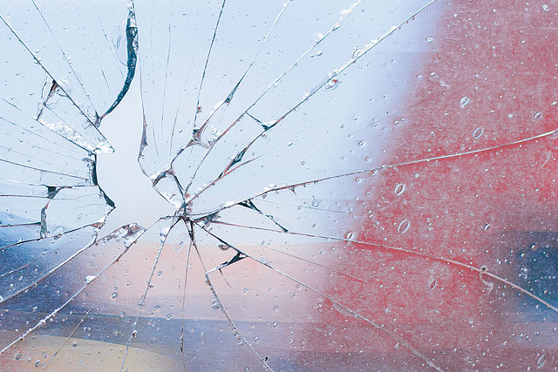
Abuses That Fractured Unity
Nepotism
Pluralism
Simony
Absenteeism
Notes:
Photo Credit: Tobias "ToMar" Maier. Creative Commons Attribution-Share Alike 3.0. Quality image. https://commons.wikimedia.org/wiki/File:Crack_in_the_window_of_St._Andreas_(Babenhausen)_tower.jpg
Directions: Have students copy information from the slide into their notes.
Teaching Points: Various abuses that had troubled the Church through much of the Mid dle Ages were widespread and seemingly condoned through the end of that period.
Nepotism: the appointment of relatives to positions of leadership even though they had little or no expertise in those positions or job requirements.
Simony: a potential appointee would bribe the official who had the power to appoint. Sometimes, an arrangement would be worked out so that a portion of the new office holder’s income would be skimmed off by the official who appointed him—in essence, a kickback.
Pluralism: to hold multiple offices such as bishop or abbot. For example, as actually happened in England in the eleventh century, one man might be simultaneously archbishop of Canterbury, bishop of Winchester, and abbot of Gloucester.
Absenteeism A bishop who led two different dioceses might choose to live full-time in only one of them, or even neither, receiving the income from both benefices but exhibiting no personal interest in the priests or people of one or both dioceses.
Online Resources: View video, Trent Horn: Reviewing Allie Beth Stuckey on the Reformation. URL here: https://youtu.be/Dao6Lx0gN5g
The resources linked in this presentation file may contain copyright material. Such material is made available for educational purposes only. This constitutes a “fair use” of any such copyright material as provided for in Title 17 U.S.C. section106A-117 of the US Copyright Law.

Slide 10
Three Errors Made by Protestant Reformers
Scripture Alone
Grace Alone and Faith Alone
Catholics believe Divine Revelation is contained in both Sacred Scripture and Sacred Tradition. The Church is the official interpreter of both.
Catholic teaching emphasizes that Baptism, the sacrament of faith, is the means by which God justifies a person. Through this gift, God makes us inwardly righteous and pours faith, hope, and charity into our souls.
Notes:
Directions: Have students copy information from the slide into their notes.
Teaching Points: It is important to point out the differences between Catholics and Protestant Christians because we believe clarity is an act of charity. We love and appreciate our fellow Christians and we desire unity.
The basic differences between Protestants and the Catholic Church can be grouped around the three solas: sola scriptura (Scripture alone), sola gratia (grace alone), and sola fide (faith alone), which rejected Sacred Tradition and denied the necessity of a person doing good works to cooperate with God’s grace as taught by the Church.
As they applied these ideas to the life of the Church, the reformers modified or abandoned many Catholic practices. As they saw it, there was no mandate in Scripture for many Catholic beliefs, and so those false ideas needed to be purged.
The sacraments of Holy Orders, Matrimony, Anointing of the Sick, Confirmation, and Penance would no longer be sacraments or would be done away with completely. There would be no ordained, celibate priesthood separate from the laity. The bread and wine were not truly transformed into the Body and Blood of Jesus in the Eucharist, and so the liturgy was not a renewal of Christ’s sacrifice on Calvary but instead a communal meal and an opportunity to hear the Word of God.
Many practices associated with Catholicism that were believed to not have roots in Scripture (they do) were shunned or at least diminished in importance, for example, the use of sacramentals such as rosaries, crucifixes, holy water, and statues; veneration of Mary and other saints; prayers for the dead (the souls in Purgatory); and the hierarchical structure of the Church (bishops and the pope).
Online Resources: Assign article, A Quick Ten-Step Refutation of Sola Scriptura. URL here: https://www.catholic.com/magazine/print-edition/a-quick-ten-step-refutation-of-sola-scriptura
The resources linked in this presentation file may contain copyright material. Such material is made available for educational purposes only. This constitutes a “fair use” of any such copyright material as provided for in Title 17 U.S.C. section106A-117 of the US Copyright Law.

Slide 11

Challenge
Question
The use of subsists is meant to show that in other church communities not in full communion with the Catholic Church, “many elements of sanctification and truth” can be found. But he added that in those communities, these elements are derived from and entrusted to the Catholic Church which contains the fullness of truth.
What does it mean to say that the Church of Christ ‘subsists in’ the Catholic Church?
Notes:
Directions: Use the animation feature to have the yellow answer box appear after you ask the students to respond out loud to the question on the left.
Online Resources: Read article, Why Subsist Instead of Is. URL here:
https://www.catholic.com/qa/why-subsists-in-instead-of-is
The resources linked in this presentation file may contain copyright material. Such material is made available for educational purposes only. This constitutes a “fair use” of any such copyright material as provided for in Title 17 U.S.C. section106A-117 of the US Copyright Law.

Slide 12

Turn and Talk
What are some similarities that Catholics and Protestants have?
Notes:
Directions: Have students write down the question and then write down their answer….Then have students share their answers with one person close by.
The resources linked in this presentation file may contain copyright material. Such material is made available for educational purposes only. This constitutes a “fair use” of any such copyright material as provided for in Title 17 U.S.C. section106A-117 of the US Copyright Law.

Slide 13
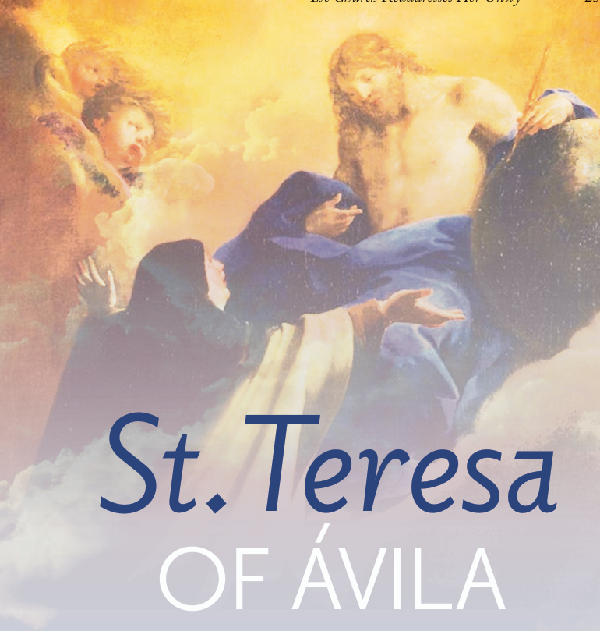
Catholic Reformers
The temptation to sin is not a problem that can be dealt with once and for all; the need for reform is persistent. The Church is constantly in need of reformation.
Saint Teresa of Avila was one of many counter-reformation Saints who helped the Church recover from the Protestant Reformation.
Notes:
Photo Credit: AMP Textbook p. 259.
Directions: Have students copy information from the slide into their notes.
Teaching Point: St. Teresa of Ávila is recognized today as one of the great figures of the Catholic Reformation. To reform the genuine purpose of the Carmelite order, Teresa founded a new convent of Carmelite nuns that enforced the rules of the order more strictly. She inspired others, including Carmelite men such as St. John of the Cross, to reform their own religious houses as well. Teresa faced severe opposition at times, often from fellow Carmelites and others in the Church, but she forged ahead with confidence that the reform she championed was the way God was calling her to be faithful to and serve the Church. She also hoped that the reform of the Carmelites would serve as a model of reform in the Church at large.
Online Resources: View video, Bishop Barron: Counter Reformation and the Council of Trent. URL Here: https://youtu.be/VRZK92T8k28
Have students view video, Saint of the Day, St. Theresa of Avila. URL here: https://youtu.be/XLSraY_Vybg
The resources linked in this presentation file may contain copyright material. Such material is made available for educational purposes only. This constitutes a “fair use” of any such copyright material as provided for in Title 17 U.S.C. section106A-117 of the US Copyright Law.

Slide 14
What Catholics Believe About Mary
Immaculate Conception
Perpetual Virginity
Mother of God
Assumption
Mary, the mother of Jesus, was preserved free from the effects of the sin of Adam (usually referred to as “original sin”) from the first instant of her conception.
Mary, the mother of Jesus, was a virgin "before, during and after" the birth of Christ. When the Bible speaks of Jesus’ brothers and sisters it is referring to kinsmen.
Mary is the Theotokos (Greek for Christ Bearer or Mother of God). Jesus is God and Mary is his mother, therefore Mary is the mother of God.
Mary was "assumed"or taken into heaven instead of going through the natural process of physical decay upon death.
Notes:
Directions: Have students copy information from the slide into their notes.
Teaching Points: Many Protestant Christians have dropped the Catholic teachings on Mary. Some believe that the Catholic church worships Mary which is not true. These are the four most important beliefs we have which are considered dogmas. A dogma is a doctrine that has the most weight and that we are obligated to accept in faith.
A dogma proposes truths contained in Divine Revelation or having a necessary connection with it.
These truths are immediately or mediately grounded in Scripture.
They reflect not only the full authority of the Church received from Christ but also the Church's tradition, liturgical practice and the faith of the people (sensus fidelium).
Dogmas are lights on our path of faith. They have binding character, and intellect and heart to a deeper understanding of God's mystery. Read CCC 88-89 (85-95).
There are four dogmas stating important aspects of Mary's role in salvation and her personal relationship with God. Each of these teachings are rooted in Scripture, some are explicitly stated others are implicitly stated. Their names are:
Divine Motherhood
Perpetual Virginity
Immaculate Conception
Assumption
Online Resources: Have students view video, Four Dogmas Catholics Believe About Mary. URL here: https://youtu.be/l-FNNjQS2xk
Have students view video, The Four Marian Dogmas. URL here: https://youtu.be/D4hnSR2zkWs
View video, The Assumption of Mary. URL here: https://youtu.be/4vOPWJBjAPg
Assign article, The Four Marian Dogmas. URL here: https://www.catholicnewsagency.com/resource/55423/the-four-marian-dogmas
The resources linked in this presentation file may contain copyright material. Such material is made available for educational purposes only. This constitutes a “fair use” of any such copyright material as provided for in Title 17 U.S.C. section106A-117 of the US Copyright Law.

Slide 15
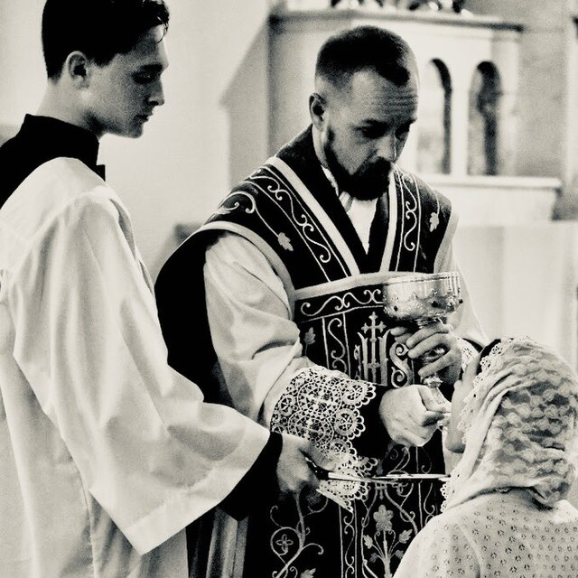
Transubstantiation
Key
Vocab
Church teaching related to the Holy Eucharist that holds that the substance of the bread and wine is changed into the substance of the Body and Blood of Christ at the consecration at Mass. Rejected by Protestant reformers.
Notes:
Photo Credit: Communion during Missa Cantata. JoeJ10.Creative Commons Attribution-Share Alike 4.0. https://commons.wikimedia.org/wiki/File:Communion_during_Missa_Cantata.jpg
Directions: Have students copy the term and the definition in the vocabulary section of their notes.
Online Resources: Have students view video, Catholic Answers: Explaining Transubstantiation. URL here: https://youtu.be/BJIj1TQptiQ
The resources linked in this presentation file may contain copyright material. Such material is made available for educational purposes only. This constitutes a “fair use” of any such copyright material as provided for in Title 17 U.S.C. section106A-117 of the US Copyright Law.

Slide 16


Memorize It
Key
Verse
“...that they may all be one.” -Jn 17:21
Notes:
Directions: Have students copy the quote. Add bonus points to the assessment if they can copy it down demonstrating that they memorized it.
The resources linked in this presentation file may contain copyright material. Such material is made available for educational purposes only. This constitutes a “fair use” of any such copyright material as provided for in Title 17 U.S.C. section106A-117 of the US Copyright Law.

