Slide 1

7. THE CHURCH FACES A MORE HOSTILE WORLD
Notes:
Suggestions for students’ note taking:
●Require students to use a three ring binder (1/2-1 inches) full of loose leaf paper (college or wide ruled).
●Notes must be taken in pen only and hand written.
●Notebooks should contain information and notes for religion class only.
●Notebooks must have a table of contents with topic of notes, dates and page numbers.
●All notes must have a topic and page number.
●Students will be required to copy each slide unless the teacher directs students to skip certain slides or parts of slides. Notebooks will be graded based on neatness, completeness and organization. Notebooks should have a significant point value representing 20-25% of the overall grade.
The resources linked in this presentation file may contain copyright material. Such material is made available for educational purposes only. This constitutes a “fair use” of any such copyright material as provided for in Title 17 U.S.C. section106A-117 of the US Copyright Law.

Slide 2
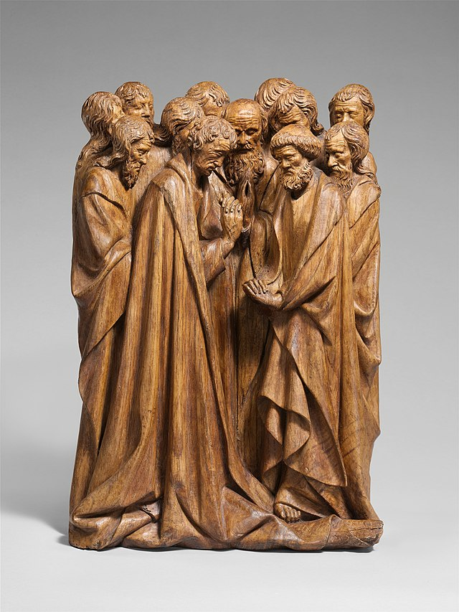

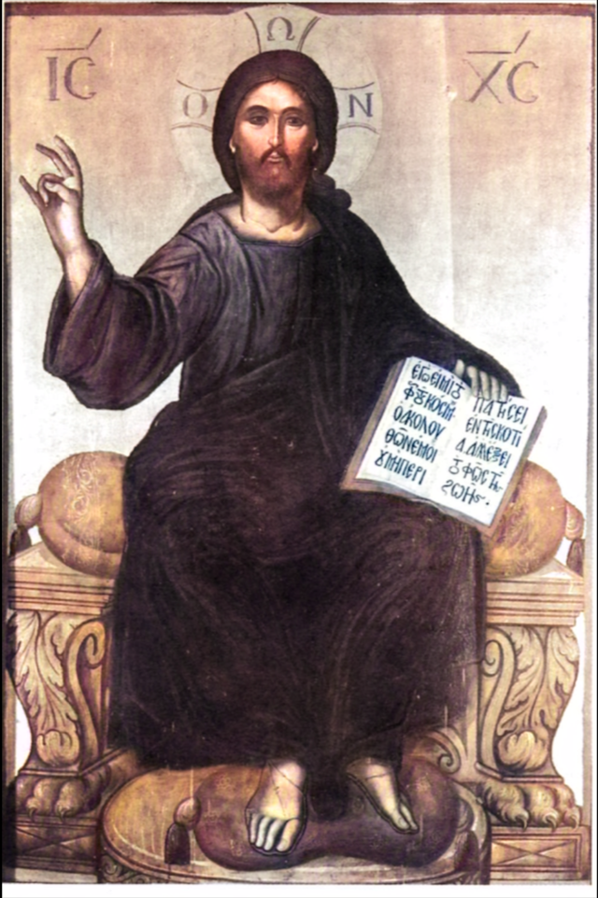
Three Ways the Church is Unchanging
Apostolic Structure
Moral Teachings
Absolute Truths Called Dogma
Notes:
Photo Credits: South Netherlandish; Relief; Sculpture-Wood. Creative Commons Zero, Public Domain Dedication. Apostles in Praye
Pro-Life demonstration in Washington. FamilyMan88. Creative Commons Attribution-Share Alike 4.0.
Pro-life-march.png. Jesus Enthroned. Thomas Bathas. Public domain. https://commons.wikimedia.org/
Directions: Have students copy down information from the slide into their notes.
Teaching Points: Part of the Church’s own mystery is that she is also unchanging.
The Body of Christ, the Church, is constant in her…
permanent apostolic structure established by Jesus
her permanent moral teachings, which likewise are rooted in the teachings of Jesus
her permanent dogma, those absolute truths that were revealed by Christ and are so indispensable to the Christian faith that their essence can never be changed.
These three pillars provide the Church the stability she needs to adapt to an ever-changing world.
The Church’s understanding of God’s revelation has increased throughout history. Although Jesus Christ is the absolute and complete self-communication of God to humanity, the Church’s understanding of Jesus and the truth that he revealed is constantly growing and deepening. The role of the Church as the Body of Christ guided by the Holy Spirit is to continue to reveal the presence of God and to lead all people to unity with the Father, just as Jesus did. It is the task of the Church to interpret what is going on in today’s world in light of the Gospel.
Online Resources: Assign article, An Unchanging Church. URL here: https://catholicexchange.com/an-unchanging-church/
The resources linked in this presentation file may contain copyright material. Such material is made available for educational purposes only. This constitutes a “fair use” of any such copyright material as provided for in Title 17 U.S.C. section106A-117 of the US Copyright Law.

Slide 3

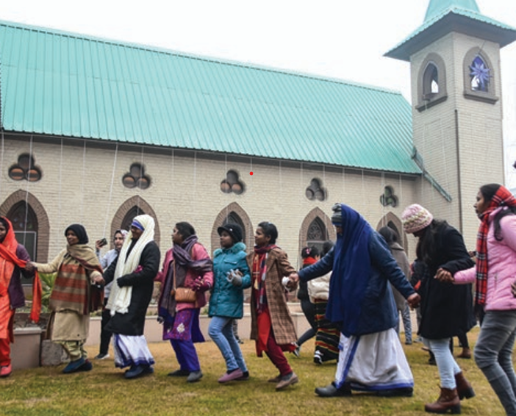
A Pilgrim People
Like pilgrims, Catholics are on a journey, on their way to a destination at which they have not yet arrived.
The Church is striving toward perfection, toward deeper communion with God through Christ.
Notes:
Photo Credit: AMP Textbook p. 355.
Directions: Have students copy the side information in their notebooks.
Teaching Points: While the Church seeks to proclaim the Gospel and build the kingdom, her goal is not worldly success. Rather, the Church’s goal is the sanctification of her people, so that they will find salvation through Christ and thus find their way home to him in heaven.
The twentieth century underscored the Catholic Church’s character as a pilgrim people. While the Church continued to spread across the world and grew to encompass a billion believers, in many places she faced hostility from…
Governments
The societal elite
The dominant cultural and intellectual movements.
Totalitarian regimes under the influence of communist and Nazi ideologies persecuted Christians who refused to cede to the state all authority over every aspect of life. In other places, false ideas about wealth, status, marriage, and family came to dominate the culture, undermining the Church’s efforts to guide her people on the way of true happiness
1 Peter 2:11-12, Beloved, I urge you as aliens and sojourners to keep away from worldly desires that wage war against the soul. Maintain good conduct among the Gentiles, so that if they speak of you as evildoers, they may observe your good works and glorify God on the day of visitation.
Online Resources: Assign article, Theology of Pilgrimage: Home to Heaven. URL here: https://www.ncregister.com/commentaries/the-theology-of-pilgrimage-our-path-home-to-heaven
The resources linked in this presentation file may contain copyright material. Such material is made available for educational purposes only. This constitutes a “fair use” of any such copyright material as provided for in Title 17 U.S.C. section106A-117 of the US Copyright Law.

Slide 4

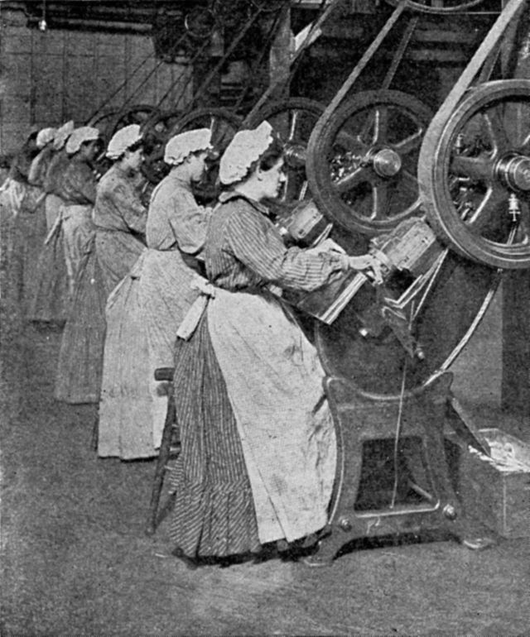
The social dimension of the Gospel
“The Gospel encountered modern industrial society with its new structures for the production of consumer goods, its new concept of society, the state and authority, and its new forms of labor and ownership.”
-CCC 2421
Notes:
Photo Credit: Factory workers stamping out end disks. Scanned by the Seattle Public Library.
Public domain. Can factory workers stamping out end discs, published 1909. https://commons.wikimedia.org/wiki/File:Can_factory_workers_stamping_out_end_discs,_published_1909.jpg
Directions: Have students copy the side information in their notebooks.
Teaching Points: At the dawn of the Industrial Revolution with its new structures, society began to change. There was a need for a systemic teaching that would help apply the principles of the Gospel to changing social situations.
Catholic social teaching upholds that humans are called to work as a participation in God's creation. Workers have basic rights that must be respected, including the right to safe working conditions and just wages.
.
Online Resources: View video, Bishop Barron: Theology of Work. URL here: https://youtu.be/wX9gBAP6XOI
Assign article Seven Themes of Catholic Social Teaching. URL here: https://www.usccb.org/beliefs-and-teachings/what-we-believe/catholic-social-teaching/seven-themes-of-catholic-social-teaching
The resources linked in this presentation file may contain copyright material. Such material is made available for educational purposes only. This constitutes a “fair use” of any such copyright material as provided for in Title 17 U.S.C. section106A-117 of the US Copyright Law.

Slide 5
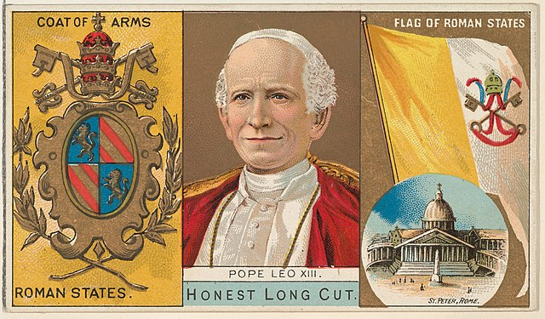
Rerum Novarum
Key
Vocab
A 1891 encyclical written by Pope Leo XIII emphasising the basic economic principles of Christianity: the right of property ownership, the duty to provide for the common good and to use that property for the benefit of others, a fair wage, and charity toward the poor.
Notes:
Photo Credit: W. Duke, Sons & Co.. Creative Commons Zero, Public Domain Dedication. Pope Leo XIII. https://commons.wikimedia.org/wiki/File:Pope_Leo_XIII,_Roman_States,_from_the_Rulers,_Flags,_and_Coats_of_Arms_series_(N126-1)_issued_by_W._Duke,_Sons_%26_Co._MET_DPB873799.jpg (cropped).
Directions: Have students copy down this key term in their vocab section of their notes.
Teaching Points: Rerum Novarum is an example of how the Church adapts to the circumstances of the times. The gospel message doesn’t change but Rerum Novarum was a response to how the Industrial Revolution changed the societal roles of individuals and families. Working conditions were often inhumane. The advent of industrialization increased the production of goods but moved the workforce to crowded cities, away from small, local shops and farms. Human rights violations were rampant. Living wages were disregarded. There were few employer savings or pension programs. Most despicably, children as young as six years old were made to work long days—sometimes up to nineteen hours per day—in cramped buildings known as sweatshops.
Online Resources: View video, Rerum Novarum Catholic Social Teaching on Capital and Labour. URL here: https://youtu.be/vjVaIt7Ur14
The resources linked in this presentation file may contain copyright material. Such material is made available for educational purposes only. This constitutes a “fair use” of any such copyright material as provided for in Title 17 U.S.C. section106A-117 of the US Copyright Law.

Slide 6

Mater et Magistra
Key
Vocab
A 1961 encyclical written by Pope John XXIII emphasising the role of the Church in our times as both a mother and a teacher. The Church is our mother, nurturing us as we grow and mature in our faith. She teaches us truth which illumines our pilgrim journey on earth.
Notes:
Photo Credit: AMP Textbook pg. 360
Directions: Have students copy down this key term in their vocab section of their notes.
Teaching Points: Pope John XXIII wrote that the Church “was entrusted by her holy Founder the twofold task of giving life to her children and of teaching them and guiding them—both as individuals and as nations—with maternal care” (MM, 1) The Church is our mother, nurturing us as we grow and mature in our faith. (“Holy Mother Church” is a phrase that used to be common among Catholics.) Even as human mothers are also teachers, instructing their children in countless ways through word and example, so the Church is both mother and teacher.
Online Resources: Read article, EWTN: From Rerum Novarum to Mater et Magistra. URL here: https://www.ewtn.com/catholicism/library/rerum-novarum-to-mater-et-magistra-4198
The resources linked in this presentation file may contain copyright material. Such material is made available for educational purposes only. This constitutes a “fair use” of any such copyright material as provided for in Title 17 U.S.C. section106A-117 of the US Copyright Law.

Slide 7
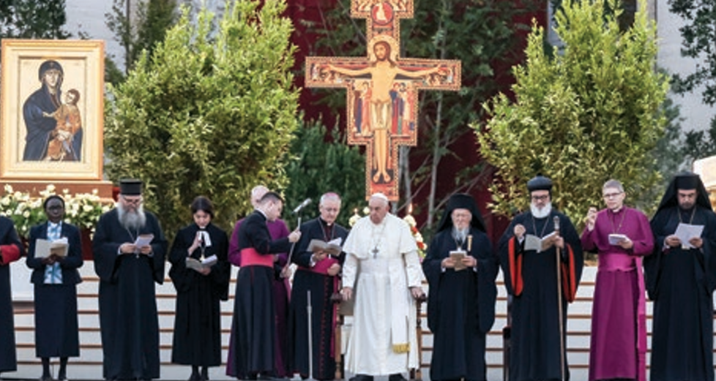
Ecumenism
Key
Vocab
From the Greek word “oikoumene,” meaning “the whole inhabited world,” is the promotion of dialogue, cooperation and unity among Christians.
Notes:
Photo Credit: AMP Textbook pg. 369.
Directions: Have students copy down this key term in their vocab section of their notes.
Online Resources: Have students view video, Catholic Central: Ecumenism. URL here: https://youtu.be/KVsMYoeKDoU
The resources linked in this presentation file may contain copyright material. Such material is made available for educational purposes only. This constitutes a “fair use” of any such copyright material as provided for in Title 17 U.S.C. section106A-117 of the US Copyright Law.

Slide 8
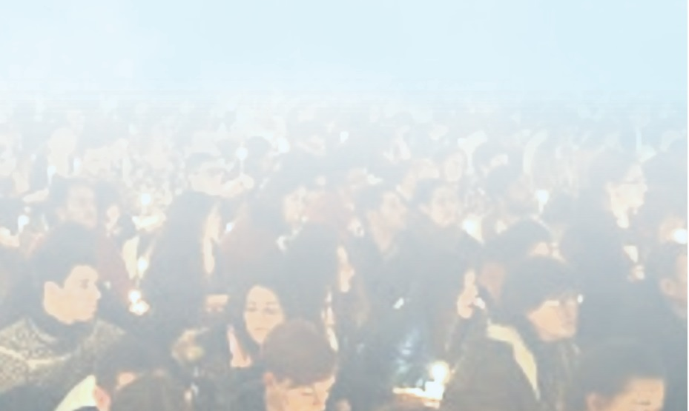
Working Toward Unity
Ecumenical efforts of both Protestants and Catholics have yielded some success. Healing to the wounds that began at the time of the Reformation.
Interreligious dialogue also increased in the twentieth century, beginning with the Jews, who are our ancestors of faith.
The work of ecumenism and interreligious dialogue has sometimes begun with making and accepting apologies.
It is the task of all Catholics to strive to improve unity with other Christians.
Notes:
Photo Credit: AMP Textbook pg. 373
Directions: Have students copy down these four points in heir notes.
Teaching Points: The wounds to Church unity, exacerbated in the years since the Protestant Reformation, remained present at the turn of the twentieth century. Unity, or oneness, as one of the marks of the Church, is something that should never be abandoned over an unwillingness to dialogue and heal divisions.
The Church, like any family, has breaks in her unity. Today, there remain different ecclesial or church communities—for example, Baptists, Methodists, and Presbyterians—that profess belief in Jesus Christ but are not fully united with the Catholic Church.
These divisions must always be addressed with prayer. Throughout the twentieth century, more and more efforts were begun on all sides to forge discussion and agreement as well.
Pope Francis has said many things about prayer and ecumenical unity, including:
Prayer for peace: "Grant us peace, teach us peace; guide our steps in the way of peace. Open our eyes and our hearts, and give us the courage to say: 'Never again war!'"
Prayer for unity: "Prayer for unity is a sacred responsibility, because it means being in communion with the Lord".
Lack of unity:"Our lack of unity is openly contrary to the will of Christ, but is also a scandal to the world".
Christian unity: "Christian unity is a journey of synodality and witness. A journey toward harmony, not uniformity".
Harmony among diversity: "Unity is harmony among the diversity of charisms, brought to life by the Holy Spirit for the benefit of all Christians".
Trust in the Holy Spirit: "Let us trust the Holy Spirit, who draws us to unity in the harmony of a multi-faceted diversity".
The resources linked in this presentation file may contain copyright material. Such material is made available for educational purposes only. This constitutes a “fair use” of any such copyright material as provided for in Title 17 U.S.C. section106A-117 of the US Copyright Law.

Slide 9
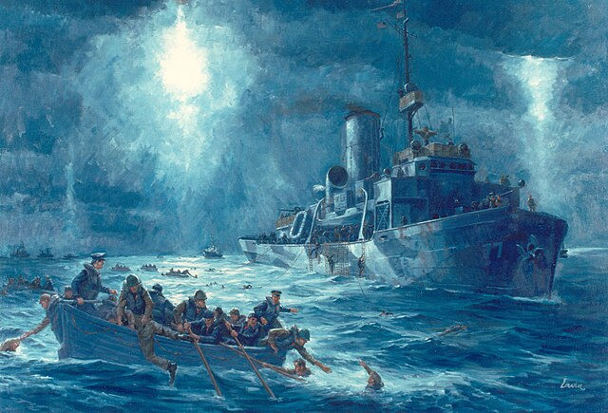
Sinking of the SS Dorchester
“I could also hear the chaplains preaching courage. Their voices were the only thing that kept me going”.
Notes:
Photo Credit: Painting of the rescue of USAT Dorchester survivors by USCGC Escanaba (WPG-77) on 3 February 1943 in the North Atlantic Ocean. Robert Lavin. Public domain. https://commons.wikimedia.org/wiki/File:Escanaba-Dorchester_rescue.jpg
Directions: Have students read, A Common Witness to Love, the description of the ecumenical coming together of the four chaplains for prayer as the boat sank. See AMP textbook pgs. 376-377. Follow up with one of the videos below.
Teaching Points: View video, The 4 Chaplains of the SS Dorchester. URL here: https://youtu.be/TT8uP02KPKs
Have students view video,The Story of Five Men’s Heroism and Sacrifice: 80 years after the sinking of the USAT Dorchester
URL here: https://youtu.be/4Q6hy_uwkd8 (start at minute 5:21).
The resources linked in this presentation file may contain copyright material. Such material is made available for educational purposes only. This constitutes a “fair use” of any such copyright material as provided for in Title 17 U.S.C. section106A-117 of the US Copyright Law.

Slide 10

Turn and Talk
What do you think God thought about the heroism and unity of the religious leaders of the SS Dorchester? Explain.
Notes:
Directions: Have students write down the question and then write down their answer….Then have students share their answers with one person close by.
The resources linked in this presentation file may contain copyright material. Such material is made available for educational purposes only. This constitutes a “fair use” of any such copyright material as provided for in Title 17 U.S.C. section106A-117 of the US Copyright Law.

Slide 11
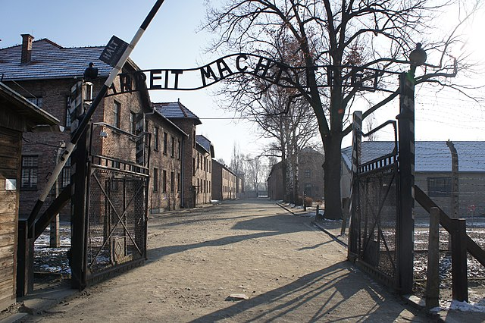
Totalitarian
Key
Vocab
A term to describe a government with total control by an authoritarian leader or
party. Under totalitarianism, Catholics were frequently persecuted, and the Church struggled to survive and continue her mission.
Notes:
Photo Credit: Auschwitz-Work Set Free. Bibi595. Creative Commons Attribution-Share Alike 3.0. Valued image. https://commons.wikimedia.org/wiki/File:Auschwitz-Work_Set_Free-new.JPG
Directions: Have students copy down this key term in their vocab section of their notes.
Teaching Points: Nazism and communism are extreme forms of totalitarianism, a concept of society that sees the state as total, controlling every aspect of a nation’s existence. Under these forms of government, religion must be either absent or utterly controlled by the state. Because the Catholic Church must remain faithful to the mission conferred by Jesus Christ, she cannot accept this view of the relationship between the Church and government.
The resources linked in this presentation file may contain copyright material. Such material is made available for educational purposes only. This constitutes a “fair use” of any such copyright material as provided for in Title 17 U.S.C. section106A-117 of the US Copyright Law.

Slide 12
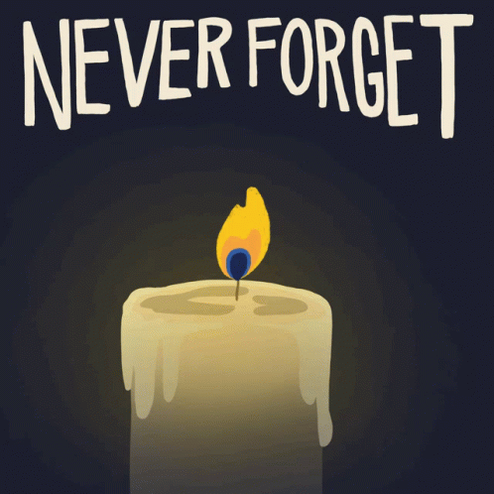
The Church and Totalitarianism
Political authorities are required to respect the fundamental rights of the human person. One of the most fundamental rights is freedom, and in particular religious freedom.
Notes:
Photo Credit: Google Slides images GIF.
Directions: Have students copy the side information in their notebooks.
Teaching Point:
The Church herself is not a political society, nor is she bound to any government.
The primary duty of the Church is the spiritual needs of her people, whereas governments are responsible for managing temporal affairs.
Because of the necessity of religious freedom, no government should interfere with the Church’s mission.
For her part, the Church respects the legitimate autonomy of the democratic order and is not entitled to express preferences for what type of government or political structure is in power, except in connection with her mission.
However, while the Church does not promote a singular form of government, she is very clear that political communities that uphold democratic values—that is, ones that call for the involvement of citizens—are integral for upholding human rights and religious freedom.
Many Catholic priests and religious sister have suffered with the people affected by totalitarianism. Saints and holy people such as: Saint Maximilian Kolbe (1894-1941) -- Franciscan priest (Auschwitz). Blessed Alice Kotowska (1900-1939) -- Resurrection nun who helped Jews (forest of Piasnicy). Blessed Michal Kozal (1893-1943) -- Polish bishop (Dachau). Blessed Karl Leisner (1915-1945) -- German priest (Dachau) and Sr. Benedicta of the Cross. All were victims of totalitarian regimes during World War II.
Online Resources: Have students view video, The Saint of Auschwitz. URL here: https://youtu.be/A8MbKF8YfiU
View video, Pope Pius XII and the Vatican's efforts to aid persecuted Jews during World War II. URL here: https://youtu.be/6J9PQ5wsIuY
The resources linked in this presentation file may contain copyright material. Such material is made available for educational purposes only. This constitutes a “fair use” of any such copyright material as provided for in Title 17 U.S.C. section106A-117 of the US Copyright Law.

Slide 13
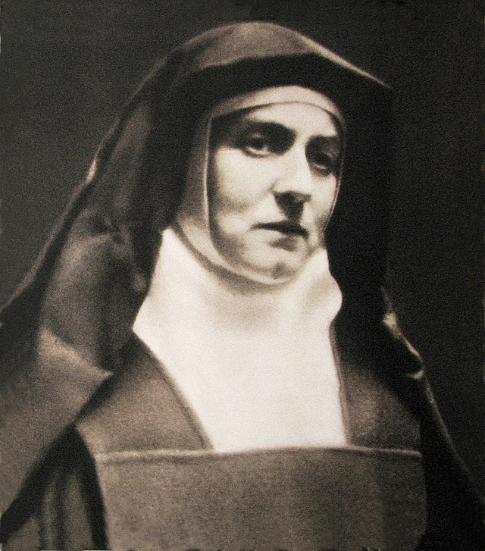
Teresa Benedicta of the Cross
“When we are united with the Lord, we are members of the Mystical Body of Christ: Christ lives on in his members and continues to suffer in them. And the suffering borne in union with the Lord is his suffering, incorporated in the great work of salvation and fruitful therein.”
-St. Edith Stein
Notes:
Photo Credit: . Edith Stein (ca. 1938-1939). Unknown author. Public domain https://commons.wikimedia.org/wiki/File:Edith_Stein_(ca._1938-1939).jpg
Directions: Have students copy the side information in their notebooks.
Teaching Point: The so-called "passport" photo taken in the doorway of the Cologne Carmel. A passport picture that Edith Stein (1891–1942) had to have taken for her passport (ca. December 1938-1939) before moving to Echt, Netherlands. Edith Stein, a German Jewish philosopher, converted to the Roman Catholic Church, became a Discalced Carmelite nun and took the religious name of Teresa Benedicta of the Cross. On 7 August 1942, she was deported to the Auschwitz concentration camp and killed in a mass gas chamber.
Online Resources: Have students view video, Edith Stein A Saint for our Time. URL here: https://youtu.be/bPJmsOsnHU0
The resources linked in this presentation file may contain copyright material. Such material is made available for educational purposes only. This constitutes a “fair use” of any such copyright material as provided for in Title 17 U.S.C. section106A-117 of the US Copyright Law.

Slide 14

Memorize It
Key
Verse
“Now I rejoice in my sufferings for your sake, and in my flesh I am filling up what is lacking in the afflictions of Christ on behalf of his body, which is the church.” -Col 1:24
Notes:
Directions: Have students copy the quote. Add bonus points to the assessment if they can copy it down demonstrating that they memorized it.
The resources linked in this presentation file may contain copyright material. Such material is made available for educational purposes only. This constitutes a “fair use” of any such copyright material as provided for in Title 17 U.S.C. section106A-117 of the US Copyright Law.

Slide 15
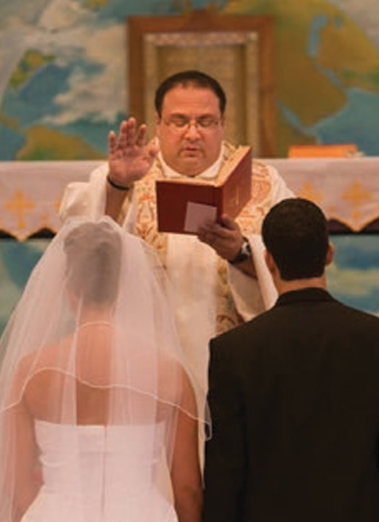
In the Domestic Church which is the family…
We learn the meaning of love
We learn to want the good of another
We learn how to place ourselves at the service of others and thereby find meaning in our own lives
We learn how to put God at the center of our existence
Notes:
Photo Credit: AMP Textbook p. 393.
Directions: Have students copy the side information in their notebooks.
Teaching Points:
The family itself is a concrete example of the Church. The Church is present in family life. This has been true since the beginning of creation when man and woman came together as one. This was also true in the early years of the Church when the Eucharist was celebrated in family homes.
The vocations of those who become priests and members of the consecrated life have always been nurtured and developed through family life. The family is the first place for education in prayer and the practice of prayer.
The family is the domestic church and the “original cell of social life” (CCC, 2207), and it must always be protected, including against cultural threats that may be supported by governments.
Online Resources: Have students view video, Knights of Columbus: Catholic Family in a Post-Christian World. URL here: https://youtu.be/V2_fVfgVpRg
The resources linked in this presentation file may contain copyright material. Such material is made available for educational purposes only. This constitutes a “fair use” of any such copyright material as provided for in Title 17 U.S.C. section106A-117 of the US Copyright Law.

Slide 16
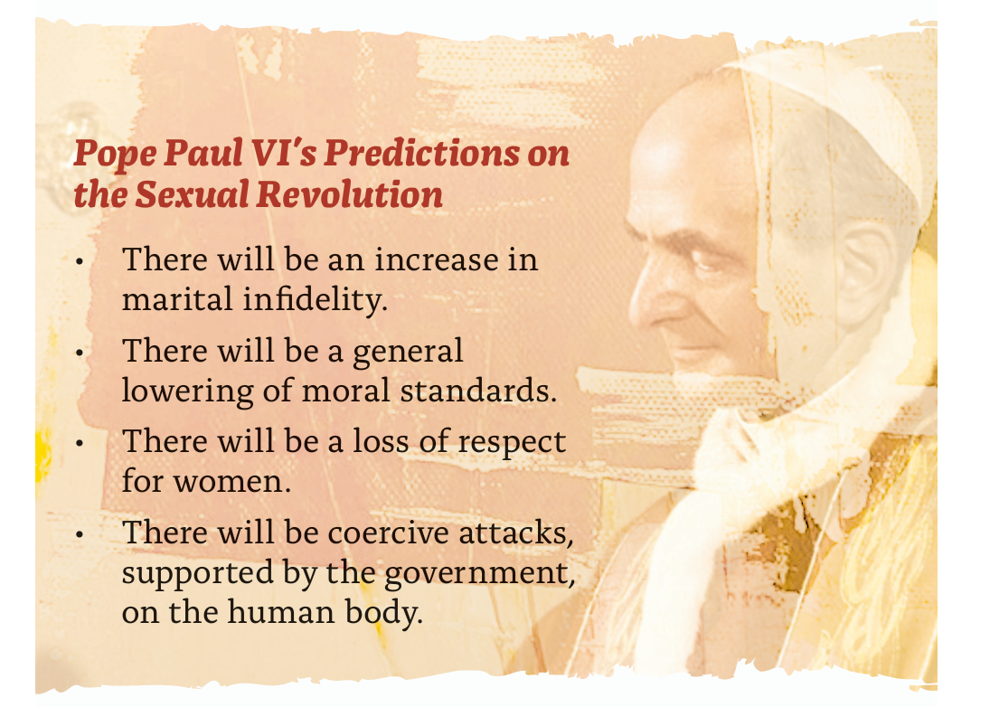
Notes:
Photo Credit: AMP Textbook p. 392.
Directions: Have students copy the side information in their notebooks.
Teaching Points:
The “sexual revolution” of the 1960s in large part destroyed this common understanding of the connection between sex and marriage.
For many, sex became a recreational activity for consenting adults, with increasingly few limits placed on it. Sins against the Sixth Commandment—”You shall not commit adultery”—not only became increasingly common but were also defended as harmless or even beneficial.
In the face of opposition from the dominant culture, the Church continues to insist on God’s design for sex and marriage.
The truth of the Church’s teaching has been borne out in the negative psychological, medical, and spiritual fallout from widespread extramarital sexual relationships brought about by the mentality of the ‘sexual revolution’.
Online Resources:Have students view video, Bishop Barron on Contraception and Social Change URL here: https://youtu.be/JWyWgNTf9ec
Have students view, The Problem With hook-Up Culture. URL here: https://youtu.be/BrwetR5Qc9s
The resources linked in this presentation file may contain copyright material. Such material is made available for educational purposes only. This constitutes a “fair use” of any such copyright material as provided for in Title 17 U.S.C. section106A-117 of the US Copyright Law.

