Slide 1
Chapter 10 PowerPoint

Slide 3
Introduction: Who Is Jesus to You?

Slide 4
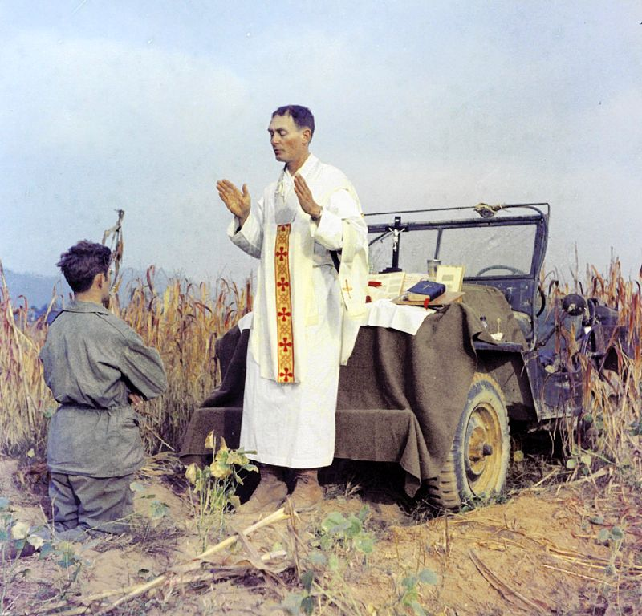
Servant of God Fr. Emil Kapaun (1916 – 1951) celebrates Mass on the hood of his jeep in the Korean War
Introduction: Who Is Jesus to You?

Slide 5
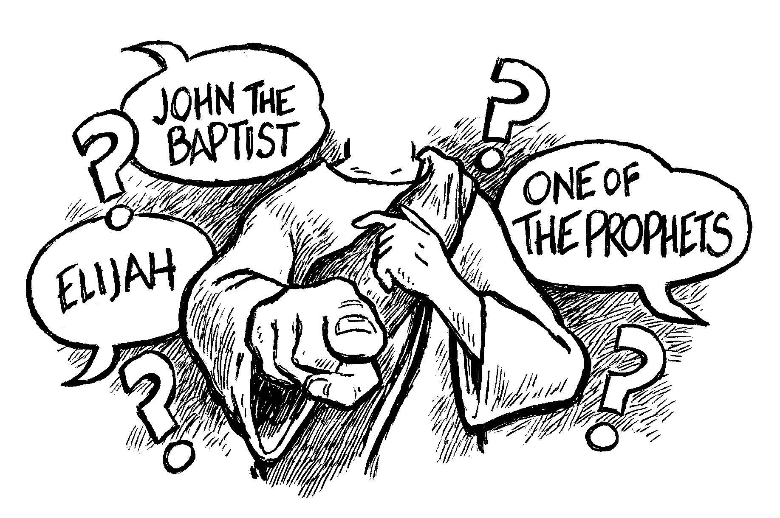
“But who do you say that I am?
Matthew 16:14
Introduction: Who Is Jesus to You?

Slide 6
I AM
the
WAY
TRUTH
LIFE
John 24:6
Introduction: Who Is Jesus to You?

Slide 7
Peter’s Confession About Jesus. When Jesus went into the region of Caesarea Philippi he asked his disciples, “Who do people say that the Son of Man is?” They replied, “Some say John the Baptist, others Elijah, still others Jeremiah or one of the prophets.” He said to them, “But who do you say that I am?” Simon Peter said in reply, “You are the Messiah, the Son of the living God.” Jesus said to him in reply, “Blessed are you, Simon son of Jonah. For flesh and blood has not revealed this to you, but my heavenly Father. And so I say to you, you are Peter, and upon this rock I will build my church, and the gates of the netherworld shall not prevail against it. I will give you the keys to the kingdom of heaven. Whatever you bind on earth shall be bound in heaven; and whatever you loose on earth shall be loosed in heaven.” Matthew 16:13-19
Introduction: Who Is Jesus to You?

Slide 8
The Gospel Portrait of Jesus

Slide 9
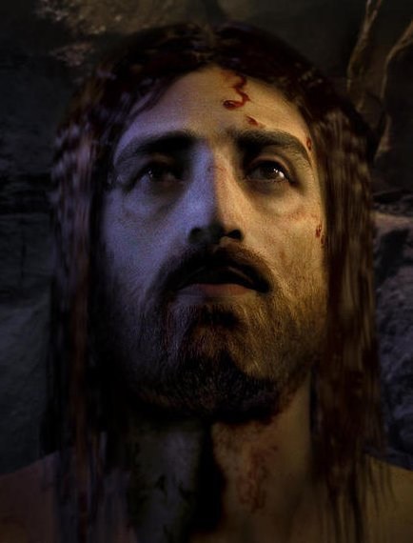
“Behold the Man!” John 19:5
In May 2010, the History Channel aired “The Real Face of Jesus,” a documentary featuring the work of computer artists from Studio Macbeth who recreated the face of Jesus in 3D based on the Shroud of Turin.
The Gospel Portrait of Jesus

Slide 10
MARK
the Gospel of Christ, the Anointed Servant
LUKE
the Gospel of the Savior of humanity
Jesus Christ
the Son
of God
MATTHEW
the Gospel of the King
JOHN
the Gospel of the God in Christ
The Gospel Portrait of Jesus

Slide 11
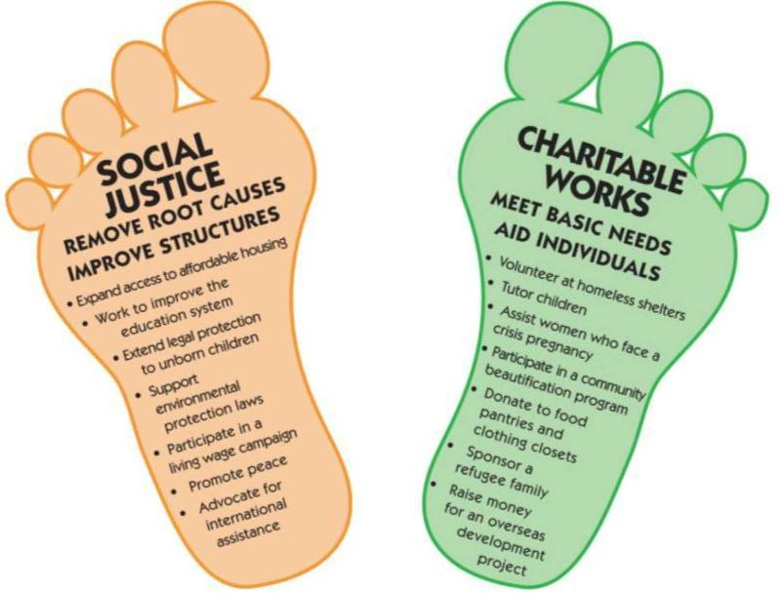
Living what Jesus taught
The Gospel Portrait of Jesus

Slide 12
The Early Church Preaches about Jesus

Slide 13
The Early Church Preaches about Jesus

Slide 14
Redeemer
Redemption is the process that frees your from the slavery of sin. Jesus Christ is your Redeemer because he paid the price of his own sacrificial Death on the Cross to save you from sin.
The Early Church Preaches about Jesus

Slide 15
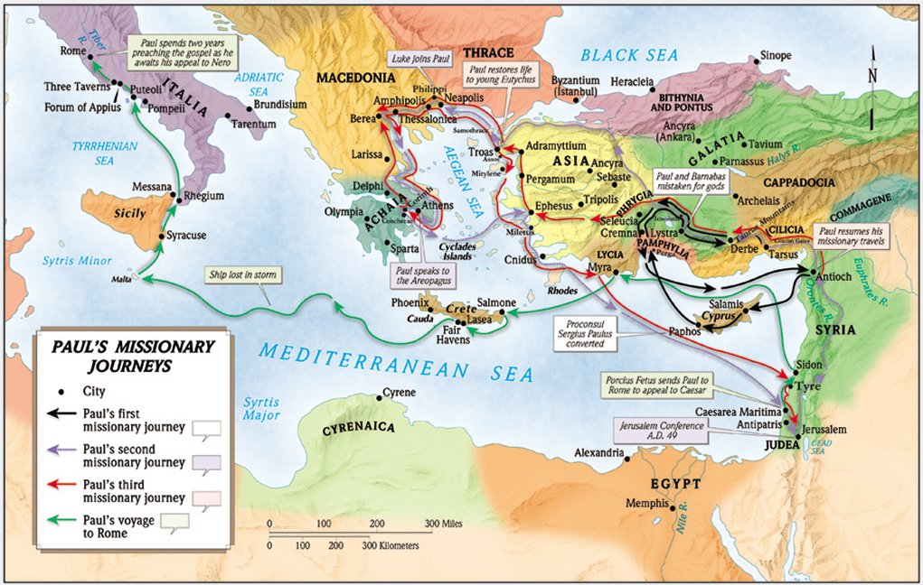
Estimates reveal St. Paul traveled at least 10,000 miles to spread the gospel of Jesus Christ throughout the Roman Empire.
The Early Church Preaches about Jesus

Slide 16
New Testament Epistles
The New Testament contains twenty-one letters. The first thirteen of these are attributed to St. Paul and they are arranged from longest to shortest. The next eight are those letters not written by Paul and they too are arranged from longest to shortest.
Pauline Epistles
Romans
1 & 3 Corinthians
Galatians
Ephesians
Philippians
Colossians
1 & 2 Thessalonians
1 & 2 Timothy
Titus
Philemon
Non–Pauline Epistles
Hebrews
James
1 & 2 Peter
1, 2, & 3 John
Jude
The Early Church Preaches about Jesus

Slide 17
Make a Commitment to Really Know Jesus

Slide 18
Make a Commitment to Really Know Jesus

Slide 19
Make a Commitment to Really Know Jesus

Slide 20
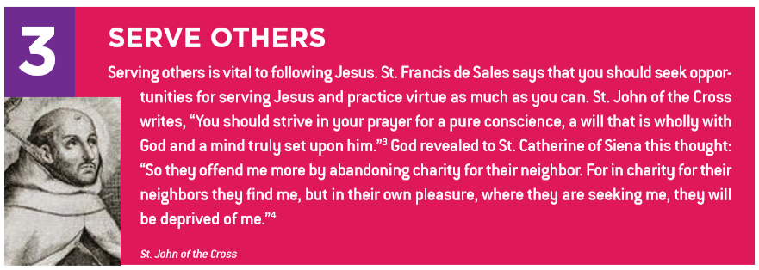
Make a Commitment to Really Know Jesus

Slide 21
Make a Commitment to Really Know Jesus

Slide 22
Make a Commitment to Really Know Jesus

Slide 23
Endnotes
Quotations from Sacred Scripture come from the New American Bible, Revised Edition (NABRE) http://wwwmigrate.usccb.org/bible/
Quotations from the Catechism of the Catholic Church http://www.vatican.va/archive/ENG0015/_INDEX.HTM
Quotations from Documents of the Second Vatican Council http://www.vatican.va/archive/hist_councils/ii_vatican_council/index.htm
Pope Francis’ Three Keys to Knowing Jesus https://www.catholiccompany.com/getfed/pope-francis-three-keys-to-knowing-jesus/
The Real Face of Jesus http://historicconnections.webs.com/crucifixion.htm

