Slide 1
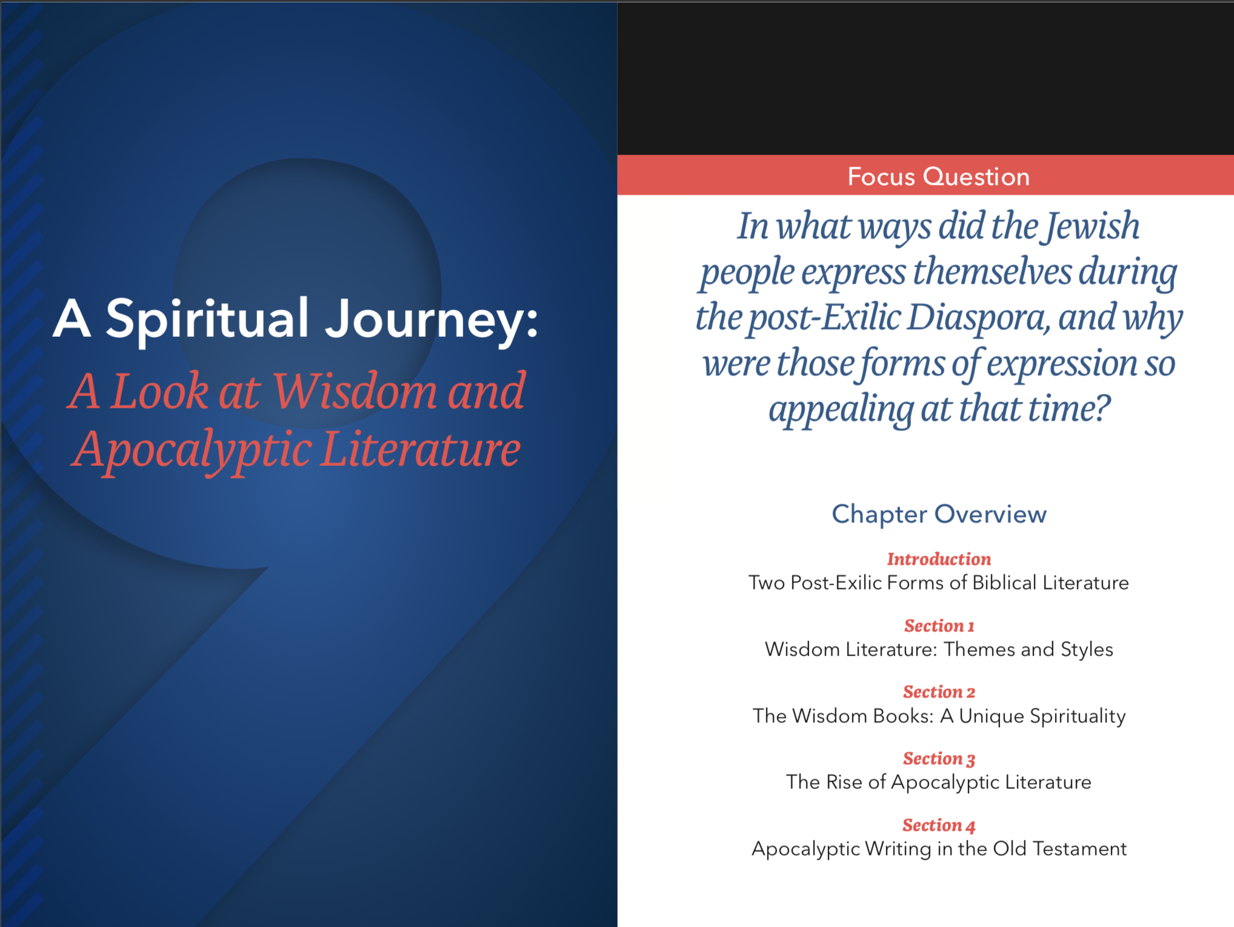
The Old Testament
Chapter Nine

Slide 2
Themes of wisdom literature and apocalyptic literature after the Exile.
God’s Creation
Natural Laws
The Future
Meaning of Life
Two Post-Exilic Forms of Biblical Literature
Notes:
See Chapter 9, Introduction, Teaching Approaches 1, 2, and 3 in the Teacher’s Wraparound Edition.

Slide 3

Wisdom Literature
The beginning of wisdom is fear of the Lord,
and knowledge of the Holy One is understanding.
(Prv 9:10)
A product of many different cultures in the ancient Middle East
Collections of wise sayings, proverbs, and short stories to help people deepen their faith and understand how to live
Often interchangeable with other cultures of the time
Old Testament wisdom literature includes the Books of Job, Psalms, Proverbs, Ecclesiastes, Song of Songs, Wisdom, and Sirach (Ecclesiasticus).
Two Post-Exilic Forms of Biblical Literature
Notes:
Introduction to Wisdom books in the Old Testament: http://www.usccb.org/bible/scripture.cfm?src=_intros/wisdom-intro.htm
An alternate slide presentation on Wisdom Books: https://www.avemariapress.com/resources/22/2624/

Slide 4
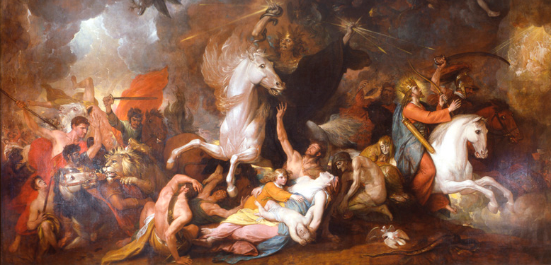
apokalypsis
The earth shall be utterly laid waste, utterly stripped,
for the LORD has decreed this word. Is 24:3
Two Post-Exilic Forms of Biblical Literature
Notes:
The Greek word apokalypsis means: “revelation” or “unveiling,” referring to how it reveals or uncovers the truth. The following are examples of this type of writing from the Old Testament:
Book of Daniel
Portions of Isaiah (24–27)
Ezekiel (38–39), Joel (2:1–11, 4:1–21), and Zechariah (1:7–6:8)
This image entitled “Death on a Pale Horse” is based on Revelation 6:8 by artist Benjamin West in 1817. Apocalyptic subject matter has long been something that interests humanity because of the subject of the end of days.
See Chapter 9, Introduction, Teaching Approach 3 in the Teacher’s Wraparound Edition.

Slide 5
Wise Person | Foolish Person | Reference
Walks in light | Walks in darkness | Ecclesiastes 2:14
Acts prudently | Parades folly | Proverbs 13:16
Possesses glory | Bears shame | Proverbs 3:35
Listens to advice | Thinks they are always right | Proverbs 12:15
Wins favor with their words | Lets their words consume them | Ecclesiastes 10:12
Builds her house | Tears down her house | Proverbs 14:1
Lives in the house of mourning | Lives in the house of merriment | Ecclesiastes 7:4
Wisdom Literature: Styles and Sources
Notes:
Have the students read each set of examples and accompanying passage and write a concrete example for both the wise and foolish person.
As an alternate activity, have the students work in pairs. Assign each pair at least one example and passage. Have them prepare a short silent skit or mime to illustrate their example and perform it before the class. Have the class guess the example being portrayed.

Slide 6

Wisdom for Today
By wisdom a house is built,
by understanding it is established;
And by knowledge its rooms are filled
with every precious and pleasing possession.
Proverbs 24:3
Notes:
Brainstorm with the students words of wisdom that form the foundations of their lives, understanding that helps them grow, and types of knowledge that are essential and long-lasting.
Assign them to draw a “house” that represents their own life and incorporates in words or symbols some of the examples discussed.

Slide 7
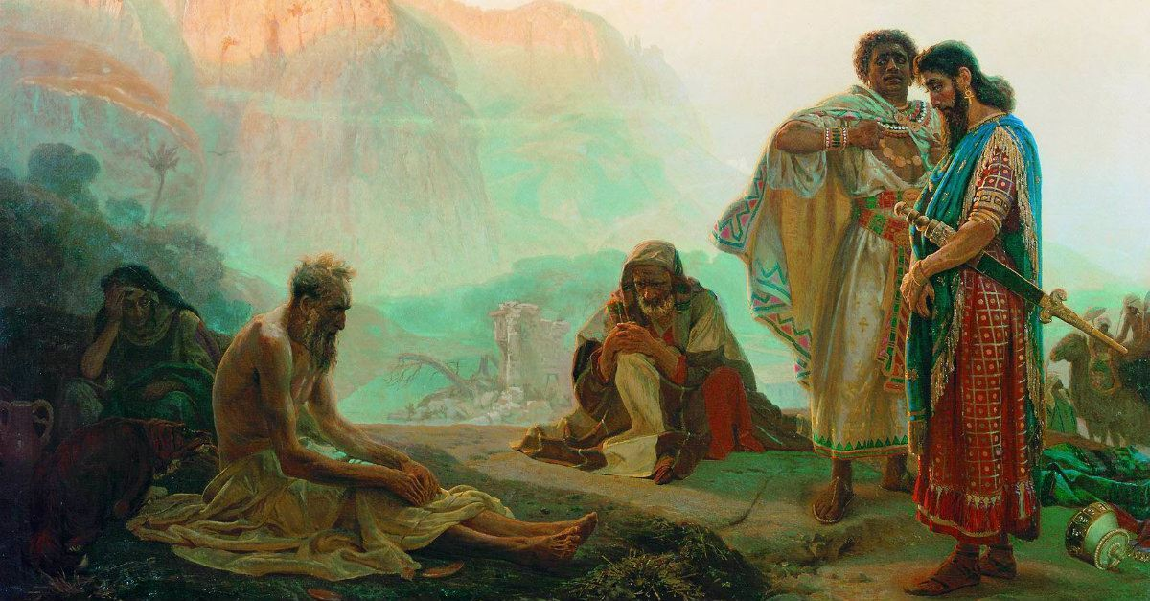
The Book of Job
The Wisdom Books: A Unique Spirituality
Notes:
Introduction to the Book of Job: http://www.usccb.org/bible/job/0
Play “Overview: Job” (11:00) https://www.youtube.com/watch?v=xQwnH8th_fs
See pages 401-403 of the Student Text.
See Chapter 9, Introduction, Extending the Lesson 1 (including Handout 9C) from the Teacher’s Wraparound Edition.
*The image is entitled “Job and his Friends” and was completed in 1869 by Russian artist Ilya Repin

Slide 8

Proverbs
The proverbs teach three kinds of wisdom: knowledge of God’s created world, the skill of making right choices, and the art of living before God.
The Wisdom Books: A Unique Spirituality
Notes:
See Chapter 9, Section 1, Teaching Approach 1 in the Teacher’s Wraparound Edition.
See pages 403-404 in the Student Text.
Have the students browse the Book of Proverbs for examples of each of the three kinds of wisdom defined and write their examples in their notebooks or journals.

Slide 9

The Book of Ecclesiastes
Ecclesiastes is a loose collection of proverbs, laments (“expressions of grief”), poems, and rhetorical questions.
The Wisdom Books: A Unique Spirituality
Notes:
See Chapter 2, Section 2, Teaching Approach 2 in the Teacher’s Wraparound Edition.
See pages 404-40 of the Student Text.
Play the Byrds “Turn Turn Turn” with Scripture subtitles: https://www.youtube.com/watch?v=9PvxAOGYjY0

Slide 10
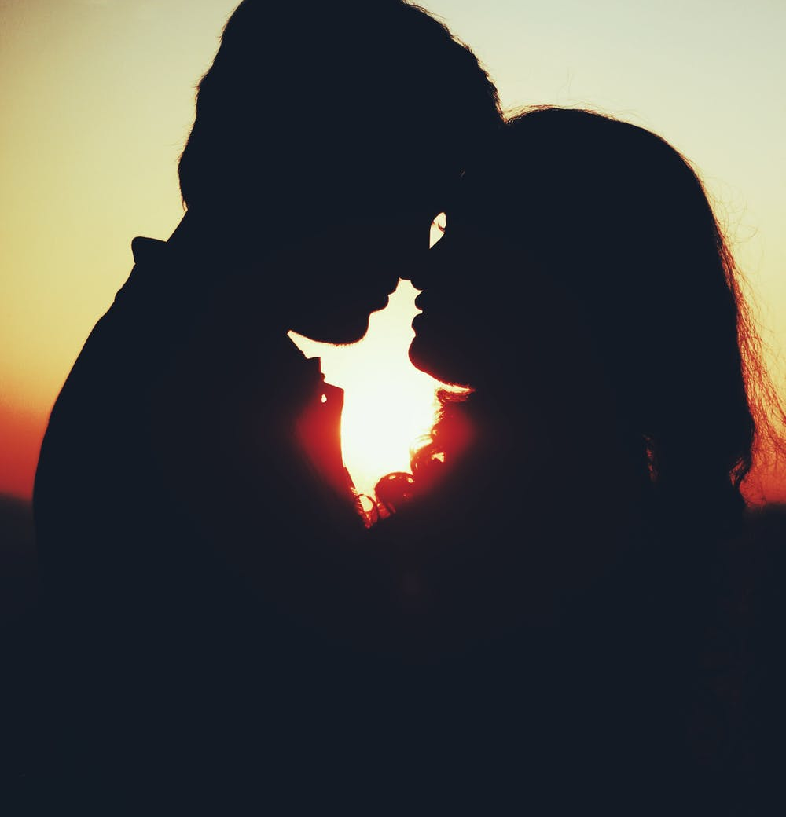
Song of Songs
An allegory for:
the love between YHWH and Israel
Christ’s love for the Church
The Song of Songs is also a joyful celebration of the love between a husband and wife.
The Wisdom Books: A Unique Spirituality
Notes:
See page 405 of the Student Text.
Read and contrast the two verse collections from Song of Songs: 3:1-2, 5:2-6
Ask: How does the longing of the woman for her beloved mirror the relationship between Christ and his Church?
See also: Chapter 9, Section 2, Extending the Lesson 2 in the Teacher’s Wraparound Edition.

Slide 11
The Book of Wisdom
The Reward of Righteousness
Human destiny is in God’s hands but influenced by our choices
Praise of Wisdom by Solomon
History of Israel reveals God’s wisdom
Special Providence of God during the Exodus
Sufferings of the Egyptians were from their own sins
The evils that affected all the enemies of Israel were a part of God’s salvation offered to his Chosen People.
The Wisdom Books: A Unique Spirituality
Notes:
Have the students read the corresponding passages for each of the characteristics from page 406 of the Student Text.

Slide 12
The Psalms
Psalms of Lament
Psalms of Praise and Thanksgiving
Psalms of Instruction
Liturgical Psalms
The Wisdom Books: A Unique Spirituality
Notes:
Book of Psalms introduction: http://www.usccb.org/bible/psalms/0
A video to accompany prayer of Psalm 23: https://www.youtube.com/watch?v=U89I_Sb87Wo
See pages 407-414 in the Student Text.
See Chapter 9, Section 2, Teaching Approach 3 in the Teacher’s Wraparound Edition.

Slide 13
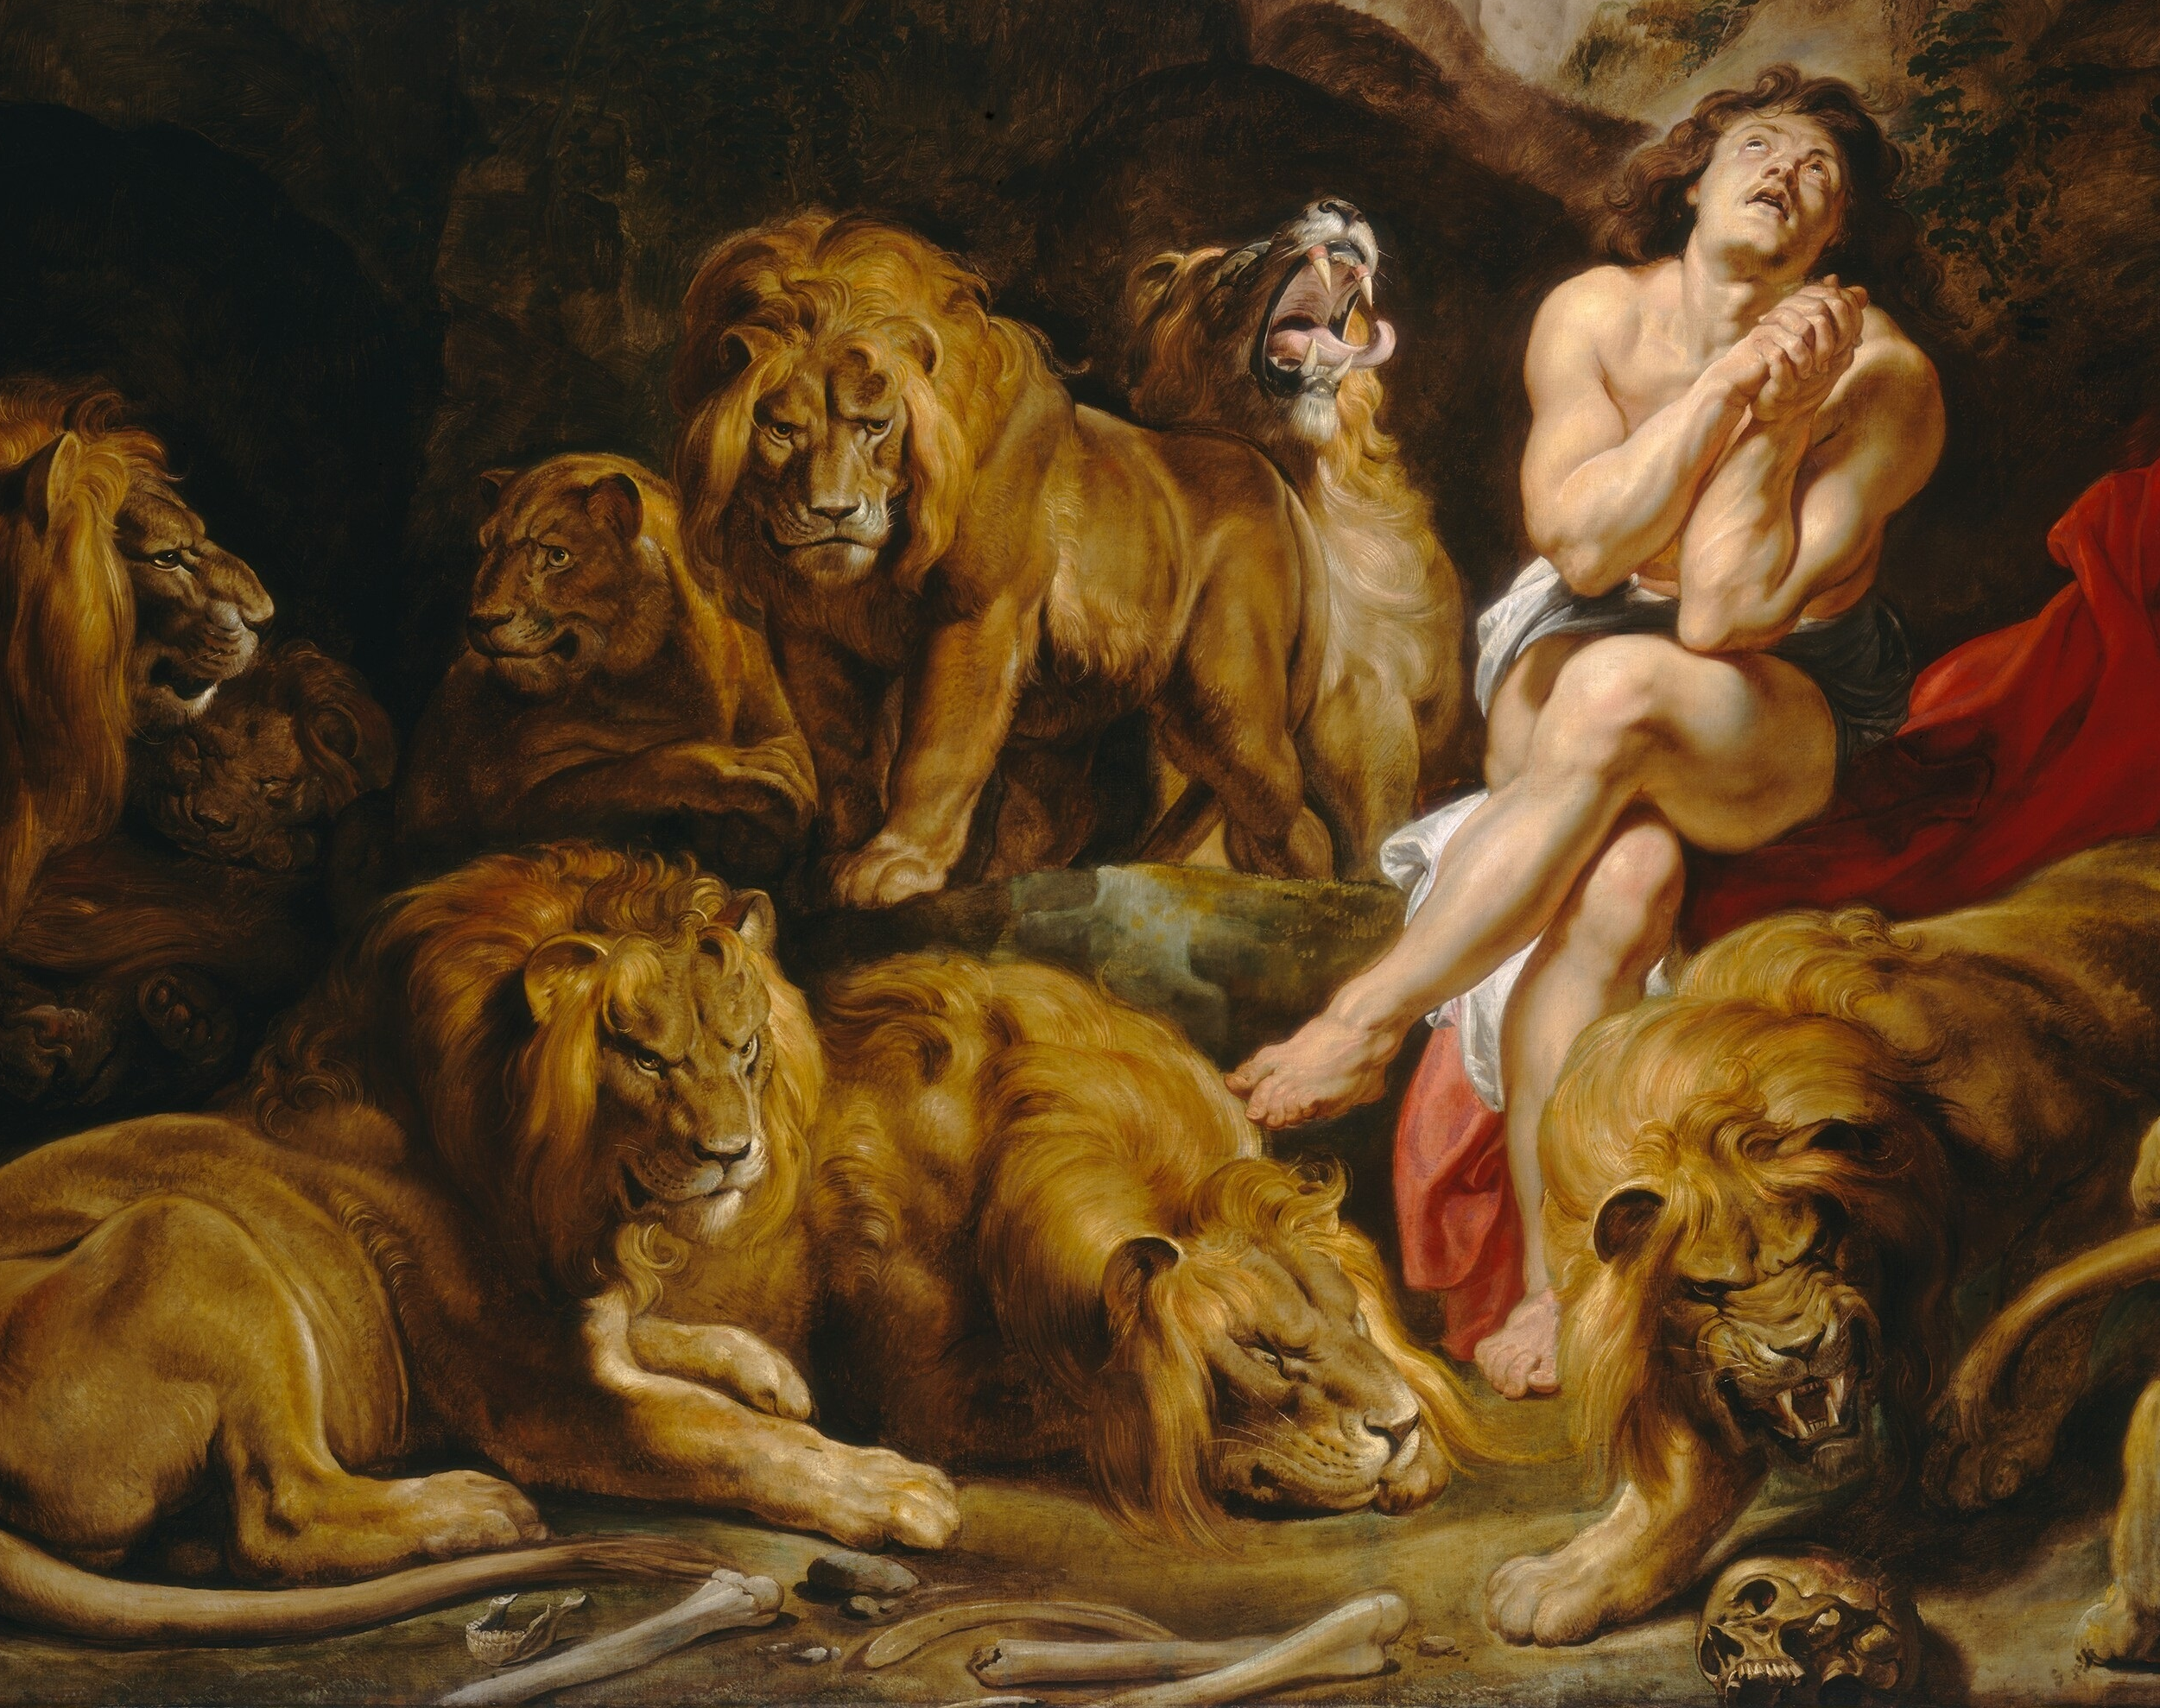
Apocalyptic Literature
A highly symbolic style of writing in which hidden truths are revealed within a narrative framework. The revelation is often delivered by an angelic or visionary being.
The Rise of Apocalyptic Literature
Notes:
Apocalyptic Literature answers the question: What is God going to do?
See Chapter 9, Section 3, Teaching Approach 1.
Watch the video “Bishop Barron Comments on Apocalyptic Literature” (7:53) https://www.youtube.com/watch?v=rrOQ3YKSEFQ
The painting is Daniel in the Lion’s Den by Rubens

Slide 14
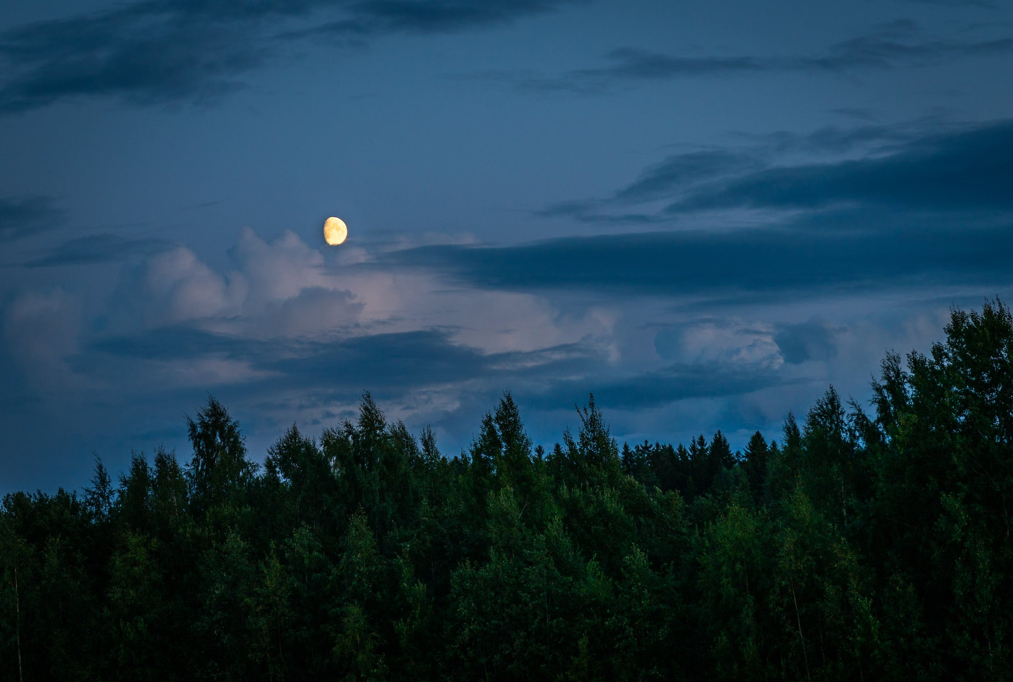
Eschatology
A study of the “last things,” such as death, judgment, immortality, heaven and hell, and the like.
Apocalyptic Writing in the Old Testament
Apocalyptic Writing in the Old Testament
Notes:
See page 422 of the Student Text.
Have the students research and explain the differences between the last and general judgments.

Slide 15
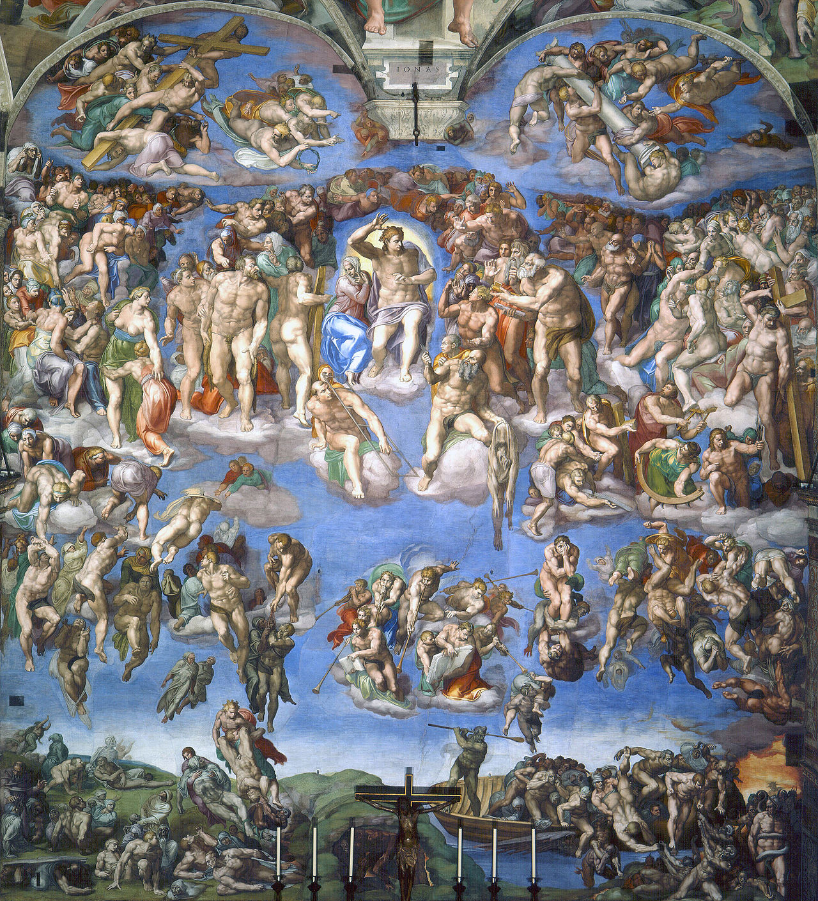
“He will come again to judge the living and the dead”
Apocalyptic Writing in the Old Testament
Notes:
Have the students write one-sentence summaries of each paragraph of the Catechism of the Catholic Church that teaches on the end times. See paragraphs 675-682.
Michelangelo's Last Judgment

Slide 16
Images
Slide 3: https://www.pexels.com/photo/adventure-calm-clouds-dawn-414171/
Slide 4: https://www.pafa.org/museum/collection/item/death-pale-horse
Slide 6: https://www.pexels.com/photo/apartment-architecture-blue-sky-building-358636/
Slide 7: https://commons.wikimedia.org/wiki/File:Job_and_his_friends.jpg
Slide 8: https://www.pexels.com/photo/man-and-child-walking-near-bushes-during-daytime-167300/
Slide 9: https://www.pexels.com/photo/woman-looking-at-sea-while-sitting-on-beach-247314/
Slide 10: https://www.pexels.com/photo/silhouette-photo-of-man-and-woman-about-to-kiss-870861/
Slide 13: https://en.wikipedia.org/wiki/Book_of_Daniel#/media/File:Sir_Peter_Paul_Rubens_-_Daniel_in_the_Lions'_Den_-_Google_Art_Project.jpg
Slide 14: https://www.pexels.com/photo/moon-above-forest-during-night-time-1685543/
Slide 15: https://en.wikipedia.org/wiki/The_Last_Judgment_(Michelangelo)#/media/File:Last_Judgement_(Michelangelo).jpg

