Slide 1
The Old Testament
Chapter Ten

Slide 2
Rulers of the Jews after the Babylonian Exile
539–333 BC Persian Empire (some Jews return from exile)
333–323 BC Alexander the Great and Hellenistic Rulers
323–200 BC Ptolemies (from Egypt) (Hellenistic Rule)
200–63 BC Seleucids (from Babylon and the East) (Hellenistic
Rule)
63 BC–313 AD Roman Empire
How God’s People Lived Under Foreign Rule
Notes:
Review also this complete timeline of Jewish history: https://www.jewishvirtuallibrary.org/timeline-for-the-history-of-jerusalem-4500-bce-present
See Chapter 10, Introduction, Teaching Approaches 1 and 2 in the Teacher’s Wraparound Edition.

Slide 3
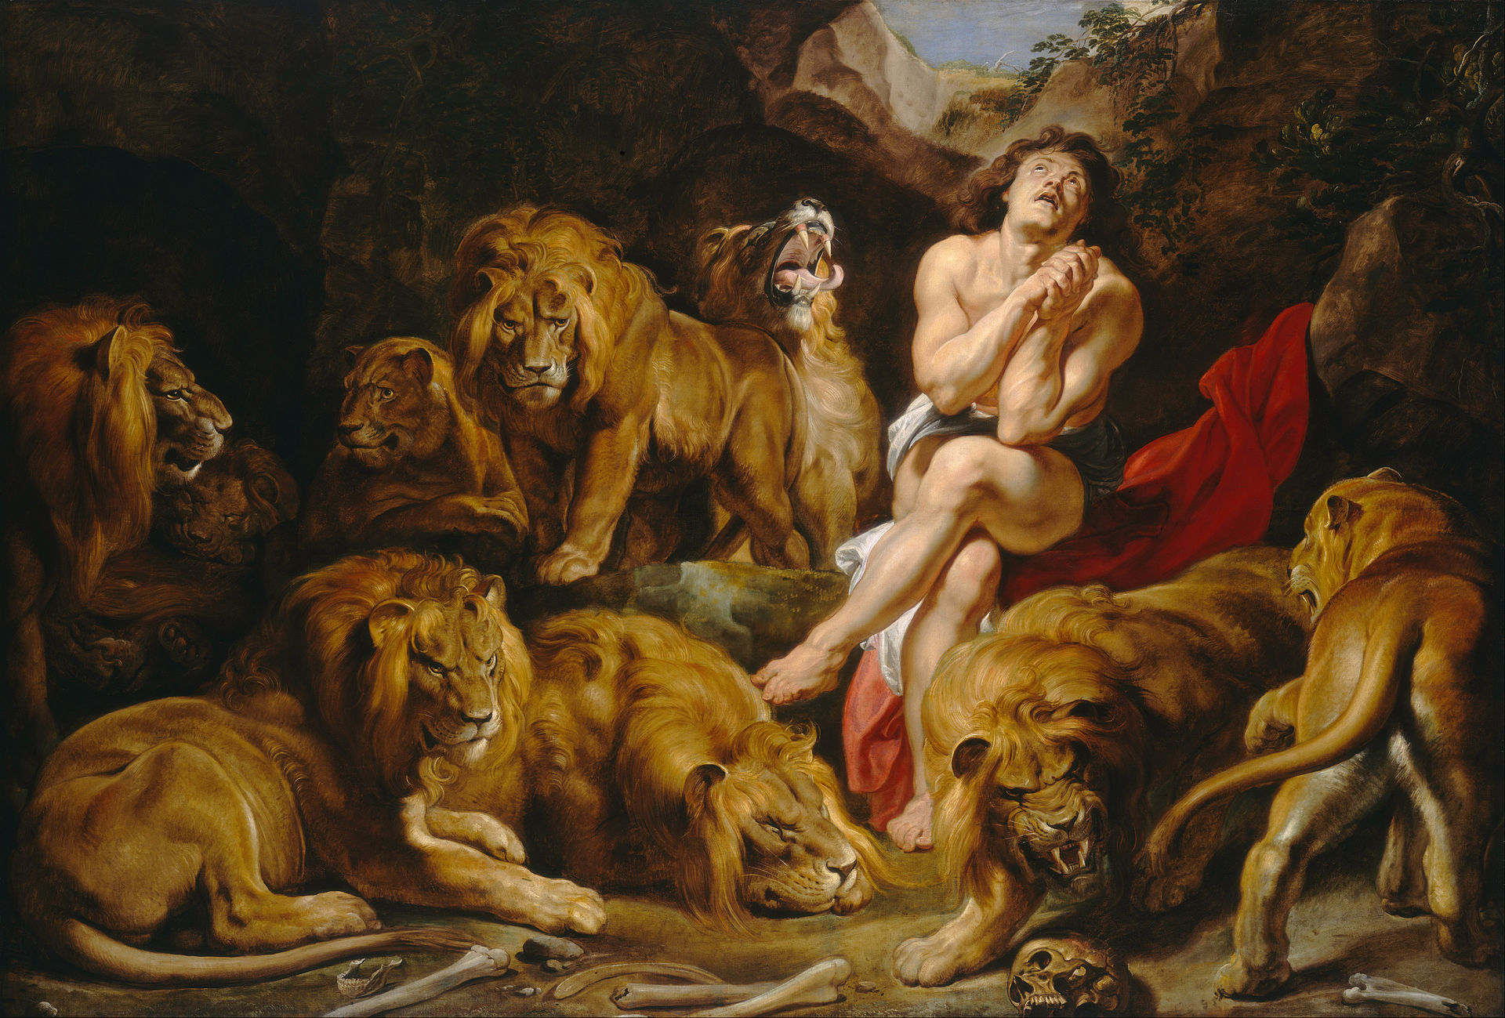
Daniel
Faithfulness to God
Daniel is portrayed in Daniel 1—6 as a young Hebrew living during the time of the Babylonian Exile, about 400 years before these chapters were written.
The Book of Daniel describes Daniel as someone who cooperated with the civil authorities and remained faithful to YHWH.
The message to Jews in the current time of the writing was to follow Daniel’s example.
How God’s People Lived Under Foreign Rule
Notes:
See Chapter 10, Introduction, Teaching Approach 2 (partially concerns Daniel 1—6).
Play “Apocalypse of Daniel” (6:35), an overview of the Book of Daniel. https://www.youtube.com/watch?v=HpJ-3RvTs5o

Slide 4
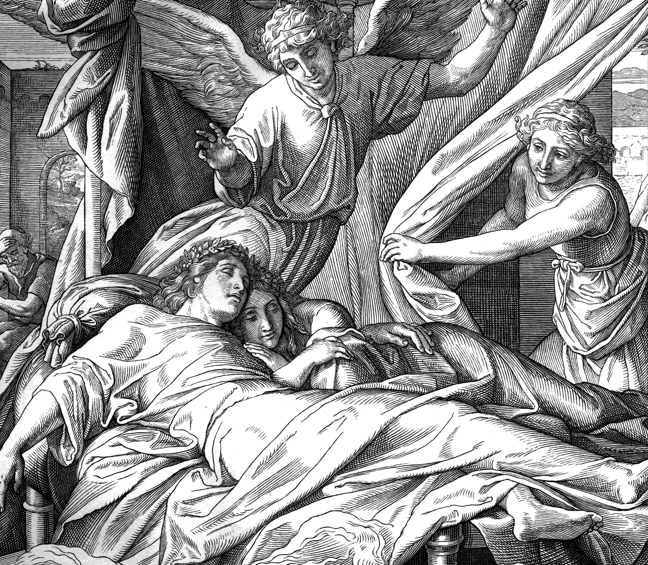
The Book of Tobit
Written as a religious novel in the second or third century BC.
Tobit emphasizes prayer, fasting, and almsgiving, especially for those living in the time of persecution.
How God’s People Lived Under Foreign Rule
Notes:
See Chapter 10, Introduction, Teaching Approach 2 (partially concerns Tobit).
See Called to Prayer, pages 487-488 of the Student Text.

Slide 5
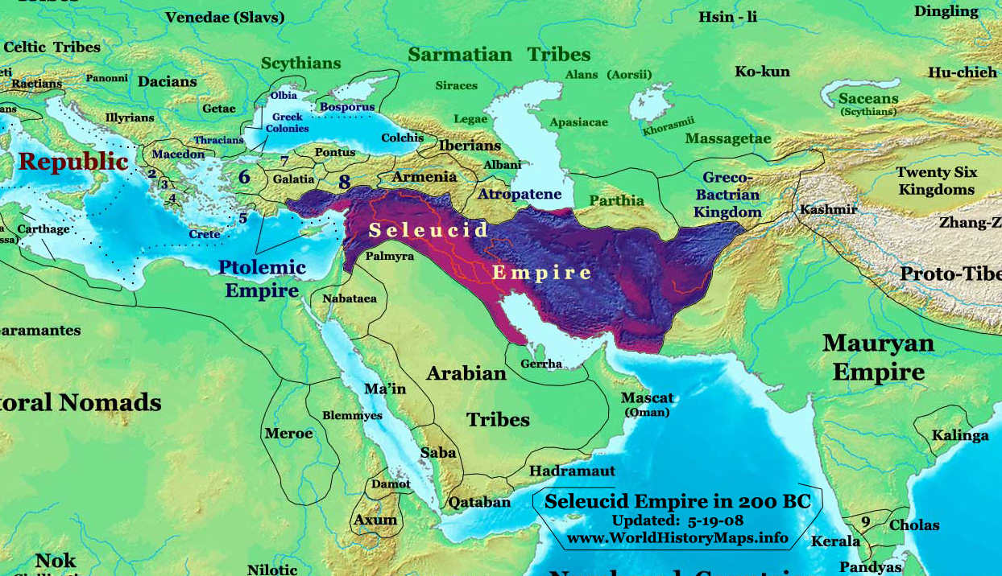
Alexander the Great followed by Hellenization
Alexander the Great 333-323BC)
Ptolemy Lagi (and Seleucus)
Antiochus
Cassander
Lysimachus
Ptolemies
Seleucids
Jewish History Prior to the Maccabean Revolt
Notes:
Background of Alexander the Great: https://www.jewishvirtuallibrary.org/alexander-the-great
Show “Alexander the Great and the Jews” (6:47)
Diadochoi was a name that meant “successors”. The four generals of Alexander the Great each ran a division of Alexander’s conquests. Seleucus, originally was given Babylon, but was overtaken by Antiochus. Eventually the other three allied against Antiochus and drove him out. Seleucus took back Babylon territory, absorbed the land of Lysimachus and controlled all of the north and Ptolemy took control of lands of the Jews in the South.

Slide 6
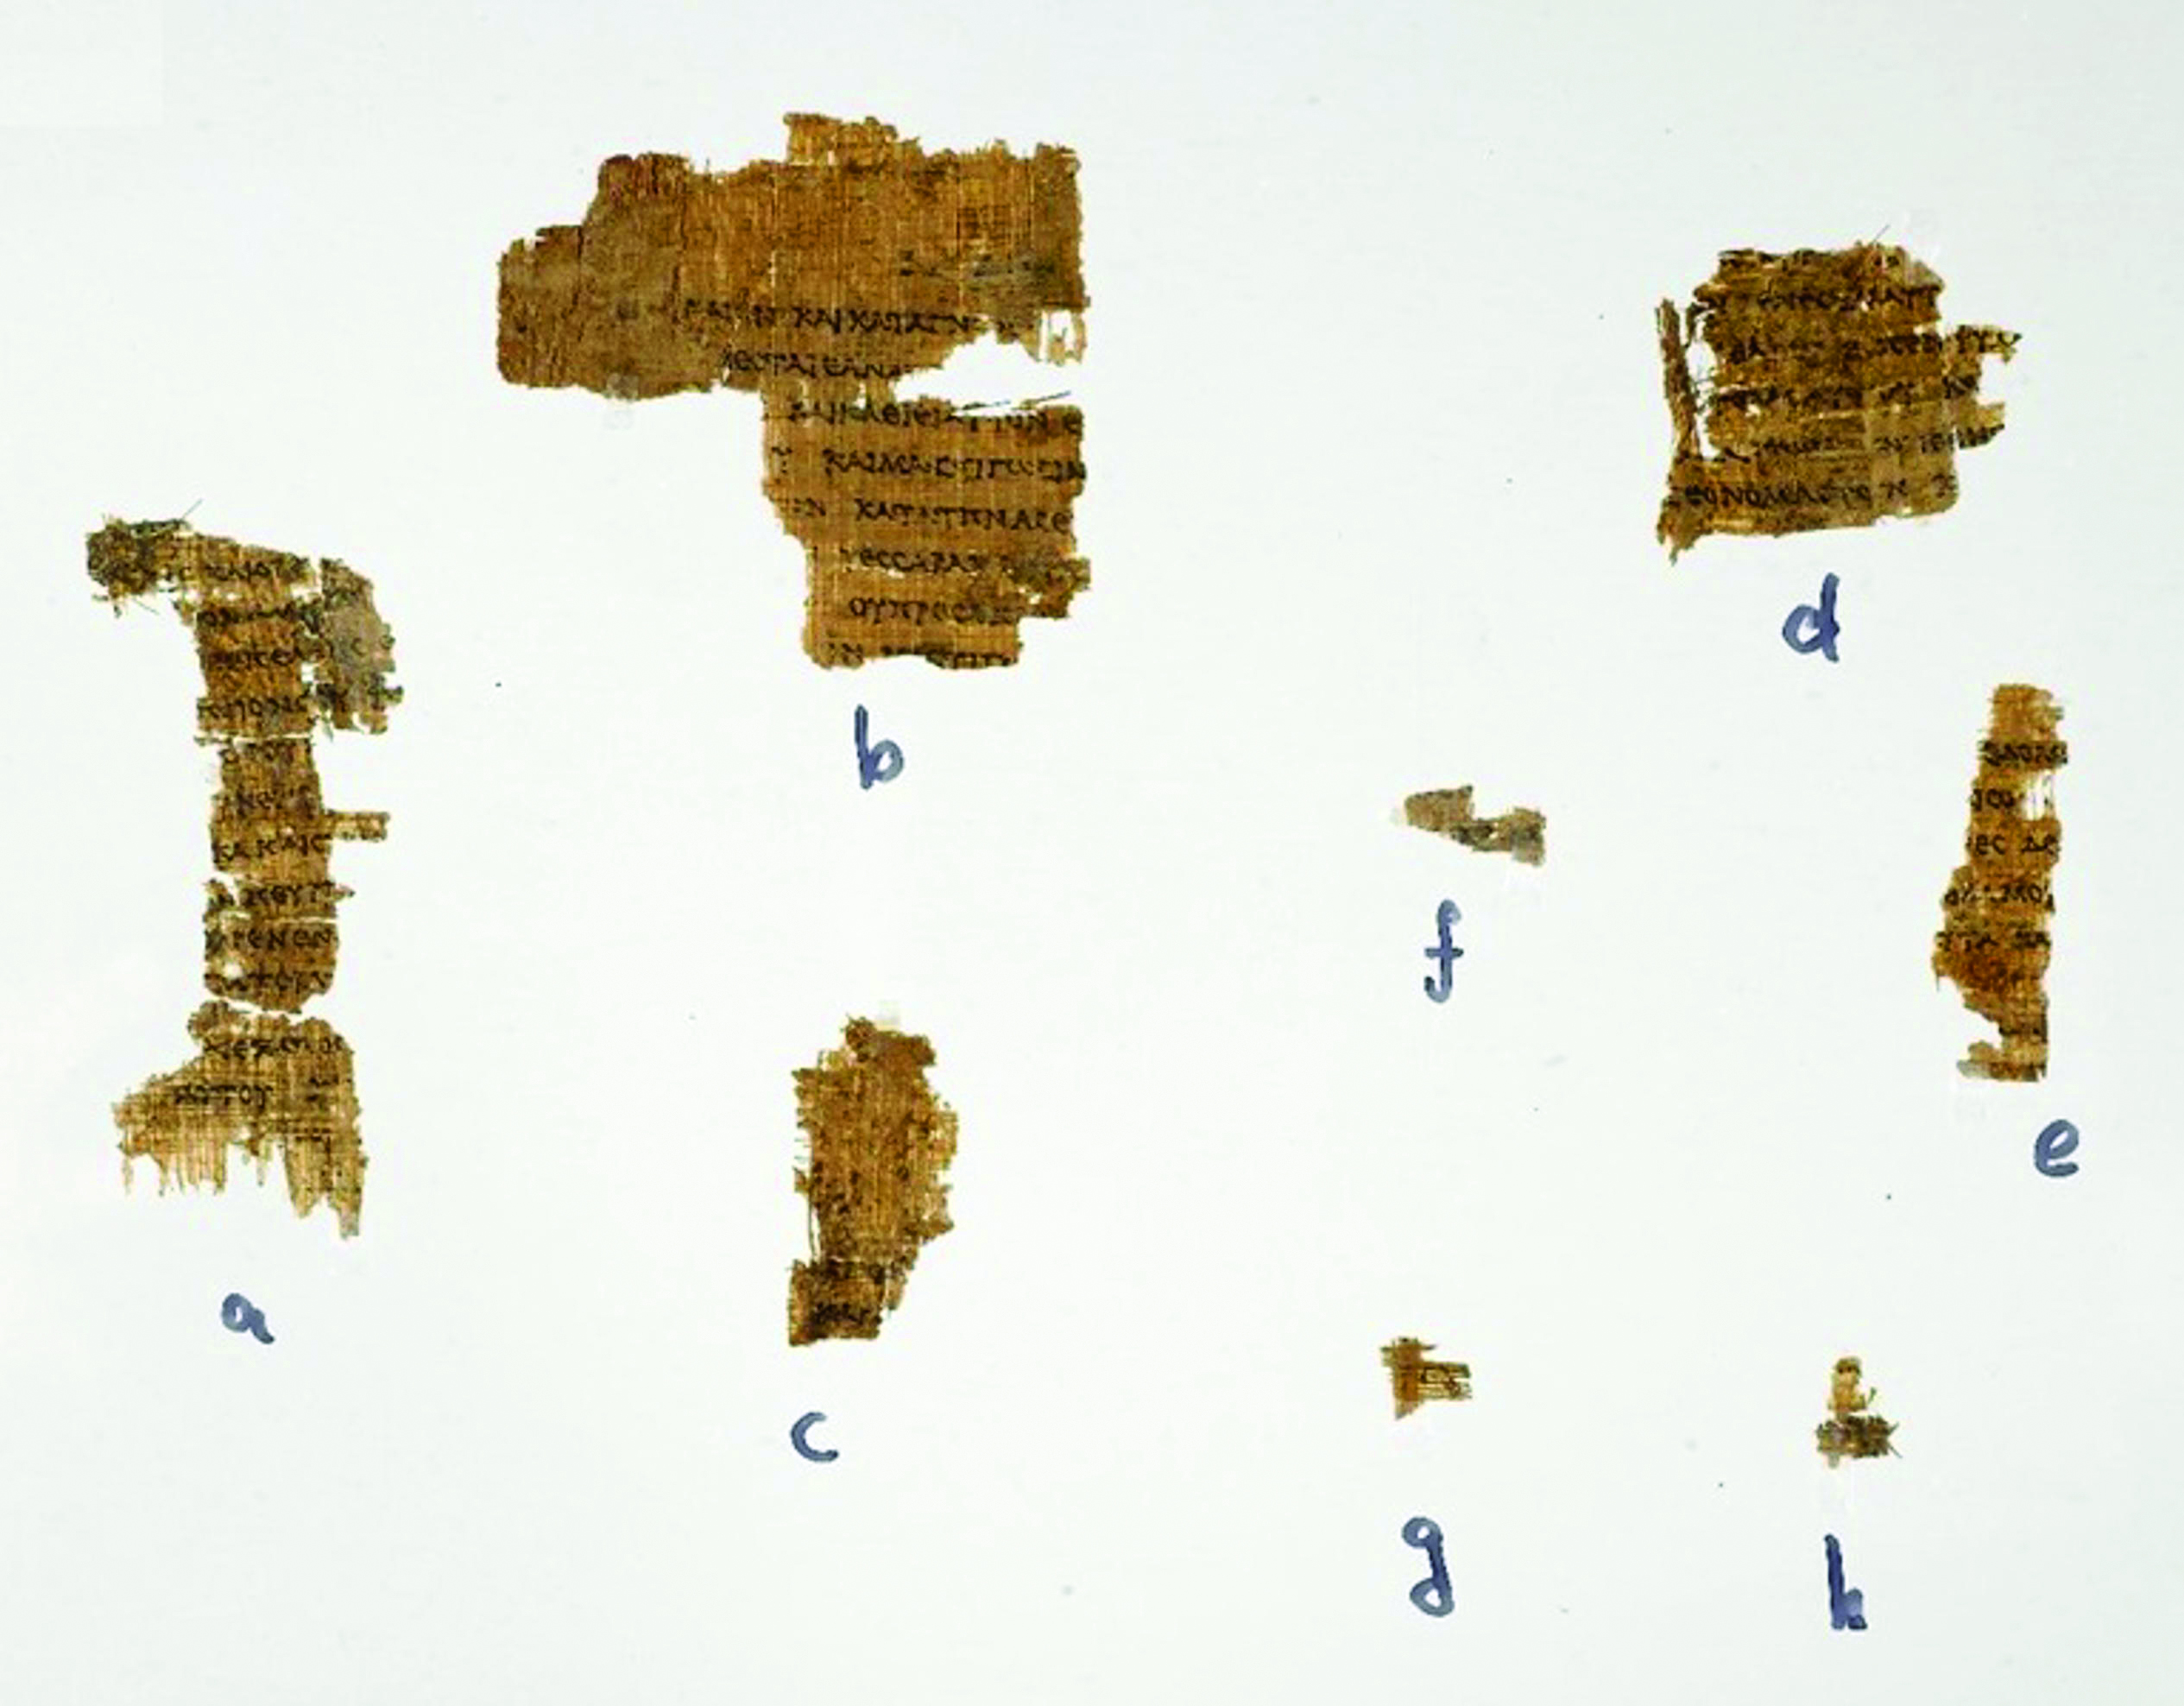
Septuagint
The Septuagint is a Greek translation of the Hebrew Scriptures and the entire New Testament. This version of the Bible, which contains seventy books, was the oldest known form of the Bible before the discovery of the Dead Sea Scrolls.
Jewish History Prior to the Maccabean Revolt
Notes:
See the separate feature on the Septuagint on pages 448-449 of the Student Text including the assignment on the Dead Seal Scrolls.

Slide 7
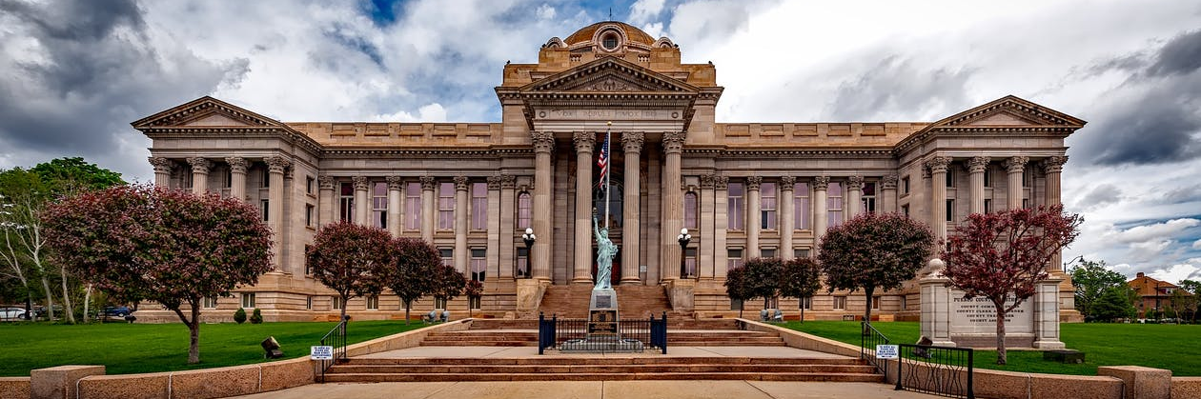
Influences of Hellenistic Culture on Modern Times
Jewish History Prior to the Maccabean Revolt
Notes:
Several parts of our current modern western civilization were adopted from the Ancient Greeks. Among these:
Democracy
The Alphabet
The Library
The Olympics
Science and Mathematics
Architecture
Mythology
Standardized Medicine
Trial by Jury
The Theater
Assign students working in small groups to research one of these Greek influences on western civilization and share a brief report to the entire class.

Slide 8
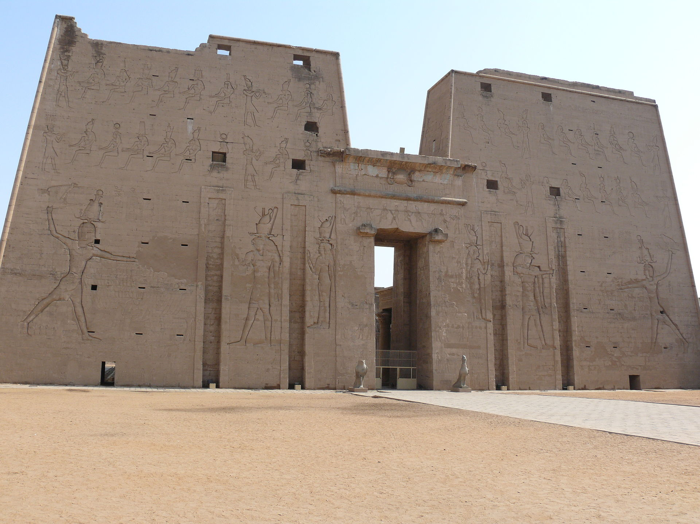
Ptolemies
Jewish History Prior to the Maccabean Revolt
Notes:
See Chapter 10, Section 1, Teacher Background Information in the Teacher’s Wraparound Edition.
The image in this slide is of the Temple of Edfu which was constructed during the Ptolemy reign and dedicated to the Egyptian god Horus (Greek god Apollo). The Ptolemies allowed religious autonomy.
The Ptolemies also built the Great Library at Alexandria, the likely place where the Septuagint was first transcribed from Hebrew.
The video “What really happened to the Library of Alexandria?” (4:52) shares the rise and fall of the Great Library. https://www.youtube.com/watch?time_continue=14&v=jvWncVbXfJ0&feature=emb_logo

Slide 9
Hellenized Jews
Adoption of Greek Customs
Less observation of Jewish practices and rites
Antiochus IV appoints Jason as High Priest
Traditional Jews
Strict adherence to Jewish customs
Critical of the rejection of Temple and central Jewish practices
Onias is the rightful high priest and is removed
Jewish History Prior to the Maccabean Revolt
Notes:
The rift between the Hellenized Jews (those who adopted Greek practices and culture) and the Traditional Jews (those who adhered to strict Judaism) led to the eventual tensions that caused the Maccabean revolt.
See pages 452-455 of the Student Text.

Slide 10
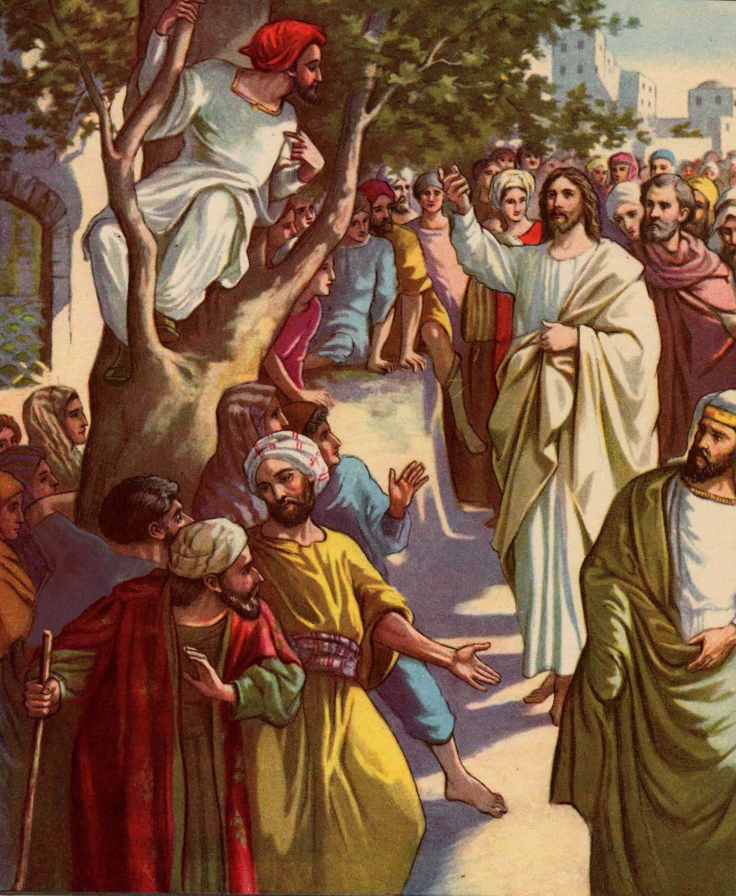
Jewish Tax Collectors
Tasked with collecting taxes for the Greek governments, often heavy taxes
Jewish History Prior to the Maccabean Revolt
Notes:
History of Jewish tax collectors: https://www.jewishvirtuallibrary.org/tax-gatherers
The Jewish Tax collector imposed the law of the Greeks, and later the Romans on his fellow Jews. It was a tax collector’s right to keep whatever he collected beyond obligations to the government. The potential for abuse under such a system was obviously very great. Tax Collectors were later considered among the lowest of the low, and sinners, by most Jews. How did Jesus address this?
Assign for reading: Luke 18:9-14, and Matthew 21:27-32. Ask: How does Jesus treat Zacchaeus, a hated tax collector, in Luke 19:2-8?

Slide 11
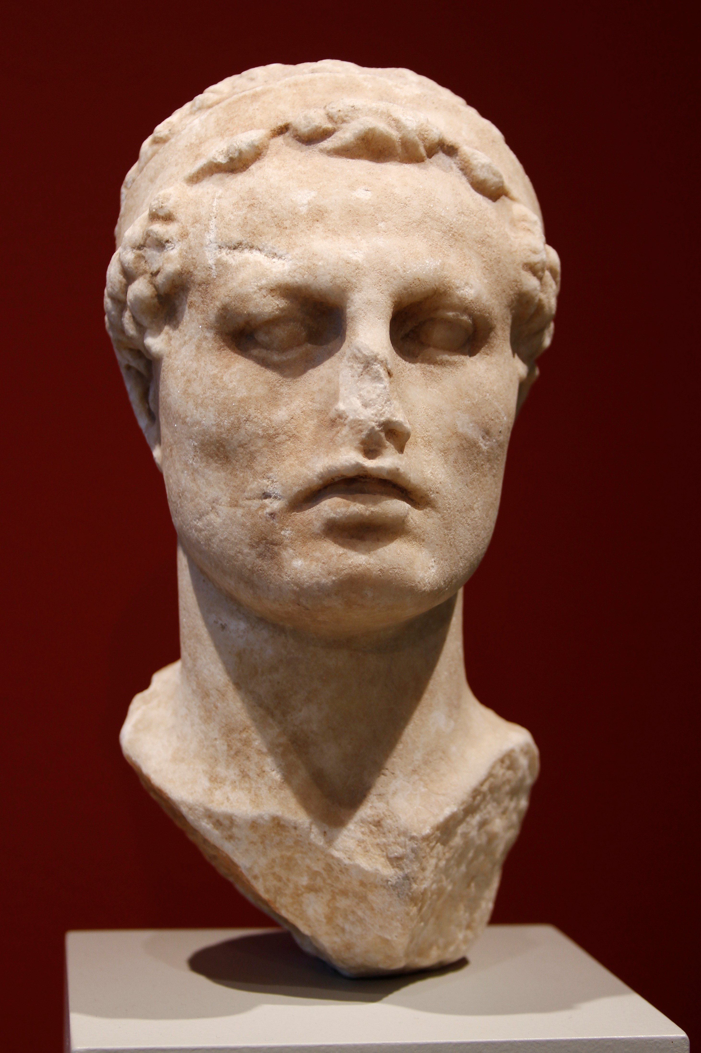
Antiochus IV
Antiochus IV, who called himself Epiphanes, assumed control of the failing Seleucid in 175 BC. He fast-tracked Hellenization and brutally persecuted the Jews forcing them to, among other things:
worship false gods
participate in Greek games in the gymnasiums in the nude
eat forbidden foods
erect an altar to Zeus in the Temple
Jewish History Prior to the Maccabean Revolt
Notes:
Encouraged by Hellenistic Jews, Antiochus IV also forbade study of the Law, observance of the Sabbath, circumcision of male children, and Temple sacrifice (unless it was pagan sacrifice).
Background on Antiochus IV: https://www.jewishvirtuallibrary.org/antiochus

Slide 12
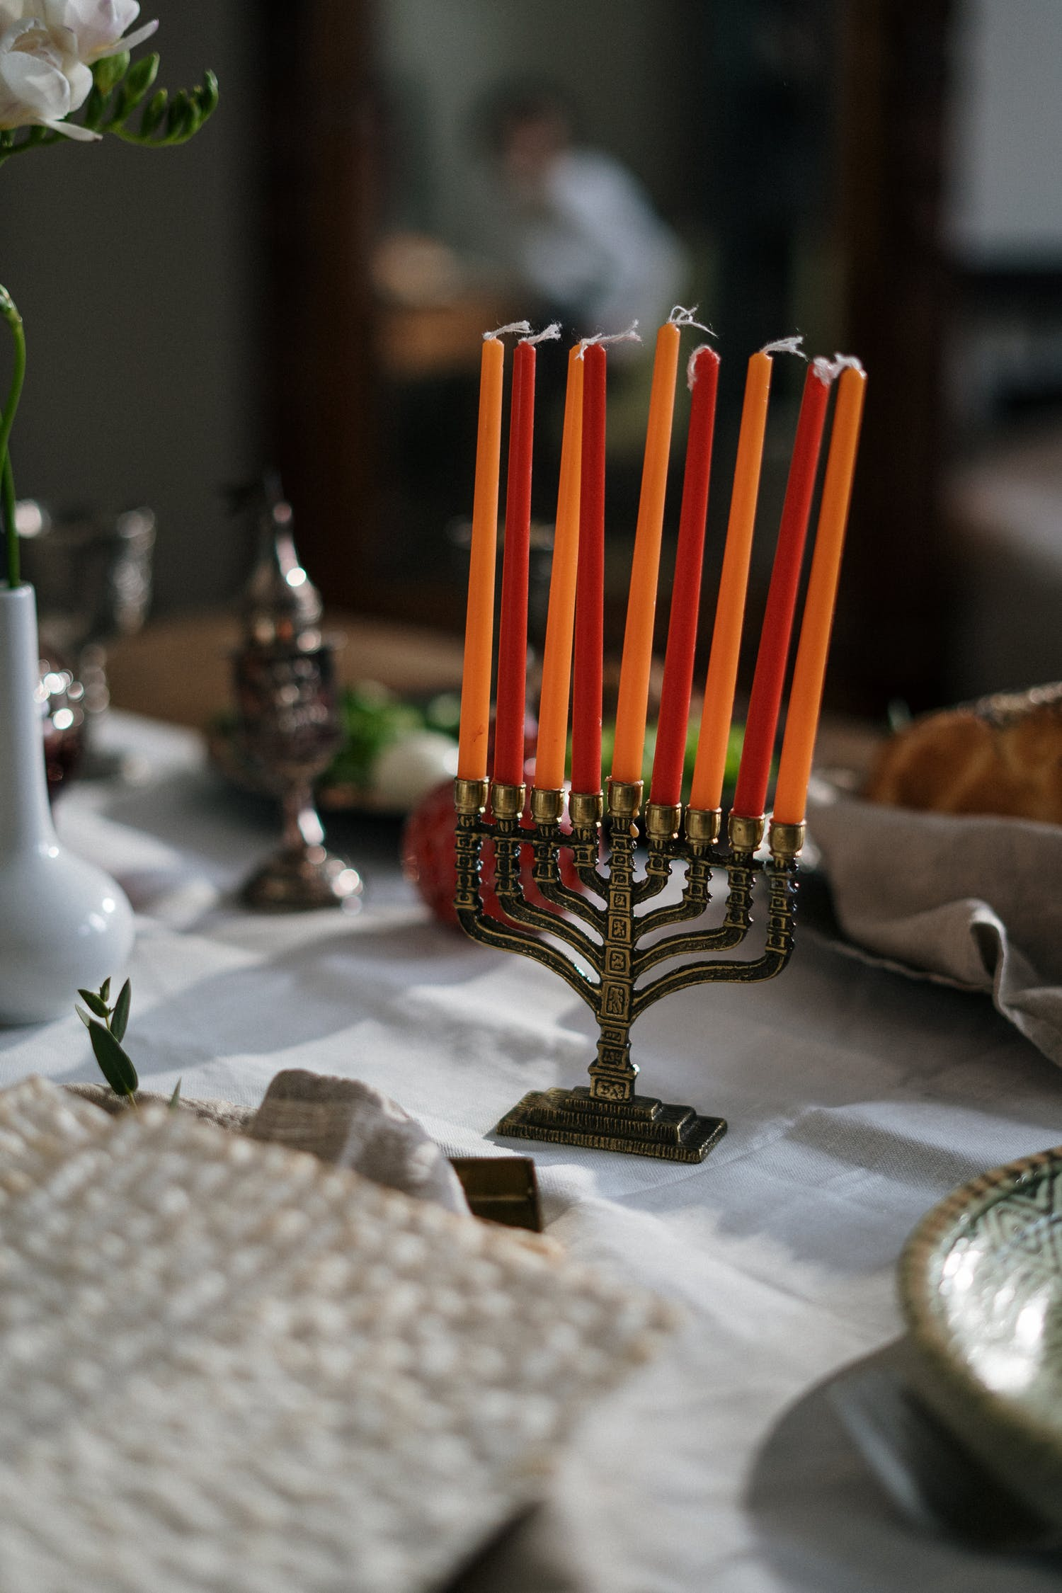
Hanukkah
Jewish holiday celebrating the miracle at the rededication of the Temple
From the Maccabees to Roman Control
Notes:
Hanukkah is the sacred Jewish holiday that commemorates the burning of the lamp of the rededicated temple after Judas Maccabee led the revolt against Antiochus IV. The tradition states there was only enough oil to burn the lamp for one day but the lamp remained lit for eight. The traditional Menorah contains nine candles.
See page 458 in the Student Text.

Slide 13
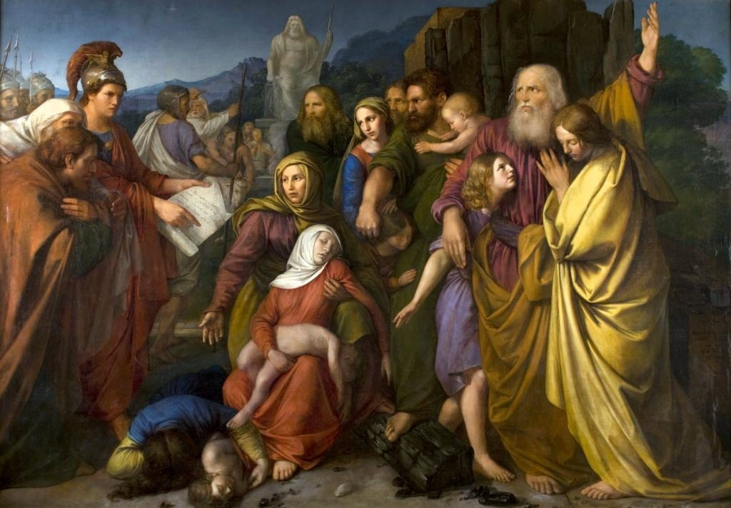
Hasmonean Dynasty
The Hasmonean Dynasty was established by the descendants of the Maccabees who ruled in Judea from after the ousting of the last of the Syrians in 141 BC until the establishment of Roman authority in 63 BC. John Hyrcanus, the first ruler in this dynasty, ruled until 104 BC.
From the Maccabees to Roman Control
Notes:
See Chapter 10, Section 2, Teaching Approach 2 in the Teacher’s Wraparound Edition.
See Student Text pages 460-463.

Slide 14
Jews Near the Time of Jesus
Sadducees
Pharisees
Essenes
Zealots
Aristocratic Jews
Strictly adhered to Jewish Law and Temple worship
Denied the resurrection of the dead and angels because they were not in the Torah
Exhibited a great respect for their learned teachers and preserved their written commentaries
Introduced a local meeting place designed for prayer and study known as the synagogue and a local leader called a rabbi.
Removed themselves from the political scene in Jerusalem to the desert around the Dead Sea beginning in the second century BC.
Likely hid the Dead Sea Scrolls
Favored military resistance to Roman authority.
Their belief in the coming of the Messiah was strongly linked to their desire for Jewish independence.
Cooperation or Resistance: Which was Best for the Jews?
Notes:
See Chapter 10, Section 4, Teaching Approach 3 in the Teacher’s Wraparound Edition.

Slide 15
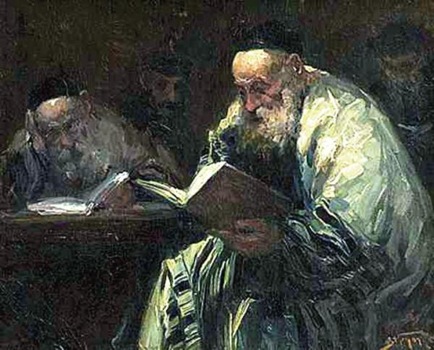
Talmud
A collection of rabbinical teachings compiled after the destruction of the Jerusalem Temple in AD 70.
Judaism after the Destruction of the Temple
Notes:
See pages 474-475 in the Student Text.

Slide 16
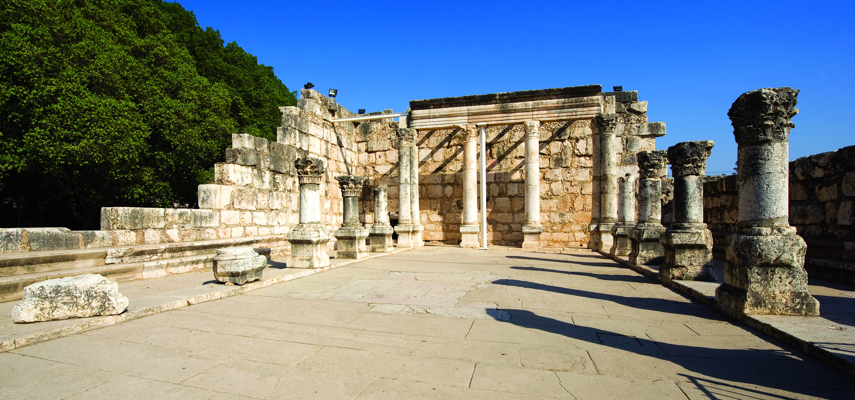
The Synagogue A meeting place for study and prayer introduced by the Pharisees to foster study of the Law and adherence to the Covenant Code.
Judaism after the Destruction of the Temple
Notes:
Play the video “What Is a Synagogue: Walk Through A Jewish Synagogue” (8:15)
https://www.youtube.com/watch?v=dokQ4Hin9GQ
Reference: The Synagogue: Background and Overview https://www.jewishvirtuallibrary.org/synagogue-background-and-overview

Slide 17
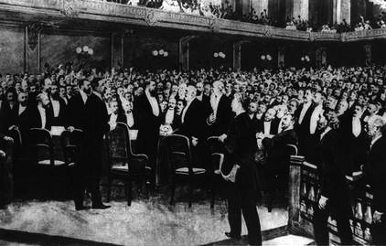
The State of Israel
In the late nineteenth century, Zionism, or Jewish nationalism, began as a political movement to return the Jews to their homeland in Palestine. After the murder of about six million Jews by the Nazi Germans in the 1930s and 1940s, the worldwide community responded to the goals of Zionism and, with the help of the United Nations, established the State of Israel in 1948.
Judaism after the Destruction of the Temple
Notes:
See Chapter 10, Section 10, Teaching Approach 2 in the Teacher’s Wraparound Edition.

Slide 18
Images
Slide 3: https://en.wikipedia.org/wiki/Book_of_Daniel#/media/File:Sir_Peter_Paul_Rubens_-_Daniel_in_the_Lions'_Den_-_Google_Art_Project.jpg
Slide 5: https://upload.wikimedia.org/wikipedia/commons/2/2c/Seleucid-Empire_200bc.jpg
Slide 7: https://www.pexels.com/photo/administration-ancient-architecture-art-208603/
Slide 8: https://en.wikipedia.org/wiki/Temple_of_Edfu#/media/File:Temple_of_Edfu_02.jpg
Slide 10: http://marysrosaries.com/collaboration/index.php?title=File:Jesus_said_Zacchaeus_make_haste_and_come_down.jpg&action=edit
Slide 11: https://en.wikipedia.org/wiki/Antiochus_IV_Epiphanes#/media/File:Antiochus_IV_Epiphanes_-_Altes_Museum_-_Berlin_-_Germany_2017.jpg
Slide 12: https://www.pexels.com/photo/menorah-with-red-and-orange-candles-4038215/
Slide 13: https://en.wikipedia.org/wiki/Maccabees#/media/File:Stattler-Machabeusze.jpg
Slide 15: https://en.wikipedia.org/wiki/Talmud#/media/File:Adolf_Behrman_-_Talmudysci.jpg
Slide 17: https://he.m.wikipedia.org/wiki/%D7%A7%D7%95%D7%91%D7%A5:Delegates_at_First_Zionist_Congress.jpg

