Slide 1
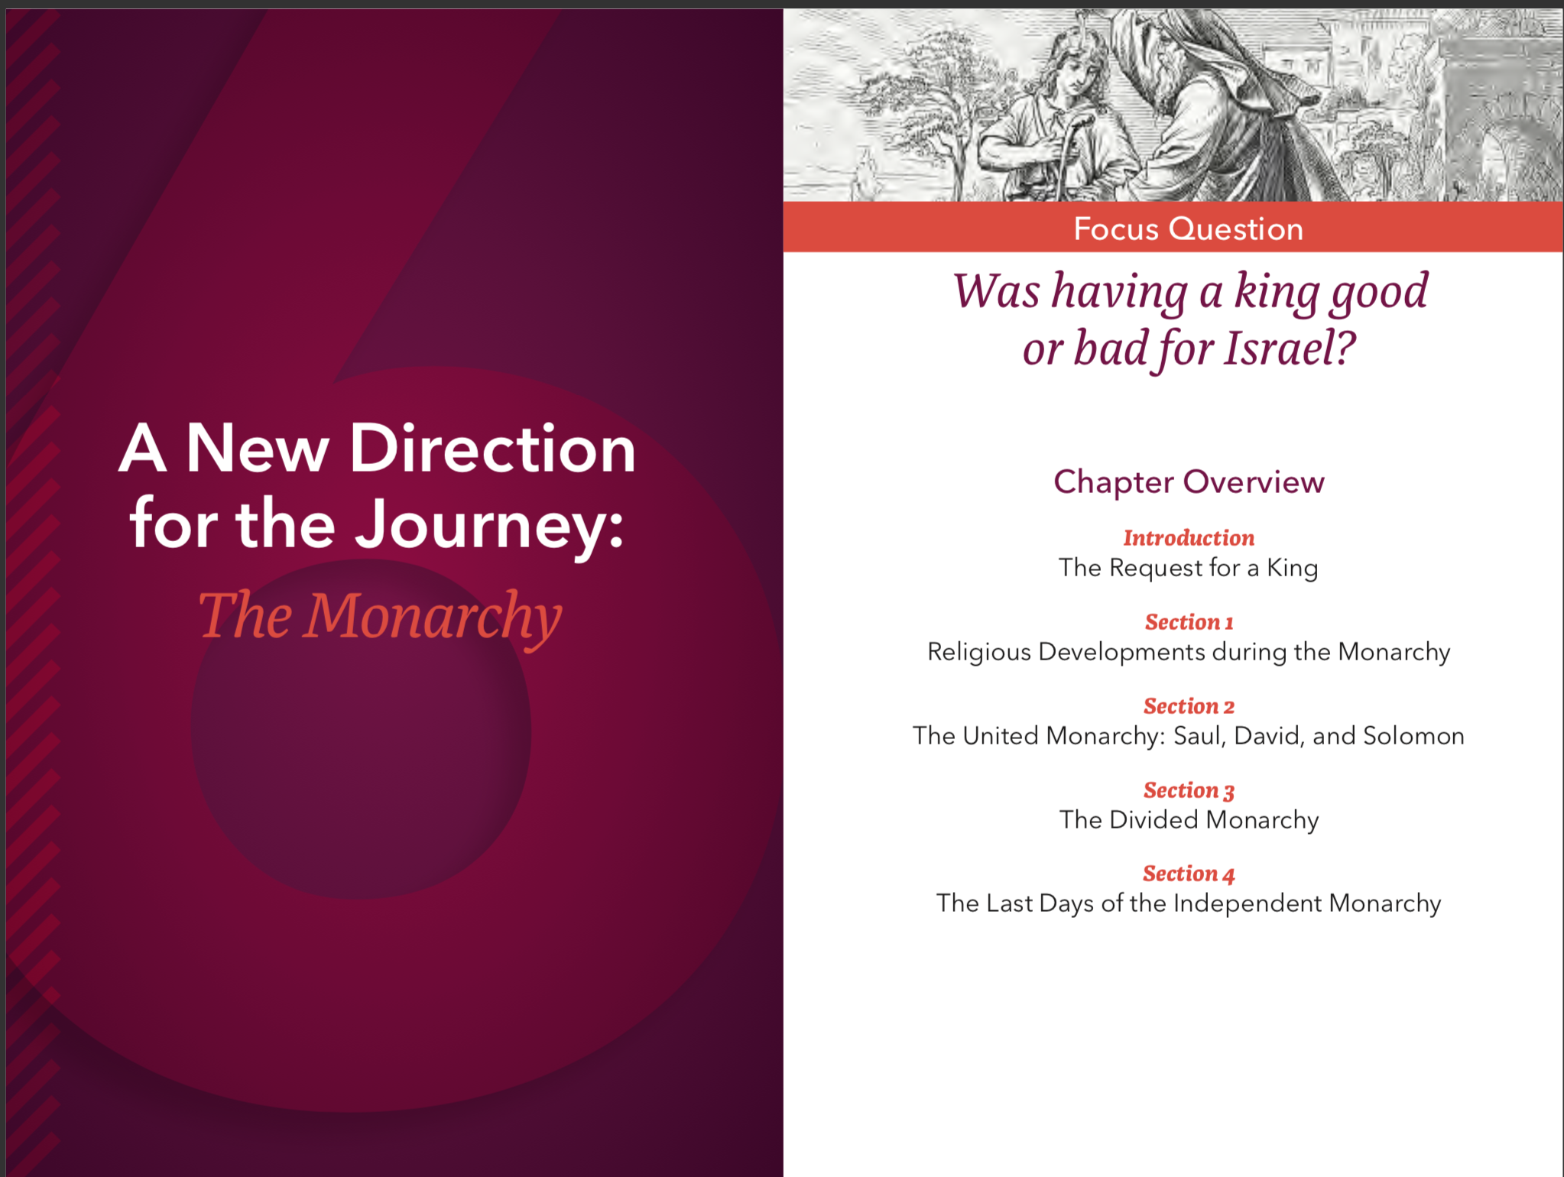
The Old Testament

Slide 2
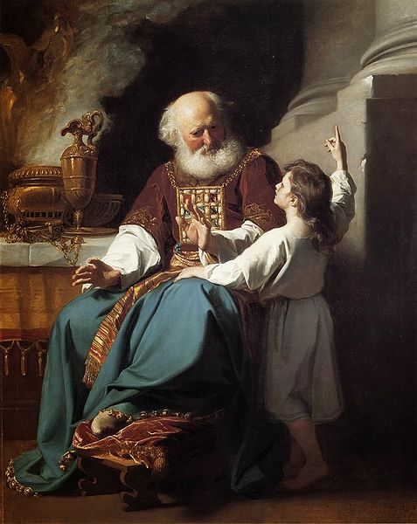
Samuel Final Judge of Israel Prophet Priest
The Request for a King
Notes:
See Chapter 6, Introduction, Extending the Lesson 1 in the Teacher’s Wraparound Edition for more material on teaching about the life of Samuel. The Student Text (page 248) enumerates the reasons Samuel gave the Israelites against having a king.

Slide 3
Monarchy of Israel
Positives of Monarchy | Negatives of Monarchy
Strong central leadership | King David had many failings
Jerusalem conquered and made into a holy city | King Solomon compromised his faith in God
From the Davidic line would come a Messiah | Kings favored rich and hurt the poor
The Request for a King
Notes:
This slide summarizes points introduced on pages 248 and 249 of the Student Text. See also: Chapter 6, Introduction, Teaching Approach 2 in the Teacher’s Wraparound Edition.

Slide 4
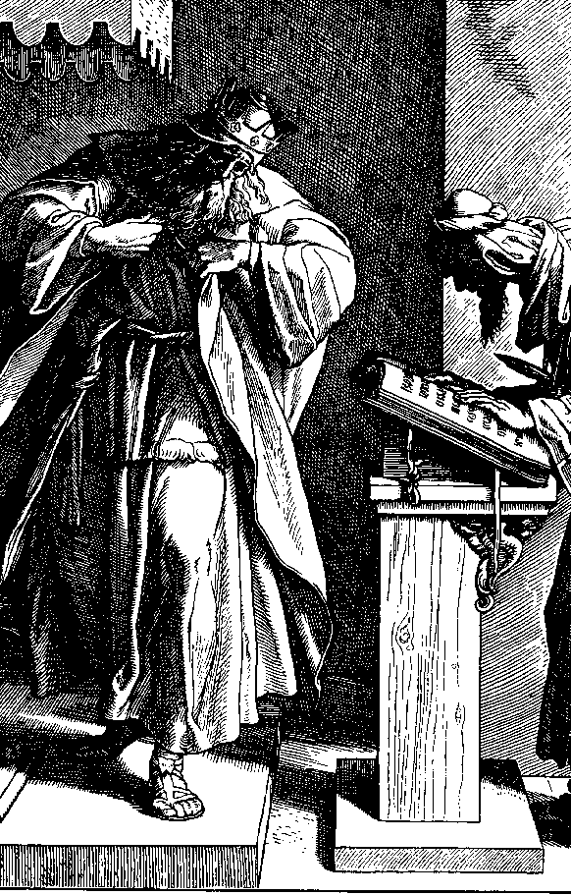
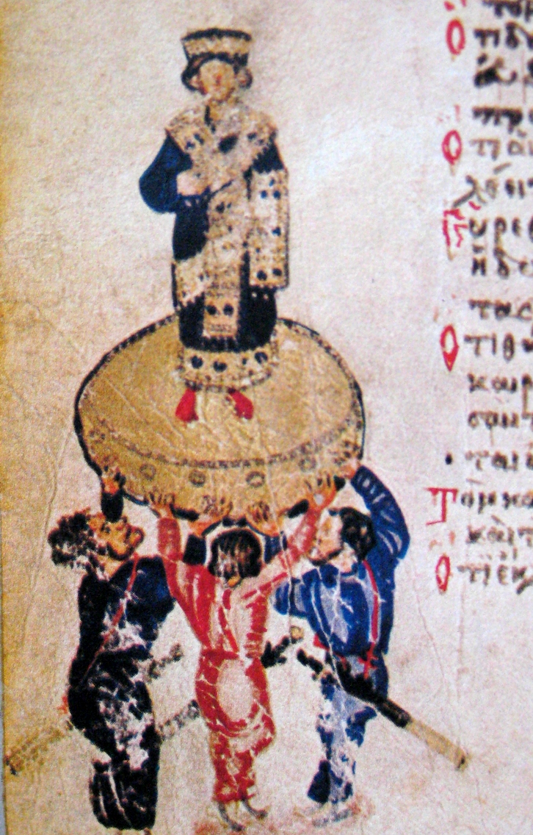
Josiah
Two kings who faithfully followed the Lord
Hezekiah
The Request for a King
Notes:
Share descriptions of these two kings:
Hezekiah
He put his trust in the Lord, the God of Israel; and neither before nor after him was there anyone like him among all the kings of Judah. (2 Kgs 18:3–5)
See also Chapter 6, Section 1, Teaching Approach 3 in the Teacher’s Wraparound Edition for information on Hezekiah and Hezekiah’s Tunnel.
Josiah
Before [Josiah] there had been no king who turned to the Lord as he did, with his whole heart, his whole being, and his whole strength. (2 Kgs 23:25)
See also Chapter 6, Section 1, Teaching Approach 2 in the Teacher’s Wraparound Edition for a lesson on Josiah.

Slide 5
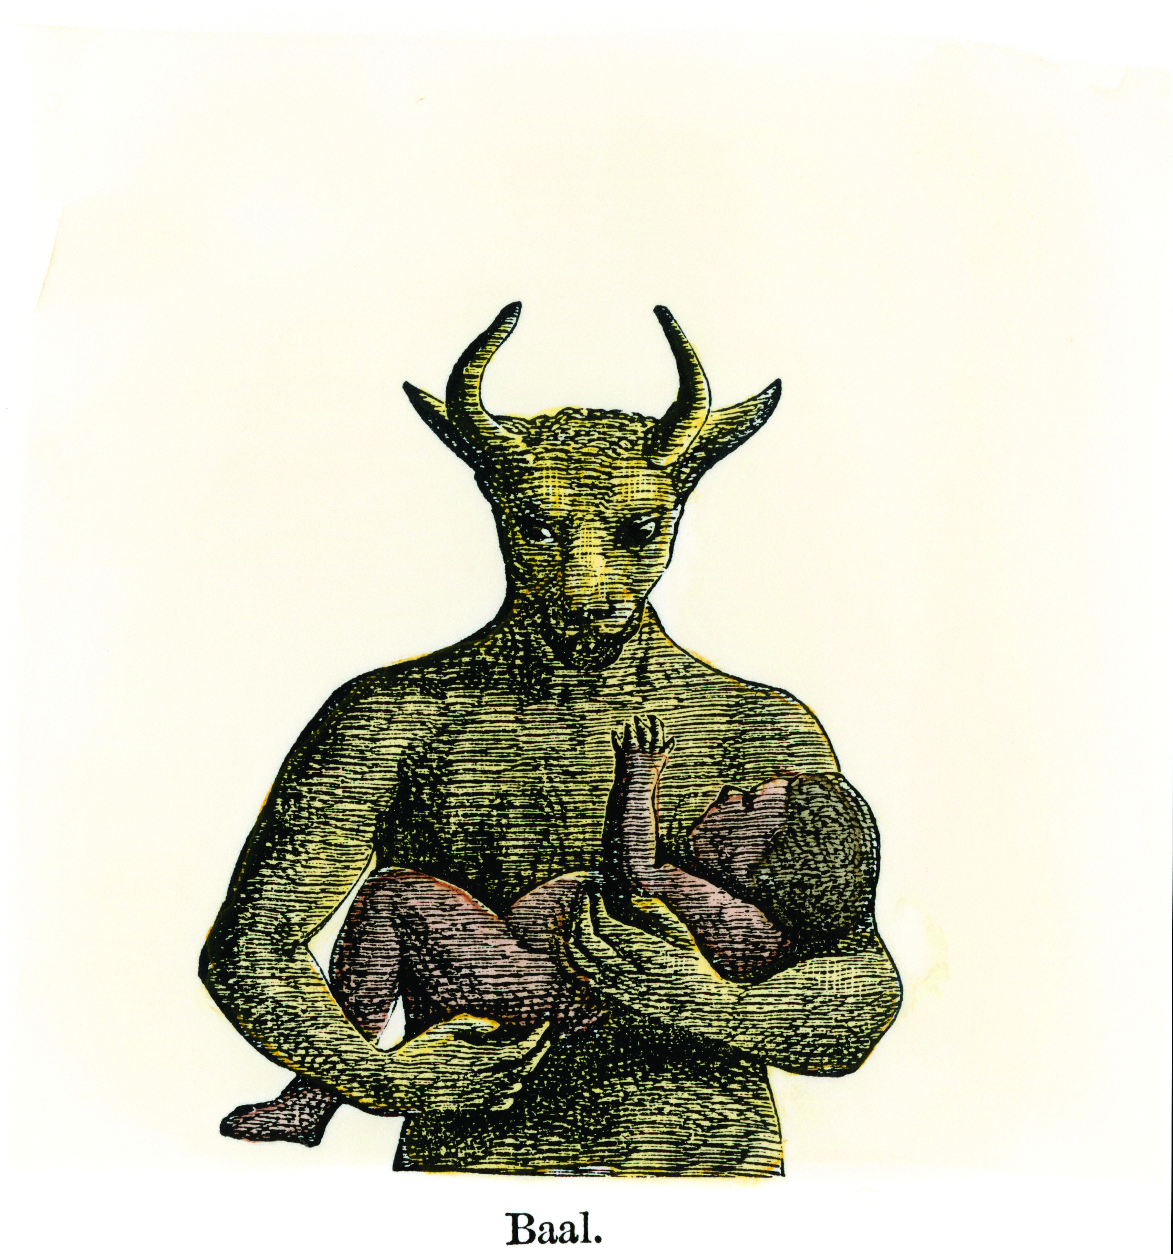
Under the monarchy Israelite religious practice strayed from worshiping YHWH. It began to include:
Idolatry
Worship of false gods
Canaanite practices
Offerings made in the Temple
Images of gods
Burning incense to Baal, the sun, the moon and the signs of the zodiac
Religious Developments during the Monarchy
Notes:
See Chapter 6, Section 1, Extending the Lesson 3 from the Teacher’s Wraparound Edition for more information about why polytheistic worship was tempting for Israel during this period.

Slide 6
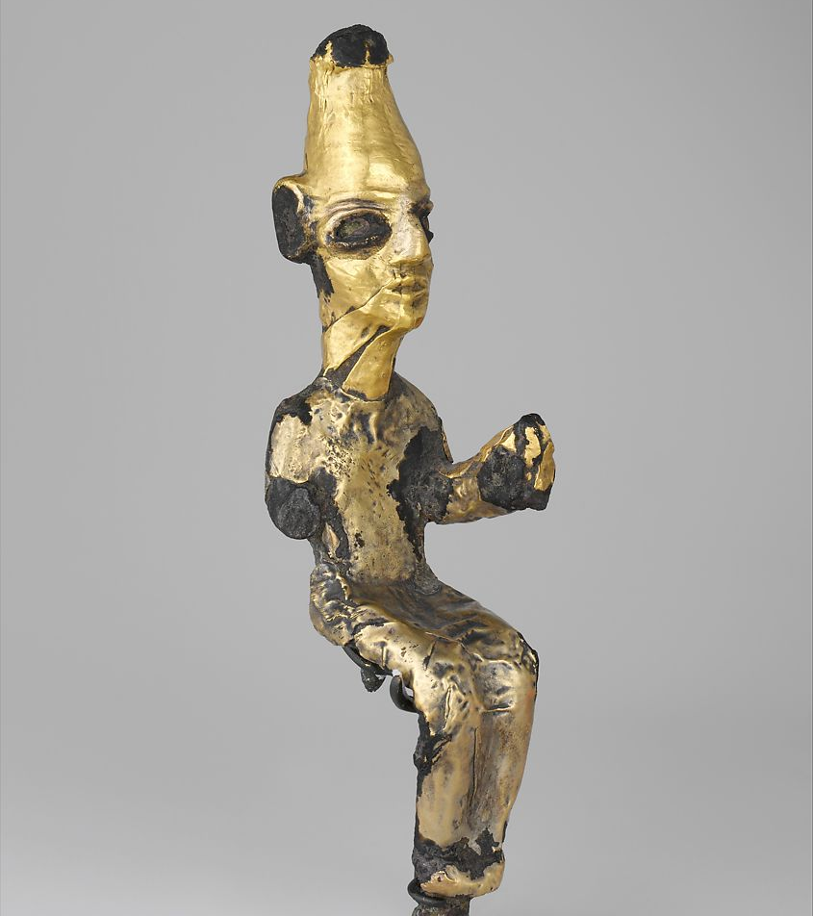
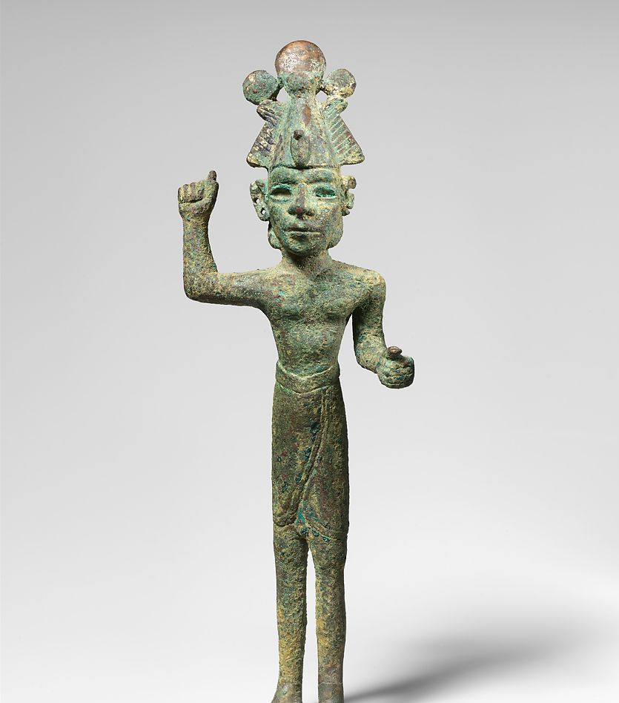
Canaanite gods
Religious Developments during the Monarchy
Notes:
The gold statue on the left likely represented El, the main Canaanite god. The smiting god on the right likely represented a god like Baal. See https://www.metmuseum.org/art/collection/search/322889

Slide 7
Religious Developments during the Monarchy
Notes:
The graphic above is meant to illustrate the disparity between the elite and ruling class and the poor workers.

Slide 8
Israelite Religion
Canaanite Religion
Liberated slaves from the pharaoh of Egypt
Its laws directed people to share resources
Did not advocate for oppressive rulers
Care for the weakest members of society
Was religion of the majority
Associated with fertility and agriculture (majority were farmers)
Served kings and taught common people that their fate was determined by the gods
Religious Developments during the Monarchy
Notes:
See pages 252-255 of the Student Text and Chapter 6, Section 1, Extending the Lesson 3 of the Teacher’s Wraparound Edition.

Slide 9
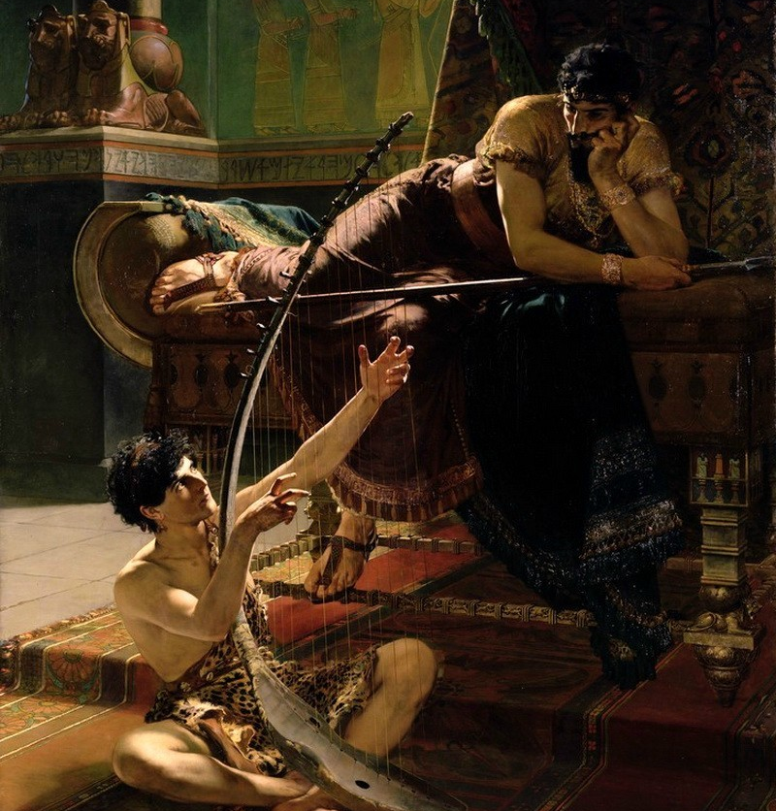
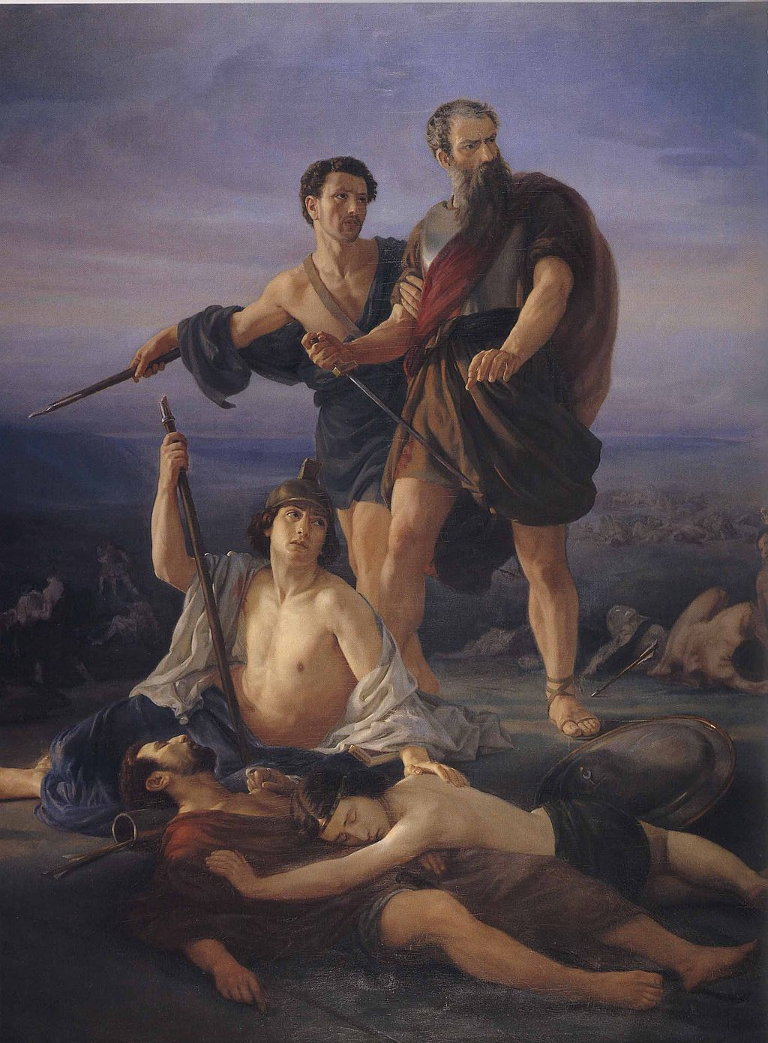
Saul
First King of Israel
The United Monarchy: Saul, David, and Solomon
Notes:
The first image is David playing the harp for King Saul, the second is entitled “Death of Saul.”
See pages 258-259 of the Student Text.
See Chapter 6, Section 2, Teaching Approach 2 of the Teacher’s Wraparound Edition.
Summarize for the students or make copies of the article “Samuel: A Spiritual and Political Tale of Two Kings: Part one: Saul” which covers the highlights of Saul’s rise to and fall from power. https://www.catholicculture.org/commentary/samuel-spiritual-and-political-tale-two-kings-part-one-saul/

Slide 10
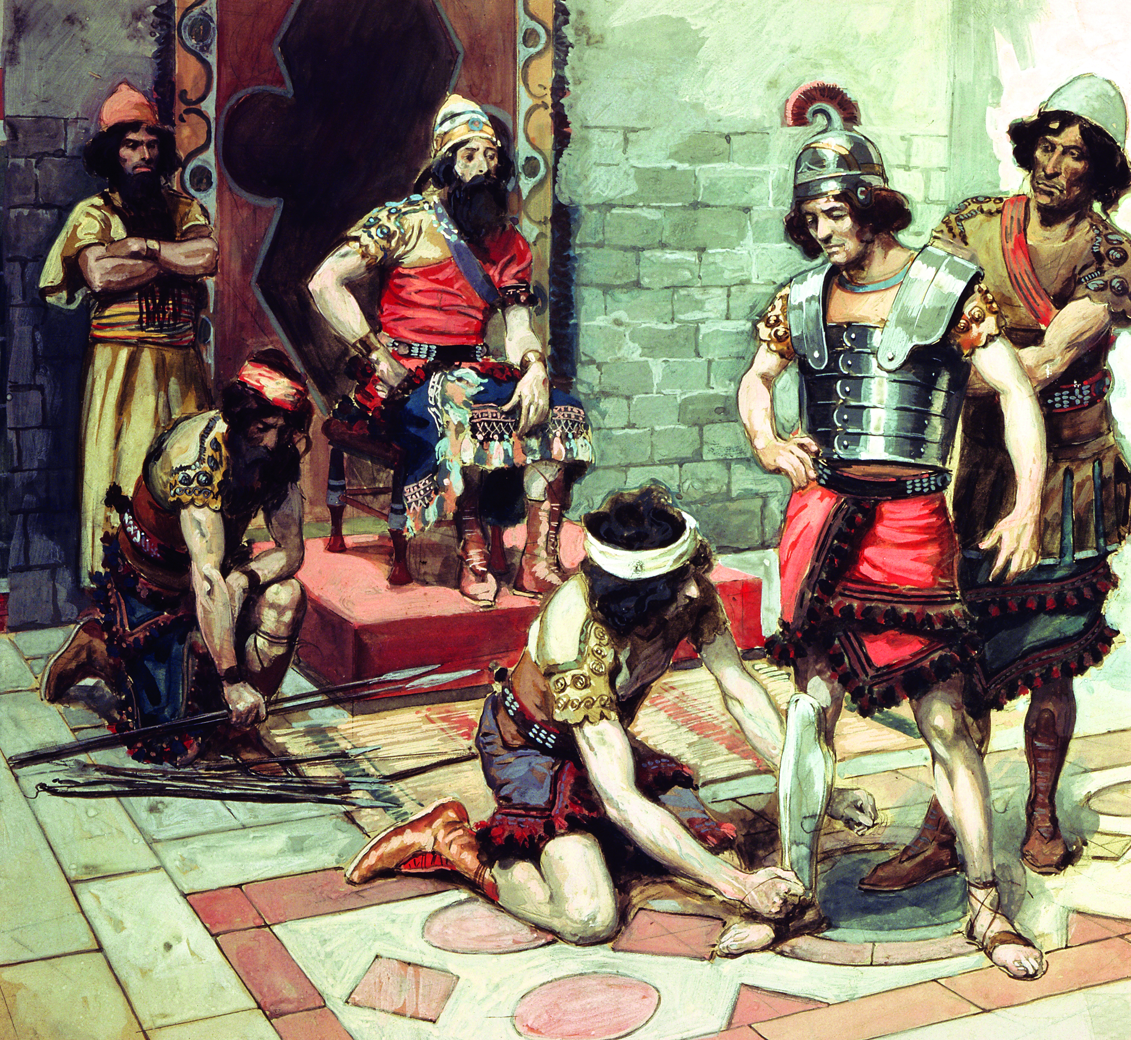
“I will raise up your offspring after you, sprung from your loins, and I will establish his kingdom.” 2 Samuel 7:12
The United Monarchy: Saul, David and Solomon
Notes:
The Lord foretells of the offspring he will give to the world through the line of David. Because Jesus is descended through the line of King David, he does fulfill this prophecy.
See Matthew 1:1-17; Luke 3:23-38 and the Davidic Line feature and Genealogies of Jesus assignment on page 261 of the Student Text.

Slide 11
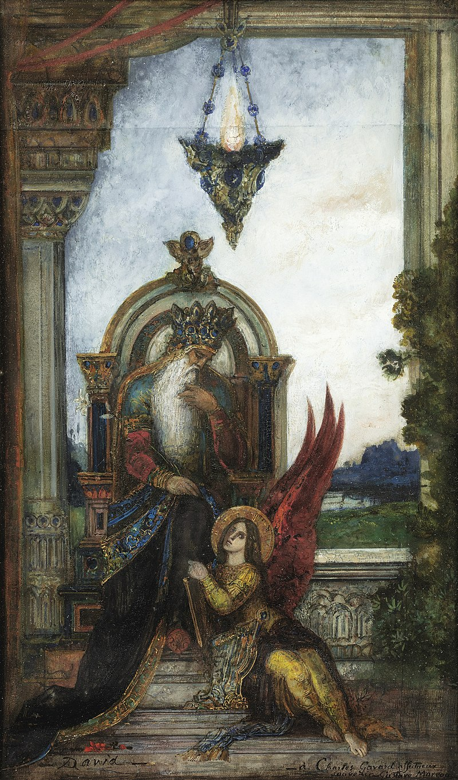
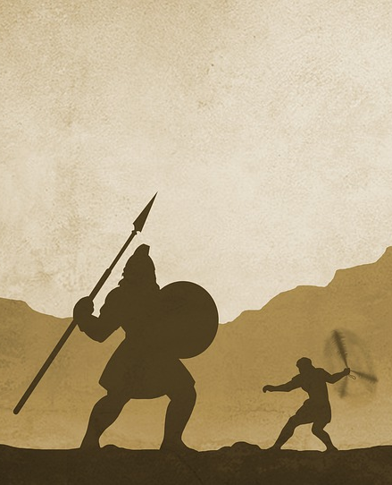
King David
Israel’s Greatest King
1099-969 BC
The United Monarchy: Saul, David and Solomon
Notes:
See pages 258-263 of the Student Text and Chapter 6, Section 2, Teaching Approaches 1 and 2 of the Teacher’s Wraparound Edition.

Slide 12
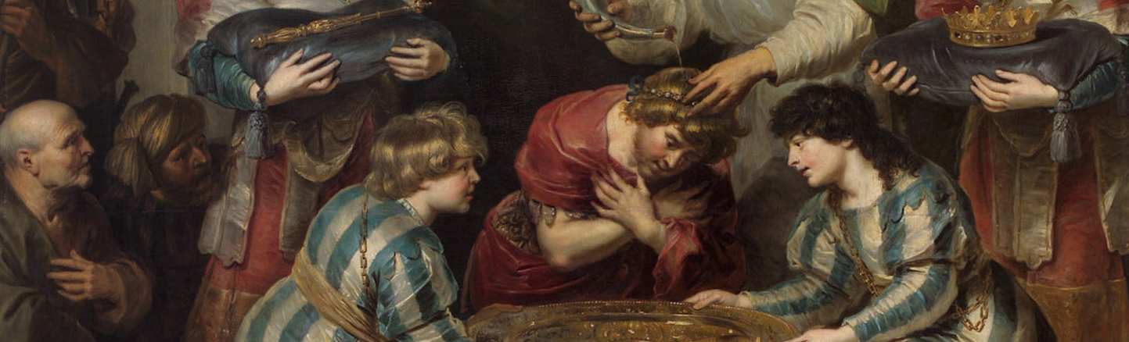
King Solomon
A king with mixed results
970-931 BC
The United Monarchy: Saul, David and Solomon
Notes:
The image is ”The Anointing of Solomon” by Cornelius de Vos in 1630 according to 1 Kings 1:39
Positive views of Solomon:
Solomon sought out God’s help asking for: “a listening heart to judge your people and to distinguish between good and evil” (1 Kgs 3:9)
Solomon settled a dispute between two women over a baby showing great wisdom (1 Kgs 3:16-28).
Solomon built a great Temple to house the Ark of the Covenant.
Negative views of Solomon:
Solomon engaged in several political marriages with pagan women who perpetuate polytheistic views to the Israelites.
Solomon enslaved non-Israelites to build the Temple.
Solomon forced Israelites to work as laborers and taxed them heavily.

Slide 13
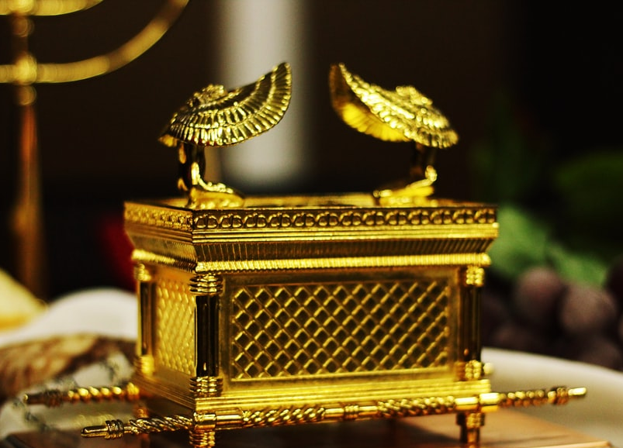
Catholic Tabernacle
The tabernacle is the sacred vessel that holds the Blessed Sacrament at a Catholic Church. Some are fashioned after the Ark of the Covenant.
The United Monarchy: Saul, David and Solomon
Notes:
Read Exodus 37:1-9 (Description of the Ark).
See the assignment “Building Solomon’s Temple” on page 265 of the Student Text.
You may wish to have the students work individually or in small groups to locate, print, and display other Catholic tabernacles that resemble the Ark of the Covenant and also provide background information on each (e.g., location, age, artist, etc.).

Slide 14
Hierarchy of the Kings
Saul
David
Solomon
Jeroboam
Rehoboam
KEY
Davidic Line
Kingdom of Israel
The Kingdom of Judah
The 8 Northern Tribes of Israel
The Divided Monarchy
Notes:
Bishop Robert Barron shares a brief description of King David: https://www.wordonfire.org/study-programs/david-the-king/.

Slide 15
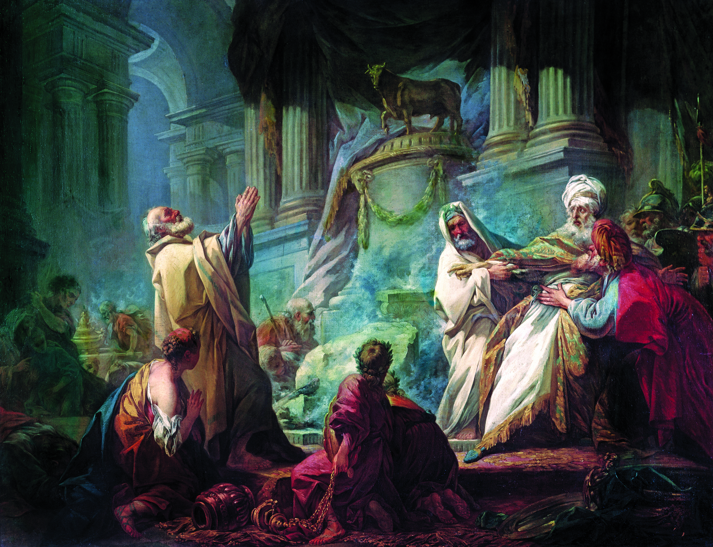
Jeroboam
Son of Nebat and a servant of King Solomon’s, he led the insurrection against King Rehoboam and founded the Northern Kingdom of Israel.
The Divided Monarchy
Notes:
The image above depicts Jeroboam worshipping at the idol’s foot; a direct violation of the First Commandment.
See Chapter 6, Section 3, Teaching Approach 1 from the Teacher’s Wraparound Edition.

Slide 16
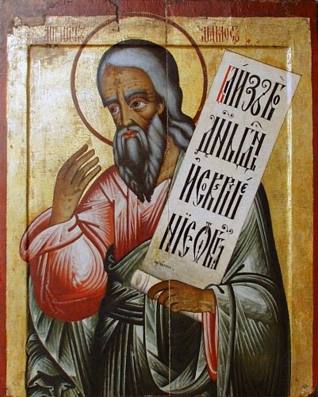
Journal Question
The prophet Amos, decrying the lifestyle of the Hebrew rich and elite, said:
They trample the heads of the destitute into the dust of the earth, and force the lowly out of the way.
(Am 2:7a)
Who are the poor today who are victimized by those more rich and powerful? Write a short prayer for them and their life situation.
Notes:
Possible answers could compare and contrast among the following range: the Nazis of WWII, the victims of abortion, the poor, the marginalized, the elderly.

Slide 17
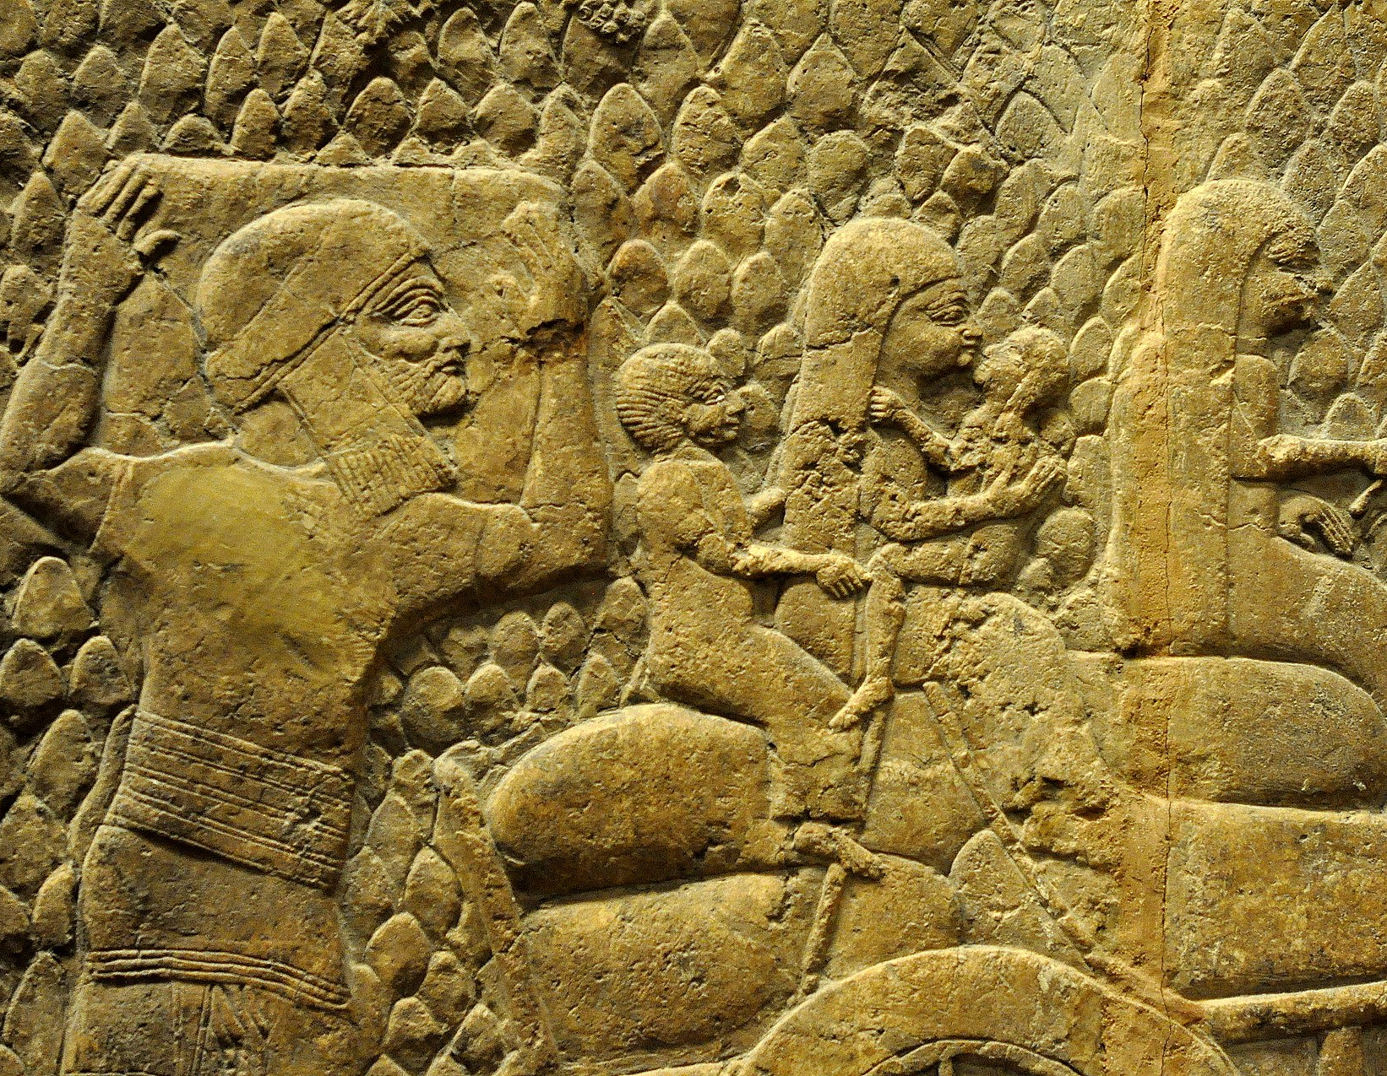
Ten Lost Tribes of Israel
This came about because the children of Israel sinned against the LORD, their God, who had brought them up from the land of Egypt, from under the domination of Pharaoh, king of Egypt, and because they venerated other gods. They followed the rites of the nations whom the LORD had cleared out of the way of the children of Israel and the kings of Israel whom they set up. (2 Kings 17:7-8)
The Last Days of the Independent Monarchy
Notes:
The image is of “A family being deported after the Siege of Lachish; wall relief from the South-West Palace at Nineveh” from Wikipedia commons
2 Kings 17:7-8 explains how YHWH allowed the Israelites to become a lost people.
Read Isaiah 66:18-21. Discuss how God gathering the nations would speak promise to those lost tribes of Israel who were exiled from the Northern Kingdom of Israel after the Assyrian capture. How would God continue to draw the Israelites into relationship with him? Ask the students to respond in a discussion or in writing.
See pages 275-276 of the Student Text.

Slide 18
Images
Slide 2: https://commons.wikimedia.org/wiki/File:Eli_and_Samuel.jpg
Slide 4:
https://commons.wikimedia.org/wiki/File:Chludov_proclamation.jpg
https://commons.wikimedia.org/w/index.php?sort=relevance&search=king+josiah&title=Special:Search&profile=advanced&fulltext=1&advancedSearch-current=%7B%7D&ns0=1&ns6=1&ns12=1&ns14=1&ns100=1&ns106=1#/media/File:Josiah.gif
Slide 6:
https://www.metmuseum.org/art/collection/search/322889
https://www.metmuseum.org/art/collection/search/327231
Slide 9:
https://en.wikipedia.org/wiki/Saul#/media/File:David_and_Saul_(Julius_Kronberg)_-_Nationalmuseum_-_18384.tif
https://commons.wikimedia.org/wiki/File:Elie_Marcuse_saul.jpg
Slide 11:
https://pixabay.com/illustrations/jesus-christ-god-holy-spirit-4779546/
https://commons.wikimedia.org/w/index.php?search=king+david&title=Special:Search&go=Go&ns0=1&ns6=1&ns12=1&ns14=1&ns100=1&ns106=1#/media/File:King_David_by_Gustave_Moreau.jpg
Slide 12: https://commons.wikimedia.org/wiki/File:Cornelis_de_Vos_-_The_Anointing_of_Solomon.jpg
Slide 13: https://unsplash.com/photos/Ug2aF0-HmnE
Slide 16: https://en.wikipedia.org/wiki/Amos_(prophet)#/media/File:Amos-prophet.jpg
Slide 17: https://en.wikipedia.org/wiki/Resettlement_policy_of_the_Neo-Assyrian_Empire#/media/File:Judaean_people_are_being_deported_into_exile_after_the_capture_of_Lachish.jpg

