Slide 1
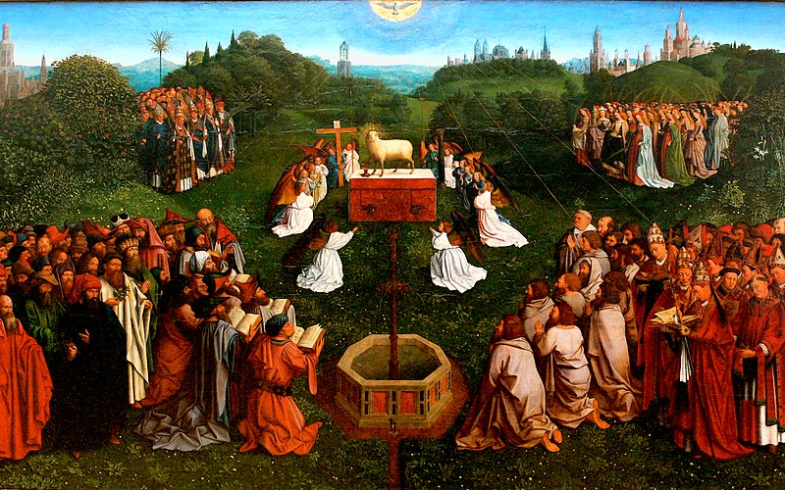
4
We Are Redeemed through
the Paschal Mystery
God Saves: We Are Redeemed through the Paschal Mystery
Notes:
Photo Credit: https://commons.wikimedia.org/wiki/File:Genter_altar,_lamb_adoration_-_Jan_van_Eyck.jpg
Suggestions for students’ note taking:
●Require students to use a three ring binder (1/2-1 inches) full of loose leaf paper (college or wide ruled).
●Notes must be taken in pen only and hand written.
●Notebooks should contain information and notes for religion class only.
●Notebooks must have a table of contents with topic of notes, dates and page numbers.
●All notes must have a topic and page number.
●Students will be required to copy each slide unless the teacher directs students to skip certain slides or parts of slides. Notebooks will be graded based on neatness, completeness and organization. Notebooks should have a significant point value representing 20-25% of the overall grade.
The videos linked in this presentation file may contain copyright material. Such material is made available for educational purposes only. This constitutes a “fair use” of any such copyright material as provided for in Title 17 U.S.C. section106A-117 of the US Copyright Law.

Slide 2
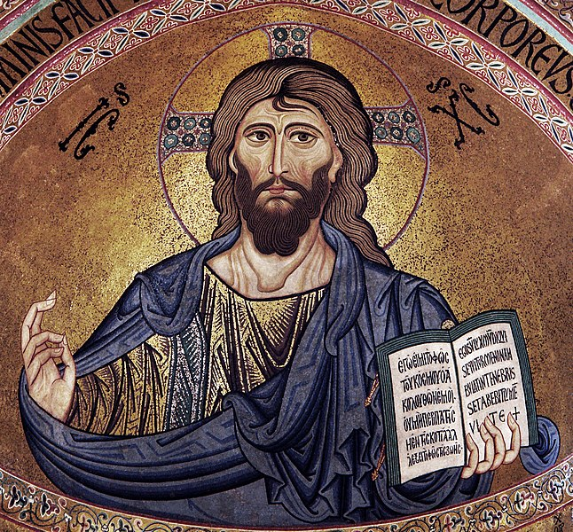
The Meaning of Redemption
“For the wages of sin is death, but the gift of God is eternal life in Christ Jesus our Lord.”
Romans 6:23
Notes:
Photo Credit: Jesus.Rahulmanoj.Creative Commons Attribution-Share Alike 3.0. https://commons.wikimedia.org/wiki/File:Jesus_love.jpg
Directions: Have students copy the information from the slide into their notes.
Teaching points: Jesus taught that love was the greatest command. He redeemed the meaning of the Old Covenant by calling us to love and then showing us the redemptive meaning of love. God the Son ultimately proved his love of God the Father and neighbor through the sacrifice of himself on the Cross. This was the greatest love possible. Jesus's violent Death on the Cross was not a result of happenstance. Jesus's Death was part of the providence of God’s plan. By doing this Jesus showed that love and mercy are greater than sin. This is the meaning of redemption and the source of eternal life.
Online Resource: To see the relationship between love and suffering have students view the video, The God of our Brokenness - Fr. Mike Schmitz
. URL here: https://youtu.be/XuNYgicVvZ0
The videos linked in this presentation file may contain copyright material. Such material is made available for educational purposes only. This constitutes a “fair use” of any such copyright material as provided for in Title 17 U.S.C. section106A-117 of the US Copyright Law.

Slide 3

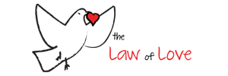
Great Commandments
Key
Vocab!
“You shall love the Lord your God with all your heart, with all your
soul, with all your mind, and with all your strength. You shall love your neighbor as yourself.”
Mark 12:30–31
Notes:
Photo Credit: Law of Love Ministries Logo.Zimvid88.Creative Commons Attribution-Share Alike 3.0. https://commons.wikimedia.org/wiki/File:Law_of_Love_Ministries_Logo.png
Directions: Have students copy the key vocabulary in their notes.
The videos linked in this presentation file may contain copyright material. Such material is made available for educational purposes only. This constitutes a “fair use” of any such copyright material as provided for in Title 17 U.S.C. section106A-117 of the US Copyright Law.

Slide 4
“Are you saved? Are you born again?”
‘Redemption’ has been given to all…
“Christ died for all . . . without exception” -CCC 605 Jesus gave his life on the cross as a ransom to pay the debt of our sins.
Redemption of our sins and reconciliation
with God is only the beginning of the process of salvation.
‘Salvation’ is about living a new life in Christ…
The next step is accepting God’s grace, which calls us to repent of our own sins, have faith in Jesus and live the life of the sacraments.
Salvation begins with being born to new life in the sacrament of Baptism.
We attain our final salvation when we enter into heaven at the end of our lives.
We hope for heaven but never presume salvation.
Notes:
Directions: Have students copy the side information in their notebooks.
Teaching Points: Point out that Baptism is the beginning of salvation for Catholics. Jesus said to Nicodemus, “Amen, amen, I say to you, no one can enter the kingdom of God without being born of water and the Spirit”(Jn 3:3). Baptism is how Catholics are born anew and how we first attain forgiveness of sins including Original Sin. Peter reiterated this connection in his speech at Pentecost: “Repent and be baptized, every one of you, in the name of Jesus Christ for the forgiveness of sins; and you will receive the gift of the Holy Spirit” (Acts 2:38).
Point out that many adult or college age Catholics have no been prepared to answer these questions and as a result end up leaving the Church for other Christian denominations. The online resources below equip students with reasonable and convincing answers to these questions.
Share how important the sacraments of Eucharist and Reconciliation is to you in your faith life and in striving for salvation.
Online Resources: Have students read the article, ‘Are you saved? If only. URL here: https://www.catholic.com/magazine/print-edition/are-you-saved-if-only
Have students read the article, Can Infants be Born Again? URL here: https://www.catholic.com/magazine/print-edition/can-infants-be-born-again
The videos linked in this presentation file may contain copyright material. Such material is made available for educational purposes only. This constitutes a “fair use” of any such copyright material as provided for in Title 17 U.S.C. section106A-117 of the US Copyright Law.

Slide 5
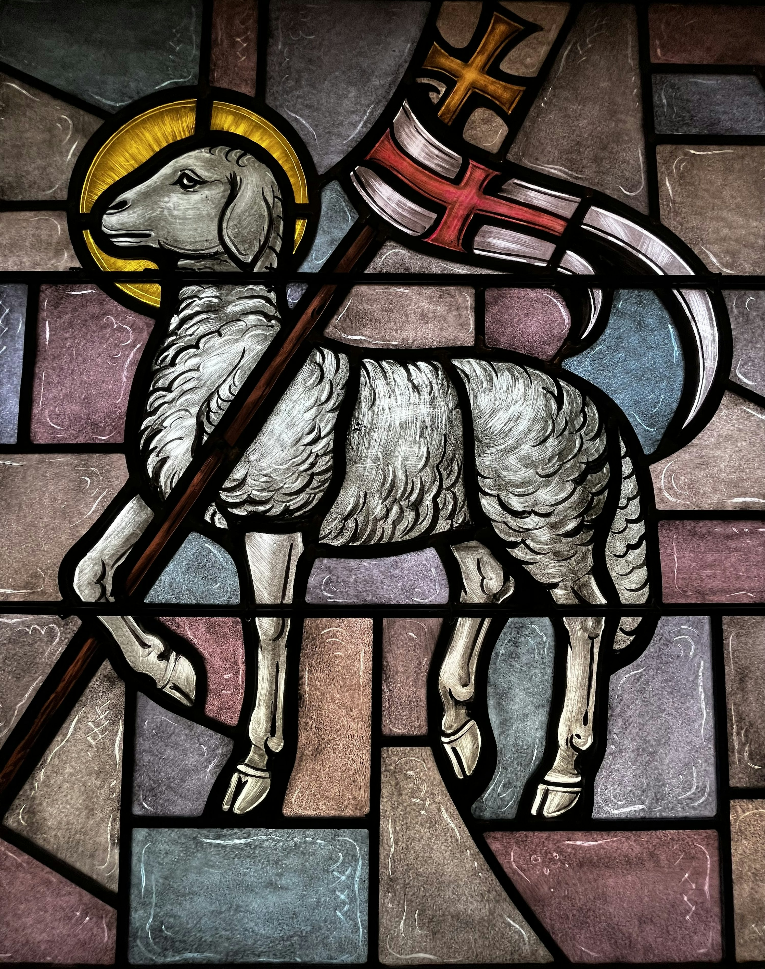
The Lamb of God
Jesus freely chose to suffer and die
Jesus is called our ‘Passover Lamb’
Jesus was crucified as the Passover sacrifices were carried ou
Jesus was male, had no broken bones and was spiritually unblemished like the Passover Lamb
“Behold, the Lamb of God,
who takes away the sin of the world.”
John 1:29
Notes:
Photo Credit: https://unsplash.com/photos/a-stained-glass-window-with-a-sheep-holding-a-flag-0yOOTVWznDI
Directions: Have students copy the side information in their notebooks.
Teaching Points: In order to understand the title of Lamb of God students should be reminded of the lambs that were sacrificed in the Old Testament. To drive home this point use the online resource below.
Online Resources: Have students read the following aloud together in class, Jesus and the Passover Lamb: A Biblical Narrative
Aloud. URL here: https://www.catholic365.com/article/32633/jesus-and-the-passover-lamb-a-biblical-narrative.html
The videos linked in this presentation file may contain copyright material. Such material is made available for educational purposes only. This constitutes a “fair use” of any such copyright material as provided for in Title 17 U.S.C. section106A-117 of the US Copyright Law.

Slide 6
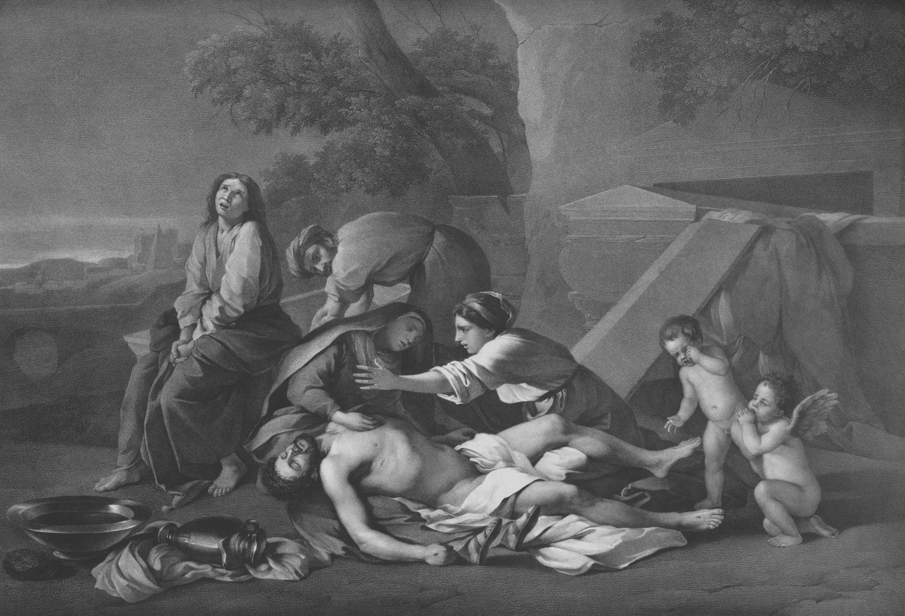
The Paschal Mystery
Key
Vocab!
Christ’s Suffering, Death,
Resurrection and Ascension.
This fourfold event
is the pinnacle of the story of the Bible and the source of our redemption and salvation.
Notes:
*Photo Credit: https://unsplash.com/photos/urNw9_uK-7Y
Directions: Have students copy down the key Vocabulary in their notes.
Online Resource: Have students view the video, ‘The Way of Christ: The Paschal Mystery’. URL here: https://youtu.be/AI97PCs-Pck
The videos linked in this presentation file may contain copyright material. Such material is made available for educational purposes only. This constitutes a “fair use” of any such copyright material as provided for in Title 17 U.S.C. section106A-117 of the US Copyright Law.

Slide 7
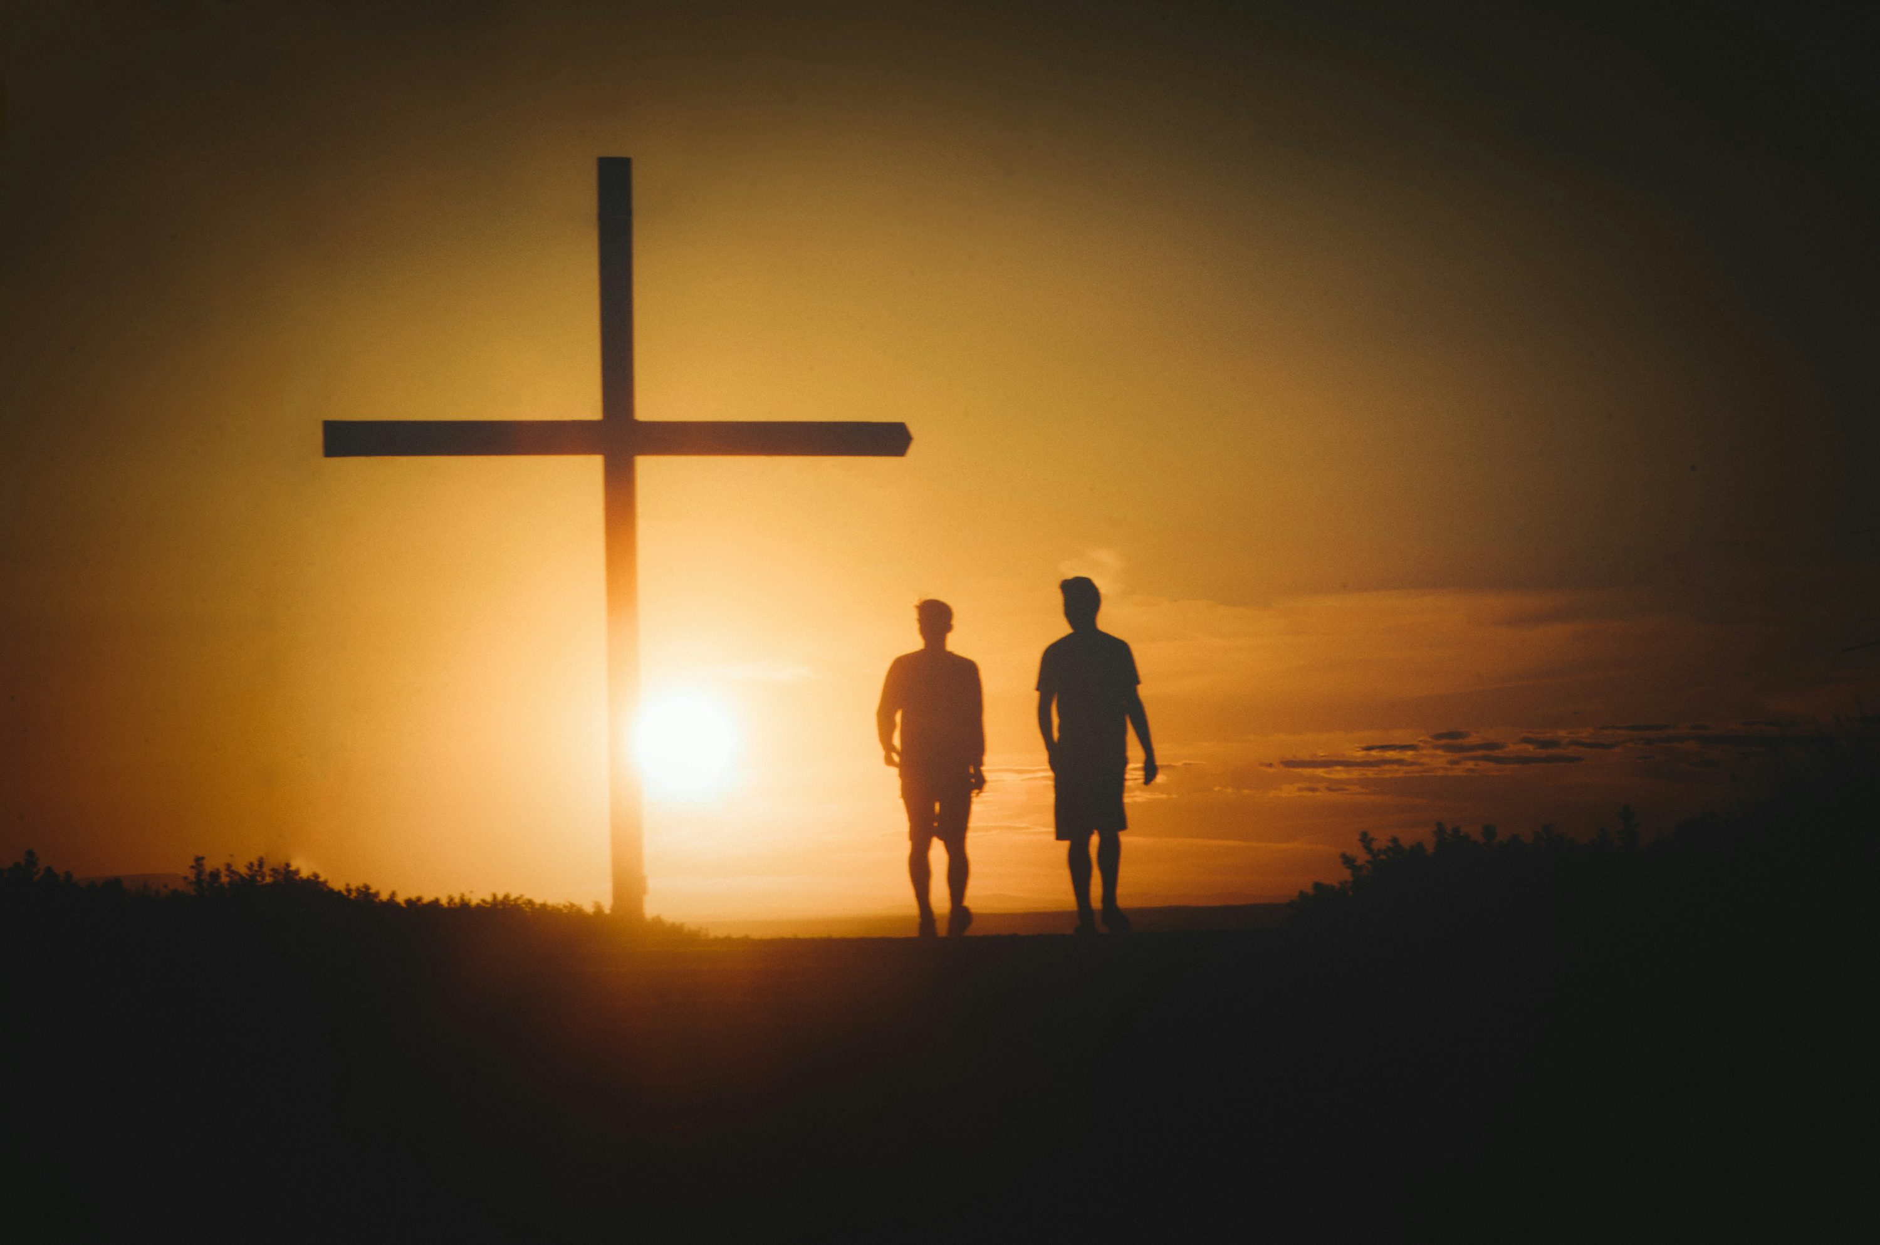
The Road to Emmaus
He said to them, “These are my words that I spoke to you while I was still with you, that everything written about me in the law of Moses and in the prophets and psalms must be fulfilled.” Then he opened their minds to understand the scriptures. And he said to them, “Thus it is written that the Messiah would suffer and rise from the dead on the third day and that repentance, for the forgiveness of sins, would be preached in his name to all the nations, beginning from Jerusalem. You are witnesses of these things.”
Luke 24:44–48
Notes:
Photo Credit: https://unsplash.com/photos/two-people-standing-in-front-of-a-cross-at-sunset-a2F5f8aXu_w
Directions: Have a student read the text on the slide aloud for the class to hear. Ask students to locate the Paschal Mystery in the words of Jesus.
Teaching Points: Point out that Jesus appeared on the Road to Emmaus primarily to announce the Good News of the Paschal Mystery. Because Jesus is truly God and truly man, he was able to bridge the gap between God the Father and humans in a unique way. He was able to bear the full weight of human sinfulness and death and to be expiation for sin. Through his Death and Resurrection, he justified humanity—that is, made humanity holy, acceptable, and just—and reconciled people with God. We are all invited to share in Christ’s achievement on the Cross and in his Resurrection through the sacramental life of the Church, especially the holy Eucharist.
The videos linked in this presentation file may contain copyright material. Such material is made available for educational purposes only. This constitutes a “fair use” of any such copyright material as provided for in Title 17 U.S.C. section106A-117 of the US Copyright Law.

Slide 8
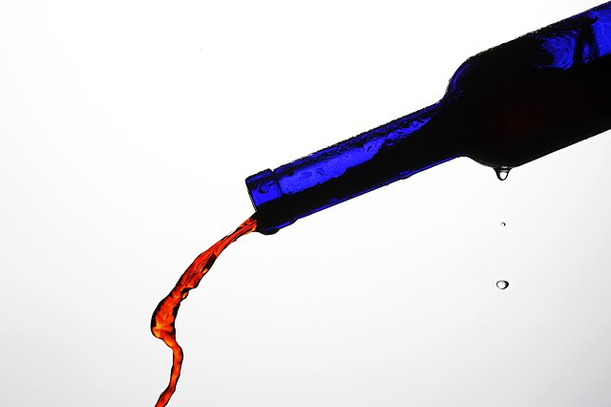
Kenosis
Key
Vocab!
Christ Jesus “emptied himself.” The Greek term Paul uses for “emptied” is kenosis This kenosis is the ultimate expression of the humility of Jesus, who put aside all the advantages and powers of divinity in order to save us.
Notes:
*Photo Credit: Wine exiting a blue bottle.Taro Taylor from Sydney, Australia.Creative Commons Attribution 2.0. https://commons.wikimedia.org/wiki/File:Wine_exiting_a_blue_bottle.jpg
Directions: Have students copy down key vocabulary while you read the quote below…
“We are called to follow Jesus in a personal kenosis or death to self, the result is paradoxically, exaltation. Jesus himself said, “For every one who exalts himself will be humbled, and he who humbles himself will be exalted” (Luke 14:11).An early Christian hymn quoted in the Letter to the Philippians states that Christ “emptied himself, taking the form of a slave . . . he humbled himself, becoming obedient to death, even death on a cross” (Phil 2:7, 8).
The videos linked in this presentation file may contain copyright material. Such material is made available for educational purposes only. This constitutes a “fair use” of any such copyright material as provided for in Title 17 U.S.C. section106A-117 of the US Copyright Law.

Slide 9

Turn and Talk
What do you think it means to say that God the Father “made his sinless Son to be sin?”
Notes:
Directions: Have students write down the question and then write down their answer….Then have students share their answers with one person close by.
The videos linked in this presentation file may contain copyright material. Such material is made available for educational purposes only. This constitutes a “fair use” of any such copyright material as provided for in Title 17 U.S.C. section106A-117 of the US Copyright Law.

Slide 10
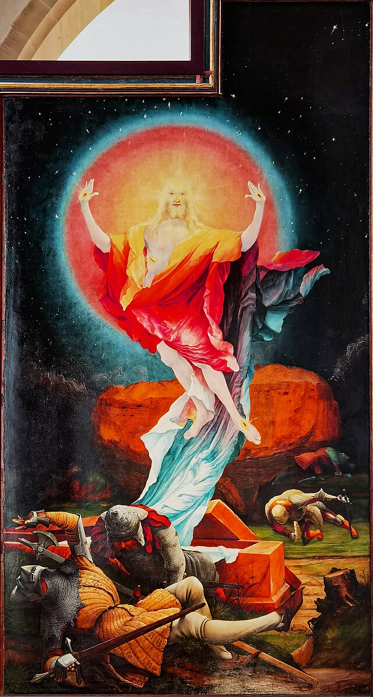
Resurrection of Jesus
Jesus rose bodily on Sunday after Good Friday
Most important miracle
Jesus is vindicated
Defeated Death and Sin
He shows us what will happen to our bodies
Jesus is still alive
Notes:
Photo Credit: Colmar - Unterlinden Museum - The Isenheim Altarpiece 1512-16 by Matthias Grünewald (ca 1470-1528) - Resurrection.Txllxt TxllxT.Creative Commons Attribution-Share Alike 4.0. https://commons.wikimedia.org/wiki/File:Colmar_-_Unterlinden_Museum_-_The_Isenheim_Altarpiece_1512-16_by_Matthias_Gr%C3%BCnewald_(ca_1470-1528)_-_Resurrection_02.jpg. Cropped.
Directions: Have students copy down the information from the slide in their notes.
Teaching Point: Point out that Jesus predicted that he would rise on the third day after his death. In doing so he vindicated all of his teachings. He showed that he defeated death and the other effects of sin. It was a real historical event and it was bodily NOT just spiritual.Its historical verification is found in three key pieces of evidence: the empty tomb, the appearances of the Risen One, and the rapid founding and expansion of Christ’s Church in difficult societal times.
Online Resource: See website, Catholic Resources; Resurrection in the New Testament for more teaching material. URL here: https://catholic-resources.org/Bible/Resurrection.htm
See article, The Gospels Say Trust Women. URL here: https://www.catholic.com/magazine/online-edition/why-the-resurrection-was-not-a-conspiracy
The videos linked in this presentation file may contain copyright material. Such material is made available for educational purposes only. This constitutes a “fair use” of any such copyright material as provided for in Title 17 U.S.C. section106A-117 of the US Copyright Law.

Slide 11


Memorize It
Key
Verse!
“If Christ has not been raised, then empty is our preaching; empty, too, your faith.”
1 Corinthians 15:14
Notes:
Directions: Have students copy the quote. Add bonus points to the assessment if they can copy it down demonstrating that they memorized it.
The videos linked in this presentation file may contain copyright material. Such material is made available for educational purposes only. This constitutes a “fair use” of any such copyright material as provided for in Title 17 U.S.C. section106A-117 of the US Copyright Law.

Slide 12
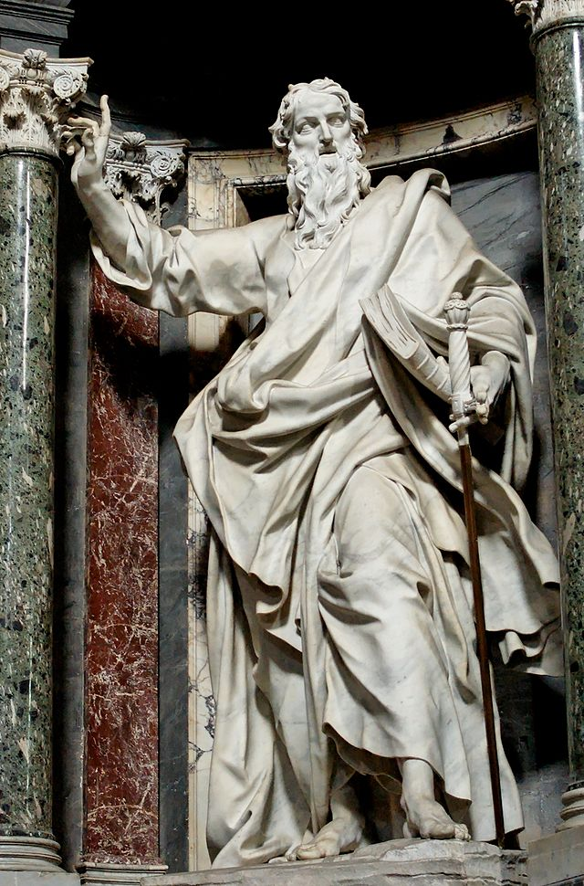
Kerygma
Key
Vocab!
A “proclamation, announcement, or preaching,” given by evangelists and men like Saint Paul. The basic message of Christianity is that “Jesus is risen.”
Notes:
*Photo Credit: Paulus San Giovanni in Laterano 2006-09-07.jpg.St. Paul by Pierre-Étienne Monnot. Nave of the Basilica of St. John Lateran (Rome).Jastrow. Creative Commons Attribution 2.5. https://commons.wikimedia.org/wiki/File:Paulus_San_Giovanni_in_Laterano_2006-09-07.jpg
Directions: Have students copy down key vocabulary while you read the quote below. Have students write out a one paragraph kerygma statement.about Jesus after seeing article below.
Online Resource: Have students listen to article, ‘Kerygma’. URL here: https://www.catholic.com/magazine/print-edition/kerygma
The videos linked in this presentation file may contain copyright material. Such material is made available for educational purposes only. This constitutes a “fair use” of any such copyright material as provided for in Title 17 U.S.C. section106A-117 of the US Copyright Law.

Slide 13
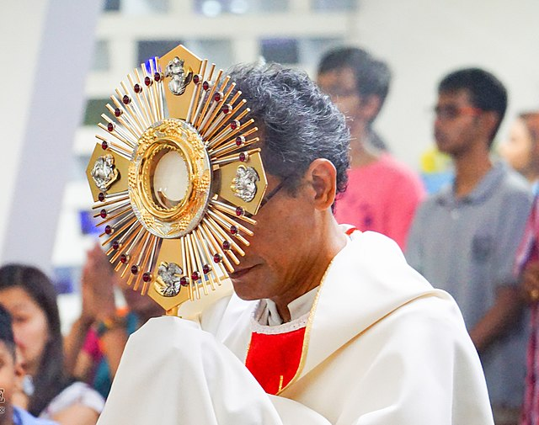
Real Presence
Key
Vocab!
The doctrine that Jesus Christ, resurrected, is truly present in his Body, Blood, Soul
and Divinity
under the form of bread and wine in the Eucharist.
Notes:
*Photo Credit: Fr Paulino Miranda carries the monstrance into the church after the procession.TheRedBaron93.Creative Commons Attribution-Share Alike 4.0. https://commons.wikimedia.org/wiki/File:Fr_Paulino_Miranda.jpg
Directions: Have students copy down key vocabulary in their notes.
Teaching Point: As Catholics we can be certain to encounter the resurrected Jesus in Communion at Mass and during times of Eucharistic Adoration.
Online Resources: Video by the Nashville Dominicans on Eucharistic Adoration. URL here: https://youtu.be/3InivX9vwEo
The videos linked in this presentation file may contain copyright material. Such material is made available for educational purposes only. This constitutes a “fair use” of any such copyright material as provided for in Title 17 U.S.C. section106A-117 of the US Copyright Law.

Slide 14
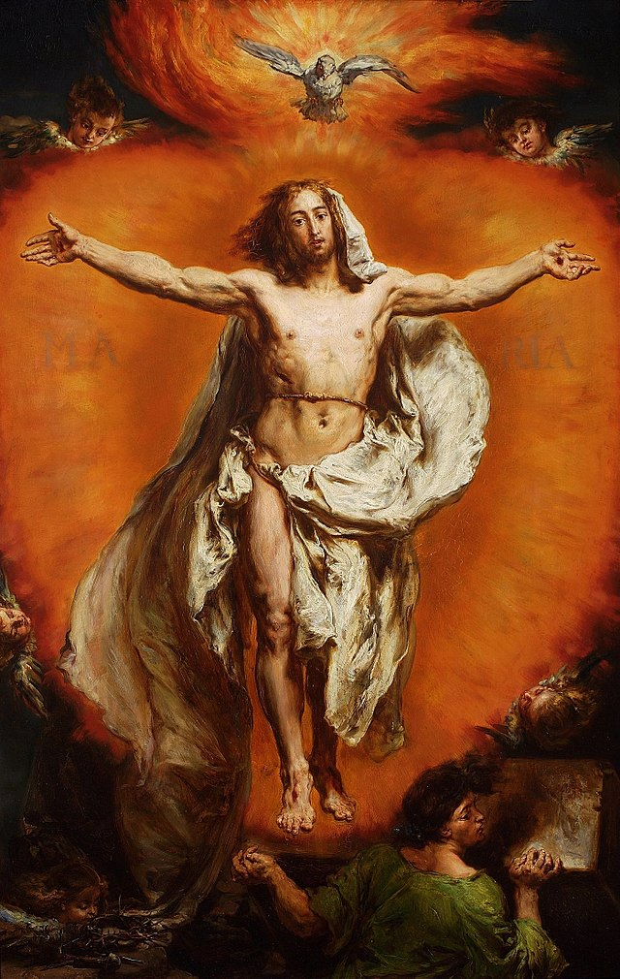
The Ascension
of Jesus
Jesus ascended after 40 days of appearing in his resurrected body
It took place with the apostles present on the Mount of Olives
Jesus acted as the High Priest taking the sacrifice of his body and blood to the sanctuary in heaven
Notes:
Photo Credit: Matejko Ascension of Christ.jpg.Jan Matejko.Public domain. https://commons.wikimedia.org/wiki/File:Matejko_Ascension_of_Christ.jpg
Directions: Have students copy down the information from the slide in their notes.
Teaching Points: Point out that the Ascension reveals Jesus as the one, true High Priest. In the Old Testament, on Yom Kippur, the High Priest entered the most sacred and innermost room of the Temple, the Holy of Holies, bringing
with him the blood of sacrificed animals, their carcasses rising to the sky in smoke. According to the Letter to the Hebrews, the Holy of Holies is symbolic of heaven. Christ, the eternal High Priest, provides the lasting sacrifice
by offering his own bloody sacrifice both by being lifted onto the Cross and by being lifted to heaven by his Ascension: “For Christ did not enter into a sanctuary made by hands, a copy of the true one, but heaven itself, that he might
appear before God on our behalf” (Heb 9:24).
Online Resource: View video, The Ascension. URL here: https://youtu.be/0uM9ByIh6qU
The videos linked in this presentation file may contain copyright material. Such material is made available for educational purposes only. This constitutes a “fair use” of any such copyright material as provided for in Title 17 U.S.C. section106A-117 of the US Copyright Law.

Slide 15
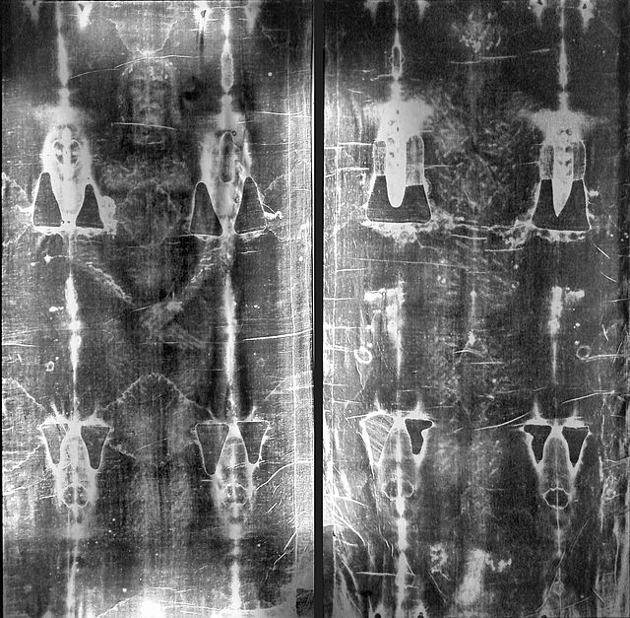
The Shroud of Turin
The Burial Cloth that Covered Jesus’s Body?
A receipt of the price of our redemption?
A tangible sign of the Paschal Mystery?
Notes:
Photo Credit: Full_length_negatives_of_the_shroud of Turin.Unknown author.Public domain. https://commons.wikimedia.org/wiki/File:Full_length_negatives_of_the_shroud_of_Turin.jpg
Directions: Have students copy down the questions in their notes.Follow up by using the online resources below.
Online Resources: Official Shroud of Turin Website. URL here: https://www.shroud.com/
Have students read article, The Paschal Mystery and the Shroud of Turin. URL Here: https://www.catholic365.com/article/30067/the-paschal-mystery-and-the-shroud-of-turin.html
View video, The Truth about the Shroud of Turin, Fr. Spitzer. URL here: https://youtu.be/5xxiR37eUt8
The videos linked in this presentation file may contain copyright material. Such material is made available for educational purposes only. This constitutes a “fair use” of any such copyright material as provided for in Title 17 U.S.C. section106A-117 of the US Copyright Law.

