Slide 1
CHAPTER 9

Slide 2
Chapter 9
The Sacrament
of
Matrimony

Slide 3
Reasons for marriage
God established marriage for two purposes:
unity of husband and wife
procreation and education of children.
Man and woman form a lifelong covenant.
Throughout their lives, they support each other, help each other grow in love and bring each other closer to God.
Helping Each Other Grow in Love

Slide 4
Fidelity
From the Latin word des, meaning faith. “Fidelity expresses constancy in keeping one’s given word. God is faithful” (CCC, 2365).
Helping Each Other Grow in Love

Slide 5
Marriage in the Old versus New Covenant
Marriage in the Old Covenant | Marriage in the New Covenant
Private contract initiated between two male heads of families much like buying and selling of property | Marriage was restored to its original state and raised it to a sacrament among the baptized
Mosaic Law permitted a decree of divorce | “What God has joined together, no human being must separate” (Mt 19:6)
Polygamy was practiced among the Israelites. This practice signified wealth and privilege and established political alliances and ensured a man would have an heir | The couple achieves faithfulness that does not end until death, just as Christ was faithful to his mission until his Death
God loves his people like a bridegroom cares for the woman he loves | The relationship between husband and wife reflects the intimacy and union between Christ and the Church
Helping Each Other Grow in Love

Slide 6
Declaration of Nullity
The Church’s declaration that a particular marriage—whether presumed as a sacramental bond or simply a natural bond—was never valid.
This is not a “Catholic divorce” but rather states that the necessary components of a sacramental marriage were not present when the “marriage” took place and therefore was never valid.
Understanding the Sacrament of Matrimony

Slide 7
Requirements of Marriage
Must be free to marry
If married before the spouse must have either passed away or the marriage annulled by the Church.
Must be of legal age.
Must marry someone of the opposite sex.
Must give their free consent to marry
No one can be forcing either spouse to marry.
Must follow canonical form of marriage (according to the laws of the Church)
Understanding the Sacrament of Matrimony

Slide 8
Marriage Preparation
A Catholic who enters into a mixed marriage (with a baptized non-Catholic) or a marriage with a disparity of cult (with a non-baptized person) first needs a dispensation or permission from the proper Church authorities
Both spouses must show that they understand and agree to what the Church teaches bout the purposes and dignity of marriage and the Catholic spouse must promise that any children born to the couple will be baptized and educated as Catholics.
Finances
In-laws
Family size
Children’s education
Values
Preferences
Sexuality
Conflict styles
Celebrating the Sacrament of Matrimony

Slide 9
Differences between Sacramental and Non-Sacramental Marriages
Sacramental Marriage | Natural Born Marriage or Civil Marriage
Can only be dissolved by death | May be dissolved during the lifetime of the parties
Between two baptized people | One or more parties may not be baptized
Marriage is a contract, covenant and sacrament and the priest or deacon acts as a witness for the Church | Contract is a legal one and the minister or official acts as an agent to the state
Does not have any bearing on finances or custody of children | Has everything to do with finances and custody or financial obligations of children
Celebrating the Sacrament of Matrimony

Slide 10
Three Rites of Matrimony within the Catholic Church
Free Consent and Exchange of Vows
Rite for Celebrating Marriage during Mass
Usually used for two baptized Catholics
Rite for Celebrating Marriage outside of Mass
Celebrates a wedding between a Catholic and a baptized person who is not Catholic. Takes place during a Liturgy of the Word.
Rite for Celebrating Marriage between a Catholic and an Unbaptized person
Sacramental Marriage
Non Sacramental Marriage
Celebrating the Sacrament of Matrimony

Slide 11
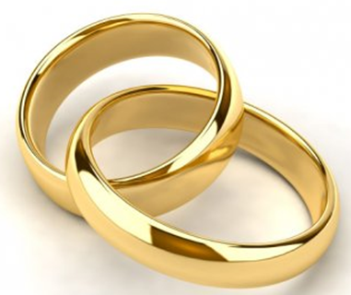
Vows, Rings and Blessings
Nuptial blessing: A blessing intended for the bride and groom and the marriage covenant that takes place after the couple gives their consent to be married. The word nuptial comes from a Latin word that means “wedding.”
Marriage Vows: The promises made by the bride and groom to honor one another and to be faithful in good times and in bad, in sickness and in health, throughout their lives. By their consent to one another, the couple establishes a permanent covenant in love.
Rings are exchanged as a sign of love and fidelity. Circles have no beginning and no end. They symbolize the love God has for human and the commitment of Christ to the Church as well as the couples lifelong faithfulness.
Celebrating the Sacrament of Matrimony

Slide 12
Sacrament of Matrimony
mental
emotional
spiritual
physical
Sign of God’s faithfulness
Helps the couple to grow in love and holiness in their daily life together
Fullness of sacrament is realized only after years of fidelity and affection
Communion
The Graces of the Sacrament of Matrimony

Slide 13
Journal Question
How can you witness to and support the sacramental marriage in your current state of life?

Slide 14
Natural Family Planning
Fruitful love is mutual productive and open to new life.
Children are “the supreme gift of marriage.”
NFP calls the couple to discern reasons to attempt to influence the timing of pregnancy for unselfish reasons
NFP is in accord with God’s will because it is unselfish practicing of periodic abstinence and the use of infertile periods by observing and charting natural fluctuations in a woman’s reproductive cycle.
The Graces of the Sacrament of Matrimony

Slide 15
Why is contraception against God’s Will?
Contraception is forbidden because it as an artificial means that deliberately and directly has an outcome of closing off one of the aims of sexual intercourse—openness to life.
Contraception opposes the unitive aspect of the conjugal act by not allowing for the total self-giving of the couple to one another
In the Rite of Marriage the Church prays for all married couples asking that their love may be unconditional, complete, and unselfish.

Slide 16
Family Communion
To be Christ to one another means striving to build loving relationships.
All family members are called to be Christ to one another.
“The Christian family…is the first community called to announce the Gospel to the human person during growth and to bring him or her, through a progressive educatin and catechesis, to full human and Christian maturity” (Familiaris Consortio, 2).
The Graces of the Sacrament of Matrimony

Slide 17
The Domestic Church
The family acts as the Church in miniature. The Sacrament of Matrimony helps Christian families mirror the love between Christ and his Church
The Graces of the Sacrament of Matrimony

Slide 18
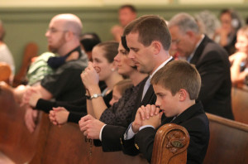
Communion with the Church
Christian families promote faith and evangelization, both at home and with others
Families worship together on Sundays.
Families. participate in the sacraments.
Families make time for family prayer.
Groups of families meet regularly to form small Christian communities to support one another in faith.
Christian families help serve the needs of the parish
Families help during liturgy.
Families take on special parish projects.
Families visit the sick and elderly.
The Graces of the Sacrament of Matrimony

Slide 19
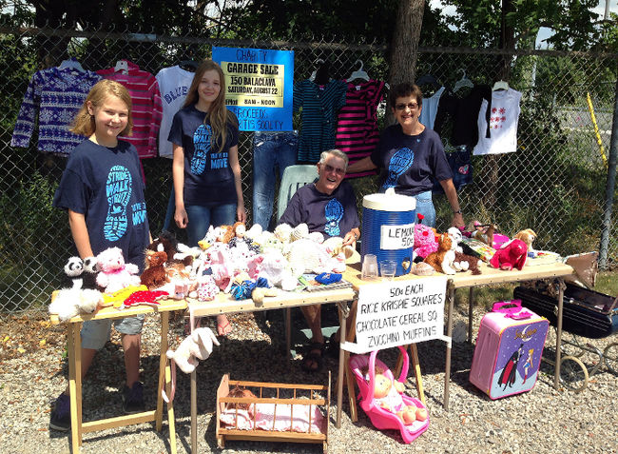
Community with Society
Husbands and wives socialize their own children.
Children learn respect for life, love of poor, and good citizenship.
Christian families participate in politics, promoting and safeguarding family values in society.
Voters, lobbyists to ensure rights of every family.
Christian families work for justice and peace.
Families serve the poor.
Families stand for human dignity.
The Graces of the Sacrament of Matrimony

Slide 20
“Husbands, love your wives, even as Christ loved the church and handed himself over for her.
(Eph 5:25)

