Slide 1

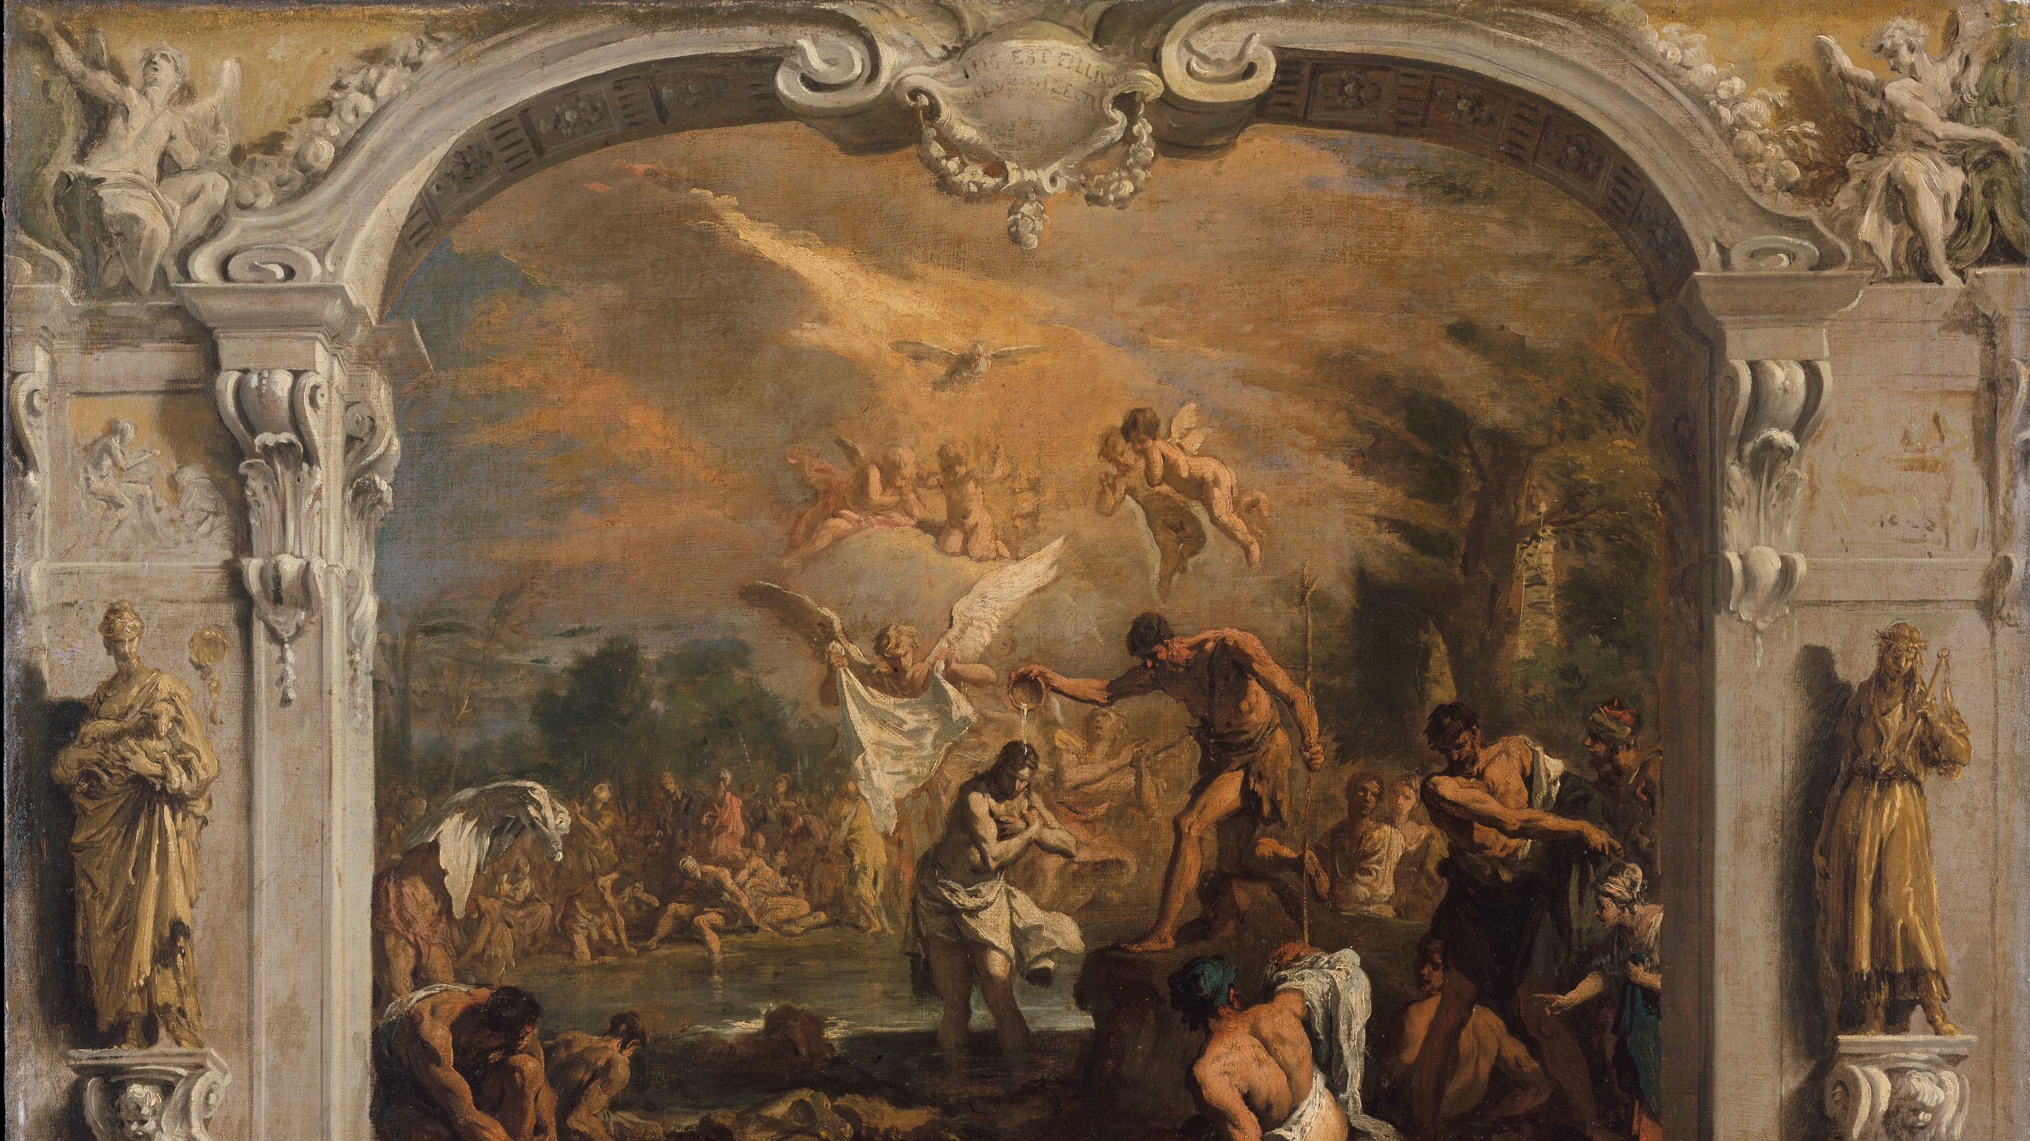
2. THE SACRAMENT OF BAPTISM
2
The Sacrament of Baptism
The Seven Sacraments: Signs of God’s Grace
Notes:
Suggestions for taking notes on the slides:
Require students to use a three ring binder (1/2-1 inches) full of loose leaf paper (college or wide ruled).
Notes must be taken in pen only and handwritten.
Notebook binders should contain information and notes for religion class only.
Notebook binders must have a table of contents with topics of notes, dates, and page numbers.
All notes must have a topic and page number.
Students will be required to copy each slide unless the teacher directs students to skip certain slides or parts of slides. Binder notebooks will be graded based on neatness, completeness and organization.

Slide 2
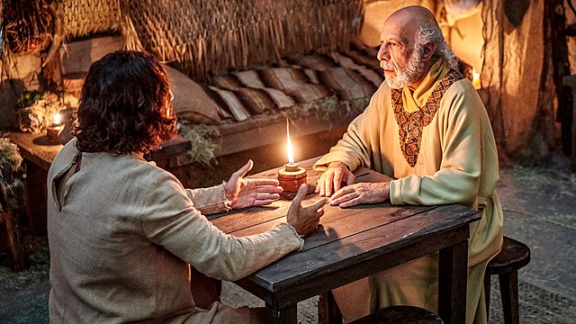
Born Again?
Nicodemus said to him, “How can a person once grown old be born again? Surely he cannot reenter his mother’s womb and be born again, can he?”
Jesus answered, “Amen, amen, I say to you, no one can enter the kingdom of God without being born of water and Spirit.” (Jn 3:4–5)
Notes:
Photo Credit: Wikimedia Commons, “The Chosen – Nicodemus and Jesus,” The Chosen press photos (press.the chosen.tv), https://commons.wikimedia.org/wiki/File:The_Chosen_-_Nicodemus_and_Jesus.jpg. License: https://creativecommons.org/licenses/by-sa/4.0/deed.en
Directions: Have students copy down the information from this slide into their notes.
Teaching Points:
Perhaps you have had a Protestant friend say to you that “unless you are born again” you cannot be saved. What does this statement mean? What does this question have to do with Baptism? How do Catholics respond? This question comes from an exchange between Jesus and his secret follower, the Pharisee Nicodemus. Jesus had instructed Nicodemus: “No one can see the kingdom of God without being born from above” (Jn 3:3). Nicodemus did not understand this teaching. He asked, “How can a person once grown old be born again? Surely he cannot reenter his mother's womb and be born again, can he?” Jesus answered, “Amen, amen, I say to you, no one can enter the kingdom of God without being born of water and Spirit. What is born of flesh is flesh and what is born of spirit is spirit” (Jn 3:4-6).
Catholics interpret this being “born again” as a spiritual rebirth. We believe this takes place at Baptism. Baptism bestows on us the new life of Jesus and the gift of the Holy Spirit, who empowers us to live Christ-like lives. Various Christian denominations, however, interpret “born again” to be a personal experience that guarantees someone his or her salvation. They often explain this as a specific emotional or spiritual event or an individual private revelation. Often, they believe this takes place at a revival where the preacher invites the person to come up and proclaim his or her faith in Jesus Christ. This highly emotional experience convinces the person to accept Jesus Christ as their personal Savior. This pivotal event also marks the day on which the person commits his or her life to the Lord. According to this interpretation, if you have this experience, you are saved; if you have not had it, salvation is not yours.
The Church rejects the interpretation that you must have this earth-shattering experience to be born again. Certainly, some Christians, like St. Paul, do experience the Lord in a way that turns their lives completely around. But having this single experience is not a necessary condition for salvation. Baptism begins a new life of spiritual growth. Most often, the Holy Spirit gently leads God's people. Over time, most Christians gradually turn their lives over to Christ. Spiritual rebirth to a life in Christ is another name for Christian conversion. It begins at Baptism and signals a lifelong journey of growth. It is not simply a one-time event.
Online Resource: Have students view the following videos: John 3:16 (The Chosen Scene) URL here: https://youtu.be/_p2XIUK9VgA Bishop Barron on Being Born Again URL here: https://youtu.be/ZZ1pLyLdnhM?si=aE3W1Belvg6KB5SP
The videos linked in this presentation file may contain copyrighted material. Such material is made available for educational purposes only. This constitutes a “fair use” of any such copyrighted material as provided for in Title 17 U.S.C. section 106A-117 of the US Copyright Law.

Slide 3


Becoming ‘Other Christs’
ICHTHYS (Jesus-Christ- Son of God-Savior)
"Other Christs” are born anew in the waters of Baptism.
The Church gives birth to us from a womb-shaped baptismal font.
“But we, little fishes, after the example of our ΙΧΘΥΣ Jesus Christ, are born in water, nor have we safety in any other way than by permanently abiding in water…”
- Tertullian, On Baptism AD 193
Notes:
Photo Credit: Wikimedia Commons, “Fish schools at Castle Rock.JPG,” Alexander Vasenin, https://commons.wikimedia.org/wiki/File:Fish_schools_at_Castle_Rock.JPG.
License: https://creativecommons.org/licenses/by-sa/3.0/deed.en
Tertullian Quote Source: Tertullian, Latin Christianity: Its Founder, Tertullian, “II. On Baptism,” trans. Rev. S. Thelwall, Christian Classics Ethereal Library, https://ccel.org/ccel/tertullian/baptism/anf03.vi.iii.i.html.
Directions: Have students copy down the information from this slide into their notes.
Teaching Point:
Through the presence and action of the Holy Spirit at the reception of Baptism, we become what St. Louis de Montfort called “other Christs.” It was through the Incarnation of his Son that God brought salvation to the world. It is through the Sacrament of Baptism that we become holy. Both Original Sin and any actual sin are wiped away through Baptism.
Online Resources: Assign the article, Saint Catherine’s Best Fish Quote. URL here: https://www.catholic365.com/article/49044/saint-catherine-of-siennas-best-quote.html

Slide 4
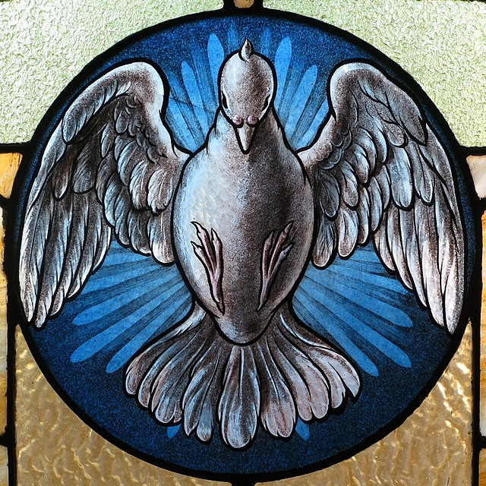
The Lord, the Giver of Life
“By virtue of the Holy Spirit, Baptism immerses us in the Death and Resurrection of the Lord, drowning out the old person—dominated by sin that divides us from God—in the baptismal font and giving birth to the new person, recreated in Jesus. In him, we are all called to new life.” – Pope Francis
Notes:
Photo Credit: Wikimedia Commons, “Saint Joseph Catholic Church (Wapakoneta, Ohio) – stained glass, Holy Spirit,” Nheyob, https://commons.wikimedia.org/wiki/File:Saint_Joseph_Catholic_Church_(Wapakoneta,_Ohio)_-_stained_glass,_Holy_Spirit.jpg.
License: https://creativecommons.org/licenses/by-sa/4.0/deed.en
Directions: Have students copy information from the slide into their notes.
Teaching Point:
The symbolism of water signifies the Holy Spirit's action in Baptism, since after the invocation of the Holy Spirit it becomes the efficacious sacramental sign of new birth: just as the gestation of our first birth took place in water, so the water of Baptism truly signifies that our birth into the divine life is given to us in the Holy Spirit. As “in one Spirit we were all baptized," so we are also “given to drink of one Spirit" (1 Cor 12:13). Thus the Spirit is also personally the living water welling up from Christ crucified as its source and welling up in us to eternal life.
Online Resources: Assign the article, The Holy Spirit, Giver of Life. URL here: https://www.ewtn.com/catholicism/library/holy-spirit-giver-of-life-22758

Slide 5

Baptism Terminology
The word “baptism” comes from the Greek word “baptizein,” which means to plunge or immerse.
The Sacrament of Baptism also goes by several other names, including:
  The washing of regeneration and renewal by the Holy Spirit
  Enlightenment
  The Sacrament of Faith
Notes:
Photo Credit: Google Slides GIF (Plunge)
Directions: Have students copy down the information from this slide into their notes.
Teaching Points:
Because the word baptism comes from the Greek word baptizein, which means “to plunge or immerse,” the Sacrament takes its name from the central rite by which it is carried out. The immersion of the catechumens into water represents their burial with Christ. Their rising up out of the water represents their resurrection with Christ as “new creatures” (CCC, 1214).
The washing of regeneration and renewal by the Holy Spirit. This name refers to the regeneration or rebirth of a person by water and Spirit that the Sacrament brings about. Jesus spoke of this rebirth: “Amen, amen, I say to you, no one can enter the kingdom of God without being born of water and Spirit” (Jn 3:5) (CCC, 1215).
Enlightenment. St. Justin Martyr called Baptism enlightenment “because those who receive this [catechetical] instruction are enlightened in their understanding.” Jesus is the light of the world, who enlightens everyone (CCC, 1216)
The Sacrament of Faith. St. Augustine described Baptism as the Sacrament of Faith because by receiving it, we profess our faith in all the Church teaches.
Online Resources: Have students view this following video: The Sacrament of Baptism. URL here: https://youtu.be/Eq_3mGV6RU8

Slide 6

The Universal Meaning of Water
LIFE
DEATH
CLEANSING
Notes:
Photo Credit: Wikimedia Commons, “The underwater surface structures of an iceberg in Svalbard.jpg” (cropped), Andreas Weith, https://commons.wikimedia.org/wiki/File:The_underwater_surface_structures_of_an_iceberg_in_Svalbard.jpg.
License: https://creativecommons.org/licenses/by-sa/4.0/deed.en
Directions: Have students copy information from this slide into their notes.
Teaching Point:
Water is the principal symbol for Baptism. John baptized Jesus with water in the Jordan River. Jesus and his disciples went into the region of Judea, where they baptized others with water (Jn 3:22-23). When Jesus died, water flowed from his pierced side (Jn 19:34), an outpouring of his grace through water. It is a rich symbol filled with spiritual meaning. It is necessary for life. It can cause death (drowning/floods) and it can cleanse. In Baptism all three meanings are present.
Online Resources: Assign article, The waters of baptism. URL here: https://www.thecatholicspirit.com/faith/focus-on-faith/faith-fundamentals/the-waters-of-baptism/
Assign students to watch the following video: Unique Earth: The Essence of Water | Full Documentary URL here: https://youtu.be/K6Qh4xBxUy8
The videos linked in this presentation file may contain copyrighted material. Such material is made available for educational purposes only. This constitutes a “fair use” of any such copyrighted material as provided for in Title 17 U.S.C. section 106A-117 of the US Copyright Law.

Slide 7
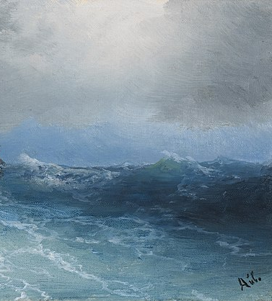
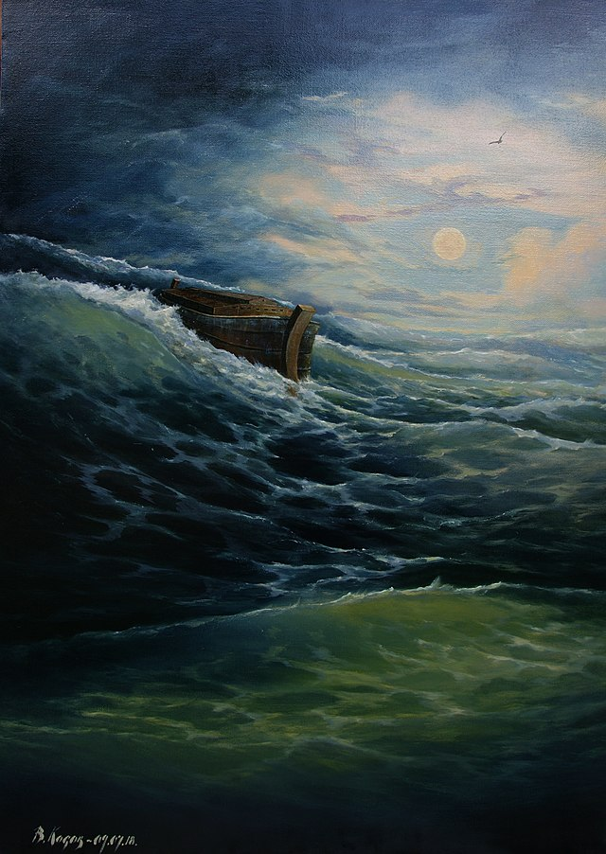
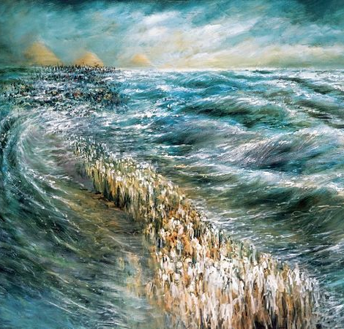
Baptism Prefigured in the OT
Creation
Flood and Ark
Exodus at Red Sea
Notes:
Photo Credit: Ivan Kostantinovich, Gathering Storm (cropped), 1889.
Wikimedia Commons, “НОЕВ КОВЧЕГ. В.Косов 140х100 х.м. 2018.jpg” (cropped), Kosov vladimir 09071967, http://commons.wikimedia.org/wiki/File:%D0%9D%D0%9E%D0%95%D0%92_%D0%9A%D0%9E%D0%92%D0%A7%D0%95%D0%93._%D0%92.%D0%9A%D0%BE%D1%81%D0%BE%D0%B2_140%D1%85100_%D1%85.%D0%BC._2018.jpg. License: https://creativecommons.org/licenses/by-sa/4.0/deed.en
Wikimedia Commons, “KriatYamSoof.jpg: (cropped), Dr. Lidia Kozenitzky, https://commons.wikimedia.org/wiki/File:KriatYamSoof.jpg.
Directions: Have students copy information from the slide into their notes.
Teaching Points:
Creation. The Old Testament roots of the Sacrament of Baptism begin in the creation account in the Book of Genesis, when the Holy Spirit hovered over the waters and brought new life from them: “In the beginning, when God created the heavens and the earth—and the earth was without form or shape, with darkness over the abyss and a mighty wind sweeping over the waters . . .” (Gn 1:1–2). Thus, since the beginning of the world, water has been a source of life (see CCC, 1218). Through the waters of Baptism, we are brought to new life with the Blessed Trinity.
Flood and Ark. Water can also bring about great destruction. This is witnessed in the Book of Genesis in the account of the Great Flood (Gen 6:5–8:22). In this event, God sent a deluge to wipe out all human life, which had been overwhelmed by sin, saving only Noah and his family. Through the waters of the Flood, God created a new beginning. Humanity’s sinfulness was buried, and, through the remaining people—Noah and his family—a new creation was established. The death and new life brought about by the Flood foreshadow the death and new life we experience in Baptism. In Baptism, we are buried in water, symbolizing our death to sin, and rise to new life with Christ. The waters of Baptism signify and make real an end of sin and a new beginning of goodness.
Exodus at Red Sea. In the waters of Baptism, the Church also recalls God’s saving plan to rescue Moses and the Israelites from slavery in Egypt. With God’s help, the Israelites crossed the Red Sea and reached the opposite side, free to continue on their journey to the Promised Land (Ex 14:10–31). God gave them new life as free people. He made a covenant with them and taught them to live by the Ten Commandments as his own people. They were to choose life rather than death by “loving the Lord . . . obeying his voice, and holding fast to him” (Dt 30:19–20). The waters of Baptism remind us of the promise God made to be with the Israelites always and to bring them safely to their home in Canaan. Furthermore, these waters free us from sin and allow us safe passage on our journey to the Promised Land of eternal life with God.
Online Resources: Have students view video, Baptism Foreshadowed in the Old Testament. URL here: https://youtu.be/BbK5Lph34WQ
The videos linked in this presentation file may contain copyrighted material. Such material is made available for educational purposes only. This constitutes a “fair use” of any such copyrighted material as provided for in Title 17 U.S.C. section 106A-117 of the US Copyright Law.

Slide 8
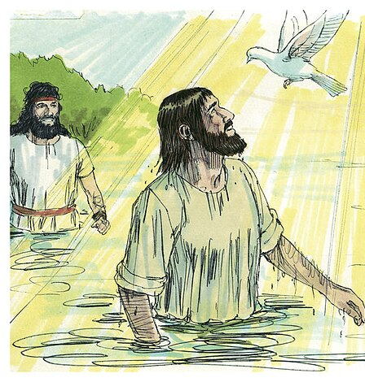
Lessons of Jesus’s Baptism
He associated with sinners.
His baptism pointed to the Paschal Mystery.
The Holy Trinity was revealed:
  Voice: Father
  Jesus: Son
  Dove: Holy Spirit
Notes:
Photo Credit: Wikimedia Commons, “Gospel of John Chapter 1-3 (Bible Illustrations by Sweet Media).jpg” (cropped), Jim Padgett, https://commons.wikimedia.org/wiki/File:Gospel_of_John_Chapter_1-3_(Bible_Illustrations_by_Sweet_Media).jpg.
License: https://creativecommons.org/licenses/by-sa/3.0/deed.en
Directions: Have students copy down the information from this slide into their notes.
Teaching Points:
John the Baptist, sometimes referred to as the “last Old Testament prophet,” preached repentance of sin and urged people to prepare for the coming of the long-awaited Messiah. Even though Jesus was without sin, he went to John to be baptized (see Mt 3:13–17; Mk 1:9–11; Lk 3:21–22; Jn 1:31–34).
In all four Gospels, the baptism of Jesus marks the beginning of his public ministry, his preaching of the coming of God’s Kingdom, and the necessity of his own Death and Resurrection for the forgiveness of sins. His baptism with water prefigured his baptism in blood at his Death on the Cross.
Baptism also recalls the Paschal Mystery—Jesus’s suffering, dying, and rising from the dead. The immersion in water during Baptism signifies his Death. The rising from the water in Baptism signifies his Resurrection. As St. Paul explained to the Colossians, “You were buried with [Christ] in baptism, in which you were also raised with him through faith in the power of God, who raised him from the dead” (Col 2:12).
Online Resources: Have students view the following video: The Bible – Jesus Baptism. URL here: https://youtu.be/CbwdLC_yAPs

Slide 9
Baptism Essentials
Minister | Matter | Form
Bishop Priest Deacon Anyone in an emergency | Water and Pouring Immersion | “I baptize you in the Name of the Father, the Son and the Holy Spirit.”
Notes:
Directions: Have students copy this information into their notes.

Slide 10
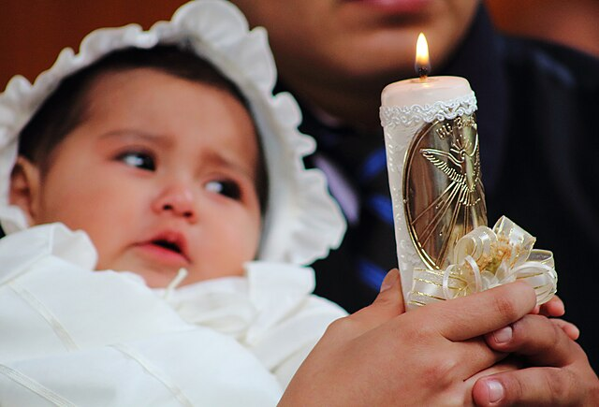
Celebration of Baptism
“Repent and be baptized, every one of you, in the name of Jesus Christ for the forgiveness of your sins; and you will receive the gift of the holy Spirit.”
—Acts 2:38
Notes:
Photo Credit: Wikimedia Commons, “Vela en un bautismo católico.JPG,” Adrián Cerón, https://commons.wikimedia.org/wiki/File:Vela_en_un_bautismo_cat%C3%B3lico.JPG.
License: https://creativecommons.org/licenses/by-sa/4.0/deed.en
Directions: Have students copy information from the slide into their notes.
Teaching Points:
The celebration of the sacrament consists of the following elements:
Sign of the Cross: The priest or deacon imprints a cross on the forehead of the catechumen as a sign that he or she belongs to Christ. This sign also reminds the person of the grace Christ won for him or her by his Death on the Cross. Then, the minister asks the adult to be baptized (or in the case of infant Baptism, the parents and godparents), “What do you ask of God’s Church?” The response is “faith” or “Baptism.”
The Word of God: The multiple Scripture readings and responsorial psalms from the Easter Vigil teach that God always initiates your relationship with him. For example, some of the options for Gospel readings in the Rite of Baptism of Children are John 3:1–6, Matthew 28:18–20, Mark 1:9–11, and Mark 10:13–16.
Exorcisms and Profession of Faith: Because Baptism signifies liberation from sin and from the one who brings about sin, Satan, one or more exorcisms are said over each candidate. The priest asks publicly and authoritatively in the name of Jesus Christ that each person be protected against the power of Satan and the lure of sin. The celebrant then anoints each candidate with the oil of catechumens, or lays hands on him or her, and renounces Satan. Each candidate is thus prepared to confess the faith of the Church, which will be entrusted to the candidate by Baptism.
Blessing of the water: The celebrant calls on the Holy Spirit to bless the water that will be used for Baptism. In this blessing, “the Church asks God that through his Son the power of the Holy Spirit may be sent upon the water, so that those who will be baptized in it may be “born of water and the Spirit” (Jn 3:5)” (CCC, 1238).
The Essential Rite of Baptism: The essential rite of the sacrament is very simple. The celebrant immerses each candidate in the blessed water three times or pours water three times over the candidate’s head. At the same time, the celebrant says,. “Immersion in water symbolizes not only death and purification, but also regeneration and renewal” (CCC, 1262). “N., I baptize you in the name of the Father, and of the Son, and of the Holy Spirit” (CCC, 1240)
Anointing with sacred chrism: If the celebration of Confirmation does not follow immediately (as in adult Baptism), the celebrant anoints each newly baptized (neophyte) on the crown of the head with consecrated oil known as sacred chrism. This anointing symbolizes the coming of the Holy Spirit to the newly baptized. It signifies that a new character, or identity, has been given to the person. He or she now officially belongs to Christ and may be called a Christian. The anointing also brings the baptized person into union with the threefold mission of Christ as priest (participating in the Church’s worship), prophet (proclaiming God’s word), and king (humbly serving others in Christ’s name).
Receiving or clothing in a white garment: Each of the neophytes either receives or is dressed in a white robe.The white robe signifies that the person is now freed from the darkness of sin and has “put on Christ” (CCC, 1242).
Receiving of a lit candle: The celebrant then gives the newly baptized a small white candle lit from the Easter Candle, which was blessed and lit earlier in the Easter Vigil service. The candle symbolizes the light of Christ that the newly baptized have received. In the case of infant Baptisms, the light is entrusted to the parents and godparents, who have the responsibility to keep the light of Christ burning bright in the life of the child. For neophytes, the candle not only symbolizes the light of Christ they have received, but also their responsibility to bring that light into the world.
Online Resources: Have students view the following video: St. Michael’s Catholic Church: Baptism. URL here: https://youtu.be/pD7kE8qUz5A

Slide 11
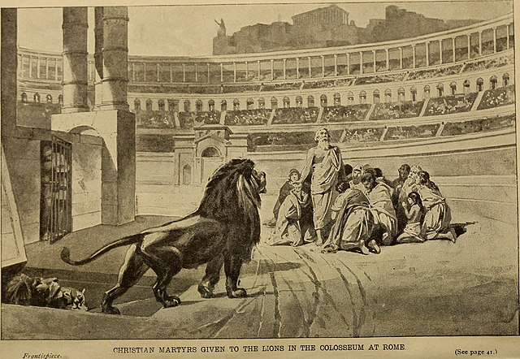
Baptism of Blood
Key
Vocab
Definition: Those who suffer death for their faith prior to having received the Sacrament of Baptism are baptized by their death. This brings about the fruits of Baptism for these Christian martyrs.
Notes:
Photo Credit: Internet Archive Book Images.No known copyright restrictions. Foxe's Christian martyrs of the world; the story of the advance of Christianity from Bible times to latest periods of persecution (1907). https://commons.wikimedia.org/wiki/File:Foxe%27s_Christian_martyrs_of_the_world;_the_story_of_the_advance_of_Christianity_from_Bible_times_to_latest_periods_of_persecution_(1907)_(14783517042).jpg
Directions: Have students write down the term and definition as part of a Key Vocab section in their notes.
Online Resource: Assign article, The Vatican Says a Newborn Martyr Had a ‘Baptism of Blood’: What Does That Mean?
URL here: https://www.ncregister.com/cna/the-vatican-says-a-newborn-martyr-had-a-baptism-of-blood-what-does-that-mean

Slide 12
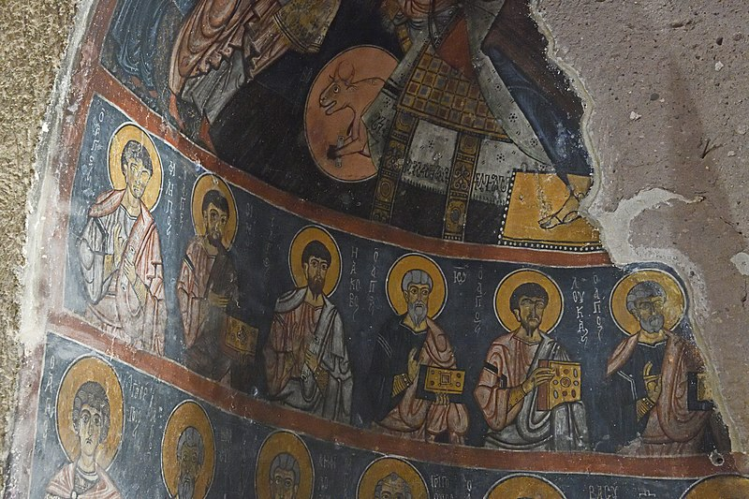
Baptism of Desire
Key
Vocab
Definition: The Church also holds that those who never heard the Gospel, lived a life according to God’s will the best they could, and would have been baptized if they had known of the necessity can also be saved through the baptism of desire.
Notes:
Photo Credit: Wikimedia Commons, “Gumusler Monastery Main apse Disciples 1151.jpg, Dosseman, https://commons.wikimedia.org/wiki/File:Gumusler_Monastery_Main_apse_Disciples_1151.jpg.
License: https://creativecommons.org/licenses/by-sa/4.0/deed.en
Directions: Have students write down the term and definition as part of a Key Vocab section in their notes.
Online Resource: Assign article, Baptism of Desire. URL here: https://www.catholic.com/magazine/print-edition/baptism-of-desire

Slide 13

The Spiritual Effect of Baptism
New Life in Christ
Adopted as a Child of God
Washing Away of Original Sin
Body becomes a Holy Temple of God
Given an Invisible Mark
Claimed for Christ
Given the Theological Virtues
Illumininated by Faith
Opens door to all other Sacraments
Incorporated into Body of Christ
. . . and more!!!
Notes:
Photo Credit: Wikimedia Commons, “The joy of the happy face by Rasheedhrasheed.jpg, Rasheedhrasheed, https://commons.wikimedia.org/wiki/File:The_joy_of_the_happy_face_by_Rasheedhrasheed.jpg,
License: https://creativecommons.org/licenses/by-sa/4.0/deed.en
Directions: Have students copy information from the slide into their notes.
Teaching Point:
“The fruit of Baptism, or baptismal grace, is a rich reality that includes forgiveness of original sin and all personal sins, birth into the new life by which man becomes an adoptive son of the Father, a member of Christ and a temple of the Holy Spirit. By this very fact the person baptized is incorporated into the Church, the Body of Christ, and made a sharer in the priesthood of Christ. Baptism imprints on the soul an indelible spiritual sign, the character, which consecrates the baptized person for Christian worship. Because of the character Baptism cannot be repeated.” (CCC 1279–1280)
Online Resources: Have students view the following video: Lesson 12 - The Effects of Baptism. URL here: https://youtu.be/jNBz3KUqd6g
The videos linked in this presentation file may contain copyrighted material. Such material is made available for educational purposes only. This constitutes a “fair use” of any such copyrighted material as provided for in Title 17 U.S.C. section 106A-117 of the US Copyright Law.

Slide 14
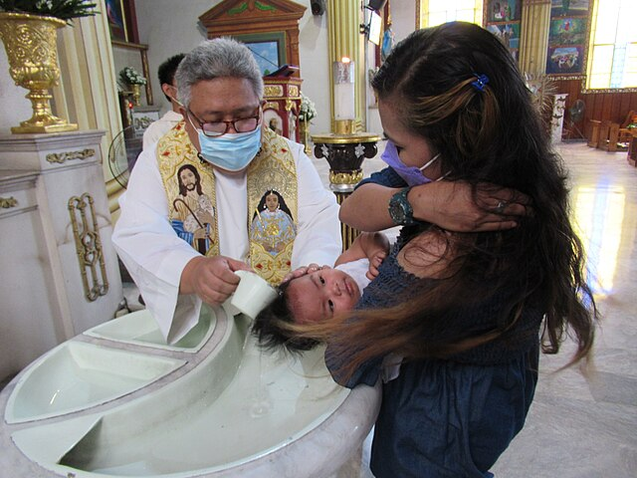
The Common Priesthood
Key
Vocab
Definition: The priesthood Christians possess through their Baptism. It involves actively living out their faith through prayer, sacrifice, and service. It is distinct from the ministerial priesthood, which is specific to ordained priests who are empowered to administer the sacraments and offer the Eucharist.
Notes:
Photo Credit: Wikimedia Commons, “Roman Catholic Infant Baptism in Pandi Church 23.jpg,” FBenjr123, https://commons.wikimedia.org/wiki/File:Roman_Catholic_Infant_Baptism_in_Pandi_Church_23.jpg.
License: https://creativecommons.org/licenses/by-sa/4.0/deed.en
Directions: Have students write down the term and definition as part of a Key Vocab section in their notes.
Online Resource: Assign article, Called to participate: Understanding baptismal and ministerial priesthood. URL Here: https://catholicphilly.com/2010/01/features/year-of-the-priest/called-to-participate-understanding-baptismal-and-ministerial-priesthood/

Slide 15


Memorize It
Key
Verse
“Amen, amen, I say to you, no one can enter the kingdom of God without being born of water and Spirit.” —John 3:5
Notes:
Directions: Have students write down the quote and commit it to memory. Bonus points may be awarded if they can add it to the end of the chapter assessment.

