Slide 1

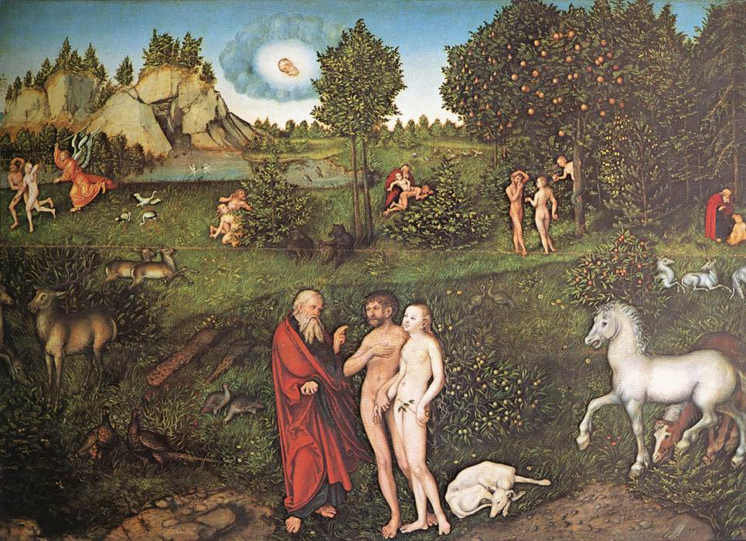
1
The Beginning of Creation
and Man's Fall from Grace
God Saves: We Are Redeemed through the Paschal Mystery
Notes:
Suggestions for students’ note taking:
●Require students to use a three ring binder (1/2-1 inches) full of loose leaf paper (college or wide ruled).
●Notes must be taken in pen only and hand written.
●Notebooks should contain information and notes for religion class only.
●Notebooks must have a table of contents with topic of notes, dates and page numbers.
●All notes must have a topic and page number.
●Students will be required to copy each slide unless the teacher directs students to skip certain slides or parts of slides. Notebooks will be graded based on neatness, completeness and organization. Notebooks should have a significant point value representing 20-25% of the overall grade.
Image Source: https://upload.wikimedia.org/wikipedia/commons/4/4c/Adam_and_Eve_by_Lucas_Cranach_%28I%29.jpg
The videos linked in this presentation file may contain copyright material. Such material is made available for educational purposes only. This constitutes a “fair use” of any such copyright material as provided for in Title 17 U.S.C. section106A-117 of the US Copyright Law.

Slide 2



Good Questions about God
What Does It Mean to Say God Is Eternal?
What Did God Do before Creation?
Who Created God?
What Did God Create?
Why Did God Create?
Notes:
Photo Credit: People.svg,Creative Commons Zero, Public Domain Dedication. https://commons.wikimedia.org/wiki/File:People.svg
Directions: 1. Ask a student to pick any question to read aloud (until they are all asked) and then ask all students to think about the answer.
2. Ask students if they have questions about God that are not on the slide.
3. Review the answers to these questions below…as well as the list of attributes of God below……
Teaching Points:
“Who created God?” really doesn’t make much sense, as God lives apart from time and space.
“God is eternal?” God is eternal when we try to place him in a container of time and space. Remember that if God had not created time and space, it would not exist. God is eternal in that he is outside of time and space. All things are present to God as if they were happening now.
“What did God do before creation?” Because God is outside of time and not subject to it, God was not “waiting around” for millions and millions of years before he created the world. In his famous Confessions, St. Augustine wrote: “You O Lord made that very time, and no time could pass by before you made those times.”
“Why Did God Create?” God is love and that love could not be contained. He created out of love. Though he doesn’t need it, “The world was made for the glory of God.” Our purpose is connected to our giving glory to God by participating in his love.
“What did God create?” According to the Nicene Creed, : “I believe in one God, the Father almighty, maker of heaven and earth, of all things visible and invisible.”
Attributes of God
There is one God. Though he is three person there is only one divine nature.
God is Creator, not created.
God is almighty.
God is Trinitarian.Though he is three person there is only one divine nature.
God is eternal. He has no beginning and no end. To put it another way, God always was, always is, and always will be.
God is unique. He is the designer of a one-and-only world. Even the people he creates are unique.
God is infinite and omnipotent. He has no limits. He has supreme power and authority over all his creation. God creates out of nothing.
Online Resources: Have students view, The Divine Attributes. URL here: https://youtu.be/53wHJiGoBpI
Have students view, God is Love. URL here: https://youtu.be/jhyEOd8TzDk
The videos linked in this presentation file may contain copyright material. Such material is made available for educational purposes only. This constitutes a “fair use” of any such copyright material as provided for in Title 17 U.S.C. section106A-117 of the US Copyright Law.

Slide 3
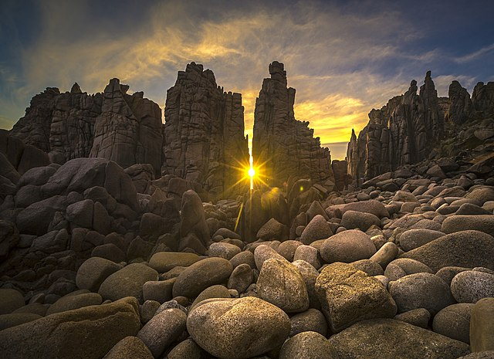
If you had to put an X on the central event of all salvation history, where would you put it and what would it be?
Notes:
Photo Credit: ArloISM,Creative Commons Attribution-Share Alike 4.0. https://commons.wikimedia.org/wiki/File:Sunset_between_the_pinnacles.jpg
Directions: Ask, Why is the Paschal Mystery at the center of all history? Let students know that as Catholics we know how to answer this question. (Share quote below).
The Catechism of the Catholic Church highlights the importance of the Paschal Mystery: “The Paschal Mystery of Christ’s cross and Resurrection stands at the center of the Good News that the apostles, and the church following them, are to proclaim to the world. God’s saving plan was accomplished “once and for all” by the redemptive Death of his son Jesus Christ” (571).
Online Resources: To reinforce this concept assign for reading, The Paschal Mystery Time Machine . URL here: https://www.catholic365.com/article/30129/the-paschal-mystery-time-machine.html
The videos linked in this presentation file may contain copyright material. Such material is made available for educational purposes only. This constitutes a “fair use” of any such copyright material as provided for in Title 17 U.S.C. section106A-117 of the US Copyright Law.

Slide 4

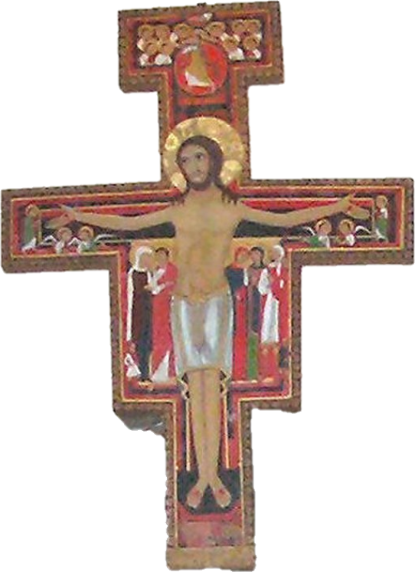
Paschal Mystery
Key
Vocab!
Christ’s work of redemption, accomplished principally by his Passion, Death, Resurrection, and glorious Ascension. The mystery is commemorated and made present through the sacraments, especially the Eucharist..
Notes:
Photo Credit: FuriousYogi, Rose Window at Lisbon Cathedral, Creative Commons Attribution-Share Alike 4.0, https://commons.wikimedia.org/wiki/File:Rose_window_in_Lisbon_Cathedral.jpg
Directions: Have students write down the term and definition as part of a Key Vocab section in their notes.
Online Resources: Have students locate the four parts of the Paschal Mystery (suffering, death, resurrection, ascension) which are represented in the San Damiano cross. URL here: https://peaceandallgood.org/wp-content/uploads/2014/01/San-Damiano-Crucifix-2.pdf
See also this interactive lesson on the Paschal mystery. URL here:https://olala-collateral.s3-us-west-2.amazonaws.com/DCS/Theology/4/PMandSacraments/content/index.html#/
The videos linked in this presentation file may contain copyright material. Such material is made available for educational purposes only. This constitutes a “fair use” of any such copyright material as provided for in Title 17 U.S.C. section106A-117 of the US Copyright Law.

Slide 5
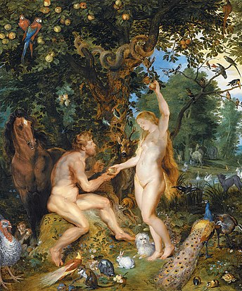
Original Sin
Key
Vocab!
The sin by which the first human beings disobeyed the commandment of God, choosing to follow their own will rather than God’s will. As a consequence they lost the grace of original holiness, and became subject to the law of death; sin became universally present in world.
Notes:
Photo Credit: Peter Paul Rubens / Jan Brueghel the Elder. Cropped. Public Domain. https://commons.wikimedia.org/wiki/File:Jan_Brueghel_de_Oude_en_Peter_Paul_Rubens_-_Het_aards_paradijs_met_de_zondeval_van_Adam_en_Eva.jpg
Directions: Have students write down the term and definition as part of a Key Vocab section in their notes. As you share the quote below.
‘From that point of Original Sin and on, God looked for a way to redeem the world from that point in history onward, culminating in Jesus Christ, the Savior of the world, and the events of the Paschal Mystery.’
The videos linked in this presentation file may contain copyright material. Such material is made available for educational purposes only. This constitutes a “fair use” of any such copyright material as provided for in Title 17 U.S.C. section106A-117 of the US Copyright Law.

Slide 6
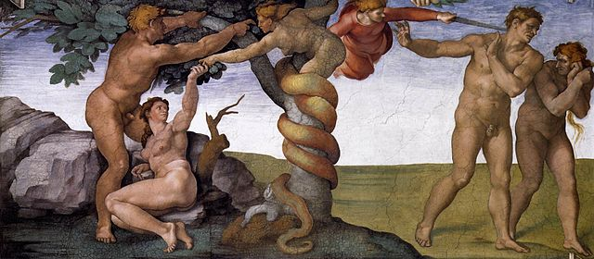
Before Sin
After Sin
Notes:
Photo Credit: Michelangelo,Public domain. https://commons.wikimedia.org/wiki/File:Michelangelo,_Fall_and_Expulsion_from_Garden_of_Eden_00.jpg
Directions: Define original holiness and original justice The state of man and woman in paradise before sin. The grace of original holiness was to share in the divine life (see CCC, 375). “The inner harmony of the human person, the harmony between man and woman, and finally the harmony between the first couple and all of creation comprised the state called ‘original justice’” (CCC, 376). “From [Adam and Eve’s] friendship with God flowed the happiness of existence in paradise” (CCC, 384). Compare what humans had before sin (preternatural gifts) to what they have after sin. See below…
Before Sin
impassibility (freedom from pain)
immortality (freedom from death)
integrity (freedom from concupiscence, or disordered
desires)
infused knowledge (freedom from ignorance in matters
essential for happiness)
After Sin
Ignorance
Pain and suffering
Death
Disordered desires (concupiscence)
The videos linked in this presentation file may contain copyright material. Such material is made available for educational purposes only. This constitutes a “fair use” of any such copyright material as provided for in Title 17 U.S.C. section106A-117 of the US Copyright Law.

Slide 7
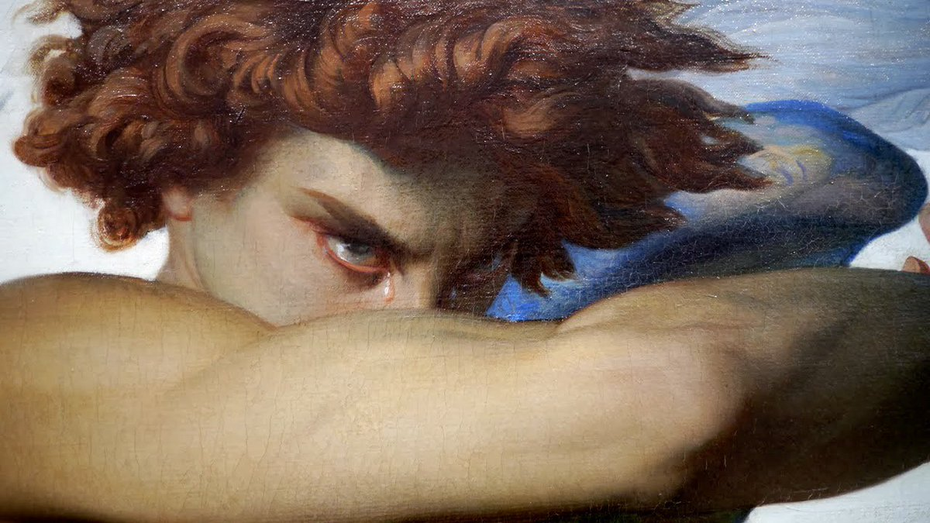
The Fall of the Angels
"Satan or the devil and the other demons are fallen angels who have freely refused to serve God and his plan. Their choice against God is definitive. They try to associate man in their revolt against God."
-Catechism of the Catholic Church 414
Notes:
Photo Credit: Alexandre Cabanel, Public domain, Fallen Angel. https://commons.wikimedia.org/wiki/File:Fallen_Angel_(Alexandre_Cabanel)_crop.jpg
Teaching Points:: ‘God created angels before he made humans. Angels are “surpassing in perfection all visible creatures” (CCC, 330). Angels are messengers of God’s plan; for example, the angel Gabriel who was present at the Annunciation, angels who were present to announce Christ’s birth to the shepherds, angels who were with Christ when he was tempted in the desert, and angels who were present with him in the Garden of Gethsemane, at his Resurrection, and at his Ascension. Like humans, angels have a free will and can choose to accept or reject God. Angels who reject God by their own free will are demons or devils. Satan is the prince of the demons.’
Online Resources: For further reflection on this topic assign for reading, How Could Lucifer, an Archangel, Have Rebelled against God?
URL here: https://www.catholic.com/qa/how-could-lucifer-an-archangel-have-rebelled-against-god
The videos linked in this presentation file may contain copyright material. Such material is made available for educational purposes only. This constitutes a “fair use” of any such copyright material as provided for in Title 17 U.S.C. section106A-117 of the US Copyright Law.

Slide 8
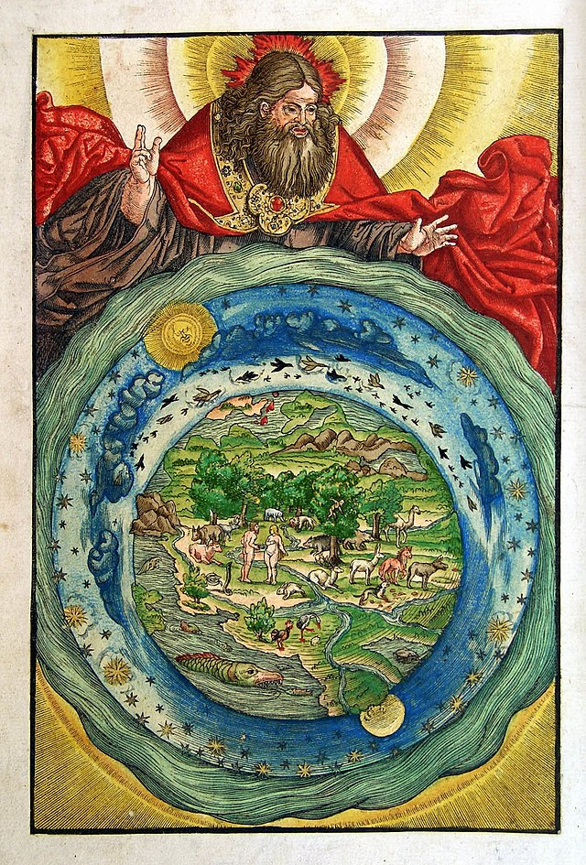
Truth in the Genesis Story of Creation
The creation accounts in Genesis 1 and 2 are part of primeval history. The authors used language, myths, stories, and other devices from the religious beliefs of their neighbors in order to distinguish their understanding of the one, true God.
Notes:
Photo Credit: Workshop of Lucas Cranach.Public domain. https://commons.wikimedia.org/wiki/File:Creation-Luther-Bible-1534.jpg
Directions: Give the following ten theological truths that we extract from the Genesis accounts of creation.
Theological truth in Genesis focuses on what the text is revealing about God and about how we can relate to God. Here are ten basic theological truths extracted from Genesis chapters 1-3…
1. God is good and his love spills out from the family of the Trinity into creation. This answers, ‘Why is there something rather than nothing?’
2. All that exists is created by Almighty God. He created everything out of nothing through his Word.
3. There was a special and direct creation of man, done by the spirit or breath of God. Humans are made in God’s image and have dominion over creation as responsible stewards.
4. God was pleased with everything He created. At the end of each day, God appraised His work and said it was all good except Adam being alone. That was the only thing that was not good.
Advertisement - Continue Reading Below
5. Human beings are created as male and female to be in a complimentary relationship of life giving love.
6. Every human being coming into the world to the present day is likewise a special and direct creation, being endowed with an immortal soul by God. There are no accidental people. Infusion of soul happens at conception.
7. All creation is held in existence by the ongoing providential care of the Creator. Creation is ongoing and under the direction of God. God is not indifferent but personally involved.
8. Humans have a fallen nature due to this original sin…We now live in a fallen world with disorder, pain, suffering, sickness, death and evil.
9. This fallenness is brought about by the free choice of angels and people to choose against God.
10. We need help. We are in need of God’s saving grace.
Online Resources: Assign for reading, Truth in the Genesis Story of Creation. URL here: https://www.catholic365.com/article/36973/historical-theological-and-symbolic-truth-in-the-genesis.html
Have students view, Misreading Genesis. URL here: https://youtu.be/UVsbVAVSssc
The videos linked in this presentation file may contain copyright material. Such material is made available for educational purposes only. This constitutes a “fair use” of any such copyright material as provided for in Title 17 U.S.C. section106A-117 of the US Copyright Law.

Slide 9
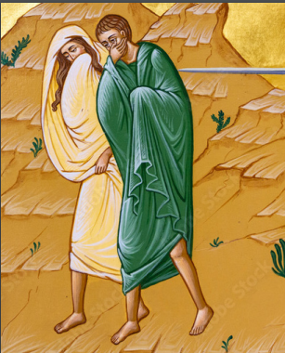
Our Problem of Sin
“Tempted by the serpent, he harbors the suspicion that in the end, God takes something away from his life, that God is a rival who curtails our freedom and that we will be fully human only when we have cast him aside.”
-Pope Benedict XVI
Notes:
Photo Credit: AMP Textbook. Pg. 30
Directions: Start with asking students to respond to the quote on the slide. What did Pope Benedict mean? Why is this a problem?
Explain that everyone has a sin problem because we inherit it spiritually through our connection to Adam and Eve...
The sin problem means that we are inclined to be selfish, lazy and indifferent to others.
This inclination toward sin and evil is called "concupiscence".
We all have to resist that on a natural level and seek God’s grace (his help and salvation from sin).
Baptism is the beginning of reception of that grace which helps us to deal with our sin problem.
A common error is to think that we can be good and be holy without God’s help.
This heresy is known as Pelagianism. Saint Augustine refuted Pelagius and gave the Church the doctrine of grace.
Online Resources: View video, How Baptism Changes You. URL here: https://youtu.be/Euxu36jVJpU?list=PL_kd4Kgq4tP9fmK4bD0OHJCI3Hsajzv2i
View video, Augustine and Pelagius. URL here: https://youtu.be/UrklQpIdv3g
Assign for reading, The Marks of Original Sin. URL here: https://www.catholiceducation.org/en/religion-and-philosophy/spiritual-life/the-marks-of-original-sin.html
View video, Do We Really Inherit Sin from Adam and Eve?. URL here: https://youtu.be/_yT0YpOrz_4
The videos linked in this presentation file may contain copyright material. Such material is made available for educational purposes only. This constitutes a “fair use” of any such copyright material as provided for in Title 17 U.S.C. section106A-117 of the US Copyright Law.

Slide 10
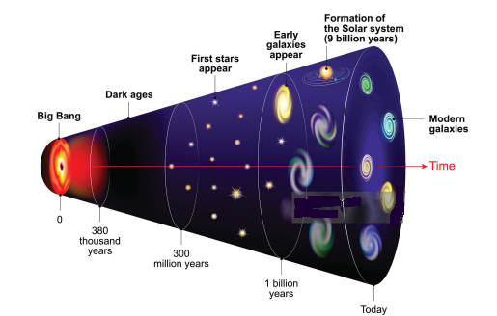
The Big Bang Theory
The Big Bang theory is the main cosmological model for the earliest moments of the universe. This theory—always in development—agrees with what the Church has always taught: creation (that is, the universe) has a beginning in time.
Notes:
Photo Credit: AMP Textbook p.21
Directions: Have students write down the information on the slide into their notes.
Online Resources: Assign for reading, Why is There Something Rather Than Nothing?. URL here: https://strangenotions.com/why-something-rather-nothing/
The videos linked in this presentation file may contain copyright material. Such material is made available for educational purposes only. This constitutes a “fair use” of any such copyright material as provided for in Title 17 U.S.C. section106A-117 of the US Copyright Law.

Slide 11
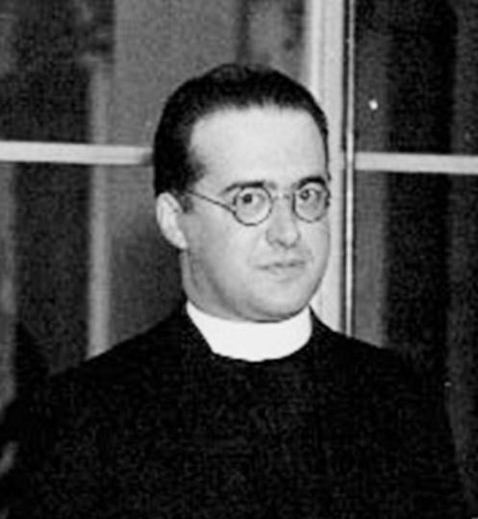
Fr. Georges Lemaitre
A Belgian Catholic priest and physicist who published a paper showing that the universe was expanding and that it therefore must have been at one point very condensed. Today we call it The Big Bang Theory.
Notes:
Photo Credit: unknown photographer, probably a CalTech employee. Cropped by Artistosteles, Public domain. https://commons.wikimedia.org/wiki/File:Lemaitre.jpg
Directions: Have students write down the information on the slide into their notes.
Online Resources: Have students view video, Georges Lemaître: The Priest Who Discovered the Big Bang
https://youtu.be/qym7ZuGdCsU or The Greatest Scientist of the 20th Century You've Probably Never Heard Of. URL here:
https://youtu.be/853zY24cf5Q
The videos linked in this presentation file may contain copyright material. Such material is made available for educational purposes only. This constitutes a “fair use” of any such copyright material as provided for in Title 17 U.S.C. section106A-117 of the US Copyright Law.

Slide 12
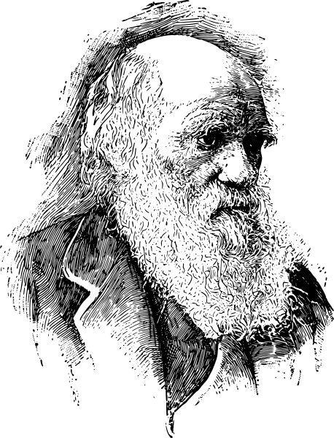
Scientific and Philosophical Theories
The Church encourages the scientific study of theories such as evolution, but it rejects philosophies such as Atheistic Darwinism, Deism and Materialism.
Charles Darwin
Notes:
Photo Credit: Charles Darwin,Public domain. https://commons.wikimedia.org/wiki/File:Charles-darwin-portrait2.svg
Directions: Have students write down the following terms and definitions in their notes.
Evolution: There are two ways of looking at evolution. 1. Micro-Evolution: aka Natural selection. Species adapt to their environment over time. Macro-Evolution: All species came from one original cell and species evolve into other species over time.
Atheistic Darwinism: The atheistic claim that all organisms, living and dead, are the consequence of a long slow UNDIRECTED and RANDOM process of natural change. on.
Deism: The belief that while God does exist and did create the world, he refrains from any kind of interference or direct participation in his creation
Materialism: The theory that all of reality is only material or matter, or derived from matter. It holds that there is no distinction between matter and spirit. Even the human soul is thought of as matter and not uniquely created by God.
Online Resources: For further understanding of these terms as they relate to Darwin have students read, Darwin’s Blind Spot. URL here: https://strangenotions.com/darwins-blind-spot/
Assign article for reading…What Is the Difference Between Creation, Evolution, and Intelligent Design? URL here:
https://strangenotions.com/what-is-the-difference-between-creation-evolution-intelligent-design/
The videos linked in this presentation file may contain copyright material. Such material is made available for educational purposes only. This constitutes a “fair use” of any such copyright material as provided for in Title 17 U.S.C. section106A-117 of the US Copyright Law.

Slide 13
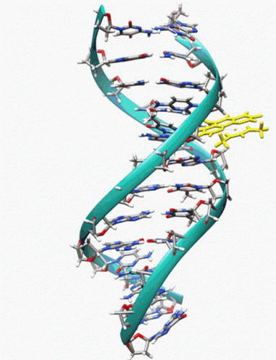
The Language of God
RNA and DNA offer compelling evidence of divine order as the blueprint for biological structures and characteristic activities.
The genetic code is an intelligible code in which information is coordinated in a way much like human writing
Notes:
Photo Credit: badaman, treasure chest, Creative Commons Zero, Public Domain Dedication. https://commons.wikimedia.org/wiki/File:Treasure_chest.svg
Directions: Have students write down the term and definition as part of a Key Vocab section in their notes as you share the quote below.
Online Resources: View video DNA and Language. URL here: https://youtu.be/peXDx_qVYWM
Assign for reading, The Scientific Possibility of Adam and Eve. URL here: https://strangenotions.com/the-scientific-possibility-of-adam-and-eve/
For an explanation of the complexity of life and of the cell view: Expelled: No Intelligence Allowed from minute 31-45. URL here: https://youtu.be/V5EPymcWp-g
The videos linked in this presentation file may contain copyright material. Such material is made available for educational purposes only. This constitutes a “fair use” of any such copyright material as provided for in Title 17 U.S.C. section106A-117 of the US Copyright Law.

Slide 14

The Uniqueness of Being Human
God created mankind in his image; in the image of God he created them; male and female he created them.
-Genesis 1:27
Notes:
*Photo Credit: https://upload.wikimedia.org/wikipedia/commons/6/6d/Jan_Brueghel_de_Oude_en_Peter_Paul_Rubens_-_Het_aards_paradijs_met_de_zondeval_van_Adam_en_Eva.jpg
Directions: Have students copy the information from the slide into their notes. Explain that we are made in the Image of God because…
Human persons can love, create, and truly choose good.
We are capable of truly and freely choosing to do good and to love.
Human persons are not mere reactionary creatures but a creation that, like God, can choose to do good and to love one another.
Human persons are also able to know and understand goodness and love.
Human persons can mirror God in the manner we know, understand, love and do good.
BUT…As with a cracked mirror, our ability to reflect God’s image and likeness is thwarted when knowledge and love is damaged by sin. To restore His image within us, God sends His Son, Jesus Christ, who is not in the image of God, but is Himself that “image of the invisible God”
The Catechism of the Catholic Church says…
The human person participates in the light and power of the divine Spirit. By his reason, he is capable of understanding the order of things established by the Creator. By free will, he is capable of directing himself toward his true good. He finds his perfection “in seeking and loving what is true and good” (1704).
By virtue of his soul and his spiritual powers of intellect and will, man is endowed with freedom, an “outstanding manifestation of the divine image” (1705).
Online Resources: View video, Created in the Image and Likeness of God. URL here: https://youtu.be/lwBI-hk8-hI
The videos linked in this presentation file may contain copyright material. Such material is made available for educational purposes only. This constitutes a “fair use” of any such copyright material as provided for in Title 17 U.S.C. section106A-117 of the US Copyright Law.

Slide 15

The Human Soul
God wants to share his love freely with you and because he wants you to…
  have the capacity to freely receive his love
  share in it
  return your love to him.
God created you as a spiritual person and animated your body by the gift of a soul.
Notes:
Photo Credit: AMP Textbook p.28
Directions: Have students copy the information from the slide into their notes.
Online Resources: For a series of articles about the human soul from a Catholic perspective see this website, strangenotions.com. URL here: https://strangenotions.com/index.php?s=soul
View video, Body and Soul. URL here: https://youtu.be/mTzNGUCJkm4
The videos linked in this presentation file may contain copyright material. Such material is made available for educational purposes only. This constitutes a “fair use” of any such copyright material as provided for in Title 17 U.S.C. section106A-117 of the US Copyright Law.

Slide 16
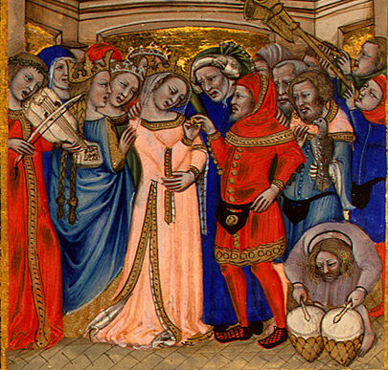
Male and Female Are God’s Idea
"Everyone, man and woman, should acknowledge and accept his sexual identity. Physical, moral, and spiritual difference and complementarity are oriented toward the goods of marriage and the flourishing of family life." -CCC 2333
Notes:
Photo Credit: AMP Textbook p 25 Nicolo da Bologna,Public domain. https://commons.wikimedia.org/wiki/File:Bologna_marriage.jpg
Directions: Begin by defining ‘sexual complementarity’. Saint John Paul II described sexual complementarity as stipulating that “man and. woman are called from the beginning not only to exist 'side by side' or 'together,' but also 'they are . . . called to exist mutually 'one for the other.'”
Explain that we discover in nature that men and women are created both equal and different. Each possesses inalienable and equal dignity as a person, “since both were created in the image and likeness of a personal God” (CCC, 2334, quoting Mulieris Dignitatem). Catholic Faith and science agree on this topic. Go over the scientific reality of sexual difference:
The essential distinction between men and women is genetic. All men have a Y chromosome (typically XY, although in some cases XXY or XYY), and no women have Y chromosomes. In other words, men are adult male humans and women are adult female humans.
This genetic difference tends to express itself in different sexual organs. In rare cases, something impedes this from happening as it is ought to, or something happens to the sexual organs. But even in the case of those borned “intersexed,” there is a genetic sex: it just may be harder to tell.
This genetic difference also tends to express itself in different brain chemistry, different levels of various hormones, and differences (big and small) in cognitive and behavioral development.
Society also plays a role, and environmental factors can even impact hormone levels. It is not always easy to determine which social behaviors are attributable to social roles, or environment, or innate genetics. But most societies amplify the differences between the sexes by creating a set of gender roles.
Online Resources: Assign for reading, Just What are Men and Women Anyway?. URL here: https://strangenotions.com/just-what-are-men-and-women-anyway/
Assign for reading, Men and Women’s Brains Do Work Differently. URL here: https://news.yahoo.com/men-womens-brains-differently-scientists-204332939.html
Assign for reading, Male and Female. URL here: https://www.catholiceducation.org/en/marriage-and-family/sexuality/male-and-female.html
Assign for reading,There Are Two Sexes, and They Are Complementary — Denial of This Fact Brings Ruin. URL here: https://www.ncregister.com/blog/complementarity-of-the-sexes
The videos linked in this presentation file may contain copyright material. Such material is made available for educational purposes only. This constitutes a “fair use” of any such copyright material as provided for in Title 17 U.S.C. section106A-117 of the US Copyright Law.

