Slide 1
Chapter 2 PowerPoint

Slide 3
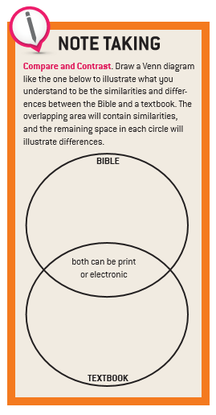
The Bible is the Inspired Word of God

Slide 4
The Bible is the Inspired Word of God

Slide 5
Scriptural Foundation of the Mysteries and Prayers of the Rosary
† Our Father – Mt. 6:9-13 † Hail Mary – Lk. 1:28 † Glory Be – Phil. 4:20
Joyful |  | Sorrowful |  | Luminous |  | Glorious
Annunciation | Lk 1:26-38 | Agony in the Garden | Mt 26:35-56 | Baptism of our Lord | Mt. 3:13-17 | Resurrection | Lk 24:1-12
Visitation | Lk 1:39-56 | Scourging | Mk 15:15 | Miracle at Cana | Jn 2:1-12 | Ascension | Acts 1:9-11
Nativity | Lk 1 | Crowning | Mk 15:16-19 | Proclamation of the Kingdom | Lk 2:1-20 | Pentecost | Acts 2
Presentation | Lk 2:21-24 | Carrying the Cross | Lk 23:21-32 | Transfiguration | Lk 9:28-36 | Assumption | Lk 1:28 Mt. 27:52 Rev. 11:19
Finding in the Temple | Lk 2:41-52 | Crucifixion | Lk 23:33-46 | Institution of the Eucharist | Mk 14:22-24. | Coronation | Lk 1:48 Rev. 12:1; 11:19
The Bible is the Inspired Word of God

Slide 6
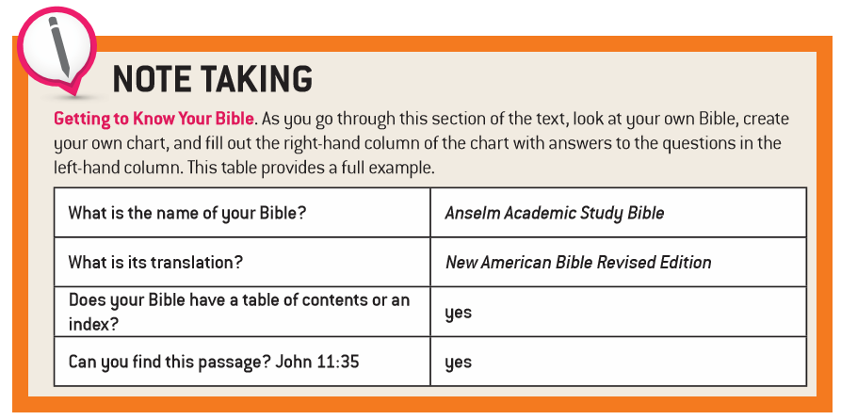
Not All Bibles Are the Same

Slide 7
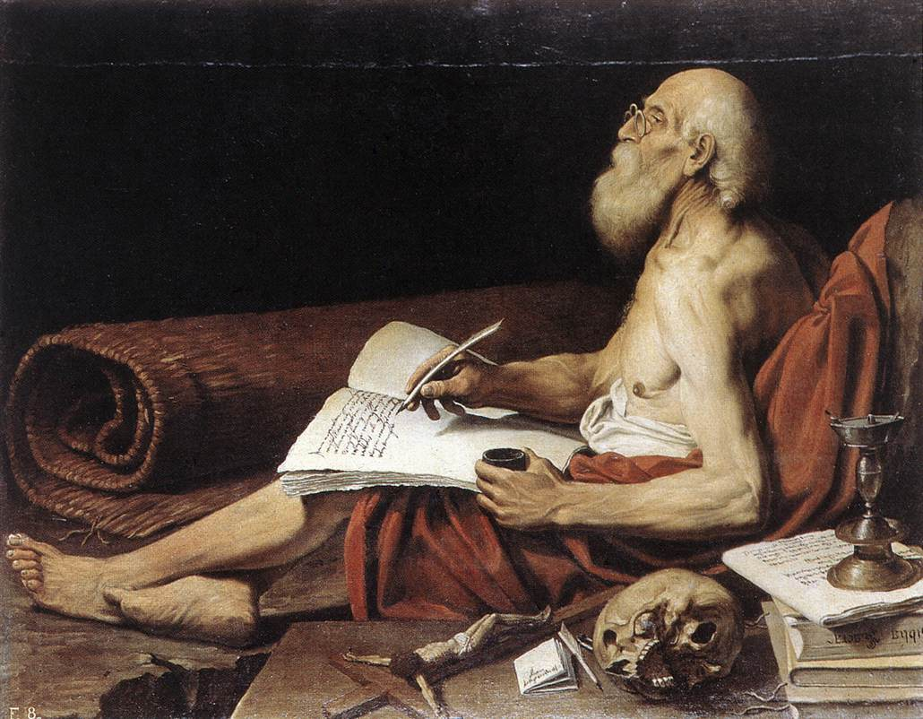
Vulgate
St. Jerome’s fourth-century translation of the Bible from Greek into the common language of the people of his day, Latin.
Not All Bibles Are the Same

Slide 8
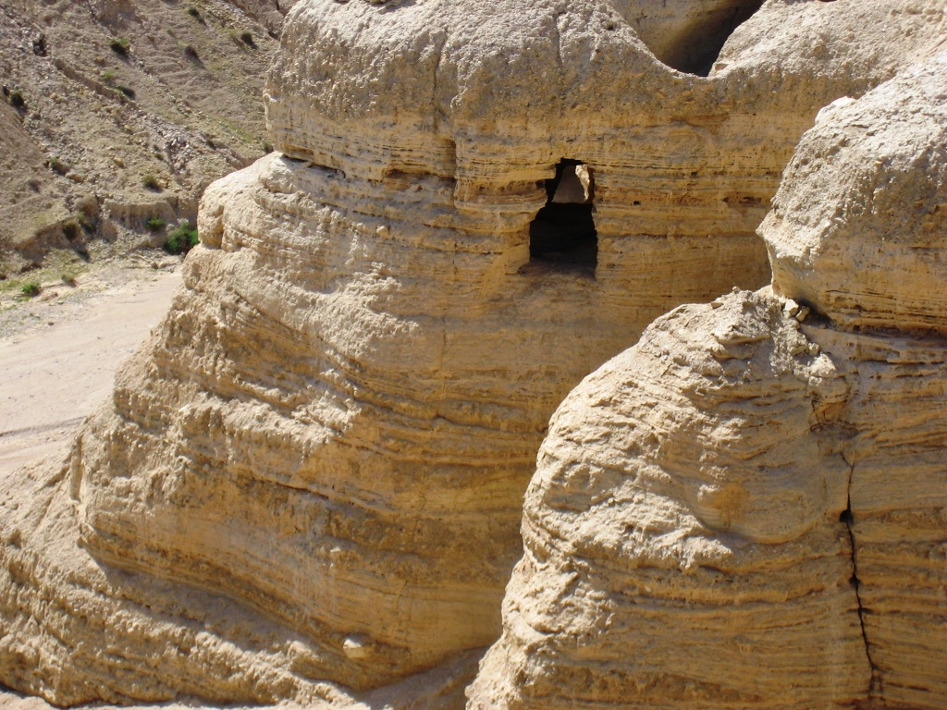
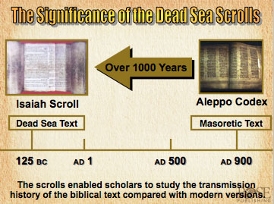
Cave number four, Qumran
Not All Bibles Are the Same

Slide 9
Types of Bible Translations
Not All Bibles Are the Same

Slide 10
Not All Bibles Are the Same

Slide 11
Catholic versus Protestant Canons
Catholic Canon
● Based on the Septuagint
● Includes 73 books:
† Old Testament: 46
† New Testament: 27
Protestant Canon
● Based on the Palestinian Canon
● Includes 66 books:
† Old Testament: 39
† New Testament: 27
Not All Bibles Are the Same

Slide 12
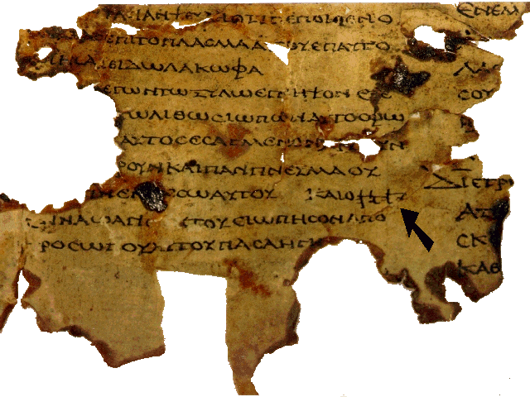
Septuagint A second-century BC Greek translation of the Hebrew Bible made at Alexandria, Egypt. The term is from a Latin word meaning “seventy” for the legendary seventy scholars who worked on the translation.
Not All Bibles Are the Same

Slide 13
Dogmatic Constitution on Divine Revelation, 10 … the task of authentically interpreting the word of God, whether written or handed on, has been entrusted exclusively to the living teaching office of the Church, whose authority is exercised in the name of Jesus Christ. This teaching office is not above the word of God, but serves it, teaching only what has been handed on, listening to it devoutly, guarding it scrupulously and explaining it faithfully in accord with a divine commission and with the help of the Holy Spirit, it draws from this one deposit of faith everything which it presents for belief as divinely revealed.
What Does the Bible Mean Literally?
Not All Bibles Are the Same

Slide 14
Book | Genre | Purpose
Genesis | Narrative / History | Theological history of Israel
Exodus, Leviticus, Numbers, Deuteronomy | Narrative and Law / Legal | Theological history of Israel
Joshua, Judges, Ruth, 1 & 2 Samuel, 1 & 2 Kings, 1 & 2 Chronicles, Ezra, Nehemiah, Esther | Narrative / History | Theological history of Israel
Psalms | Poetry / Songs | Emotional praises and cries to God
Job, Proverbs, Ecclesiastes, Song of Songs | Wisdom | Wise living
Isaiah, Jeremiah, Lamentations, Ezekiel, Daniel, Hosea, Joel, Amos, Obadiah, Jonah, Micah, Nahum, Habakkuk, Zephaniah, Haggai, Zechariah, Malachi | Prophecy and Apocalyptic | Calls Israel to repentance
Matthew, Mark, Luke, John, Acts | Narrative | Theological history of Christ
Romans, 1 & 2 Corinthians, Galatians, Ephesians, Philippians, Colossians, 1 & 1 Timothy, Titus, Philemon, Hebrews, James, 1 & 2 Peter, 1, 2, & 3 John, Jude | Epistle / Letter, personal and public | Didactic and pastoral letters written to explain theological teaching for the Church
Revelation | Apocalyptic | Message of home for the Church

Slide 15
What Does the Bible Mean Literally?

Slide 16
Ark of the Covenant
The most important symbol of the Jewish faith. It served as the only physical manifestation of God on earth. The Ark was built while the Israelites wandered in the desert and was used until the building of the First Temple.
What Does the Bible Mean Literally?

Slide 17
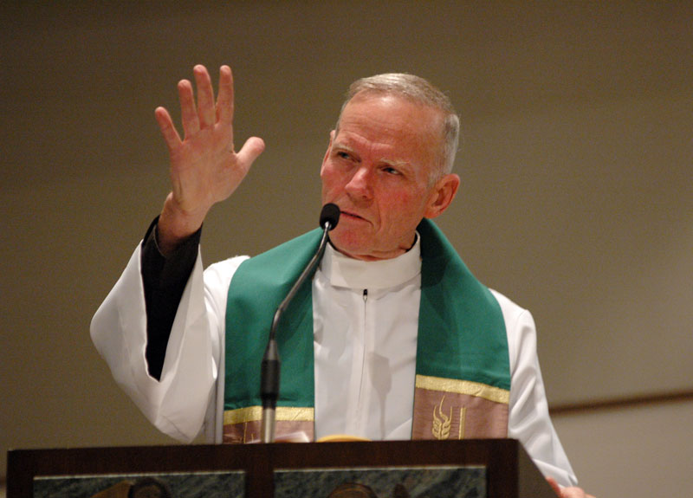
Exegesis The process used by scholars to discover the literal meaning of the biblical text.
What Does the Bible Mean Literally?

Slide 18
What Does the Bible Mean Spiritually?

Slide 19
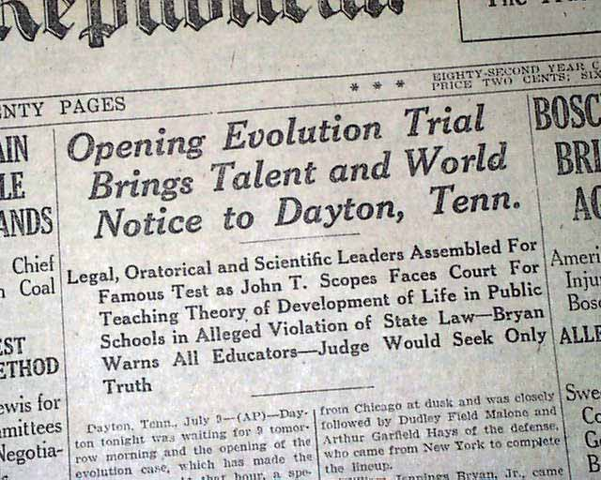
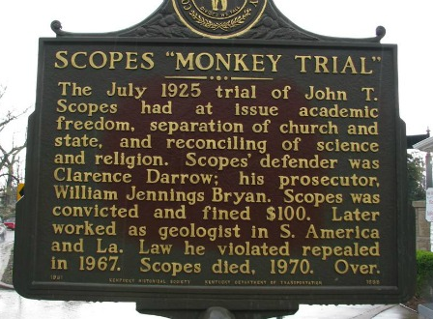
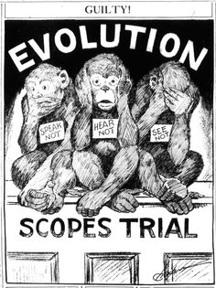
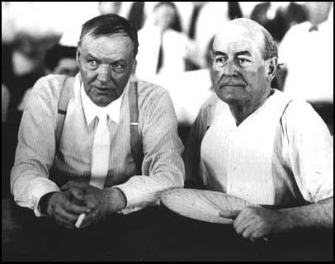
What Does the Bible Mean Spiritually?

Slide 20
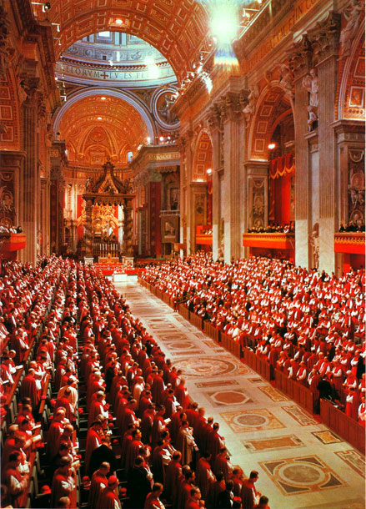
Because Sacred Scripture is inspired, it “must be read and interpreted in the light of the same Spirit by whom it was written” (Dei Verbum, 12 § 3, quoted in CCC, 111).
1. Read specific passages with the whole content and unity of Scripture in mind.
2. Read the Scripture within “the living Tradition of the whole Church.”
3. Pay attention to the analogy of faith: the unity “of the truths of the faith among themselves and within the whole plan of Revelation.”
What Does the Bible Mean Spiritually?

Slide 21
Senses of Sacred Scripture
Literal
Spiritual
Allegorical
Anagogical
Moral
What Does the Bible Mean Spiritually?

Slide 22
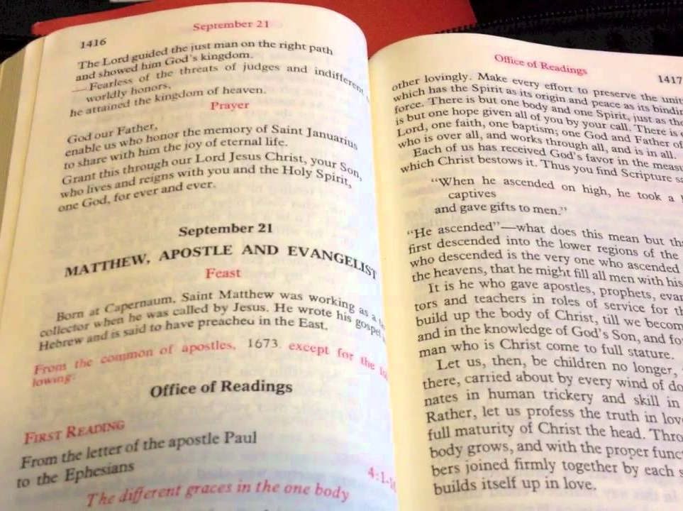
Liturgy of the Hours
The prayer of the Church at specific times of the day; also known as the Divine Office. The Liturgy of the Hours uses readings from Scripture, particularly the psalms and hymns.
What Does the Bible Mean Spiritually?

Slide 23
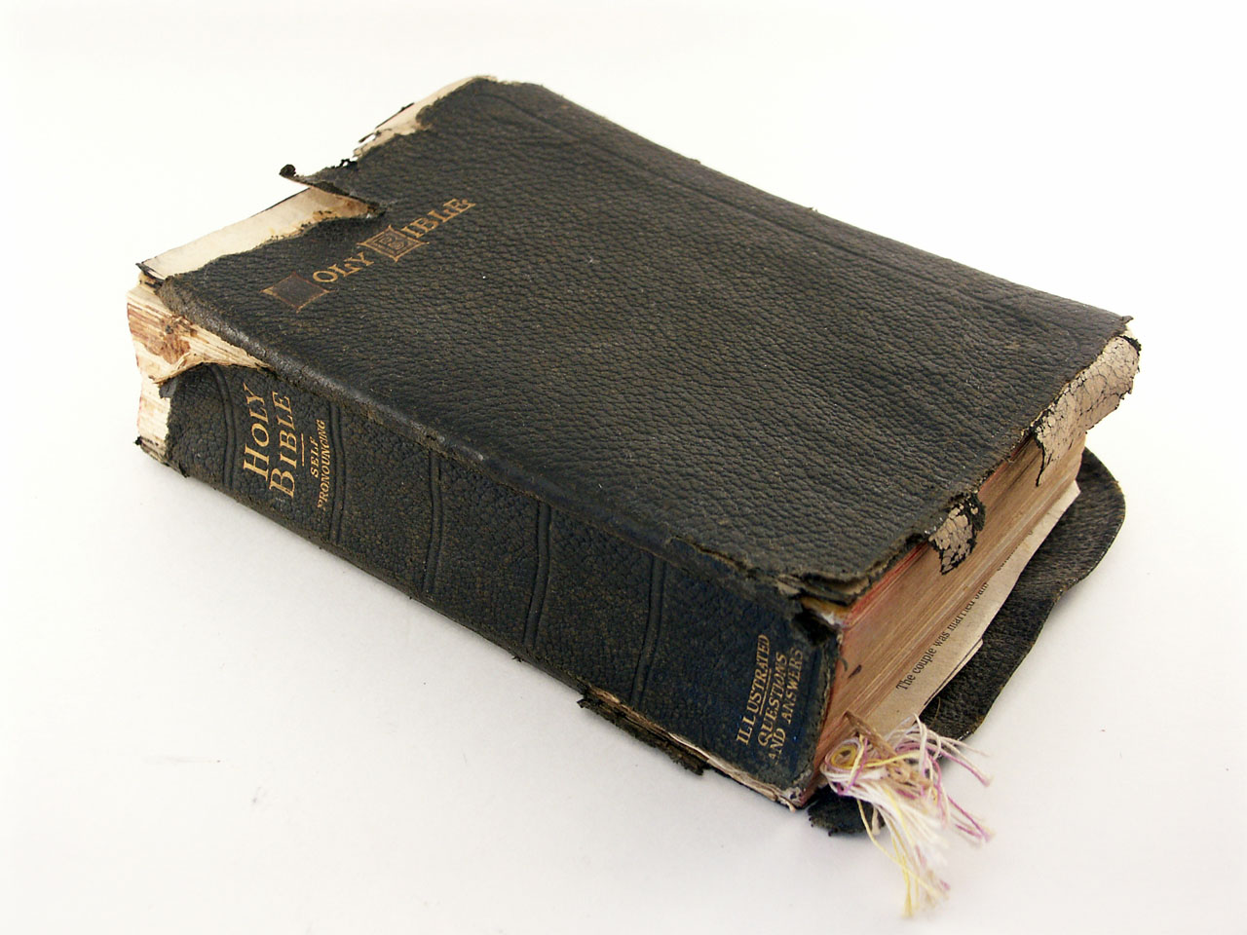
A Bible that is falling apart is usually owned by someone who isn’t.
What Does the Bible Mean Spiritually?

Slide 24
Endnotes
Quotations from Sacred Scripture come from the New American Bible, Revised Edition (NABRE) http://wwwmigrate.usccb.org/bible/
Quotations from the Catechism of the Catholic Church http://www.vatican.va/archive/ENG0015/_INDEX.HTM
Quotations from Documents of the Second Vatican Council http://www.vatican.va/archive/hist_councils/ii_vatican_council/index.htm

