Slide 1
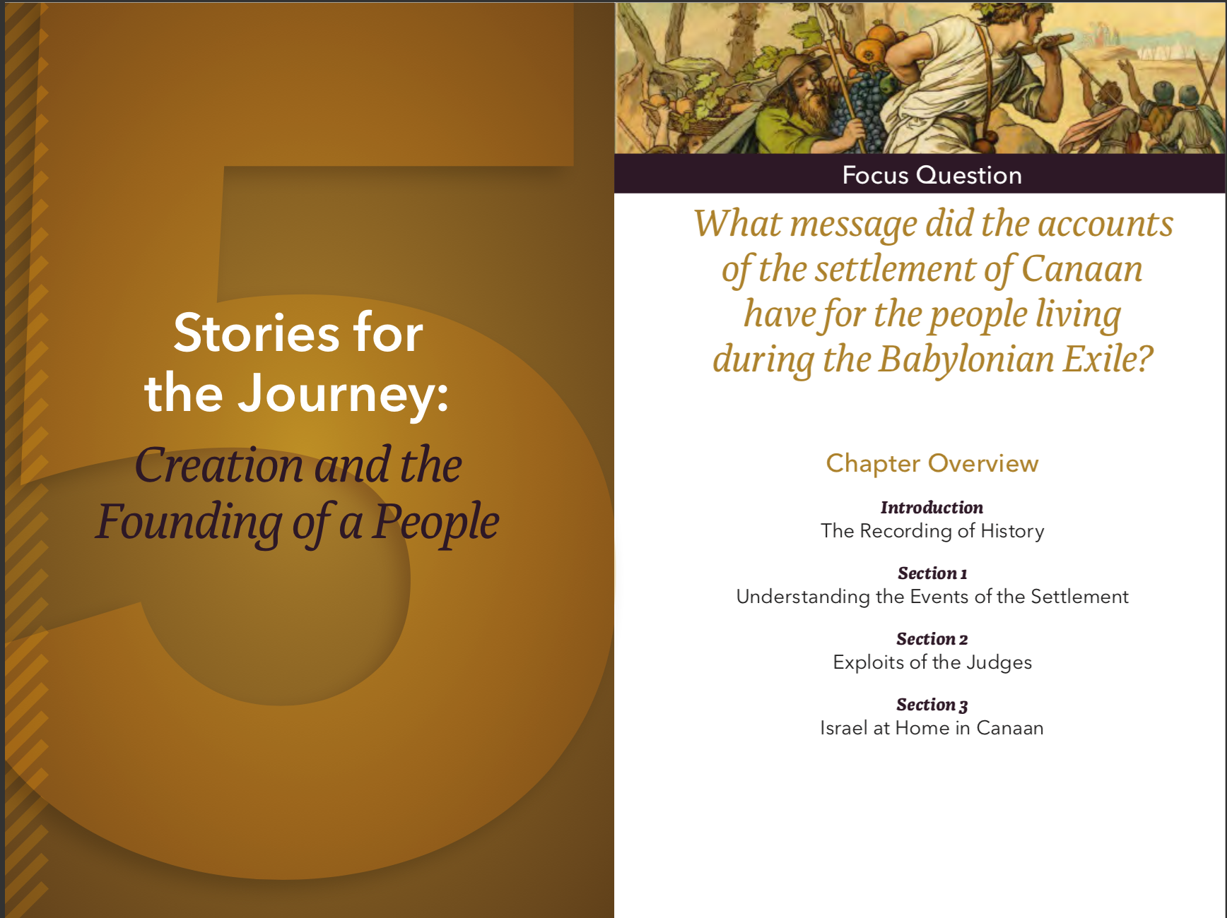
The Old Testament
Chapter Five

Slide 2
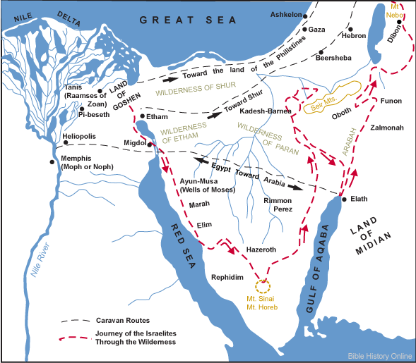
The Route of the Exodus
Notes:
Chapter Assignment 3 (page 197 of the Student Text) ask students to highlight the following places of the Exodus journey on a map. Use this list and a map similar to the one above to help students identify these locations.
Rameses (Exodus 12:37)
Succoth (Exodus 13:20–22)
Pi-hahiroth (Exodus 14:2–9)
Marah (Exodus 15:23–26)
Elim (Exodus 15:27)
Wilderness of Sin (Exodus 16)
Rephidim (Exodus 17)
Mount Sinai (Exodus 19–29)
Wilderness of Sinai (Exodus 25–30)
Ezion-geber (Deuteronomy 2:8)
Kadesh-barnea (Numbers 20:1–13; Deuteronomy 1:19–46)

Slide 3
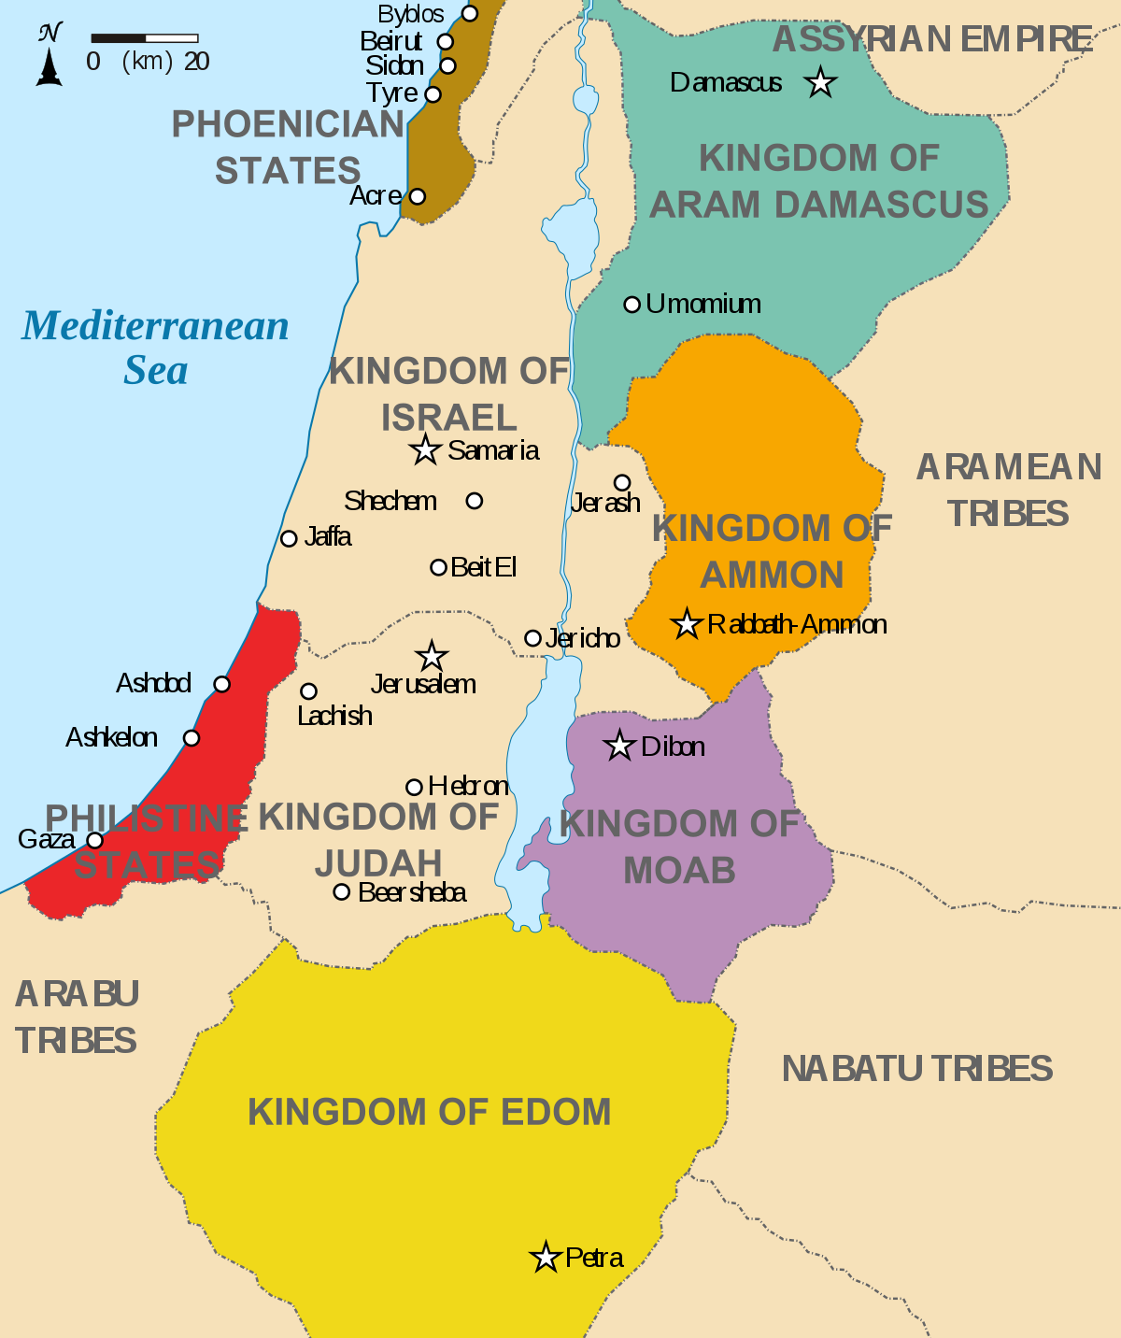
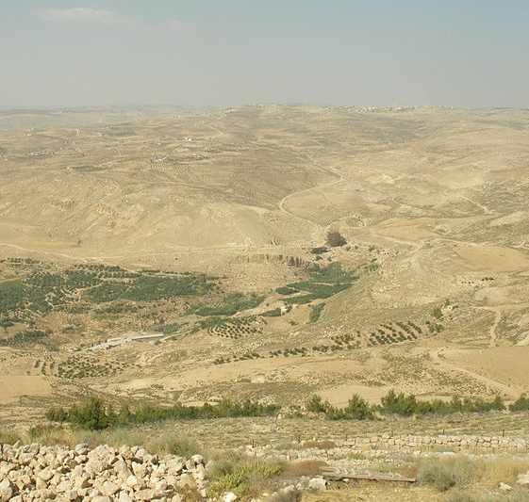
40 Years
Plains of Moab to the Jordan River
The Recording of History
Notes:
Read a description of the Israelites journey from Sinai to Moab in Deuteronomy 1–4:43.

Slide 4
Deuteronomy
“The Second Law”
First Discourse
Second Discourse
Third Discourse
Historical Appendix
"And Moses began to expound the law and to say”
Deuteronomy 1:5
The Recording of History
Notes:
The discourses and the historical appendix from the Book of Deuteronomy can be enumerated and the contents of each discourse discussed In length. See http://www.newadvent.org/cathen/11646c.htm for additional information.

Slide 5
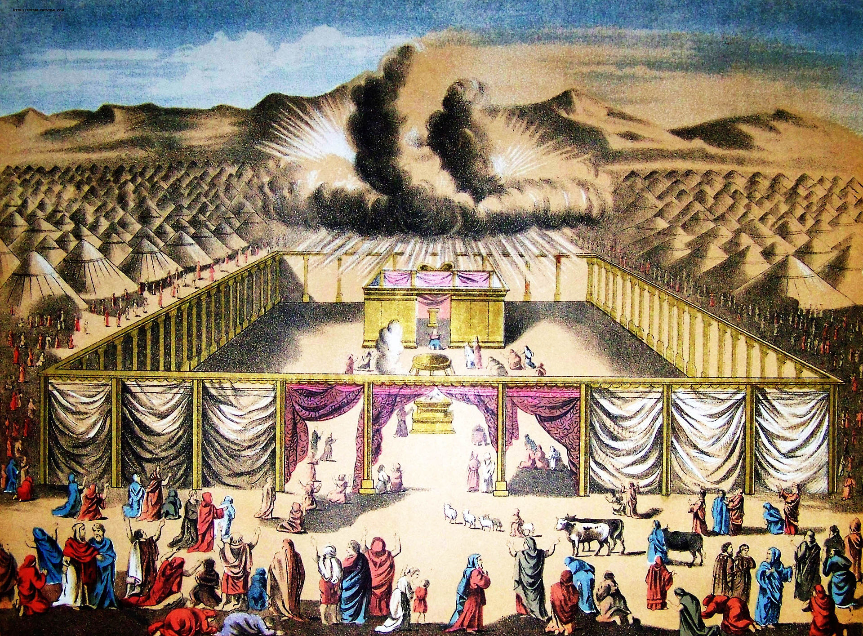
Three regulations in the Book of Deuteronomy that are not found in older collections of the Law.
The Temple is the only acceptable location for sacrifice on the face of the earth (see Deuteronomy 16:5–6).
The worship of stars or other heavenly bodies is forbidden (see Deuteronomy 4:19).
Annual celebration of the Passover is legally required among all the Israelites (see Deuteronomy 16:1–8).
The Recording of History
Notes:
See pages 205-210 of the Student Text.

Slide 6
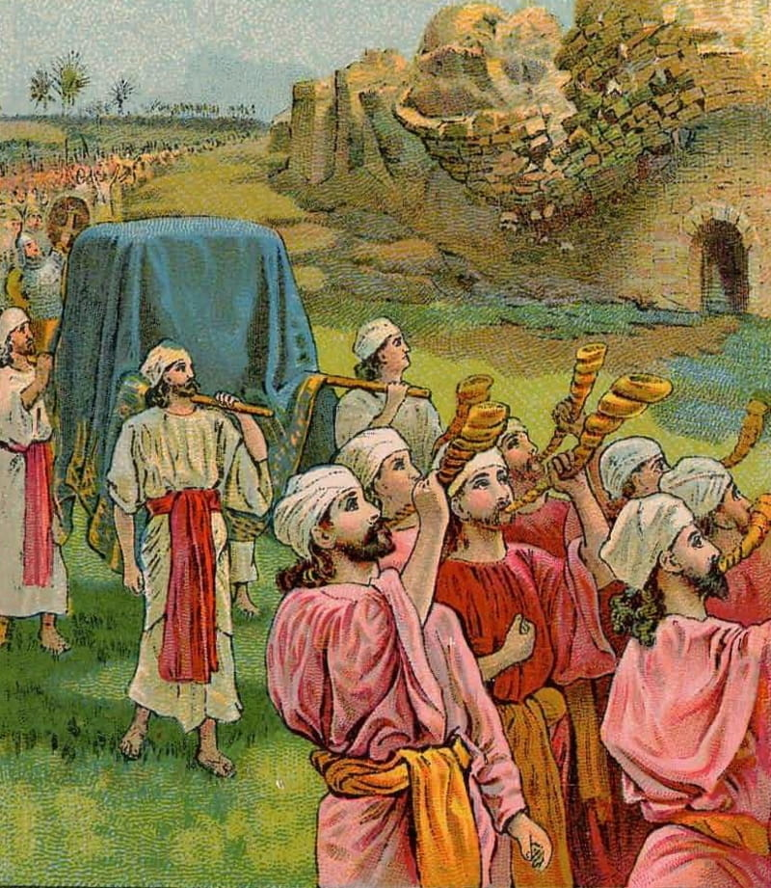
Conquest of Jericho
Joshua was the leader after the death of Moses and led the Chosen People into the Promised Land around the years 1200-1250 BC.
Understanding the Events of Settlement
Notes:
See Chapter 5, Section 1, Teaching Approach 2 in the Teacher’s Wraparound Edition. Also refer the students to Joshua 2–6. Discuss the differing options of settlement of the Promised Land explained in Chapter 5, Section 1 of the Student Text.

Slide 7
Israelite Warfare Traditions
Characteristics of Warfare | Examples From Old Testament
Fought by God alone or with very limited help from the Israelites | -Egyptian defeat in Red Sea -The walls of Jericho being brought done and the city overcome -Gideon’s reduction of the massive army
Exemptions to go to war | -Man who planted a vineyard -Man who built a house -Man engaged to be married
Rejection of God as king in favor of a human king | -taxation -military draft
Understanding the Events of Settlement
Notes:
See “Israelite Warfare Traditions” (pages 216-218 of the Student Text).

Slide 8
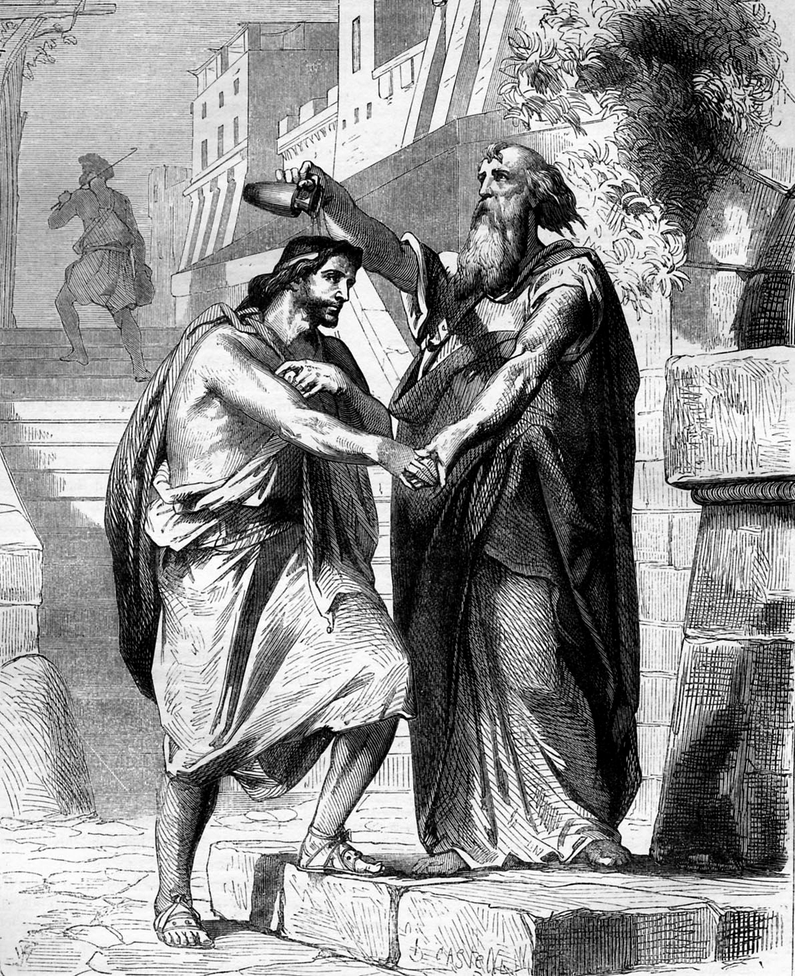
Electing Saul: 1 Samuel 8
Rejecting God as King
By requesting a human king, the Israelites forego any help from God. They are subject to military draft and taxation to support their warrior king. No more miracles will be available to defeat their enemies.
Understanding the Events of Settlement
Notes:
See pages 218-221 of the Student Text.
For an overview of 1 Samuel show the video “Overview: 1 Samuel” (7:18) https://www.youtube.com/watch?v=QJOju5Dw0V0&t=4s

Slide 9
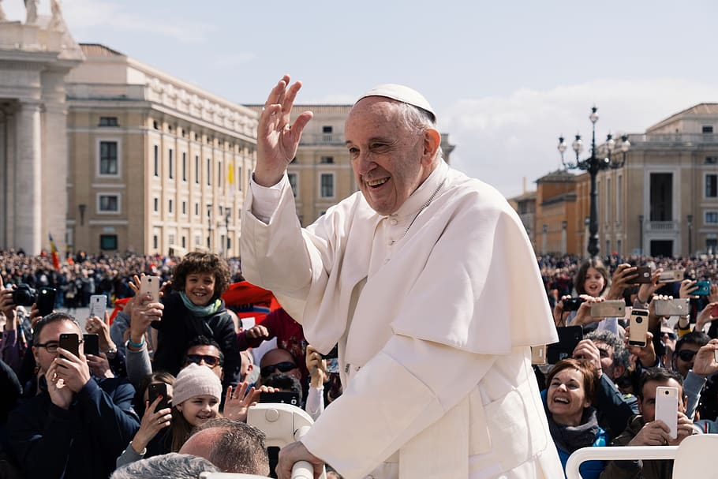
Just War Doctrine
Teachings of the Church that define the moral limits of warfare.
Understanding the Events of Settlement
Notes:
For a war to be considered “just” it must have a just cause such as self-defense or be called by a legitimate moral authority. In December 2019, Pope Francis sent a message for World Peace Day 2020 saying: “peace and international stability are incompatible with attempts to build upon the fear of mutual destruction or the threat of total annihilation.” The Catechism of the Catholic Church (2309) teaches these additional points:
all other means of putting an end to it must have been shown to be impractical or ineffective;
there must be serious prospects of success;
the use of arms must not produce evils and disorders graver than the evil to be eliminated. The power of modern means of destruction weighs very heavily in evaluating this condition.

Slide 10
Who Were the Judges?
They were selected by God to lead tribal people.
They were arbiters of disputes within the tribes.
They reminded the people that YHWH alone was their king.
The were “Shofet,” that is, temporary military leaders.
Exploits of the Judges
Notes:
See Chapter 5, Section 2, Teaching Approaches 1 and 2 of the Teacher’s Wraparound Edition.
You may also show the video “Overview: Judges” (7:29) https://www.youtube.com/watch?v=kOYy8iCfIJ4

Slide 11
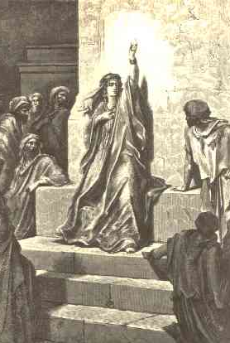
Deborah
Prophetess and Judge
So perish all your enemies, O Lord!
  But may those who love you be like the
      Sun rising in its might! (Jgs 5:31)
Exploits of the Judges
Notes:
Sr. Laurence Oliver leads a reading from Judges 4:10, 4:13-24, 5 (https://www.youtube.com/watch?v=GbOmruiAeYk). The translation of the reading is from the King James Bible.

Slide 12
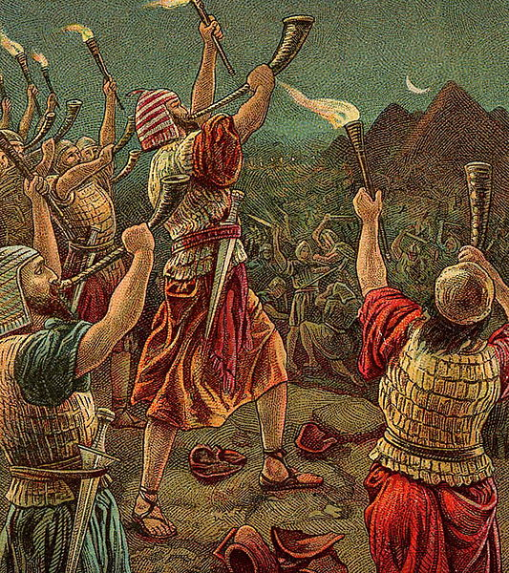
Gideon
Judge
Gideon told them: “I will not rule over you, nor shall my son rule over you. The Lord must rule over you” (Jgs 8:23)
Exploits of the Judges
Notes:
As an extension to the lessons on the Judges and kings, share this assignment and background information on famous battles in the Old Testament: https://www.avemariapress.com/engagingfaith/2010/02/old-testament-battles-and-warriors/

Slide 13
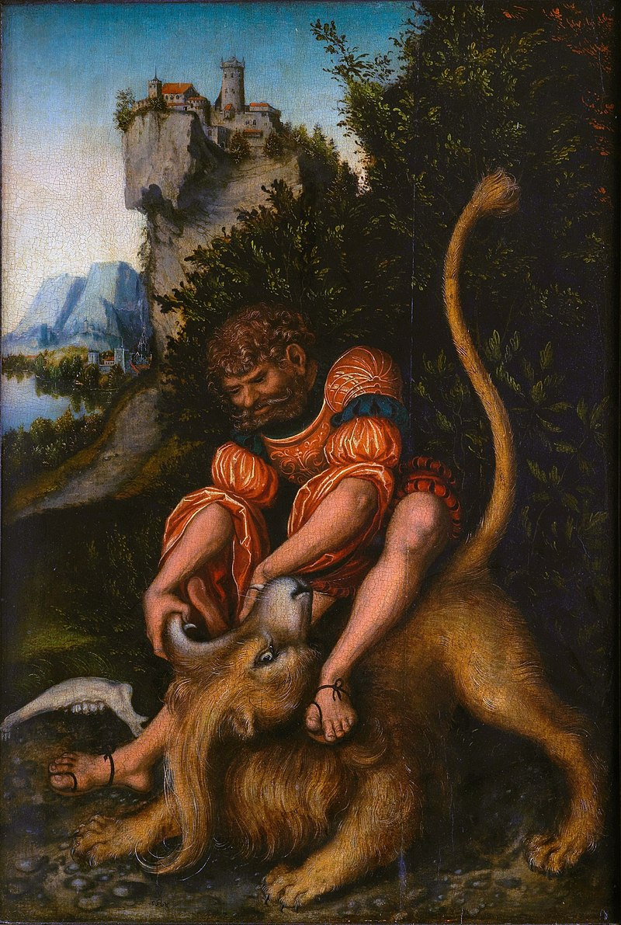
Samson
Judge
[Y]ou will conceive and bear a son. No razor shall touch his head, for the boy is to be a nazirite for God from the womb. It is he who will begin to save Israel from the power of the Philistines. (Jgs 13:5)
Exploits of the Judges
Notes:
Have students read Numbers 6:5. A nazarite oath was taking an oath to be faithful to God, and God in return would use Samson to deliver the Israelites. Because of Samson’s pride and infidelity to God’s law, Samson lost his strength and was left a hero that some would pity.
Nazarite Vow reference: http://www.rosarychurch.net/mystic/nazarite.html

Slide 14
Levirate Marriage
The marriage of a widow to a near relative of her deceased husband. The first male child of a levirate marriage would be considered the legal son of the widow’s first husband.
Naomi & Elimelech
Ruth (of Moab)
Mahlon
Offspring of Ruth and Boaz
Boaz
Exploits of the Judges
Notes:
You might discuss the reasons Ruth married Boaz and how the offspring of Boaz and Ruth would be descendants of the Israelite patriarch Mahlon.

Slide 15
The Philistines
The “sea people” some of whom may have moved toward the hill country of Canaan to dwell with the Israelites in the times before the monarchies. These are the same people Samson helped fight with God’s power.
Israel at Home In Canaan
Notes:
There is some evidence to indicate that the sea peoples may have come to Canaan
because of climatic changes that made their own homelands uninhabitable. See pages 232-233 of the Student Text. See Chapter 5, Section 3, Teaching Approach 2 of the Teacher’s Wraparound Edition.

Slide 16

Israel’s Homeland
Israel at Home In Canaan
Notes:
Pages 232-234 of the Student Text describe why the Israelites made their home in the hill country of Canaan, what other cultures may have joined with the Israelite slaves to form the tribes of Israel and reasons why this land would have been chosen for settlement. See Chapter 5, Section 3, Teaching Approach 1.

Slide 17
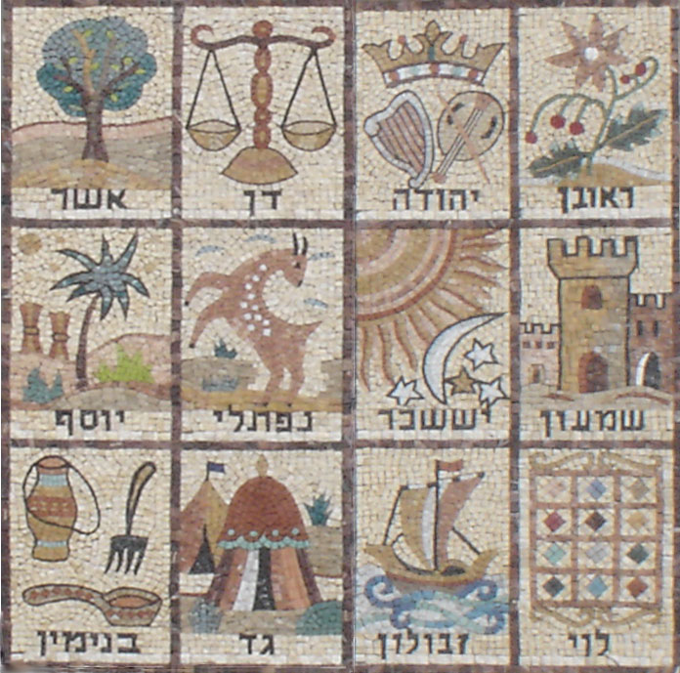
Twelve Tribes of Israel
Reuben, Simeon, Levi, Judah,
Dan, Naphtali,
Gad, Asher, Issachar, Zebulun, Joseph and Benjamin
Israel at Home in Canaan
Notes:
Above is an example of a Jewish Mosaic from the fifth century AD. Mosaics were influenced by Byzantine culture and found in the floors of synagogues . This mosaic depicts the 12 tribes of Israel, named after the 12 sons of Jacob.
See Chapter 3, Section 4, Teacher Background Information in the Teacher’s Wraparound Edition for more information and Scripture references on the twelve tribes of Israel.

Slide 18
References
Slide 3: http://www.newadvent.org/cathen/11646c.htm
https://www.artbible.info/art/large/661.html
Slide 10: https://www.vaticannews.va/en/pope/news/2019-12/pope-wrold-peace-day-message.html

Slide 19
Images
Slide 2: https://www.bible-history.com/maps/route_exodus.html
Slide 3:
  https://en.wikipedia.org/wiki/Edom#/media/File:Kingdoms_around_Israel_830_map.svg
  https://commons.wikimedia.org/wiki/File:Mount_Nebo_(2007-05-824)_(1330154039).jpg
Slide 4: https://en.wikipedia.org/wiki/Va%27etchanan#/media/File:G%C3%A9r%C3%B4me,_Jean-L%C3%A9on_-_Moses_on_Mount_Sinai_Jean-L%C3%A9on_G%C3%A9r%C3%B4me_-1895-1900.jpg
Slide 5: https://en.wikipedia.org/wiki/Terumah_(parsha)#/media/File:Holman_The_Tabernacle_in_the_Wilderness.jpg
Slide 6: https://it.m.wikipedia.org/wiki/File:The_Fall_of_Jericho.jpg
Slide 9: https://www.wallpaperflare.com/pope-francis-architecture-real-people-group-of-people-crowd-wallpaper-egjyz
Slide 11: https://commons.wikimedia.org/w/index.php?search=prophetess+deborah&title=Special%3ASearch&go=Go&ns0=1&ns6=1&ns12=1&ns14=1&ns100=1&ns106=1#/media/File:Deborah.jpg
Slide 12: https://commons.wikimedia.org/wiki/File:Gideon_and_His_Three_Hundred_(Bible_Card).jpg
Slide 13: https://en.wikipedia.org/wiki/Samson#/media/File:Lucas_Cranach_d.Ä._-_Simson_bezwingt_den_Löwen.jpg
  Slide 15: https://en.wikipedia.org/wiki/Edom#/media/File:Kingdoms_around_Israel_830_map.svg
Slide 16: https://www.pexels.com/photo/green-and-brown-plants-near-terrain-2102627/
Slide 17: https://upload.wikimedia.org/wikipedia/commons/a/ad/Mosaic_Tribes.jpg

