Slide 1
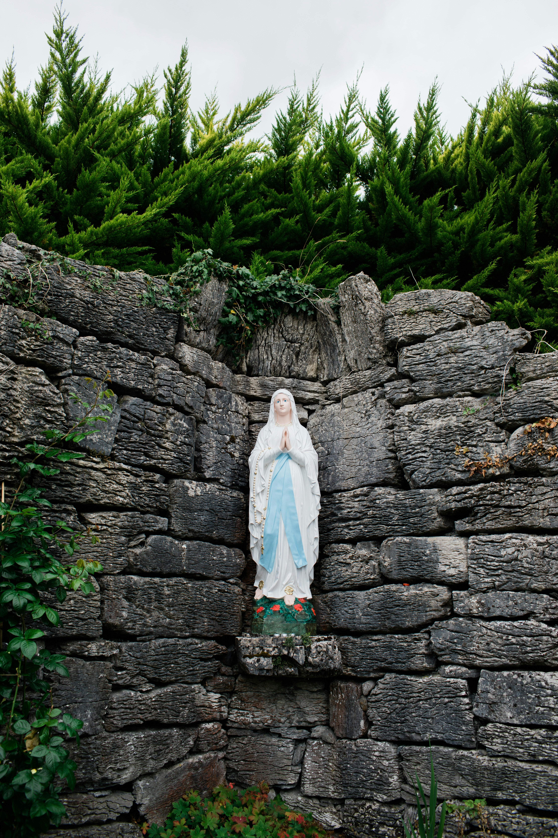
Our Lady of Lourdes
Bobby, Sue, Betty, and Jerry
3rd Block
Intro to the Catechism

Slide 2
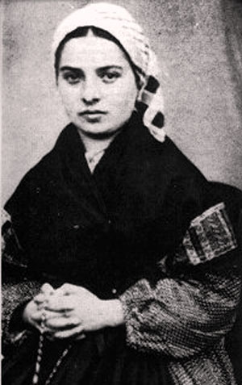
Who was St. Bernadette?
Bernadette Soubrious (January 7, 1844-April 16, 1879):
lived in Lourdes, France (Pyrenees Mountains)
from an impoverished but close-knit family
was illiterate and uneducated in her faith life
had strong personality but generous heart
became a Sister of the Sisters of Charity of Nevers
died of poor health at 35 years old

Slide 3
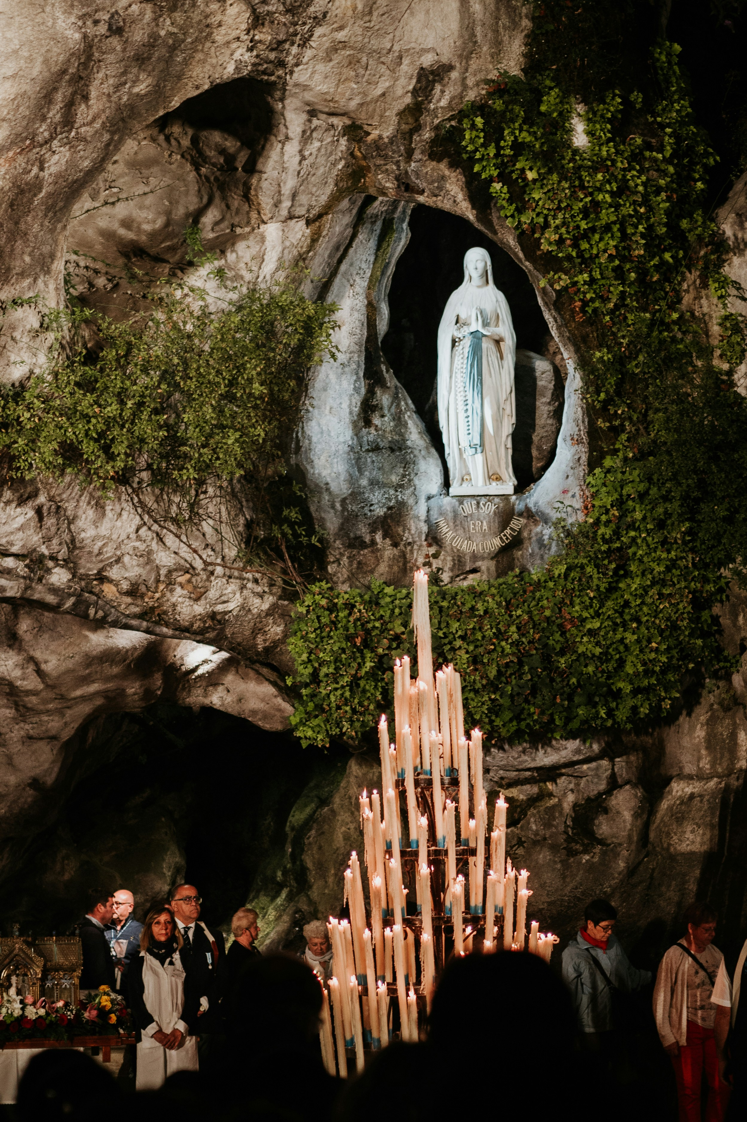
Overview
St. Bernadette received the revelations of Our Lady in a grotto.
No one else could see the visions she saw.
St. Bernadette was mocked and many were skeptical.
St. Bernadette stayed strong in her responsibility to share the messages.
Due to the unusual experiences, local officials suppressed the apparitions.

Slide 4
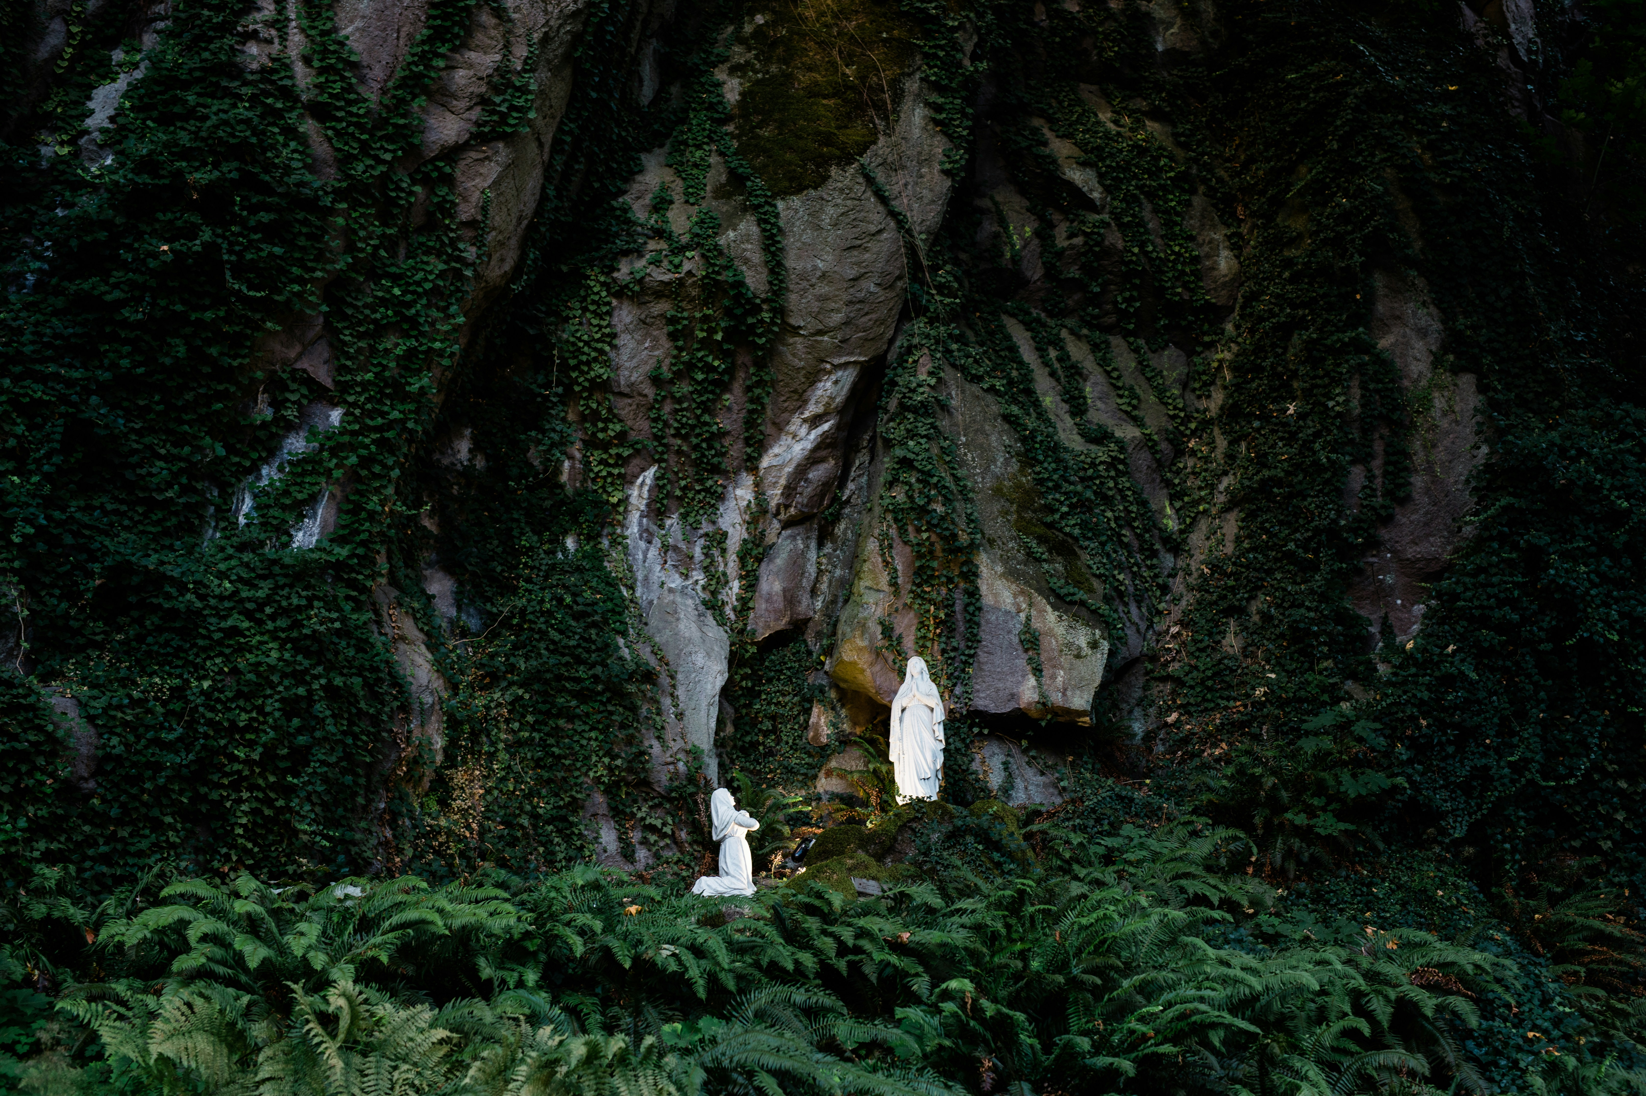
Apparitions Begin
Feb. 11 1858
Grotto of Massabielle
Bernadette, sister, and friend went looking for firewood to buy bread.
At the stream, she heard wind, and looked up and saw the Blessed Mother.
Mary was clothed in white, blue, a veil, yellow roses, and a Rosary
Mary smiled at Bernadette and asked her to pray her Rosary

Slide 5
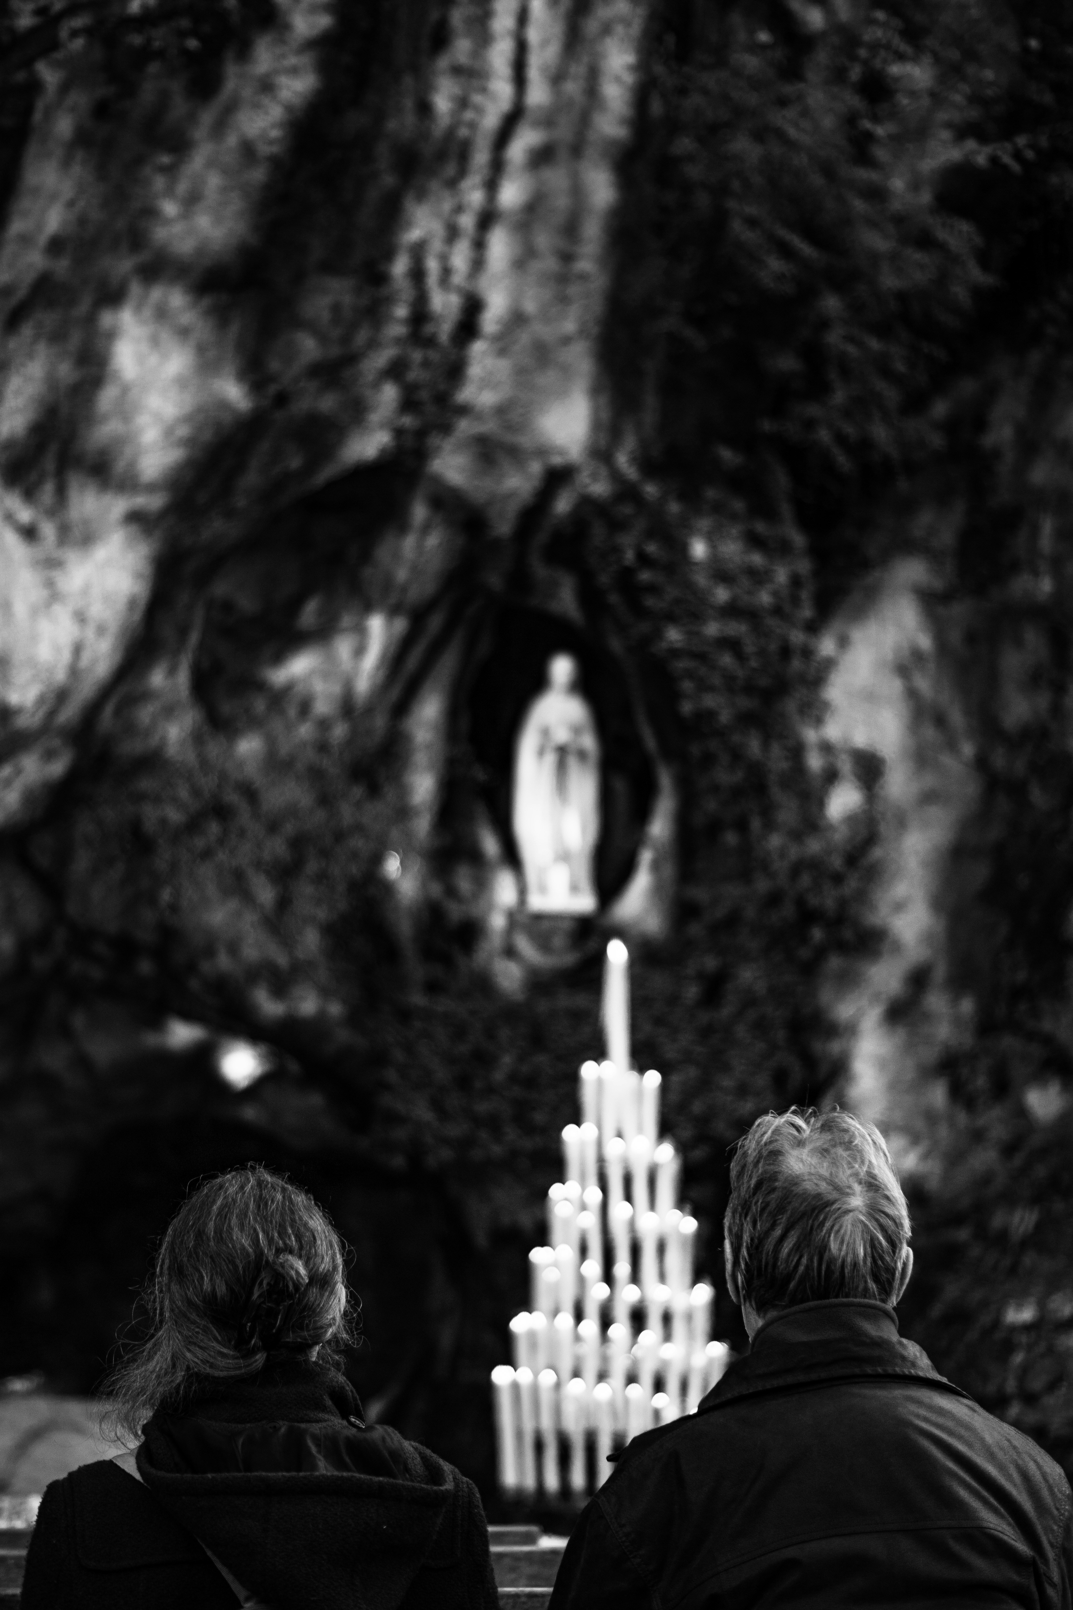
Continuing Apparitions
February
March
14: Bernadette sprinkles holy water at Our Lady; Mary smiles.
18: Our Lady request her to come for 15 days to pray
19: Bernadette brings her family to pray the Rosary
20: Mary teaches Bernadette a personal prayer and tells her to always to bring a candle to the grotto
21: Bernadette is questioned by police and examined by a doctor after story of the apparitions is made known.
23: Our Lady reveals a secret to Bernadette..
24: Our Lady asks for prayers of Penance.
25: The flowing spring of water "for sinners" appears at the grotto.
More apparitions occur praying for penance and sinners.
1: First healings at the grotto occur
2: Our Lady asks for a procession and a chapel to be built at the grotto
3-4: Our Lady refuses to reveal her name
25: Our Lady reveals she is the Immaculate Conception
April
7: A flame of a candle burns through Bernadette’s hands and they remain unscathed
The grotto is closed and altar dismantled after this incident

Slide 6
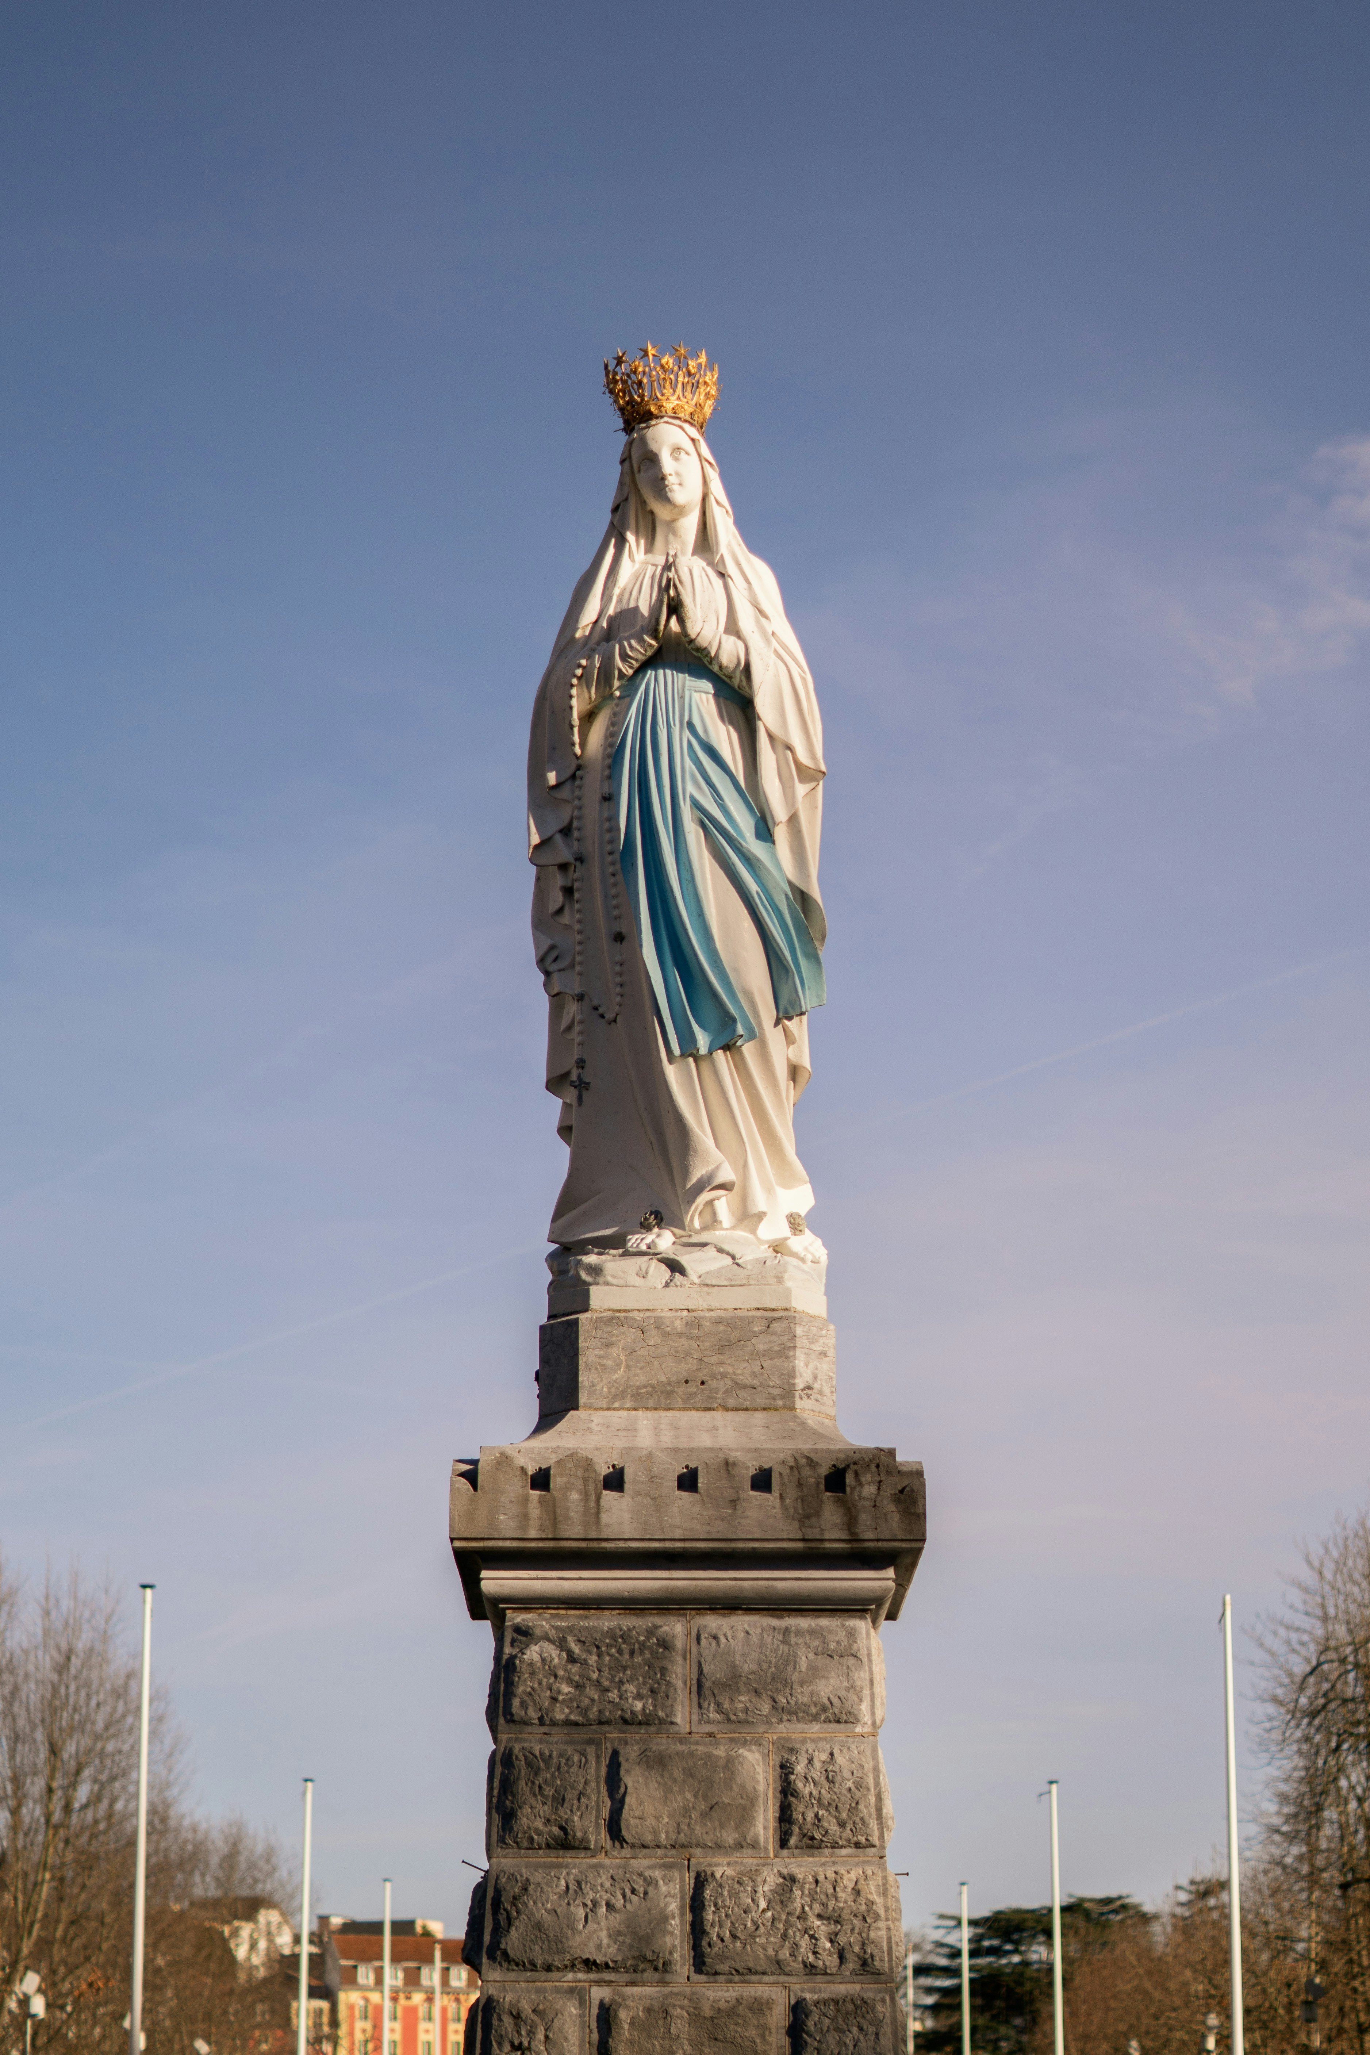
Messages
The purpose of the apparitions are:
penance and praying for sinners through the Rosary
a focus on the Immaculate Conception
to introduce the spring as a place of healing

Slide 7

"I am the Immaculate Conception."
- Our Lady-

Slide 8
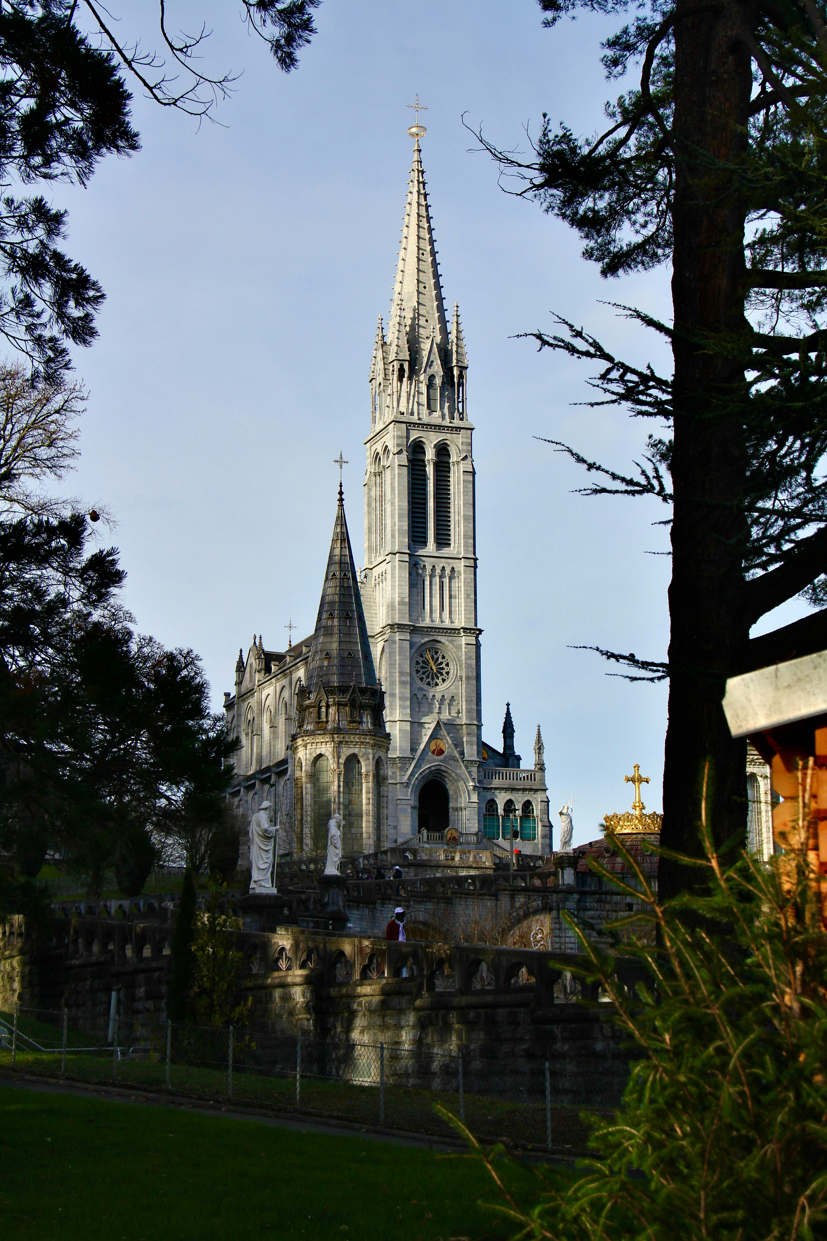
Investigation & Approval
Reports of revelations and healings quickly drew attention
1862: the Church confirmed authenticity of apparitions
1907: worldwide Feast of Our Lady of Lourdes
1909 and1919: St. Bernadette's body was exhumed twice and uncorrupted
1933: St. Bernadette canonized a saint

Slide 9
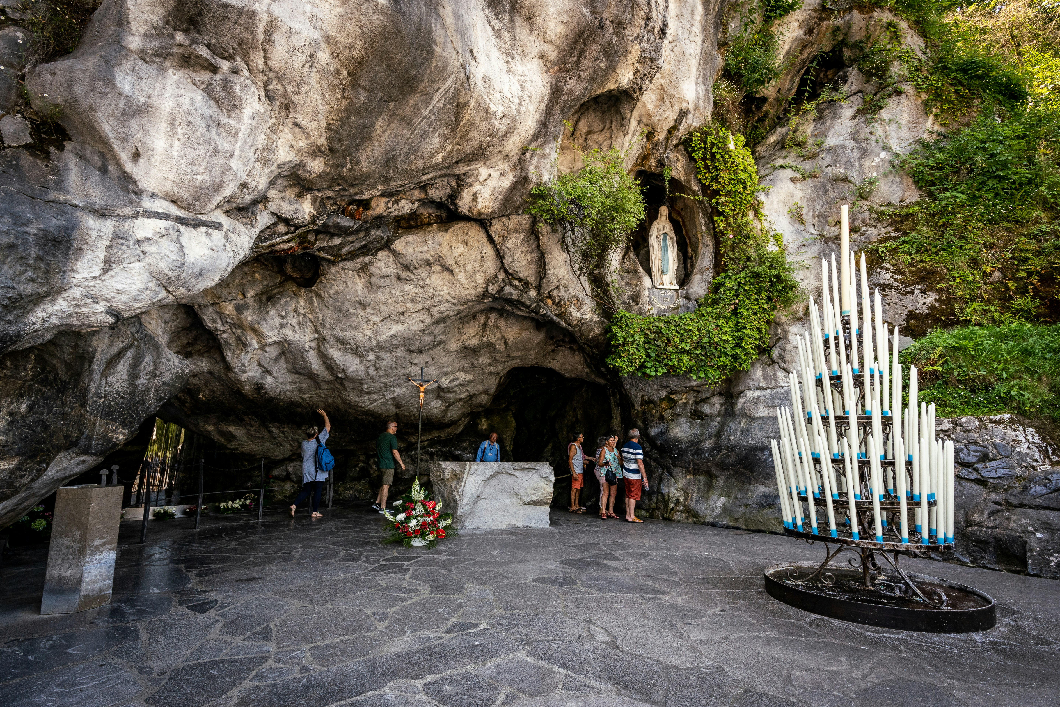
Healing & Hope: Impact
Miraculous healings
Spiritual renewal
Devotion to prayer and the Rosary
Pilgrimages to Lourdes occur
Grottos made to duplicate Lourdes across the world

Slide 10
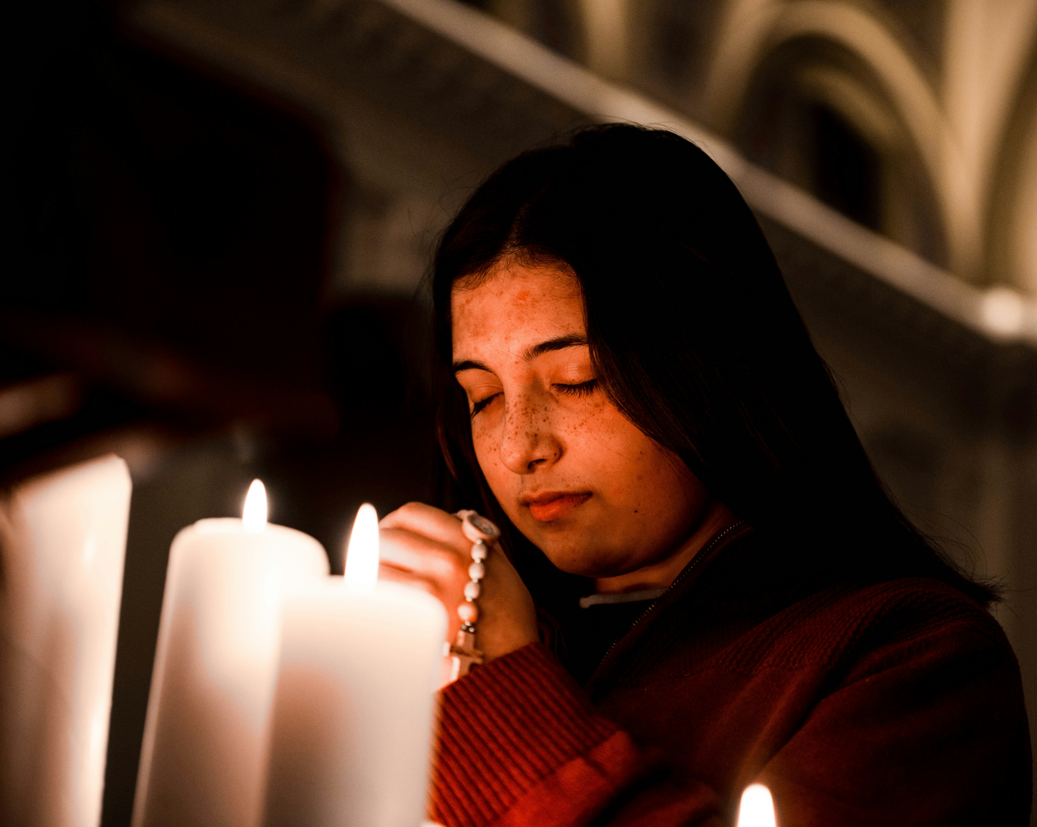
Our Thoughts
The apparitions of Our Lady to St. Bernadette at Lourdes:
are a symbol of hope and miracles
serve as a source of renewal to pray.
encourage us to pray the Rosary more.
challenges us to believe God can do the impossible!

Slide 11
Works Cited
https://www.catholicjourneys.com/our-lady-of-lourdes-facts-pilgrimage/
https://dornsife.usc.edu/news/stories/lourdes-byword-for-hope/
https://www.franciscanmedia.org/franciscan-spirit-blog/sisterhood-of-saints-bernadette-soubirous/
https://www.franciscanmedia.org/saint-of-the-day/our-lady-of-lourdes/
https://www.lourdes-france.org/en/bernadette-soubirous/
https://lourdesvolunteers.org/the-apparitions/

