Slide 1

6. THE CHURCH ENTERS THE MODERN WORLD
Notes:
Suggestions for students’ note taking:
●Require students to use a three ring binder (1/2-1 inches) full of loose leaf paper (college or wide ruled).
●Notes must be taken in pen only and hand written.
●Notebooks should contain information and notes for religion class only.
●Notebooks must have a table of contents with topic of notes, dates and page numbers.
●All notes must have a topic and page number.
●Students will be required to copy each slide unless the teacher directs students to skip certain slides or parts of slides. Notebooks will be graded based on neatness, completeness and organization. Notebooks should have a significant point value representing 20-25% of the overall grade.
The resources linked in this presentation file may contain copyright material. Such material is made available for educational purposes only. This constitutes a “fair use” of any such copyright material as provided for in Title 17 U.S.C. section106A-117 of the US Copyright Law.

Slide 2

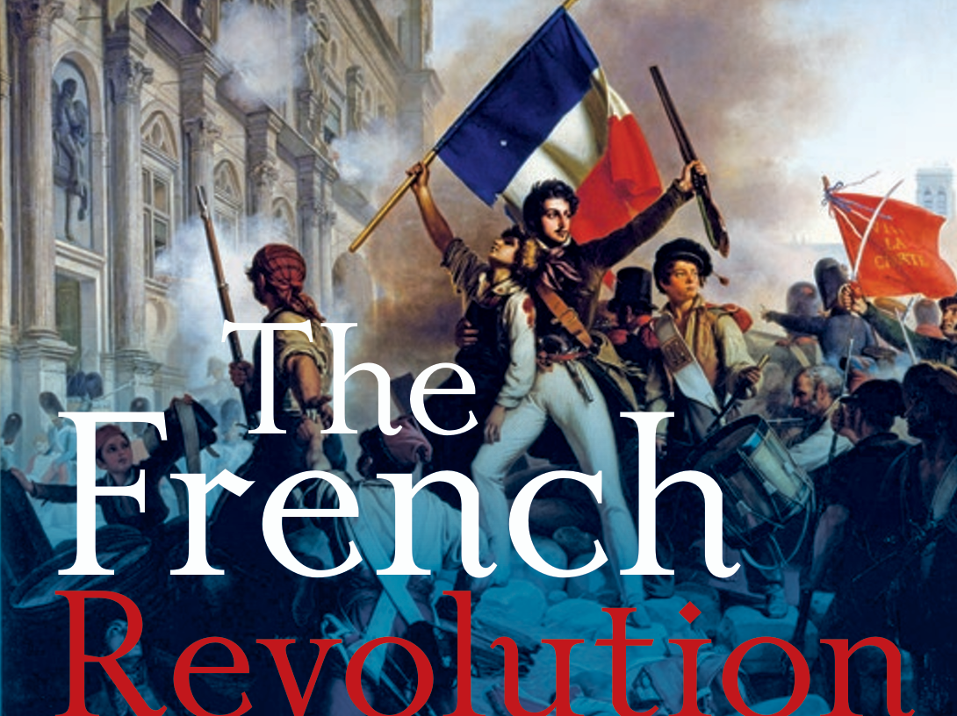
What began in the spirit of "Liberty, Equality, Fraternity" took a dark and radical turn as it
began to violently attack the Catholic Church.
Notes:
Photo Credit: AMP Textbook pg. 294
Directions: Have students copy information from slide into their notes.
Teaching Points: The French Revolution began in a spirit of hope with the belief that the abuses of power perpetrated by the aristocratic classes against the common people could be ended and that the rights of all people could be respected. Many priests and bishops originally supported its goals and mission, but the revolution soon took a dark turn as radical, anti-Christian forces gained control of its direction. Instead of establishing justice and equality for all, the revolutionaries used power to perpetuate abuse and violence against targets who were perceived to be the oppressive forces of the past: the royal family, the titled nobility, and the Catholic Church.
The Church was seen as part of the Ancien Régime, the “old rule” that needed to be thrown off. The state saw the Church as its enemy, or at least as a threat to its aim of securing the complete loyalty of its people. But for the most part, for the common people, the Church, which provided education and charity to the poor, remained a friend and an ally.
Online Resources: Have students view video, EWTN: The French Revolution and the Catholic Church. URL here: https://youtu.be/tXJ6ydcS0rs
The resources linked in this presentation file may contain copyright material. Such material is made available for educational purposes only. This constitutes a “fair use” of any such copyright material as provided for in Title 17 U.S.C. section106A-117 of the US Copyright Law.

Slide 3
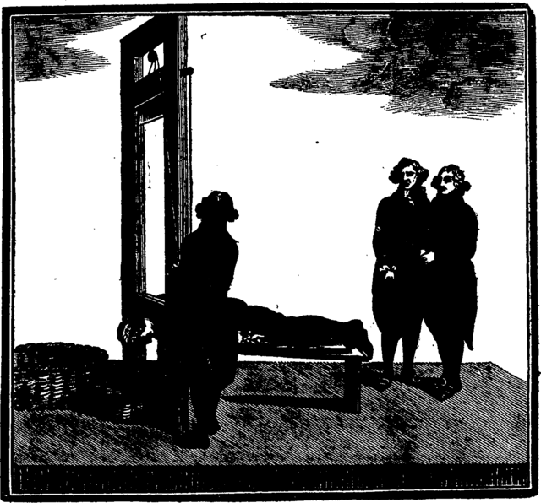
The Reign of Terror
Key
Vocab
Persecutions in France lasting from 1793 to 1794, the king and queen had been beheaded, and thousands of nobles, priests, and nuns were executed. Catholic churches were seized and converted into “Temples of Reason”.
Notes:
Photo Credit: Massacre of the French King! View of la guillotine; or the modern beheading machine, at Paris. By which the unfortunate Louis XVI. (late King of France) suffered on the scaffold, January 21st, 1793.. Unknown author. Public domain. https://commons.wikimedia.org/wiki/File:Massacre_of_the_French_King!_View_of_la_guillotine;_or_the_modern_beheading_machine,_at_Paris_Fleuron_T039027-1.png
Directions: Have students add this vocabulary term to their notes.
Teaching Points:
The Reign of Terror was a period of intense anti-clericalism during the French Revolution that targeted Catholics in many ways, including:
Confiscating Church property: The revolutionaries took over Church land, wealth, and tithes
Closing religious institutions: The revolutionaries closed convents, seminaries, and monasteries
Abolishing the Catholic monarchy: The revolutionaries abolished the Catholic monarchy and severed ties with Rome
Exiling and killing priests: The revolutionaries exiled 30,000 priests and killed hundreds more
Requiring clergy to swear an oath: The revolutionaries required clergy to swear an oath that was condemned by Pope Pius VI
Persecuting the clergy: The revolutionaries persecuted the clergy and increased violence against priests, nuns, and laity
Replacing Catholicism with the Cult of the Supreme Being: Maximilien Robespierre established the Cult of the Supreme Being as the state religion of France, replacing Catholicism and the Cult of Reason
Online Resources: Have students view video, Blessed Martyrs of Compiegne. URL here: https://youtu.be/Z7iqa6O4jJ8
The resources linked in this presentation file may contain copyright material. Such material is made available for educational purposes only. This constitutes a “fair use” of any such copyright material as provided for in Title 17 U.S.C. section106A-117 of the US Copyright Law.

Slide 4
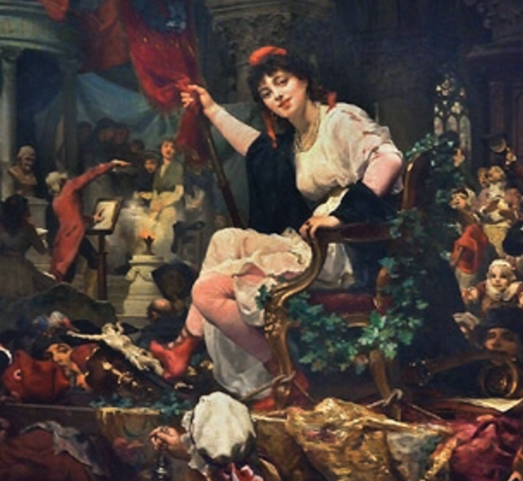
The Cult of Reason
Key
Vocab
From the French: Culte de la Raison, France's first established state-sponsored atheistic religion, intended as a replacement for Roman Catholicism during the French Revolution.
Notes:
Photo Credit: AMP Textbook pg. 293.
Directions: Have students add this vocabulary term to their notes.
Online Resources: Read article, The Cult of Reason. URL here: https://en.wikipedia.org/wiki/Cult_of_Reason
The resources linked in this presentation file may contain copyright material. Such material is made available for educational purposes only. This constitutes a “fair use” of any such copyright material as provided for in Title 17 U.S.C. section106A-117 of the US Copyright Law.

Slide 5
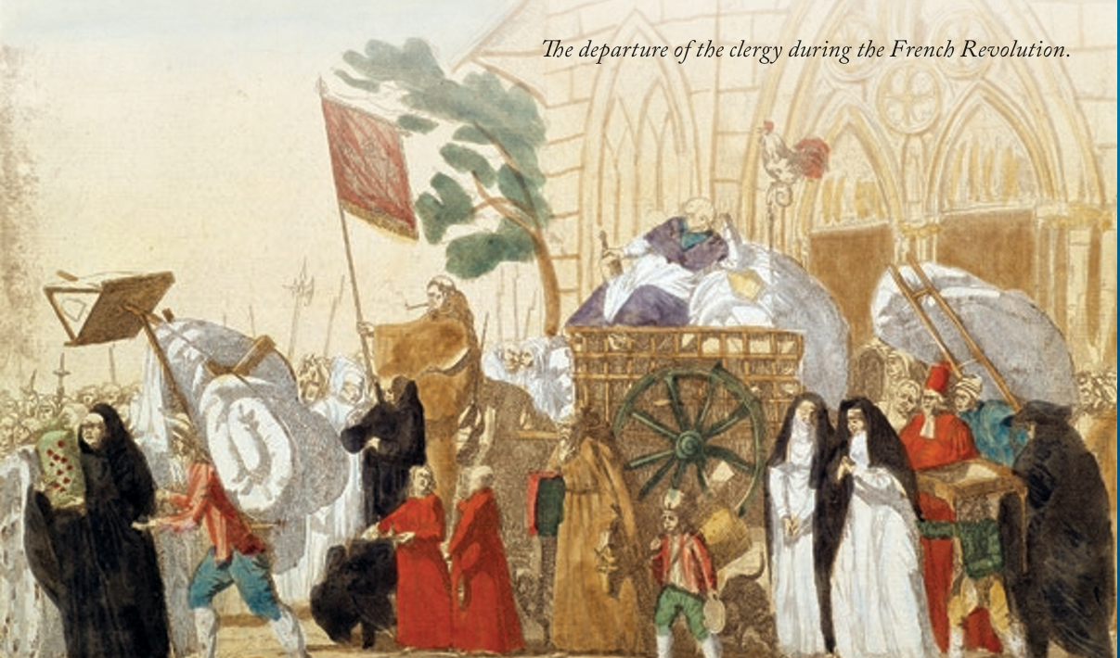
Notes:
Photo Credit: AMP Textbook pg. 294
Teaching Points: The modern world period (approximately the sixteenth through the nineteenth centuries) saw the rise of secular (non-religious or atheistic) governments throughout the world. Many times this resulted in the persecution of the Catholic Church. The French Revolution was just the beginning of this phenomenon.
Another example of the Church being persecuted in the secular state in Mexico during the beginning of the 20th century. Mexican catholics fought back under the name Cristeros and they had as their battle cry, ‘Viva Cristo Rey’ which means, ‘Long live Christ the King’.
Blessed Miguel Pro who was a Jesuit priest became a martyr during the state crack down on Catholicism and Catholic priests. HGe died only two years after Pope Pius Xi declared the feast day of Christ the King to be celebrated at the end of the liturgical year to remind everyone, Catholic or not, that Christ is above all kings and all governments. He is the King of kings.
Online Resources: Assign article, ‘Viva Cristo Rey’. URL here: https://www.catholic365.com/article/44144/viva-christo-rey.html
The resources linked in this presentation file may contain copyright material. Such material is made available for educational purposes only. This constitutes a “fair use” of any such copyright material as provided for in Title 17 U.S.C. section106A-117 of the US Copyright Law.

Slide 6

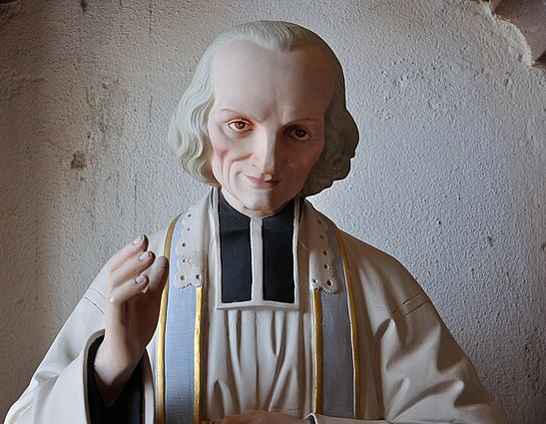
French Catholicism Bounced Back
After the French Revolution, several powerful witnesses to faith and truth emerged, such as Saint John Vianney, as a source of renewal and growth…
Notes:
Photo Credit: Statue de Jean-Marie Vianney à Meroux.jpg. Il veille à l'entrée de l'église Saint-Nicolas à Meroux. Cette photo a été prise par André ALLIOT .
Creative Commons Zero, Public Domain Dedication. https://commons.wikimedia.org/wiki/File:Statue_de_Jean-Marie_Vianney_%C3%A0_Meroux.jpg
Directions: Have students summarize the information from the slide into their notes. Question: Why does the Church always seems to come back bigger and better after it undergoes persecution?
Teaching Points:
St. John Vianney provided a model for the priesthood, dedicating his life not to gaining power and enjoying comfort but to caring for his parishioners.
St. Bernadette Soubirous saw visions of the Blessed Virgin Mary, reigniting Marian devotion and laying the foundation for a Marian shrine at Lourdes that became famous for miracles of healing.
Blessed Frédéric Ozanam renewed the Church’s dedication to the poor by devoting himself to caring for the neglected people of Paris and in the process founding one of the world’s largest charitable organizations, the Society of St. Vincent de Paul.
Nineteenth-century French missionaries such as St. Isaac Jogues, Fr. Jacques Marquette and Fr. Stephen Badin. They shared the Gospel across the world to the Americas, Africa, and Asia.
Online Resources: Have students view video, Saint John Vianney. URL here: https://youtu.be/rqrLEFUmLl0
The resources linked in this presentation file may contain copyright material. Such material is made available for educational purposes only. This constitutes a “fair use” of any such copyright material as provided for in Title 17 U.S.C. section106A-117 of the US Copyright Law.

Slide 7
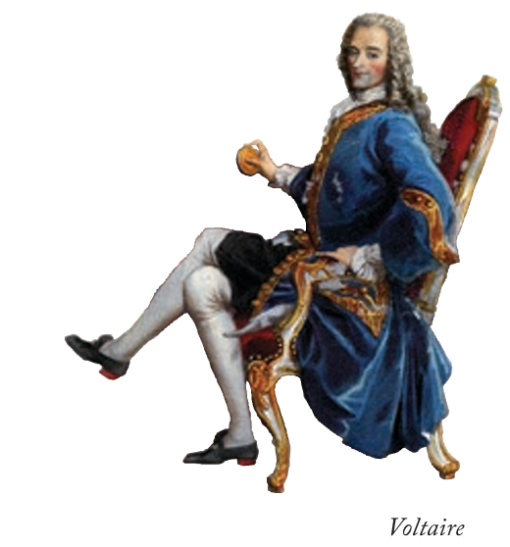
The Enlightenment
Key
Vocab
An intellectual movement in the 17th and 18th centuries that pitted reason and science over faith and superstition.
Notes:
Photo Credit: AMP Textbook pg. 300.
Directions: Have students add this vocabulary term to their notes.
Online Resources: View video, Bishop Barron: What was the Enlightenment?. URL here: https://youtu.be/A_aiAAzRRc4
The resources linked in this presentation file may contain copyright material. Such material is made available for educational purposes only. This constitutes a “fair use” of any such copyright material as provided for in Title 17 U.S.C. section106A-117 of the US Copyright Law.

Slide 8
The Enlightenment Mentality
Christianity, according to Voltaire, was “assuredly the most ridiculous, the most absurd and the most bloody religion which has ever infected this world.”
Notes:
Photo Credit: AMP Textbook pg. 300.
Directions: Have students summarize the information from the slide into their notes. Question: Do you know people who still have this bias against the Christian religion?
Teaching Points: The Catholic Church in France and the rest of Europe had the next major challenge ahead which was responding to the Enlightenment mentality that rejected God and religion. The Enlightenment intellectuals like Voltaire proposed, ‘If people abandoned their commitment to religion then they could base their lives on reason rather than on irrational faith, and the world would be a better, more peaceful place’.
Such ideas were spreading throughout Europe, weakening both support for the Catholic Church as an institution and adherence to the Christian faith (Catholic or Protestant) in general.
When Enlightenment thinkers sought to understand the world apart from God’s revelation, they misunderstood its purpose and the nature of true progress, which was this: “God created the world for the sake of communion with his divine life, a communion brought about by the ‘convocation’ of men in Christ, and this ‘convocation’ is the Church” (CCC, 760).
The spread of democratic governments, scientific and technological advances, and an increase in economic prosperity are all positive developments that came with modernity. Yet these developments were often accompanied by the disintegration of traditional communities, the breakdown of family life, and a decreasing concern for the spiritual well-being of the human person. These negative developments gave rise to the paradox of modernity: unprecedented material wealth and technology combined with spiritual confusion and disillusionment.
The resources linked in this presentation file may contain copyright material. Such material is made available for educational purposes only. This constitutes a “fair use” of any such copyright material as provided for in Title 17 U.S.C. section106A-117 of the US Copyright Law.

Slide 9
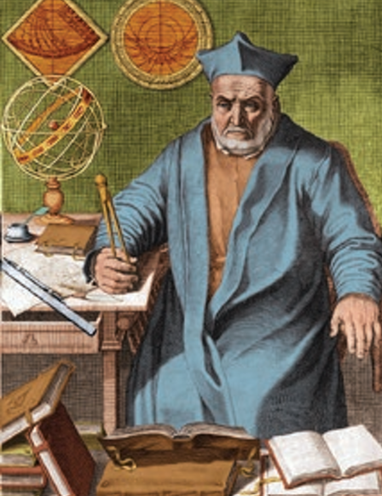
The Church is a Pioneer of Science
‘Faith Does not Fear reason’
-Pope Pius XII
‘Truth cannot contradict truth’
-Pope JPII
Notes:
Photo Credit: AMP Textbook pg. 302.
Directions: Have students copy information from slide into their notes.
Teaching Points: Pictured on the slide, a Jesuit astronomer, Christopher Clavius (d. 1612), was responsible for an astronomical discovery that removed ten days from the year 1582 and created the Gregorian calendar.
Online Resources: Have students view video, Ground-breaking Achievements of Catholic Scientists. URL here: https://youtu.be/w8iRWSgnxWQ
Assign article. Ten Catholic Scientists and Inventors. URL here: https://www.catholicworldreport.com/2022/07/21/ten-catholic-scientists-and-inventors/
Assign article, The Man on the Train. URL here: https://www.catholic365.com/article/36741/the-man-on-the-train.html
The resources linked in this presentation file may contain copyright material. Such material is made available for educational purposes only. This constitutes a “fair use” of any such copyright material as provided for in Title 17 U.S.C. section106A-117 of the US Copyright Law.

Slide 10

Turn and Talk
Which scientist who was also devoted to their Catholic Faith is most impressive? Why?
Notes:
Directions: Have students write down the question and then write down their answer….Then have students share their answers with one person close by.
The resources linked in this presentation file may contain copyright material. Such material is made available for educational purposes only. This constitutes a “fair use” of any such copyright material as provided for in Title 17 U.S.C. section106A-117 of the US Copyright Law.

Slide 11
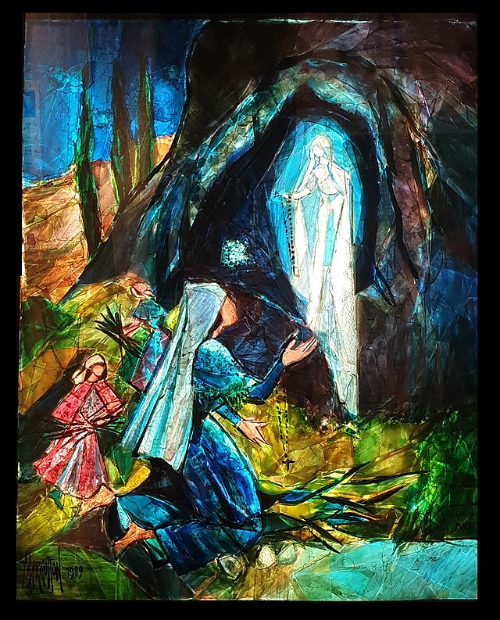
Marian Apparitions
Key
Vocab
Supernatural appearances of Mary to a person or group of people on earth. There have been thousands of reported Marian apparitions over the centuries.
Notes:
Photo Credit: Apparition of the Virgin Mary to Bernadette Soubirous. Frédérique Défrade. Creative Commons Attribution-Share Alike 4.0. https://commons.wikimedia.org/wiki/File:Gemmail_des_apparitions_de_la_Vierge_%C3%A0_Bernadette_Soubirous.jpg
Directions: Have students add this vocabulary term to their notes.
Teaching Points: Marian devotion is based on our belief that Mary is the perfect disciple of Jesus and therefore the model of our faith. As the Mother of the Church, she is our mother because we are part of Christ’s Body. Conceived immaculately, she was the vessel for bringing God’s Son into the world. She is also the vessel for the beginning of the Church. She was perpetually a virgin, and God rewarded her at the end of her life by assuming her body and soul directly into heaven. Mary enables and emboldens our own holiness. There were several Marian apparitions in the nineteenth century that witnessed to her motherhood to all believers.
Online Resources: Read article, The Cult of Reason. URL here: https://en.wikipedia.org/wiki/Cult_of_Reason
The resources linked in this presentation file may contain copyright material. Such material is made available for educational purposes only. This constitutes a “fair use” of any such copyright material as provided for in Title 17 U.S.C. section106A-117 of the US Copyright Law.

Slide 12
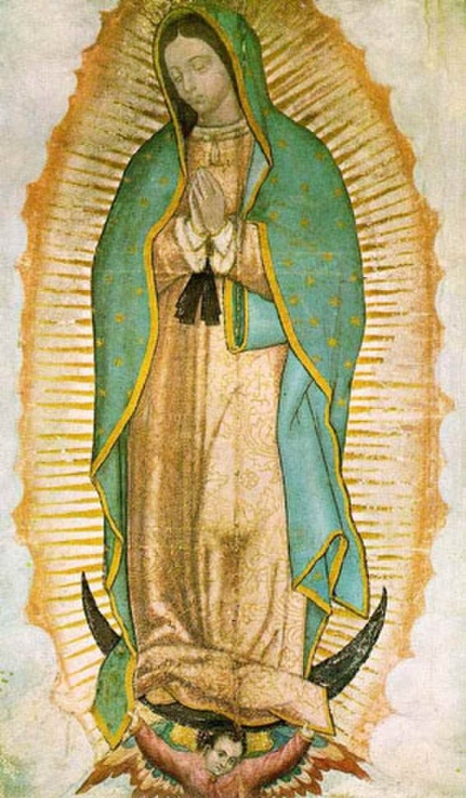
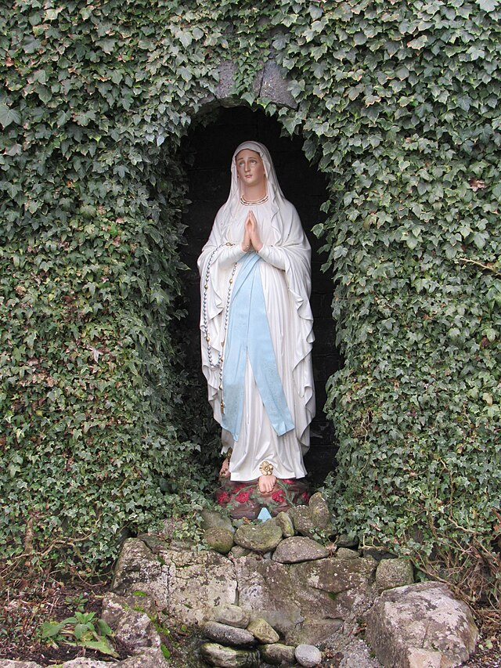
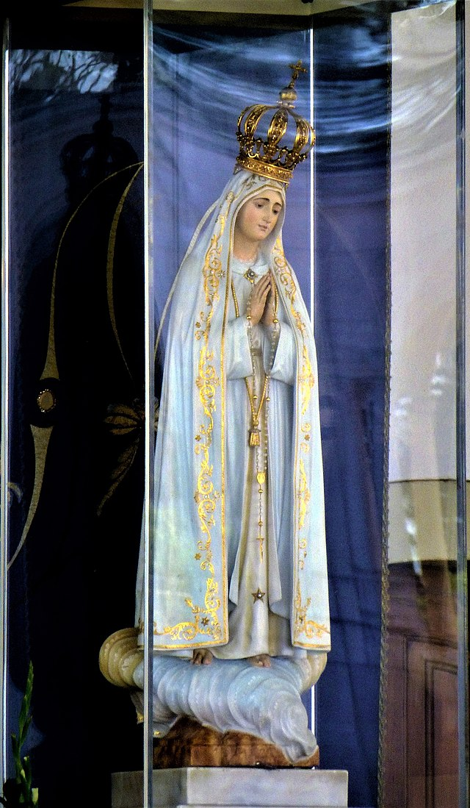
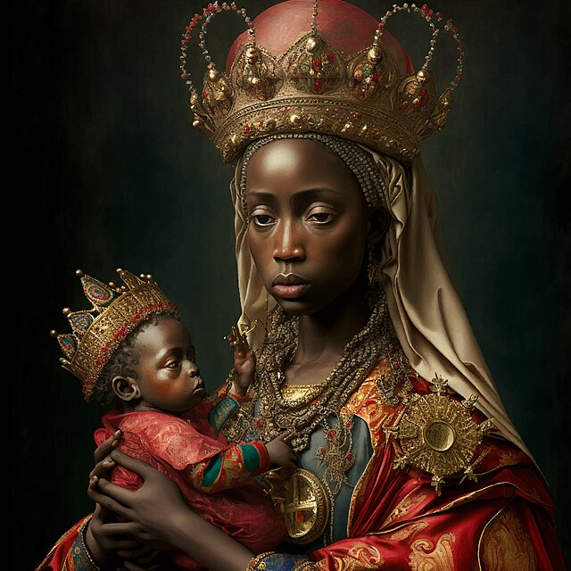
Four Key Apparitions of Mary
Our Lady of Guadalupe
Our Lady of Lourdes
Our Lady of Fatima
Our Lady of Kibeho
Notes:
Photo Credit: Our Lady of Guadalupe. Unknown author. Public domain. FredSeiller. Creative Commons Zero, Public Domain Dedication. Lourdes grotto. First Sculpture of Our Lady of Fatima.jpg. Fatima. Bingar1234.Our Lady of Sorrows, title under which the Virgin Mary presented herself at Kibeho. Rosary Team. Public domain. Our Lady of Kibeho. https://commons.wikimedia.org/
Directions: Have students copy down information from the slide into their notes.
Teaching Points: Mary appeared in 1531 to a Mexican peasant named Saint Juan Diego in modern day Mexico city. Mary appeared in 1858 in the grotto at Lourdes, France to Saint Bernadette Soubirous, a fourteen-year-old peasant girl. Mary appeared in 1917 to three shepherd children, Lúcia dos Santos and her cousins Francisco and Jacinta Marto, at the Cova da Iria in Fátima, Portugal. Mary appeared in 1981, to young girls in Kibeho, Rwanda under the name “Nyina wa Jambo” or “Mother of the Word”. It’s the only approved apparition in Africa.
Online Resources: Have students view video, Our Lady’s Wardrobe. URL here: https://youtu.be/rv1UsMzxIOY
View Video, Mysteries of the Church: Marian Episode. URL here: https://youtu.be/_Dl1aGN_nJI
The resources linked in this presentation file may contain copyright material. Such material is made available for educational purposes only. This constitutes a “fair use” of any such copyright material as provided for in Title 17 U.S.C. section106A-117 of the US Copyright Law.

Slide 13
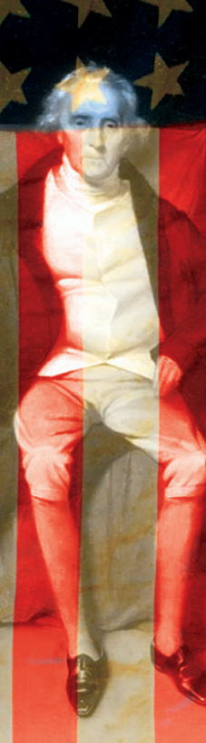
Catholicism and America
The Catholic Faith was brought to the Americas by European Missionaries.
The Catholic Church appreciated the American commitment to religious freedom that became part of the American Constitution.
In spite of anti-Catholic sentiment by some, Catholics have managed to grow in what was considered a Protestant country.
Notes:
Photo Credit: AMP Textbook pg. 323.
Directions: Have students view the slide into their notes.Ask them to locate one interesting detail as you read the Gospel below Then discuss the image.
Teaching Points:
Although they were a very small percentage of the American colonists, Catholics did join in the American Revolution. Charles Carroll of Carrollton, Maryland, was the most prominent Catholic patriot. A wealthy landowner, Carroll argued publicly against the injustice of British taxation of the colonies. He participated in the Continental Congress leading up to the Declaration of Independence and was the only Catholic to sign that historic document. At the time of his death in 1832, he was the last surviving of the fifty-six signers.
The Catholic Faith was, in large part, brought to the United States by these 17 Missionaries…
Juan Baptista de Segura: One of eight Jesuit missionaries killed by natives near the future site of Jamestown, Virginia, in 1571
Georgia Martyrs: Six Franciscans killed near their mission base of St. Augustine, Florida, in 1597
St. Isaac Jogues: With the other North American Martyrs, was put to death by the Iroquois in the seventeenth century
Andrew White: English Jesuit who was known as the “Apostle of Maryland”
Sébastien Râle: Jesuit missionary who ministered to the indigenous Abenaki people around Maine at the beginning of the eighteenth century
Eusebio Kino: Jesuit martyr who founded twenty-four missions in Mexico and the southwestern United States
Ferdinand Farmer: Eighteenth-century German Jesuit priest who ministered to Catholics in eastern Pennsylvania, New Jersey, and New York
Jacques Marquette: French Jesuit priest who traveled with Louis Jolliet on his exploration of the Mississippi River and founded the first European settlement in Michigan
Gabriel Richard: French priest who became a delegate to the United States House of Representatives from the Michigan Territory in the early eighteenth century
Frederic Baraga: First bishop in the Upper Peninsula in Michigan
Stephen Badin: First priest ordained in the United States; explored Kentucky and the Ohio Valley in the early nineteenth century
St. Elizabeth Ann Bayley Seton: Religious sister and first American saint; was instrumental in laying the groundwork for the Catholic school system in the United States
Demetrius Gallitzin and Peter Henry Lemke: Helped Catholics to settle in western Pennsylvania
St. Junípero Serra and Fermín de Lasuén: Spanish Franciscans who founded twenty-one missions in California Pierre de Smet: Traveled nearly 180,000 miles in the western United States to minister to Native Americans; known as a friend of Sitting Bull
St. Katharine Drexel and Venerable Samuel Mazzuchelli: Focused on missions to Native Americans and African Americans
St. Damien of Molokai and Blessed Marianne Cope: The first missionaries in Hawaii, focusing eventually on the leper colony there
Venerable Fulton J. Sheen: Head of the Society for the Propagation of the Faith in the 1950s and 1960s who also had a nationally televised program of evangelization
Referring to President George Washington and Archbishop John Carroll of Baltimore, Pope Leo XIII continued: “At the very time when the popular suffrage placed the great Washington at the helm of the Republic, the first bishop was set by apostolic authority over the American Church. The well-known friendship and familiar intercourse which subsisted between these two men seems to be an evidence that the United States ought to be conjoined in concord and amity with the Catholic Church.”
Pope Leo attributed the American Church’s growth, in part, to the nation’s favorable laws. “Thanks are due,” he wrote, “to the equity of the laws which obtain in America and to the customs of the well-ordered Republic.” The Church in the United States, he observed, was “fettered by no hostile legislation, protected against violence by the common laws and the impartiality of the tribunals,” and therefore “free to live and act without hindrance.”
This not to say that Catholic coming to America, a predominantly Protestant country, did not have a hard time. There was a great deal of anti-catholic bias and the American catholic Church had to struggle to be truly free and equal.
Online Resources: Have students view video, The History of Catholicism in the United States. URL here: https://youtu.be/k9rSsJk17Us
The resources linked in this presentation file may contain copyright material. Such material is made available for educational purposes only. This constitutes a “fair use” of any such copyright material as provided for in Title 17 U.S.C. section106A-117 of the US Copyright Law.

Slide 14
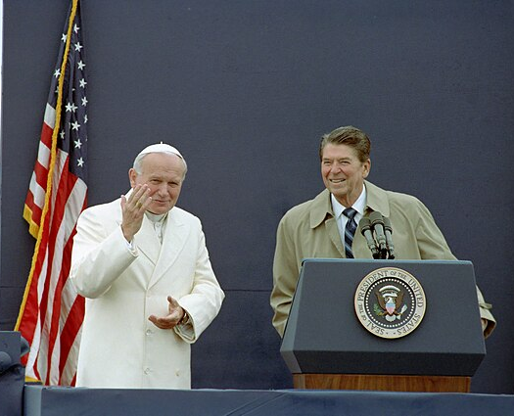
Religious Freedom
Key
Vocab
A term that promotes human dignity and recognizes and defends the fundamental human right to be free from coercion in religious matters. Freedom to accept Jesus Christ and his Church.
Notes:
Photo Credit: President Ronald Reagan and Pope John Paul Ii at The Fairbanks Airport in Fairbanks Alaska, 5/2/1984. Series: Reagan White House Photographs, 1/20/1981 - 1/20/1989 Collection: White House Photographic Collection, 1/20/1981 - 1/20/1989. Public domain. https://commons.wikimedia.org/wiki/File:Ronald_Reagan_with_John_Paul_II_1987.jpg
Directions: Have students add this vocabulary term to their notes.
The resources linked in this presentation file may contain copyright material. Such material is made available for educational purposes only. This constitutes a “fair use” of any such copyright material as provided for in Title 17 U.S.C. section106A-117 of the US Copyright Law.

Slide 15
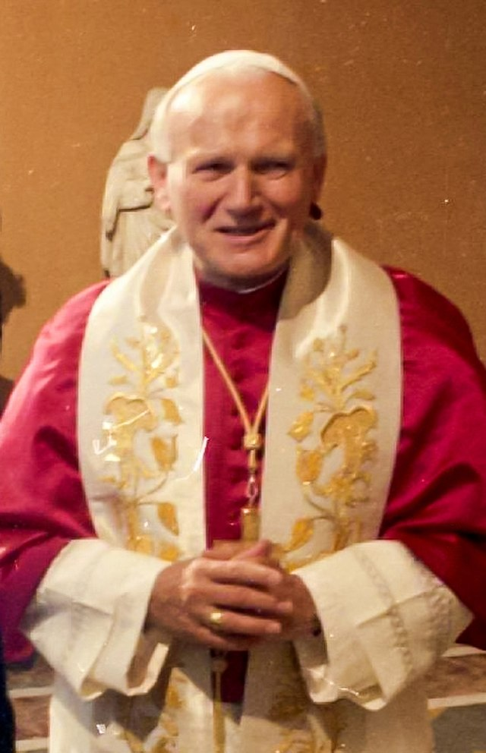
Champion of Religious Freedom
“Freedom is an essential part of that creaturely image which is the basis of the dignity of the person. Within that freedom there is an echo of the primordial vocation whereby the Creator calls man to the true Good…to become his friend and to share his own divine life…Freedom then is rooted in the truth about man, and it is ultimately directed towards communion.” -Pope John Paul II
Notes:
Photo Credit: Pope John Paul II 1984 portrait.jpg. Portrait of Pope John Paul II, Saint. Unknown author. Attribution. https://commons.wikimedia.org/wiki/File:Pope_John_Paul_II_1984_portrait.jpg
Directions: Have students summarize the main points of the quote on the slide in their notes.
Teaching Points: Religious freedom is the right to practice or not practice a religion, and to express one's religious beliefs, without government interference or favoritism. It's also known as the right of conscience.
For hundreds of years, a majority of Catholics lived in predominantly Catholic nations that were ruled by Catholic monarchs and in which the Church enjoyed the support of the government. The Church gradually adapted to the modern world, reorienting her thought and structure to continue her mission in countries that were variously open, hostile, or indifferent to the Church’s freedom to exist and of individual Catholics to practice their religion.
In some cases, the Catholic Church was the only voice insisting on religious freedom for the people of a certain nations.
In the latter half of the 20th century, Pope John Paul II became the champion of the Polish people and all people under the rule of communism throughout the world. He successfully advocated for peaceful and non-violent resistance.
Authors and scholars have recounted that the pope’s journey to Poland marked a shift toward the demise of communism in Europe. His words of encouragement and witness of strong discipleship, in the face of the powers of evil, helped drive oppression away. There is no overestimating the impact that John Paul II had in aiding the crush of these powers. However, in typical fashion, it is very likely that the pope would deflect this credit off of himself and place it on two factors: the true presence of Jesus Christ in the Eucharist and the multitudes that gathered that day.
Online Resources: Have students view video, John Paul II’s 1979 Trip to Poland. URL here: https://youtu.be/n1hCP7ZHay0
The resources linked in this presentation file may contain copyright material. Such material is made available for educational purposes only. This constitutes a “fair use” of any such copyright material as provided for in Title 17 U.S.C. section106A-117 of the US Copyright Law.

Slide 16
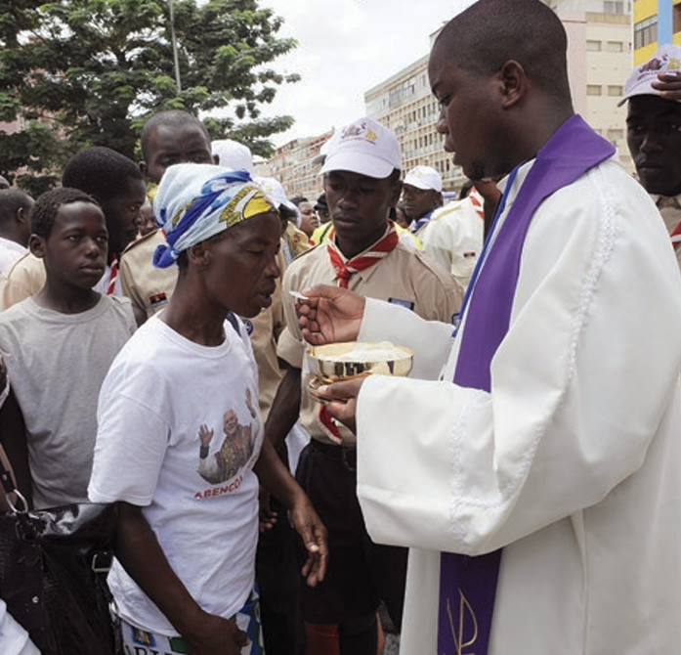
Individualism and Communion
When God saw Adam by himself in the garden, he said, “It is not good for the man to be alone” (Gn 2:18).
People are designed by God to be in relationship with others, to love and be loved.
Notes:
Photo Credit: AMP Textbook pg. 324.
Directions: Have students summarize the information from the slide into their notes.
Teaching Points: In the Modern world, the Church often has to remind us that we need a balance between individual concern and concern for the community.
The strong focus of the Enlightenment on individual rights led to views that opposed the Christian understanding of personhood.
A radical individualism sees the person as the fundamental unit of society, disconnected from family, church, and community. Western culture has often celebrated this idea, as for example represented in the early-twentieth-century ideal of “rugged individualism.” Being able to take care of one’s sellf is a virtue but we also have a responsibility to help others.
The Catholic view of the person understands all people as inherently oriented toward community.
As the Genesis account of Creation relates, when God saw Adam by himself in the garden, he said, “It is not good for the man to be alone” (Gn 2:18). People are designed by God to be in relationship with others, to love and be loved.
“I can pray alone. I might take a walk in nature where I feel God’s presence.” This line of individualistic thought may deprive yourself of a source of grace that builds necessary communion with God and others. The Eucharist, for example strengthens individuals but it is always communal. It is never just me, my bible and God. In Catholicism it is always ‘we’.
The resources linked in this presentation file may contain copyright material. Such material is made available for educational purposes only. This constitutes a “fair use” of any such copyright material as provided for in Title 17 U.S.C. section106A-117 of the US Copyright Law.

Slide 17

Memorize It
Key
Verse
"The fool says in his heart,
‘There is no God’.”
-Psalm 14:1
Notes:
Directions: Have students copy the quote. Add bonus points to the assessment if they can copy it down demonstrating that they memorized it.
The resources linked in this presentation file may contain copyright material. Such material is made available for educational purposes only. This constitutes a “fair use” of any such copyright material as provided for in Title 17 U.S.C. section106A-117 of the US Copyright Law.

