Slide 1
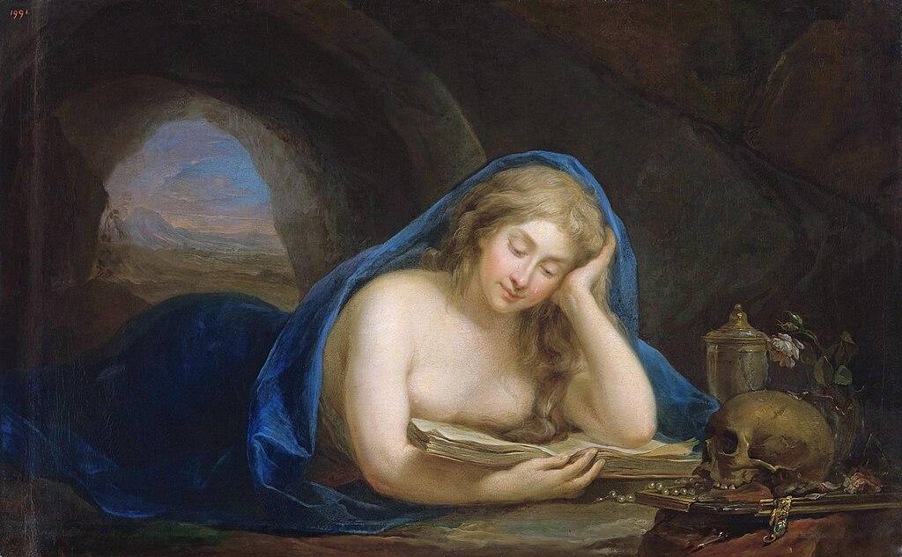
7
Jesus Calls Disciples
God Loves: Jesus Christ Enters the World
Notes:
Photo Credit: Penitent Mary Magdalene in a grotto. Marcello Bacciarelli. Public Domain.
Suggestions for students’ note taking:
●Require students to use a three ring binder (1/2-1 inches) full of loose leaf paper (college or wide ruled).
●Notes must be taken in pen only and hand written.
●Notebooks should contain information and notes for religion class only.
●Notebooks must have a table of contents with topic of notes, dates and page numbers.
●All notes must have a topic and page number.
●Students will be required to copy each slide unless the teacher directs students to skip certain slides or parts of slides. Notebooks will be graded based on neatness, completeness and organization. Notebooks should have a significant point value representing 20-25% of the overall grade.
The videos linked in this presentation file may contain copyright material. Such material is made available for educational purposes only. This constitutes a “fair use” of any such copyright material as provided for in Title 17 U.S.C. section106A-117 of the US Copyright Law.

Slide 2
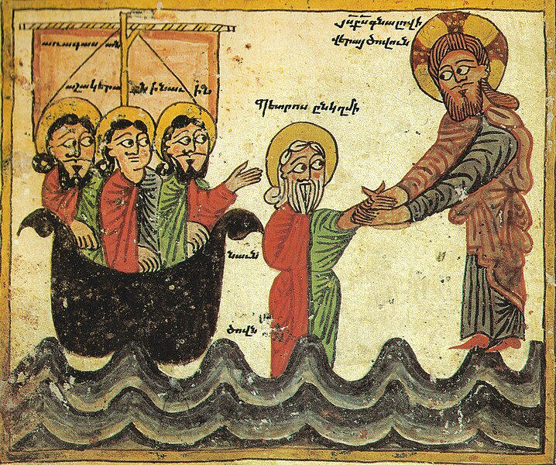
Disciple
Key
Vocab
The word disciple means follower, those who accept Jesus’ message to follow him. A personal follower of Jesus during his life, especially one of the twelve Apostles.
Notes:
Photo Credit: Jesus Walking on Water. Daniel of Uranc. Public Domain.
Directions: Have students copy down this key term in their vocab section of their notes.
Online Resources: Assign article, Apostle or Disciple?. URL here: https://www.orlandodiocese.org/e-scroll/archive/catholic-culture-whats-the-difference-between-an-apostle-and-a-disciple/
The videos linked in this presentation file may contain copyright material. Such material is made available for educational purposes only. This constitutes a “fair use” of any such copyright material as provided for in Title 17 U.S.C. section106A-117 of the US Copyright Law.

Slide 3
Becoming a Disciple (Or Not)
Reasons Some Reject Following Jesus:
A decline of social trust in institutions
No involvement in religious education or youth ministry
Dislike for the religion’s rules and perceived rigidity
Notes:
Photo Credit: Cross in Kadisha Valley, Lebanon. Vyacheslav Argenberg. CC BY 4.0 (Deed - Attribution 4.0 International - Creative Commons).
Directions: Have students copy the side information in their notebooks.
Teaching Points: There have always been people who were once followers of Christ but later ignored or outright rejected him.
Recall another incident described in the Gospel of Mark about the rich man who approached Jesus. The man was looking for an answer to one of the most basic human questions. He asked Jesus, “Good teacher, what must I do to inherit eternal life?” (Mk 10:17). Jesus told the man to keep all of the commandments. The man told Jesus he had always done just that. Then Jesus said to him, “You are lacking in one thing. Go, sell what you have, and give to [the] poor and you will have treasure in heaven; then come, follow me” (Mk 10:21). The man went away from Jesus and did not follow him.
In this case, the Gospel says, it was because “he had many possessions” (Mk 10:22).
A recent study on young adults leaving the Catholic Church reported that some people quit identifying as Catholics at the average age of thirteen, even before they stopped attending a Catholic school or parish. Why? Some of the reasons had to do with “a decline of social trust in institutions,” “no involvement in religious education or youth ministry,” and “dislike for the religion’s rules and rigidity.”
Online Resources: View video, The Rich Young Man and the Divinity of Jesus, URL here: https://youtu.be/xbW9451PAoo
Have students view video, Rise of The Nones. URL here: https://youtu.be/pG2mtELrxkg
The videos linked in this presentation file may contain copyright material. Such material is made available for educational purposes only. This constitutes a “fair use” of any such copyright material as provided for in Title 17 U.S.C. section106A-117 of the US Copyright Law.

Slide 4
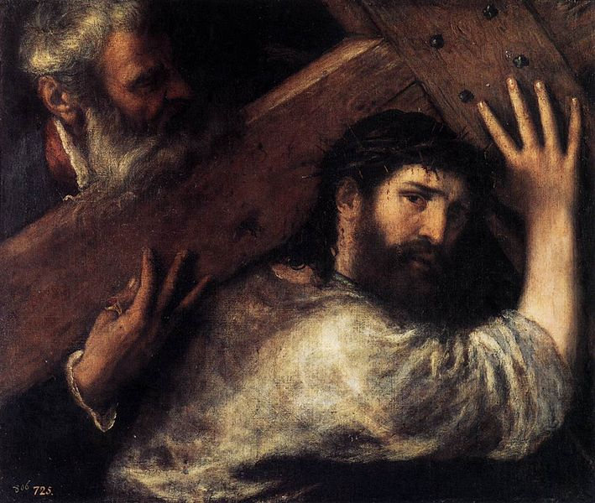
‘Take up Your Cross and Follow Me’
There is a cost in following Jesus.
Notes:
Photo Credit: Christ Carrying the Cross. Titian. Public Domain.
Directions: Have students copy the side information in their notebooks.
Teaching Points:
The Apostles sacrificed family life for Jesus.
Mary suffered the death of her only son.
The rich man had to give up his possessions.
Many young people risk popularity for being openly Catholic.
Real discipleship has always involved turning away from the norms, what is comfortable, or “what everyone else is doing.” A disciple of Jesus is not someone who takes his invitation to follow him, absorbs his lessons, but then retreats to a former way of life.
No one will tell you there won’t be challenges in being a disciple. Mary, Jesus’s first disciple, suffered by watching her Son’s suffering and Death.
Recall that many of Jesus’s disciples from the first two centuries, including the Apostles who were originally simple fishermen, were martyred. Today, you will still face challenges in being a true disciple—likely not death, but perhaps wonderment, ridicule, and questioning about why you continue to be an active Catholic when so many your age have chosen not to be.
However, the rewards of faith (e.g., a life based in truth, the opportunity for heaven) are so great that these challenges are worth overcoming. They can also serve as reminders to analyze how you are currently practicing your faith. It is wise to be aware of any signs of why you might be “drifting away” from the faith.
Online Resources: Have students view video, The Cost of Discipleship.URL here: https://youtu.be/QBO1IuDmmaM
The videos linked in this presentation file may contain copyright material. Such material is made available for educational purposes only. This constitutes a “fair use” of any such copyright material as provided for in Title 17 U.S.C. section106A-117 of the US Copyright Law.

Slide 5
Turn & Talk
Name a practical way you or someone you know “takes up the cross” for Jesus in everyday life.
Notes:
Directions: Have students write down the question and then write down their answer….Then have students share their answers with one person close by.
The videos linked in this presentation file may contain copyright material. Such material is made available for educational purposes only. This constitutes a “fair use” of any such copyright material as provided for in Title 17 U.S.C. section106A-117 of the US Copyright Law.

Slide 6
Discipleship is Worth It
‘I have come so that they may have life and have it in abundance.’
-Jn 10:10
Notes:
Photo Credit: Laughing boy at golden hour, in Don Det (Si Phan Don), Laos. Basile Morin
Creative Commons Attribution-Share Alike 4.0. https://commons.wikimedia.org/wiki/File:Laughing_boy_at_golden_hour.jpg
Directions: Have students copy the side information in their notebooks.
Teaching Points:
We get a God who is the perfect teacher, who is understanding, patient, and kind.
We get a God who loves perfectly.
This friendship Jesus offers includes happiness and peace through a participation in the inner life of God.
He offers you the chance to live forever in eternal happiness.
The central promise of the Beatitudes is that our sorrows — whatever kind of sorrow it is or however long it lasts – will be turned to joy. Christ who has experienced all our sufferings keeps his promises that he made to his disciples.
These promises include:
“Seek First His Kingdom.”
“He who comes to me shall not hunger.”
“Ask and you shall receive.”
“Nothing is concealed that will not be revealed.”
“Whatever you ask in my name, I will do it.”
“Come to me … and I will give you rest.”
“In me you have peace.”
“The Holy Spirit will teach you.”
“All things are possible with God.”
“Your hearts will rejoice.”
The videos linked in this presentation file may contain copyright material. Such material is made available for educational purposes only. This constitutes a “fair use” of any such copyright material as provided for in Title 17 U.S.C. section106A-117 of the US Copyright Law.

Slide 7
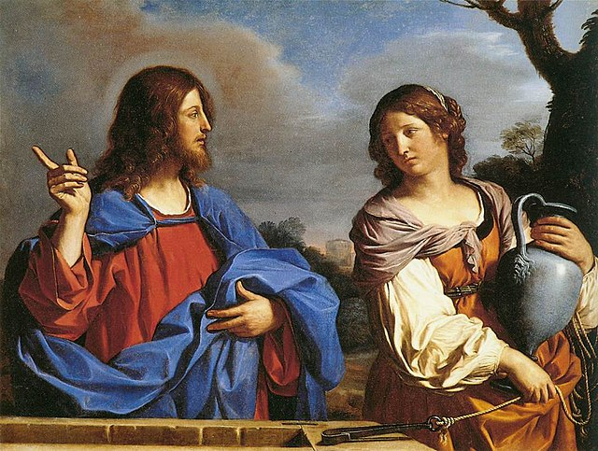
The Way
Key
Vocab
The early Christians used “the way” to describe the Church itself. It is not a path to heaven and the Father that one travels half-heartedly. Rather, as Jesus said, he himself is “the way.” To follow Jesus “on the way” means forging a deep friendship and bond with Jesus.
Notes:
Photo Credit: Guercino. Public domain. Guercino - Jesus and the Samaritan Woman at the Well . https://commons.wikimedia.org/wiki/File:Guercino_-_Jesus_and_the_Samaritan_Woman_at_the_Well_-_WGA10946.jpg
Directions: Have students copy down this key term in their vocab section of their notes.
Online Resources: View video, I Am the Way. URL here: https://youtu.be/rzCXj2QdgFo
The videos linked in this presentation file may contain copyright material. Such material is made available for educational purposes only. This constitutes a “fair use” of any such copyright material as provided for in Title 17 U.S.C. section106A-117 of the US Copyright Law.

Slide 8
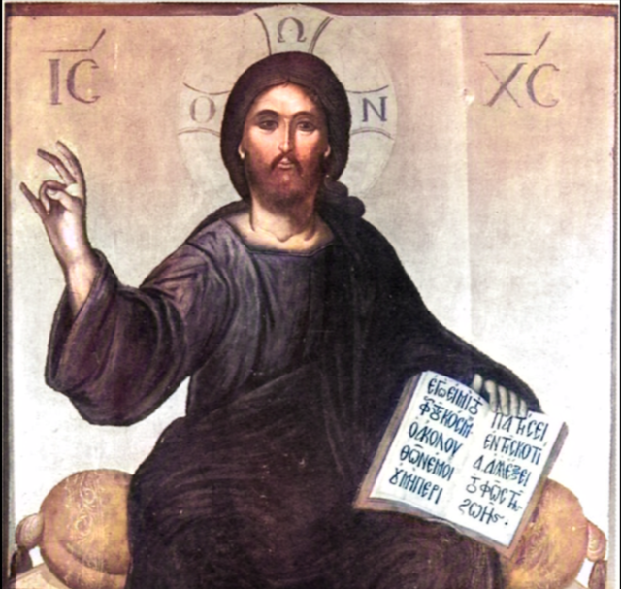
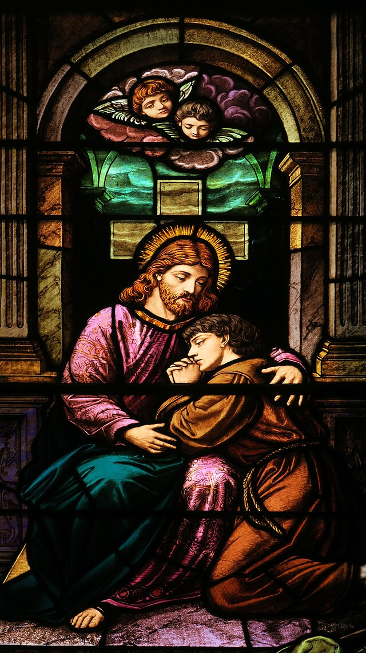
Three Steps to Becoming a Better Disciple
Learn from Jesus’s Teaching
Develop a deep and loving Commitment
Help Jesus Share His Message
Notes:
*Photo credits:Jesus Enthroned.Thomas Bathas.Public domain. Nheyob.Creative Commons Attribution 4.0
Saint Patrick Church (Troy, Ohio) - stained-glass windows, Christ comforts a penitent sinner
various ages and backgrounds engaged in a circle, sharing stories with one another. Dall-E. Public domain. https://commons.wikimedia.org
Directions: Have students copy down information from the slide into their notes.
Teaching Points:
1. The first step to discipleship is learning from Jesus’s teaching. At this initial stage, discipleship is primarily an activity of the intellect. Disciples gather knowledge about what Jesus taught, who he is, and what he expects of them. This first step is very important. Knowing someone well can lead to a lasting personal relationship. The true disciples are those who get to know Jesus so well that they want to be with him and do what he asks. The challenge here is to understand how Jesus defined discipleship. The first disciples found this difficult to do. Fortunately, now we can learn from their misunderstandings.
2. It is Jesus himself who initiates the second step of discipleship—a deep and loving commitment—by inviting you to be his friend. In John’s Gospel, Jesus says, “I have called you friends. . . . It was not you who chose me, but I who chose you and appointed you to go and bear fruit” (Jn 15:15–16).
3. The third step of discipleship is helping Jesus to share his message. his is the part of discipleship exhibited boldly by Mary, St. Peter, St. Paul, and countless other saints over the centuries. Reading about the lives of these saints and other disciples will help you stand firm in the face of challenges and remain committed to Jesus and the Church in a way that may be uncomfortable at times but also exhilarating and very much worth it.
Online Resources: Have students view video, How to be a Good Disciple of Christ. URL here: https://youtu.be/Fis29rZ2n_4
The videos linked in this presentation file may contain copyright material. Such material is made available for educational purposes only. This constitutes a “fair use” of any such copyright material as provided for in Title 17 U.S.C. section106A-117 of the US Copyright Law.

Slide 9
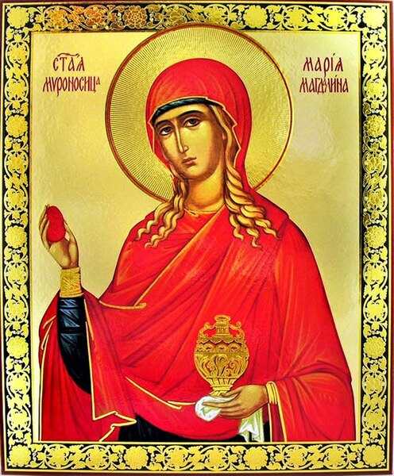
Jesus’s Friends: Mary Magdalene
"I was one way, and now I'm completely different. And the thing that happened in between was Him.”
-Mary Magdalene, The Chosen
Notes:
Photo Credit: Saint Mary Magdalene. Unknown. Public Domain.
Directions: Have students copy the side information in their notebooks.
Teaching Point: Among his disciples, Jesus formed many deep friendships. His Apostles were certainly counted among his closest friends. Commitment and friendship go hand in hand.
Mary Magdalene, by all accounts, was one of Jesus’s closest friends. Her name is mentioned fourteen times in the Gospels, more than many of the Apostles. Whenever the women who traveled with Jesus are listed in the Gospels, Mary Magdalene is always named first. In fact, the only time her name does not appear first is when she is identified at the foot of Jesus’s Cross. On that occasion, the name of Mary, Jesus’s mother, appears first. Jesus first encountered Mary Magdalene and other Galilean women while traveling from village to village. He cured them of evil spirits and Mary Magdalene, in particular, of “seven demons” (Lk 8:2).
Online Resources: Have students view video, Mary Magdalene in the Chosen. URL here: https://youtu.be/xCI3eV-v31Q
The videos linked in this presentation file may contain copyright material. Such material is made available for educational purposes only. This constitutes a “fair use” of any such copyright material as provided for in Title 17 U.S.C. section106A-117 of the US Copyright Law.

Slide 10
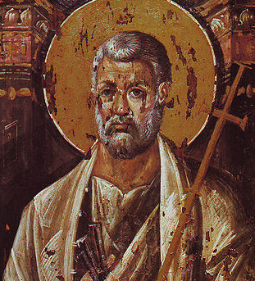
Jesus’s Friends: Peter
Then Peter got down out of the boat, walked on the water and came toward Jesus. But when he saw the wind, he was afraid and, beginning to sink, cried out, “Lord, save me!”
Immediately Jesus reached out his hand and caught him. “You of little faith,” he said, “why did you doubt?”
-Mt 14:30-31
Notes:
Photo Credit: Saint Peter. Unknown. Public Domain.
Directions: Have students copy the side information in their notebooks.
Teaching Point: Among his disciples, Jesus formed many deep friendships. His Apostles were certainly counted among his closest friends. Commitment and friendship go hand in hand.
Some consider Peter to have been Jesus’s best friend. Peter is an example for Christians whose faith is challenged (Matthew 14:28–31). He frequently was unsure of his position and understanding, acting out in ways that caused Christ to scold him for behaving irrationally. Although with many flaws, Peter always sought to do what Christ asked. Peter dared to be different from the other Apostles because he truly loved his teacher and would do anything for Christ, even if he had his moments. Peter was impulsive and acted without thinking things through especially when he denied knowing Jesus but Jesus still elevated him to become the leader of the Church.
Online Resources: Have students view video, Peter in the Chosen. URL here: https://youtu.be/0QcOWhJ-BfU
The videos linked in this presentation file may contain copyright material. Such material is made available for educational purposes only. This constitutes a “fair use” of any such copyright material as provided for in Title 17 U.S.C. section106A-117 of the US Copyright Law.

Slide 11
Jesus has chosen us to be his friends
It is a friendship of remaining or abiding. Christ isn’t just someone who walks next to you; rather, you are to enter into profound communion with him. Again, this is more intensely life-changing than any human friendship.
Notes:
Photo Credit: Keith Allison from Hanover, MD, USA. Creative Commons Attribution-Share Alike 2.0.Francisco Lindor, Lonnie Chisenhall high five. https://commons.wikimedia.org/wiki/File:Francisco_Lindor,_Lonnie_Chisenhall_high_five_(35071472720).jpg
Directions: Have students copy the side information in their notebooks. Ask, Which three of the eight requests Jesus made about friendship do you find the most important? Explain your response.
Teaching Point: His words uncover a way for us to be friends with him in a different way, a deeper way. Here are eight requests Jesus makes to be friends with Jesus…
1 Believe in Jesus I am the resurrection and the life; whoever believes in me, even if he dies, will live, and everyone who lives and believes in me will never die. Do you believe this? (Jn 11:25–26)
2 Invite Jesus into Your Life Behold, I stand at the door and knock. If anyone hears my voice and opens the door, [then] I will enter his house and dine with him, and he with me. (Rv 3:20)
3 Love God You shall love the Lord, your God, with all your heart, with all your soul, and with all your mind. This is the greatest and the first commandment. (Mt 22:37–38)
4 Put the Son of God First Whoever loves father or mother more than me is not worthy of me, and whoever loves son or daughter more than me is not worthy of me. (Mt 10:37)
5 Love Others Love one another. As I have loved you, so you also should love one another. This is how all will know that you are my disciples, if you have love for one another. (Jn 13:34–35)
6 Serve Others If I, therefore, the master and teacher, have washed your feet, you ought to wash one another’s feet. I have given you a model to follow, so that as I have done for you, you should also do. (Jn 13:14–15)
7 Forgive Others Then Peter approaching asked him, “Lord, if my brother sins against me, how often must I forgive him? As many as seven times?” Jesus answered, “I say to you, not seven times but seventy-seven times.” (Mt 18:21–22)
8 Witness to Jesus without Fear Do not be afraid. . . . I tell you, everyone who acknowledges me before others the Son of Man will acknowledge before the angels of God. (Lk 12:7, 8)
Online Resources: Have students view video, Do Catholics Have a Relationship With Jesus? URL here: https://youtu.be/K16iIuk6eAs
The videos linked in this presentation file may contain copyright material. Such material is made available for educational purposes only. This constitutes a “fair use” of any such copyright material as provided for in Title 17 U.S.C. section106A-117 of the US Copyright Law.

Slide 12
Memorize It
Key
Verse
“I have called you friends, for everything that I learned from my Father I have
made known to you.”
-Jn 15:15
Notes:
Directions: Have students copy the quote. Add bonus points to the assessment if they can copy it down demonstrating that they memorized it.
The videos linked in this presentation file may contain copyright material. Such material is made available for educational purposes only. This constitutes a “fair use” of any such copyright material as provided for in Title 17 U.S.C. section106A-117 of the US Copyright Law.

Slide 13
Evangelization
Key
Vocab
The bringing of the Good News of Jesus Christ to others through
words and actions.
Notes:
Photo Credit: Unsplash. Creative Commons Zero, Public Domain Dedication.I love Jesus Christ. https://commons.wikimedia.org/wiki/File:I_love_Jesus_Christ.jpg
Directions: Have students copy down this key term in their vocab section of their notes.
The videos linked in this presentation file may contain copyright material. Such material is made available for educational purposes only. This constitutes a “fair use” of any such copyright material as provided for in Title 17 U.S.C. section106A-117 of the US Copyright Law.

Slide 14
Discipleship & Commitment
In the word discipleship we see the word ‘discipline’. List three things in your life that require discipline and commitment.
Notes:
Directions: Have students copy the side information in their notebooks.
Teaching Point: The high school years are chock-full of examples of dedicated commitment. Consider, for example, the commitment it takes to complete a broad academic course of study, often including college preparatory classes make an athletic team and compete against rival schools memorize a part in a school play master a musical composition, maybe while learning marching steps work at a part-time job, maybe in a high-pressure retail situation.
Of those three things you listed how would that level of commitment make your faith life better if you gave it to Jesus?
Online Resources: Assign article, Catholic Discipline. URL here: https://catholicexchange.com/catholic-discipline/
The videos linked in this presentation file may contain copyright material. Such material is made available for educational purposes only. This constitutes a “fair use” of any such copyright material as provided for in Title 17 U.S.C. section106A-117 of the US Copyright Law.

Slide 15
Four Ways to Evangelize
Engage
Greet
Invite
Todos Todos Todos
Question
Notes:
Directions: Have students copy the side information in their notebooks.
Teaching Points: Ten years after the World Youth Day in Rio de Janeiro, Pope Francis told those gathered at the 2023 World Youth Day in Lisbon, Portugal, that the Church is meant to be a home for “everyone, everyone, everyone!” (“todos, todos, todos,” in Spanish and Portuguese). “This is the Church,” the pope said, “the mother of all; there is room for all.” It is our task to make sure that everyone hears these welcoming words. How do you do so?
Greet. A sincere smile, nod, or glance toward another is a friendly, simple step to acknowledge their presence and worth.
Engage. Who do you know who is in need of a friend? How can your offer of friendship be a sign of Christ’s love?
Question. What is it that keeps your peers from the love of Christ and participation in the Church? Some may cite certain issues that are bothering them. Others may be at a loss for words, perhaps acknowledging that their faith has been idle because of their own lack of effort. In any case, bring them the offer of Christ’s promise of fullness of life in this world and the next.
Invite. Certainly, an invitation to Mass or a parish-sponsored youth event would be an appropriate step here. But it’s not the only step. Remember, Jesus’s call to discipleship is rooted in friendship. As a disciple of Christ, you can be a friend to those you wish to reach. Jesus connected and formed friendships with people of all kinds. Do the same. This isn’t an exercise in popularity. Rather, make a sincere effort to be friends to all, especially those with the most need.
Online Resources: Assign article, A necessary conversion: Jesuit writes about challenge of welcoming 'todos'. URL here: https://www.usccb.org/news/2023/necessary-conversion-jesuit-writes-about-challenge-welcoming-todos
The videos linked in this presentation file may contain copyright material. Such material is made available for educational purposes only. This constitutes a “fair use” of any such copyright material as provided for in Title 17 U.S.C. section106A-117 of the US Copyright Law.

Slide 16
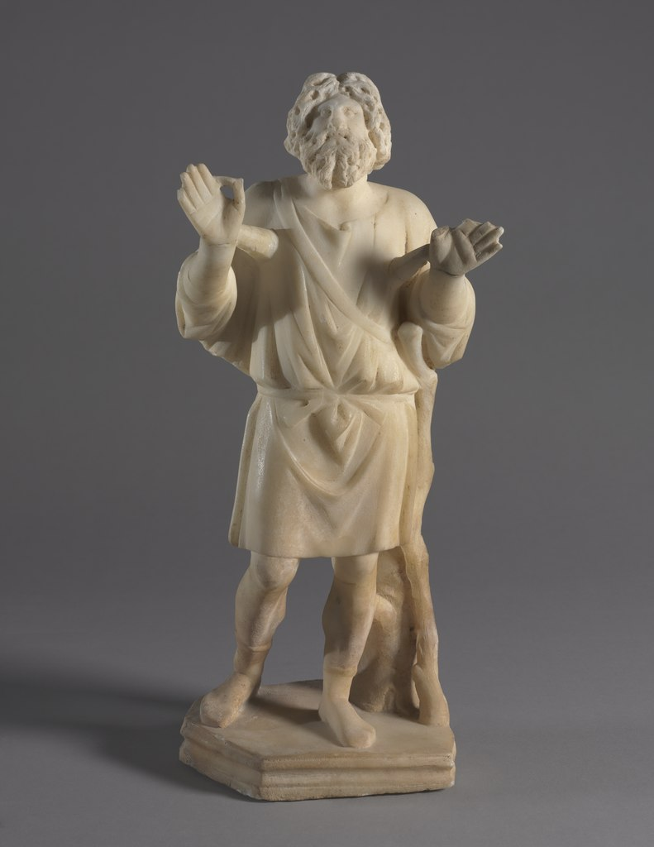
Jesus Taught His Disciples How to Pray
Pray with…
Sincerity
Confidence
Persistence
Faith
A Forgiving Heart
Others
Him
Notes:
Photo Credit: Jonah Praying. Unknown. Public Domain.
Directions: Have students copy the side information in their notebooks.
Teaching Points: Here are seven lessons Jesus taught about prayer.
1 Pray with Sincerity Sincerity, associated with truthfulness, is a virtue that Jesus practiced and preached about. He said (in regard to taking oaths), “Let your ‘Yes’ mean ‘Yes,’ and your ‘No’ mean ‘No’” (Mt 5:37). With this level of sincerity, taking an oath is unnecessary as all of our words and actions will be imbued with sincerity. We take our true selves to God in prayer. He sees us as we truly are. To counteract any temptation to hypocrisy when we pray, Jesus said to “go to your inner room, close the door, and pray to your Father in secret” (Mt 6:6). In a quiet room we can spend some time in peace with God. Being alone helps us to keep our motives pure. When we are alone, we aren’t there to impress any one. We are there to talk with God.
2 Pray with Confidence Jesus taught that we should pray with the confidence of little children, who, when they ask their parents to take care of a need (e.g., “I want dinner” or “Wipe my nose”), are 100 percent confident that their parents will respond and come to their aid. Addressing parents, Jesus said, “Which one of you would hand his son a stone when he asks for a loaf of bread, or a snake when he asks for a fish? If you then, who are wicked, know how to give good gifts to your children, how much more will your heavenly Father give good things to those who ask him” (Mt 7:9–11).
3 Pray with Persistence Do you recall the parable Jesus told of a widow and a judge (see Luke 18:1–8)? The judge was one-sided and powerful, and he ignored the widow. The widow was powerless and defenseless. There was no way she could influence the judge to decide for her, and there were little consequences to him if he ruled against her. But he did decide for the widow because she kept badgering him and would not take no for an answer. Jesus adds, “Will not God then secure the rights of his chosen ones who call out to him day and night?” (Lk 18:7). Pope Francis said to think of persistence in prayer like a houseplant. “We need to water it consistently every day. We cannot soak it and then leave it without giving it water for a week. Even more so with prayer,” the pope said.
4 Pray with Faith An increase in faith should accompany your persistence in prayer. Jesus told the Apostles, “If you have faith the size of a mustard seed, you would say to [this] mulberry tree, ‘Be uprooted and planted in the sea,’ and it would obey you” (Lk 17:6). St. Thérèse of Lisieux said that when we pray, “We must abandon the future into the hands of God.” Praying with faith is both a sign of our faith and a request for more faith. The Apostles said to Jesus, “Increase our faith” (Lk 17:5). Jesus tells them even with faith as small as the mustard seed they will be able to do momentous things. “Whatever you ask for in prayer with faith, you will receive” (Mt 21:22), Jesus also said.
5 Pray with a Forgiving Heart Jesus said, “When you stand to pray, forgive anyone against whom you have a grievance, so that your heavenly Father may in turn forgive you your transgressions” (Mk 11:25). The Lord’s Prayer states this as a requirement in one of its petitions: “And forgive us our trespasses, as we forgive those who trespass against us.” According to the second part of the petition, our prayer will not be heard unless we meet the strict requirement of forgiving anyone who has sinned against us. Christian forgiveness extends to forgiveness of our enemies: “Forgiveness is a high-point of Christian prayer; only hearts attuned to God’s compassion can receive the gift of prayer” (CCC, 2844).
6 Pray with Others We are also to pray with others and in public, for Jesus said he is present “where two or three are gathered together in my name” (Mt 18:20). These occasions of prayer include small prayer groups, praying with your family, and praying with a friend. Of course Christ is also present when we pray with the larger church community in a sacramental liturgy. Sacramental liturgy is different from informal small group prayer in that it is a public rite. Pope Francis said, “Every time we celebrate a Baptism, or consecrate the bread and wine in Eucharist, or anoint the body of a sick person with holy oil, Christ is here! It is he who acts and is present just as when he healed the weak limbs of a sick person, or when he delivered his testament for the salvation of the world at the Last Supper.”
7 Pray with Him Jesus asked his disciples in the garden the night before his Death to keep watch with him for one hour (see Matthew 26:40). Jesus also wants us to remain near. At the World Youth Day in Lisbon, hundreds of thousands of young Catholics dropped to their knees at the presence of the monstrance after Pope Francis’s address. Prayer before the Blessed Sacrament in adoration is like hanging out with a good friend without having to say a word. You know and experience the love between you just by being close
Online Resources: Assign article, Blessed Carlo Acutis And Friendship With Jesus In The Eucharist
URL here: https://spiritualdirection.com/2023/05/04/blessed-carlo-acutis-and-friendship-with-jesus-in-the-eucharist
The videos linked in this presentation file may contain copyright material. Such material is made available for educational purposes only. This constitutes a “fair use” of any such copyright material as provided for in Title 17 U.S.C. section106A-117 of the US Copyright Law.

