Slide 1
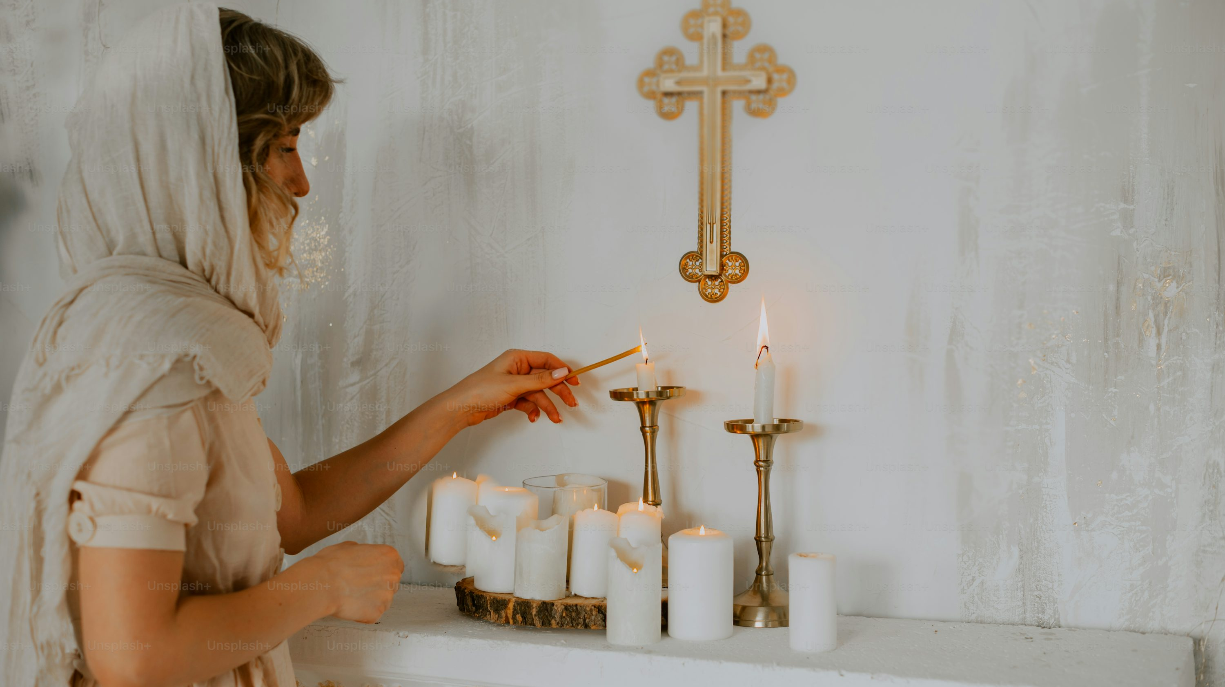
6
Our Spiritual Journey to God
God Saves: We Are Redeemed through the Paschal Mystery
Notes:
Suggestions for students’ note taking:
●Require students to use a three ring binder (1/2-1 inches) full of loose leaf paper (college or wide ruled).
●Notes must be taken in pen only and hand written.
●Notebooks should contain information and notes for religion class only.
●Notebooks must have a table of contents with topic of notes, dates and page numbers.
●All notes must have a topic and page number.
●Students will be required to copy each slide unless the teacher directs students to skip certain slides or parts of slides. Notebooks will be graded based on neatness, completeness and organization. Notebooks should have a significant point value representing 20-25% of the overall grade.
The videos linked in this presentation file may contain copyright material. Such material is made available for educational purposes only. This constitutes a “fair use” of any such copyright material as provided for in Title 17 U.S.C. section106A-117 of the US Copyright Law.

Slide 2


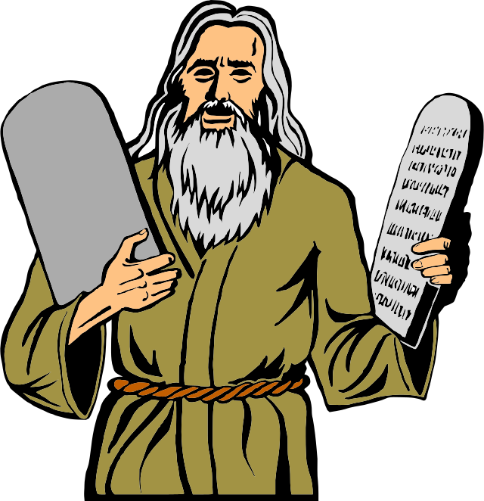

How Catholics Connect with Faith
We profess our verbal assent to the mystery of faith in the Apostles’ Creed and Nicene Creed.
We celebrate the mystery of faith in the sacraments.
We live the mystery of faith in conformity to Christ’s moral laws.
We live the mystery of faith
through a personal relationship with the living and true God.
Notes:
Photo Credit: Bread and Wine.anonymous.Creative Commons Zero, Public Domain Dedication. emoji amém.Traderb90.Creative Commons Attribution-Share Alike 4.0. Sacred Heart of Jesus Christ Majella1851.Creative Commons Attribution-Share Alike 4.0. Moses with The Ten Commandments stones clipart.ArtsyBee.Creative Commons Zero, Public Domain Dedication. https://commons.wikimedia.org/
Directions: Have students summarize into a few words the four ways Catholics connect to faith in their notes.
Teaching Points: After Jesus met Thomas in person and allowed Thomas to touch the wounds on his hands and side, he shared a message for future generations: “Have you come to believe because you have seen me? Blessed are those who have not seen and have believed” (Jn 20:29).
For us to share in the Paschal Mystery, we must do so by faith. The opening to Part Four of the Catechism of the Catholic Church (2558) summarizes how Christians are asked to connect with the great mystery of faith.
First, we are to profess the mystery as stated in the Apostles’ Creed.
Second, we are to celebrate the mystery in the sacraments.
Third, we are to live the mystery in conformity to Christ, in the Holy Spirit, and to the glory of God the Father. In other words, we are to believe in the mystery, celebrate the mystery, and live the mystery.
Finally, we are asked to do a fourth thing. We are to live the mystery through a personal relationship with the living and true God.
Online Resources: Have students read article about the four pillars of the Catechism of the Catholic Church, ‘The Catechism of the Catholic Church: Sturdy Pillars and Golden Threads’.
https://www.catholic365.com/article/30406/the-catechism-of-the-catholic-church-sturdy-pillars-and-golden-threads.html
The videos linked in this presentation file may contain copyright material. Such material is made available for educational purposes only. This constitutes a “fair use” of any such copyright material as provided for in Title 17 U.S.C. section106A-117 of the US Copyright Law.

Slide 3

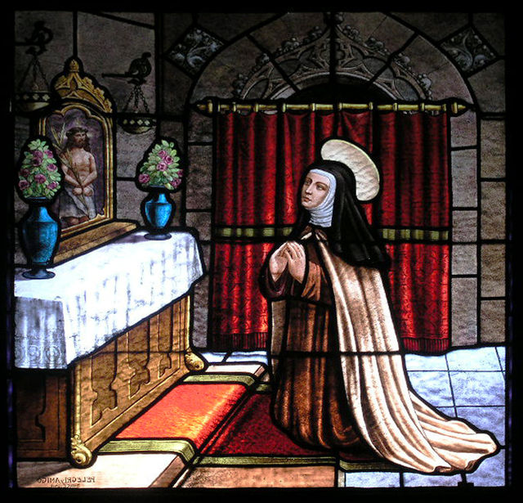
“Prayer Is Conversation with God”
The fourth way we can connect with our faith is to develop a personal relationship with God
We can develop a personal relationship with God through prayer
We can look to some good friends of Jesus to see how this worked for them
Saint Theresa of Avila
Notes:
Photo Credit: Saint Theresa, church window, Convento de Sta Teresa, Ávila de los Caballeros, Spain. Håkan Svensson
Creative Commons Attribution 2.5. https://commons.wikimedia.org/wiki/File:Avila_Convento_de_Sta_Theresa_Church_window03.jpg
Directions: Have students copy the information from the slide into their notes. Read aloud the quotes from these Saints on their prayer life.
St. Thérèse of Lisieux wrote, “For me, prayer is a surge of the heart; it is a simple look toward heaven, it is a cry of recognition and love, embracing both trial and joy.”
St. Teresa of Avila spoke of prayer as a journey with the invisible God, a companion who walks next to you along the path of life.
St. Augustine said that “true prayer is nothing but love.”
St. Clement of Alexandria also offered a description of prayer that you might be most familiar with: “Prayer is conversation with God.”
Teaching Points: All of the Saints knew about these Top Five Reasons to Pray:
Prayer is central to an ongoing relationship between people and God, facilitating a relationship between us and the three Divine Persons of the Blessed Trinity.
In prayer, we approach God the Father through God the Son and with the help of the Holy Spirit.
In order to pray, we have to be able to listen to God. He speaks to us in many ways, including, most commonly, through our mind.
He also speaks to us in the good words and actions that emanate from us after we pray.
Prayer helps us to combat evil. It is a guard against arrogance and protects us from following our own false ideology
Online Resources: View Video, ‘Approaching prayer as conversation’. URL here: https://youtu.be/hkinV3_1W5E
Assign article, ‘Nurturing a Deeper Relationship With God’. URL here: https://www.catholic365.com/article/32118/nurturing-a-deeper-relationship-with-god.html
Assign article, ‘Prayer’. URL here: https://www.catholiceducation.org/en/religion-and-philosophy/spiritual-life/prayer.html
The videos linked in this presentation file may contain copyright material. Such material is made available for educational purposes only. This constitutes a “fair use” of any such copyright material as provided for in Title 17 U.S.C. section106A-117 of the US Copyright Law.

Slide 4
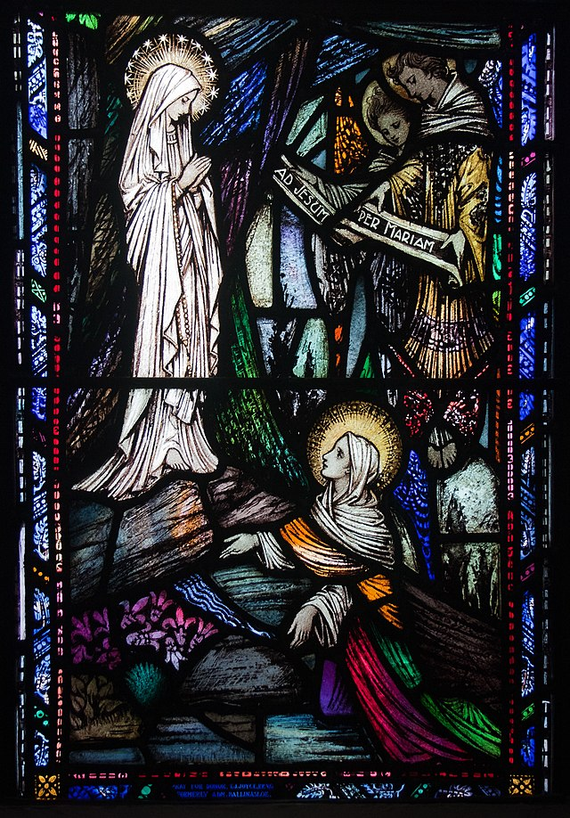
Apparitions
Key
Vocab!
Supernatural visions in which a person or angel, not accessible to human powers or senses, is seen and usually heard. The Church may confirm these or not.
Notes:
Photo Credit: St. Bernadette Lourdes. Andreas F. Borchert. Creative Commons Attribution-Share Alike 4.0. https://commons.wikimedia.org/wiki/File:Ballinasloe_St._Michael%27s_Church_South_Aisle_Fourth_Window_Our_Lady_of_Lourdes_and_Saint_Grellan_by_William_Earley_Detail_Our_Lady_of_Lourdes_and_Saint_Bernadette_2010_09_15.jpg
Directions: Have students add this vocabulary term to their notes.
Teaching Points: God has spoken to people—including many saints—through visions, revelations, and apparitions. The Church, through local bishops, has approved several specific times God has spoken in these ways to individuals and disapproved of many others
Online Resources: Have students view video, ‘Lessons from Lourdes: Our Lady of Lourdes and St. Bernadette’
URL Here: https://youtu.be/DshDkE6O9UA
The videos linked in this presentation file may contain copyright material. Such material is made available for educational purposes only. This constitutes a “fair use” of any such copyright material as provided for in Title 17 U.S.C. section106A-117 of the US Copyright Law.

Slide 5

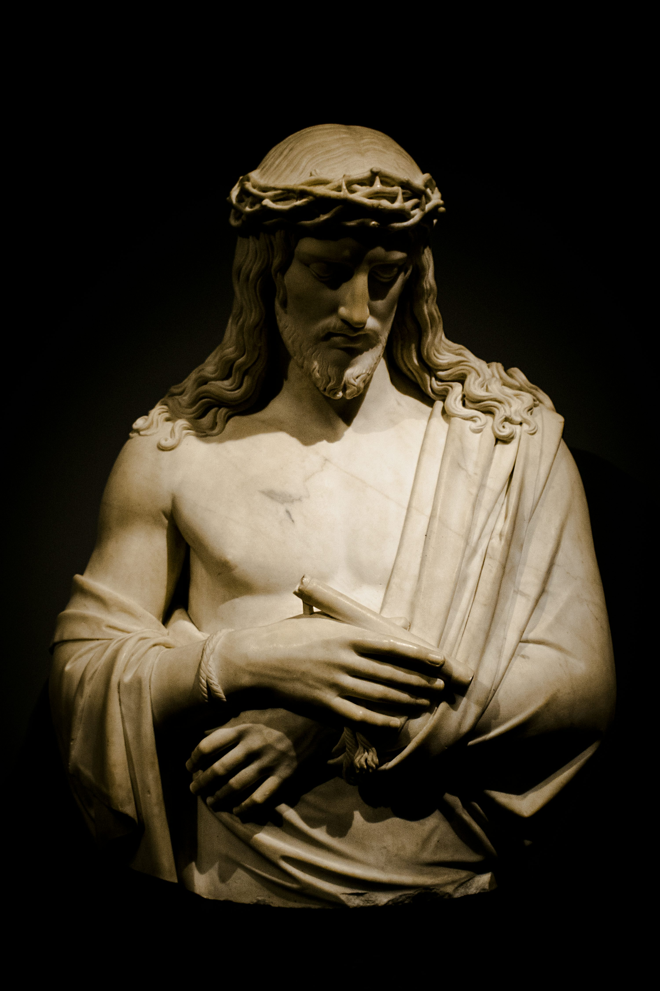
God spoke to people’s minds directly in
the Bible
Notes:
Photo Credit: https://unsplash.com/photos/jesus-christ-rvJBpwEX-1Y
Directions: Have students copy information from slide into their notes and add one example from the teaching points below.
Teaching Points: There are several occasions described in Scripture that show us that God speaks to our minds directly, revealing more of himself to us.
For example:
After Peter correctly answered Jesus’s question “Who do people say that the Son of Man is?” with “You are the Messiah, the Son of the living God,” Jesus replied: “Blessed are you, Simon son of Jonah. For flesh and blood has not revealed this to you, but my heavenly Father” (Mt 16:13, 15–16).
While in Philippi, Paul encountered a woman named Lydia, a “worshipper of God,” outside of the city gate. She listened to Paul’s preaching, “and the Lord opened her heart to pay attention to what Paul was saying” (Acts 16:14).
St. Paul wrote of knowing and preaching “God’s wisdom, mysterious, hidden, which God predetermined before the ages for our glory” and which has only been “revealed to us through the Spirit” (1 Cor 2:7, 10).
The videos linked in this presentation file may contain copyright material. Such material is made available for educational purposes only. This constitutes a “fair use” of any such copyright material as provided for in Title 17 U.S.C. section106A-117 of the US Copyright Law.

Slide 6
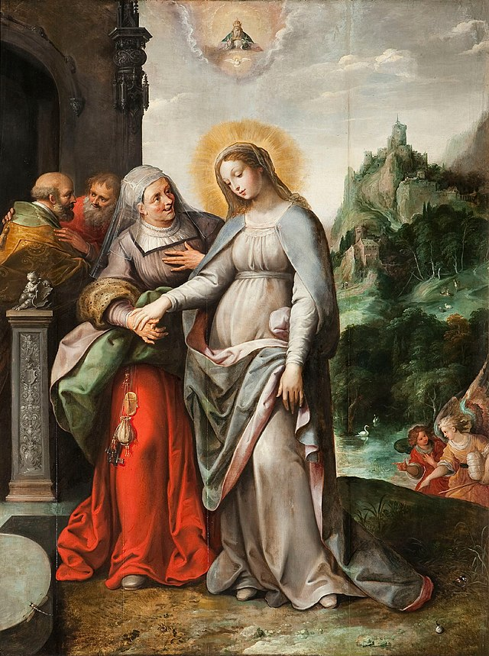
Magnificat
Key
Vocab!
Latin for “magnifies,” the term expresses the first words of the Canticle of Mary in Luke 1:46–55. Most of the canticle may have been part of a Jewish hymn from earlier generations.
Notes:
Photo Credit: Visitation. Frans Francken the Younger / Ambrosius Francken II / Joos de Momper the Younger
Public domain. https://commons.wikimedia.org/wiki/File:Ambrosius_Francken_(II),_Frans_Francken_(II)_and_Joos_de_Momper_(II)_-_Mary_visits_her_niece_Elizabeth.jpg
Directions: Have students add this vocabulary term to their notes.
The videos linked in this presentation file may contain copyright material. Such material is made available for educational purposes only. This constitutes a “fair use” of any such copyright material as provided for in Title 17 U.S.C. section106A-117 of the US Copyright Law.

Slide 7
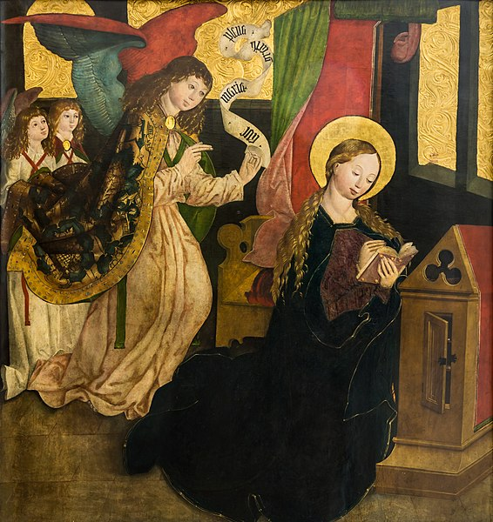
How Mary Prayed
Jesus primarily learned to pray from his parents, Mary and Joseph
Mary is sometimes called Orans, a Latin word to describe someone who is constantly at prayer (see CCC 2679)
Mary’s prayer life was fed by her love of the the Old Testament
Notes:
Photo Credit: Meister von Seitenstetten - Maria Verkündigung.JPG
Master of Seitenstetten. Public domain. https://commons.wikimedia.org/wiki/File:Meister_von_Seitenstetten_-_Maria_Verk%C3%BCndigung.JPG
Directions: Have students copy information from the slide into their notes.
Teaching Points: Mary uttered the beautiful canticle known as the Magnificat that is recorded in Luke 1:46–55. As Jesus once did, the Church now prays in communion with Mary “to magnify with her the great things the Lord has done for her, and to entrust supplications and praises to her” (CCC, 2682). St. Joseph, Jesus’ legal father, is a model of contemplative prayer. “Contemplation is a gaze of faith, fixed on Jesus"
Online Resources: View video, ‘Meaning of the Magnificat Prayer’. URL Here: https://youtu.be/TxBK4eFaqK0
The videos linked in this presentation file may contain copyright material. Such material is made available for educational purposes only. This constitutes a “fair use” of any such copyright material as provided for in Title 17 U.S.C. section106A-117 of the US Copyright Law.

Slide 8
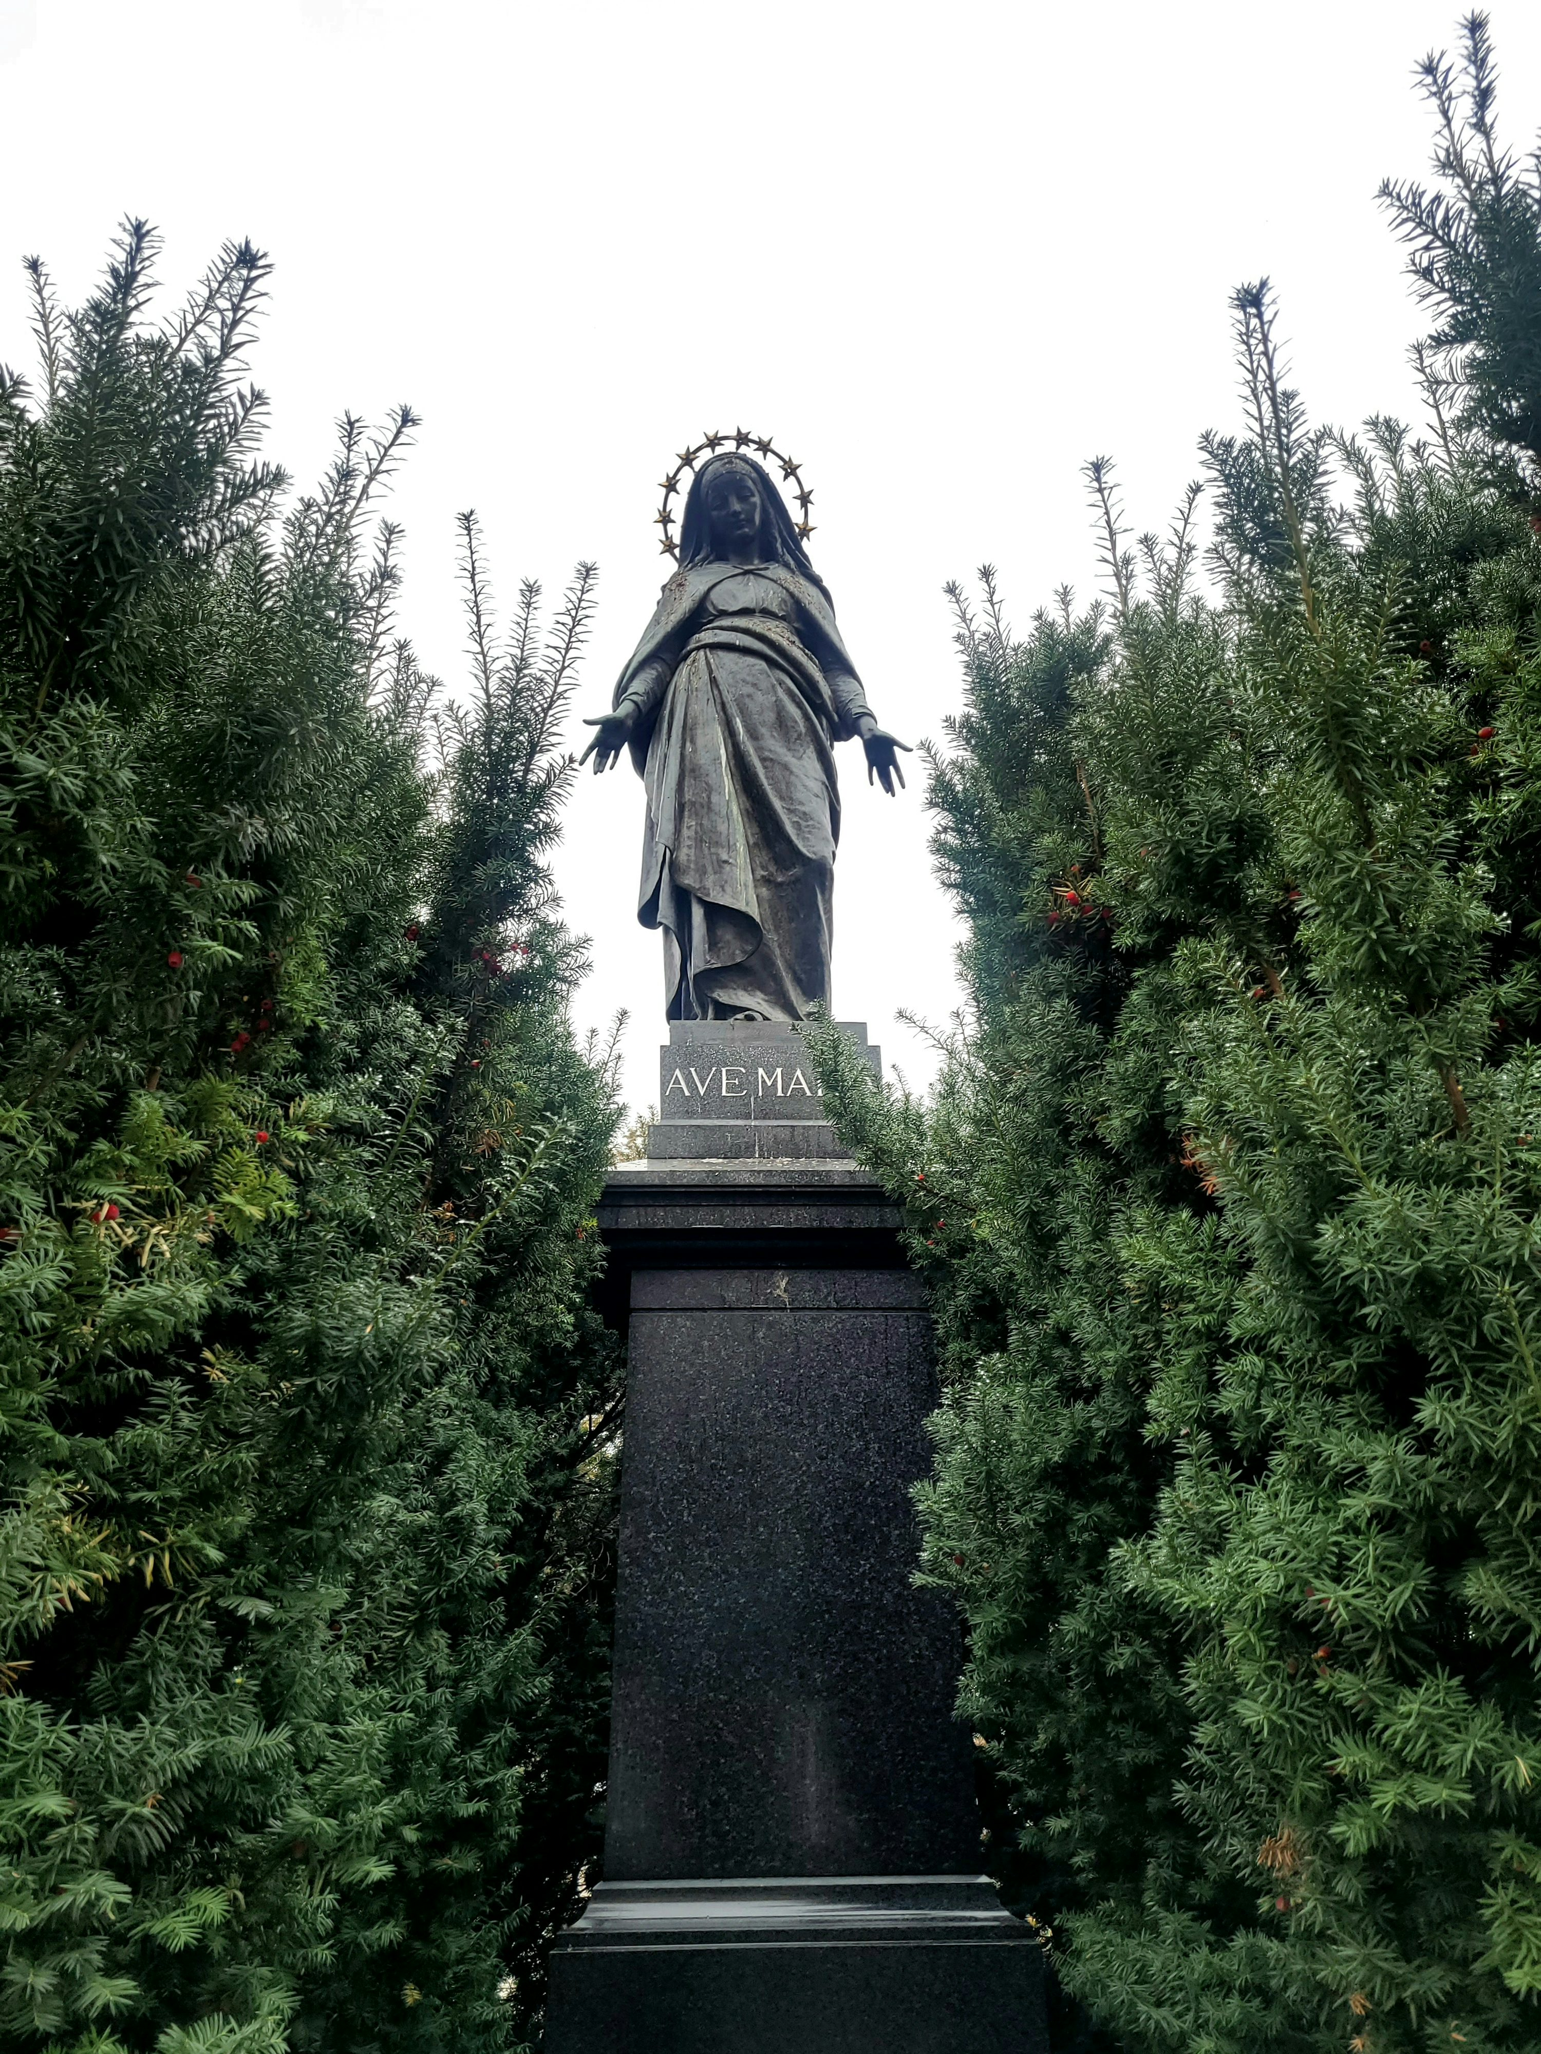
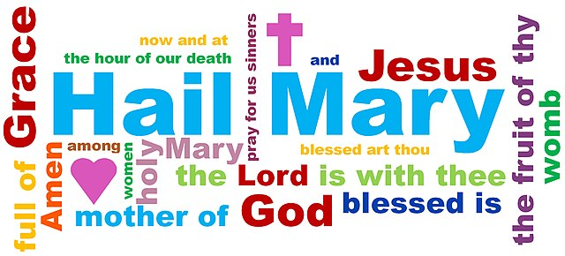
The Hail Mary is a Biblical Prayer
Notes:
Photo Credit: Mark LaPointe. Creative Commons Attribution-Share Alike 4.0. The Hail Mary prayer displayed as a word cloud.jpg. https://commons.wikimedia.org/wiki/File:The_Hail_Mary_prayer_displayed_as_a_word_cloud.jpg . Crucifix, Rosary and Holy Bible with Apocrypha NRSV.png. Kirkworld. Creative Commons Zero, Public Domain. commons.wikimedia.org
Directions: Recite the Hail Mary prayer together as a class. Have students take notes on the article in Online Resources.
Teaching Points: There are usually two identifiable obstacles that some Christians face when it comes to praying to Mary.
The first one is a misunderstanding of the word 'pray' and the second one is that they think the Hail Mary is at odds with the Bible.
Both obstacles are easy to remove…
The word pray is what throws a lot of Bible Christians off. When they hear 'pray to Mary', they equate that with 'worship Mary'. But a careful analysis of the word pray points to the fact that pray first and foremost just means 'to ask'. Here's Webster Dictionary's definition: 1: to make a request in a humble manner 2: to address God with adoration, confession, supplication, or thanksgiving. In the Hail Mary we are doing definition 1 and Mary is doing definition 2 for us.
Online Resources: Have students take notes on the article, ‘Bible Christians Should Pray to Mary Too’. URL here: https://www.catholic365.com/article/30190/why-bible-christians-should-pray-to-mary.html
The videos linked in this presentation file may contain copyright material. Such material is made available for educational purposes only. This constitutes a “fair use” of any such copyright material as provided for in Title 17 U.S.C. section106A-117 of the US Copyright Law.

Slide 9
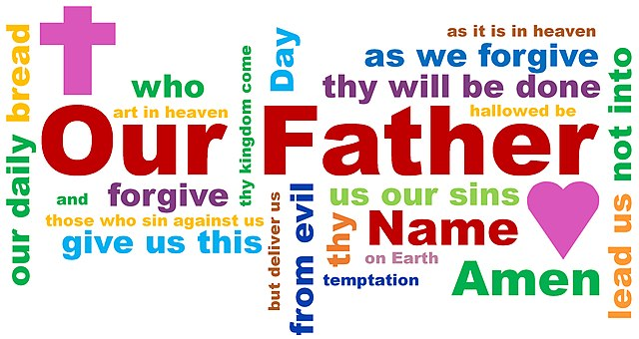
The Our Father is a Biblical Prayer
Notes:
Photo Credit: Mark LaPointe. Creative Commons Attribution-Share Alike 4.0.The Our Father prayer as a word cloud.jpg, https://commons.wikimedia.org/wiki/File:The_Our_Father_prayer_as_a_word_cloud.jpg
Directions: Recite the Our Father prayer together as a class. Have students take notes on the article in Online Resources.
Teaching Points: Jesus also taught his disciples how to pray when they asked him.
For example, in Luke 11:5–13 Jesus told his disciples to pray constantly with faith that their prayers would be answered: “I tell you, ask and you will receive; seek and you will find; knock and the door will be opened to you” (Lk 11:9).
Jesus also said that there is no need to “babble like the pagans, who think that they will be heard by their many words,” explaining that the “Father knows what you need before you ask him” (Mt 6:8).
Most importantly, Jesus gave them the words of the Our Father, also known as the Lord’s Prayer, which forms a basis for the Church’s understanding of the value of prayer
The version of the Our Father in the Gospel of Matthew has seven petitions (in contrast to five petitions in Luke’s Gospel). The first three petitions are petitions of praise made directly to God, addressing his name, his Kingdom, and his will. The last four petitions are driven by concerns for the present world, beginning with these requests: “give us,” “forgive us,” “lead us,” and “deliver us.”
Online Resources: Have students read article , ‘The Our Father’. URL here: https://www.catholic.com/tract/the-lords-prayer
The videos linked in this presentation file may contain copyright material. Such material is made available for educational purposes only. This constitutes a “fair use” of any such copyright material as provided for in Title 17 U.S.C. section106A-117 of the US Copyright Law.

Slide 10
Ways We Can Use Scripture to Pray
PRAYING THE MASS: The Mass is centered around and full of scripture
SCRIPTURAL WAY OF THE CROSS: includes only stations explicitly referenced in the Bible
THE LITURGY OF THE HOURS: a set of daily prayers and scriptures prescribed by the Church
LECTIO DIVINA: a prayerful reading of God’s Word to encounter the Holy Spirit
SCRIPTURAL ROSARY: a method of praying the Rosary using Scripture readings
Notes:
Directions: Have students copy information from the slide into their notes.
Teaching Points: Besides containing many models of prayer, Sacred Scripture is also a rich source of prayer itself. • The Mass is “the prayer par excellence” according to Pope Francis. It should be experienced attentively and with right intention. Many of the parts of the Mass are taken derived directly from the Scriptures. • The Liturgy of the Hours, or Divine Office, is known as the Church’s public worship. It is a daily prayer based on the Paschal Mystery and helps to keep the entire day holy. • Lectio divina is a component of the Liturgy of the Hours. The Latin term means “sacred reading,” and it involves meditating on short Scripture passages.
Online Resources: see Catholic Resources website, Methods of Praying with the Scriptures by Felix Just, S.J., Ph.D. URL here: https://catholic-resources.org/Bible/Prayer-Methods.htm
The videos linked in this presentation file may contain copyright material. Such material is made available for educational purposes only. This constitutes a “fair use” of any such copyright material as provided for in Title 17 U.S.C. section106A-117 of the US Copyright Law.

Slide 11

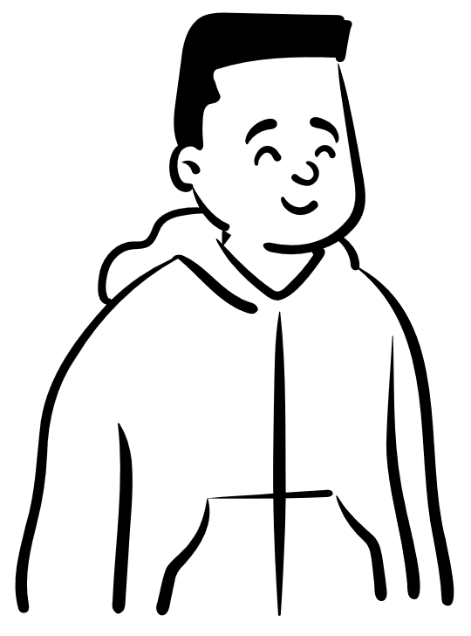
Spontaneous Prayer
Lord God, help me, help me, help me!
Lord have mercy on me
You O Lord are All Good and All Holy
Jesus, I love you
Get behind me Satan
Notes:
Photo Credit: People.svg,Creative Commons Zero, Public Domain Dedication. https://commons.wikimedia.org/wiki/File:People.svg
Directions: Ask students if they can add a spontaneous prayer to this short list what would it be?.
Share with the class any spontaneous prayers that you say throughout the day. (Come Holy Spirit, Praise the Lord, God Bless you etc.).
Teaching Point: Have you ever been moved to a silent or vocal burst of prayer? “Lord, help me!” is the short, powerful prayer phrase we probably use most often. But the Church has a long tradition of easily memorized short prayers of praise and contrition — called aspirations — that can be brought to our minds and our lips at any time during the day. They may have developed in response to St. Paul’s admonition to “pray without ceasing.”
Online Resources: Have students read article, ‘10 Short Powerful Prayers to Pray Throughout the Day’. URL here:https://aleteia.org/2017/09/19/10-short-and-powerful-prayers-to-pray-during-the-day
The videos linked in this presentation file may contain copyright material. Such material is made available for educational purposes only. This constitutes a “fair use” of any such copyright material as provided for in Title 17 U.S.C. section106A-117 of the US Copyright Law.

Slide 12
Three Basic Expressions of Prayer
01
VOCAL
Vocal prayer reflects the union of body and soul using spoken words and is the most effective expression of prayer as a group
02
Meditation is a quiet quest to uncover the why and how of the Christian life, in order to respond to what the Lord is asking
MEDITATION
03
CONTEMPLATION
In contemplation, you seek Christ, give yourself over to the will of the Father, and submit to the guidance of the Holy Spirit
Notes:
Directions: Have students copy down information from the slide into their notes. Share examples of each expression of prayer…
Example of Vocal: Reading Scripture aloud, praying the Our Father or Hail Mary prayer aloud, praying the rosary aloud.
Example of Meditation: Because distractions are plentiful, prayer reflection on a written text, as in the practice of lectio divina (see the subsection "Lectio Divina" in Chapter 6, Section 3), can help foster meditation. When you prayerfully read, you consider the words’ implications for your life. You ask God, “How are you speaking to me through these words?” You then wait for God’s response.
Example of Contemplation: St. John Vianney, the holy parish priest of eighteenth-century France, told of a simple peasant who experienced contemplative prayer. Every day, the 304 God Saves peasant sat in front of the tabernacle where the Lord present in the Blessed Sacrament is reserved. He explained, “I look at him and he looks at me.” Contemplation requires silence—silent love.
The videos linked in this presentation file may contain copyright material. Such material is made available for educational purposes only. This constitutes a “fair use” of any such copyright material as provided for in Title 17 U.S.C. section106A-117 of the US Copyright Law.

Slide 13
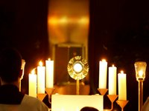
Forms of Christian Prayer
To choose the best form for prayer we must first ask…
What is the purpose of our prayer? Is it for something we need or for someone else?
To whom are we praying? Directly to God or are we asking a Saint or an Angel for their guidance and prayers?
Our we asking God for something, are we praising God, are we simply being with God in quiet?
How much time do we have?
Is it a group or an individual in prayer?
Is the Eucharist present?
Notes:
Photo Credit: altar servers who are kneeling in adoration. Melchior2008. Public domain. https://commons.wikimedia.org/wiki/File:Eucharistic_Adoration.jpg
Directions: Have students design a 30 minute prayer service by starting with the following questions. Once the questions are answered then move on to the teaching points to help them know which forms of prayer would be best. Also, use the textbook section on expressions and forms of prayer as a guide.
Teaching Points: There are many expressions of prayer—that is, personal ways to pray—with each being pleasing to God. However, when Christian prayer is heartfelt it often expresses itself in three major ways: vocal prayer, meditation, and mental prayer which may lead to contemplation. Each of these expressions may lead to a time where God’s presence is experienced intensely while at prayer. To choose the best form/expression for prayer we must first ask…
What is the purpose of our prayer? Is it for something we need or for someone else? A petition is when we are asking for something we need. An intercession is when we are praying for someone else who needs God’s help.
To whom are we praying? Directly to God or are we asking a Saint or an Angel for their guidance and prayers? We do pray directly to God but sometimes we also ask Saints or angels for their added prayers because they are closer to God in heaven and they might have a special patronage or area of life that they can relate to.
Our we asking God for something, are we praising God, are we simply being with God in quiet? If we are praying directly to God then we should determine what the best prayer form would be. Asking forgiveness, giving thanks, being in awe and wonder at His greatness and glory etc..
How much time do we have? If you are limited in time you may want to begin by asking God for his mercy and blessings. If you have more time you may want to move on to expressing your thoughts and feelings and then waiting for his reply which may be silent but still real.
Is it a group or an individual in prayer? Group prayers require more structure like using a script or readings from the Bible or praying memorized traditional prayers aloud. Usually there is always a vocal part of the prayer time when in a group but there may also be silent meditation or contemplation time as well.
Is the Eucharist present? If the tabernacle is present and/or the Eucharist is exposed in a monstrance then our posture should reflect that we are acknowledging the presence of Jesus by kneeling at the beginning and end or throughout. Adoration and thanksgiving are appropriate especially when the Eucharist is present.
Online Resources: Have students read article , ‘The Our Father’. URL here: https://www.catholic.com/tract/the-lords-prayer
The videos linked in this presentation file may contain copyright material. Such material is made available for educational purposes only. This constitutes a “fair use” of any such copyright material as provided for in Title 17 U.S.C. section106A-117 of the US Copyright Law.

Slide 14

Turn and Talk
Based on your personality which form of praying do you prefer? Explain your answer.
Notes:
Directions: Have students write down the question and then write down their answer….Then have students share their answers with one person close by.
The videos linked in this presentation file may contain copyright material. Such material is made available for educational purposes only. This constitutes a “fair use” of any such copyright material as provided for in Title 17 U.S.C. section106A-117 of the US Copyright Law.

Slide 15

Memorize It
Key
Verse!
“...pray for one another… The fervent prayer of a righteous person is very powerful.”
James 5:16
Notes:
Directions: Have students copy the quote. Add bonus points to the assessment if they can copy it down demonstrating that they memorized it.
The videos linked in this presentation file may contain copyright material. Such material is made available for educational purposes only. This constitutes a “fair use” of any such copyright material as provided for in Title 17 U.S.C. section106A-117 of the US Copyright Law.

