Slide 1
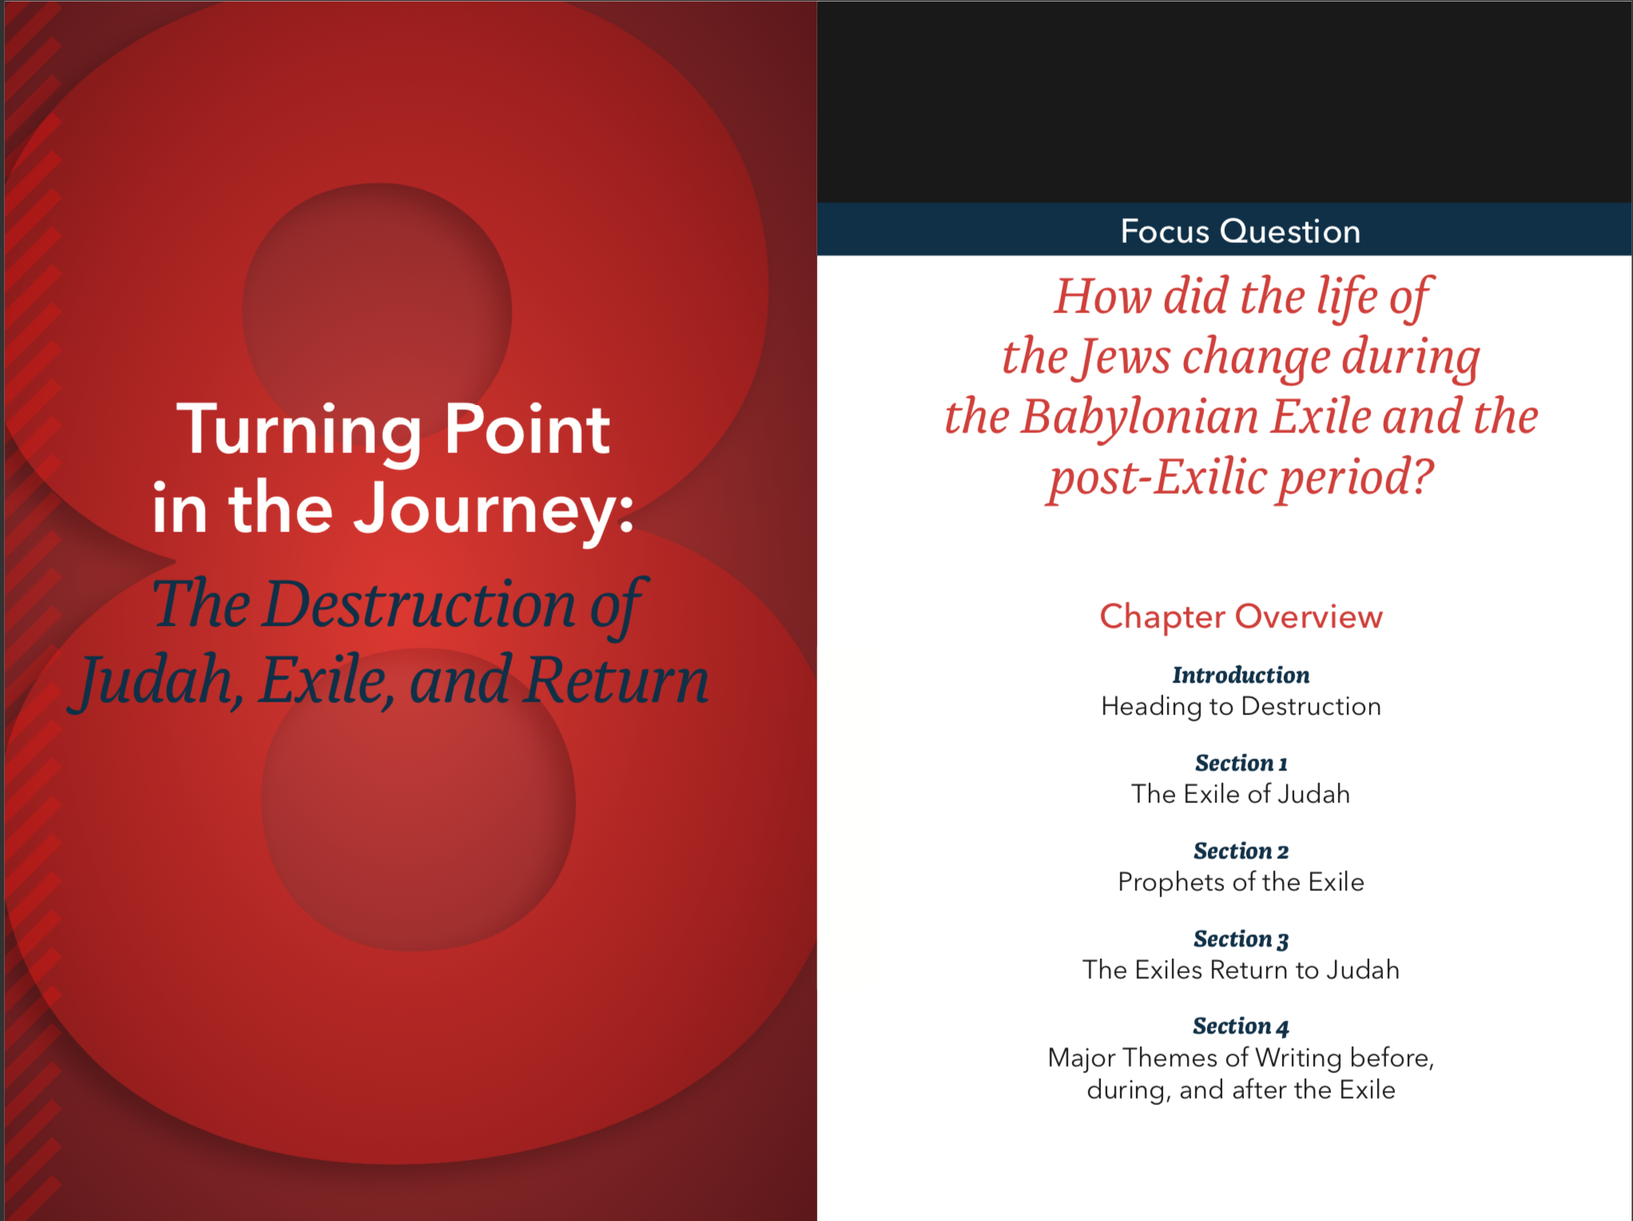
The Old Testament
Chapter Eight

Slide 2
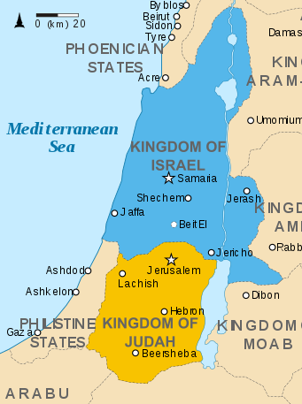
Judah
Israel
Tribes of Benjamin and Judah (less land and population)
Capital: Jerusalem
Conquered by Neo-Babylonian Empire in 586 BC
Davidic Kings
Remaining 10 tribes of the original 12 (more land and population)
Capital: Samaria
Conquered by Assyrian Empire in 722 BC
Broke off from Israel’s united kingdom
Heading to Destruction
Notes:
This slide highlights the differences between the Kingdom of Judah and the Kingdom of Israel covered further in Chapter 8.

Slide 3
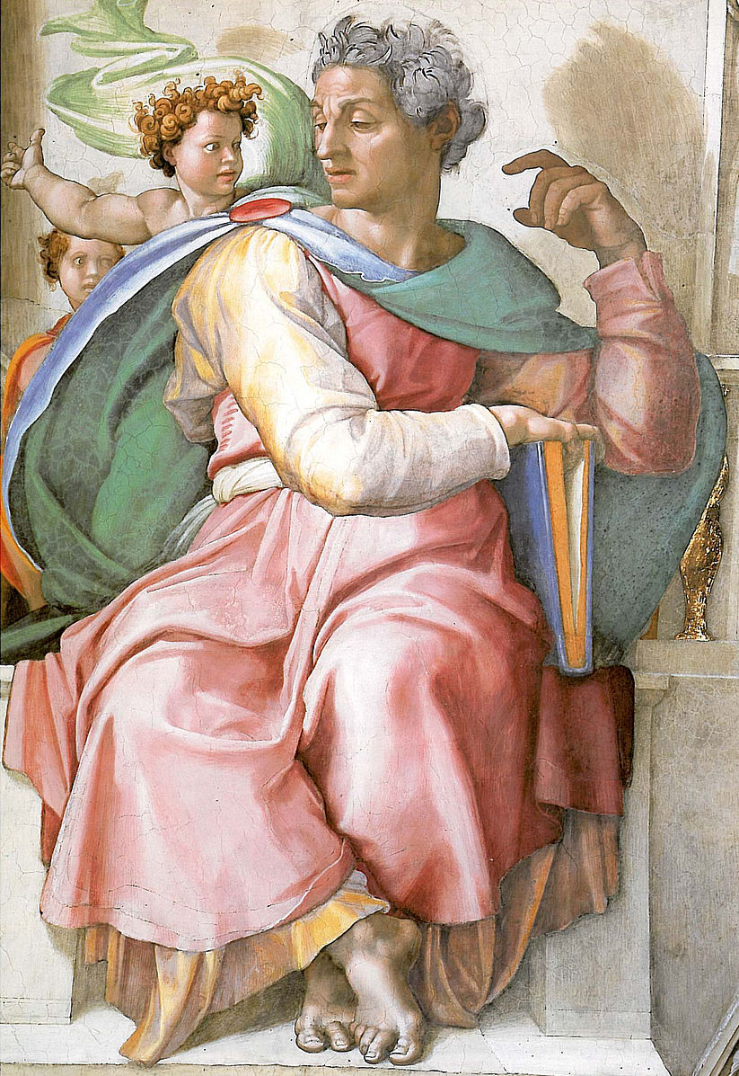
The Book of Isaiah
Isaiah 1–39
Stories and sayings of the prophet Isaiah of Jerusalem
Isaiah 40–55
A second prophet or poet, unnamed, not the original
Isaiah 55–66
Recorded by disciples of the prophet of Jerusalem inviting God’s Chosen people to share at the temple
Heading to Destruction
Notes:
See Chapter 8, Introduction, Teaching Approaches 1 and 3 in the Teacher’s Wraparound Edition.
See pages 334-335 of the Student Text.
Reference: An Introduction to the Book of Isaiah (http://www.usccb.org/bible/isaiah/0)

Slide 4
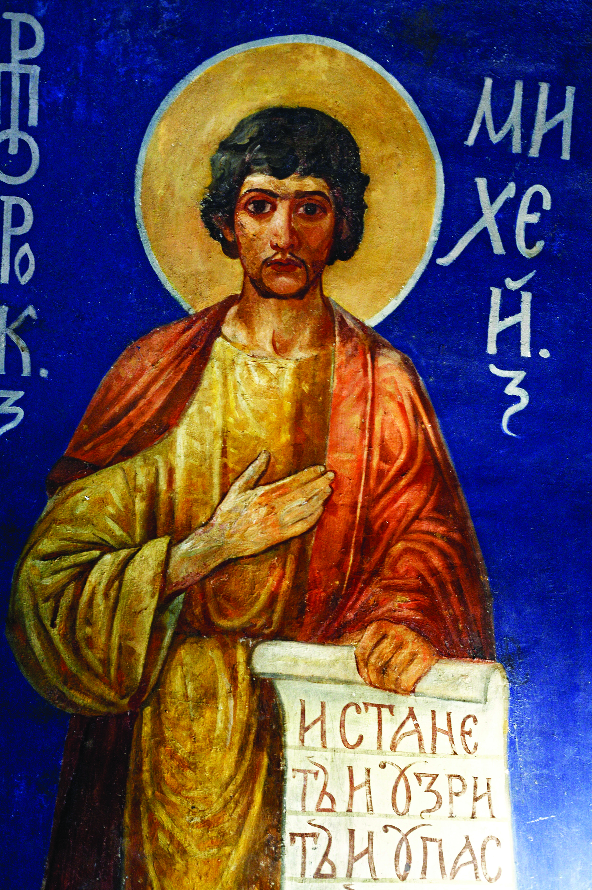
Micah’s foretelling of Jesus
But you, Bethlehem-Ephrathah
least among the clans of Judah,
From you shall come forth for me
one who is to be ruler in Israel;
Whose origin is from of old,
from ancient times.
Therefore the Lord will give them up, until the time
when she who is to give birth has borne,
Then the rest of his kindred shall return
to the children of Israel.
Micah 5:1-2
Heading to Destruction
Notes:
See Chapter 8, Introduction, Teaching Approach 3 in the Teacher’s Wraparound Edition.
See pages 336-337 of the Student Text.

Slide 5

Journal Question
Write these words as a heading: “Here I am Lord, send me.”
Then write an entry telling three things you are willing to do to serve God.

Slide 6
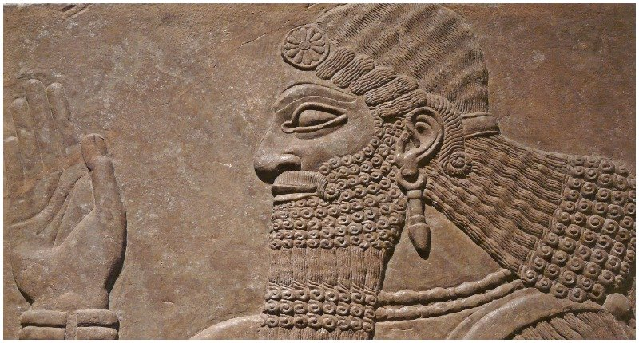
Babylonian Exile
Chronology
Babylonian king captures Jerusalem.
Many Jews are exiled.
There is an attempted revolt against by puppet king Zedekiah.
Jerusalem is crushed and the Temple is destroyed
The Exile of Judah
Notes:
Timeline of the Babylonian Exile: http://timeline.biblehistory.com/period/the-exiled to take favor from the king of Egypt, resisting Babylon.
Nebuchadnezzar returned and the city of Jerusalem was crushed. In 587 BC

Slide 7
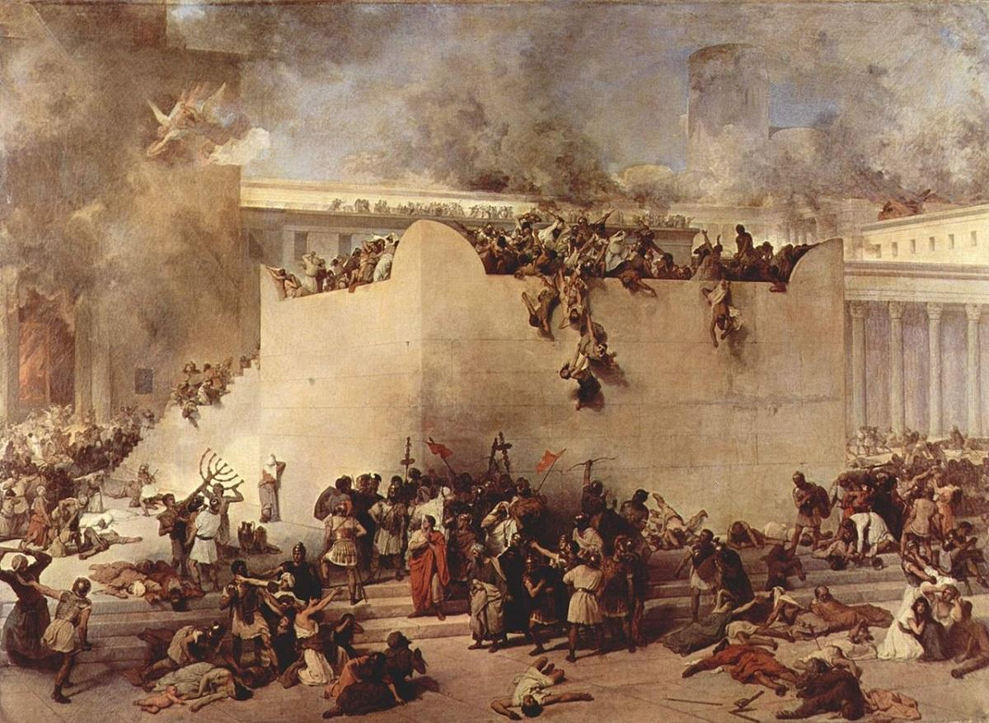
Lamentations
My eyes stream with tears over the destruction
of the daughter of my people.
My eyes will flow without ceasing,
without rest,
Until the LORD from heaven
looks down and sees.
I am tormented by the sight
of all the daughters of my city.
Lamentations 3:48-51
The Exile of Judah
Notes:
A lamentation is a passionate expression of grief or sorrow. The Book of Lamentations is a collection of Hebrew poetry written by those who remained behind in Jerusalem after the conquest of 587 BC in response to the devastation of their city.
See pages 341-342 of the Student Text.
See Chapter 8, Section 1, Teaching Approach 2 in the Teacher’s Wraparound Edition.
See “Overview: Lamentations” (7:17) https://www.youtube.com/watch?v=p8GDFPdaQZQ

Slide 8
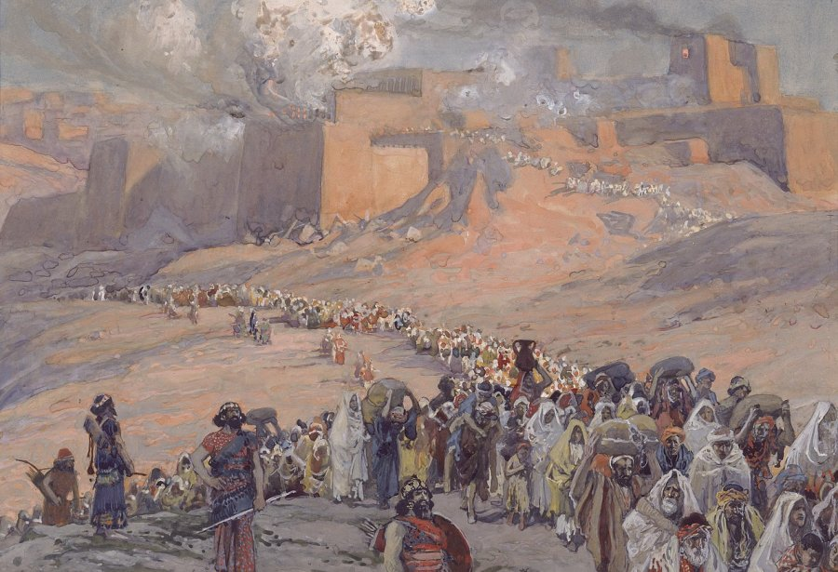
Evidence of Captivity
The Exile of Judah
Arise, shake off the dust,
sit enthroned, Jerusalem;
Loose the bonds from your neck,
captive daughter Zion! Isaiah 52:2
Yet even she became an exile,
and went into captivity;
Even her little ones were dashed to pieces
at the corner of every street;
For her nobles they cast lots,
and all her great ones were put into chains.
Nahum 3:10
He brought them forth from darkness and the shadow of death and broke their chains asunder.
Psalm 107:14
The Exile of Judah
Notes:
There are several references to Judah being in chains while held captive during Babylonian Exile, both in Old Testament verses and from inscriptions by the Babylonian king himself.
See page 344 of the Student Text.

Slide 9
Ezekiel was deported with the first group of exiles in 597 BC and began his role as a prophet in Babylonia five years later. He was the first prophet called to prophesy outside the Holy Land.
The Prophets of the Exile
Ezekiel
EXILE
Jeremiah
Jerusalem
Jeremiah stayed in Jerusalem among the ruins of the city until it was taken by force by other Jews wanting Egyptian assistance.
Prophets of the Exile
Notes:
See Chapter 8, Section 2, Teaching Approaches 1 and 2 in the Teacher’s Wraparound Edition for lessons about Ezekiel.
See Chapter 8, Section 2, Teaching Approach 3 in the Teacher’s Wraparound Edition for a lesson about Jeremiah.

Slide 10
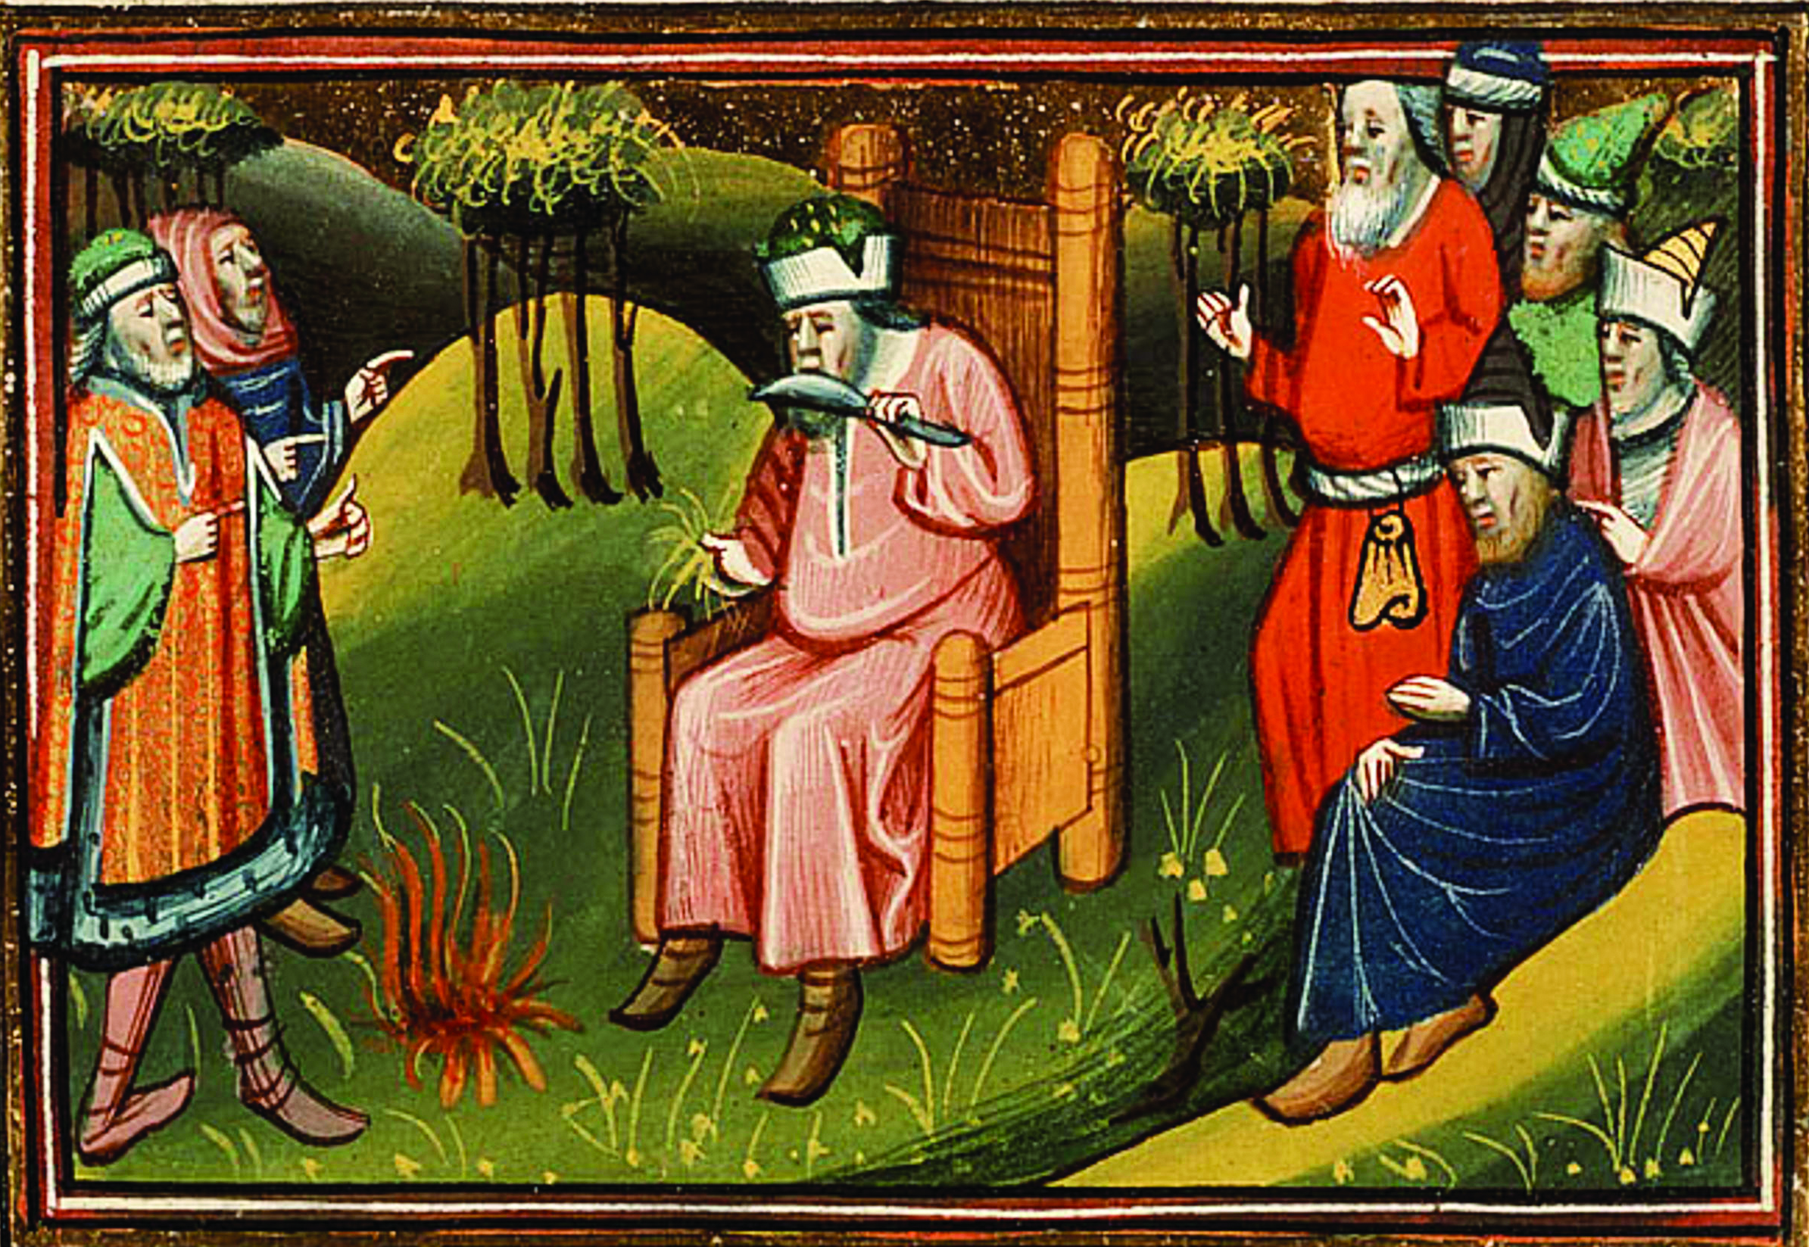
The Book of Ezekiel
Oracles of Judgment
Ezekiel 1–24
Oracles against the Nations
Ezekiel 25–32
Oracles of Hope
Ezekiel 33–48
Prophets of the Exile
Notes:
See pages 348-350 of the Student Text.
Reference information on the Book of Ezekiel: http://www.usccb.org/bible/ezekiel/0

Slide 11
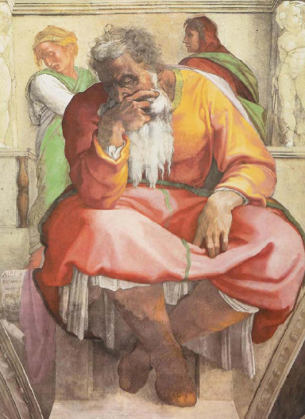
Jeremiah’s Message
The sacrificial system does not automatically take away the consequences of sin.
Jerusalem is not immune to punishment just because the Temple stands there.
The sins of pagan worship and oppression of the alien, the orphan and the widow are severely condemned
Prophets of the Exile
Notes:
Jeremiah was a prophet under King Josiah. He remained in Jerusalem during the siege and exile. He preached meekness and protection of the Temple. He was not popular with those Jews who wanted to overthrow Nebuchadnezzar. He preached that current political subjugation was a result of sinfulness and that Jews should submit and repent to YHWH.
See Chapter 8, Section 2, Teaching Approach 3 in the Teacher’s Wraparound Edition for a lesson about Jeremiah.
See pages 357-359 of the Student Text.

Slide 12
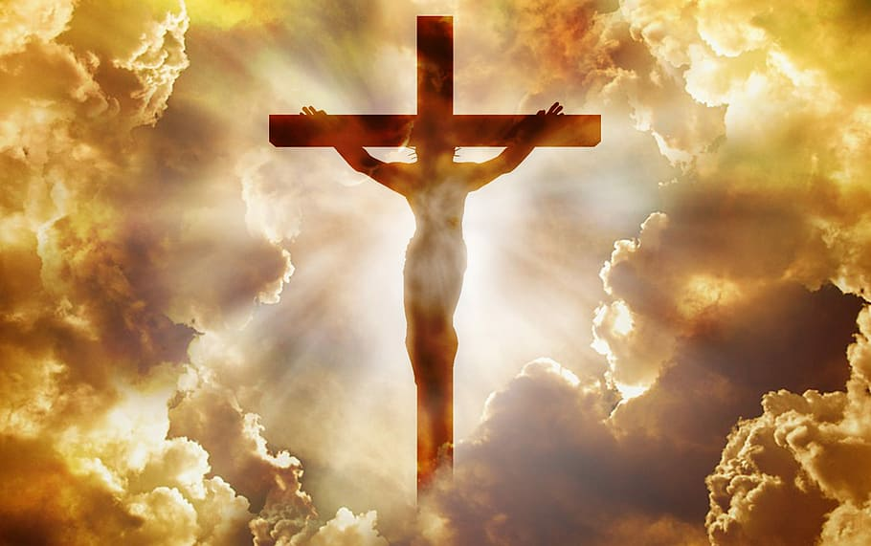
Servant Songs
But he was pierced for our sins,
crushed for our iniquity;
He bore the punishment that makes us whole,
by his wounds we were healed.
Is 53:5
I will make you a light to the nations, that my salvation may reach to the ends of the earth. Is 49:6
Prophets of the Exile
Notes:
While it is unclear exactly who the Suffering Servant is from the Servant Songs of Isaiah, the Catechism of the Catholic Church (601) makes it clear that Jesus Christ fulfilled the prophecy of the Suffering Servant. Read John 8:12 and ask the students to reflect on Christ as light of the world.
See pages 360-362 and the New Testament Connection on pages 384-385 of the Student Text .

Slide 13
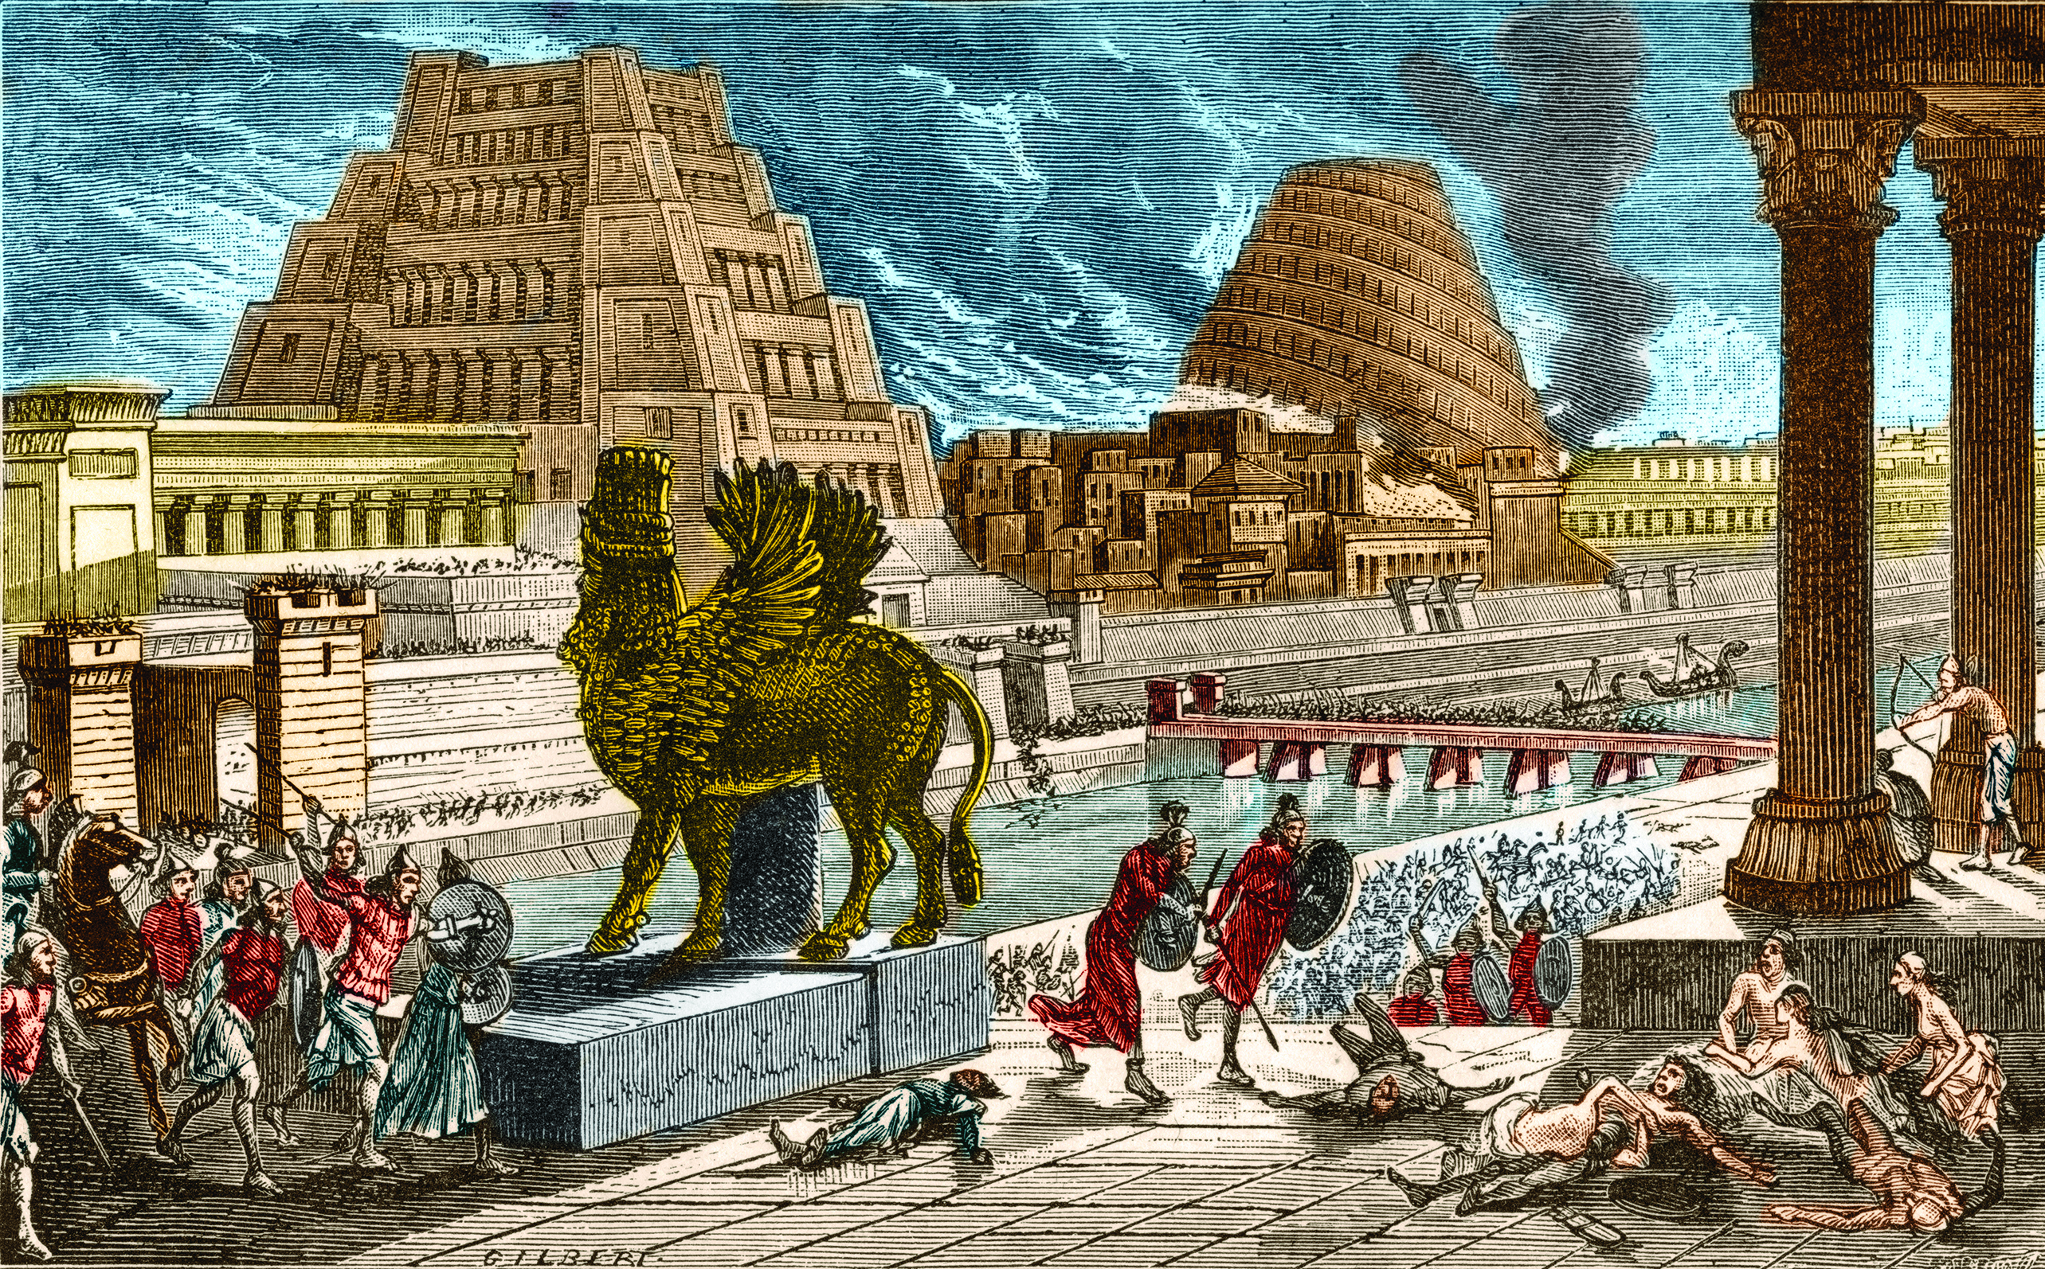
The Return from Exile
Ezra and Nehemiah led some of the Jews in Babylonia out of exile following the Inarus Revolt in 460 BC
Neo-Assyrian control was replaced by Neo-Persian control.
Persians considered all their citizens slaves
The Persian king Cyrus allowed some of the Jews to return to Jerusalem after he conquered Babylonia in 539 BC.
The Exiles Return to Judah
Notes:
The video “Exile and Return” (4:11) provides a brief review of the Babylonian Exile and the Jews return to Jerusalem. https://www.youtube.com/watch?v=jBCf1YY5pzM

Slide 14
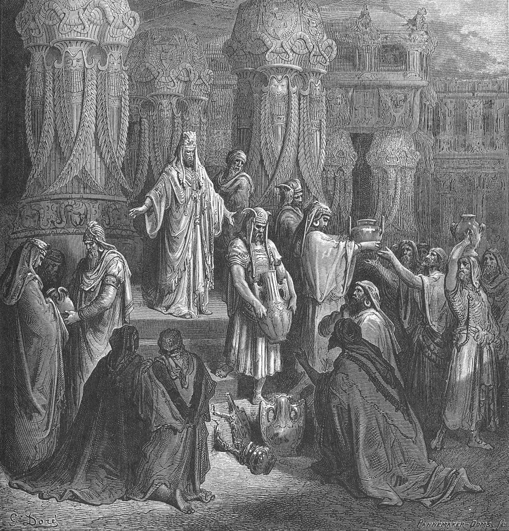
The remnant
The exiles and former exiles who remained faithful to YHWH and would ultimately restore Jerusalem
The Exiles Return to Judah
Notes:
The Books of Nehemiah and Ezra both include details about the return of the exiles to Jerusalem and the rebuilding of the Temple. While Cyrus likely helped for political reasons, it did help to restore peace with the Israel faithful, the remnant returning to the promised land. The image is Cyrus restoring the vessels of the temple, by Gustave Doré

Slide 15
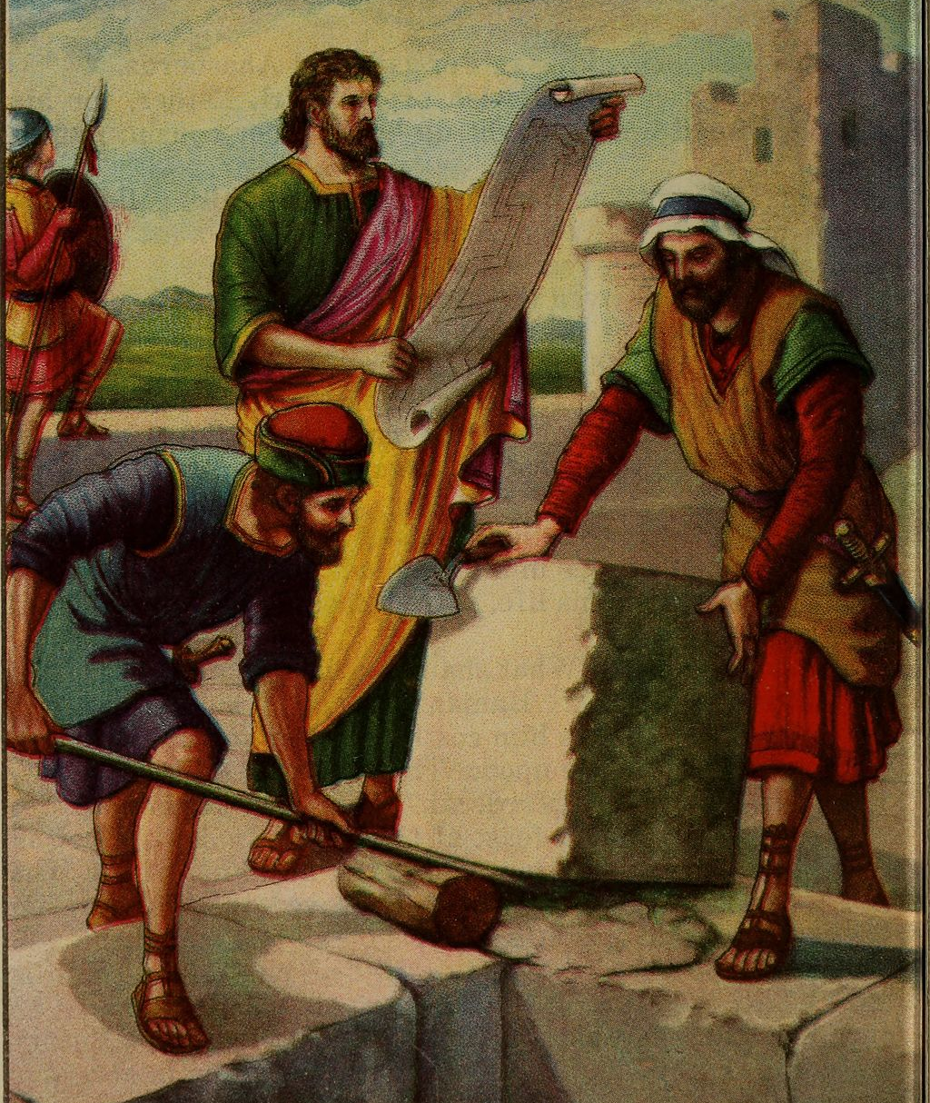
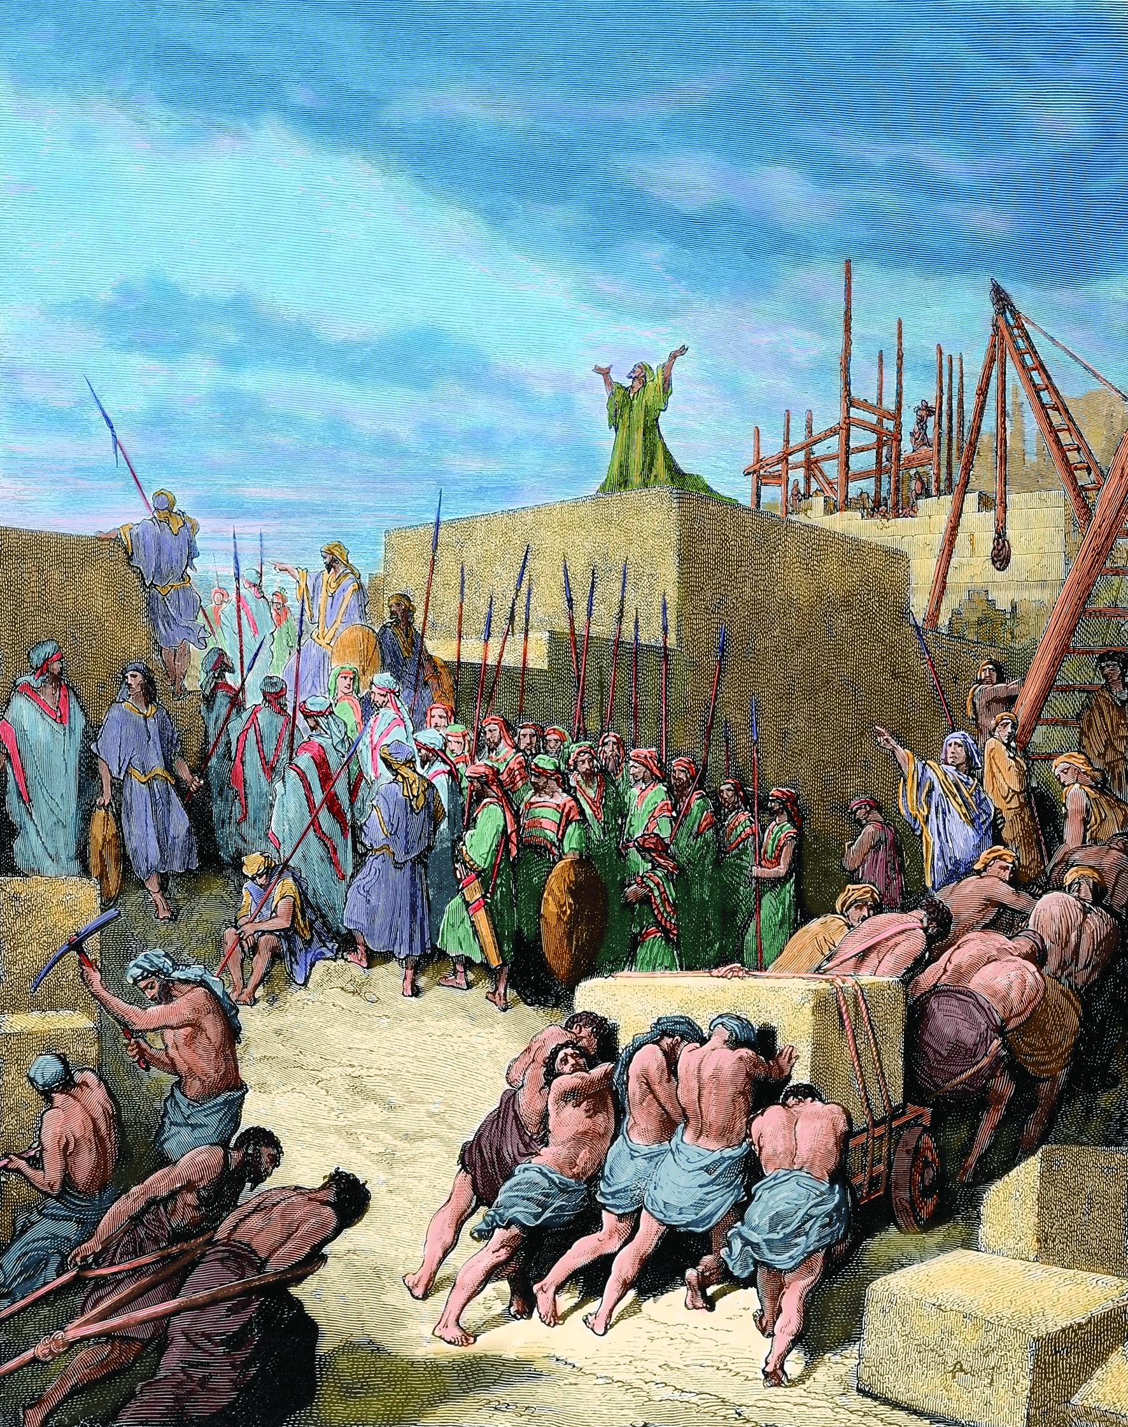
Rebuilding the Temple
The Temple was central to the religious identity of the Jews. The Temple was a central institution in the life of Jews after the exile. Rebuilding this central institution became the main mission of Nehemiah.
Major Themes of Writing Before, During and After the Exile
Notes:
“Overview: Ezra-Nehemiah” (8:36) is a video that details the rebuilding of the Temple. https://www.youtube.com/watch?v=jBCf1YY5pzM
After watching the video, ask students if they can understand why the Jews who remembered the grandeur of original Temple would be unhappy with the construction of the second Temple.
Recall the news of the fire at Notre Dame Cathedral in 2019. The fire was devastating to Catholics the world over. Perhaps ask students to compare the devastation the Jews felt at the complete destruction of their Temple to the fire at Notre Dame in Paris. Address the efforts to reconstruct the cathedral, the money, expense and time that is gone into it. Have the students compare the rebuilt Cathedral with the way it was before the fire.

Slide 16

You whom I have taken from the ends of the earth
and summoned from its far-off places,
To whom I have said, You are my servant;
I chose you, I have not rejected you—
Do not fear: I am with you;
do not be anxious: I am your God.
I will strengthen you, I will help you,
I will uphold you with my victorious right
hand.
Is 41:9
Major Themes of Writing Before, During and After the Exile
Notes:
As a class, listen to the song: “You are mine” by David Haas
https://www.youtube.com/watch?v=Sgm9lkTNQmc. The song has some lyrics taken from Isaiah 41:9-10. Ask the students to reflect and share how the words from Isaiah are relevant to their lives today.

Slide 17
Images
Slide 2: https://commons.wikimedia.org/wiki/File:Kingdoms_of_Israel_and_Judah_map_830.svg
Slide 3: https://commons.wikimedia.org/wiki/File:Jesaja_(Michelangelo).jpg
Slide 5: https://www.pexels.com/cs-cz/foto/muz-osoba-svoboda-uspech-6945/
Slide 6: https://www.thevintagenews.com/2018/12/23/nebuchadnezzar-ii/
Slide 7: https://www.thetorah.com/article/voices-in-lamentations-dialogues-in-trauma
Slide 8: https://commons.wikimedia.org/wiki/File:Francesco_Hayez_017.jpg
Slide 11: https://upload.wikimedia.org/wikipedia/commons/9/9b/Michelangelo_Buonarroti_027.jpg
Slide 12: https://www.piqsels.com/en/public-domain-photo-splne
Slide 14: https://en.wikipedia.org/wiki/Return_to_Zion#/media/File:104.Cyrus_Restores_the_Vessels_of_the_Temple.jpg
Slide 15: https://en.wikipedia.org/wiki/Nehemiah#/media/File:Bible_primer,_Old_Testament,_for_use_in_the_primary_department_of_Sunday_schools_(1919)_(14779759334).jpg
Slide 16: https://www.pexels.com/photo/flight-landscape-nature-sky-36717/

