Slide 1
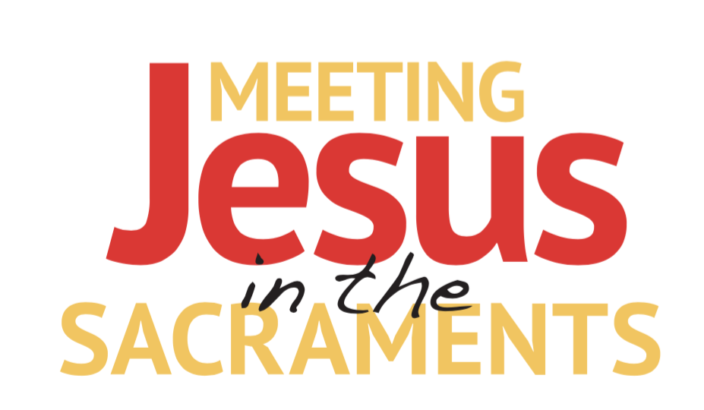
CHAPTER 8

Slide 2
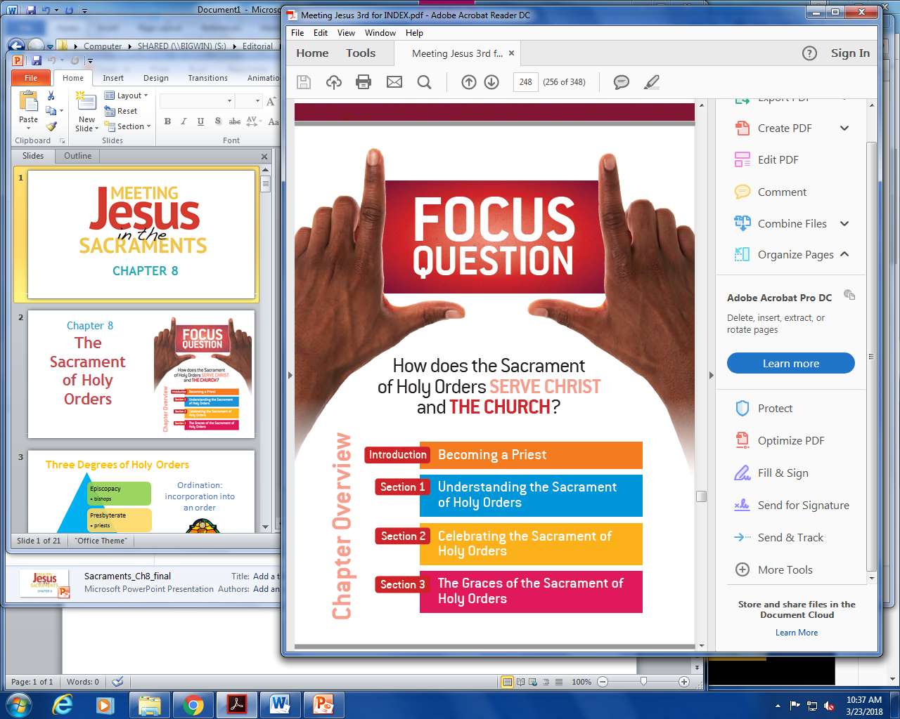
Chapter 8
The Sacrament
of Holy Orders

Slide 3
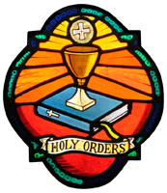
Three Degrees of Holy Orders
Episcopacy
Presbyterate
bishops
priests
Diaconate
deacons
Ordination: incorporation into an order
Becoming a Priest

Slide 4
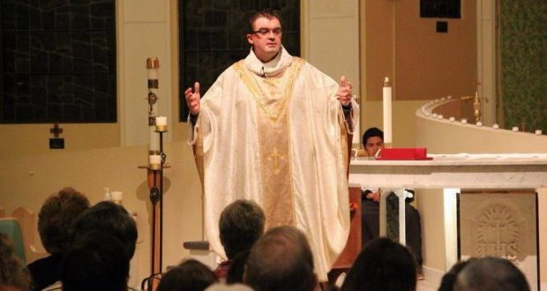
“Come after me, and I will make you fishers of men.”
(Mt 4:19; Mk 1:17)
The role of those in Holy Orders is to nourish the Church by the Word and grace of God.
Becoming a Priest

Slide 5
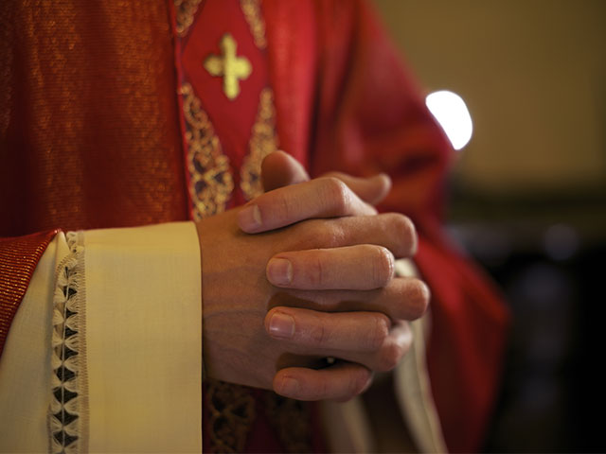
Requirements for the Priesthood
Must be called by God to the vocation
Baptized males only
Pledge to celibacy for the sake of God’s Kingdom
Pledges of humility and obedience
For religious order priests, pledges of voluntary poverty
Psychological assessment
Time spent in seminary
Becoming a Priest

Slide 6
Seminary
The place where the training of candidates for the priesthood takes place. The Council of Trent instructed the bishops in each diocese to set up a seminary college to train men for the priesthood
Formation at Seminary | What is the goal of this formation
Human Formation | Helps the candidate learn to relate well with others.
Spiritual Formation | Cultivates an intimate friendship with Jesus Christ, expressed in lifelong commitment to personal prayer and devotion.
Intellectual formation | Involves studies in theology and philosophy, leading to a deeper understanding of what it means to be human and to seek God.
Pastoral Formation | The goal of the whole process—makes candidates in to shepherds of souls in imitation of Jesus Christ, The Good Shepherd.
Understanding the Sacrament of Holy Orders

Slide 7
Structure of the Church
Pope (bishop of Rome)
Cardinals (around 217)
Archbishops (serve over several dioceses)
Bishops (preside over one diocese, many parishes)
Priests (serve one parish)
Deacons (assists the priest)
Laity (the people)
Understanding the Sacrament of Holy Orders

Slide 8
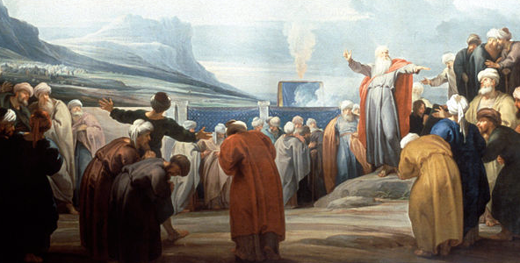
Priesthood in the Old Testament
No ordained priesthood in early Israel.
The father of a family or head of a clan acted as the group’s priest performing spiritual duties and teaching about God.
Around the time of the Exodus the clan of Aaron and tribe of Levi were set aside as priests.
During the Exodus Moses selected
70 elders to held lead 12 tribes.
Elders were known for moral character,
administrative skills and loyalty to
the Law.
After Temple construction, the main duty of priests was in the Temple to offer sacrifices.
Priesthood in the Old Testament prefigured Christ’s priesthood.
Understanding the Sacrament of Holy Orders

Slide 9
Priesthood of Christ
Jesus Christ is the only “true” priest.
All Catholics share in the common priesthood of Christ.
Ministerial Priesthood | Common Priesthood
Bishops and priests | All other baptized Catholics
Serves the common priesthood | Unfolding of baptismal grace
12 Apostles called to continue the work of the Head of the Body of Christ | The church is built with help of the ministerial priesthood
Celebrating the Sacrament of Holy Orders

Slide 10
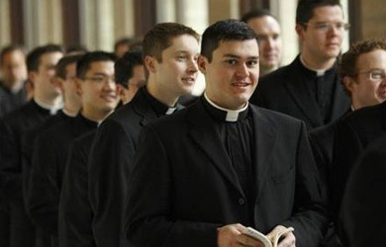
Journal Question
What are some ways you can help encourage others or discern for yourself a vocation to the priesthood?

Slide 11
Jesus Christ Head Priest
Peter (given the Keys
James
John
Andrew
Bartholomew
James the lesser
Jude
Matthew
Phillip
Simon
Thomas
Matthias
Stephen
Philip
Prochorus
Nicanor
Timon
Parmenas
Nicholas of Antioch
The Twelve Apostles
The Seven Deacons or Ministers chosen by the Twelve
Celebrating the Sacrament of Holy Orders

Slide 12
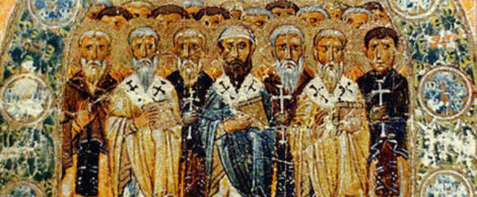
Early History of the Ministerial Priesthood
Jesus called the Twelve to continue his work with Peter as their head.
The Twelve appointed seven men to serve as deacons.
Deacons or ministers attended to the internal needs of the community:
Read aloud Scriptures
Administered Communion
Taught catechumens
Ministered to the sick
Distributed food and clothing to
the poor
Apostles chose presbyters of elders of each local church.
Invested the men through ritual involving prayer and laying on of hands
Decisions affecting the Church made at general councils by Apostles and presbyters
Apostles selected men (episcopal or bishops) to be their successors.
Celebrating the Sacrament of Holy Orders

Slide 13
Selected Historical Developments of Holy Orders
History of Penance
Date | Practice | Outcome
Second Century | St. Ignatius of Antioch repeated established tradition: bishop or his appointee could preside at the Eucharist or baptize. | The community as a whole chose bishops. They were chosen by the apparent presence of the Holy Spirit. Bishops proclaimed the Word, forgave sins, presided at Eucharist and supervised presbyters and deacons.
Council of Chalcedon (451) | Priests were to be called by the people and ordained for work in a particular parish. | Clergy gained a more privileged status.
During Middle Ages | Bishops needed priests to celebrate Mass. Deacons did not have that power. Church legislated against married priests in 1125. | Diaconate declined and instead became a step on the way to priesthood. Monastic life influenced priesthood.
Council of Trent (1545-1563) | Protestant reformers pointed to weaknesses in clergy. Council required seminary training for priests. | Holy Orders was reaffirmed as a sacrament
Second Vatican Council | Called for the permanent restoration of the diaconate. Called for a new Rite of Ordination. | Acknowledged the authority Jesus gave to his Apostles and their successors.
Celebrating the Sacrament of Holy Orders

Slide 14
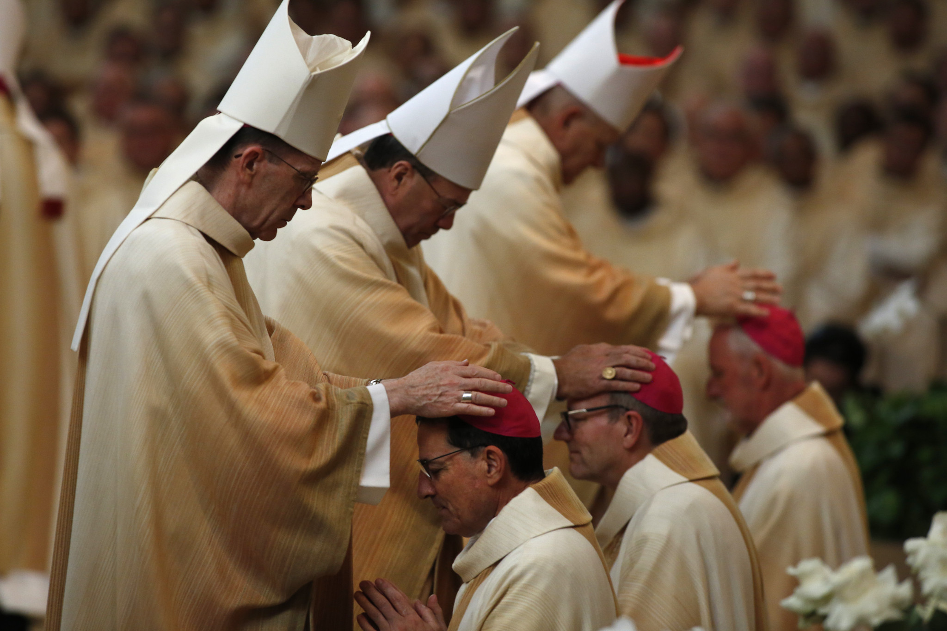
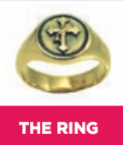
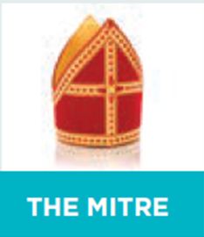
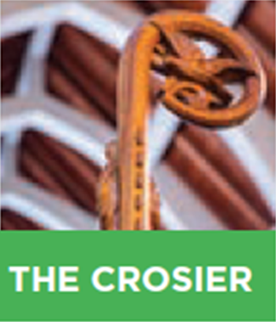
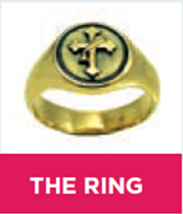
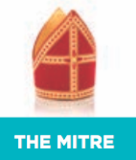
Ordination of Bishops
Only the pope chooses bishops
Candidates are identified in local dioceses and recommended by a nuncio (apostolic delegate).
A new bishop is invested with the following:
Several bishops participate in the ordination of a new bishop. The ordinary bishop confers the sacrament through laying on of hands and a prayer. Then the bishop anoints the elects head with sacred chrism.
Celebrating the Sacrament of Holy Orders

Slide 15
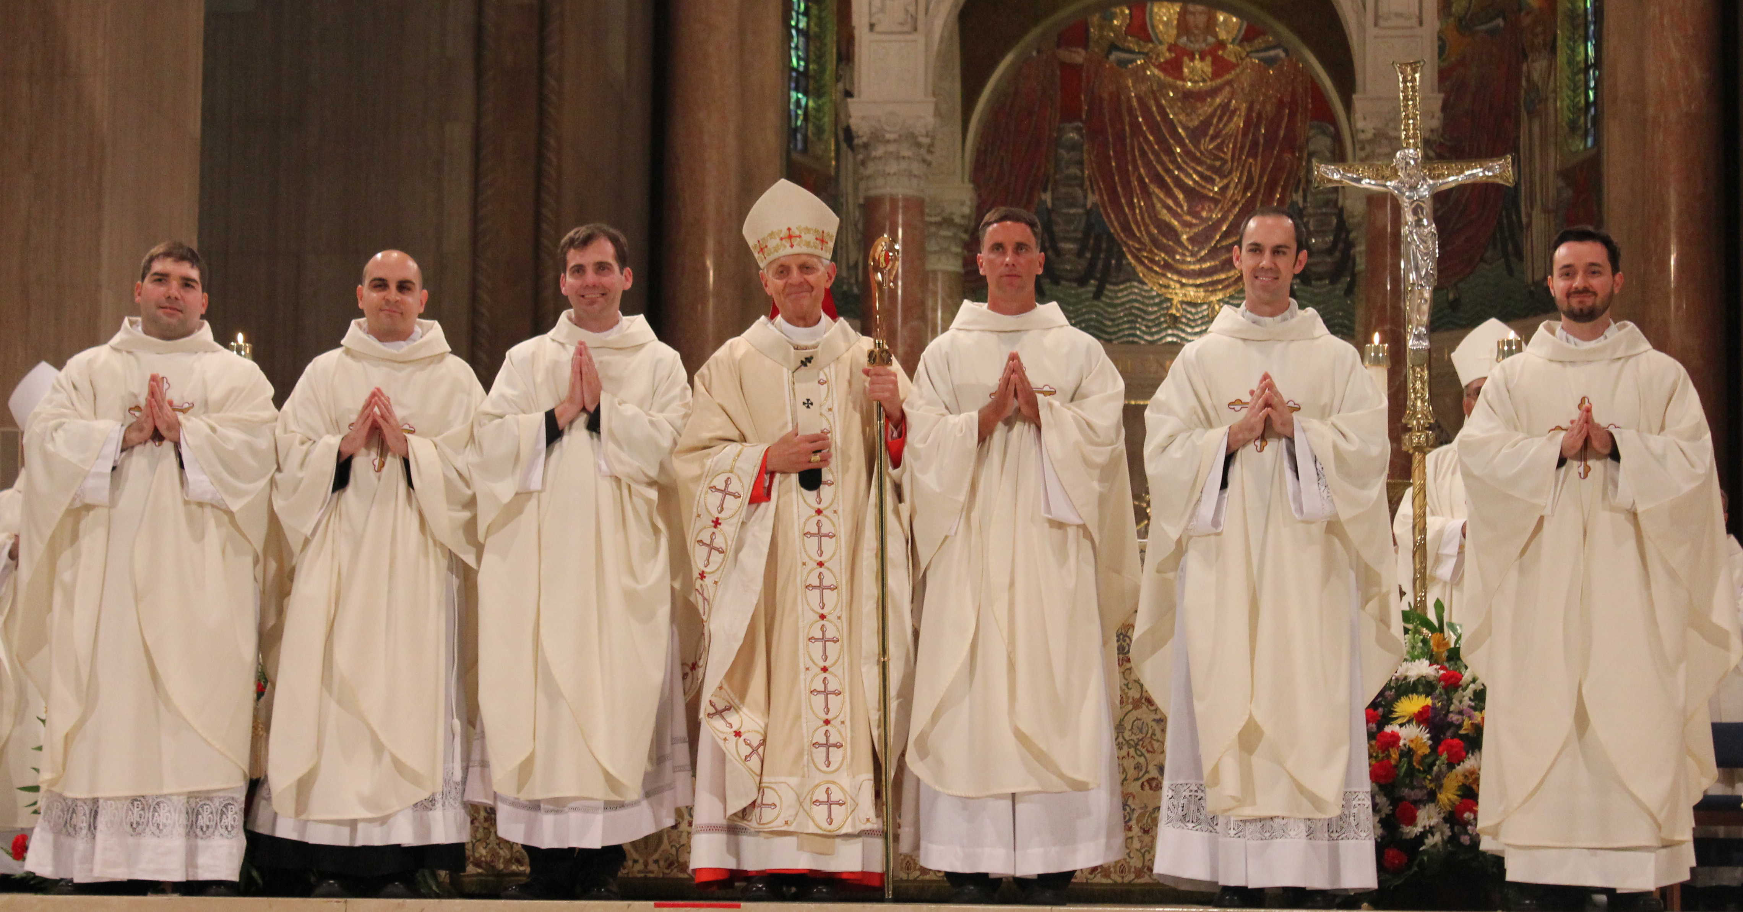
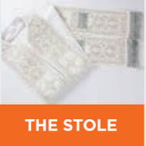
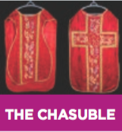
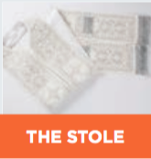
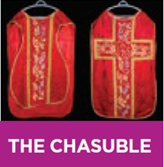
Ordination of Priests
Candidate is presented to the bishop.
Bishop confers the sacrament of Holy Orders on the ordained through laying on of hands and a prayer.
New priest is invested with a stole and chasuble.
Priests hands are anointed with sacred chrism .
The local Church calls on the entire Church in heaven and on heart to pray for the ordinand who kneels before the bishop for the essential rite of the sacrament.
Celebrating the Sacrament of Holy Orders

Slide 16
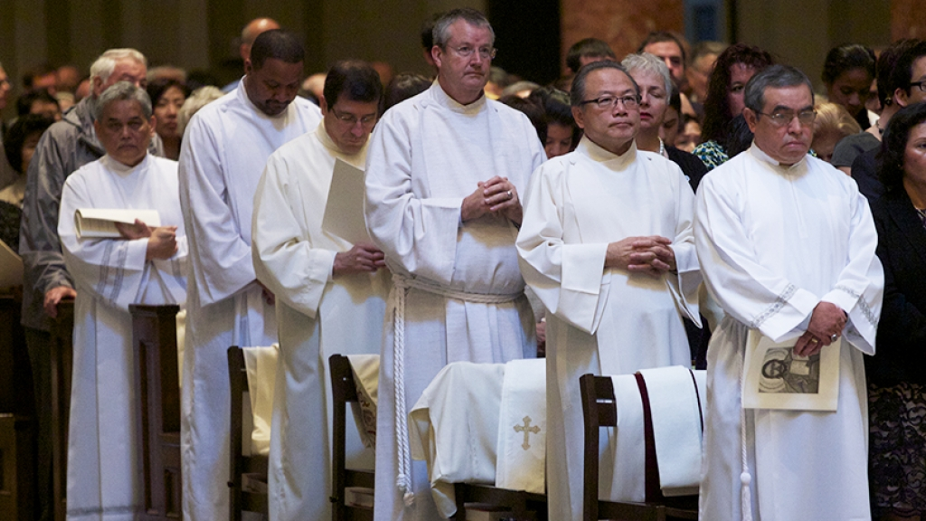
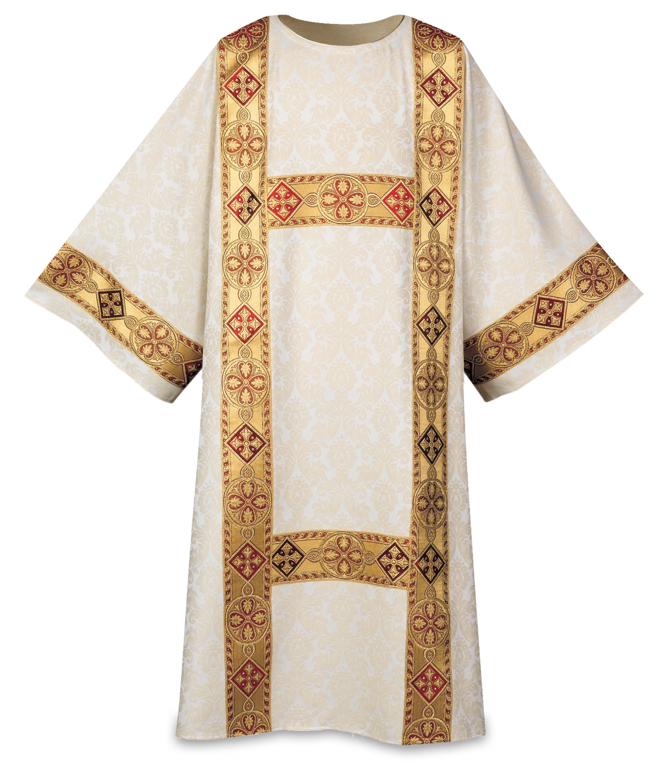
Ordination of Deacons
Bishop confers the sacrament through laying on of hands and consecratory prayer.
New deacon receives a stole, dalmatic, and Book of the Gospels.
Dalmatic: The outer liturgical vestment of a deacon. It may also be worn by bishops under the chasuble and at certain solemn liturgies.
Celebrating the Sacrament of Holy Orders

Slide 17
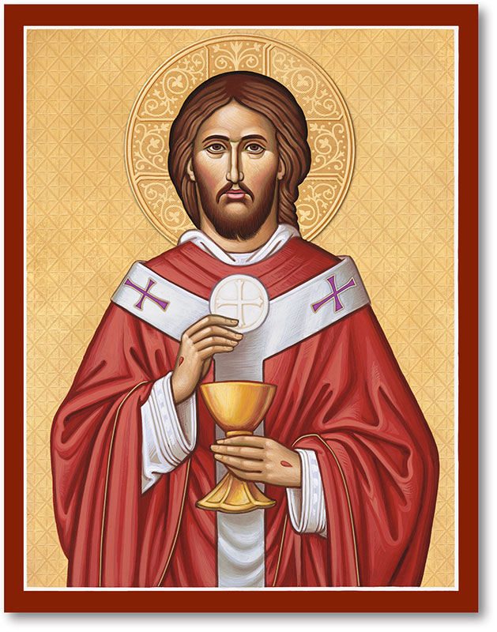
Acting as Christ the High Priest
Today’s priests do not offer a new sacrifice when they preside at the Eucharist. Christ, the eternal High Priest, acts through the ministry of the priests to offer the Eucharistic sacrifice. When a priest offers the Body of Christ to the Father during the Eucharist, it is Christ who is offering himself. Because Christ is offering himself, the whole Church—the whole Body of Christ—also offers herself “‘through him, with him, in him,’ in the unity of the Holy Spirit” (CCC, 1553).
The Graces of the Sacrament of Holy Orders

Slide 18
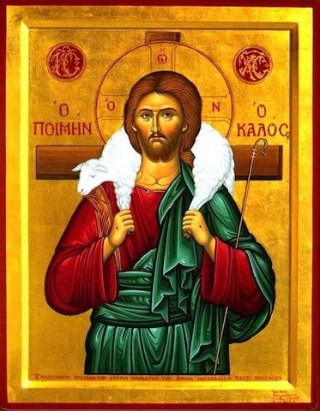
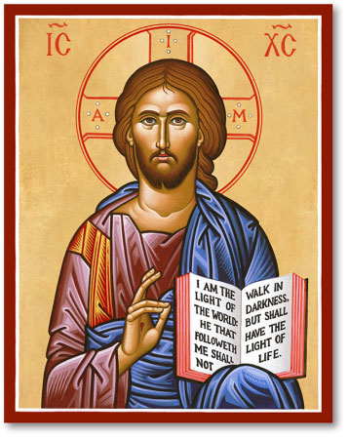
Christ the Good Shepherd
Christ the Teacher
The bishop as the leader of a diocese (a geographic section of the Church, made up of parishes) gives his life in service to the spiritual needs of Catholics just as a shepherd leads his flock.
Bishops and priest are witnesses of the truth especially in matters of faith and morals. The ministers of the church preach the Gospel message by word and behavior.
The Graces of the Sacrament of Holy Orders

Slide 19
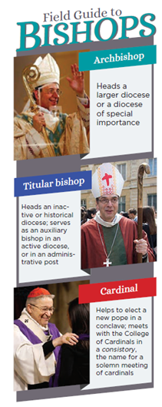
Episcopal College
The unity of all ordained bishops in the worldwide Church, in both the East and the West. The pope heads the episcopal college. The episcopal college is also called the “college of bishops.”
The Graces of the Sacrament of Holy Orders

Slide 20
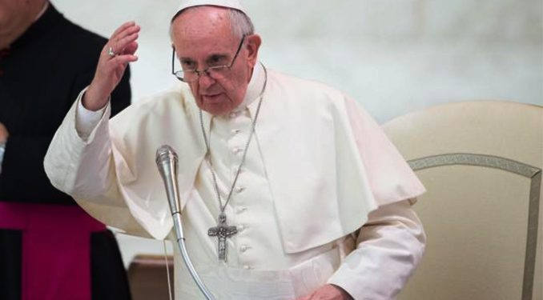
Infallibility
The charism or gift of the Church, offered by the Holy Spirit, in which the pope, and bishops in union with him, can definitively proclaim a doctrine of faith or morals for belief of all the faithful. It is a participation in the fullness of truth in Christ.
The pope, as head of the episcopal college, enjoys this gift by virtue
of his of office. Infallibility is also present in the body of bishops, especially in an ecumenical council, when they teach on matters of faith and morals
The Graces of the Sacrament of Holy Orders

Slide 21
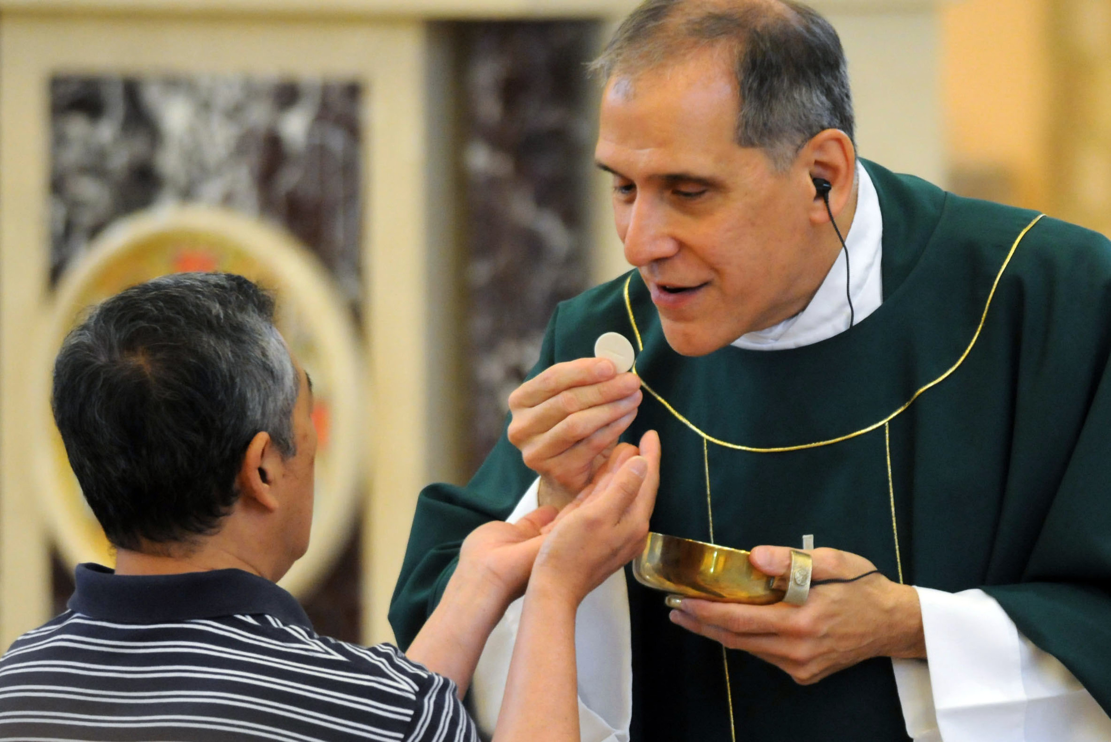
Duties of Priests
To preach the Gospel to all
To sanctify the People of God by providing the Eucharist and other sacraments
To govern the parish through pastoral ministry
The Graces of the Sacrament of Holy Orders

